Slide 1
Optical and X-Ray Charactorization of Ge_{1-y}Sn_{y} alloy on GaAs
Haley Woolf,¹ Matt Kim,² Carola Emminger,¹ Carlos Armenta,¹ Stefan Zollner¹
Department of Physics, NMSU, Las Cruces, NM
QuantTera, Scottsdale, AZ
College of Arts and Science
Department of Physics
This work was supported by Air Force Office of Scientific Research under award number FA9550-20-1-0135.
FA9550-20-1-0135

Slide 2
Outline
Background:
UV ellipsometry and x-ray diffraction
Abstract
X-ray diffraction data:
Omega rocking curves, and reciprocal pace maps on (004), (224), & $\left(\overline{2}\overline{2}4\right)$
Lattice constants
Optical data:
Pseudodielectric function, optical constants, & 2nd der. of dielectric function
Theoretical E₁ & E₁+Δ₁ with tin content
Conclusion
1

Slide 3
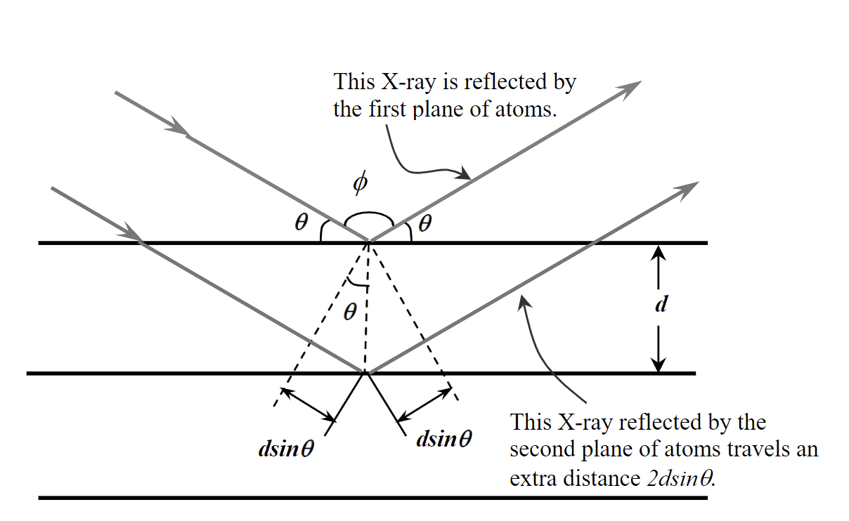
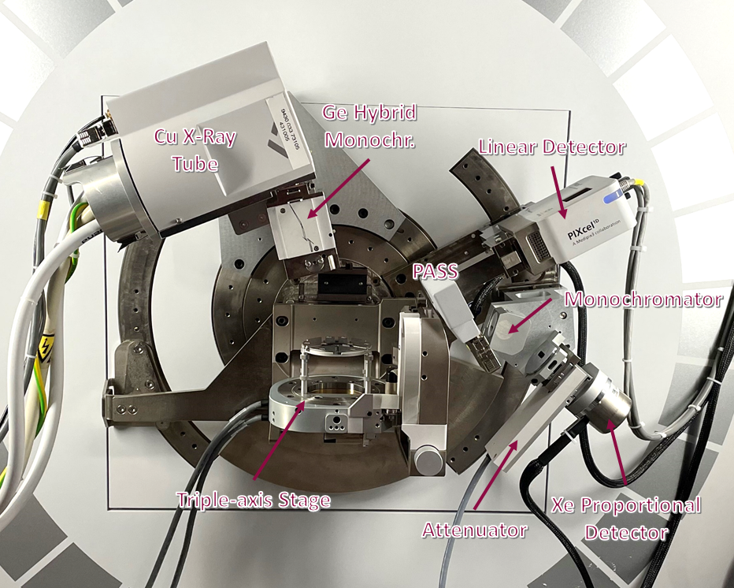
Background
X-ray diffraction uses Bragg’s Law to determine the characteristics of different materials. Omega Rocking curves were used to determine the lattice constants and reciprocal space maps were used to determine the strain and relaxation.
Bragg’s Law:
$2d\sin{θ}=nλ$
Distance between layers of atoms
Wavelength of the rays
$$λ_{X−rays}=1.5406 Å$$
Angle between incident beam and the surface of the crystal
2

Slide 4
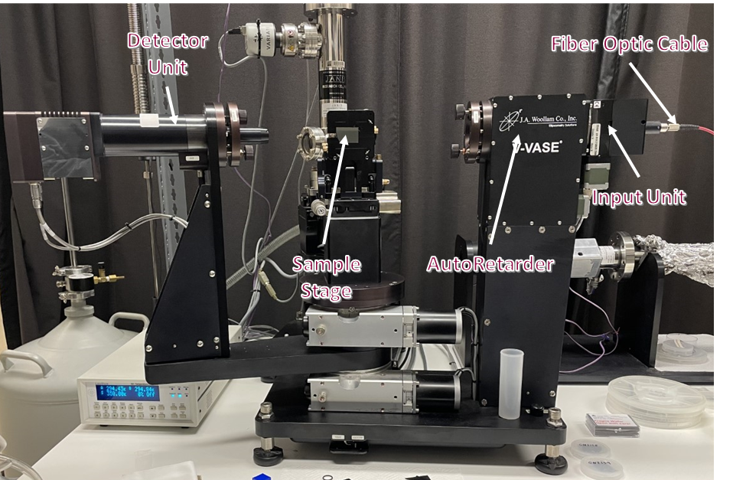
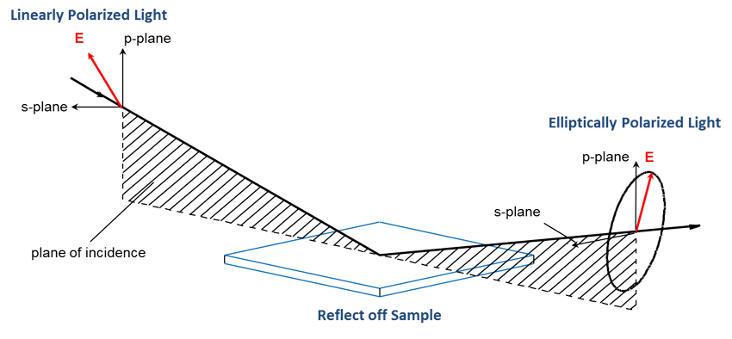
Background
In UV ellipsometry, light is reflected/transmitted from a material causing the polarization to change. ψ is the amplitude ratio and Δ is the phase difference of the light. ψ and Δ depend on the material’s optical properties and thicknesses.
3

Slide 5
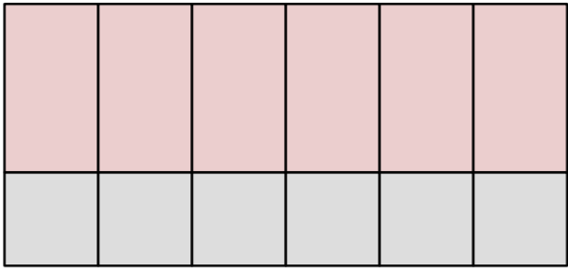
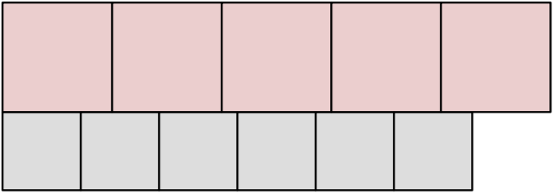
Introduction
Ge_{1-y}Sn_{y} layer is 1600 nm thick and was grown on GaAs by chemical vapor epitaxy. The tin content can be found with (004) reciprocal space map and omega rocking curves.
$\left(224\right)$ and $\left(\overline{2}\overline{2}4\right)$ reciprocal space maps will determine the strain and relaxation of the epitaxial layer
UV ellipsometry can determine the sample’s optical properties, including the dielectric function and the optical constants.
GeSn is often used in lasers and inferred detectors.
Oxide
Ge_{1-y}Sn_{y}
GaAs
Relaxed epitaxial layer
Pseudomorphic/strained epitaxial layer
4

Slide 6
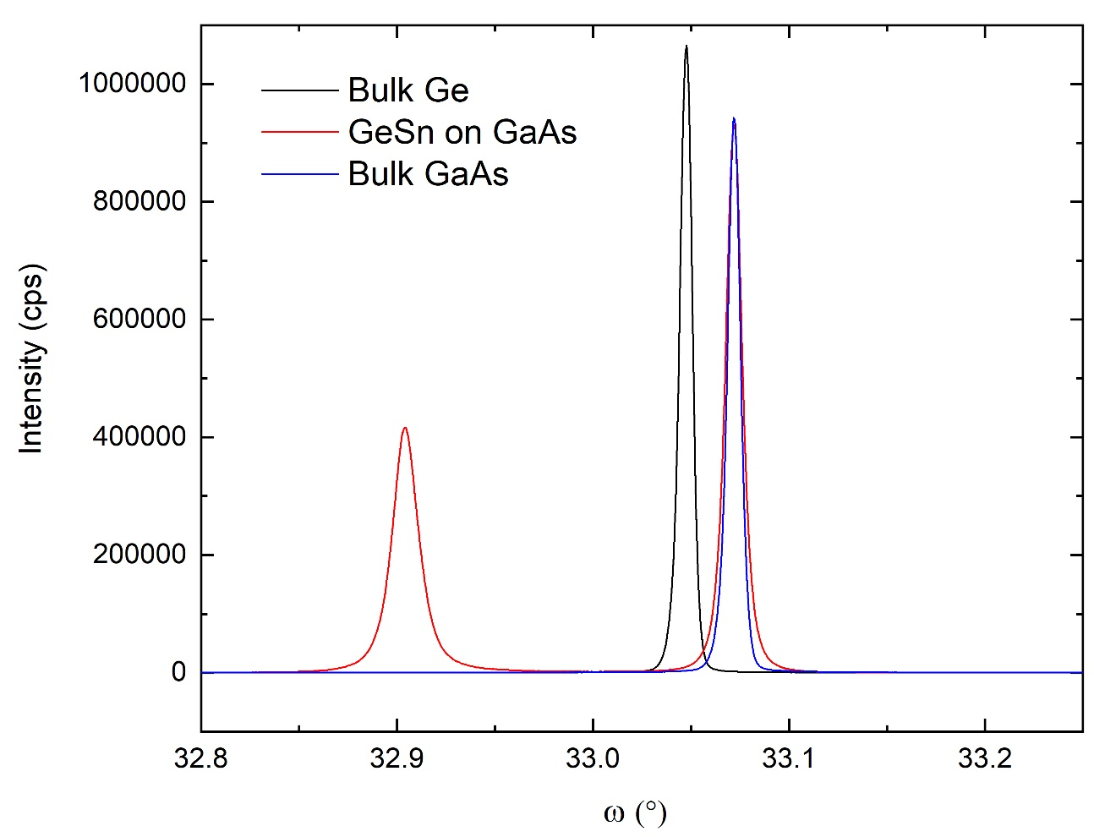
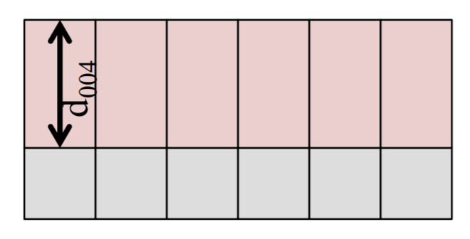
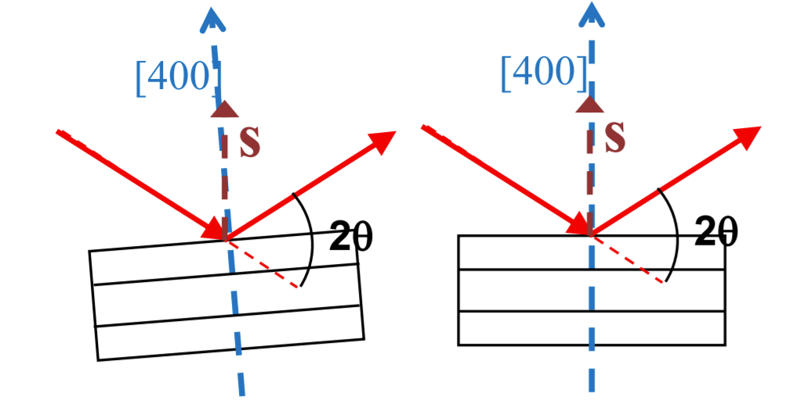
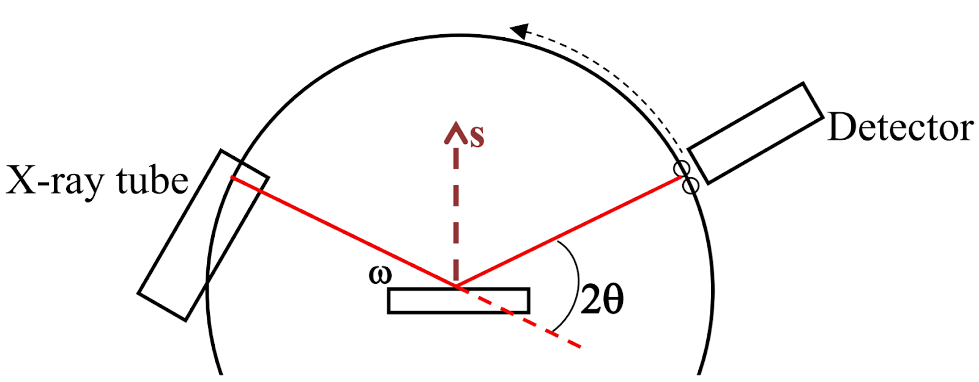
(004) Rocking Curves (Open Detector)
Braggs’s Law:
Lattice Constant:
$2d\sin{θ}=nλ$ $n=1$
$$a=d\left(\sqrt{h^{2}+k^{2}+l^{2}}\right)$$
$a$_{GeSn}= 5.679 Å
$a$_{GaAs} = 5.653 Å
$a$_{Ge} = 5.658 Å
$a$_{Sn} = 6.489 Å
$$l$$
$$k$$
$$h$$
FWHM
Bulk Ge 0.0074°
GaAs 0.0098°
GeSn 0.0155°
Bulk GaAs 0.0076°
5

Slide 7
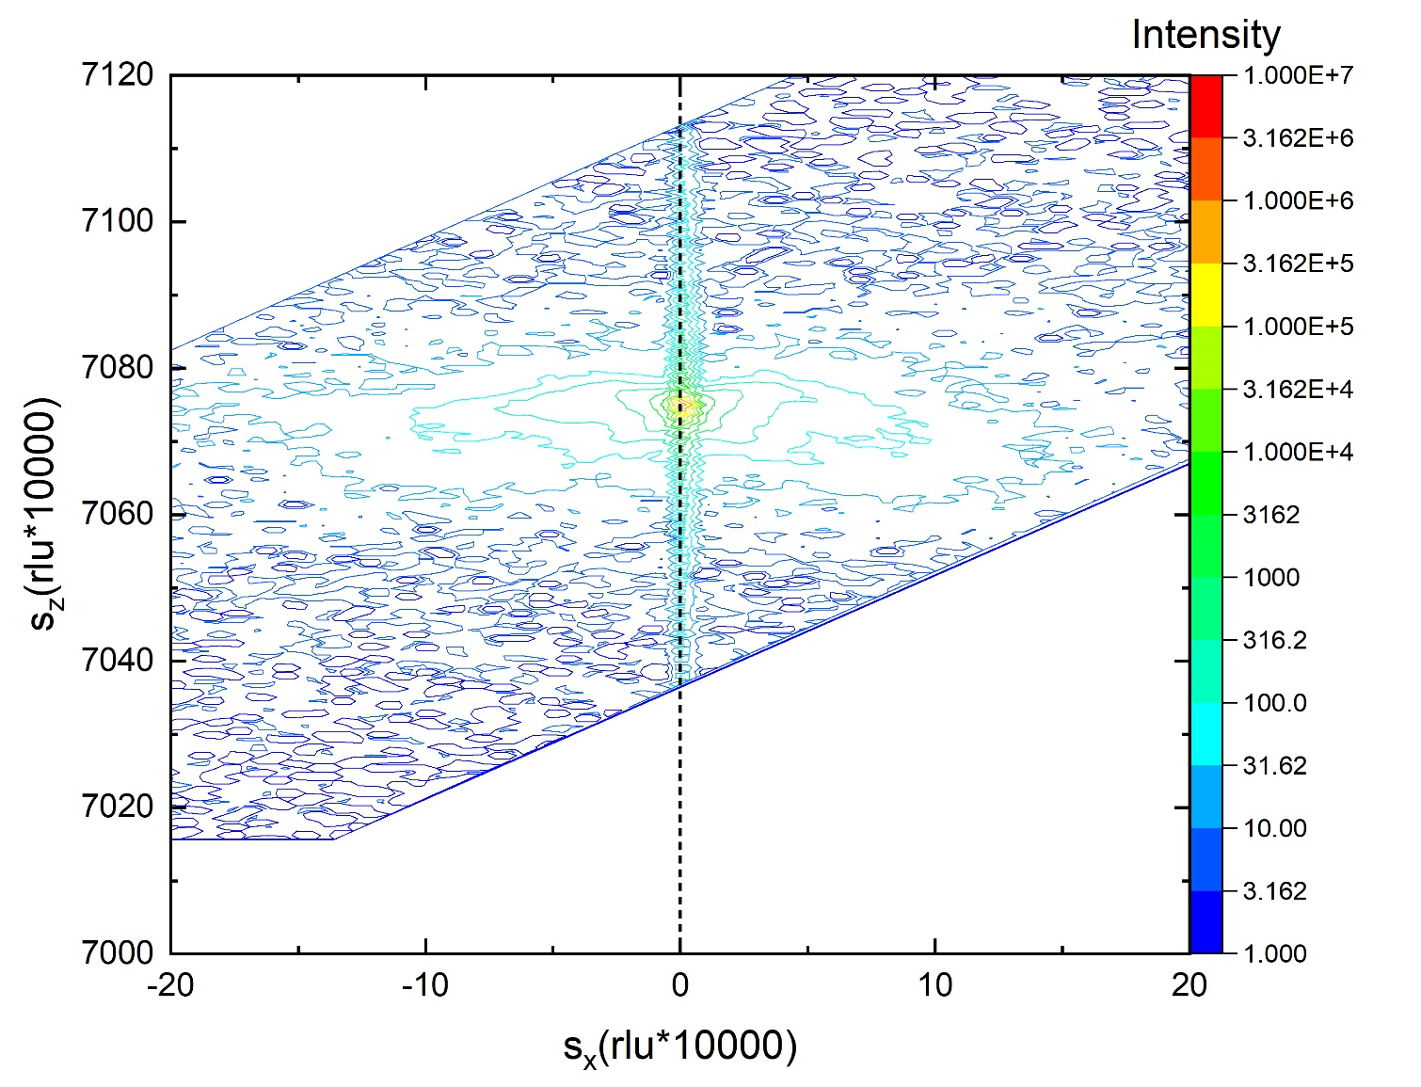
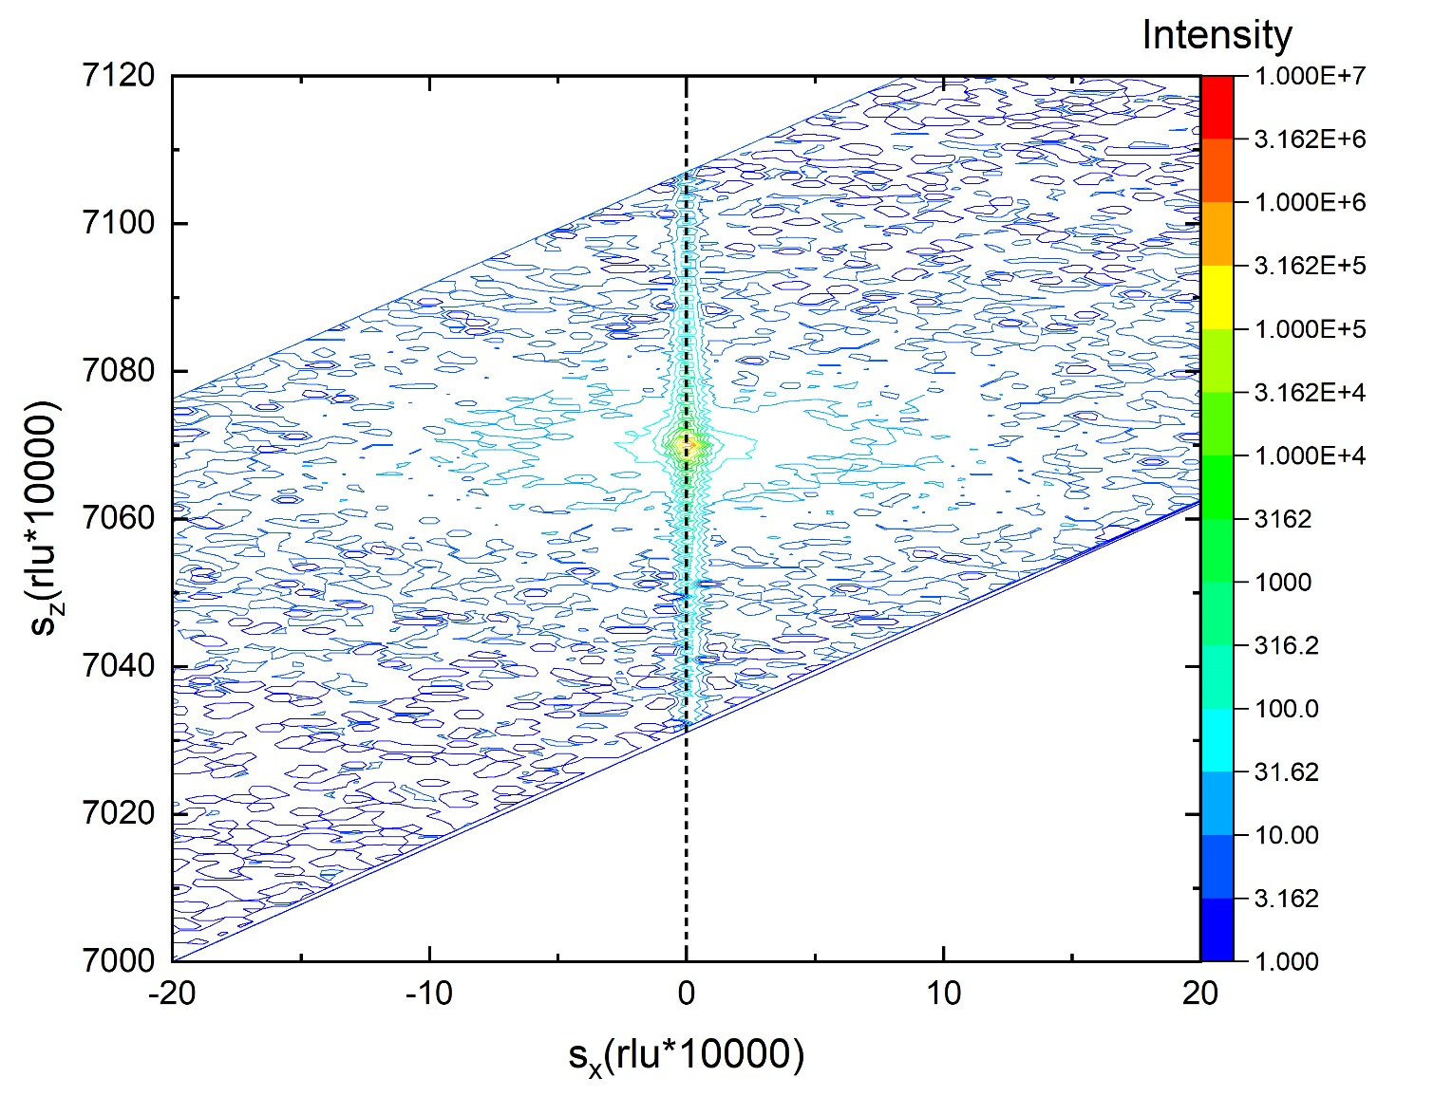
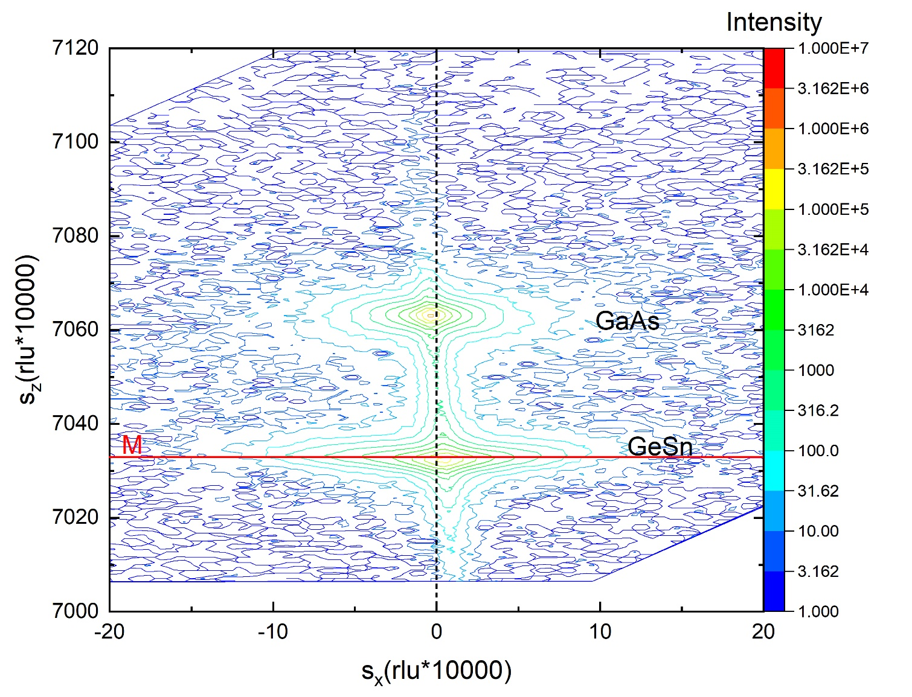
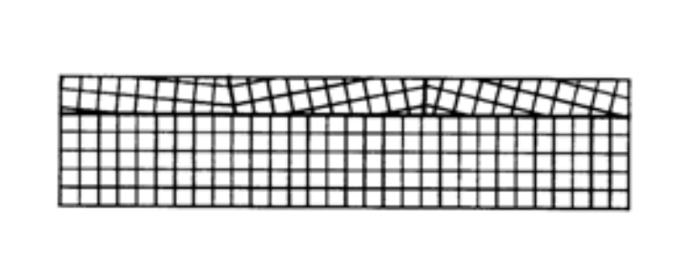
(004) Reciprocal Space Maps
Bulk GaAs
Bulk Ge
GeSn on GaAs
$$sx=\frac{qx}{2π}=\frac{1}{λ}[\cos\left(ω\right)−\cos\left(2θ−ω\right)]$$
Dashed line drawn through substrate peak
M-Mosaic Spread (Relaxation Line)
$$sz=\frac{qz}{2π}=\frac{1}{λ}[\sin\left(ω\right)+\sin\left(2θ−ω\right)]$$
$$λ=1.5406 \text{Å}$$
6

Slide 8
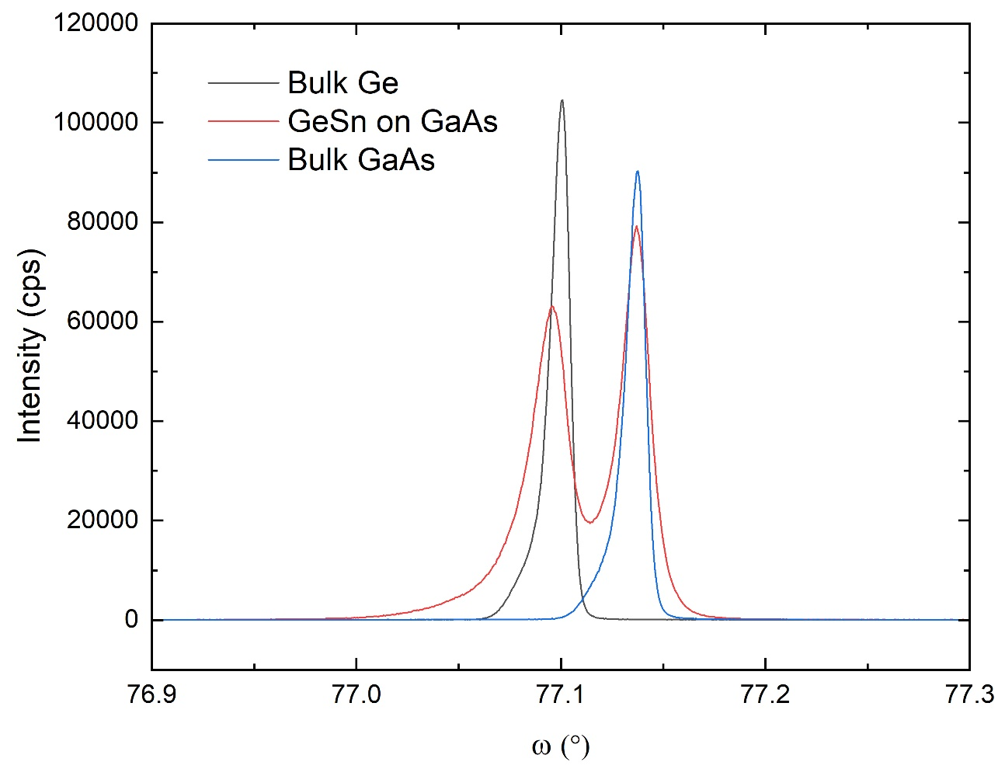
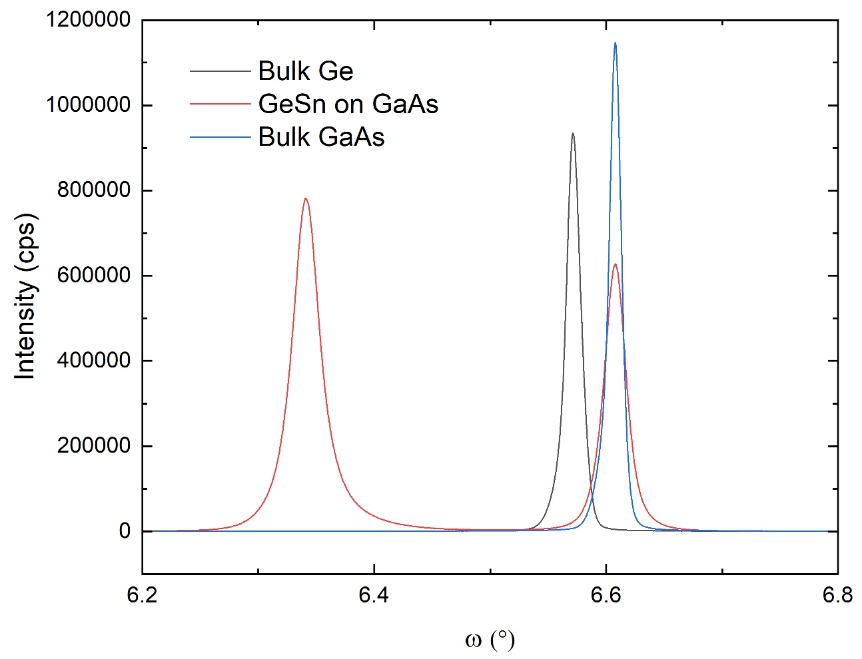
$\left(\overline{2}\overline{2}4\right)$ & $\left(224\right)$ Rocking Curve (Open Detector):
Grazing Exit:
Grazing Incidence:
FWHM
Bulk Ge: 0.0109°
GaAs: 0.0117°
GeSn: 0.0225°
Bulk GaAs: 0.0114°
FWHM
Bulk Ge: 0.0149°
GaAs: 0.0221°
GeSn: 0.0281°
Bulk GaAs: 0.0125°
$$Δω$$
$$Δω$$
X-ray tube
Detector
$$ω$$
Detector
X-ray tube
$$ω$$
7

Slide 9
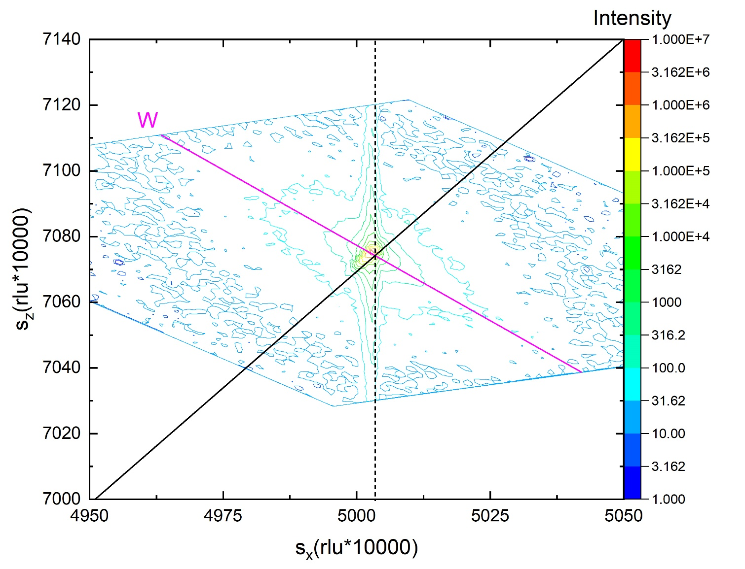
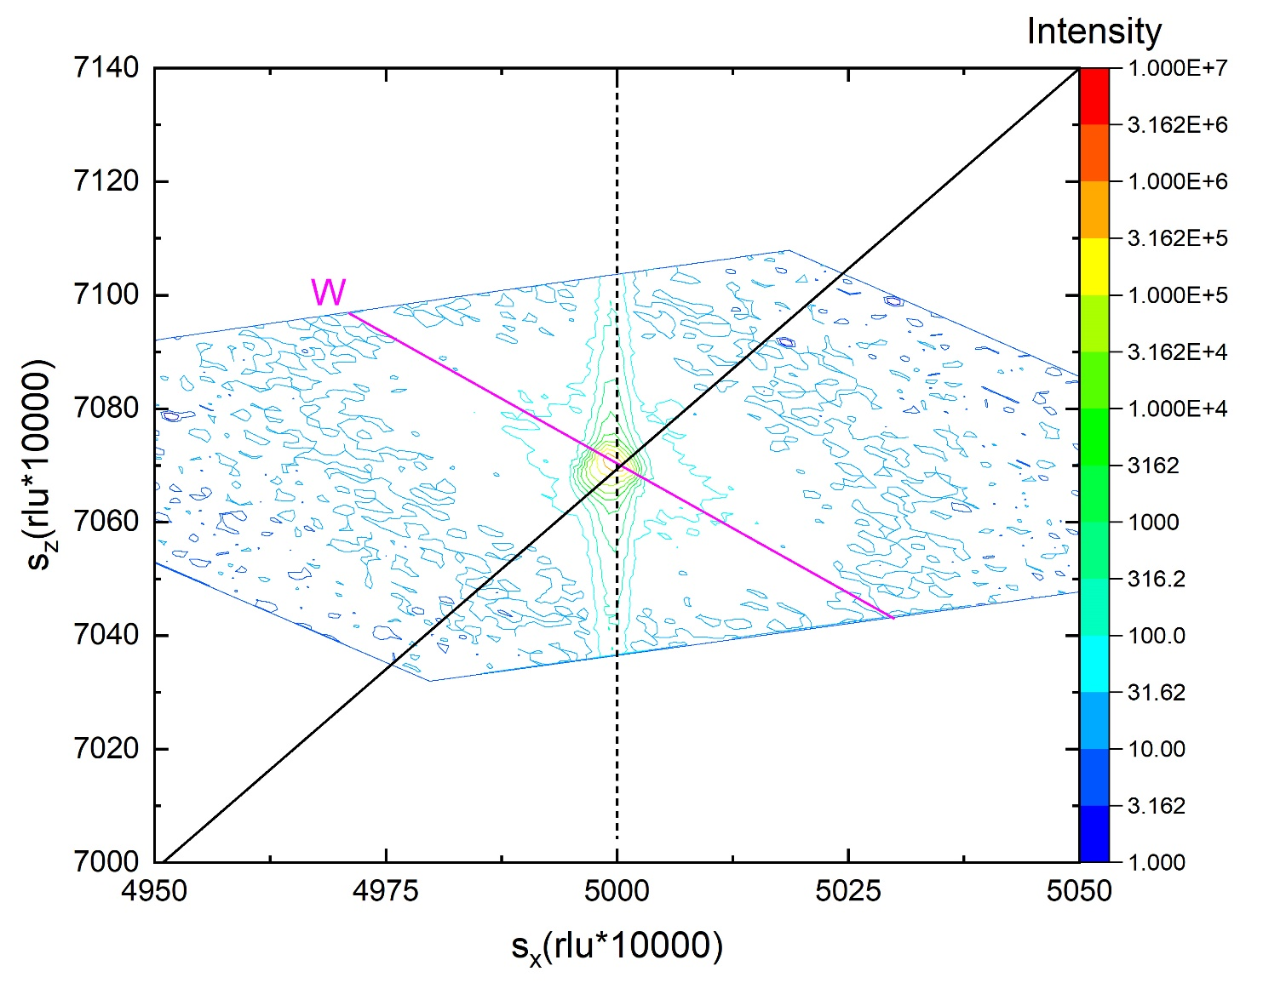
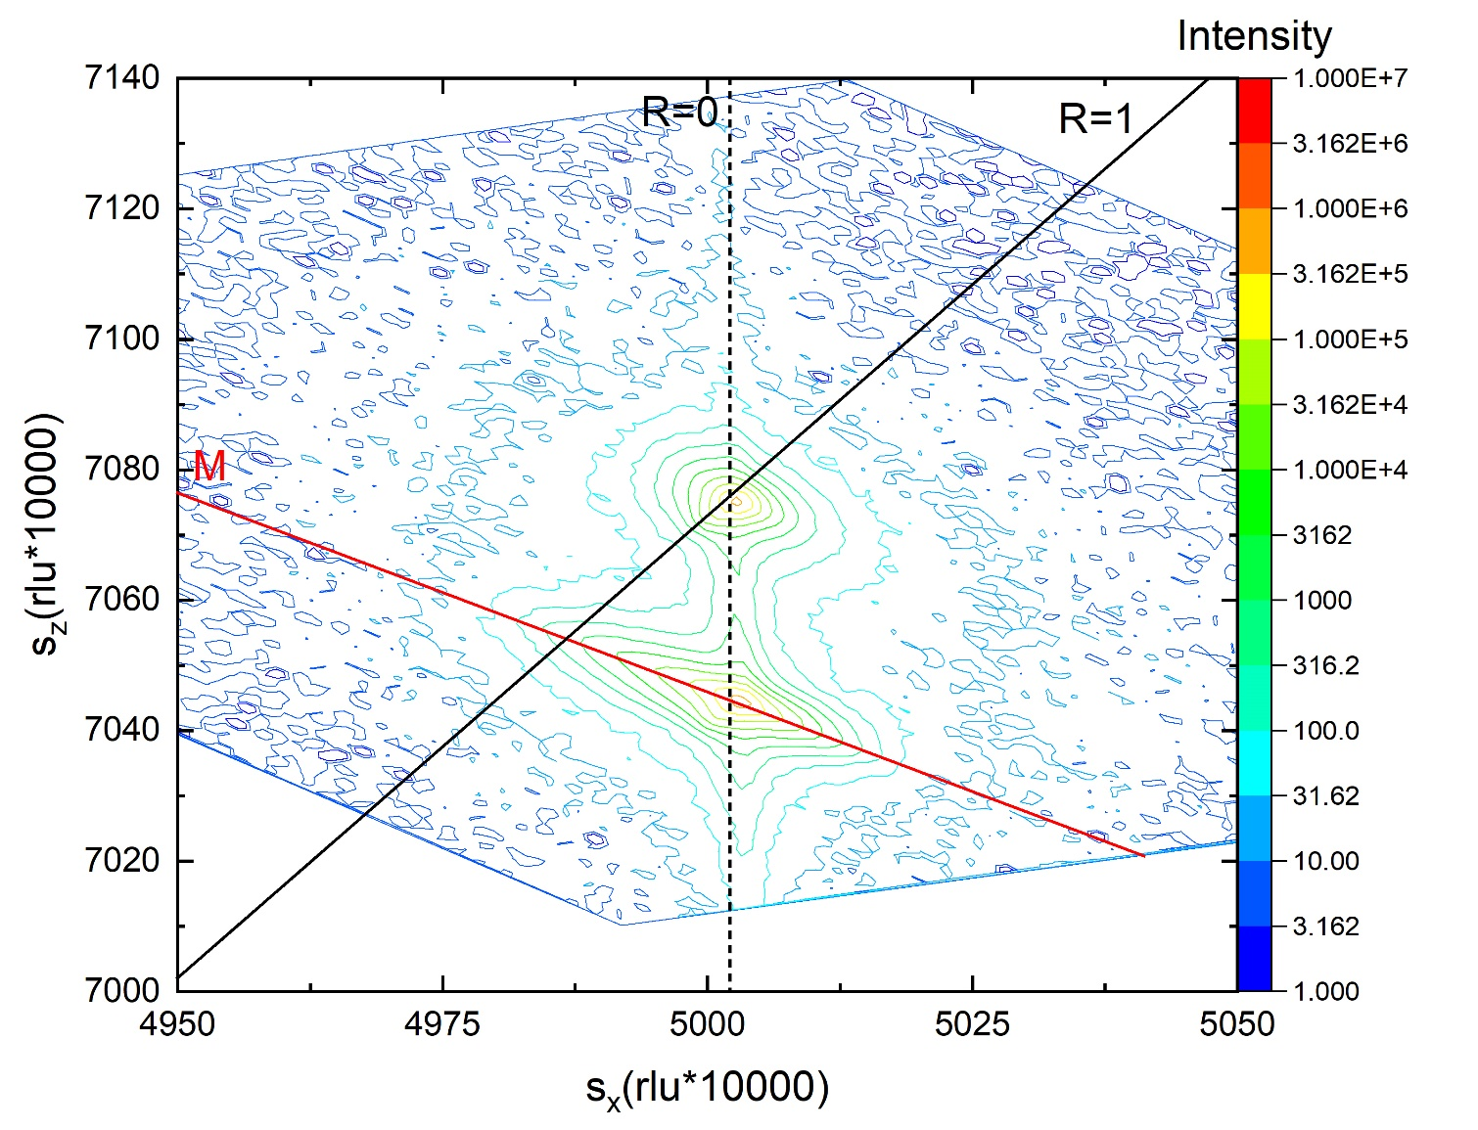
(224) Grazing Incidence Reciprocal Space Map
Bulk GaAs
Bulk Ge
GeSn on GaAs
W-Wavelength Streak
M-Mosaic Spread (Relaxation Line)
Black line drawn from origin (Relaxed)
Dashed line drawn through substrate peak (Pseudomorphic)
$$sx=\frac{qx}{2π}=\frac{1}{λ}[\cos\left(ω\right)−\cos\left(2θ−ω\right)]$$
$$sz=\frac{qz}{2π}=\frac{1}{λ}[\sin\left(ω\right)+\sin\left(2θ−ω\right)]$$
$$λ=1.5406 \text{Å}$$
8

Slide 10
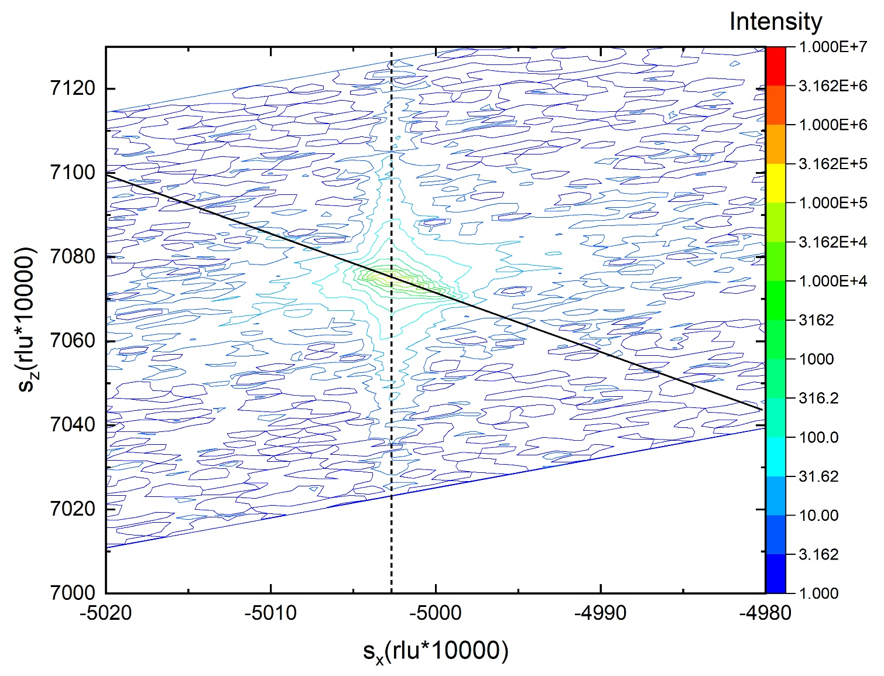
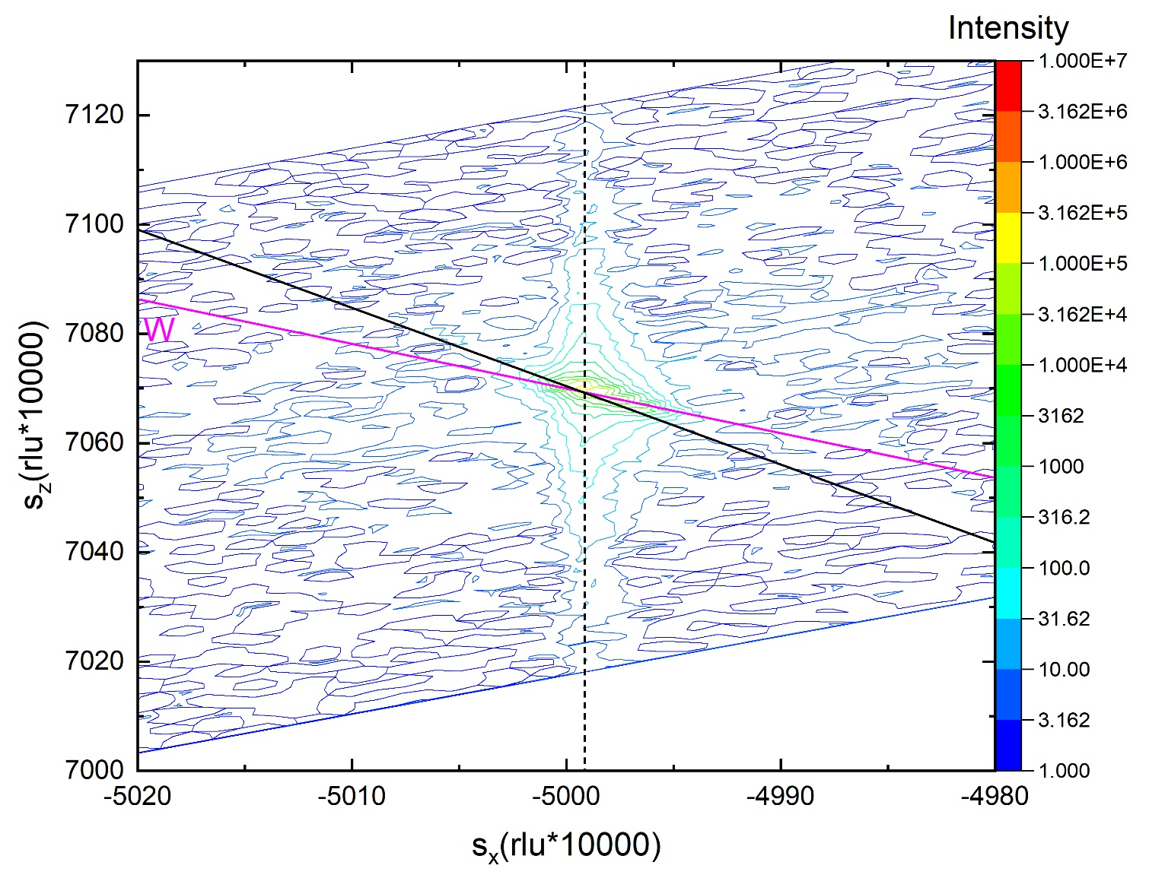
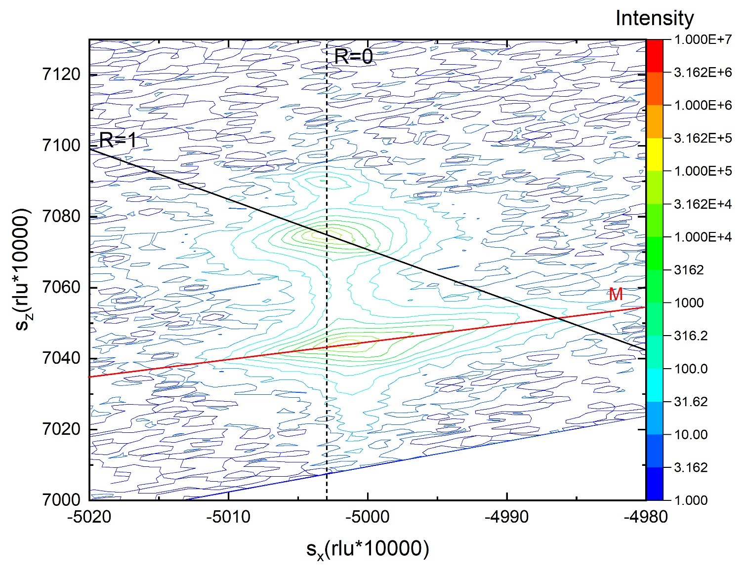
$\left(\overline{2}\overline{2}4\right)$ Grazing Exit Reciprocal Space Map
Bulk GaAs
Bulk Ge
GeSn on GaAs
W-Wavelength Streak
M-Mosaic Spread (Relaxation Line)
Black line drawn from origin (Relaxed)
Dashed line drawn through substrate peak (Pseudomorphic)
$$sx=\frac{qx}{2π}=\frac{1}{λ}[\cos\left(ω\right)−\cos\left(2θ−ω\right)]$$
$$sz=\frac{qz}{2π}=\frac{1}{λ}[\sin\left(ω\right)+\sin\left(2θ−ω\right)]$$
$$λ=1.5406 \text{Å}$$
9

Slide 11
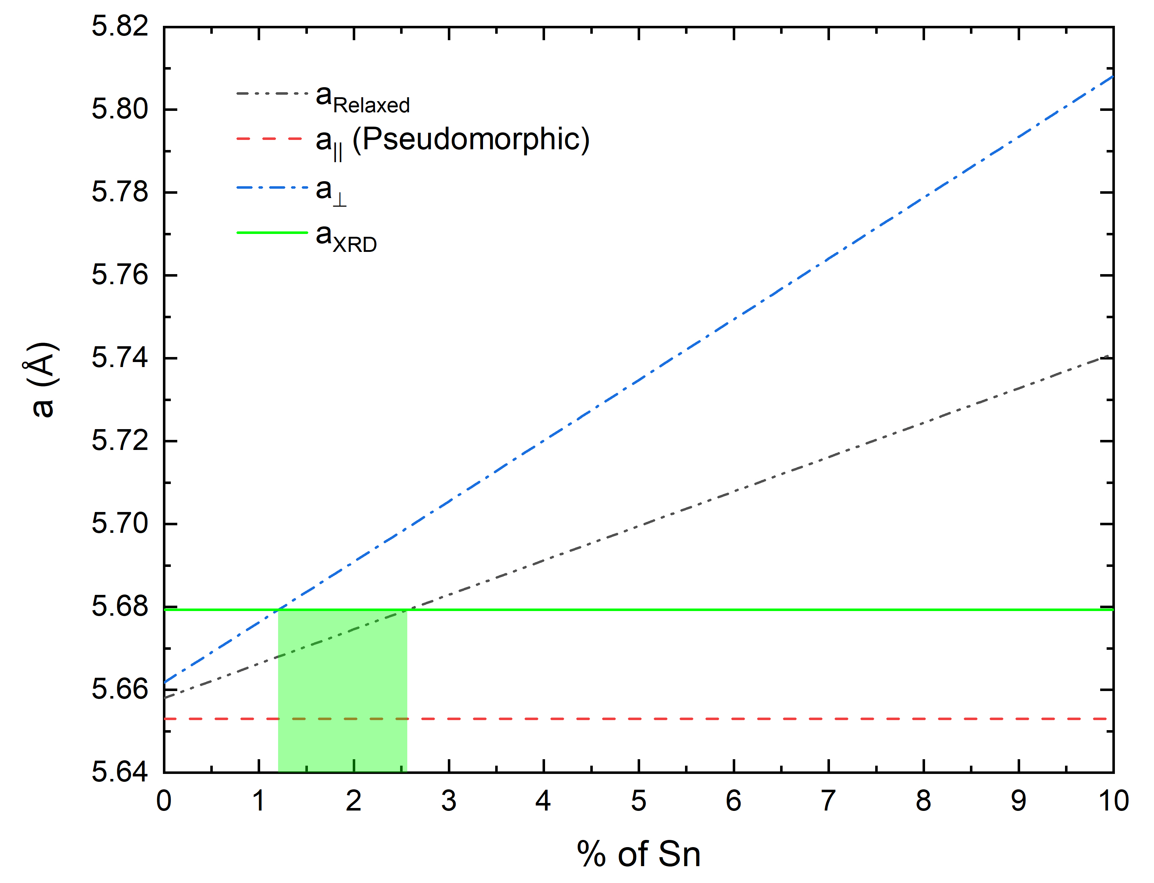
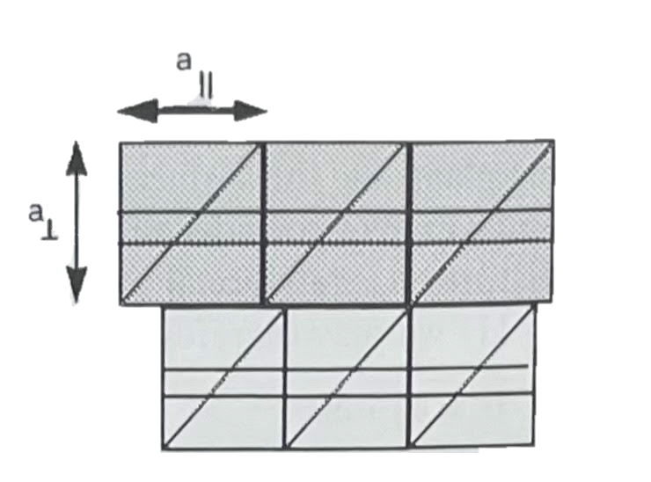
Lattice Constants
Bragg’s Law:
$$a_{GeSn}=4d$$
$a$_{GeSn}= 5.679 Å
$a$_{GaAs} = 5.653 Å
$a$_{Ge} = 5.658 Å
$a$_{Sn} = 6.489 Å
$$nλ=2d\sin{θ}$$
$a$_{GeSn}= 5.679 Å
Vegard’s Law:
$$aRelaxed(y)=aSny +aGe\left(1−y\right)$$
$a$|| $=$ $a$_{substrate}= 5.653 Å
Pseudomorphic
Condition
$$a_{⊥}=\left(1+ε_{⊥}\right)aRelaxed\left(y\right)$$
With Vegard’s law and continuum elasticity theory, the tin content of the Ge_{1-y}Sn_{y} layer can be found with the measured and known lattice constants of GaAs, Ge, and Sn.
$$ε_{⊥}=−\frac{2v}{1−v}ε_{||}$$
$a$||
Poisson Ratio:
$$v=0.3$$
$$ε_{||}=\frac{a_{||}}{aRelaxed(y)}−1$$
$$a_{⊥}$$
If layer is fully relaxed, the % Sn is 2.6%
If layer is fully strained, the % Sn is 1.2%
10
Notes:
With Vegard’s law and continuum elasticity theory, the tin content of the Ge_{1-y}Sn_{y} layer can be found with the measured and known lattice constants of GaAs, Ge, and Sn.

Slide 12
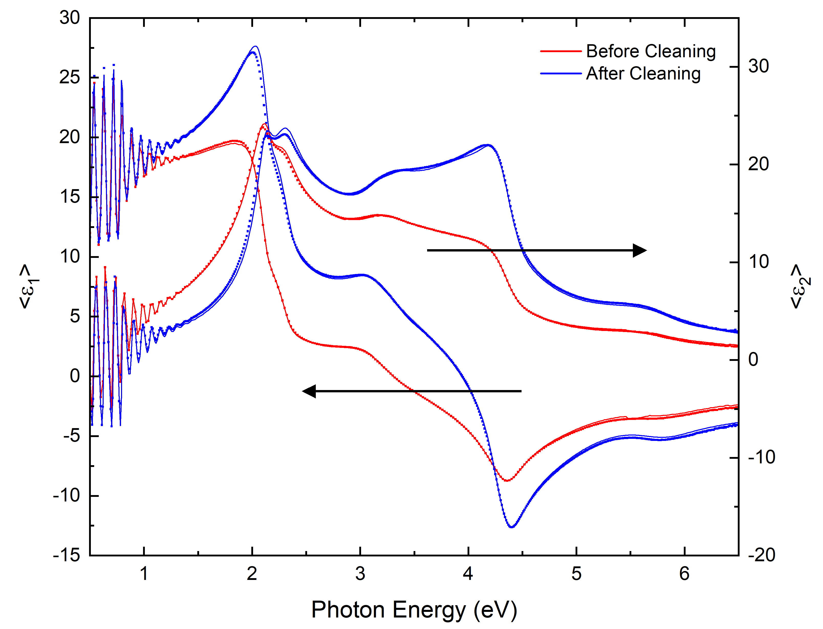
Pseudodielectric Function Before/After Cleaning
 | Oxide Thickness
As Received (May 20th): | 43.66 Å
Before Cleaning (June 14th): | 72.07 Å
After Cleaning (June 14th): | 26.50 Å
After 2nd Cleaning (June 15th): | 25.90 Å
The Ge_{1-y}Sn_{y} on GaAs sample was cleaned ultrasonically with water and then isopropanol to remove organic layers and most of the native oxide.
11

Slide 13
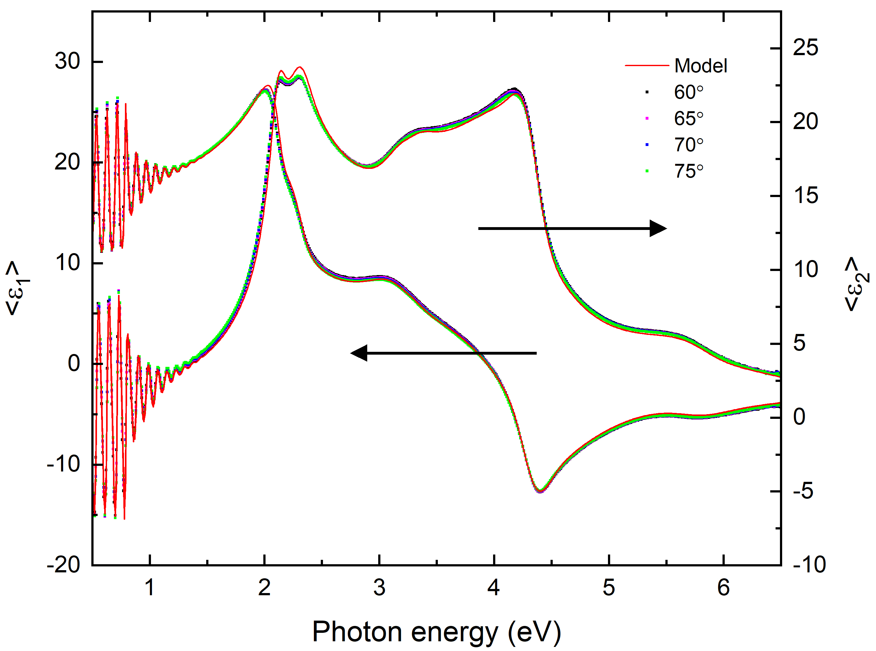
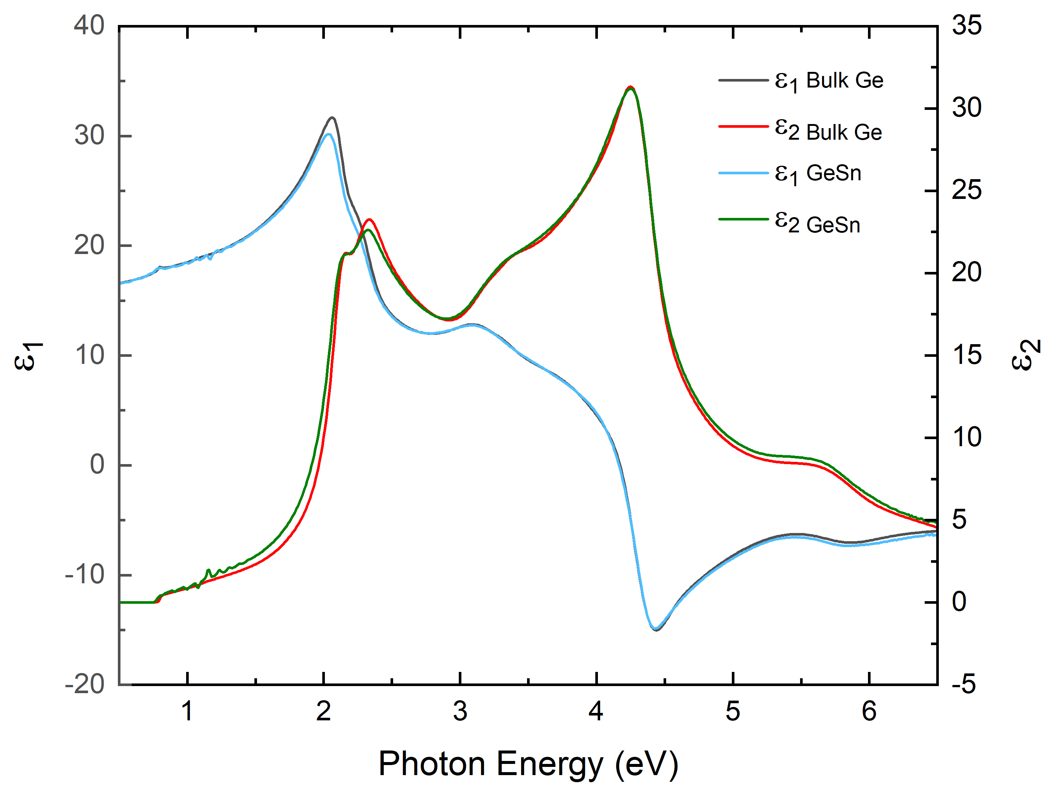
Pseudodielectric Function and Optical Constants
MODEL
Air
Oxide
Ge_{1-y}Sn_{y}
GaAs
12

Slide 14
2nd Derivative of the Dielectric Function
$$ε\left(ω\right)=\frac{Ae^{iφ}}{{\left(−Eg−ⅈΓ+ω\right)}^{2}}$$
Critical Points of GeSn (Blue)
CP | E (eV) | A | Φ (deg) | Γ (meV) | n
E₁ | 2.118 | 5.73 | 248 | 0.048 | 0
E₁+Δ₁ | 2.269 | 5.43 | 248 | 0.088 | 0
E’₀ | 3.155 | 1.32 | 224 | 0.115 | 0
E’₀+Δ’₀ | 3.324 | 0.873 | 235 | 0.103 | 0
E₂ | 4.329 | 13.1 | 310 | 0.121 | 0
Critical Points of Ge (Orange)
CP | E (eV) | A | Φ (deg) | Γ (meV) | n
E₁ | 2.113 | 5.32 | 246 | 0.050 | 0
E₁+Δ₁ | 2.314 | 3.53 | 246 | 0.066 | 0
E’₀ | 3.099 | 1.33 | 175 | 0.102 | 0
E’₀+Δ’₀ | 3.344 | 0.486 | 266 | 0.139 | 0
E₂ | 4.354 | 11.2 | 318 | 0.097 | 0
By fitting the 2nd derivative of the dielectric function, the critical point parameters were found. This includes energy, amplitude, phase angle, broadening, and the line shape. The phase angle for E₁ and E₁+Δ₁ were fixed to be the same.
13
Notes:
By fitting the 2nd derivative of the dielectric function, the critical point parameters were found. This includes energy, amplitude, phase angle, broadening, and the line shape. The phase angle for E₁ and E₁+Δ₁ were fixed to be the same.

Slide 15
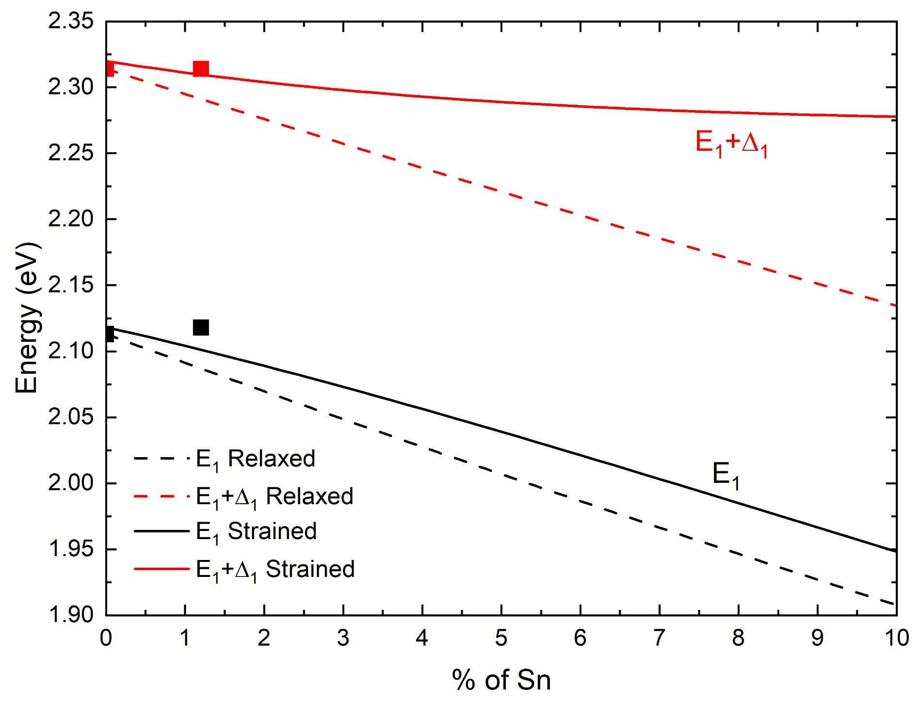
Theoretical E₁ & E₁+Δ₁ with Tin Content
Relaxed:
$$E_{1}^{GeSn}=yE_{1}^{Sn}+\left(1−y\right)E_{1}^{Ge}−b_{GeSn}y(1−y)$$
$${\left(E_{1}+∆_{1}\right)}^{GeSn}=y{\left(E_{1}+∆_{1}\right)}^{Sn}+\left(1−y\right){\left(E_{1}+∆_{1}\right)}^{Ge}−b_{GeSn}y(1−y)$$
$$b_{GeSn}=1.350 eV$$
Strained:
$$E_{1}^{GeSn}=E_{1}^{Relaxed}+{∆E}_{H}−\frac{∆E_{s}^{2}}{∆_{1}}$$
small shear approximation
$${∆E}_{s}≪∆_{1}$$
$${\left(E_{1}+∆_{1}\right)}^{GeSn}={{(E}_{1}+∆_{1})}^{Relaxed}+{∆E}_{H}+\frac{∆E_{s}^{2}}{∆_{1}}$$
$${∆E}_{H}=\sqrt{3}\left[{yD}_{1}^{1 Sn}+\left(1−y\right)D_{1}^{1 Ge}\right]ε_{H}$$
$D_{1}^{1 Sn}=−5.4$ eV,
$D_{1}^{1 Ge}=−8.7$eV,
$$ε_{H}=\frac{ε_{⊥}+{2ε}_{||}}{3}$$
$${∆E}_{S}=\sqrt{6}\left[{{yD}_{3}^{3 Sn}+\left(1−y\right)D}_{3}^{3 Ge}\right]ε_{S}$$
The marked squares are the measured energies of bulk Ge and the Ge_{1-y}Sn_{y} epitaxial layer. The Ge_{1-y}Sn_{y} energy for the E₁ is slightly higher.
$$ε_{S}=\frac{ε_{⊥}+ε_{||}}{3}$$
$D_{3}^{3 Sn}=−3.8$ eV,
$D_{3}^{3 Ge}=−5.6$ eV,
14

Slide 16
Conclusion
The (224) reciprocal space maps showed that the GeSn epitaxial layer was grown pseudomorphically (fully strained).
Using Vegard’s Law, continuum elasticity theory, and the (004) reciprocal space map, the tin content is found to be y=0.012.
After cleaning the sample, the thickness of the oxide was reduced to 26 Å
Using the ellipsometry data, the fitted GeSn dielectric function was similar to bulk Ge most likely because of the low tin content.
The fit second derivative of the dielectric function helped find the critical point parameters and compared to bulk Ge
The energy for the E₁ is slightly higher in the GeSn layer despite theory.
Ge_{1-y}Sn_{y}
15

Slide 17
Questions?

Slide 18
References
[1] P. F. Fewster, X-ray scattering from semiconductors. London: World Scientific (2016)
[2] N.S. Fernando, R.A. Carrasco, R. Hickey, J. Hart, R. Hazbun, S. Schoeche, J.N. Hilfiker, J. Kolodzey, and S. Zollner, Band gap and strain engineering of pseudomorphic Ge_{1-x-y}Si_{x}Sn_{y}alloys on Ge and GaAs for photonic applications, J. Vac. Sci. Technol. B 36, Mar/Apr (2018).
[3] N.S. Fernando, T.N. Nunley, A. R. Ghosh, C.M. Nelson, J.A. Cooke, A.A. Medina, S. Zollner, C. Xu, J. Menendez, and J. Kouvetakis, Temperature dependence of the interband critical points of bulk Ge and strained Ge on Si, Applied Surface Science 421, 905-912 (2017).
[4] T.N. Nunley, N.S. Fernando, N. Samarasingha, J.M. Moya, C.M. Nelson, A.A. Medina, and S. Zollner, Optical constants of germanium and thermally grown germanium dioxide from 0.5 to 6.6 eV via a multi-sample ellipsometry investigation, J. Vac. Sci. Technol. B 34, 061205 (2016).
[5] H.G. Tompkins, and J.N. Hilfiker. Spectroscopic Ellipsometry: Practical Application to Thin Film Characterization, Momentum Press (2016).

