Slide 1

Optical Constants of CaF2 at 300 K
NMSU – URCAS April 29th, 2022
${\text{Jaden} \text{R}\text{. }\text{Love},}^{1}$ ${\text{Nuwanjula} \text{S}\text{. }\text{Samarasingha},}^{1}$ ${\text{Carlos} \text{Armenta},}^{1}$ ${\text{Stefan} \text{Zollner},}^{1}$ ${\text{H}\text{. }\text{Kim}}^{2}$
Department of Physics, New Mexico State University, Las Cruces, NM
National Institute of Aerospace, NASA Langley Research Center, Hampton, VA
College of Arts and Sciences
Email: lovej@nmsu.edu

Slide 2
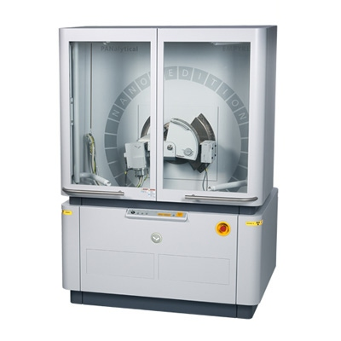
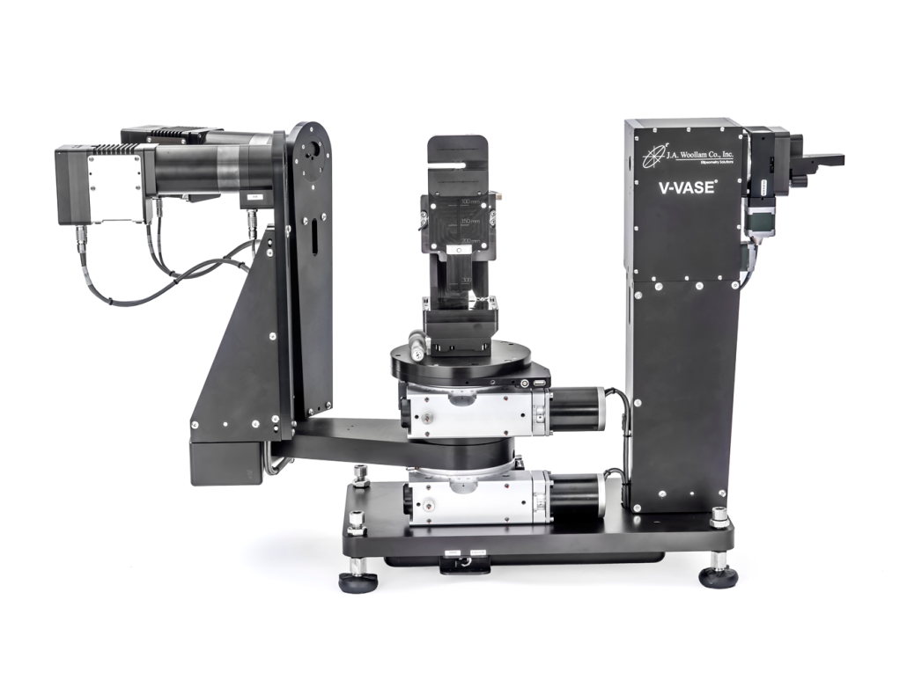
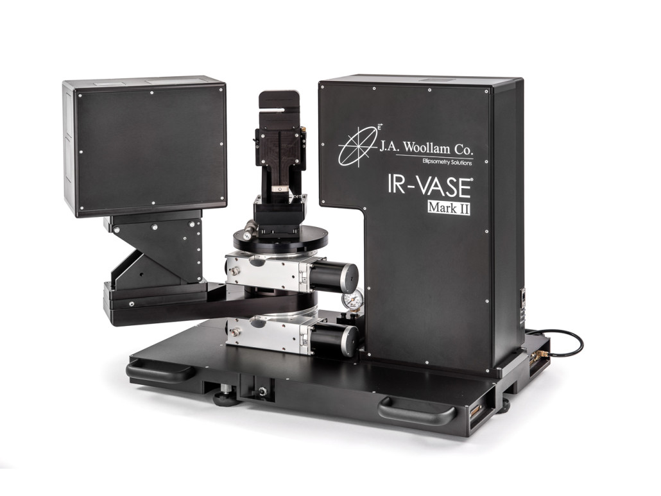

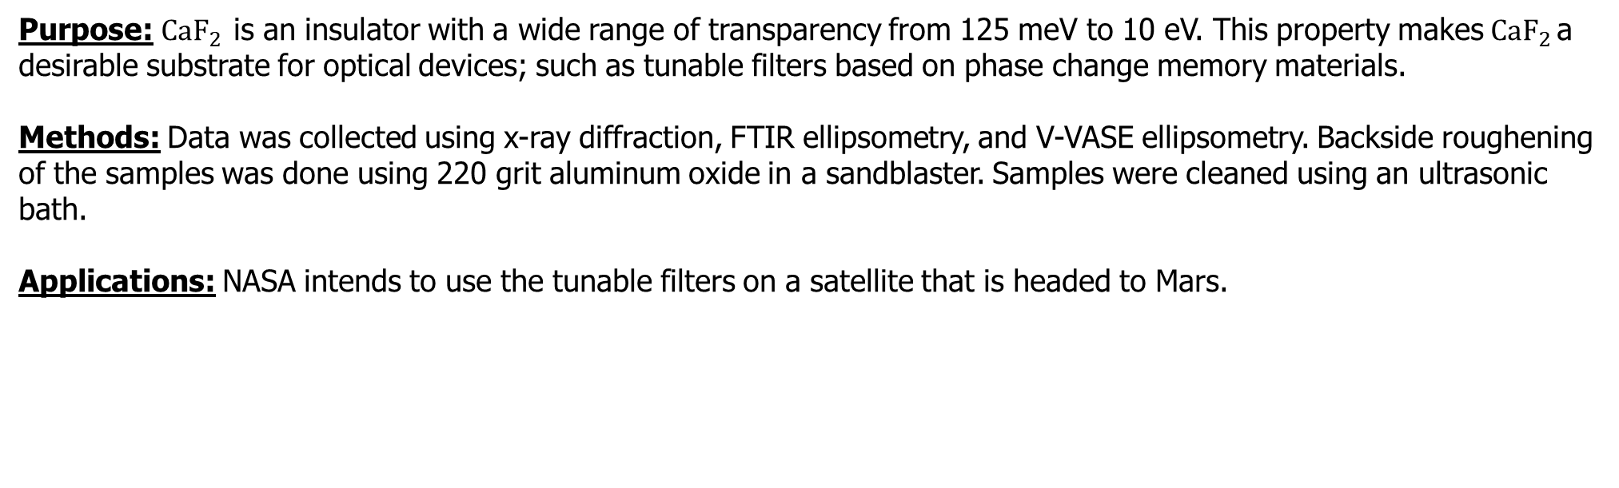
Optical & Structural Properties of ${CaF}_{2}$
Purpose: ${CaF}_{2 }$is an insulator with a wide range of transparency from 125 meV to 10 eV. This property makes${ CaF}_{2 }$a desirable substrate for optical devices; such as tunable filters based on phase change memory materials.
Methods: Data was collected using x-ray diffraction, FTIR ellipsometry, and V-VASE ellipsometry. Backside roughening of the samples was done using 220 grit aluminum oxide in a sandblaster. Samples were cleaned using an ultrasonic bath.
Applications: NASA intends to use the tunable filters on a satellite that is headed to Mars.
Malvern Panalytical: Empyrean x-ray diffractometer
JA Woollam: V-VASE Ellipsometer
JA Woollam: FTIR-VASE Mark II Ellipsometer
1

Slide 3
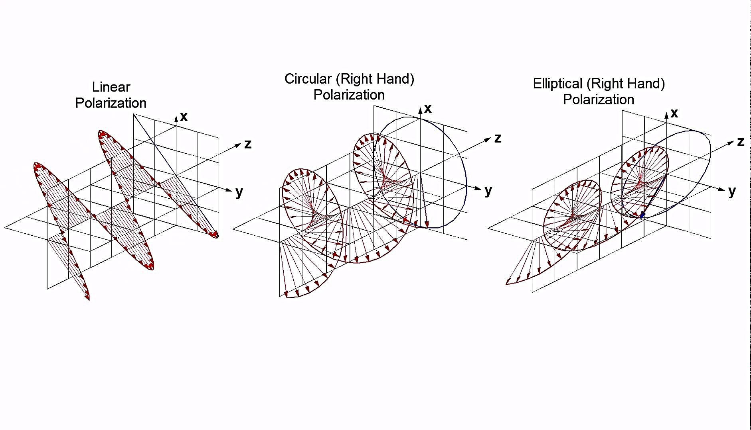
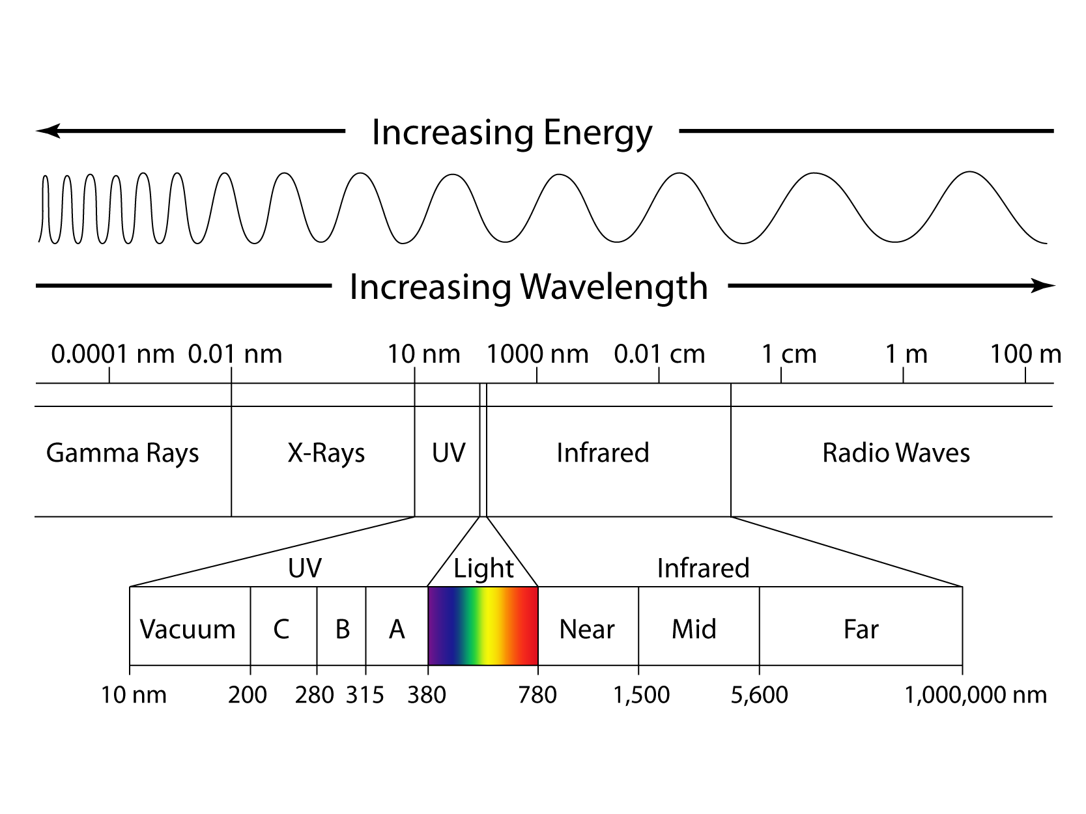
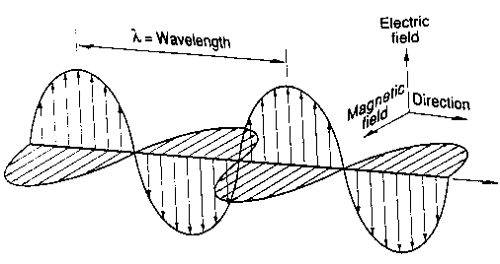
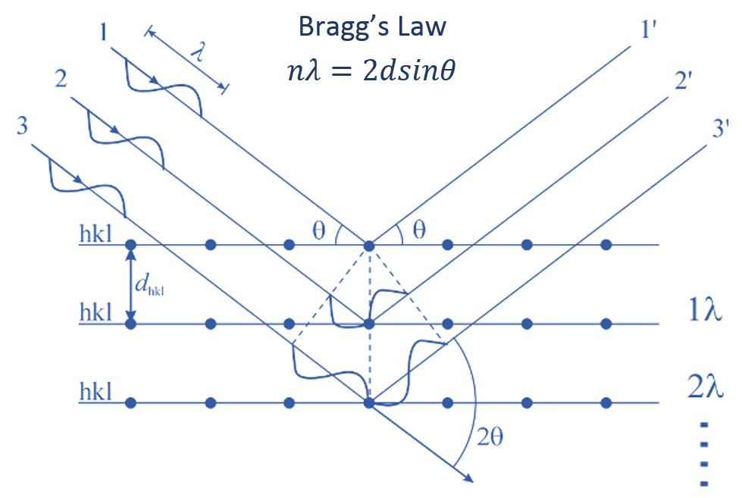
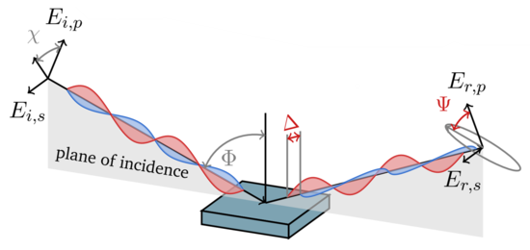
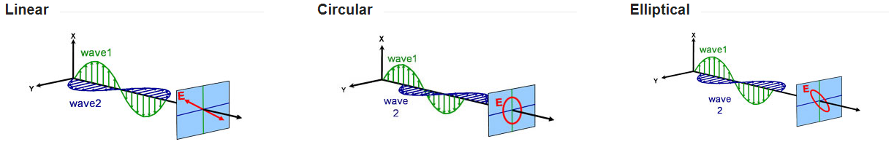










Electromagnetic Waves – “Light”
Ellipsometry (UV and IR) – Optical Properties
X-Ray Diffraction – Structural Properties
$$ρ=\tan{ψ}e^{iΔ}=\frac{r_{p}}{r_{s}}$$
2

Slide 4
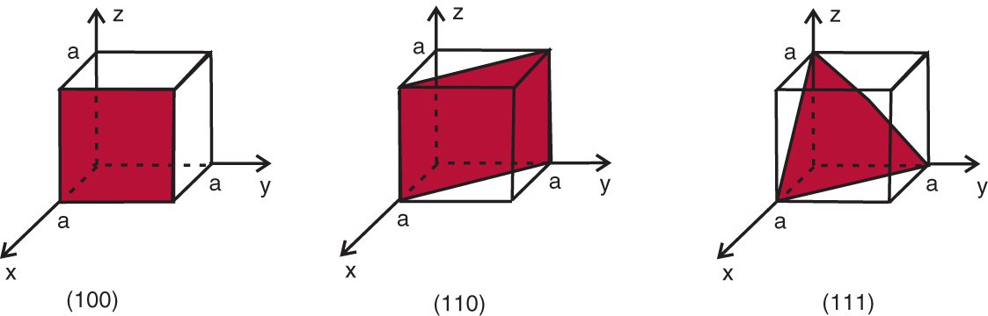
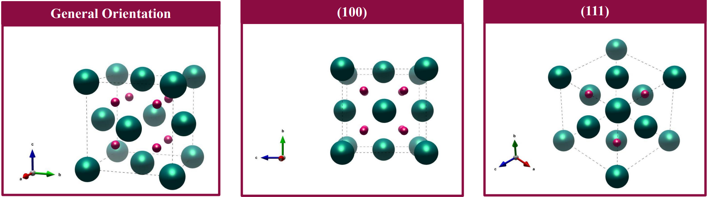

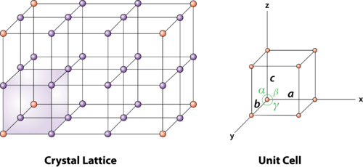
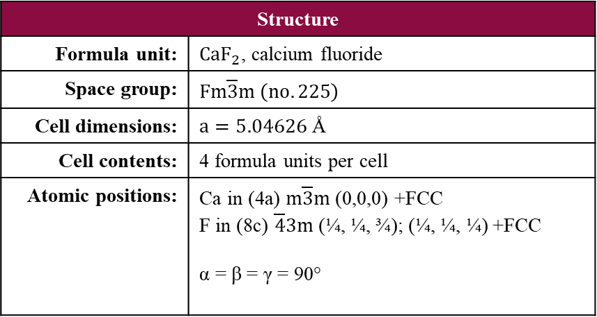
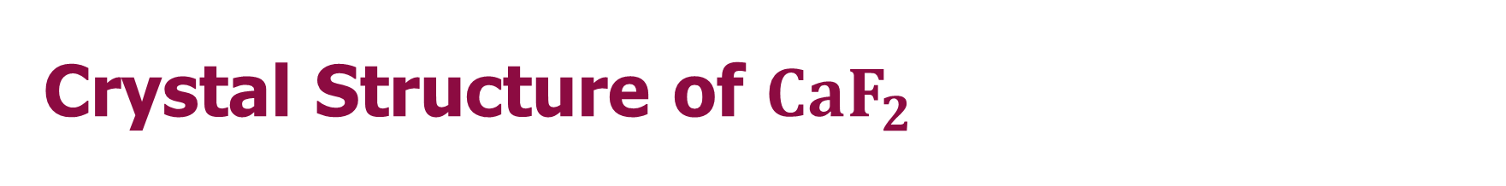
Crystal Structure of ${CaF}_{2}$
Structure | Structure
Formula unit: | ${CaF}_{2}$, calcium fluoride
Space group: | $Fm\overline{3}m \left(no. 225\right)$
Cell dimensions: | $a=5.04626$Å
Cell contents: | 4 formula units per cell
Atomic positions: | Ca in (4a) $m\overline{3}m$(0,0,0) +FCC F in (8c) $\overline{4}3m$(¼, ¼, ¾); (¼, ¼, ¼) +FCC α = β = γ = 90°
3

Slide 5
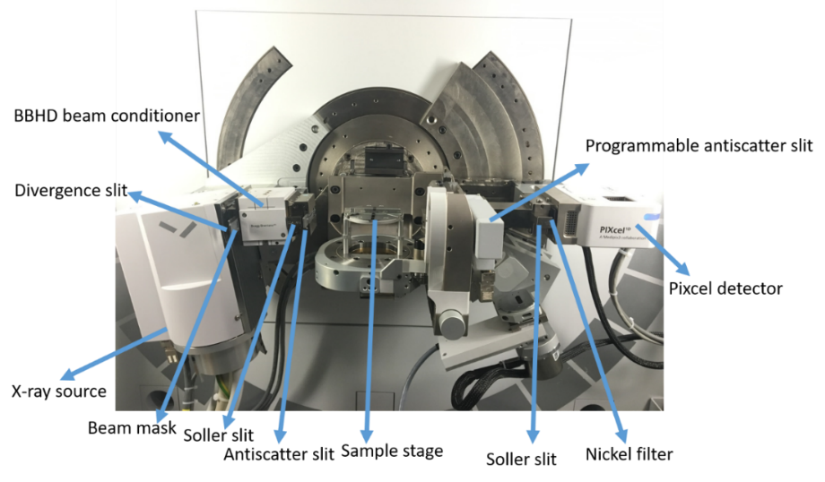
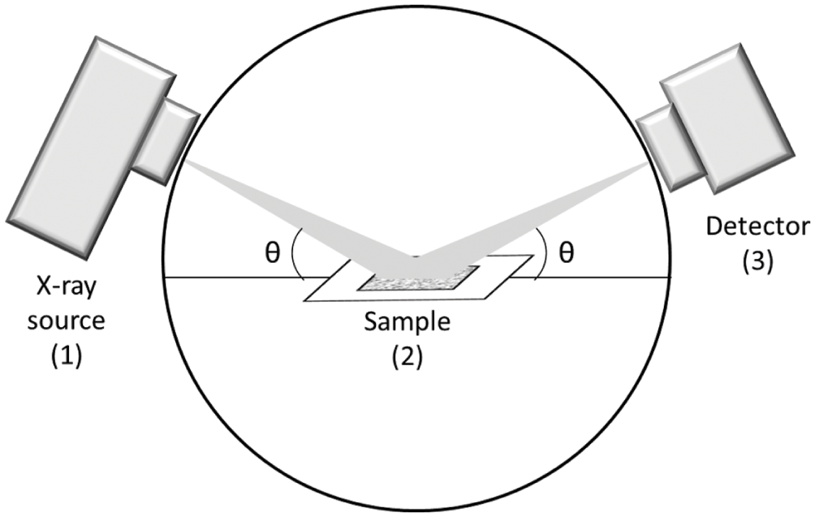
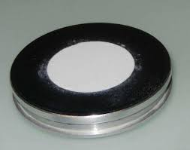
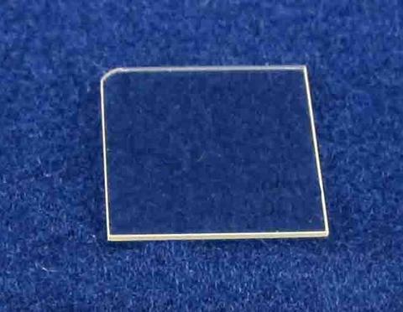


X-Ray Diffraction
${CaF}_{2}$Powder Diffraction
${CaF}_{2}$Bulk Substrate, Single Crystal
4

Slide 6

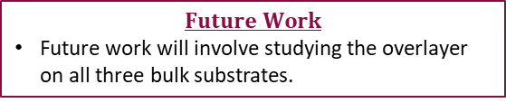

UV-VASE Ellipsometry- Sydor Optics Bulk ${CaF}_{2}$ (111)
Psuedodielectric Function Model Fit with Overlayer
Typically, <ε₂> is above 0 due to surface overlayers
The data shows that <ε₂> is negative
The surface layer can be fitted best by adding an overlayer with a thickness of 50 Å
The overlayer fit results in an MSE lower than 1 and therefore is the best fit for the data.
Real Dielectric Function: Bulk vs. Overlayer
This graph shows the variation in <ε₁> above 3 eV where the values for the overlayer are larger than that of the bulk substrate.
$$\tilde{ε}=ε_{1}+{iε}_{2}$$
$$Future Work$$
Future work will involve studying the overlayer on all three bulk substrates.
5
Notes:
${CaF}_{2}$(111) NASA, two poles + TL
<ε₁> can be fitted reasonably well with a pole at 13.1 eV with amplitude of 179 eV².
TL oscillator fixed at 20 eV
IR pole at 1 meV with a magnitude of 8.7 ${meV}^{2}.$
UV pole at 7.48 eV with a magnitude of 5.06 ${eV}^{2}.$
Broadening of 0.5 eV (fixed)
Bandgap of 6.5 eV (fixed)
Sydor Optics Bulk ${CaF}_{2}$(111)
Typically, <ε₂> is above 0 due to surface overlayers (surface roughness/ contamination)
The data shows that <ε₂> is negative indicating that the refractive index of the overlayer must be higher than that of the bulk substrate.
The surface layer can be described in the fit by adding an overlayer with a thickness of 50 Å and a fixed pole at 10 eV with a magnitude of 98.8 ${eV}^{2}.$
The overlayer fit results in an MSE lower than 1 and therefore is the best fit for the data.

Slide 7
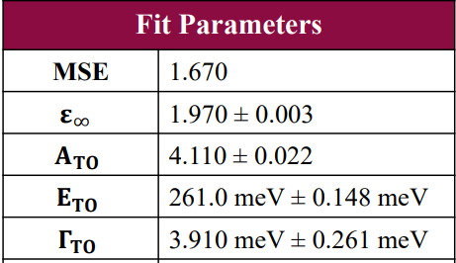
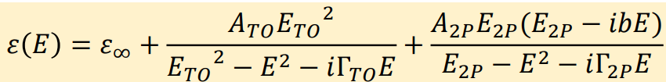


FTIR Ellipsometry- MTI Bulk ${CaF}_{2}$ (111)
Restrahlen Band
$$\tan{ψ}=\left|\frac{r_{p}}{r_{s}}\right|$$
Complex Dielectric Function
$$\tilde{ε}=ε_{1}+{iε}_{2}$$
6

Slide 8
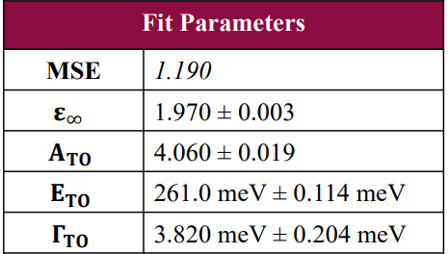



FTIR Ellipsometry- MTI Bulk ${CaF}_{2}$ (100)
Restrahlen Band
$$\tan{ψ}=\left|\frac{r_{p}}{r_{s}}\right|$$
Complex Dielectric Function
$$\tilde{ε}=ε_{1}+{iε}_{2}$$
7

Slide 9
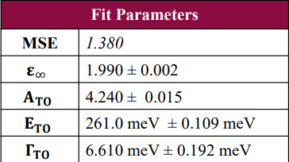


FTIR Ellipsometry- Sydor Optics Bulk ${CaF}_{2}$ (111)
Restrahlen Band
$$\tan{ψ}=\left|\frac{r_{p}}{r_{s}}\right|$$
Complex Dielectric Function
$$\tilde{ε}=ε_{1}+{iε}_{2}$$
8

Slide 10
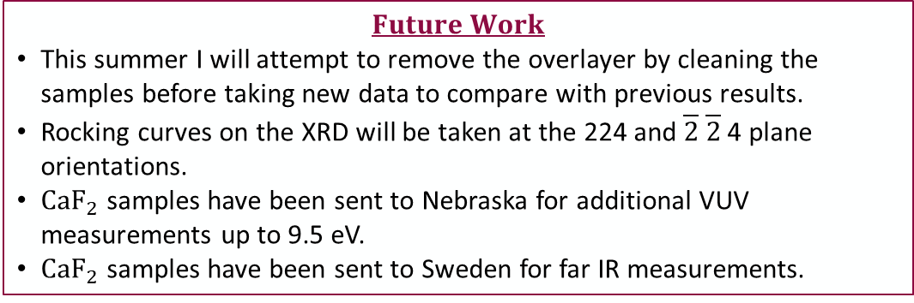
Conclusions
We determined the lattice constant and verified crystal quality in 3 bulk substrates.
We determined optical constants and TO/LO energies for 3 bulk substrates using IR ellipsometry.
Identified the existence of an overlayer on the Sydor Optics (111) substrate with a higher refractive index than the bulk substrate.
$$Future Work$$
This summer I will attempt to remove the overlayer by cleaning the samples before taking new data to compare with previous results.
Rocking curves on the XRD will be taken at the 224 and $\overline{2}$ $\overline{2}$ 4 plane orientations.
${CaF}_{2}$ samples have been sent to Nebraska for additional VUV measurements up to 9.5 eV.
${CaF}_{2}$ samples have been sent to Sweden for far IR measurements.
Questions?
9

