Slide 1

Temperature Dependence of the Direct Bandgap of InSb
URCAS, April 2022
FA9550-20-1-0135
Melissa Rivero Arias, Carola Emminger, Cesy M. Zamarripa,
Jaden R. Love, and Stefan Zollner
College of Arts and Sciences, Department of Physics

Slide 2
Outline
Scientific language
What is InSb?
Electromagnetic spectrum and band gap
Expectations
Experiment, equipment and sample preparation
Data and corrections
Analysis
Conclusions and future work

Slide 3
Temperature Dependence of the Direct Bandgap of InSb
URCAS, April 2022
Melissa Rivero
In collaboration with: Dr. Stefan Zollner, Carola Emminger, Cesy Zamarripa and Jaden R. Love
Experiments that go to low and/or high temperatures
Indium Antimonide: narrow-gap semiconductor material from the III-V group
Minimum amount of energy required for an electron to break free of its ground state
Undergraduate, Department of Physics
College of Arts and Sciences, Department of Physics
3
3

Slide 4
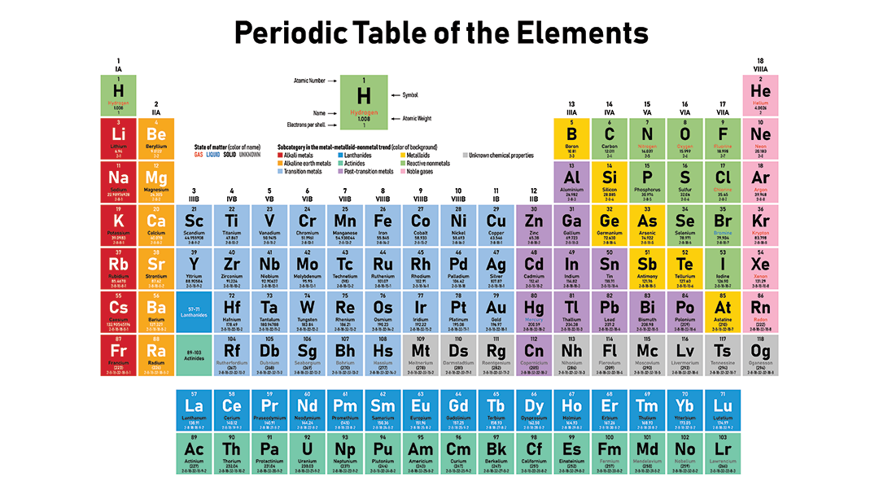
What is InSb?
Indium Antimonide: narrow-gap semiconductor material from the III-V group.
Examples (III-V):
GaSb (gallium antimonide)
InAs (indium arsenide)
GaP (gallium phosphide)

Slide 5
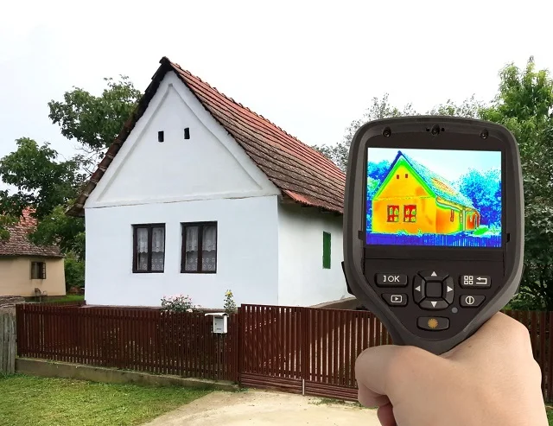
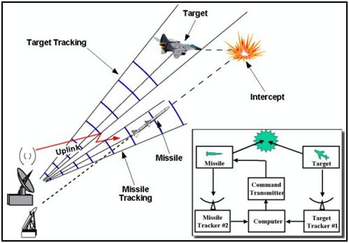
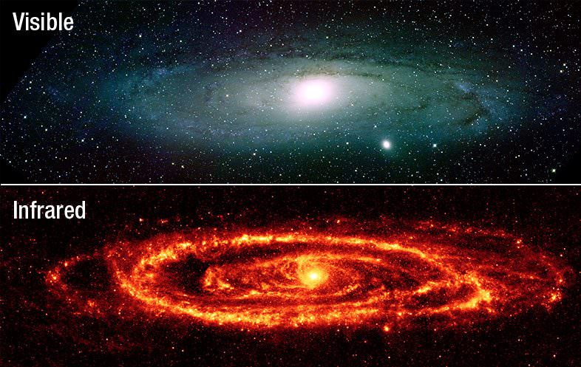
What is InSb?
Used in infrared detectors, including thermal imaging cameras, FLIR systems, infrared homing missile guidance systems, and in infrared astronomy.

Slide 6
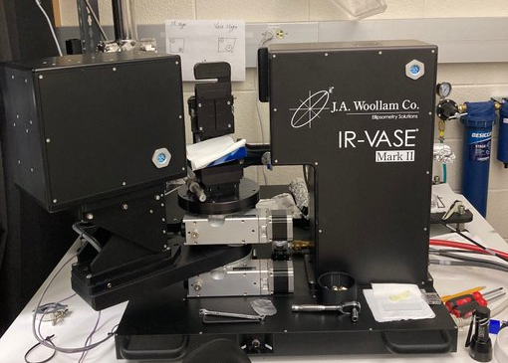
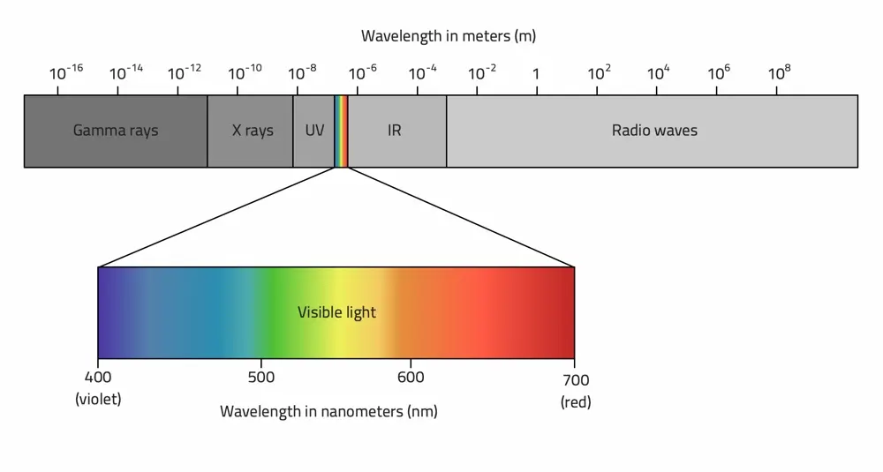
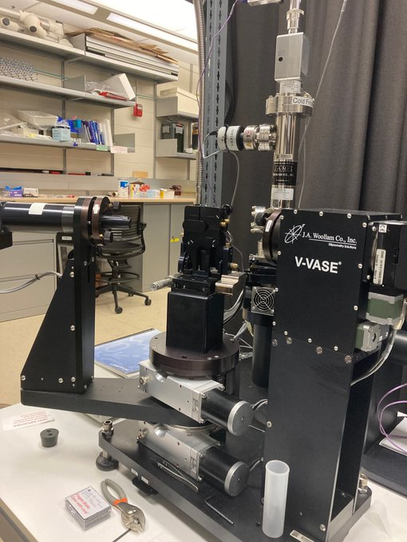
Electromagnetic Spectrum
Range of frequencies of electromagnetic radiation and their respective wavelengths and photon energies.
J.A. Woollam IR-VASE
J.A. Woollam V-VASE

Slide 7
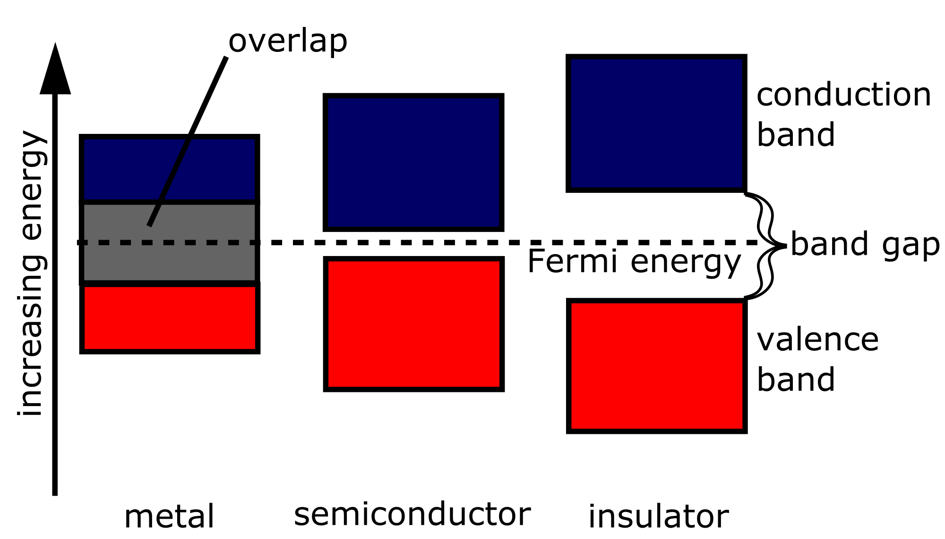
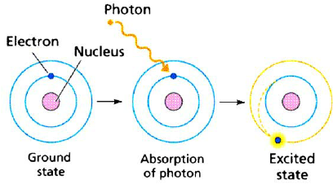
Band Gap
The band gap is the minimum amount of energy required for an electron to break free of its bound state. When the band gap energy is met, the electron is excited into a free state, and can therefore participate in conduction.
InSb

Slide 8
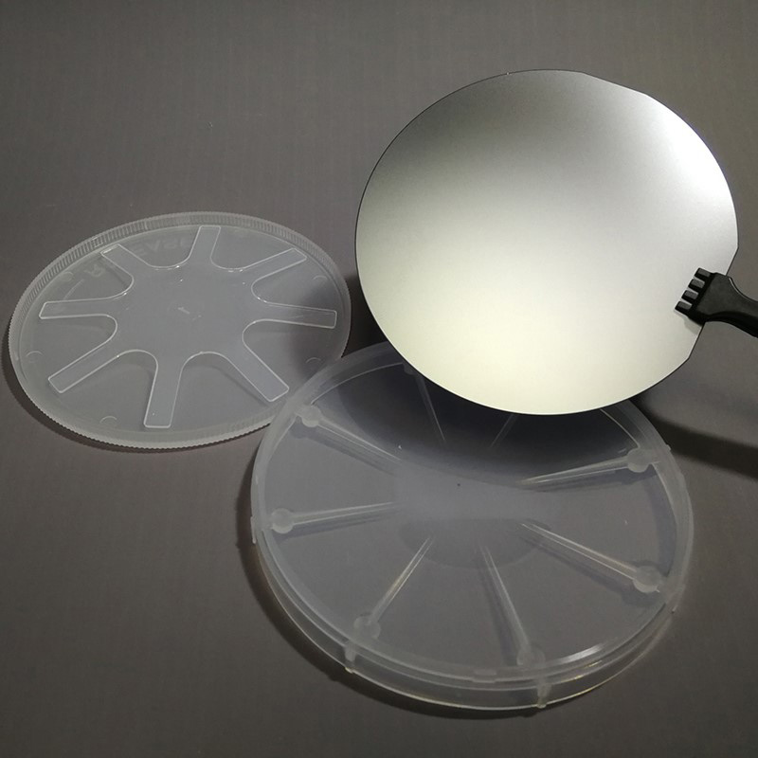
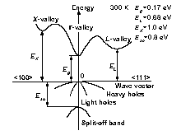
Expectations (1/3)
Measurement of the dielectric function of bulk InSb from 80 to 700 K near the direct band gap (E₀)
80 to 700 Kelvin
-193.5 to 426.85 Celsius
-315.67 to 800.33 Fahrenheit
Comparison
Direct Bandgap at 300 K (room temperature): ~0.17 eV
Bulk InSb

Slide 9
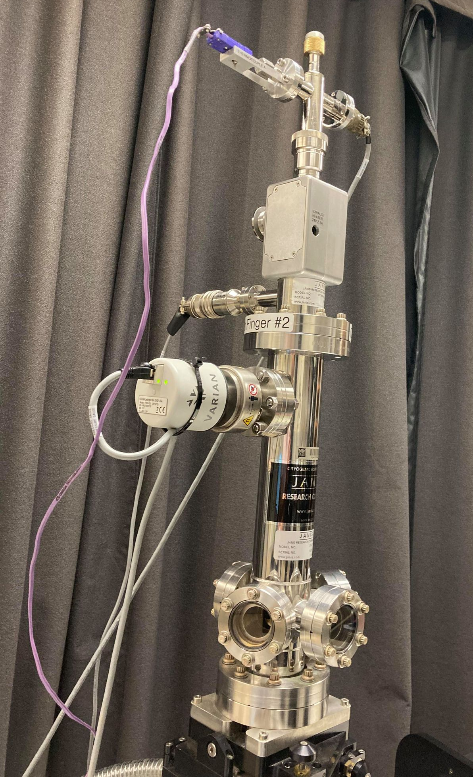
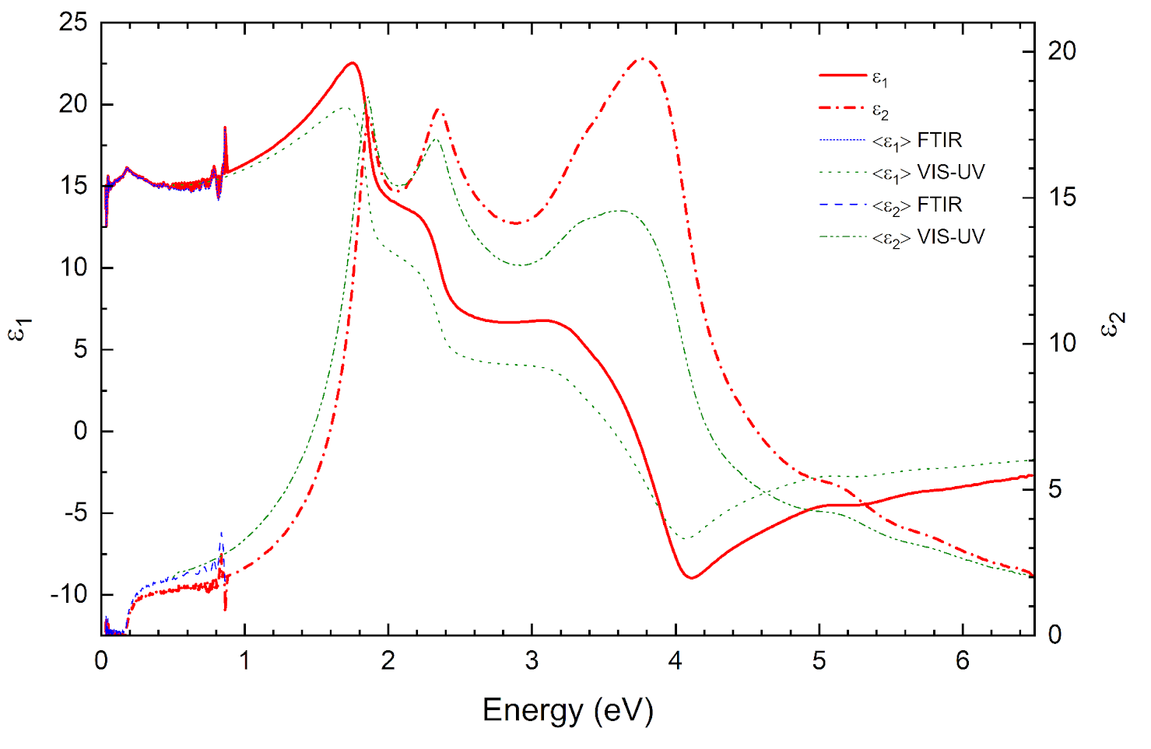
Expectations (2/3)
Using FTIR spectroscopic ellipsometry in an ultra-high vacuum (UHV) cryostat with diamond windows.
Energies: 1.24 meV to 1.7 eV
VIS-UV and FTIR spectra (dielectric functions) After oxide correction
J.A. Woollam IR-VASE
Cryostat with diamond windows

Slide 10
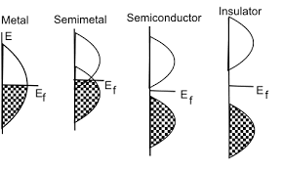
Expectations (3/3)
Calculations indicate that InSb should undergo a topological phase transition from semiconductor to semi-metal (and topological insulator) at 600 K (negative band gap).
Negative Bandgap (at high temps)

Slide 11
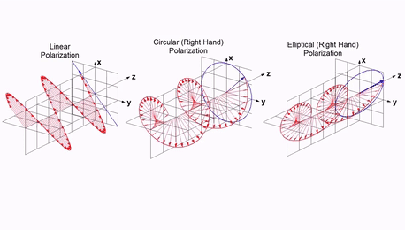
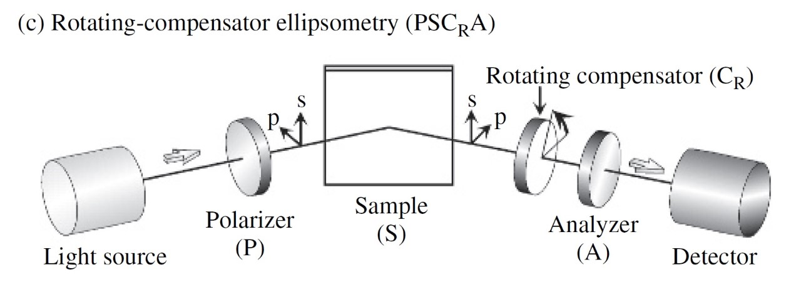
Experiment and Equipment
Non-destructive, noncontact, and non-invasive optical technique based on the change in the polarization state of light as it is reflected obliquely from a thin film sample.
Uses a model-based approach to determine thin film, interface, and surface roughness thicknesses, as well as optical properties.
Spectroscopic Ellipsometry
Oxide and organic layers
InSb
J.A. Woollam V-VASE
J.A. Woollam IR-VASE
Cryostat with diamond windows
Notes:
Rotating compensator ellipsometer

Slide 12
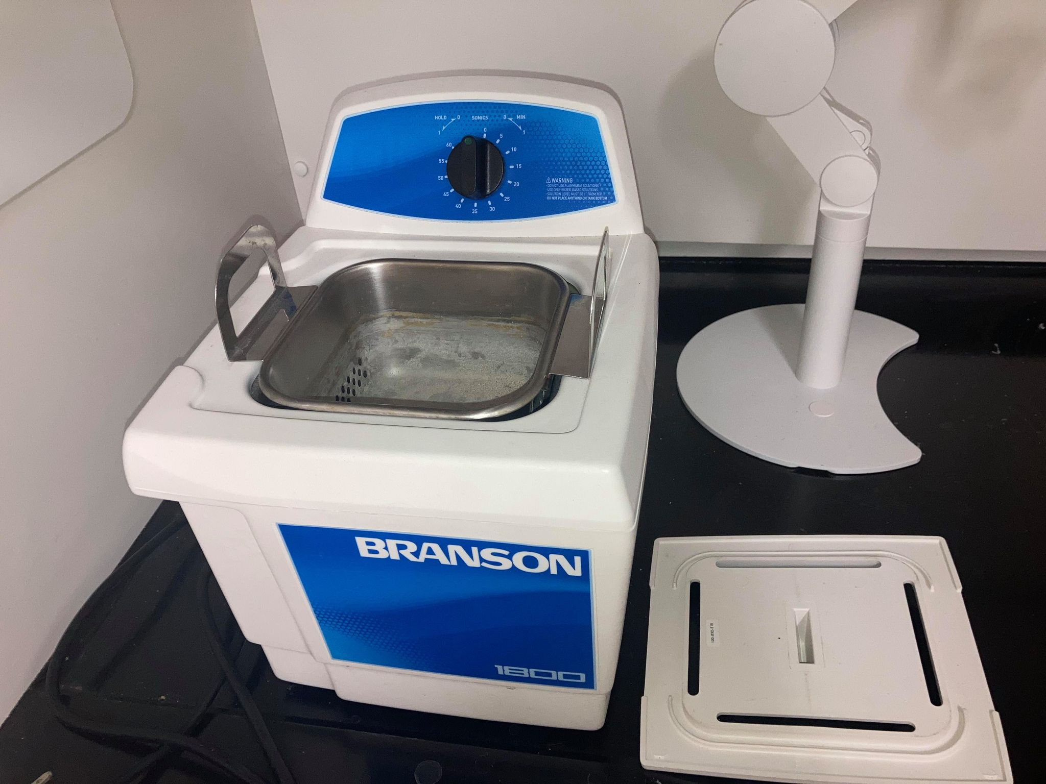
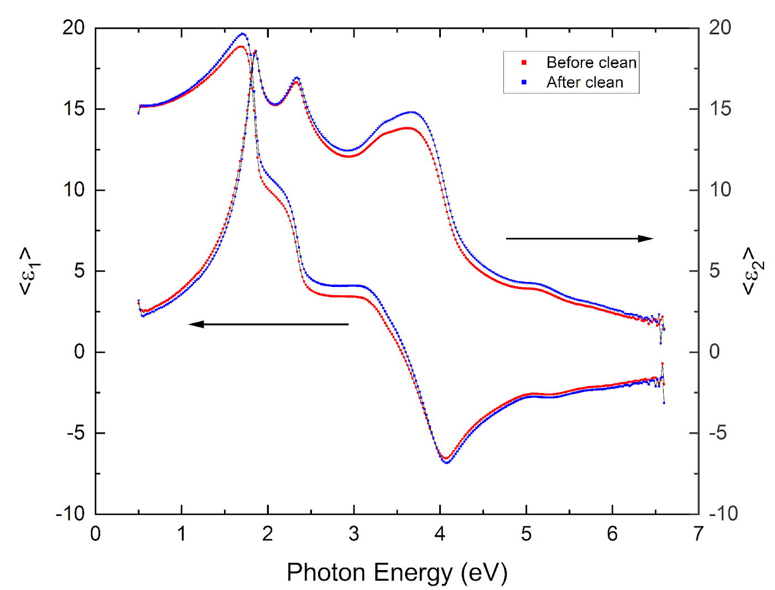
Sample preparation
InSb cleaning process (on a Branson Ultrasonic Cleaner):
Indium antimonide sample was cleaned using water and isopropanol on the ultrasonic cleaner for 15 minutes on each to remove organic layers before the temperature dependent ellipsometry measurements.
 | Oxide Thickness (Å)
Before Clean | 28.2
After Clean | 22.5

Slide 13
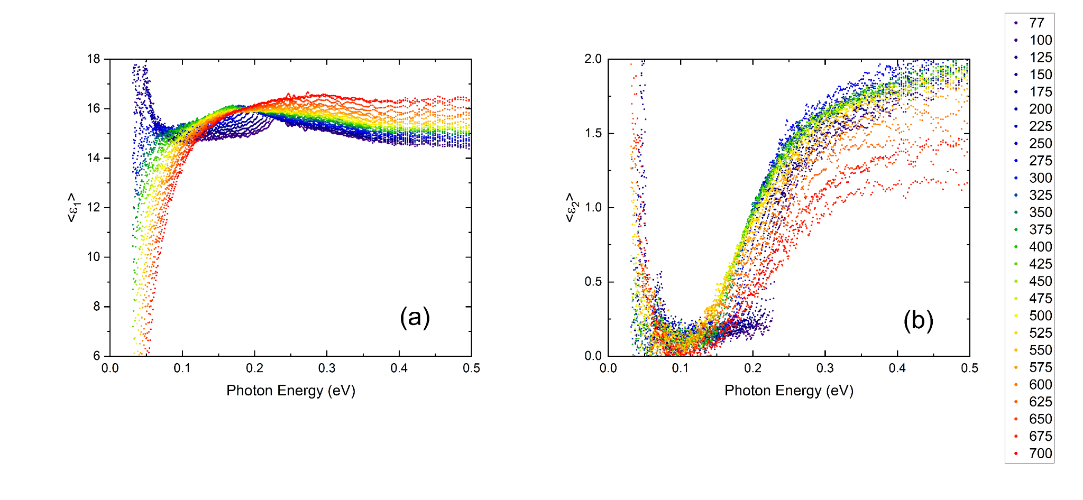
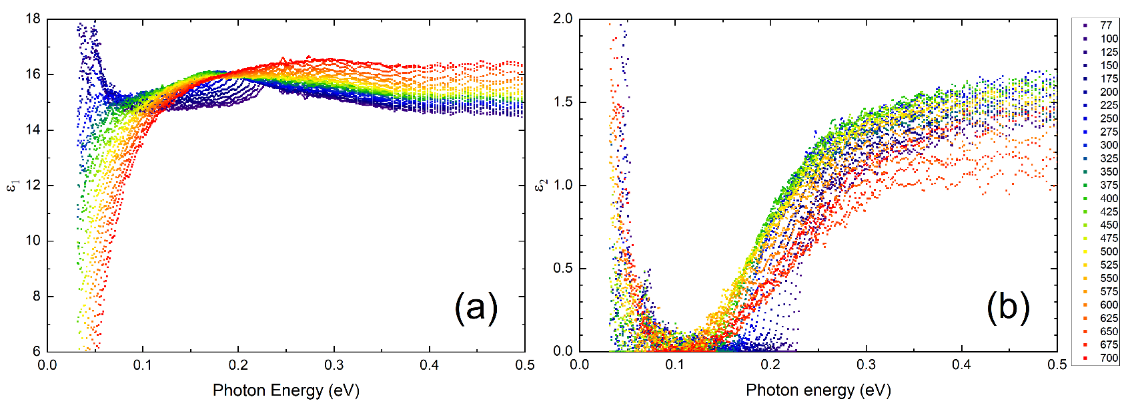




Data and Corrections
Pseudo Dielectric Functions (“raw” data)
$$E_{0}$$
$E_{0}$= Bandgap
$$E_{0}$$
$$E_{0}$$

Slide 14
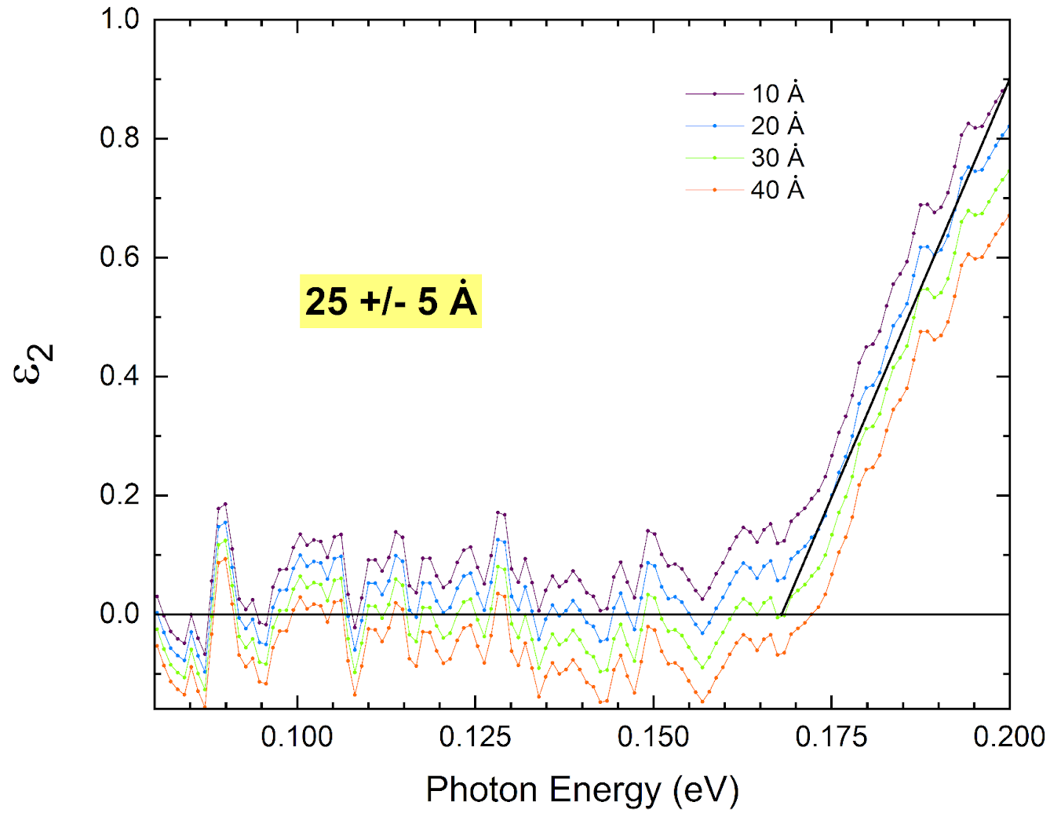
Oxide Correction

Slide 15
Dielectric Functions

Slide 16


Pseudo Dielectric Functions (“raw” data)
Oxide Correction
Dielectric Functions
+
=
$$E_{0}$$
$$E_{0}$$
$$E_{0}$$

Slide 17


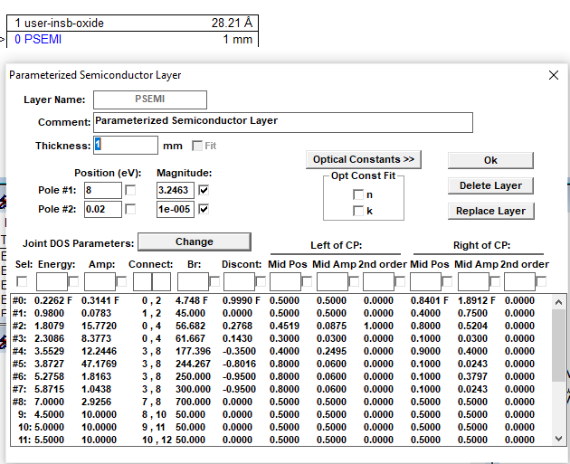
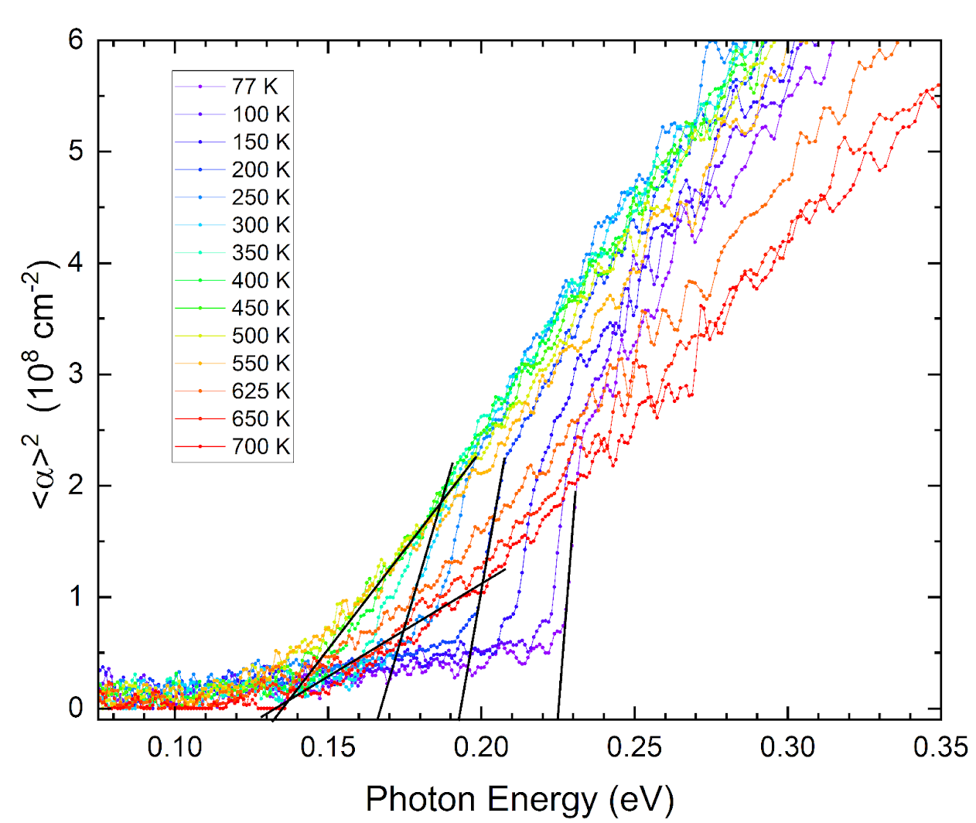
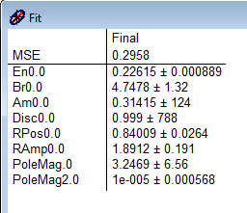

Analysis
How did the bandgap change through temperatures?
Tauc Plot:
Parametric-Semiconductor Model:
Need linear region, not possible
$$α\left(E\right)=A\sqrt{E−E_{g}}$$
*Computed manually*
*Based on computer model*

Slide 18
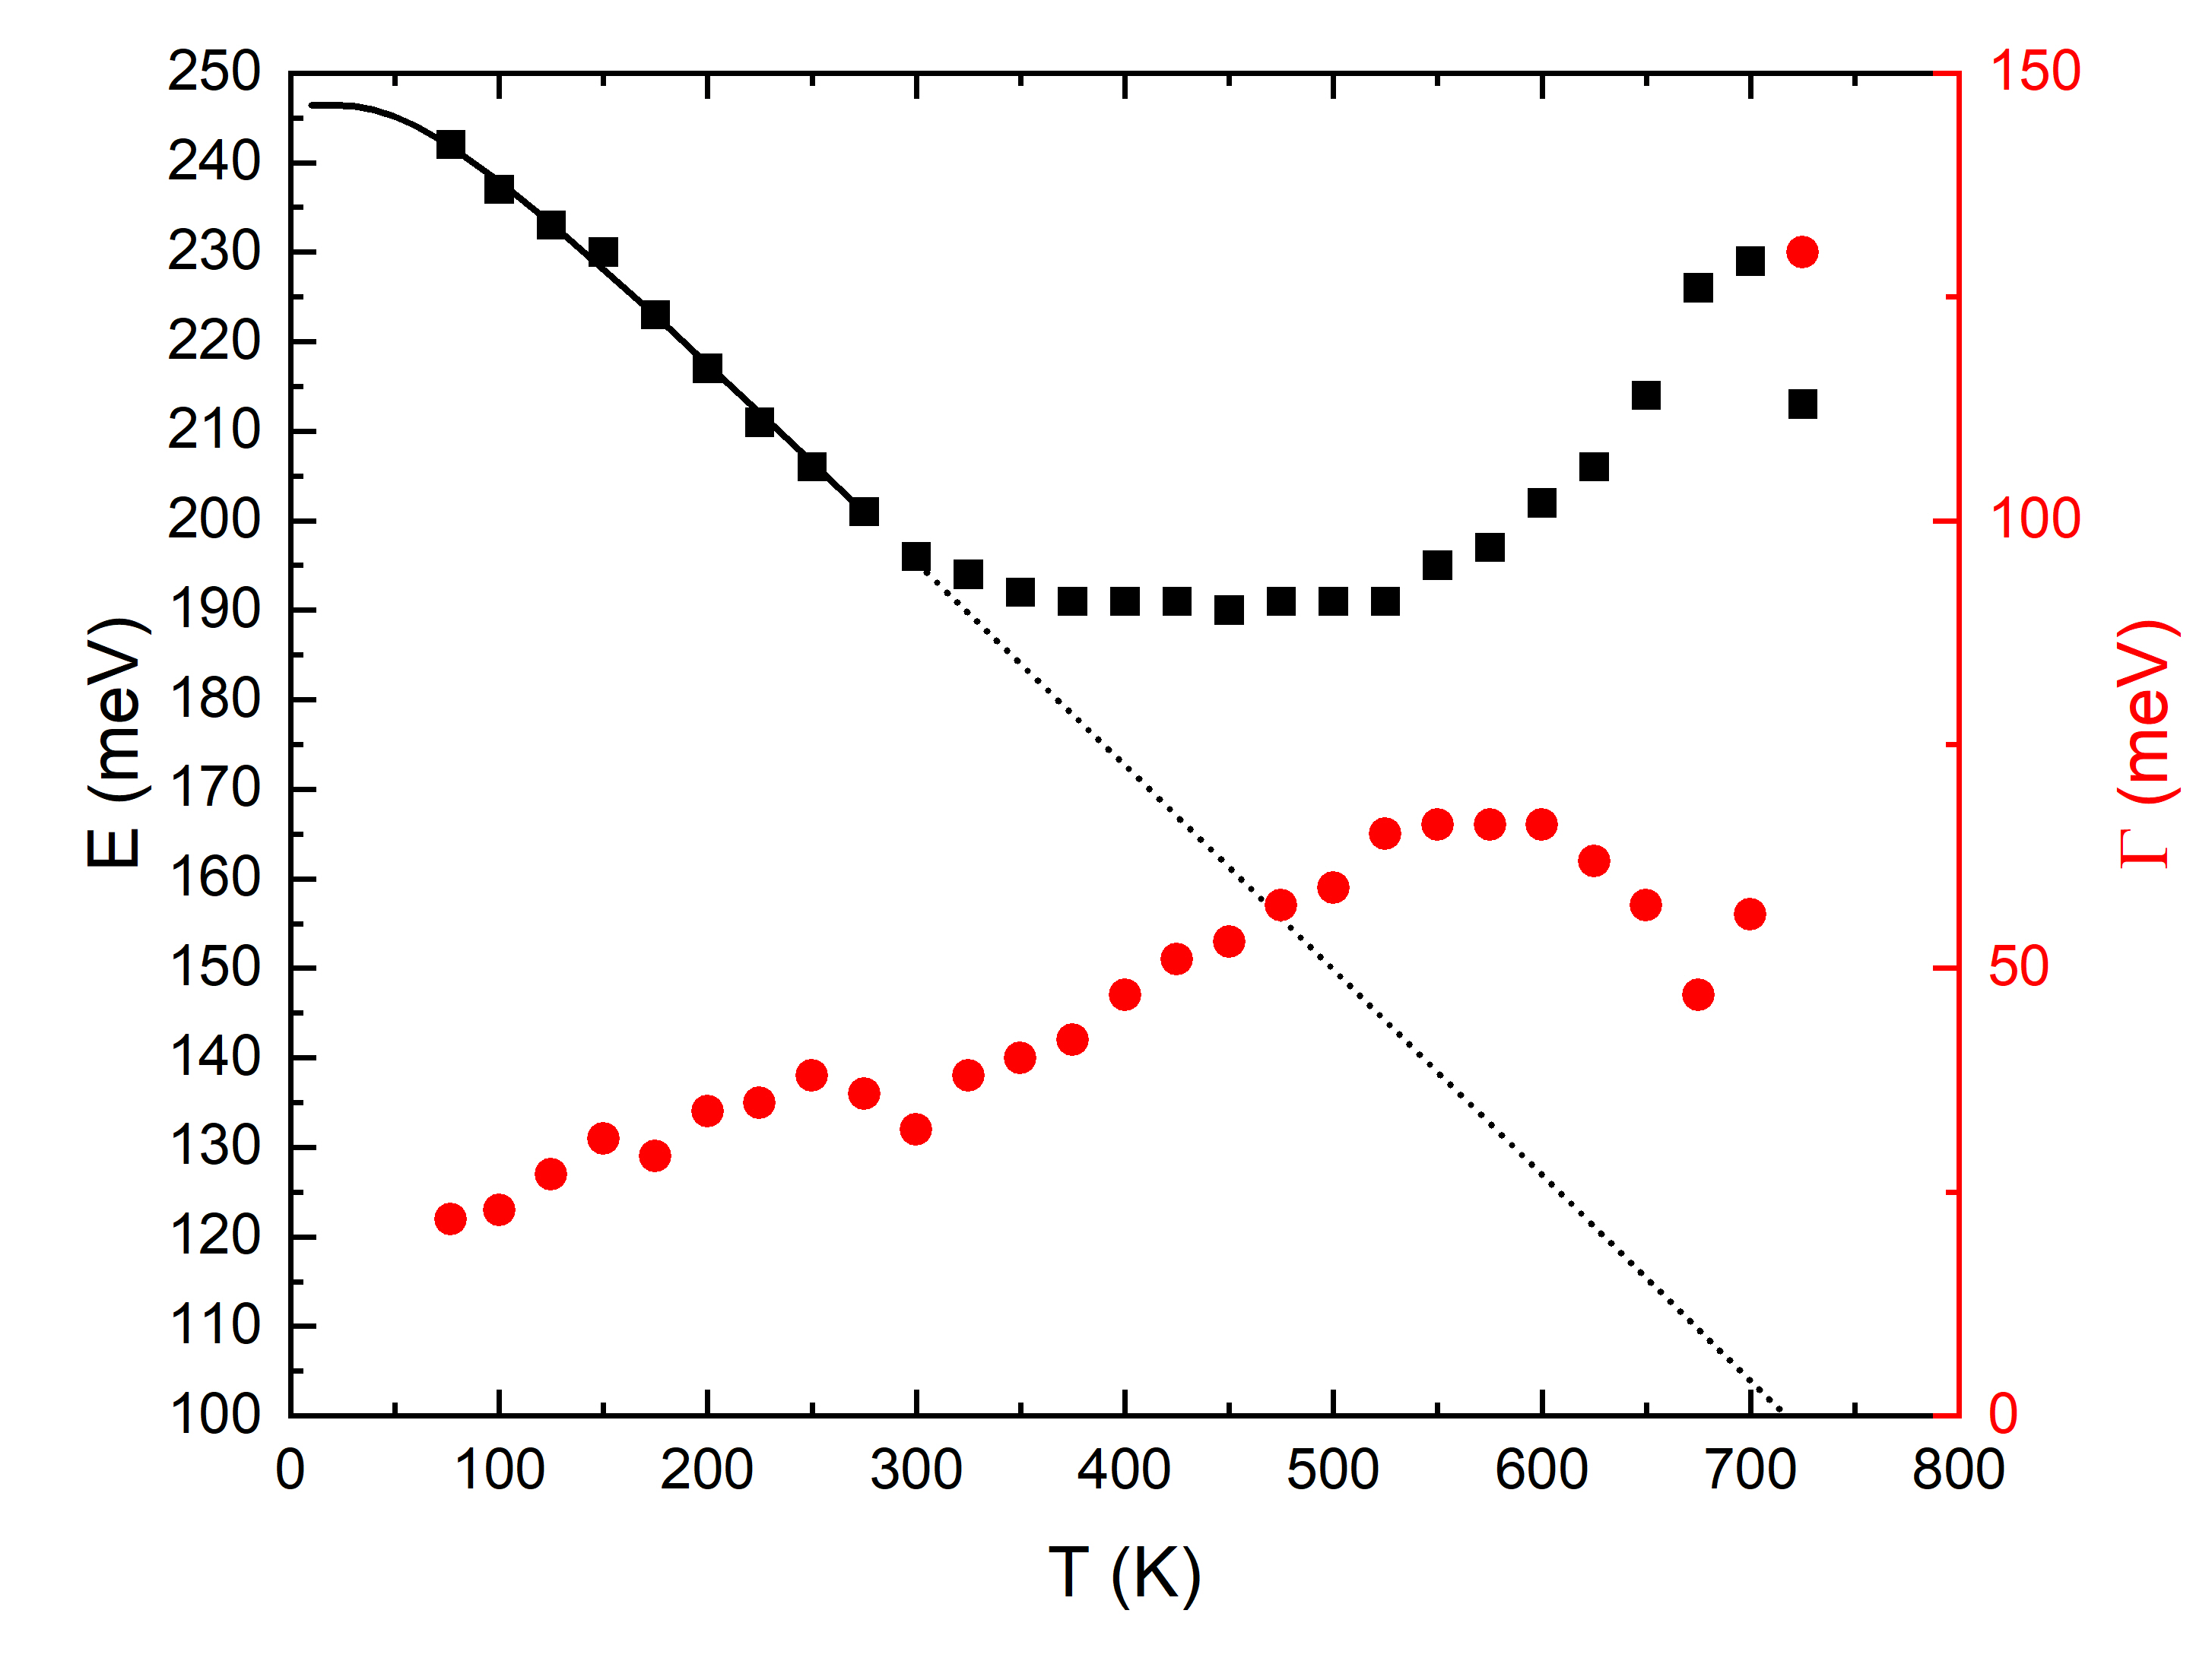

Direct Bandgap vs. Temperature
Band gap
Broadening
Bose-Einstein Model
$E_{g}\left(T\right)=a−b [1−\frac{2}{e^{\frac{θ}{T}}−1}$]

Slide 19
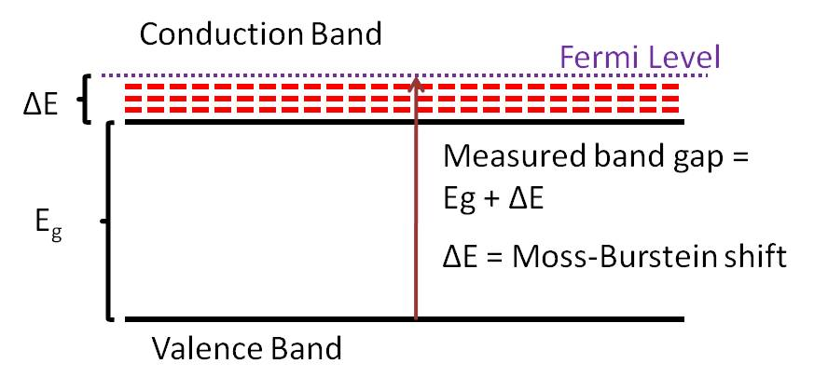
Conclusions
Dielectric function of InSb was measured from 80 to 700K with an oxide correction of 25 +/- 5 Å
Band gap is difficult to determine:
1. Parametric semiconductor model shows great results
Band gap shrinks with increasing temperature:
1. Follows Bose-Einstein relationship up to 300 K, stays constant up to 550 K and increases with temperature.
2. Thermal excitation of electron hole pairs.
First measurements of InSb band gap above 300 K
InSb would behave as a topological insulator above melting point. Not possible.
Burstein-Moss shift
Notes:
Birstein-Moss shift

Slide 20
Direct Bandgap vs. Temperature
Experimental data
Expected behavior

Slide 21
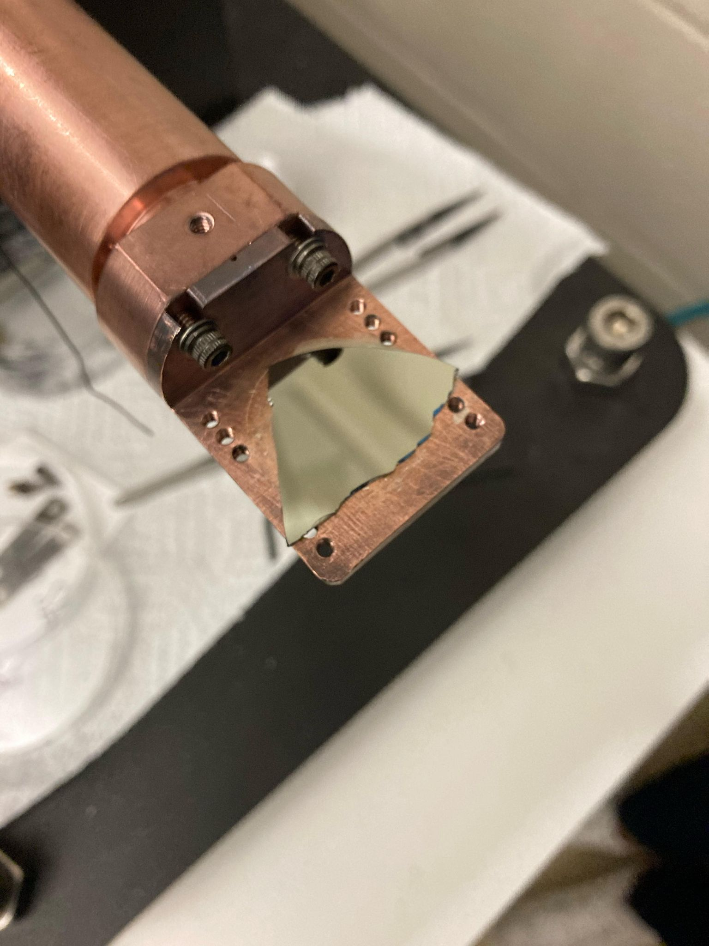
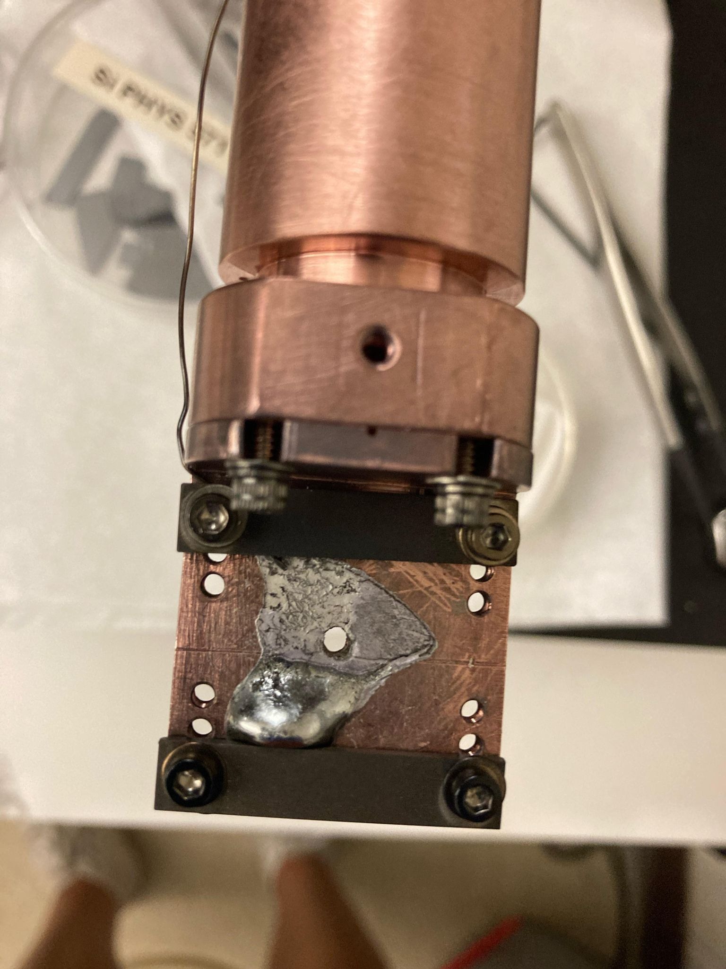
Sad ending
Unfortunately, the InSb sample melted at 750 K, but melting point is 800 K…
Before
After
Future work:
Repeat experiment at high temperatures below 750 K

Slide 22
Thank you!
Questions?

Slide 23
References
[1] C. L. Littler and D. G. Seiler, Appl. Phys. Lett. 46, 986 (1985).
[2] S. T. Schaefer, S. Gao, P. T. Webster, R. R. Kosireddy, and S. R. Johnson, J. Appl. Phys. 127, 165705 (2020).
[3] http://www.ioffe.ru/SVA/NSM/Semicond/InSb/bandstr.html
[4] S. Zollner, S. Gopalan, and M. Cardona, Solid State Commun., 77, 485 (1991).

Slide 24
https://www.pveducation.org/pvcdrom/pn-junctions/band-gap
http://www.ioffe.ru/SVA/NSM/Semicond/InSb/bandstr.html
https://www.horiba.com/ind/scientific/technologies/spectroscopic-ellipsometry/spectroscopic-ellipsometry/
http://solidstate.mines.edu/videonotes/VN_9_3.pdf
https://en.wikipedia.org/wiki/Infrared
https://energyeducation.ca/encyclopedia/Band_gap

