Slide 1


Characterization of Buffer Layers for Remote Plasma-Enhanced Chemical Vapor Deposition of Germanium-Tin Epitaxial Layers
6th Annual Tri-Service Workshop on GeSn and SiGeSn
25-26 October 2023, Colorado Springs, CO
FA8750-15-3-6003
FA9550-15-0001
FA9550-20-F-0005
Stefan Zollner,¹ Bridget Rogers,² Carlos A. Armenta,¹ Gordon J. Grzybowski,³ and Bruce Claflin⁴
¹New Mexico State University, Department of Physics, Las Cruces, NM
²Vanderbilt University, Department of Chemical and Biomolecular Engineering, Nashville, TN
³KBR, Beavercreek, OH
⁴Air Force Research Laboratory, Sensors Directorate, Dayton, OH
Email: zollner@nmsu.edu. WWW: http://femto.nmsu.edu.
Ask me about MS/Ph.D. student positions at NMSU..

Slide 2
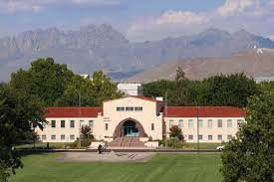

New Mexico State University, Las Cruces
Land grant institution, Carnegie R2 Comprehensive: Arts and Sciences, Education, Business, Agriculture
Ph.D. programs in sciences, engineering, agriculture; Ag extension
14,000 students (11,500 UG, 2,500 GR), 1000 faculty
Minority-serving, Hispanic-serving (60% Hispanic/NA, 26% White)
Small-town setting
Military-friendly institution (Army and Air Force ROTC programs)
Community engagement classification (first-generation students, Pell grant recipients)
Physics: BS/BA, MS, PhD degrees. 71 UG and 37 GR students.
12 faculty (HE Nuclear and Materials Physics), 1.7 M$ expenditures. ABET-accredited BS in Physics and BS in Engineering Physics
Stefan Zollner, 2023

Slide 3
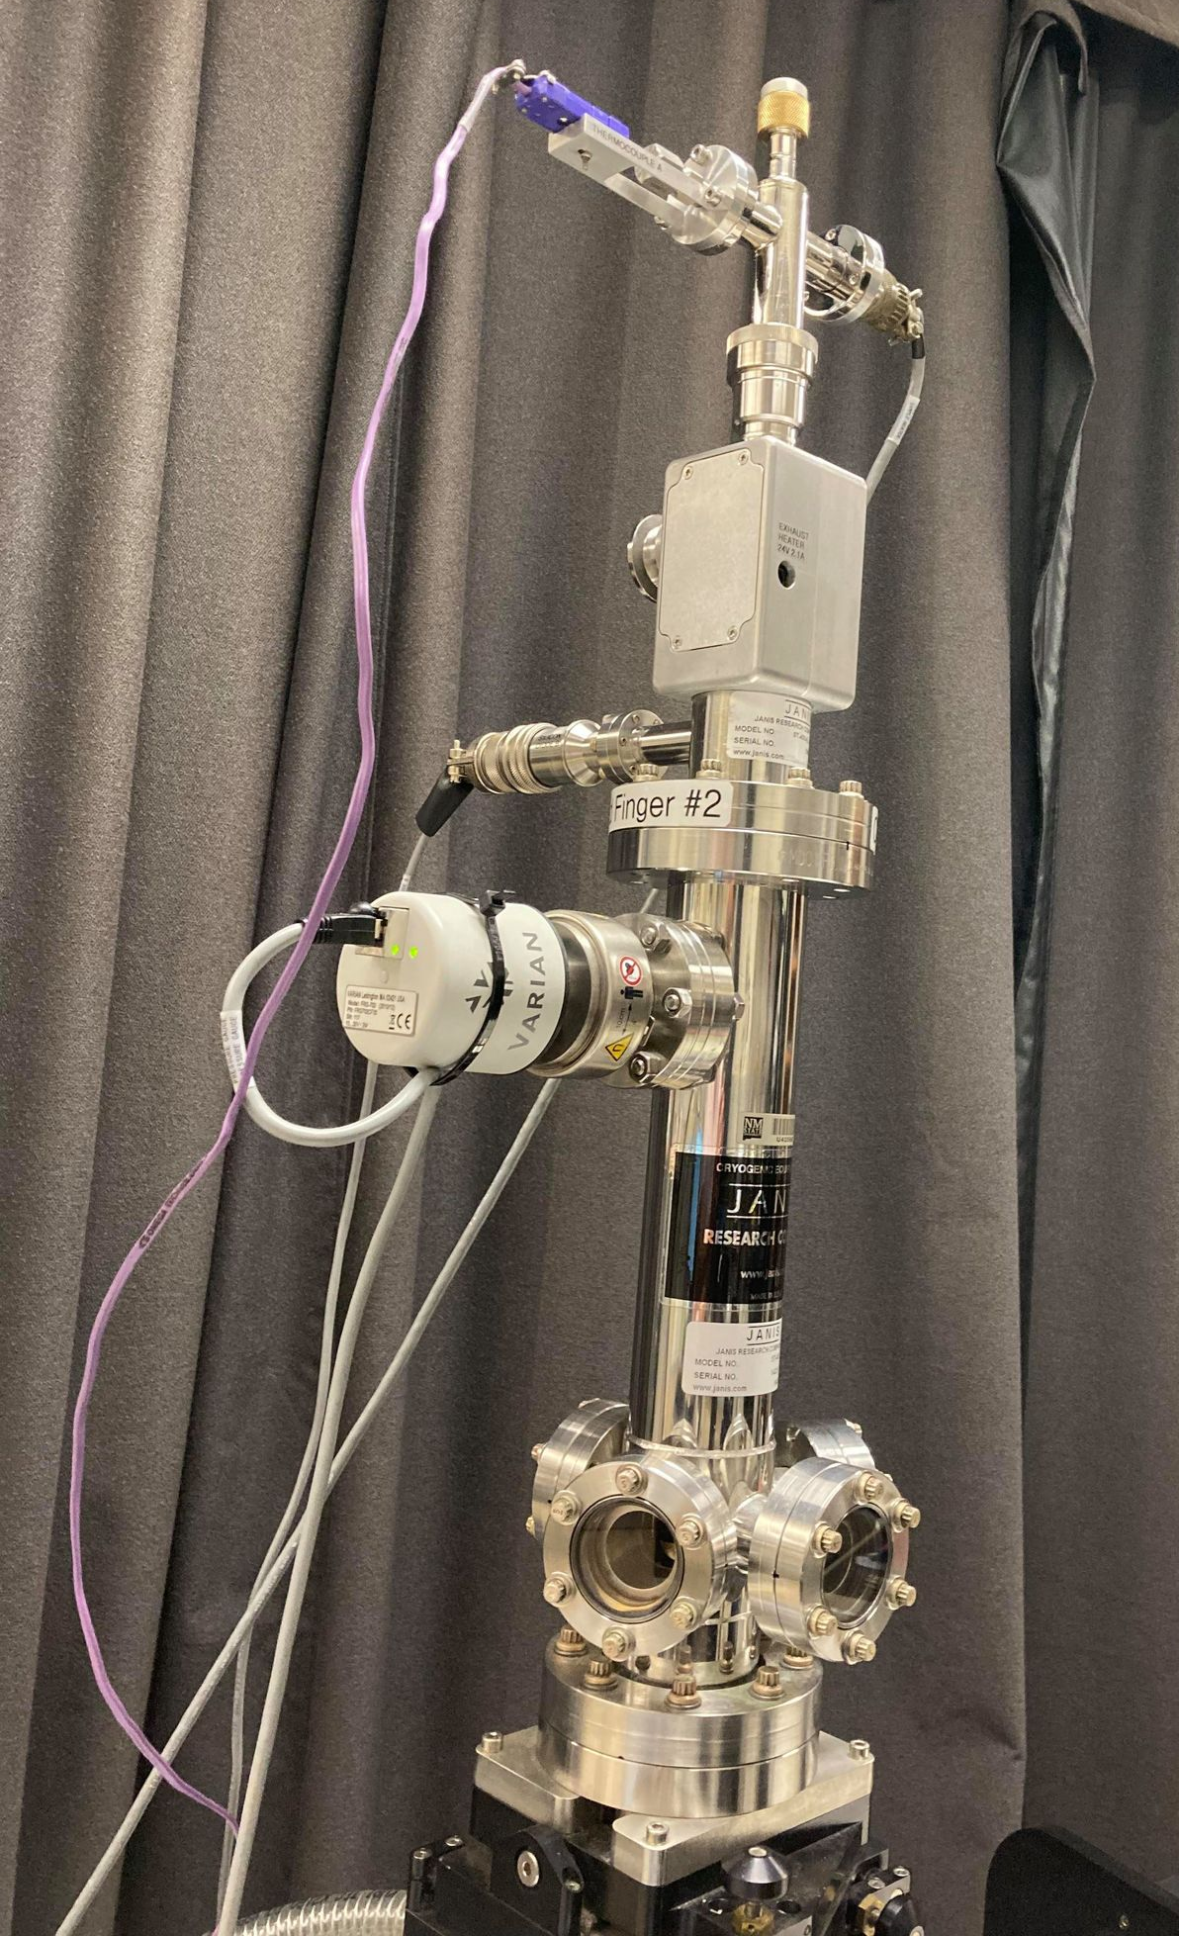


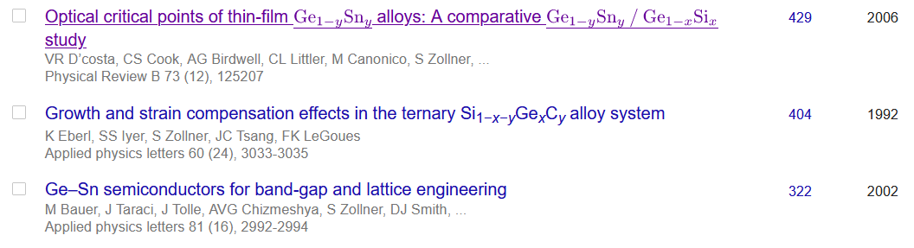
Ellipsometry at NMSU
Ellipsometry on anything (inorganic)
Metals, insulators, semiconductors
Mid-IR to vacuum UV
10 to 800 K
Ellipsometry tells us a lot about materials quality (not necessarily what we want to know).
Stefan Zollner, 2023

Slide 4
Introduction
Buffer layers can improve the quality of subsequent growth of epitaxial layers.
Examples:
Buffer grown at different temperature than target layer (encourage 2D layer growth: Ge on Si).
Graded buffer layers (ramp up composition).
Superlattice buffers (defect and dislocation control).
Characterization of thin buffer layers (10-20 nm):
Spectroscopic ellipsometry (thickness, refractive index, roughness, band gap)
X-ray diffraction (crystallinity, lattice constant, composition
X-ray photoelectron spectroscopy (composition, thickness)
Atomic force microscopy (roughness, morphology)
Optical and electron microscopy
Objective: Where does the tin go (substitutional, surfactant, beta-tin, interface, etc)?

Slide 5
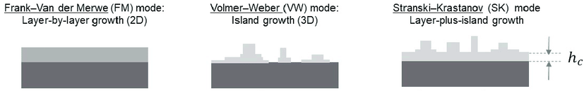
Epitaxial growth modes
<n> = n_{layer}
<n> < n_{layer}
<n> < n_{layer}
How does an ellipsometer see such layers?
Bruggeman Effective Medium Approximation: Mixture of Epilayer and Voids: <n_{eff}> < n_{layer} for island growth
Need some idea of thickness from growth conditions or XRR, XPS, RBS, etc.

Slide 6
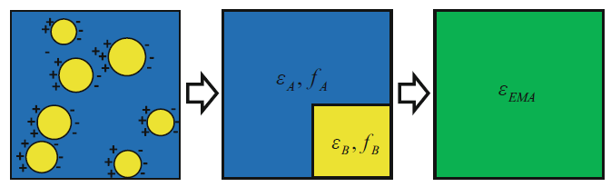


Effective medium approximation (EMA)
Two different constituents maintain their individual character.
Mixing is macroscopic, no mixing on the atomic scale.
EMA is a macroscopic average of the two components.
Ignore charge screening:
Bruggeman EMA
$$ε_{\text{EMA}}=f_{A}ε_{A}+\left(1−f_{A}\right)ε_{B}$$
Works well if at least one constituent is amorphous (or air). Not good for semiconductor alloys.
$$f_{A}\frac{ε_{A}−ε_{\text{EMA}}}{ε_{A}+2ε_{\text{EMA}}}+\left(1−f_{A}\right)\frac{ε_{B}−ε_{\text{EMA}}}{ε_{B}+2ε_{\text{EMA}}}=0$$
J.N. Hilfiker in Spectroscopic Ellipsometry for Photovoltaics, ed. by Fujiwara and Collins (Springer, 2018)
Works well for surface roughness (50/50).

Slide 7
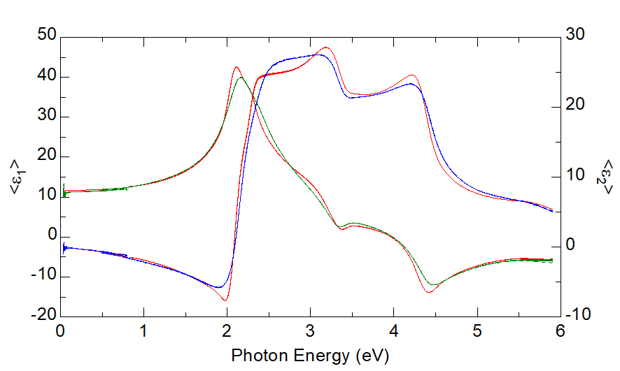
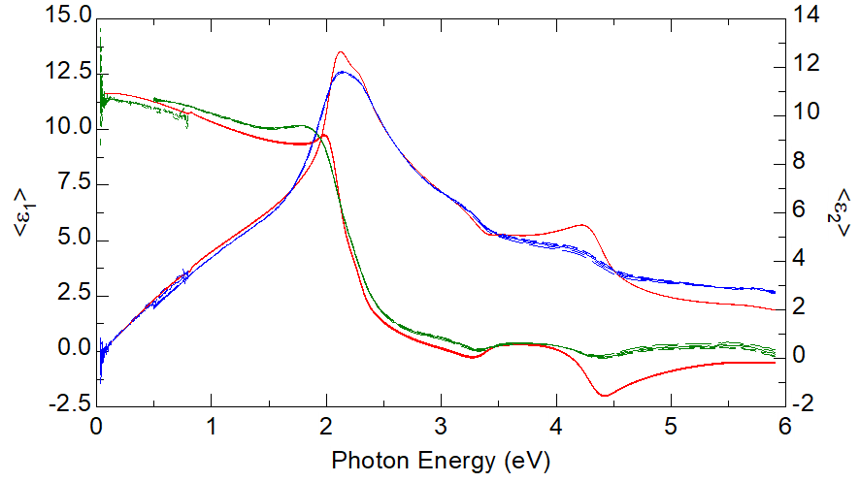
Buffer layers grown at different temperatures
382 °C
no tin
500 °C
Normal Sn flow
Negative slope
Positive slope
n_{layer}>n_{substrate}
Layer is similar to bulk Ge.
Probably layer-by-layer growth.
n_{layer}<n_{substrate}
Layer is much less dense than Ge, but still crystalline (critical points).
Probably 3D island growth mode.

Slide 8
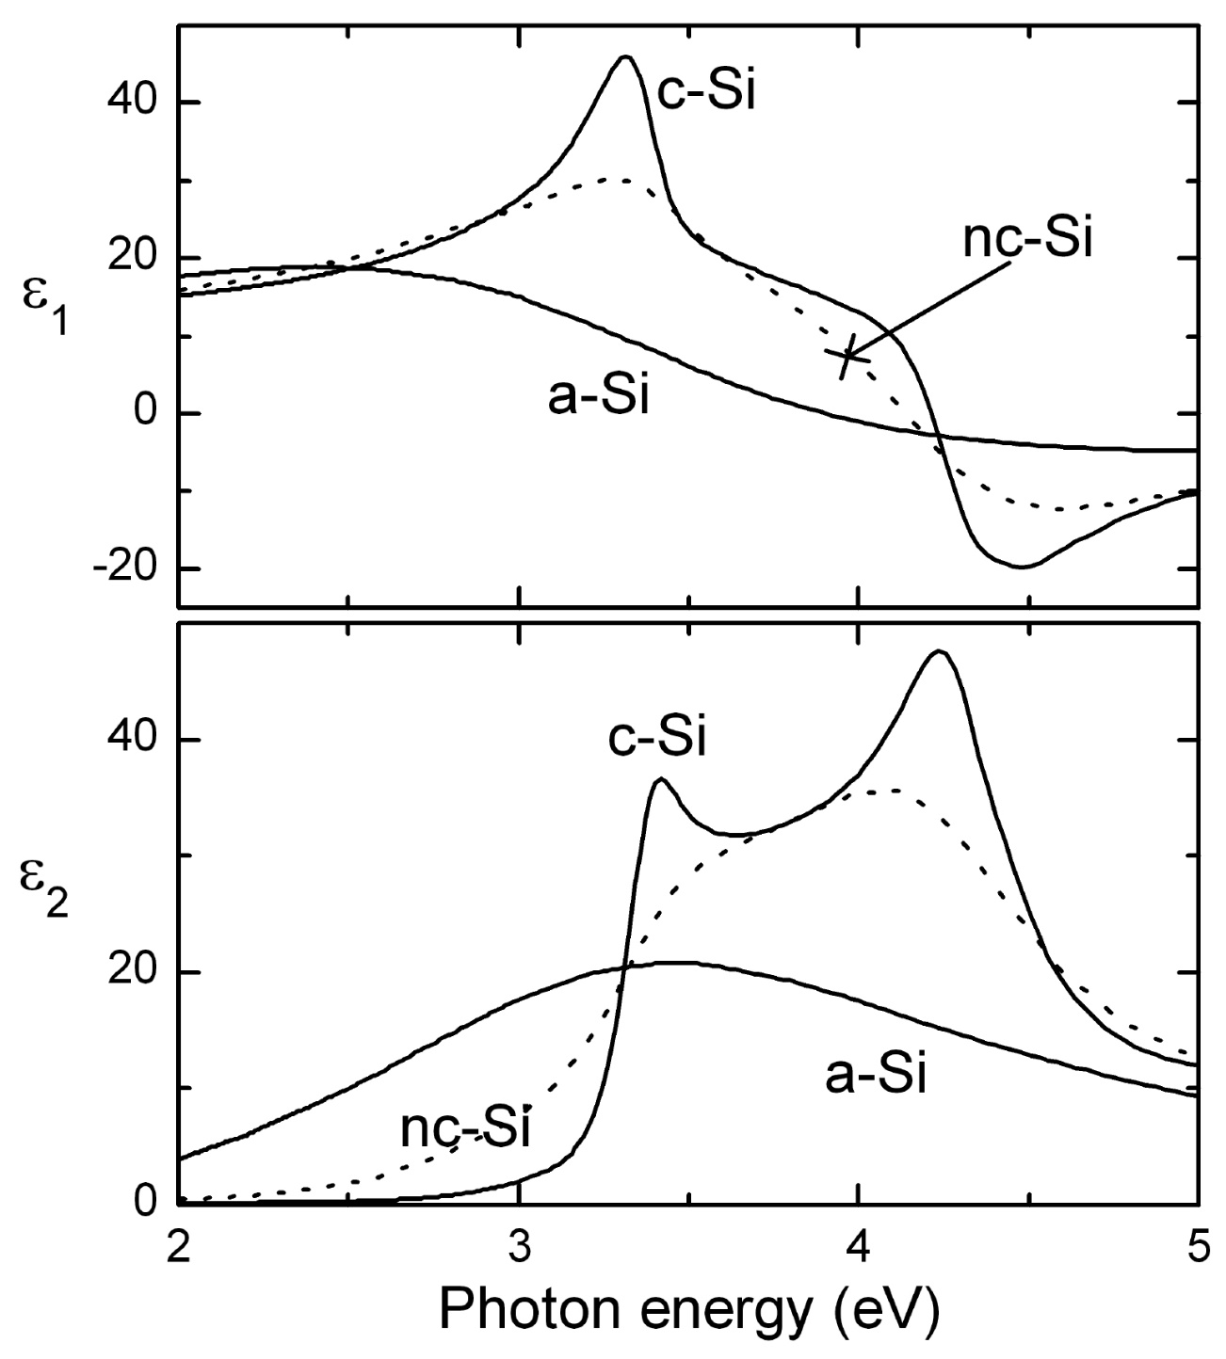
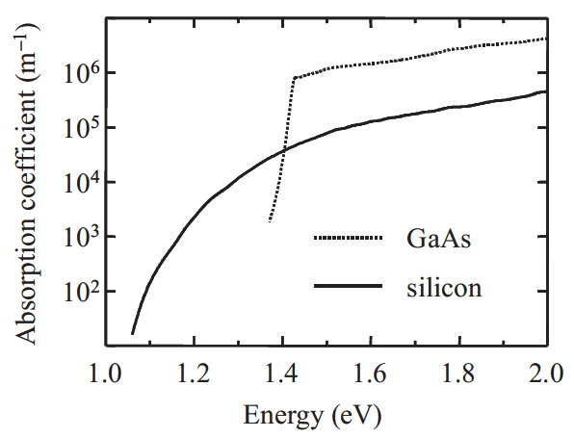
Crystallinity in ellipsometry spectra
a-Si: Single broad absorption peak
c-Si: Van Hove singularities (critical points) from different directions in the BZ.
nc-Si: Loss of periodicity: (1) critical points are broadened, (2) indirect absorption is stronger.
Peter Petrik, 2012

Slide 9
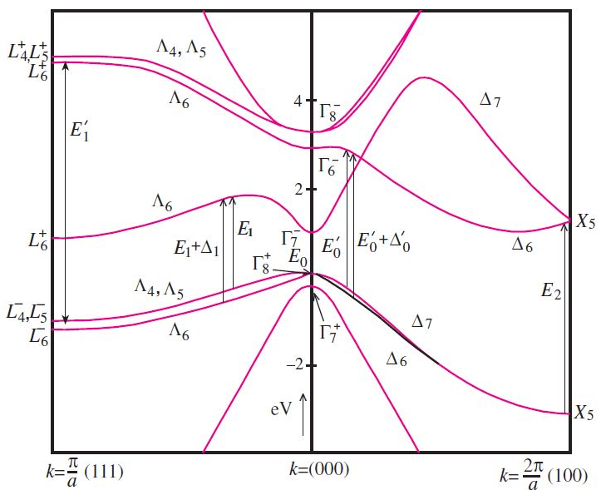
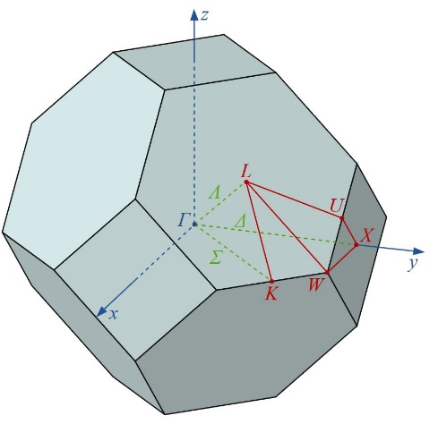
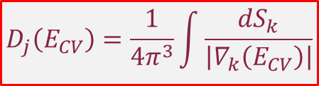
Critical points in germanium
Structures in ε due to interband transitions
Joint density of states
Van Hove singularities
$$D_{j}\left(E_{CV}\right)=\frac{1}{4π^{3}}\int{\frac{dS_{k}}{\left|∇_{k}\left(E_{CV}\right)\right|}}$$
E₁’

Slide 10
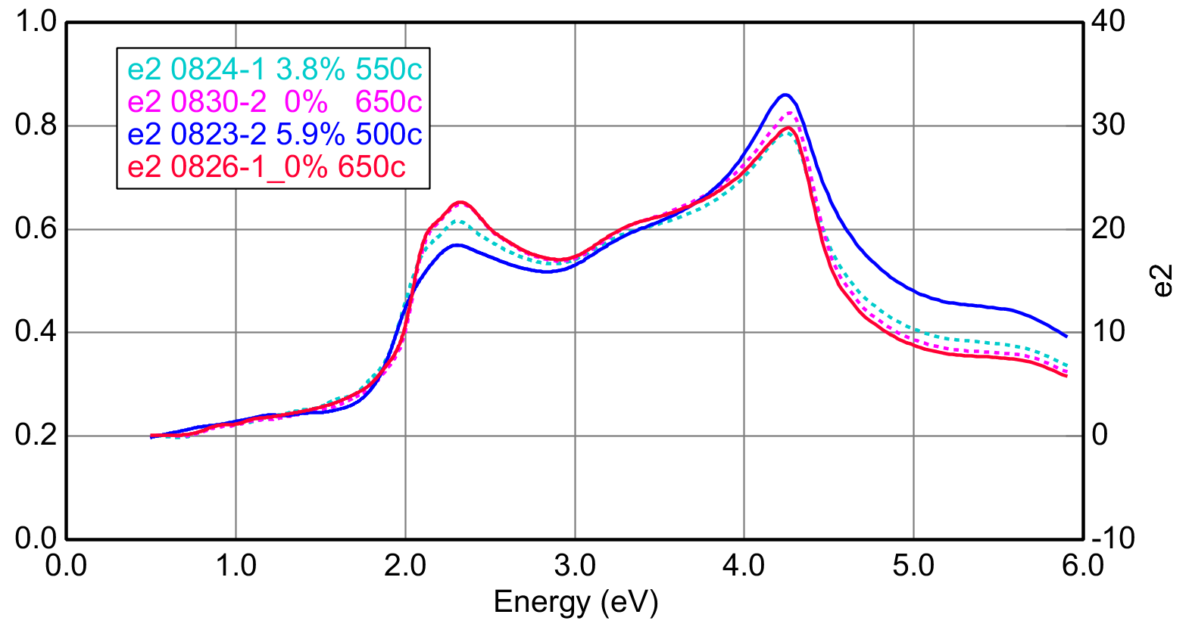
Thick crystalline Ge-Sn alloys grown by RPECVD
440 °C
520 °C
400 °C
520 °C
B-spline fit: up to 6% Sn.
E₁, E₁+Δ₁, E₀’, E₂, E₁’ critical points clearly visible.
Evidence of high crystallinity of these alloys.

Slide 11
Buffer layers grown at different temperatures
382 °C
no tin
500 °C
Normal Sn flow
n_{layer}>n_{substrate}
Critical points similar to Ge.
n_{layer}<n_{substrate}
Low density, large roughness,
but critical points similar to Ge: Buffer layer is crystalline, Ge-like.

Slide 12
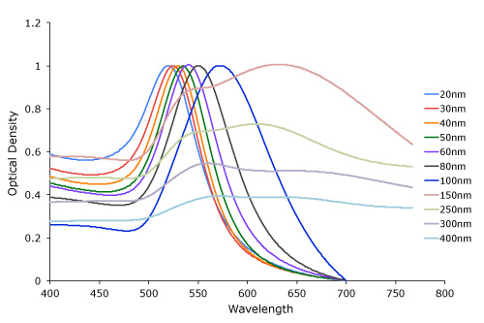
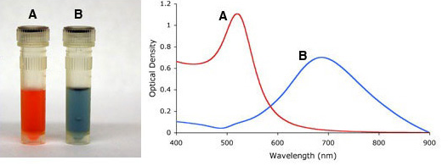
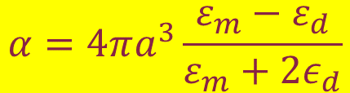
Plasmon Resonance in Gold Nanoparticles
20 to 100 nm
ln(αt)
Gold is not always yellow.
Nanoparticle radius a<λ
m: metal, d: dielectric
Enhance molecular absorption.
$$α=4πa^{3}\frac{ε_{m}−ε_{d}}{ε_{m}+{2ε}_{d}}$$
Fox, Optical Properties of Solids
Little, APL 98, 101910 (2011)

Slide 13
Plasmon Resonance in β-Tin Nanoparticles
Ge-Sn alloys with high tin content grown by MBE “have a broadened peak in ε₂, near 0.9 eV.”
“possibly caused by an intrinsic feature such as from the band structure, an extrinsic one such as from a defect, or an interference fringe from the substrate”.
Answer: None of the above.
This peak is likely a plasmon resonance of metallic β-Sn precipitates.
Ellipsometry cannot determine if the beta-tin particles are on the surface, embedded in the layer, or at the substrate/epilayer interface.
D. Imbrenda, APL 113, 122104 (2018)

Slide 14
Plasmon Resonance in β-Tin Nanoparticles
Pseudodielectric function
Dielectric function
Ge-Sn buffer layer on Si
382 °C, 10-20 nm thick
Not an interference fringe.
This Lorentzian peak (0.6 to 0.7 eV) is likely a
plasmon resonance of metallic β-Sn precipitates.

Slide 15
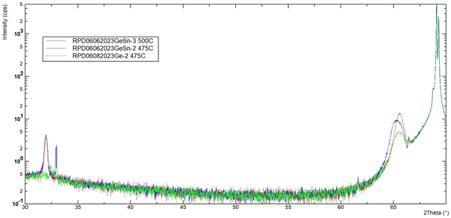
Low-resolution (powder) x-ray diffraction
Si (004) substrate
400 °C
382 °C
382 °C
Ge or Ge-Sn
(004)
Composition
Substitutional Sn
Ge-Sn (004)
allowed
Si (004) and Ge (004)
forbidden
No beta-Sn peaks

Slide 16
SEM and AFM micrographs
RPD03032023GeSn-2
RPD02282023GeSn-4
500°C substrate
30 sccm He flow through SnCl₄ bubbler
RMS roughness≈9.3 nm
489°C substrate
30 sccm He flow through SnCl₄ bubbler
RMS roughness≈11 nm

Slide 17
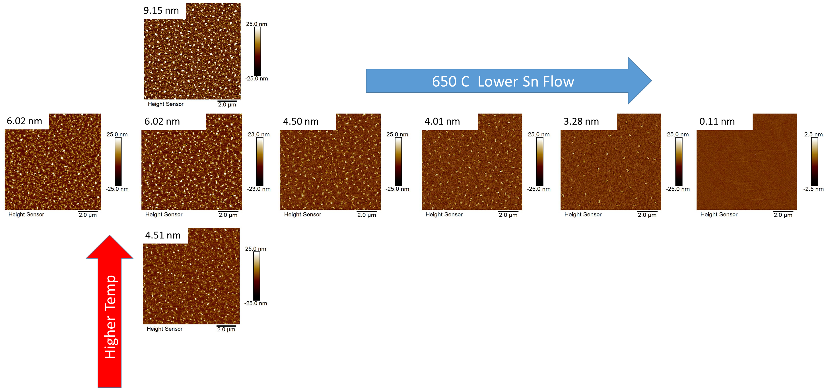
Atomic force microscopy
RMS roughness
520 °C

Slide 18
X-ray photoelectron spectroscopy
Analysis Conditions
Phi 5500 XPS instrument
Non-monochromatic Mg 𝛫𝛼 x-rays (350 W, 25 kV)
93.9 eV pass energy for high resolution spectra
As received and sputter cleaned surfaces analyzed
5 keV Ar⁺ ions
Rastered over 4 mm x 4 mm area
Sputtered until oxygen peak minimized (≈ 120 seconds)
Quantitation
Empirical sensitivity factors
Determined from pure element samples
Ge 3d5 and Sn 4d transitions used (similar analysis depth for these transitions)
Line shapes acquired from standards used for Ge 3d and Sn 4d curve fitting.

Slide 19
X-ray photoelectron spectroscopy
As Received: ≈ 49% Sn
Sputtered: ≈ 22% Sn
As Received: ≈ 40% Sn
Sputtered: ≈ 15 % Sn
As Received: ≈ 40% Sn
Sputtered: ≈ 17 % Sn

Slide 20
XPS Depth Profiles (acquired in 2022)
1 minute deposition
≈345°C substrate
Low He through bubbler
1 minute deposition
≈345°C substrate
High He through bubbler
Films about same thickness
↑ He through bubbler ↑ Sn content in film
Sn gradient through thickness
Sn-enriched surface
Interface: 9.8 minutes
Interface: 9.1 minutes
Interface defined at point where Ge signal drops to one–half its maximum value.

Slide 21
Conclusion
Multiple characterization tools are available for thin buffer layers.
Spectroscopic ellipsometry:
Density, void fraction, crystallinity, thickness (with limits)
Powder x-ray diffraction:
Substitutional alpha-Sn
Large beta-Sn clusters
Atomic force microscopy
Morphology and surface roughness
X-ray photoelectron spectroscopy
Total tin content, depth profile

Slide 22
Thank you!

