Slide 1

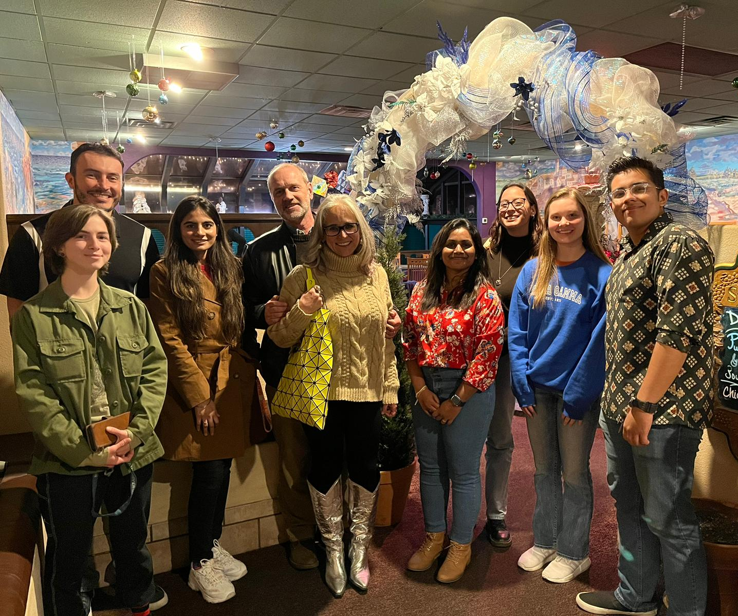
Intravalence Band Transitions in Gapless Topological Insulators
FA9550-20-1-0135
FA9550-20-F-0005
Stefan Zollner
Head, Department of Physics
New Mexico State University
Las Cruces, NM, USA
Supported by AFOSR SFFP and FA9550-20-1-0135.
Email: zollner@nmsu.edu. WWW: http://femto.nmsu.edu.
12 two-hour lectures on YouTube.

Slide 2
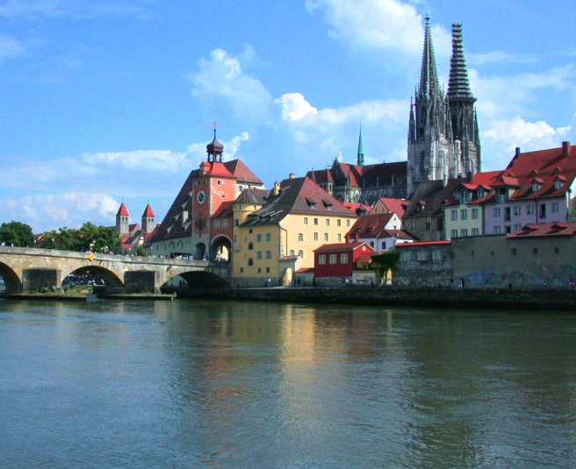


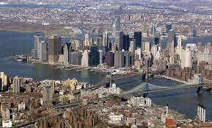

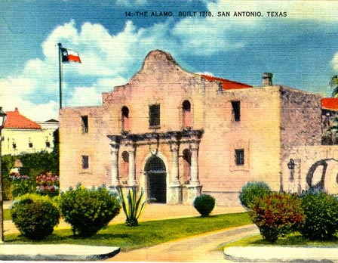
Biography
92-97
Motorola (Mesa, Tempe)
Arizona, 1997-2005
Regensburg/Stuttgart
Germany
Freescale, IBM
New York, 91-92; 07-10
NMSU
Las Cruces, NM
Since 2010
Motorola, Freescale
Texas, 2005-2007

Slide 3


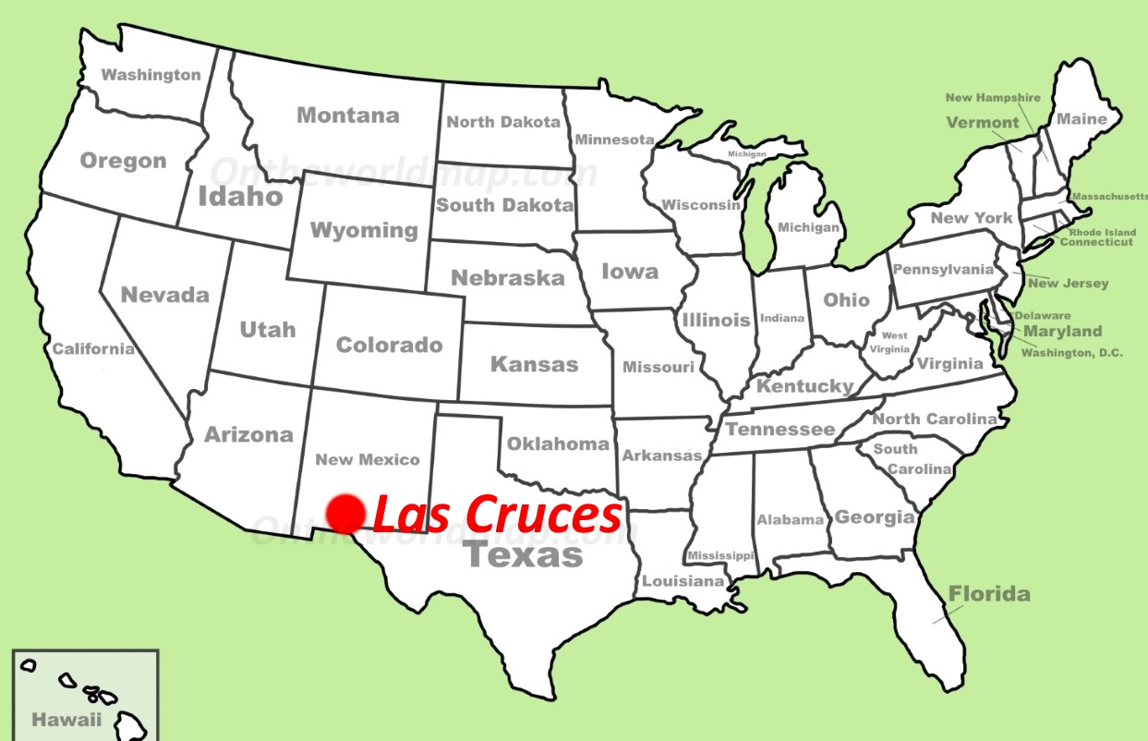

Where is Las Cruces, NM ???
White Sands NP
Stefan Zollner, 2023

Slide 4
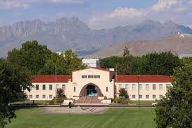
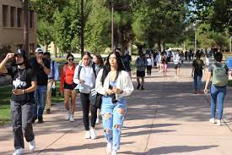
New Mexico State University, Las Cruces
Land grant institution, Carnegie R2
Comprehensive: Arts and Sciences, Education, Business, Agriculture
Ph.D. programs in sciences, engineering, agriculture; Ag extension
14,000 students (11,500 UG, 2,500 GR), 1000 faculty
Minority-serving, Hispanic-serving (60% Hispanic/NA, 26% White)
Small-town setting
Military-friendly institution (Army and Air Force ROTC programs)
Community engagement classification
(first-generation students, Pell grant recipients)
Physics: BS/BA, MS, PhD degrees. 71 UG and 37 GR students.
12 faculty (HE Nuclear and Materials Physics), 1.7 M$ expenditures.
ABET-accredited BS in Physics and BS in Engineering Physics
Stefan Zollner, 2023

Slide 5
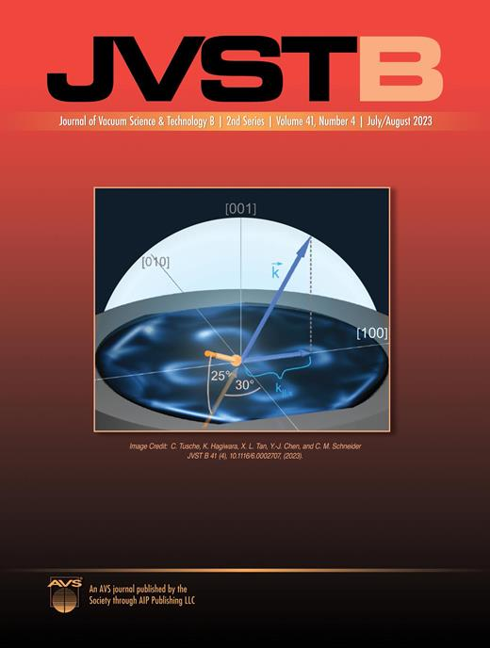
Announcement: Special Issue on SiGeSn Alloys
There will be a special issue on
Silicon-Germanium-Tin Alloys in
The Journal of Vacuum Science and Technology B.
Watch for the announcement.
Manuscripts will be due in late fall or early spring.
Guest Editors: Gernot Pomrenke (AFOSR), Tania Paskova (ARO), Chip Claflin (AFRL), etc.
Stefan Zollner, 2023

Slide 6
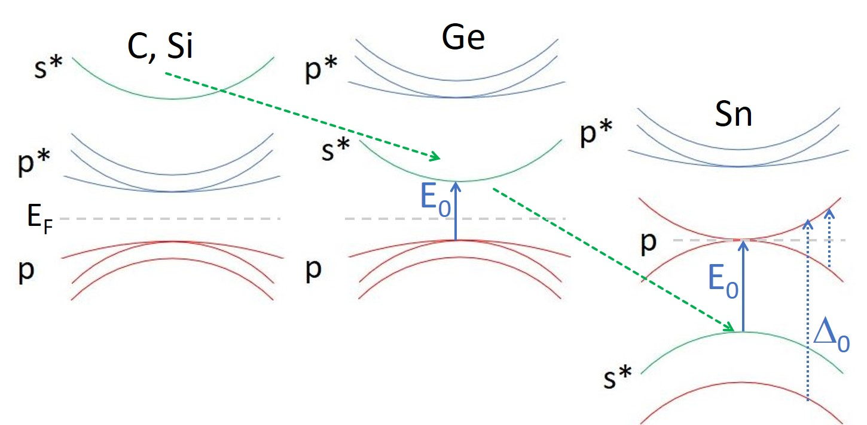
What is a Topological Insulator?
Nature web site: “Topological insulators are materials that are insulating in their interior but can support the flow of electrons on their surface. The underlying cause is time-reversal symmetry: their physics is independent of whether time is flowing backward or forward.”
Parity reversal of bands (p-s-p) is a key ingredient of topological insulators.
A topological space X is a set of points with a family (called topology) of subsets (called open sets) with the following properties:
The empty set and X itself are open.
Any arbitrary (finite or infinite) union of open sets is open.
The intersection of any finite open sets is open.
The complement of an open set is called closed.
Wikipedia: “The most general type of a mathematical space that allows for the definition of limits, continuity, and connectedness.”
p
Stefan Zollner, 2023

Slide 7
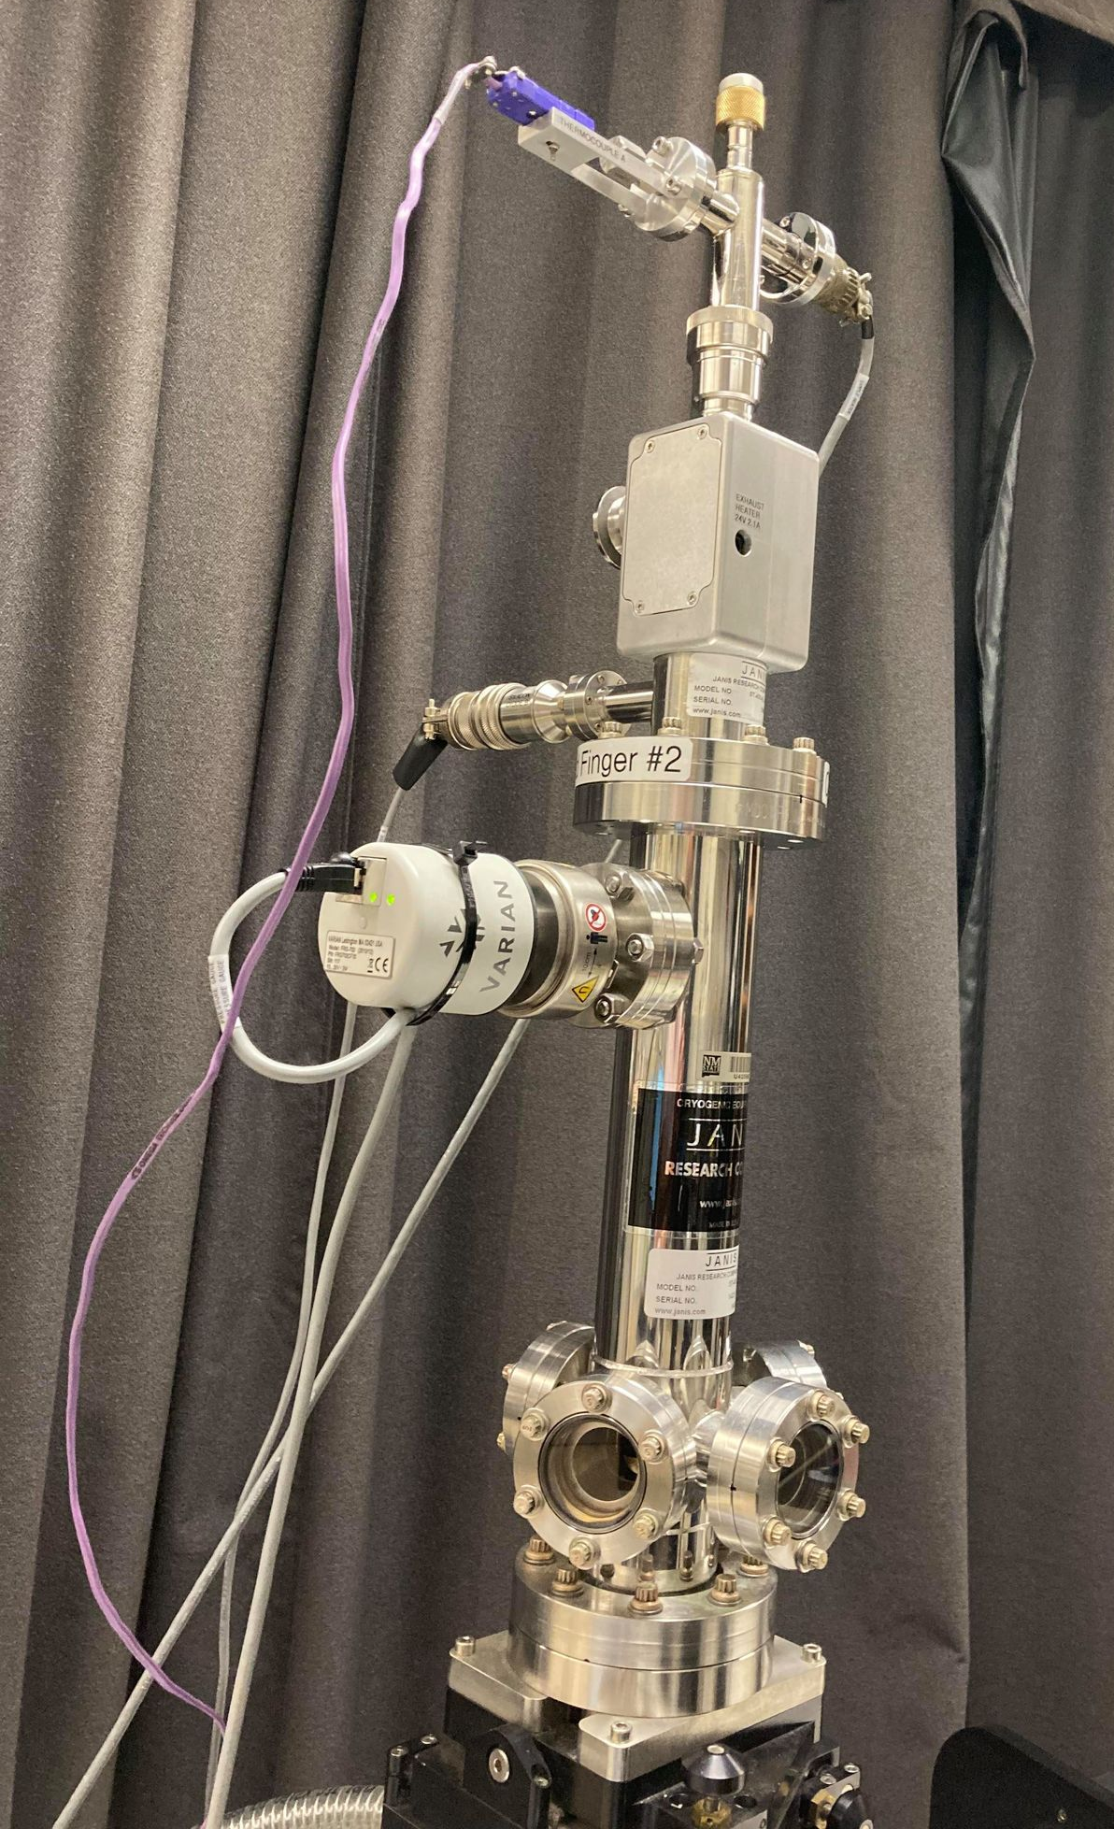
Intravalence Band Transitions in Gapless Semiconductors
Bonds and Bands
Band Structure of Silicon, Germanium, and α-Tin
Why is α-Tin a Topological Insulator?
Intravalence Band Absorption in Ge and AlSb
Intravalence Band Absorption in α-Tin
Dependence on Temperature, Substrate,
and Doping with Ge
Summary
Woollam FTIR-VASE;
cryostat with CVD diamond windows
10-800 K
Stefan Zollner, 2023

Slide 8
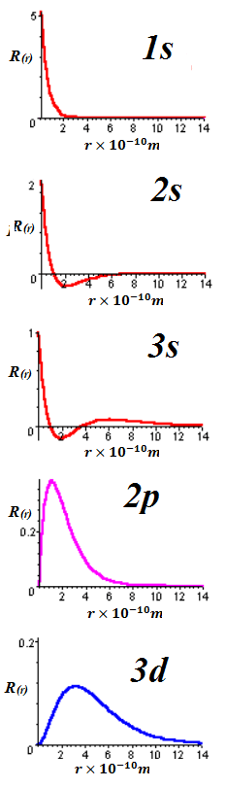
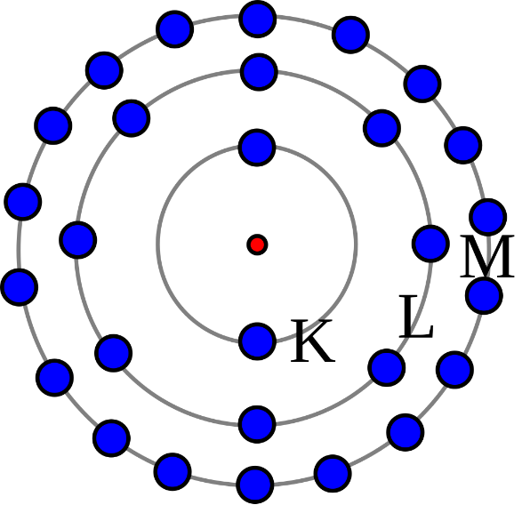
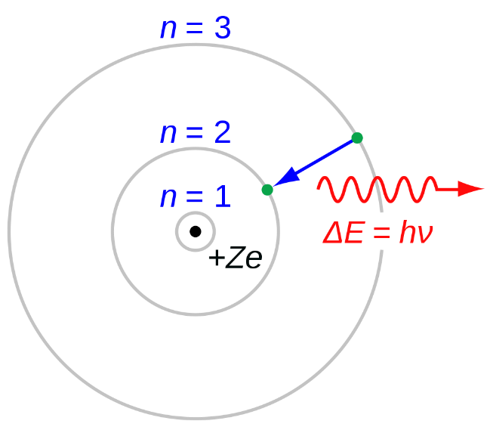
Bohr Model for the Hydrogen Atom
E(n)=−R/n²
R=13.6 eV
Quantum Numbers:
n 1,2,3,…
l 0,…,n-1
m -l,…,l
s +/- 1/2
Relativistic corrections:
s electrons (l=0) close to the core
(Darwin shift)
J=L+S total angular momentum
Spin-orbit coupling L·S
L=1, S=1/2 J=1/2 or 3/2
Stefan Zollner, 2023
Notes:
Birstein-Moss shift

Slide 9
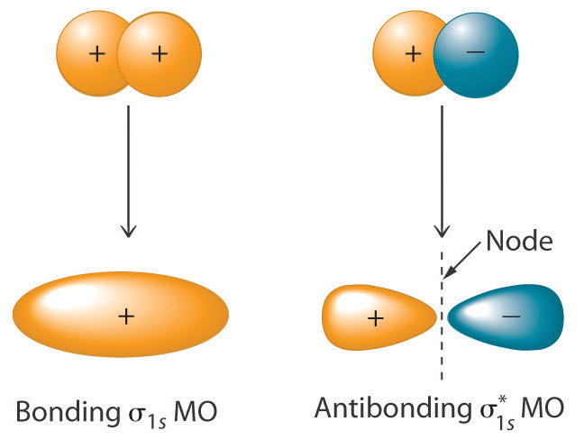
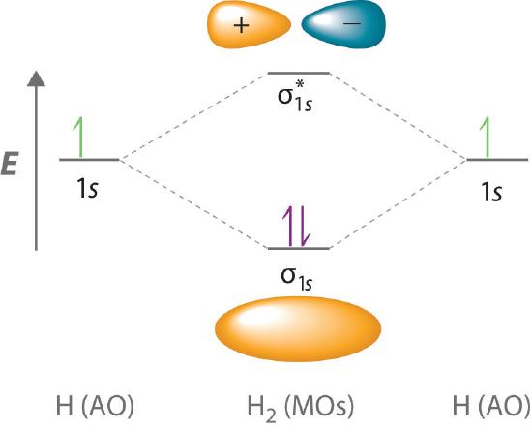
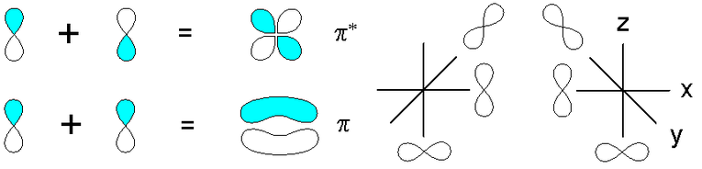
Bonding and Anti-Bonding Orbitals
Conduction Band
Valence Band
s: Ψ=ψ₁+ψ₂
s∗: Ψ=ψ₁−ψ₂
p*
p_{x}, p_{y}, p_{z}
p
C electronic configuration: 1s² 2s² 2p²
L shell forms sp³ hybrid: 1s² 2s¹ 2p³
Stefan Zollner, 2023
Notes:
Birstein-Moss shift

Slide 10
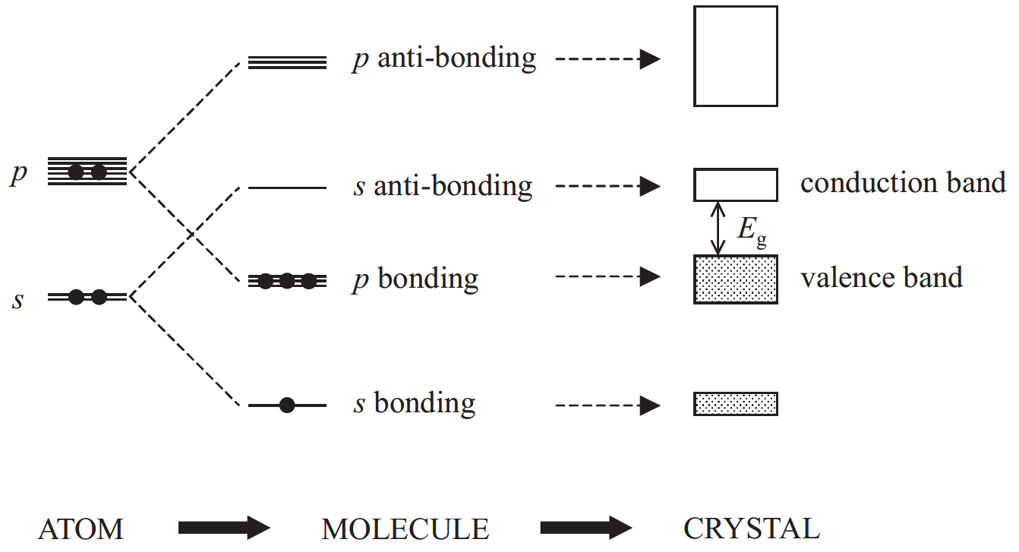
Bonds and Bands
Add kinetic energy
Fox, Chapter 3
Works well for Ge, GaAs, etc.
Stefan Zollner, 2023
10

Slide 11
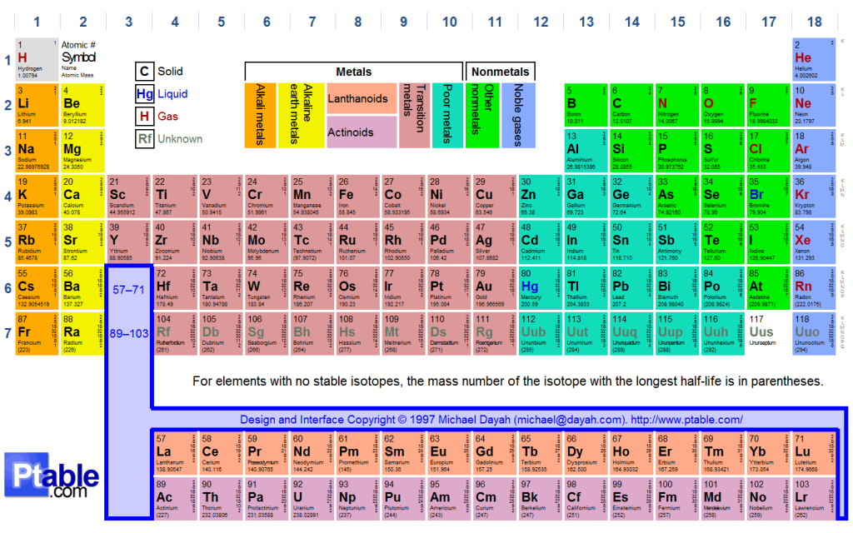
Periodic Table of the Elements
Stefan Zollner, 2023
Notes:
Birstein-Moss shift

Slide 12
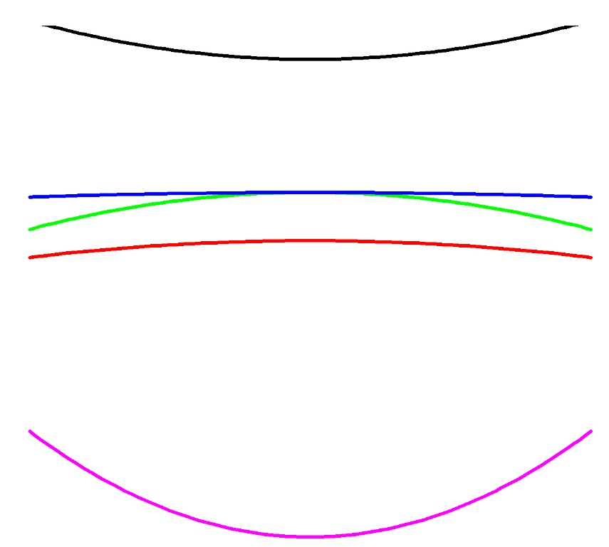
A simple band structure for Germanium
p*
j=3/2
E
K=mv²/2=p²/2m
=²k²/2m
m: effective mass
Add spin-orbit coupling: J=L+S
Δ₀’
CB
empty
j=1/2
CB (empty)
e
Add kinetic energy
s*
s*
E_{F}
E₀ band gap
E_{F}
p
j=3/2
hh
Δ₀
Δ₀
lh
j=1/2
so
VB
filled
filled
filled
s
s
4s VB
Ge electronic configuration: … 4s² 4p²
N shell forms sp³ hybrid: … 4s¹ 4p³
Stefan Zollner, 2023
Momentum k
Notes:
Birstein-Moss shift

Slide 13
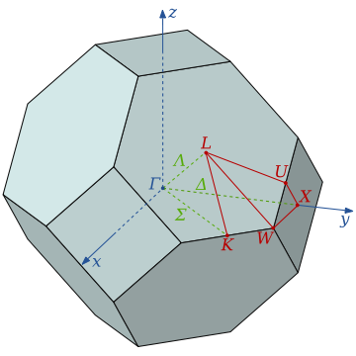
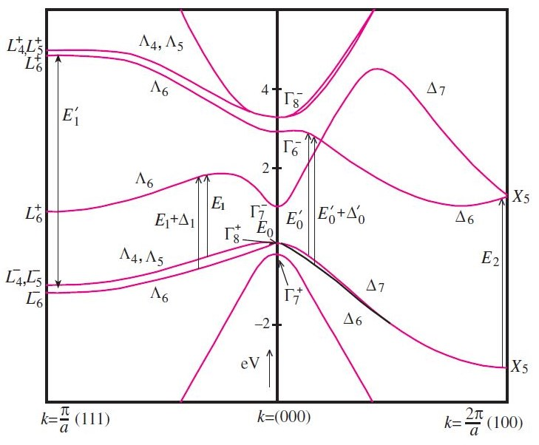
Band structure of Germanium
p*
j=3/2
E
FCC Brillouin zone
Add spin-orbit coupling: J=L+S
Δ₀’
j=1/2
empty
s*
Add FCC symmetry
E_{F}
s*
Band structure
p
j=3/2
Δ₀
j=1/2
filled
filled
s
s
Ge electronic configuration: … 4s² 4p²
N shell forms sp³ hybrid: … 4s¹ 4p³
Stefan Zollner, 2023
Momentum k
Notes:
Birstein-Moss shift

Slide 14
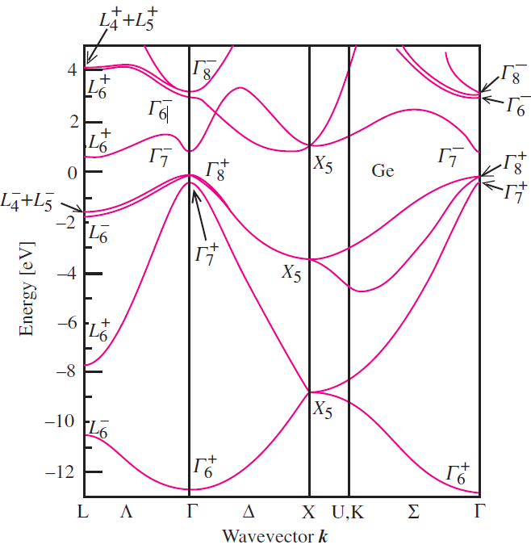
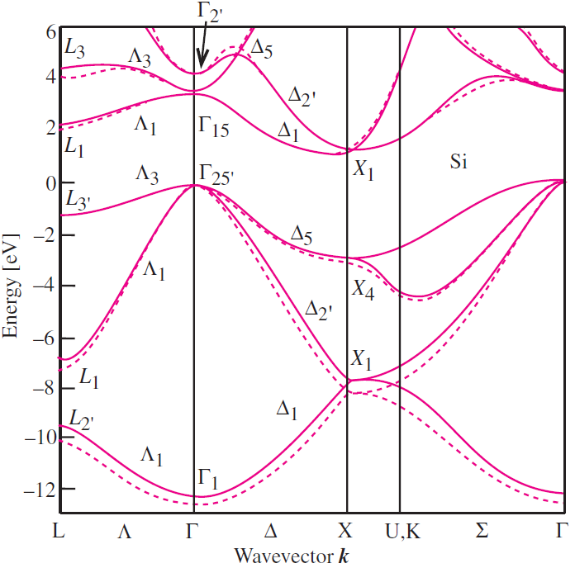
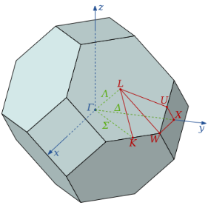
Examples of Band Structures: Si and Ge
s*
Darwin shift
p*
CB
p*
s*
gap
p
VB
p
s
s
(111)
(100)
(110)
Total Energy: E=K+V, K=p²/2m. p=0 corresponds to Γ-point in BZ.
Four valence electrons per atom: 3s², 3p² (8 e⁻ per primitive cell)
Symmetry labels are representations from the point group.
Stefan Zollner, 2023, AFRL Lectures Series 3

Slide 15
Dirac Points in Silicon and Germanium
Need “extra representations” for Ge because of strong spin effects.
Stefan Zollner, 2023
Yu and Cardona, Fundamentals of Semiconductors (Springer, 2010)
15

Slide 16
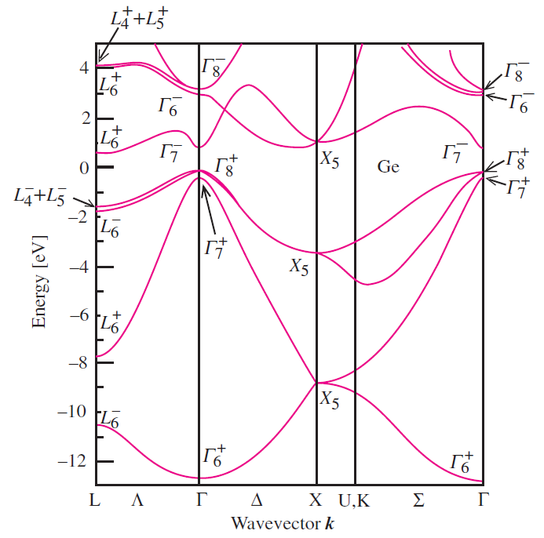
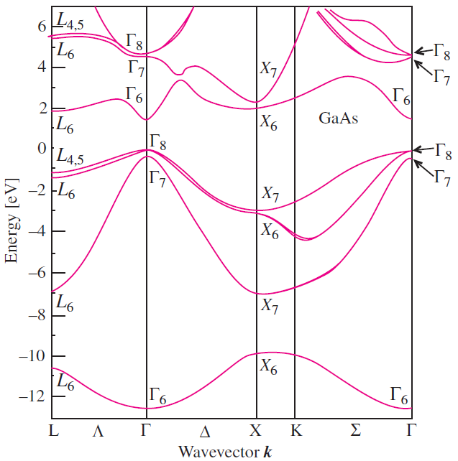
Topological Differences Between Ge and GaAs
Ge
GaAs
Bands cross: different symmetries.
Dirac point: Linear dependence on k
Inversion symmetry leads to crossing.
Bands repel: same symmetry.
Anti-crossing due to interactions.
No degeneracy at the X-point.
Stefan Zollner, 2023

Slide 17
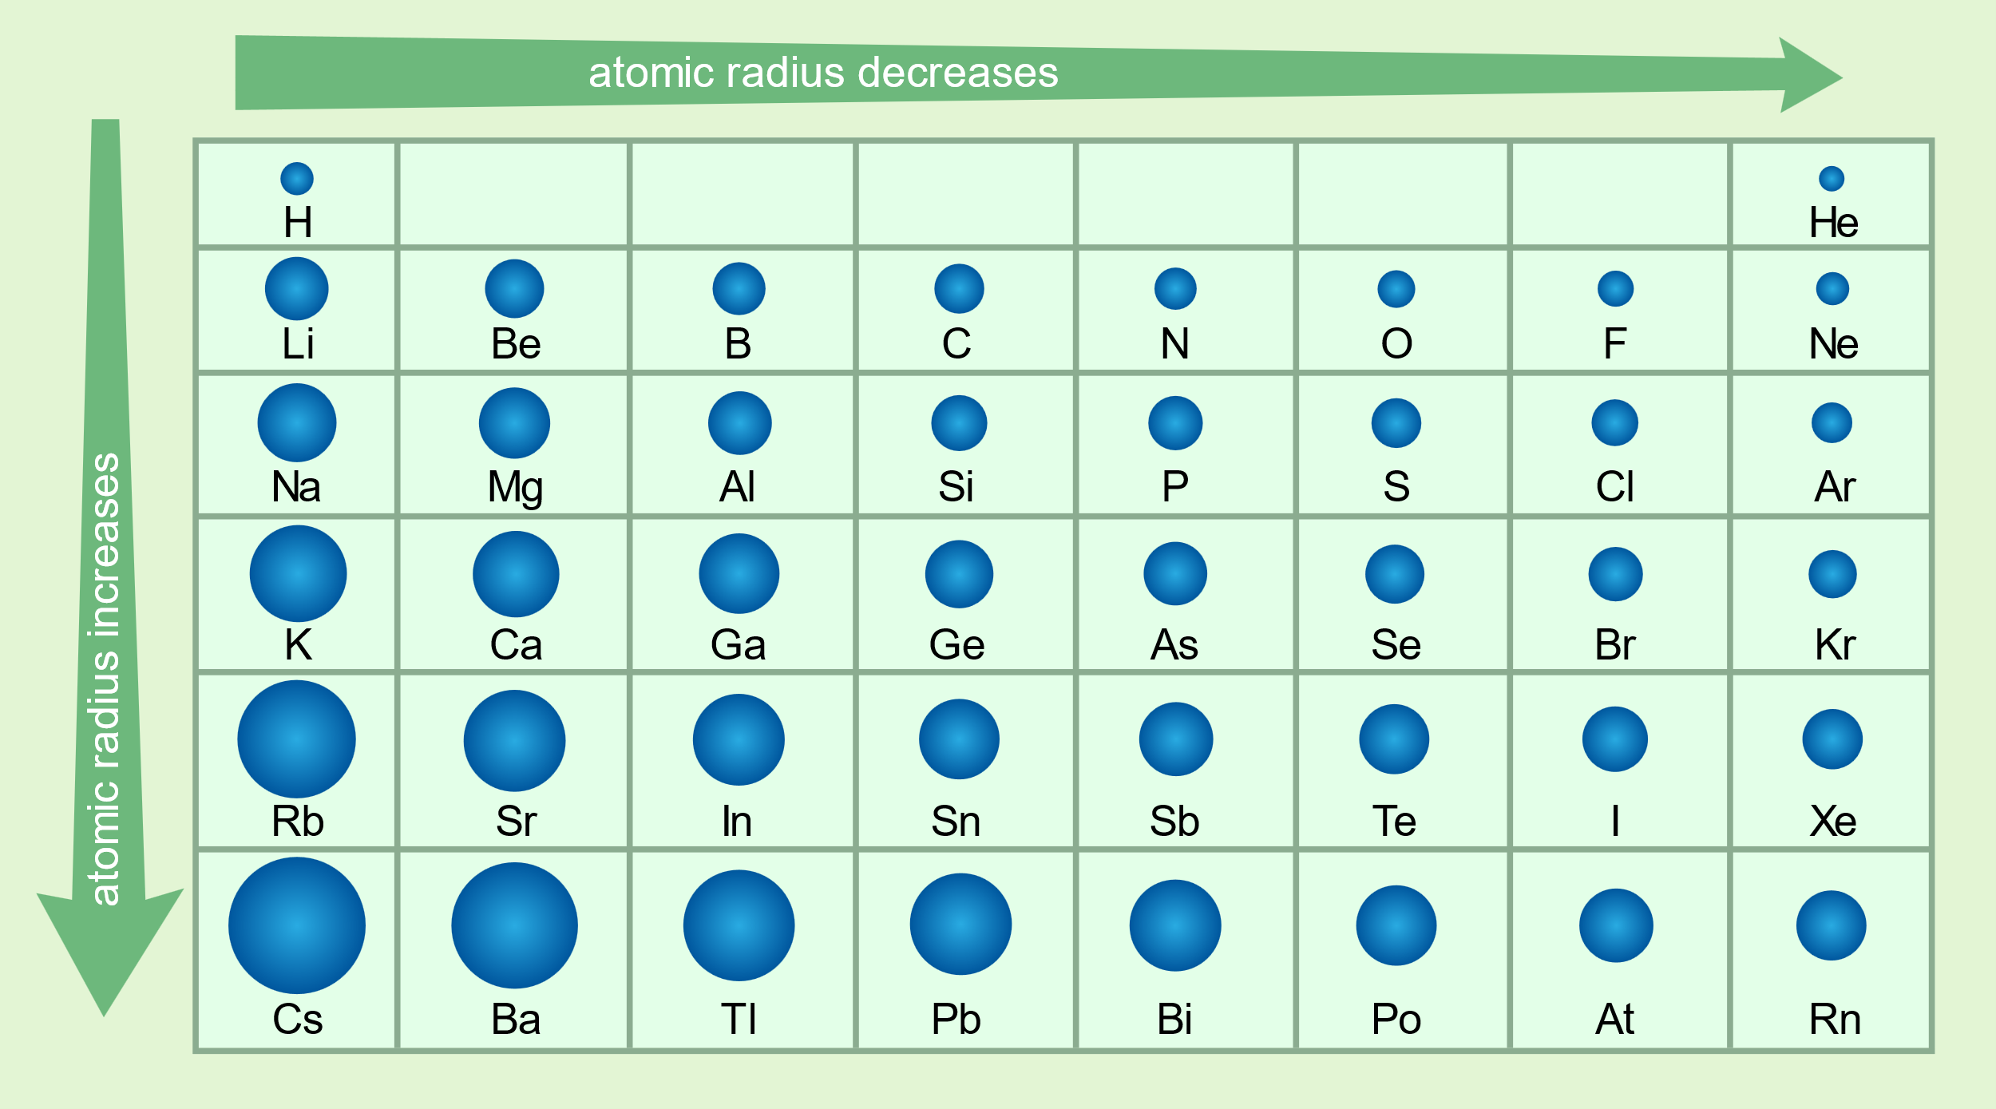
Atomic Radius
IV
Atomic radius decreases to the right, increases downward.
Relativistic effects increase downward.
Ge and Sn have d-electrons, C and Si do not.
Stefan Zollner, 2023
Notes:
Birstein-Moss shift

Slide 18
Relativistic Effects: Darwin Shift: C, Si, Ge, Sn
j=3/2
The s* band moves down, as the elements get heavier.
In α-tin, the s* band moves into the p-band manifold, between the j=1/2 and j=3/2 states.
This makes α-tin an (inverted) gapless semiconductor.
p
j=1/2
Stefan Zollner, 2023
Notes:
Birstein-Moss shift

Slide 19
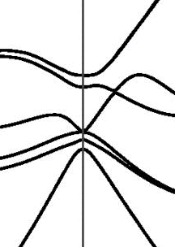
Band Inversion: Topological Insulators
Linear crossing
(Dirac point)
Inversion Symmetry
Gapless Semiconductor
p*
s*
p
j=3/2
p
s*
Germanium
α-tin
p
Band gap must be zero.
Symmetry inversion in VB.
j=1/2
Stefan Zollner, 2023, AFRL Lectures Series 1

Slide 20
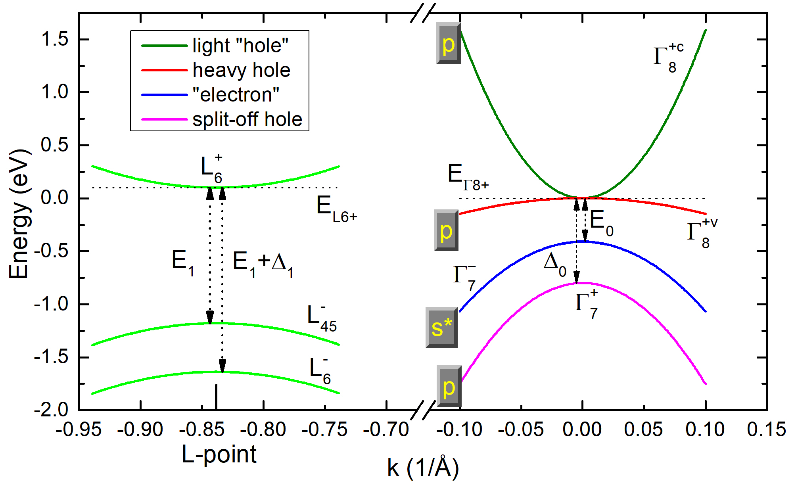
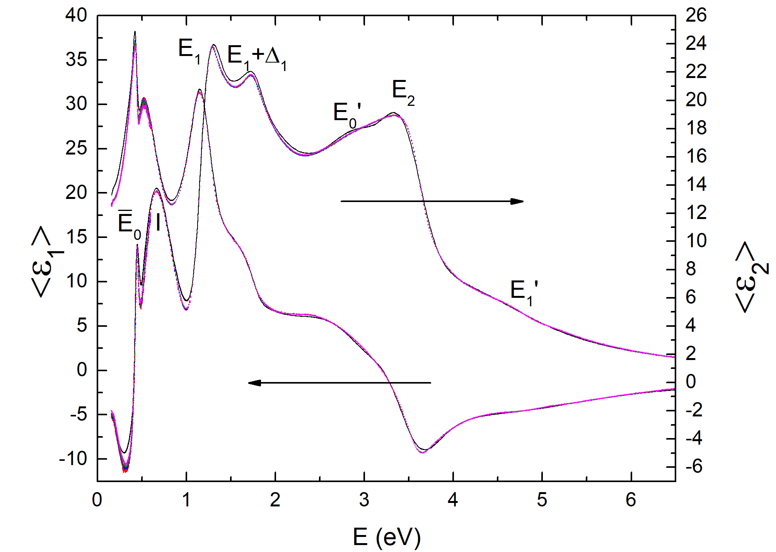
Optical Interband Transitions in α-Tin
ΔE_{ΓL}≈0
light “hole”
L-electron
heavy hole
“electron”
Spectroscopic Ellipsometry
Dielectric Function
split-off hole
R.A. Carrasco, APL 113, 232104 (2018).
Stefan Zollner, 2023

Slide 21
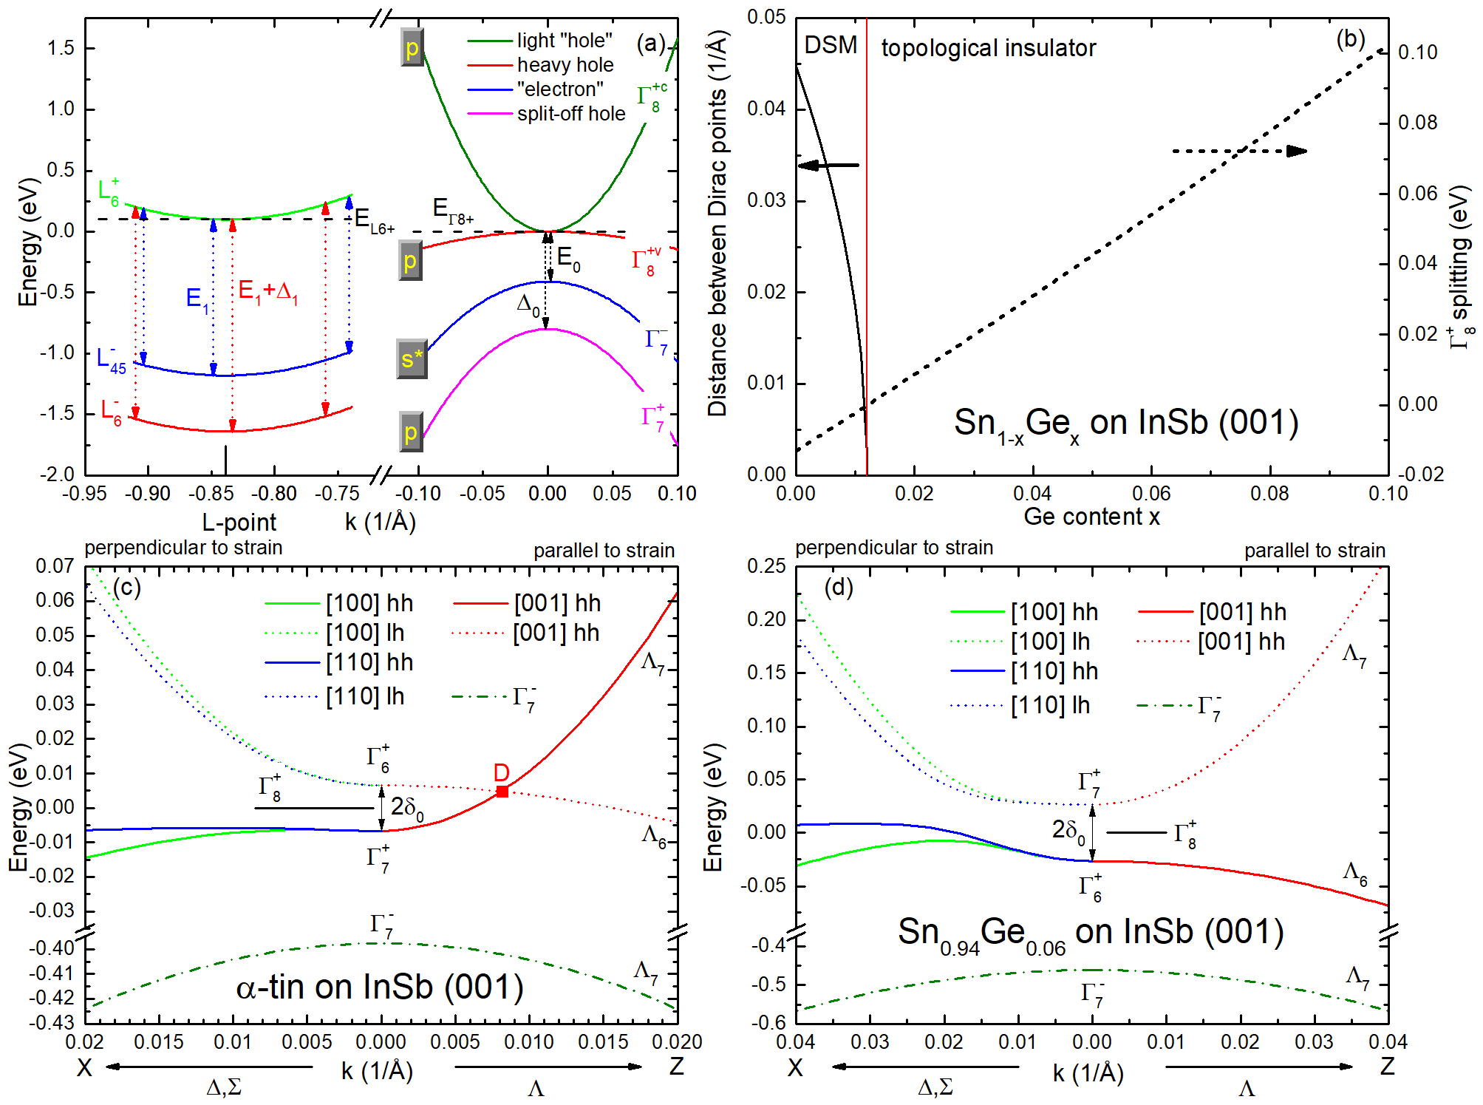
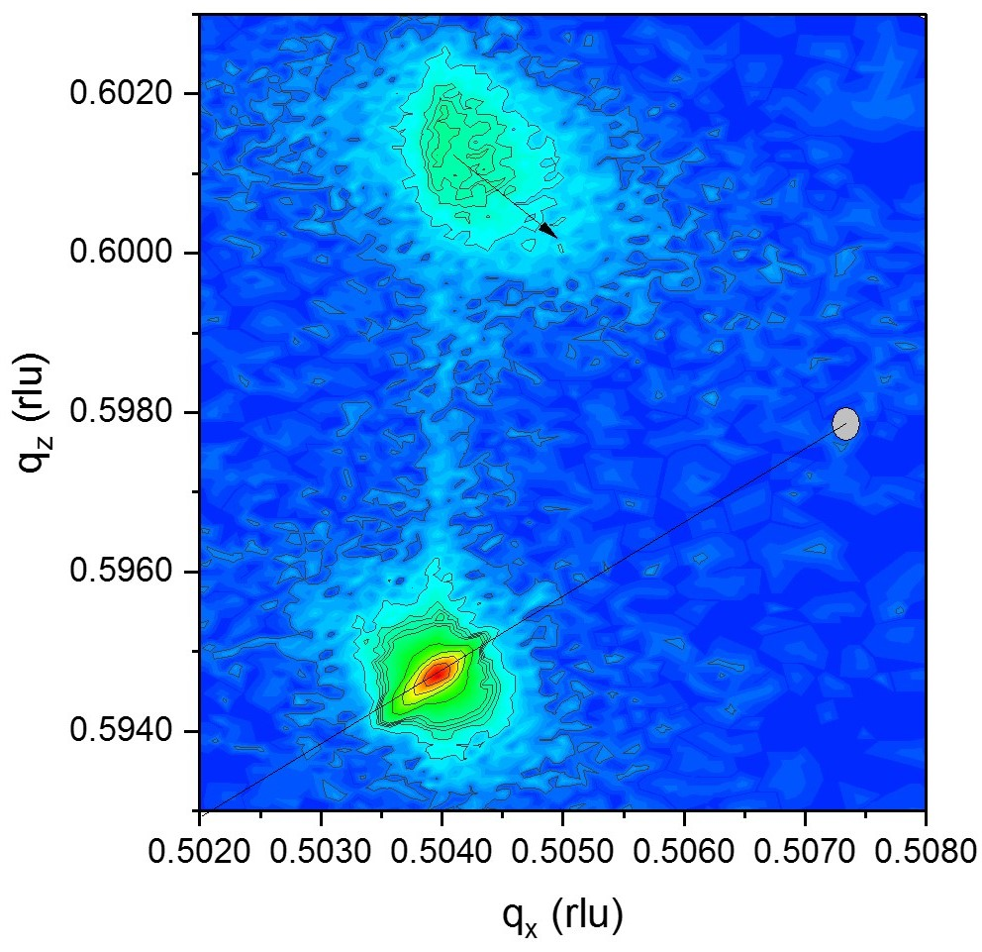
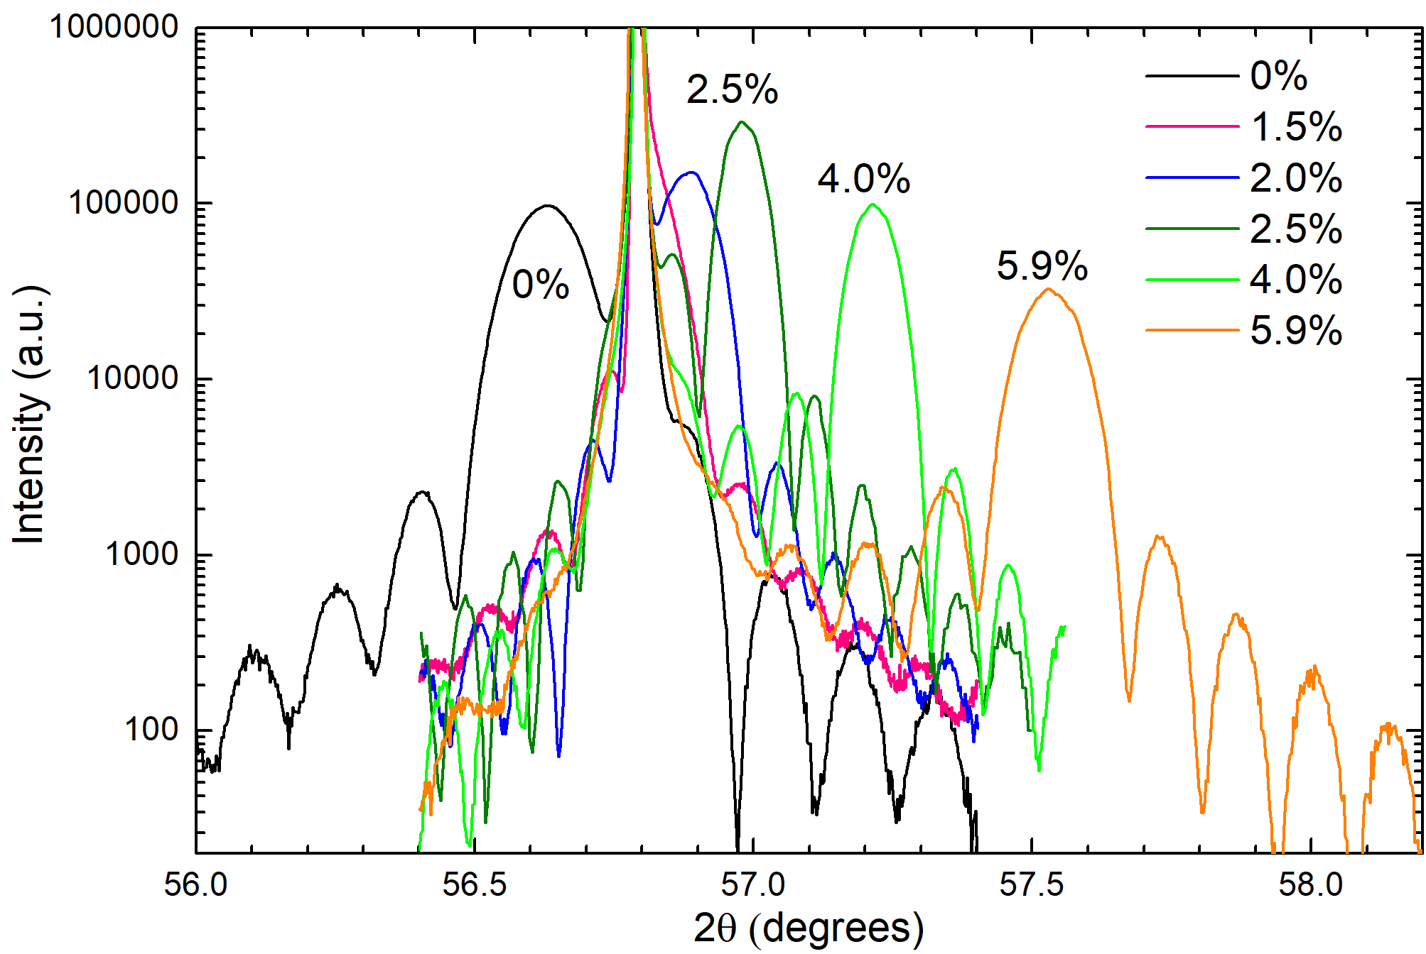
Topological Features of α-Tin under Strain
unstrained
Topological phase transition from Dirac-semimetal to topological insulator as a function of strain.
Strain can be tuned by growing on substrates with different lattice constants (InSb, CdTe, CdZnTe) or by doping with Ge.
Direct gap
400 cm⁻¹
335 RSM
Indirect
gap
004
compressive
Dirac point
Warping
tensile
R.A. Carrasco, APL 113, 232104 (2018).
Stefan Zollner, 2023

Slide 22
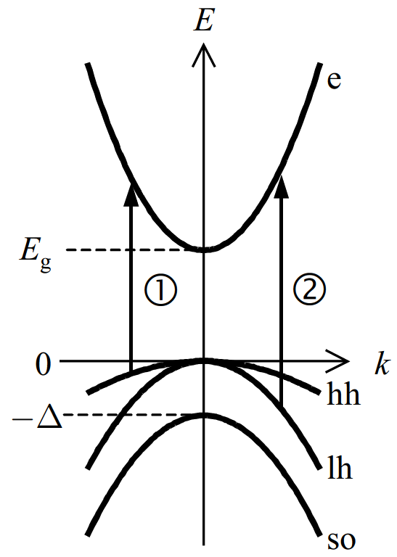
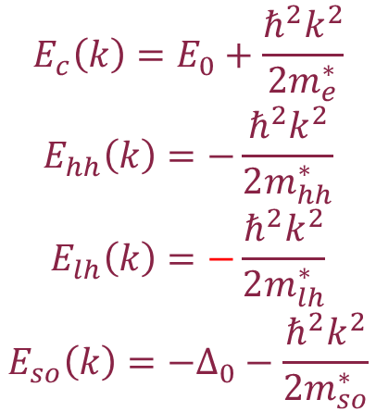
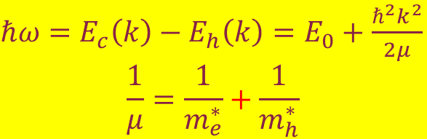
Interband Transitions in Ge
$$E_{c}\left(k\right)=E_{0}+\frac{ℏ^{2}k^{2}}{2m_{e}^{∗}}$$
$$E_{hh}\left(k\right)=−\frac{ℏ^{2}k^{2}}{2m_{hh}^{∗}}$$
$$E_{lh}\left(k\right)=−\frac{ℏ^{2}k^{2}}{2m_{lh}^{∗}}$$
$$E_{so}\left(k\right)=−Δ_{0}−\frac{ℏ^{2}k^{2}}{2m_{so}^{∗}}$$
Optical mass follows from crystal momentum conservation.
Watch the signs for inverted semiconductors.
3
$ℏω=$ $E_{c}\left(k\right)−E_{h}\left(k\right)=$ $E_{0}+\frac{ℏ^{2}k^{2}}{2μ}$
$$\frac{1}{μ}=\frac{1}{m_{e}^{∗}}+\frac{1}{m_{h}^{∗}}$$
Optical (reduced) mass μ
Fox, Chapter 3
Stefan Zollner, 2023, AFRL Lectures Series 3

Slide 23
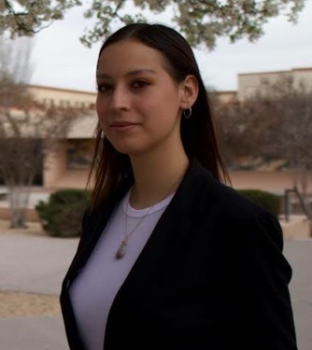
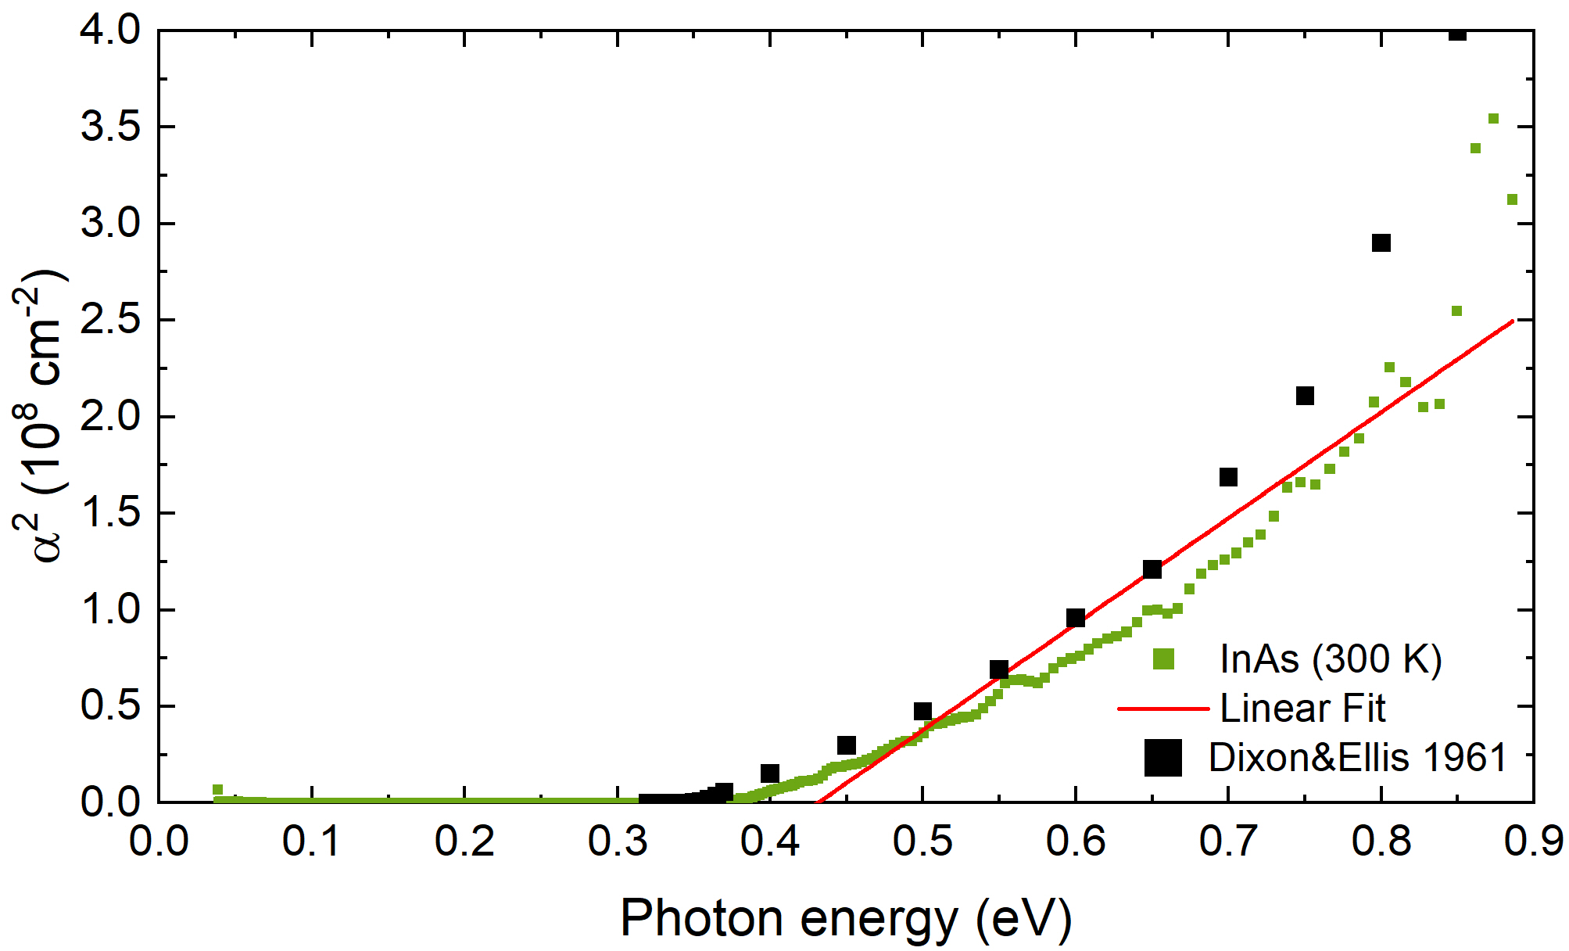
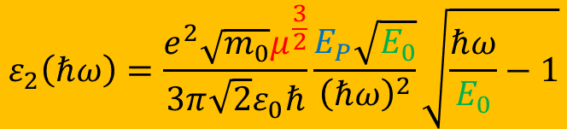
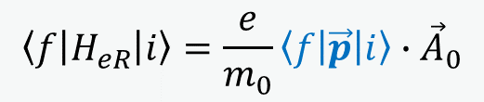
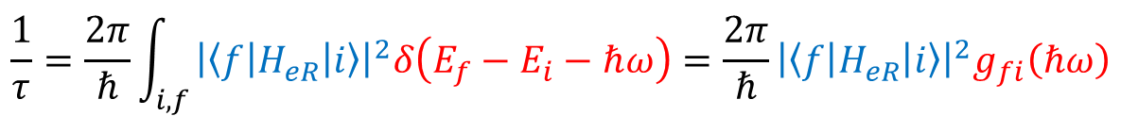
Fermi’s Golden Rule: Tauc Plot
Direct band gap absorption
$$\frac{1}{τ}=\frac{2π}{ℏ}\int_{i,f}{{\left|\left\langle f | H_{eR} | i\right\rangle \right|}^{2}δ\left(E_{f}−E_{i}−ℏω\right)}=\frac{2π}{ℏ}{\left|\left\langle f | H_{eR} | i\right\rangle \right|}^{2}g_{fi}\left(ℏω\right)$$
$$\left\langle f | H_{eR} | i\right\rangle =\frac{e}{m_{0}}\left\langle f | \vec{p} | i\right\rangle ∙{\vec{A}}_{0}$$
The Tauc plot is wishful thinking.
No linear region:
1/E² denominator
Broadening
Excitons
Nonparabolicity
Melissa Rivero Arias
Use k·p matrix element P: E_{P}=2P²/m₀
$$ε_{2}\left(ℏω\right)=\frac{e^{2}\sqrt{m_{0}}μ^{\frac{3}{2}}}{3π\sqrt{2}ε_{0}ℏ}\frac{E_{P}\sqrt{E_{0}}}{{\left(ℏω\right)}^{2}}\sqrt{\frac{ℏω}{E_{0}}−1}$$
Do not recommend the Tauc plot to find
band gaps (no obvious linear region).
Stefan Zollner, 2023
23
Notes:
Birstein-Moss shift

Slide 24
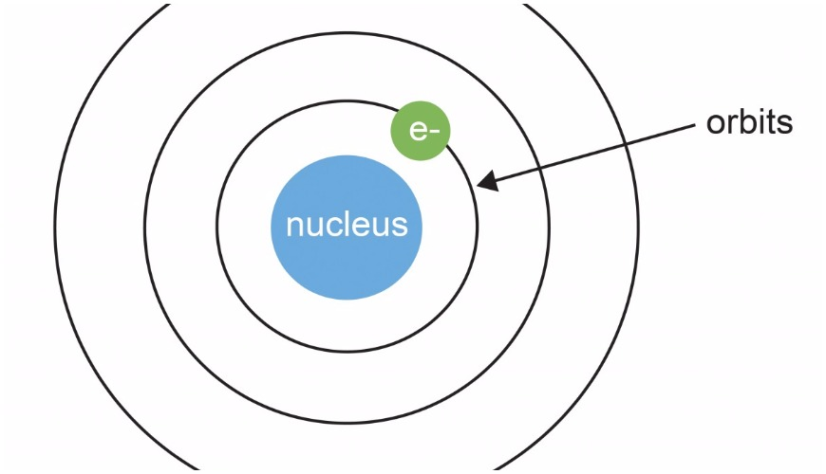
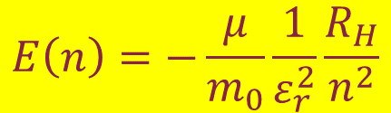


Bohr model for free excitons
Reduced electron/hole mass
(optical mass)
Static screening with static dielectric constant ε_{r}.
Exciton radius:
a_{H}=0.53 Å
Excitons stable if E_{X}>>kT ????
Exciton momentum is zero.
Exciton enhancement important even if E_{X}<<kT.
$$\frac{1}{μ}=\frac{1}{m_{e}}+\frac{1}{m_{h}}$$
Electron and hole form a bound state with binding energy.
R_{H}=13.6 eV Rydberg energy.
QM mechanical treatment easy.
$$r_{n}=\frac{m_{0}}{μ}ε_{r}n^{2}a_{H}$$
$$E\left(n\right)=−\frac{μ}{m_{0}}\frac{1}{ε_{r}^{2}}\frac{R_{H}}{n^{2}}$$
Stefan Zollner, 2023

Slide 25
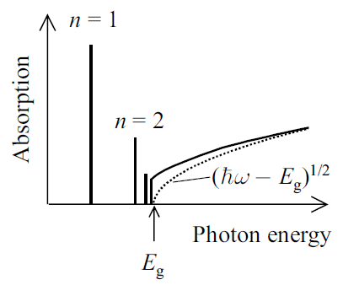
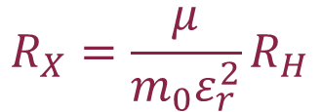

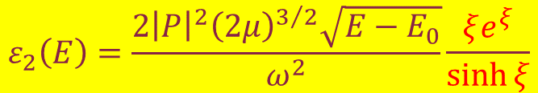
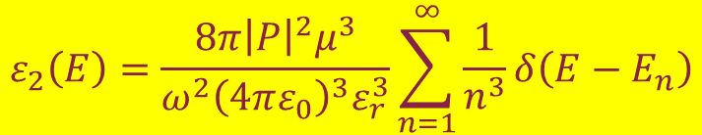
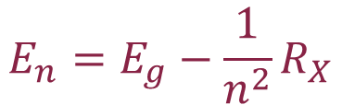
Sommerfeld enhancement
Excitonic Rydberg
energy
Discrete states
Discrete absorption
Continuum absorption
$$R_{X}=\frac{μ}{{m_{0}ε}_{r}^{2}}R_{H}$$
$$E_{n}=E_{g}−\frac{1}{n^{2}}R_{X}$$
$$ε_{2}\left(E\right)=\frac{8π{\left|P\right|}^{2}μ^{3}}{ω^{2}{\left(4πε_{0}\right)}^{3}ε_{r}^{3}}\sum_{n=1}^{∞}{\frac{1}{n^{3}}δ\left(E−E_{n}\right)}$$
$$ε_{2}\left(E\right)=\frac{2{\left|P\right|}^{2}{\left(2μ\right)}^{3/2}\sqrt{E−E_{0}}}{ω^{2}}\frac{ξe^{ξ}}{\sinh{ξ}}$$
$$ξ=π\sqrt{{R_{X}}/{E−E_{0}}}$$
Use Bohr wave functions to calculate ε₂.
Toyozawa discusses broadening.
Stefan Zollner, 2023
R. J. Elliott, Phys. Rev. 108, 1384 (1957)
Yu & Cardona

Slide 26
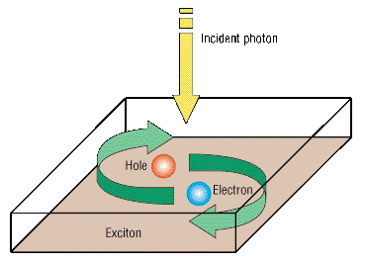

Ge: Elliott-Tanguy Exciton Absorption
Direct band gap absorption
Excitonic binding energy: R=R_{H}×μ_{h}/ε_{s}²
$$ε_{2}\left(ℏω\right)=\frac{e^{2}\sqrt{m_{0}}μ^{\frac{3}{2}}}{3π\sqrt{2}ε_{0}ℏ}\frac{E_{P}\sqrt{R}}{{\left(ℏω\right)}^{2}}\left[\sum_{n=1}^{∞}{\frac{4πR}{n^{3}}δ\left(ℏω−E_{0}+\frac{R}{n^{2}}\right)+\frac{2πH\left(ℏω−E_{0}\right)}{1−\text{exp}\left(−2π\sqrt{R/{ℏω−E_{0}}}\right)}}\right]$$
bound excitons
exciton continuum enhancement
Tanguy’s contributions:
Add Lorentzian broadening
Kramers-Kronig transform to get the real part.
×
R. J. Elliott, Phys. Rev. 108, 1384 (1957).
Christian Tanguy, Phys. Rev. Lett. 75, 4090 (1995) + (E)
Stefan Zollner, 2023, AFRL Lectures Series 3
Notes:
Birstein-Moss shift

Slide 27
Calculation of Absorption Spectrum from k.p Theory
Can we calculate the absorption spectrum?
Yes, we can for Ge in the low carrier density limit.
It does not work (yet) for other III/V compounds.
Carola Emminger et al., JAP 131, 165701 (2022).
Stefan Zollner, 2023
Notes:
Birstein-Moss shift

Slide 28


Elliott-Tanguy Theory Applied to Ge
Fixed parameters:
  Electron and hole masses (temperature dependent)
  Excitonic binding energy R
  Amplitude A (derived from matrix element P)
Adjustable parameters:
  Broadening Γ: 2.3 meV
  Band gap E₀
  Linear background A₁ and B₁
  (contribution from E₁ to real part of ε)
ε₂
Ge
Quantitative agreement
ε₁
Carola Emminger et al., JAP 131, 165701 (2022).
Stefan Zollner, 2023
Notes:
Birstein-Moss shift

Slide 29
Elliott-Tanguy Theory Applied to Ge
Good agreement at low temperatures.
Model also describes second derivatives.
Potential problems:
Matrix element k-dependent
Nonparabolicity
Resonant indirect absorption
??? at high T.
Ge
Ge
Carola Emminger et al., JAP 131, 165701 (2022).
Stefan Zollner, 2023
Notes:
Birstein-Moss shift

Slide 30


Interband Transitions
$$E_{c}\left(k\right)=E_{0}+\frac{ℏ^{2}k^{2}}{2m_{e}^{∗}}$$
$$E_{hh}\left(k\right)=−\frac{ℏ^{2}k^{2}}{2m_{hh}^{∗}}$$
$$E_{lh}\left(k\right)=−\frac{ℏ^{2}k^{2}}{2m_{lh}^{∗}}$$
$$E_{so}\left(k\right)=−Δ_{0}−\frac{ℏ^{2}k^{2}}{2m_{so}^{∗}}$$
Optical mass follows from crystal momentum conservation.
Watch the signs for inverted semiconductors.
3
$ℏω=$ $E_{c}\left(k\right)−E_{h}\left(k\right)=$ $E_{0}+\frac{ℏ^{2}k^{2}}{2μ}$
$$\frac{1}{μ}=\frac{1}{m_{e}^{∗}}+\frac{1}{m_{h}^{∗}}$$
Optical (reduced) mass μ
Fox, Chapter 3
Stefan Zollner, 2023, AFRL Lectures Series 3

Slide 31



Intravalence Band Transitions
Ge
p-type semiconductors
AlSb
E_{ind}
III/V
Δ₀
Δ₀
Δ₀
Braunstein & Kane, JPCS 1962
Braunstein, JCPS 1959
Kaiser, Phys. Rev. 91, 1380 (1953).
Kahn, Phys. Rev. 97, 1647 (1955).
Also in gapless semiconductors
Stefan Zollner, 2023

Slide 32



Carrier Concentration versus Temperature in α-Sn
n=p=4×10¹⁸ cm⁻³
$${\overline{E}}_{0}$$
Electrical Hall measurements are common to determine the dependence of the carrier concentration on temperature.
Stefan Zollner, 2023
C.A. Hoffman, PRB 40, 11693 (1989).

Slide 33

Intravalence Band Transitions in α-Sn
Experiment
Theory
All gapless (inverted) semiconductors should have this peak.
Theory calculated with same model as for Ge.
R.A. Carrasco, APL 113, 232104 (2018).
Stefan Zollner, 2023

Slide 34


Intravalence Band Transitions in α-Sn
Experiment
E_{F}
$$\frac{1}{μ}=\frac{1}{m_{e}^{∗}}−\frac{1}{m_{hh}^{∗}}$$
$${\overline{E}}_{0}$$
Optical mass μ
Theory
Note the negative sign in the optical mass.
Mid-IR absorption peak due to IVB transitions.
All gapless semiconductors should have this peak. Theory calculated with same model as for Ge.
R.A. Carrasco, APL 113, 232104 (2018).
Stefan Zollner, 2023

Slide 35
Dependence on Temperature: No shift ???
Experiment
E_{F}
$$\frac{1}{μ}=\frac{1}{m_{e}^{∗}}−\frac{1}{m_{hh}^{∗}}$$
$${\overline{E}}_{0}$$
Optical mass μ
Theory
Theory needs to address:
Fermi-Dirac statistics (not important).
Nonparabolic bands (Kane’s k·p model).
k-dependent matrix elements (Kane).
Excitons (Tanguy) – not important.
Screening of excitons (Tanguy) – not important.
R.A. Carrasco, APL 113, 232104 (2018).
Stefan Zollner, 2023, AFRL Lectures Series 3

Slide 36


Doping with Germanium: Sn_{1−x}Ge_{x} alloys
No significant change when doping α-Sn with up to 6% Ge.
R.A. Carrasco, APL 113, 232104 (2018).
Stefan Zollner, 2023

Slide 37
Dependence on Substrate (InSb or CdTe)
Red: InSb substrate
Green: CdTe substrate
The intravalence band peak in α-tin is visible on both InSb and CdTe substrates.
Linear background is different (probably doping, Drude term). Depolarization is a problem for DSP substrates.
R.A. Carrasco, APL 113, 232104 (2018).
Stefan Zollner, 2023

Slide 38



Condensation of excitons at high density
Mott transition (insulator-metal) when electron separation equals exciton radius.
Electron separation d for density N
Mott transition occurs at r_{s} near 1.
GaAs: n=10¹⁷ cm⁻³.
Biexciton, triexciton molecule formation.
Electron-hole droplets. Bose-Einstein condensation.
Exciton gas
$$d=\sqrt[3]{\frac{3}{4πn}}$$
$$r_{s}=\frac{d}{a_{X}}$$
dimensionless
Electron-hole liquid
Fox, Chapter 4
Stefan Zollner, 2023

Slide 39






Excitons in doped or excited semiconductors
Need to include exciton screening due to doping.
Yukawa potential: Schrödinger equation not solvable.
Use Hulthen potential as an approximation
Coulomb
Yukawa
Hulthen
$$V\left(r\right)=−k\frac{1}{r}$$
$$k=\frac{e^{2}}{4πε_{0}ε_{r}}$$
Debye screening length
$$V\left(r\right)=−k\frac{\text{exp}\left(−r/{λ_{\text{D}}}\right)}{r}$$
$$λ_{D}=\sqrt{\frac{ε_{r}ε_{0}k_{B}T}{ne^{2}}}=\frac{1}{k_{D}}$$
$$V\left(r\right)=−k\frac{2/{ga_{X}}}{\text{exp}\left(\frac{2r}{ga_{X}}\right)−1}$$
Unscreened: g=∞
Fully screened: g=0
Mott criterion: g=1
$$g=\frac{λ_{D}}{a_{X}}$$
Hulthen exciton
Stefan Zollner, 2023
C. Tanguy, Phys. Rev. 60, 10660 (1999).
Banyai & Koch, Z. Phys. B 63, 283 (1986).

Slide 40




Tanguy: Dielectric function of screened excitons
$$A=\frac{ℏ^{2}e^{2}}{2πε_{0}m_{0}^{2}}{\left(\frac{2μ}{ℏ^{2}}\right)}^{3/2}{\left|P\right|}^{2}$$
Bound exciton states (finite number):
$$ε_{2}\left(ω\right)=\frac{2πA\sqrt{R_{X}}}{E^{2}}\sum_{n=1}^{n^{2}<g}{2R_{X}\frac{1}{n}\left(\frac{1}{n^{2}}−\frac{n^{2}}{g^{2}}\right)δ\left[E−E_{0}+\frac{R}{n^{2}}{\left(1−\frac{n^{2}}{g}\right)}^{2}\right]}$$
Reduced Rydberg energy
exciton continuum:
$$k=π\sqrt{{\left(E−E_{0}\right)}/{R_{X}}}$$
$$ε_{2}\left(ω\right)=\frac{2πA\sqrt{R_{X}}}{E^{2}}\frac{\sinh{πgk}}{\cosh\left(πgk\right)−\cosh\left(πg\sqrt{k^{2}−\frac{4}{g}}\right)}θ\left(E−E_{0}\right)$$
Need to introduce Lorentzian broadening and perform numerical KK transform.
C. Tanguy, Phys. Rev. B 60, 10660 (1999)
Stefan Zollner, 2023

Slide 41

Tanguy: Dielectric function of screened excitons
g=∞
g=∞
g=0
g=0
g=∞
g=∞
Small Broadening
g=1.5
Large Broadening
g=0
g=0
Stefan Zollner, 2023
C. Tanguy, Phys. Rev. B 60, 10660 (1999)

Slide 42

Excitons in laser-excited GaAs
g=∞
GaAs 300 K
High laser excitation
Hulthen exciton
g small
Haug and Koch, Quantum Theory of Optical and Electronic Properties of Semiconductors
Y. H. Lee, Phys. Rev. Lett 57, 2446 (1986)
Stefan Zollner, 2023

Slide 43

Excitons in doped or excited semiconductors
High laser excitation
High doping
Exciton peak broadens
Fox, Chapter 4
Fujiwara, Phys. Rev. B 71, 075109 (2005)
Stefan Zollner, 2023

Slide 44
Thermal ionization of excitons in Germanium
Ge
Strong excitonic peak at 10 K, disappears at high T.
Excitonic (Sommerfeld) enhancement persists at high temperatures.
E_{X}(hh)=1.7 meV
k_{B}=0.086 meV/K
T_{C}=20 K
718 K
E₀+Δ₀
10 K
E₀
Stefan Zollner, 2023

Slide 45

Dielectric function of InSb from 80 to 800 K
InSb
InSb
Band gap changes with temperature (but only below 500 K).
Amplitude reduction at high temperatures (Pauli blocking, bleaching)
Drude response at high temperatures (thermally excited carriers).
Depolarization artifacts at long wavelengths (below 300 K).
Woollam FTIR-VASE
cryostat with CVD diamond windows
Rivero Arias, JVSTB 41, 022203 (2023)
Kane, J. Phys. Chem. Solids 1, 249 (1957). Kane 1966.
Stefan Zollner, 2023

Slide 46




Temperature Dependence of InSb
How does the dielectric function of InSb near the band gap change with temperature?
Parametric-Semiconductor (PSEMI) Model:
Also vary
“shape parameters”.
Asymmetric peak shape poorly described.
Try Tanguy oscillator for excitonic line shape.
InSb
$$ε_{2}≠C\frac{\sqrt{E_{0}}}{{\left(ℏω\right)}^{2}}\sqrt{\frac{ℏω}{E_{0}}−1}$$
C. M. Herzinger, B. Johs, et al., J. Appl. Phys. 83, 3323 (1998).
Rivero Arias, JVST B 41, 022203 (2023).
Stefan Zollner, 2023, AFRL Lectures Series 3

Slide 47



Burstein-Moss Shift
InSb
Bose-Einstein Model
$E_{g}\left(T\right)=a−b [1+\frac{2}{e^{\frac{θ}{T}}−1}$]
Band gap changes with temperature (but only below 500 K)
Described by Bose-Einstein model below 500 K: Logothetidis, PRB 31, 947 (1985).
No redshift above 500 K: Thermal Burstein-Moss shift
T.S. Moss, Proc. Phys. Soc. 67, 775 (1954).
E. Burstein, Phys. Rev. 93, 632 (1954).
Stefan Zollner, 2023, AFRL Lectures Series 3

Slide 48


Fermi Level versus Temperature in Intrinsic InSb
n=4x10¹⁷ cm⁻³ at 800 K
InSb
(simple model)
Calculated for constant mass and band gap.
k_{B}T=E_{g}/4 at 600 K
Fermi level above the conduction band edge above 450 K.
(Calculated for constant m and E_{g}).
Need to include nonparabolicity.
Thermal Burstein-Moss shift
Drude response of free carriers
Reduction of absorption coefficient
Kane, J. Phys. Chem. Solids 1, 249 (1957). Kane 1966.
Stefan Zollner, 2023
Rivero Arias, JVSTB 41, 022203 (2023)

Slide 49


Carrier concentration and mobility from 80 to 800 K
To model the Drude response, we make some really simple assumptions:
Parabolic bands (ignore non-parabolicity)
Effective mass constant m_{e}=0.014 (independent of temperature)
Drude mobility of InSb
Carrier concentration
of InSb
Reasonable agreement with Hall measurements.
Large errors below 400 K (depolarization).
Oswaldowski/Zimpel, J. Phys. Chem. Solids 49, 1179 (1988).
D. L. Rode, Phys. Rev. B 3, 3287 (1971).
Stefan Zollner, 2023, AFRL Lectures Series 3

Slide 50
Required improvements: Screened Excitons
$$ε_{2}\left(E\right)=\frac{2πA\sqrt{R}}{E^{2}}\left\{\sum_{n=1}^{\sqrt{g}}{\frac{2R}{n}\left(\frac{1}{n^{2}}−\frac{n^{2}}{g^{2}}\right)δ\left[E−E_{0}+\frac{R}{n^{2}}{\left(1−\frac{n^{2}}{g}\right)}^{2}\right]+\frac{\text{sinh}\left(πgk\right)\text{H}\left(E−E_{0}\right)}{\text{cosh}\left(πgk\right)−\text{cosh}\left(πg\sqrt{k^{2}−\frac{4}{g}}\right)}}\right\}\left[f_{h}\left(E\right)−f_{e}\left(E\right)\right]$$
Absorption by screened excitons (Hulthen potential): Better lineshape.
Numerical Kramers-Kronig transform (Tanguy cannot be used due to f_{h}, f_{e} ≠0).
Degenerate Fermi-Dirac statistics to calculate f_{h} and f_{e}.
Two terms for light and heavy excitons
Non-parabolicity and temperature-dependent mass included from k.p theory
k-dependent matrix element P.
Screening parameter g=12/π²a_{R}k_{TF} (large: no screening)
Only two free parameters: Band gap E₀ and broadening Γ.
Amplitude A and exciton binding energy R from k.p theory and effective masses.
This theory needs to be used for InSb, α-tin, Ge-Sn alloys.
Christian Tanguy, Phys. Rev. B 60, 10660 (1999).
Jose Menendez, Phys. Rev. B 101, 195204 (2020).
Carola Emminger, J. Appl. Phys. 131, 165701 (2022).
Stefan Zollner, 2023, AFRL Lectures Series 3

Slide 51
Germanium-Tin Alloys
Stefan Zollner, 2023

Slide 52


Germanium-Tin Alloys
indirect (Ge)
direct (GaAs)
inverted (Sn)
inverse SO
DFT calculation (GGA, WIEN2k, 54-atom supercell)
M.P. Polak, J. Phys. D 50, 195103 (2017).
topological insulators
Stefan Zollner, 2023

Slide 53

Germanium-Tin Alloys
These alloys are a rich playground to explore the various topological phases available in common semiconductors.
This DFT calculation (GGA, WIEN2k, 54-atom supercell) does not agree so well with experiments.
Synthesis of alloys over the complete range of compositions and measurements of the band gaps are needed.
M.P. Polak, J. Phys. D 50, 195103 (2017).
Stefan Zollner, 2023

Slide 54




Award-winning undergraduate research students
Stefan Zollner, 2023
54

Slide 55
Intravalence Band Transitions in Topological Insulators
Bonds and Bands
Band Structure of Silicon, Germanium, and α-Tin
Why is α-Tin a Topological Insulator?
Intravalence Band Absorption in Ge and AlSb
Intravalence Band Absorption in α-Tin
Dependence on Temperature, Substrate,
and Doping with Ge
Summary
Woollam FTIR-VASE;
cryostat with CVD diamond windows
Stefan Zollner, 2023

Slide 56

Thank you!
Questions?
AVS 2022, Pittsburgh, PA

Slide 57






Ellipsometry Measurement
Polarization State
Jones Vector
$$J=\left(\begin{matrix}E_{0x} \\ E_{0y}\end{matrix}\right)$$
Ellipsometry Experiment
$$J_{\text{out}}=\left(\begin{matrix}r_{pp} & r_{ps} \\ r_{sp} & r_{ss}\end{matrix}\right)J_{\text{in}}$$
$$ρ=\tan{ψ}\exp{iΔ}$$
Fresnel reflection coefficients
$$\left(\begin{matrix}r_{pp} & r_{ps} \\ r_{sp} & r_{ss}\end{matrix}\right)=r_{ss}\left(\begin{matrix}ρ & ρ_{ps} \\ ρ_{sp} & 1\end{matrix}\right)$$
Fresnel reflection ratio
Anisotropy or depolarization (not both)
Isotropic surface:
Off-diagonal elements vanish.
$$\left(\begin{matrix}r_{pp} & r_{ps} \\ r_{sp} & r_{ss}\end{matrix}\right)=r_{ss}\left(\begin{matrix}ρ & 0 \\ 0 & 1\end{matrix}\right)$$
Stefan Zollner, 2023, AFRL Lectures Series 1

Slide 58






Experimental Methods
Spectroscopic Ellipsometer 190 to 2500 nm (0.5 to 6.5 eV)
Infrared Ellipsometer
1.25 to 40 μm (250 to 8000 cm⁻¹)
X-ray diffraction & reflectance
Spectroscopic Ellipsometry:
Thickness (100 to 10000 Å)
Absorption, band gap
Refractive index
FTIR ellipsometry:
Very thick films (> 5000 Å)
Phonon absorption
Optical Constants
XRD/XRR:
Crystal structure
Lattice spacings (strain)
Thickness (5 Å to 1000 Å)
Surface, roughness layer
Density
detector
Monochromator
polarizer
analyzer
Φ
sample
Notes:
Birstein-Moss shift

Slide 59



Ellipsometry from 190 nm to 40,000 nm
Two different instruments are used for measurements from the mid-infrared to the deep ultraviolet spectral range.
J.A. Woollam IR-VASE
SZ, Spectroscopic Ellipsometry from 10 to 700 K, Adv. Opt. Technol. 11, 117 (2022).
J.A. Woollam V-VASE

Slide 60

Temperature-dependent ellipsometry: 10-700 K
Using FTIR spectroscopic ellipsometry in an ultra-high vacuum (UHV) cryostat with CVD diamond windows (Janis ST-400, Diamond Materials GmbH, Freiburg).
Why diamond? Large transparency range and good vacuum seals, but expensive and high reflection losses.
Energies: 30-40 meV to 1 eV
VIS-UV and FTIR spectra (dielectric functions) After oxide correction (25 Å)
Compare:
Aspnes, PRB 27, 985 (1983)
Logothetidis, PRB 31, 947 (1985).
Schaefer, JAP 127, 165705 (2020).
J.A. Woollam IR-VASE
Cryostat with CVD diamond windows
E₀
InSb
SZ, Adv. Opt. Technol. 11, 117 (2022).

Slide 61



Free-Electron Approximation with Effective Masses
$$H=T+V$$
Ignore potential energy (V=0)
$$H=\frac{p^{2}}{2m}=\frac{ℏ^{2}k^{2}}{2m}=\frac{ℏ^{2}k^{2}}{2m^{∗}m_{0}}$$
$$E_{e}=E_{g}+\frac{ℏ^{2}k^{2}}{2m_{e}m_{0}}$$
$$E_{hh}=−\frac{ℏ^{2}k^{2}}{2m_{hh}m_{0}}$$
$$E_{lh}=−\frac{ℏ^{2}k^{2}}{2m_{lh}m_{0}}$$
$$E_{so}={−Δ}_{0}−\frac{ℏ^{2}k^{2}}{2m_{so}m_{0}}$$
Effective mass m*
Ge
$${\left(m_{ij}\right)}^{−1}=\frac{1}{ℏ^{2}}\frac{∂^{2}E}{{∂k}_{i}{∂k}_{j}}$$
Effective mass tensor
Free particle: Plane wave
Stefan Zollner, 2023, AFRL Lectures Series 3
Yu & Cardona, Fundamentals of Semiconductors

Slide 62




k·p Theory (Band Structure Method)
Schrödinger equation
Use Bloch’s theorem:
Solve equation for k=0.
Eliminate green free-electron term with substitution of variables (Kane 1957).
Then treat red term in perturbation theory.
Works very well for semiconductors with local V(r) potentials.
$$HΦ_{n\vec{k}}=\left(\frac{{\vec{p}}^{2}}{2m}+V\right)Φ_{n\vec{k}}=E_{n\vec{k}}Φ_{n\vec{k}}$$
$$Φ_{n\vec{k}}\left(\vec{r}\right)=e^{i\vec{k}∙\vec{r}}u_{n\vec{k}}\left(\vec{r}\right)$$
Product rule
$${\left(fg\right)}^{′′}=f^{′′}g+2f^{′}g^{′}+fg^{′′}$$
$$\left(\frac{{\vec{p}}^{2}}{2m}+\frac{ℏ^{2}{\vec{k}}^{2}}{2m}+\frac{ℏ\vec{k}∙\vec{p}}{m}+V\right)u_{n\vec{k}}=E_{n\vec{k}}u_{n\vec{k}}$$
Yu & Cardona, Fundamentals of Semiconductors
Kane, J. Phys. Chem. Solids 1, 249 (1957). Kane 1966.
Stefan Zollner, 2023, AFRL Lectures Series 3

Slide 63




k·p Theory: Effective Mass of Non-Degenerate Band
Solve for k=0 (at Γ). Linear terms in k vanish (extremum).
Treat red term in perturbation theory (up to second order).
$$\left(\frac{{\vec{p}}^{2}}{2m}+\frac{ℏ^{2}{\vec{k}}^{2}}{2m}+\frac{ℏ\vec{k}∙\vec{p}}{m}+V\right)u_{n\vec{k}}=E_{n\vec{k}}u_{n\vec{k}}$$
$$u_{n\vec{k}}=u_{nΓ}+\frac{ℏ}{m}\sum_{n^{′}≠n}{\frac{\left\langle u_{nΓ} | \vec{k}∙\vec{p} | u_{n^{′}Γ}\right\rangle }{E_{nΓ}−E_{n^{′}Γ}}u_{n^{′}Γ}}$$
$$E_{n\vec{k}}= E_{nΓ}+\frac{ℏ^{2}k^{2}}{2m}+\frac{ℏ^{2}}{m^{2}}\sum_{n^{′}≠n}{\frac{{\left|\left\langle u_{nΓ} | \vec{k}∙\vec{p} | u_{n^{′}Γ}\right\rangle \right|}^{2}}{E_{nΓ}−E_{n^{′}Γ}}}=E_{nΓ}+\frac{ℏ^{2}k^{2}}{2m^{∗}}$$
$$\frac{1}{m^{∗}}=\frac{1}{m}+\frac{2}{m^{2}k^{2}}\sum_{n^{′}≠n}{\frac{{\left|\left\langle u_{nΓ} | \vec{k}∙\vec{p} | u_{n^{′}Γ}\right\rangle \right|}^{2}}{E_{nΓ}−E_{n^{′}Γ}}}$$
Effective mass comes from band-band interactions.
The same k·p momentum matrix element determines the strength of interband transitions.
Stefan Zollner, 2023, AFRL Lectures Series 3
Yu & Cardona, Fundamentals of Semiconductors

Slide 64




k·p Theory: Application to Electron Band at Γ
$$\frac{1}{m^{∗}}=\frac{1}{m}+\frac{2}{m^{2}k^{2}}\sum_{n^{′}≠n}{\frac{{\left|\left\langle u_{nΓ} | \vec{k}∙\vec{p} | u_{n^{′}Γ}\right\rangle \right|}^{2}}{E_{nΓ}−E_{n^{′}Γ}}}$$
E_{P}=2P²/m₀
E_{P}≈20 eV
Keep only the largest term:
$$\frac{1}{m_{e}^{∗}}=\frac{1}{m_{0}}+\frac{2{\left|\left\langle Γ_{1c} | \vec{k}∙\vec{p} | Γ_{25v}^{′}\right\rangle \right|}^{2}}{m_{0}^{2}E_{0}k^{2}}=\frac{1}{m_{0}}+\frac{2P^{2}}{m_{0}^{2}E_{0}}≅\frac{2P^{2}}{m_{0}^{2}E_{0}}$$
Momentum matrix element:
$$iP=\left\langle X | p_{x} | Γ_{1}\right\rangle =\left\langle Y | p_{Y} | Γ_{1}\right\rangle =\left\langle Z | p_{z} | Γ_{1}\right\rangle$$
Stefan Zollner, 2023, AFRL Lectures Series 3
$$m_{e}^{∗}∝E_{0}$$
Stefan Zollner, 2023, AFRL Lectures Series 3
64
Yu & Cardona, Fundamentals of Semiconductors

