Slide 1

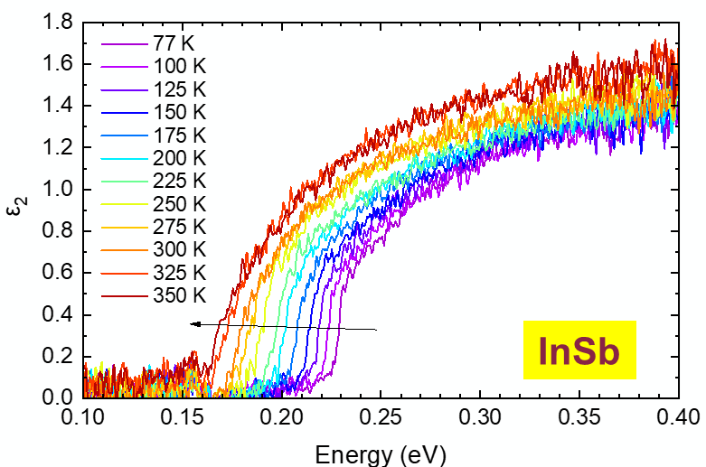
Excitonic absorption in semiconductors with low and high carrier densities
2023 Fall MRS
FA9550-20-1-0135
AFOSR
Gernot Pomrenke
Stefan Zollner
With:
Carola Emminger (Uni Leipzig and HU Berlin, Germany)
Jose Menendez (Arizona State University, Tempe, AZ)
Email: zollner@nmsu.edu. WWW: http://femto.nmsu.edu.
College of Arts and Sciences, Department of Physics
New Mexico State University, Las Cruces, NM, USA

Slide 2
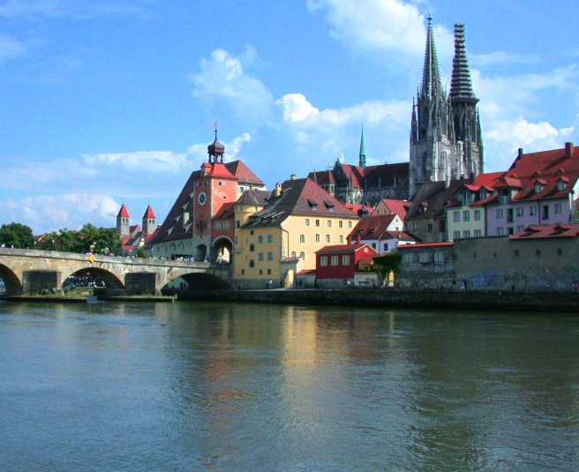

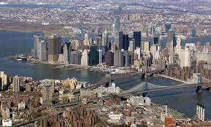

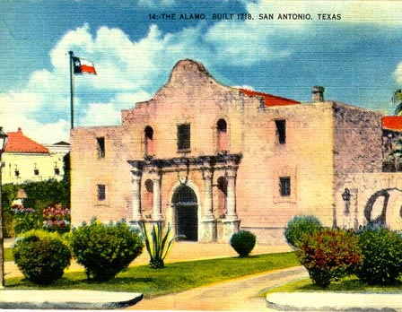
Biography
Motorola (Mesa, Tempe)
Arizona, 1997-2005
Regensburg/Stuttgart
Germany
Freescale, IBM
New York, 91-92; 07-10
NMSU
Las Cruces, NM
Since 2010
Motorola, Freescale
Texas, 2005-2007
2

Slide 3


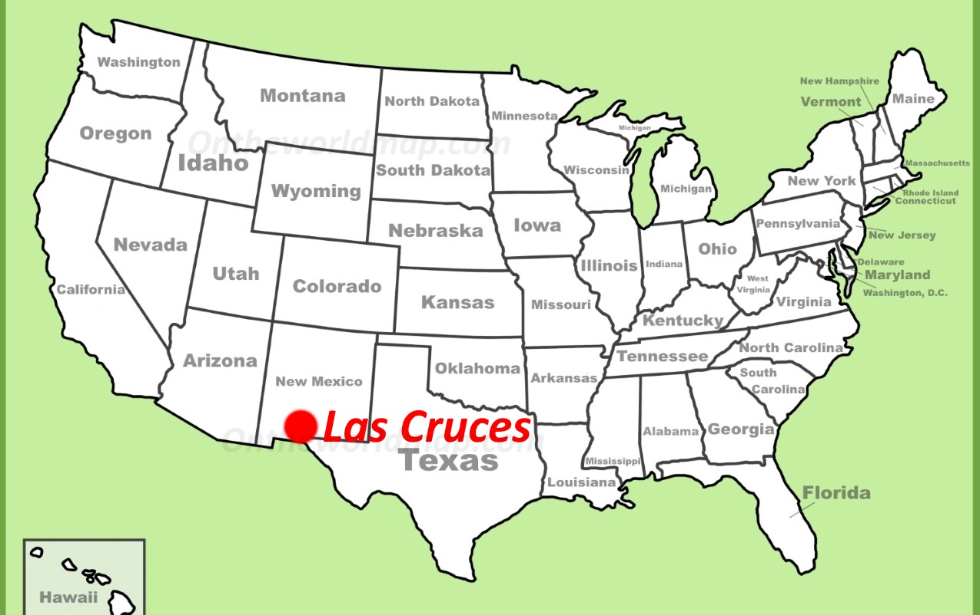

Where is Las Cruces, NM ???
White Sands NP

Slide 4
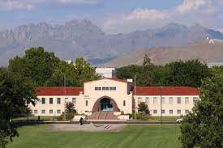
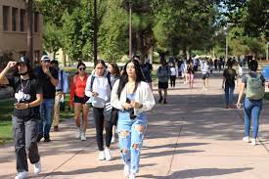
New Mexico State University, Las Cruces
Land grant institution, Carnegie R2 (soon to be R1) Comprehensive: Arts and Sciences, Education, Business, Agriculture
Ph.D. programs in sciences, engineering, agriculture; Ag extension
14,000 students (11,500 UG, 2,500 GR), 1000 faculty
Minority-serving, Hispanic-serving (60% Hispanic/NA, 26% White)
Small-town setting
Military-friendly institution (Army and Air Force ROTC programs)
Community engagement classification (first-generation students, Pell grant recipients)
Physics: BS/BA, MS, PhD degrees. 71 UG and 37 GR students.
12 faculty (HE Nuclear and Materials Physics), 1.7 M$ expenditures. ABET-accredited BS in Physics and BS in Engineering Physics
Stefan Zollner, 2023

Slide 5
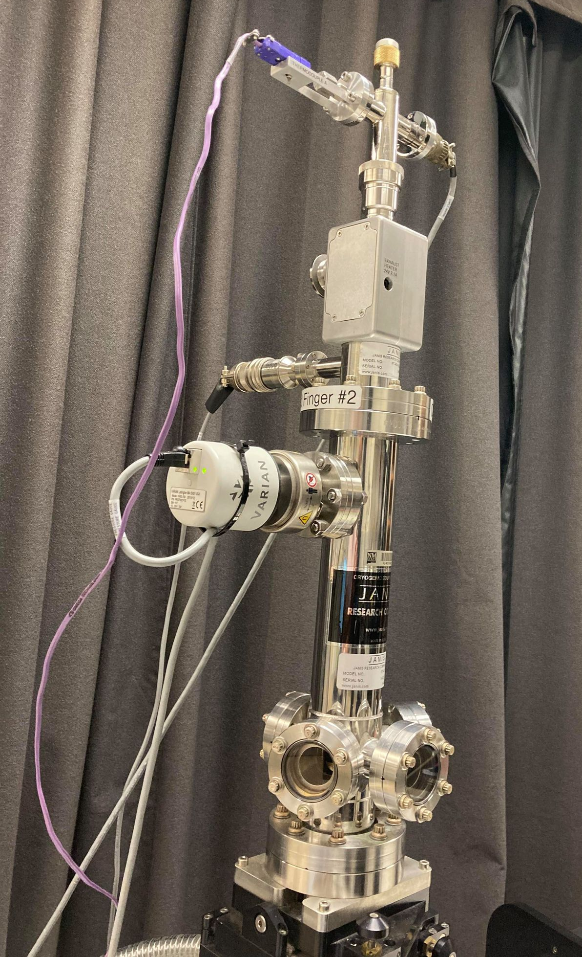
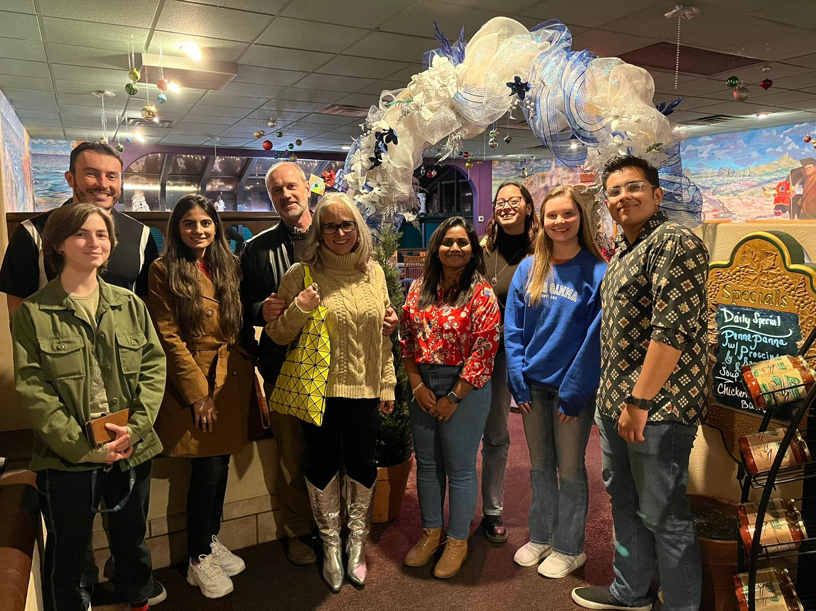
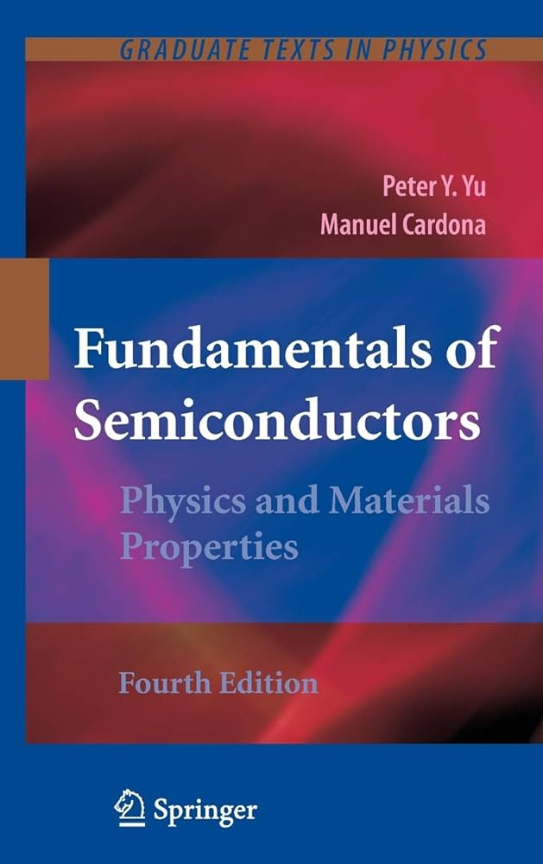
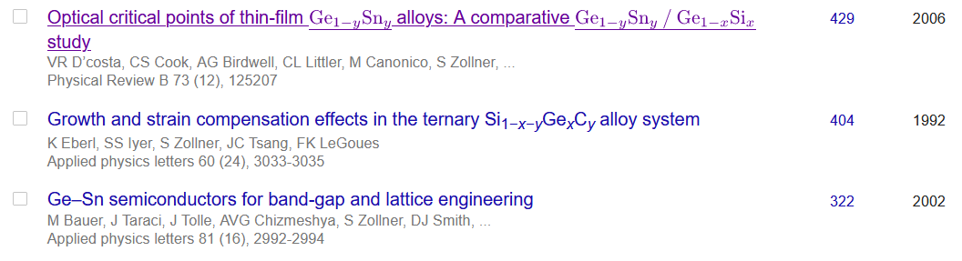
Ellipsometry at NMSU
Ellipsometry on anything (inorganic, 3D)
Metals, insulators, semiconductors
Mid-IR to vacuum UV
10 to 800 K
Ellipsometry tells us a lot about materials quality (not necessarily what we want to know).
Stefan Zollner, 2023

Slide 6
Problem statement
(1) Achieve a quantitative understanding of absorption and emission processes.
Our qualitative understanding of excitonic absorption is 50-100 years old,
But insufficient for modeling of detectors and emitters.
(2) How are optical processes affected by high carrier concentrations (screening)?
High carrier densities can be achieved with
In situ doping or
ultrafast (femtosecond) lasers or
high temperatures (narrow-gap or gapless semiconductors)
Goal: CMOS-integrated mid-infrared camera (thermal imaging with a phone).
Future: How are optical processes affected by an electric field (pin diode or thin layer)?
Stefan Zollner, Fall 2023 MRS Meeting

Slide 7
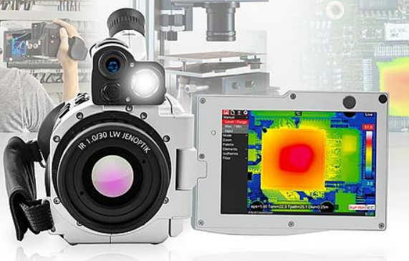
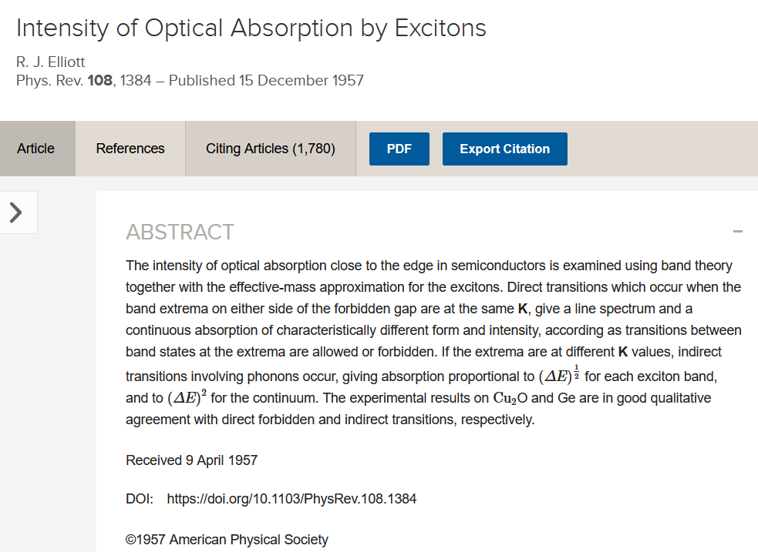

7

Slide 8
Example 1: photoluminescence in germanium
Qualitative:
Quantitative:
Roosbroeck-Shockley equation (PR 94, 1558, 1954).
Complete failure above 200 K and at RT.
Menendez, Poweleit, Tilton, PRB 101, 195204 (2020).

Slide 9
Example 2: indirect absorption in germanium
R. J. Elliott, Phys. Rev. 108, 1384 (1957).
Menendez, Lockwood, Zwinkels, Noel, PRB 98, 165207 (2018).

Slide 10
Optical constants of highly excited semiconductors
Einstein coefficients, Fermi’s Golden Rule, Elliott-Tanguy excitons
Direct gap absorption in germanium from 10 to 800 K
Optical constants of highly excited semiconductors
Direct gap absorption in InSb from 10 to 800 K
Intravalence band absorption in topological insulators (α-tin)
Optical constants of highly excited germanium (femtosecond ellipsometry at ELI Beamlines in Prague)
Conclusion and Outlook
Stefan Zollner, Fall 2023 MRS Meeting

Slide 11
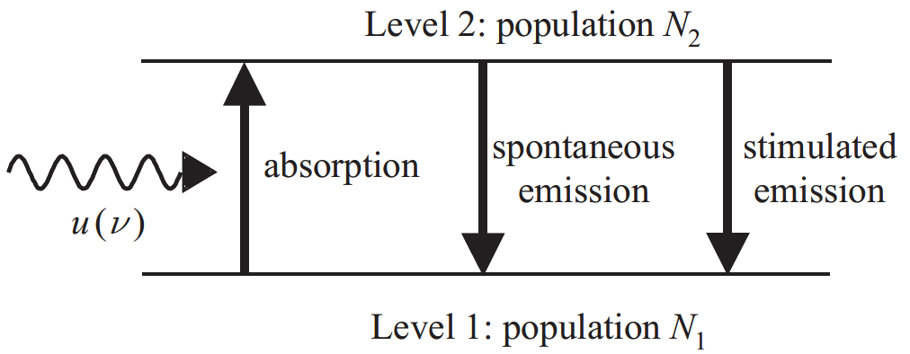

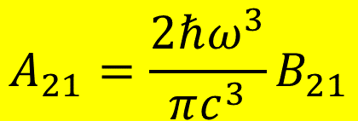

Einstein coefficients
One coefficient is sufficient:
B₁₂
A₂₁
B₂₁
$$g_{1}B_{12}=g_{2}B_{21}$$
$$A_{21}=\frac{2ℏω^{3}}{πc^{3}}B_{21}$$
In equilibrium: N₁, N₂ constant. Absorption and emission balance.
Black-body radiation
Use Fermi’s Golden Rule to calculate B₁₂
$$u\left(ℏω\right)$$
$$B_{12}N_{1}u\left(ℏω\right)=A_{21}N_{2}+B_{21}N_{2}u\left(ℏω\right)$$
Albert Einstein, Strahlungs-Emission und Absorption nach der Quantentheorie, DPG Verh. 18, 318 (1916); Phys. Z. 18, 121 (1917).

Slide 12
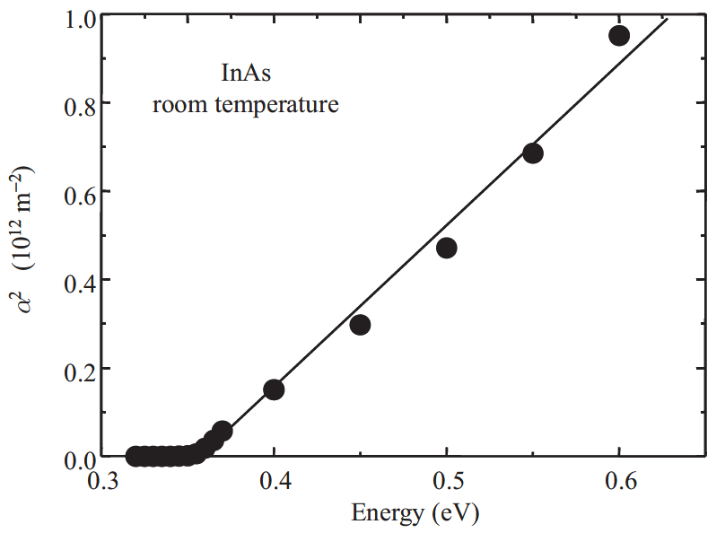
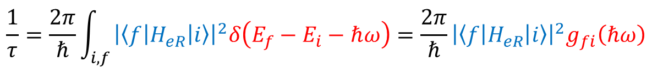
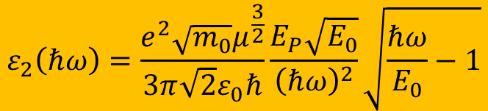
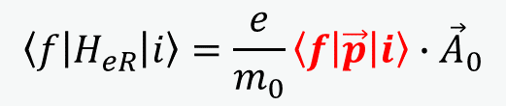
Fermi’s Golden Rule: Tauc plot
Direct band gap absorption
constant k·p matrix element
$$\frac{1}{τ}=\frac{2π}{ℏ}\int_{i,f}{{\left|\left\langle f | H_{eR} | i\right\rangle \right|}^{2}δ\left(E_{f}−E_{i}−ℏω\right)}=\frac{2π}{ℏ}{\left|\left\langle f | H_{eR} | i\right\rangle \right|}^{2}g_{fi}\left(ℏω\right)$$
Joint DOS
parabolic bands
$$\left\langle f | H_{eR} | i\right\rangle =\frac{e}{m_{0}}\left\langle f | \vec{p} | i\right\rangle ∙{\vec{A}}_{0}$$
Use k·p matrix element P: E_{P}=2P²/m₀
$$ε_{2}\left(ℏω\right)=\frac{e^{2}\sqrt{m_{0}}μ^{\frac{3}{2}}}{3π\sqrt{2}ε_{0}ℏ}\frac{E_{P}\sqrt{E_{0}}}{{\left(ℏω\right)}^{2}}\sqrt{\frac{ℏω}{E_{0}}−1}$$
Fox, Chapter 3

Slide 13
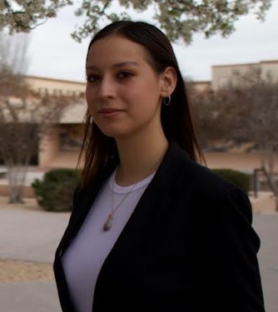
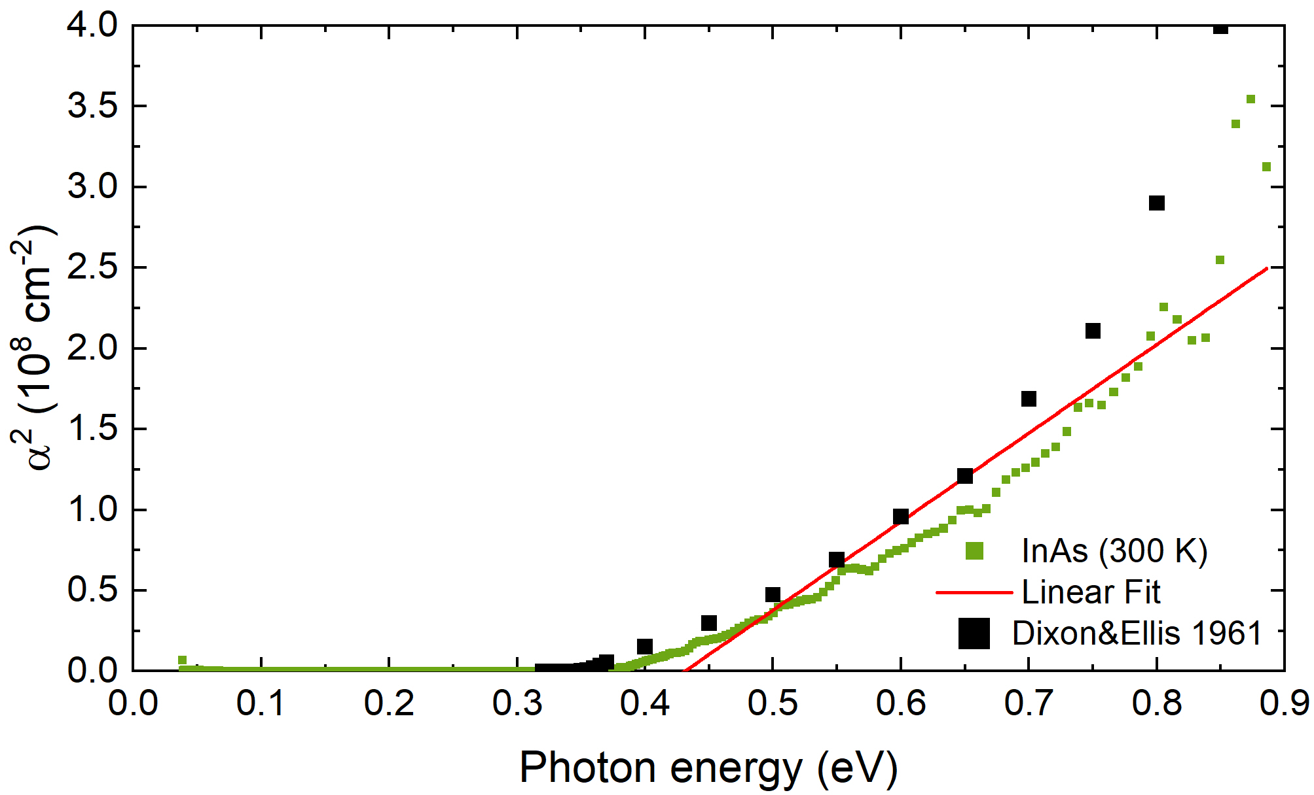

Fermi’s Golden Rule: Tauc plot
Direct band gap absorption
$$\frac{1}{τ}=\frac{2π}{ℏ}\int_{i,f}{{\left|\left\langle f | H_{eR} | i\right\rangle \right|}^{2}δ\left(E_{f}−E_{i}−ℏω\right)}=\frac{2π}{ℏ}{\left|\left\langle f | H_{eR} | i\right\rangle \right|}^{2}g_{fi}\left(ℏω\right)$$
$$\left\langle f | H_{eR} | i\right\rangle =\frac{e}{m_{0}}\left\langle f | \vec{p} | i\right\rangle ∙{\vec{A}}_{0}$$
The Tauc plot is wishful thinking.
No linear region:
Conduction band nonparabolicity
Broadening
1/E² denominator.
excitons
Melissa Rivero Arias
Use k·p matrix element P: E_{P}=2P²/m₀
$$ε_{2}\left(ℏω\right)=\frac{e^{2}\sqrt{m_{0}}μ^{\frac{3}{2}}}{3π\sqrt{2}ε_{0}ℏ}\frac{E_{P}\sqrt{E_{0}}}{{\left(ℏω\right)}^{2}}\sqrt{\frac{ℏω}{E_{0}}−1}$$

Slide 14
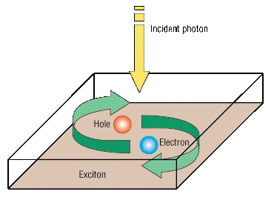
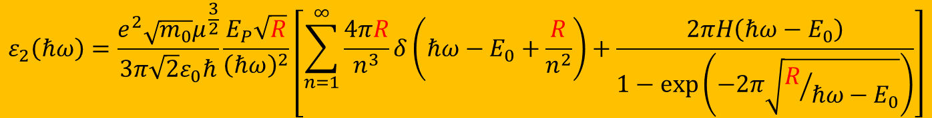
Elliott-Tanguy exciton absorption
Direct band gap absorption
Excitonic binding energy: R=R_{H}×μ_{h}/ε_{s}²
$$ε_{2}\left(ℏω\right)=\frac{e^{2}\sqrt{m_{0}}μ^{\frac{3}{2}}}{3π\sqrt{2}ε_{0}ℏ}\frac{E_{P}\sqrt{R}}{{\left(ℏω\right)}^{2}}\left[\sum_{n=1}^{∞}{\frac{4πR}{n^{3}}δ\left(ℏω−E_{0}+\frac{R}{n^{2}}\right)+\frac{2πH\left(ℏω−E_{0}\right)}{1−\text{exp}\left(−2π\sqrt{R/{ℏω−E_{0}}}\right)}}\right]$$
bound excitons
exciton continuum enhancement
Tanguy’s contributions:
Add Lorentzian broadening
Kramers-Kronig transform to get the real part.
×
R. J. Elliott, Phys. Rev. 108, 1384 (1957).
Christian Tanguy, Phys. Rev. Lett. 75, 4090 (1995) + (E)

Slide 15
Calculation of absorption spectrum from k·p theory
Can we calculate the absorption spectrum?
Yes, we can for Ge in the low carrier density limit.
It does not work for other III/V compounds.
Carola Emminger et al., JAP 131, 165701 (2022).

Slide 16
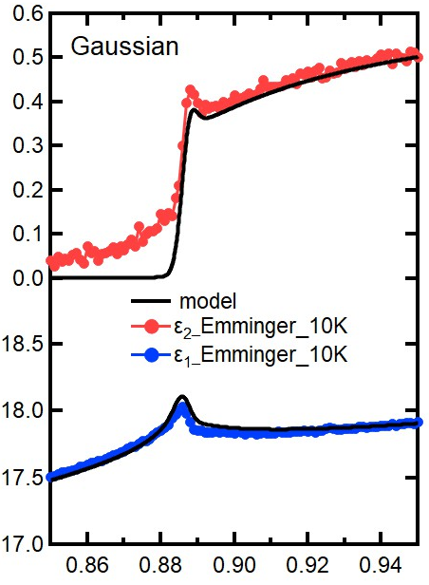
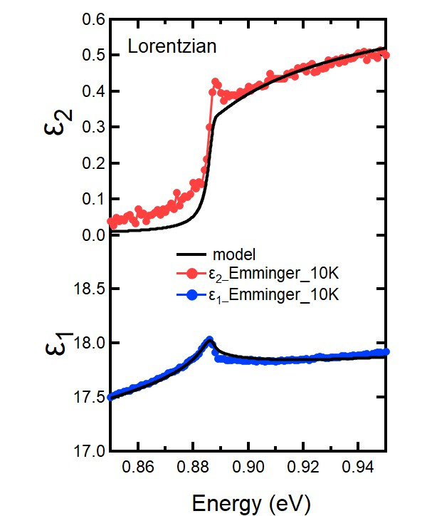
Elliott-Tanguy theory applied to Ge
Fixed parameters:
Electron and hole masses (temperature dependent)
Excitonic binding energy R
Amplitude A (derived from matrix element P)
Adjustable parameters:
Broadening Γ: 2.3 meV
Band gap E₀
Linear background A₁ and B₁ (contribution from E₁ to real part of ε)
Problems:
Broadening below the gap (band tail, oxide correction)
ε₂
Ge
Quantitative agreement
ε₁
Carola Emminger et al., JAP 131, 165701 (2022).
16

Slide 17
Elliott-Tanguy theory applied to Ge
Good agreement at low temperatures.
Model also describes second derivatives.
Potential problems:
Matrix element k-dependent
Nonparabolicity
Resonant indirect absorption
??? at high T.
Ge
Ge
Carola Emminger et al., JAP 131, 165701 (2022).
17

Slide 18
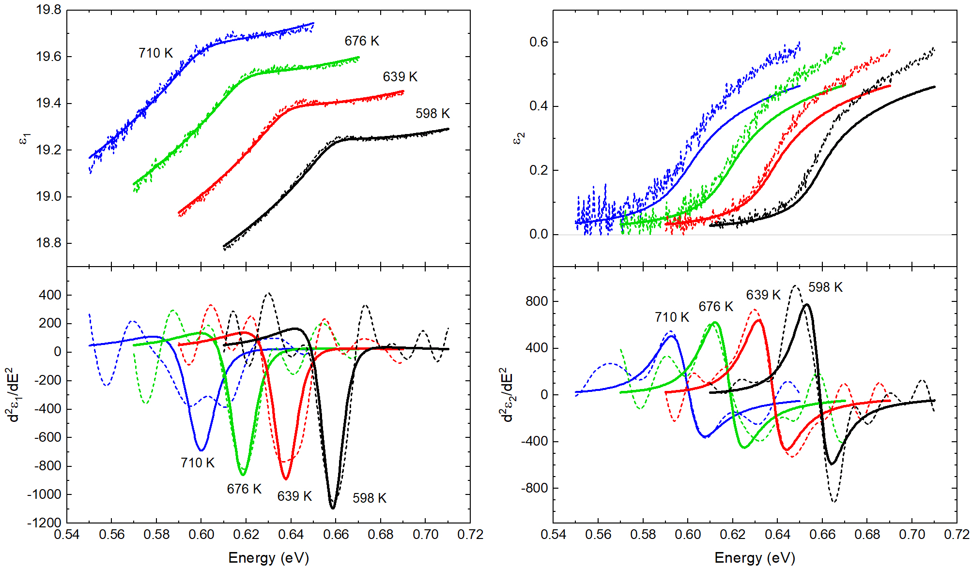
Elliott-Tanguy theory: problems for Ge at high T
Good agreement at low temperatures.
Model also describes second derivatives.
Potential problems:
Matrix element k-dependent
Nonparabolicity
Resonant indirect absorption
Temperature dependence of the effective mass.
Ge
Ge
Carola Emminger et al., JAP 131, 165701 (2022).
18

Slide 19
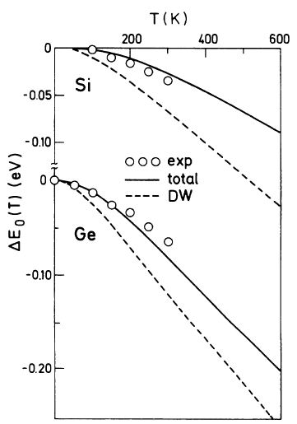
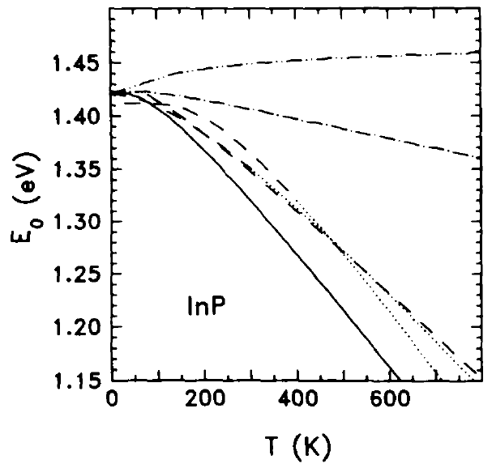
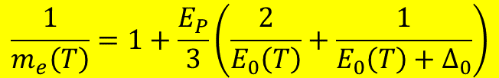
Temperature dependence of the effective mass
Effective electron mass given by k·p theory
Temperature dependence of the direct band gap has two contributions:
Thermal expansion of the lattice
Electron-phonon scattering (Debye-Waller term and self-energy)
“Mass band gap” should only include the thermal expansion.
E₀: direct band gap
k·p matrix element P: E_{P}=2P²/m₀
$$\frac{1}{m_{e}\left(T\right)}=1+\frac{E_{P}}{3}\left(\frac{2}{E_{0}\left(T\right)}+\frac{1}{E_{0}\left(T\right)+Δ_{0}}\right)$$
Self-energy
InSb
Thermal expansion
Total
Experiment
SZ, Solid State Commun. 77, 485 (1991).
P.B. Allen and M. Cardona, Phys. Rev. B 27 4760 (1983).
19

Slide 20
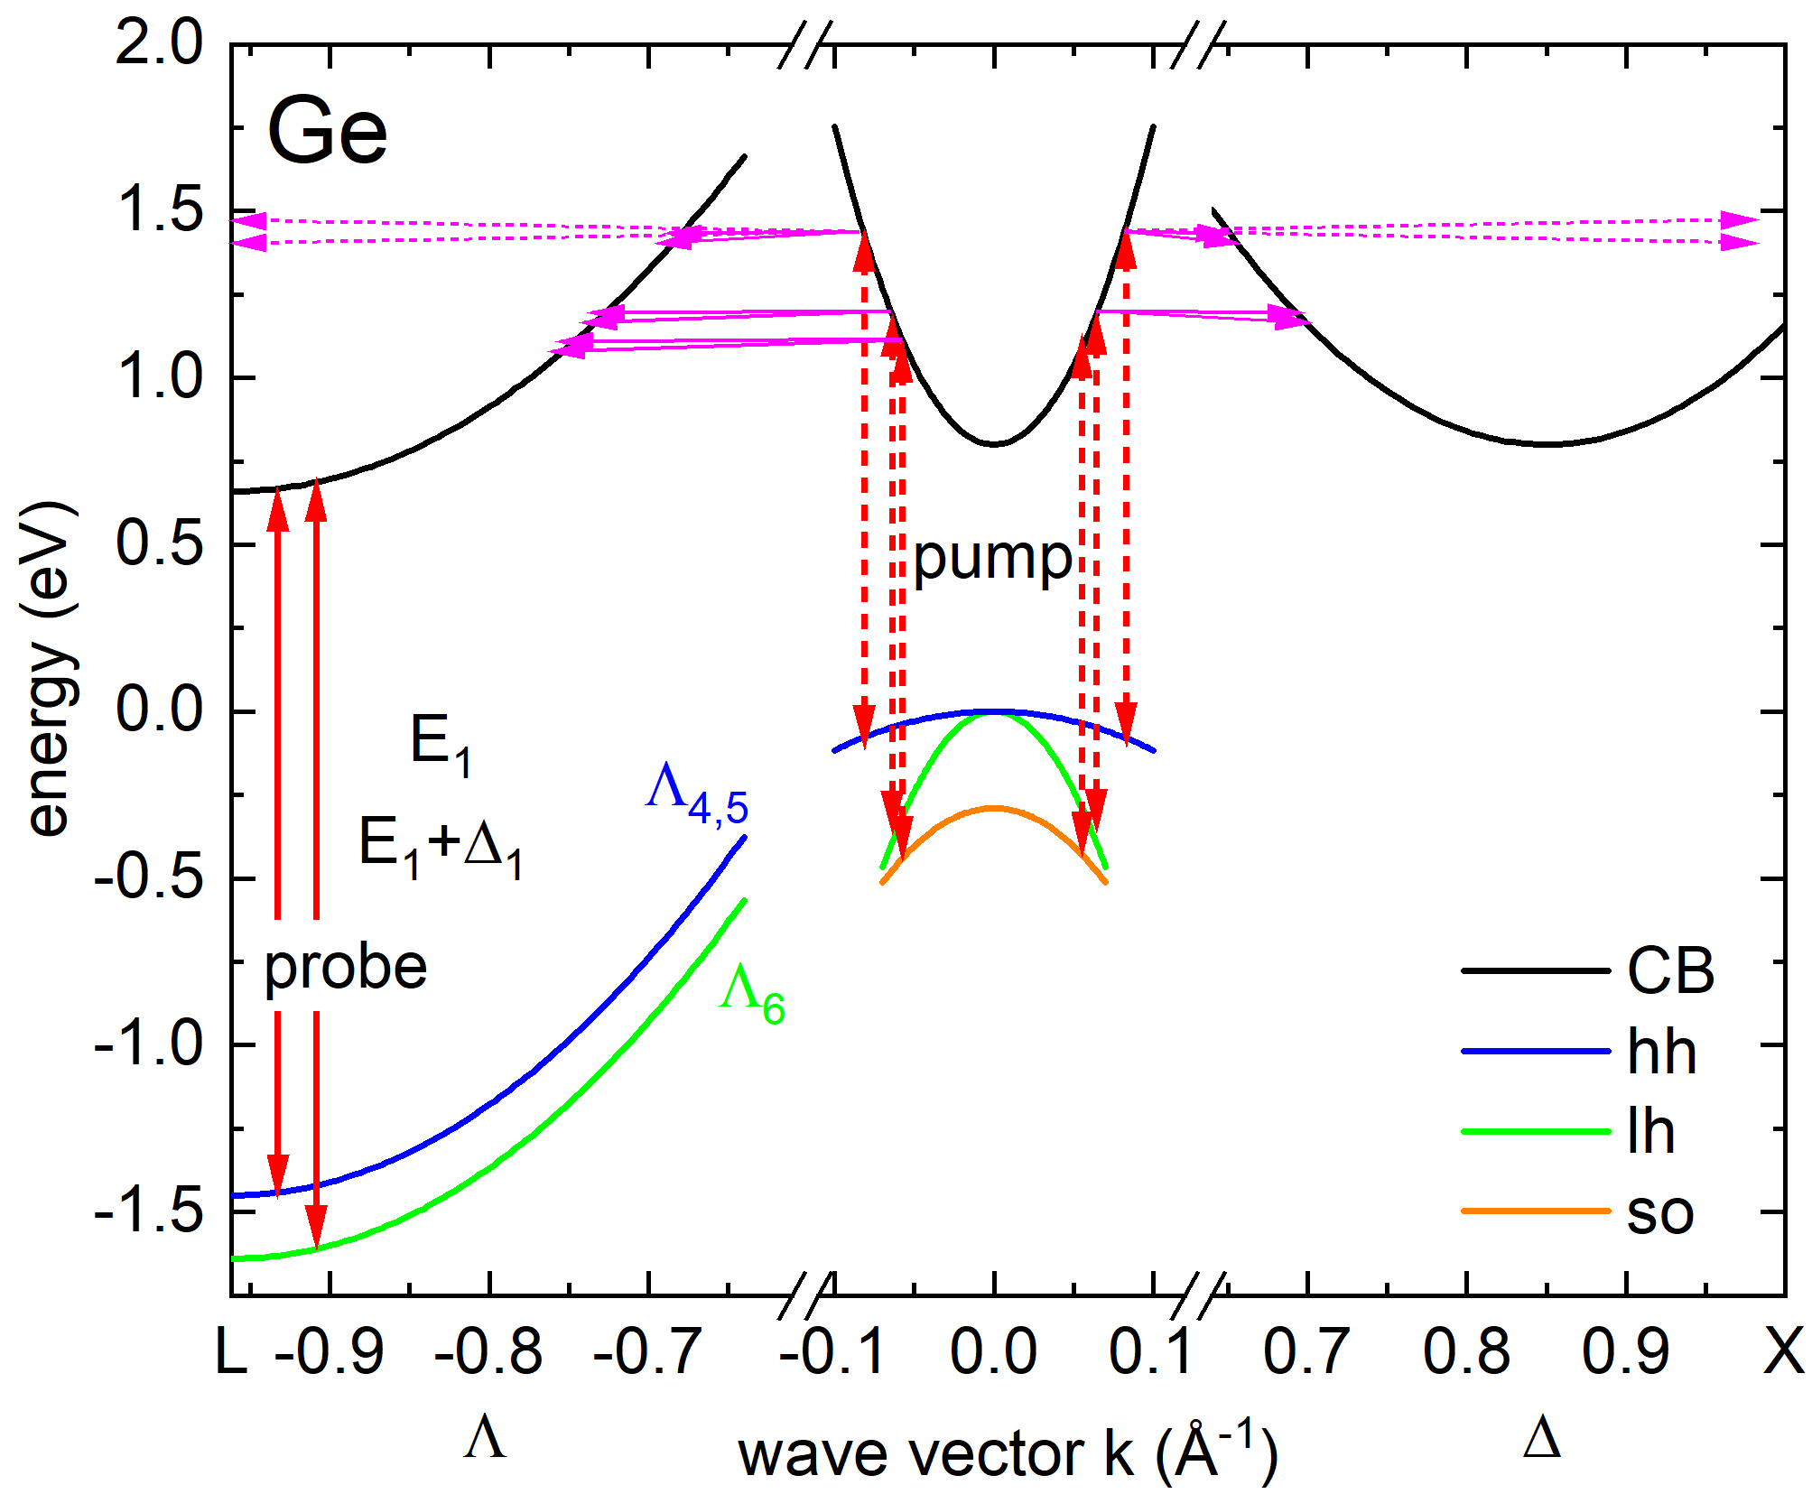
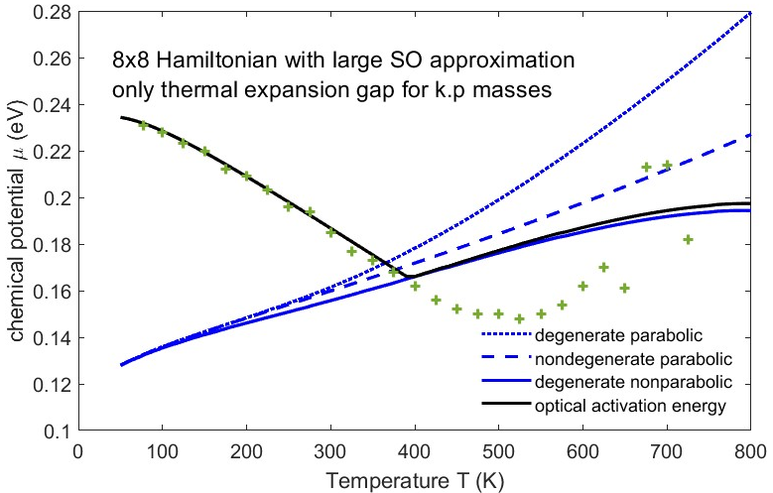
Optical Absorption at High Carrier Densities
InSb
High temperature
(thermal excitation of e-h pairs)
constant m and E₀
Intense femtosecond laser excitation (ELI Beamlines) (electrons pile at L-point)
High n-doping of Ge with P
(free electrons pile up at L-point)
Rivero, JVSTB 41, 022203 (2023)
Xu et al., PRL 118, 267402 (2017)
Espinoza, APL 115, 052105 (2019)
Stefan Zollner, Fall 2023 MRS Meeting
20

Slide 21
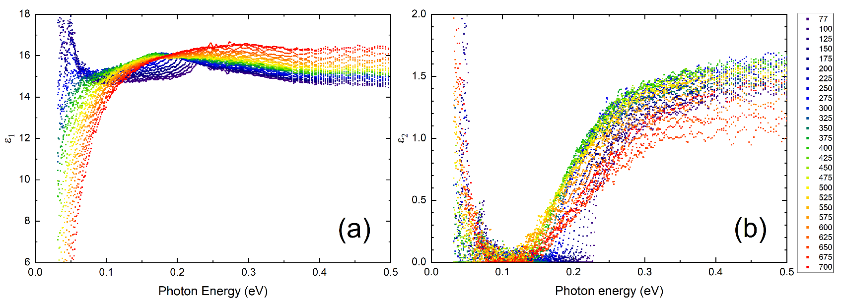
(1) Dielectric function of InSb from 80 to 800 K
InSb
InSb
Band gap changes with temperature (but only below 500 K).
Amplitude reduction at high temperatures (Pauli blocking, bleaching)
Drude response at high temperatures (thermally excited carriers).
Depolarization artifacts at long wavelengths (below 300 K).
Woollam FTIR-VASE
cryostat with CVD diamond windows
Rivero Arias, JVSTB 41, 022203 (2023)
21

Slide 22
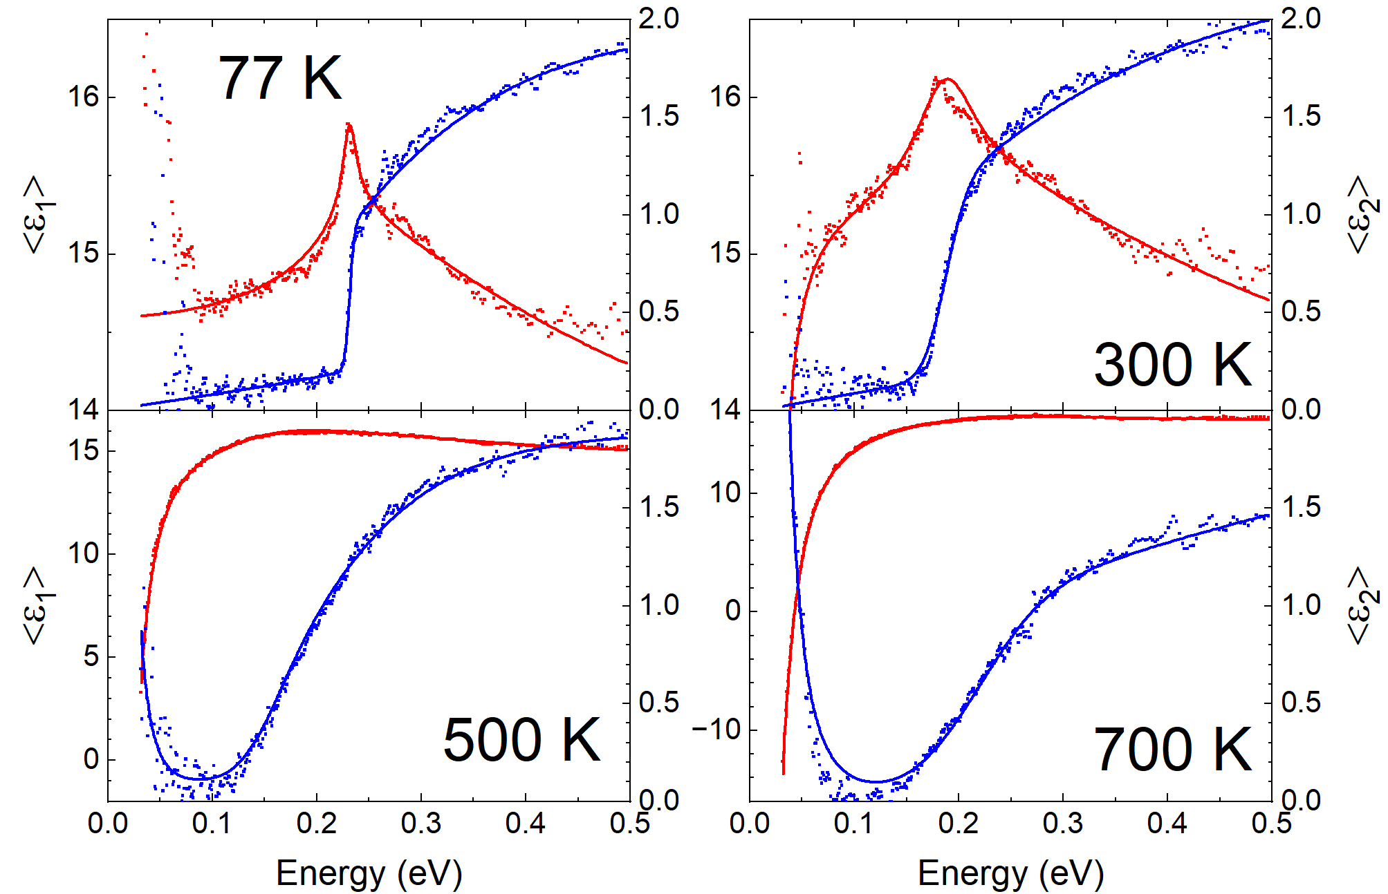
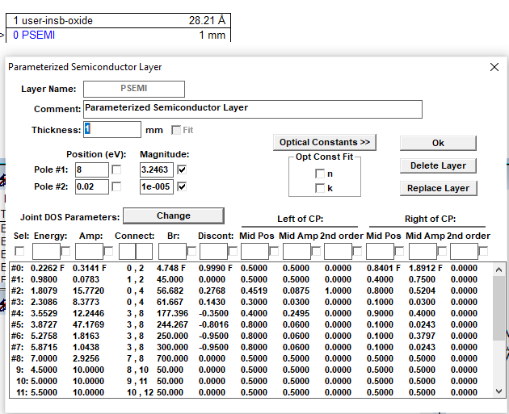
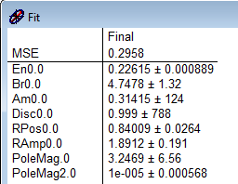
Band gap analysis for InSb
How does the band gap of InSb change with temperature?
Parametric-Semiconductor Model:
Also vary “shape parameters”.
Asymmetric peak shape poorly described.
Try Tanguy oscillator for excitonic line shape.
InSb
C. M. Herzinger, B. Johs, et al., J. Appl. Phys. 83, 3323 (1998)
Rivero Arias, JVSTB 41, 022203 (2023)
22

Slide 23
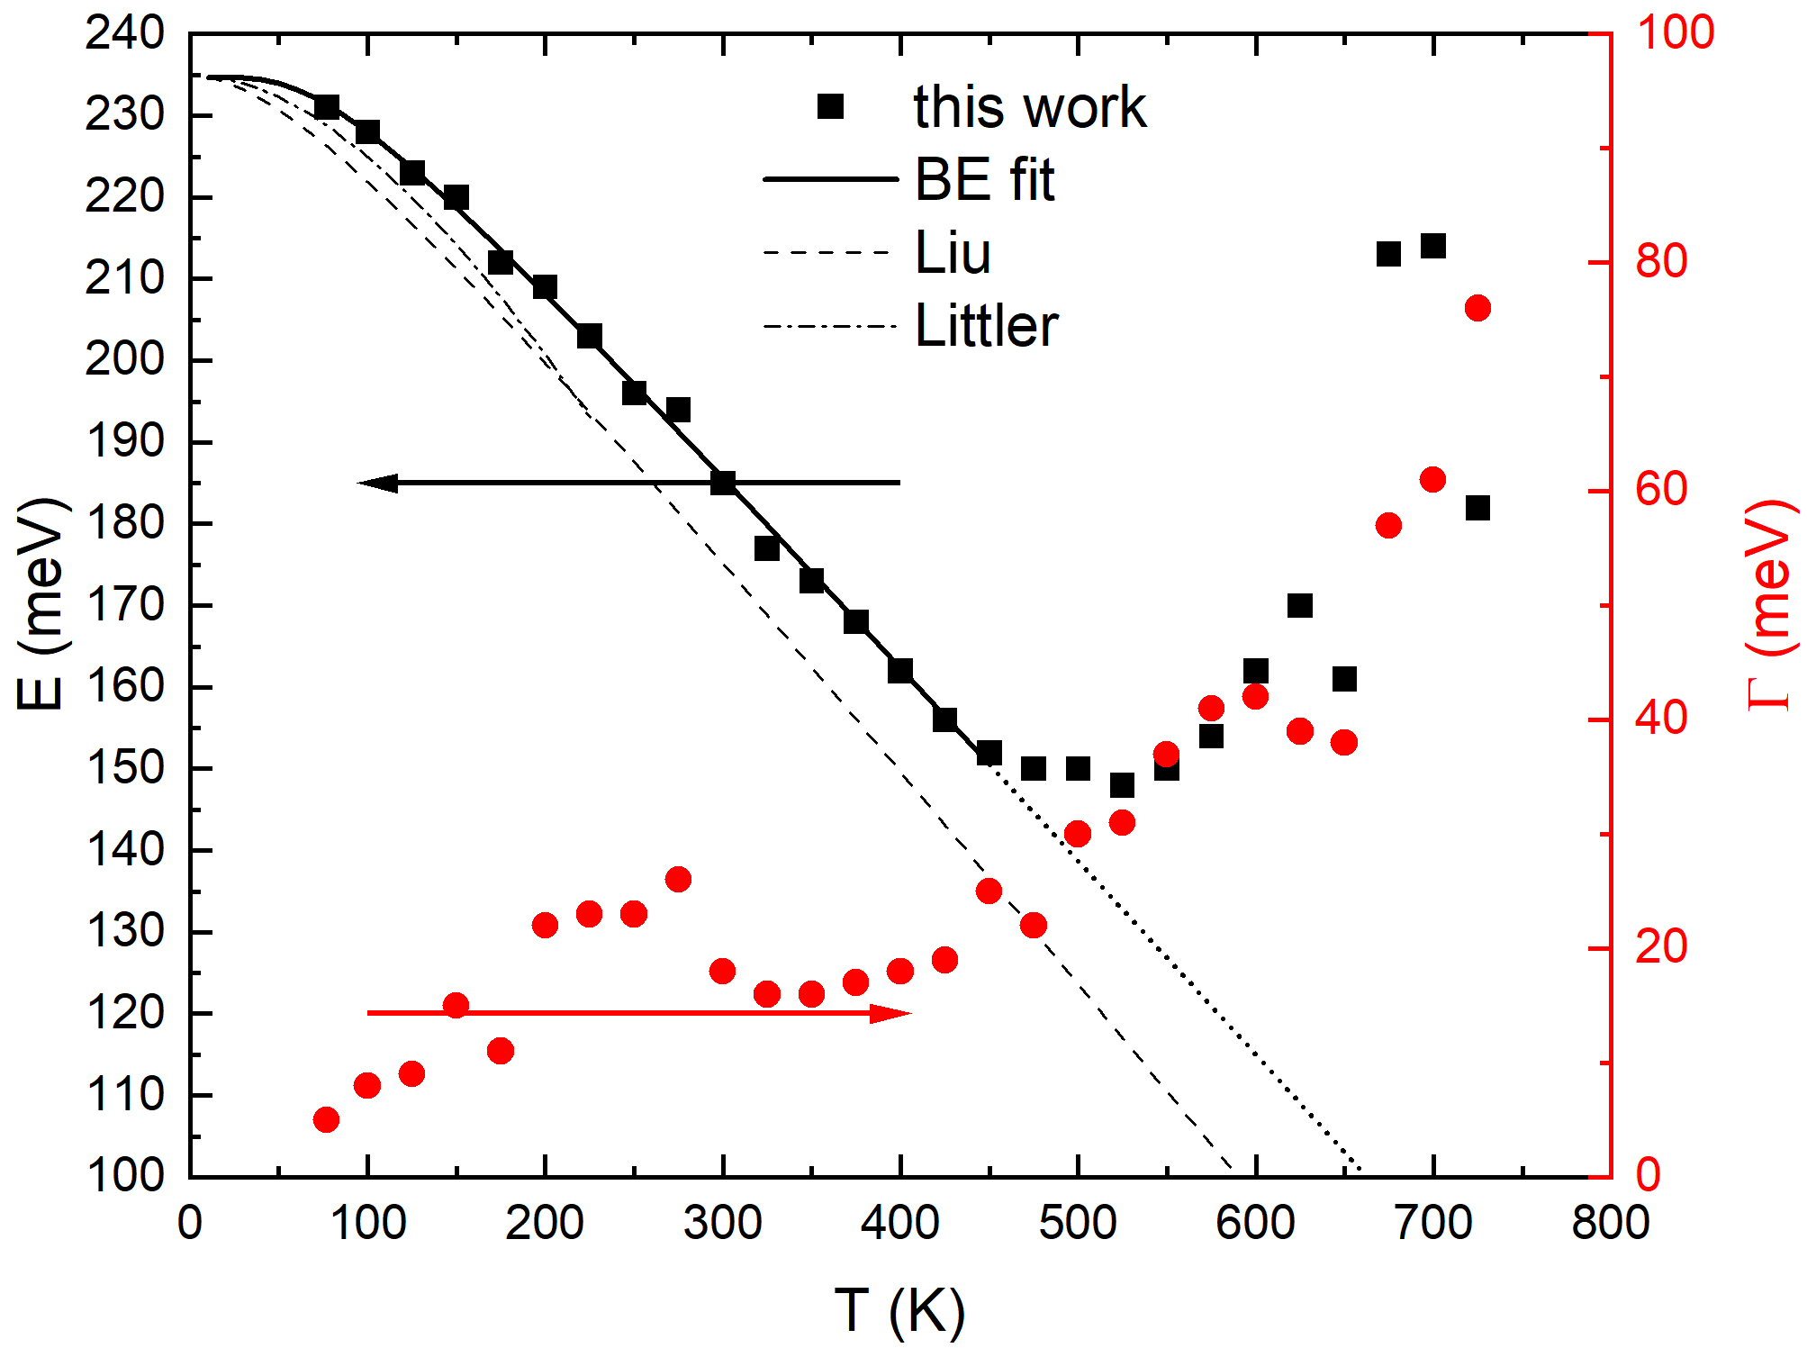
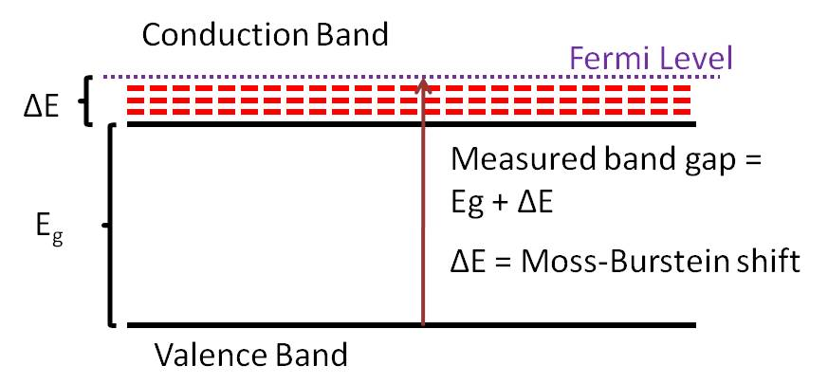
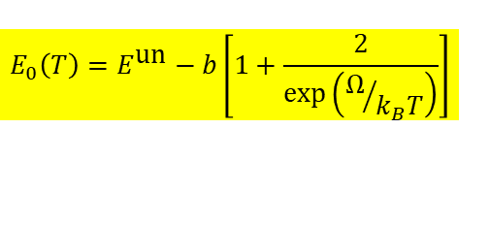
Band gap of InSb from 80 to 800 K
InSb
Bose-Einstein Model
$$E_{0}\left(T\right)=E^{\text{un}}−b\left[1+\frac{2}{\text{exp}\left(Ω/{k_{B}T}\right)}\right]$$
Band gap changes with temperature (but only below 500 K)
Described by Bose-Einstein model below 500 K: Logothetidis, PRB 31, 947 (1985).
No redshift above 500 K: Thermal Burstein-Moss shift
T.S. Moss, Proc. Phys. Soc. 67, 775 (1954).
E. Burstein, Phys. Rev. 93, 632 (1954).
23

Slide 24

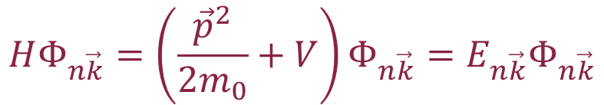

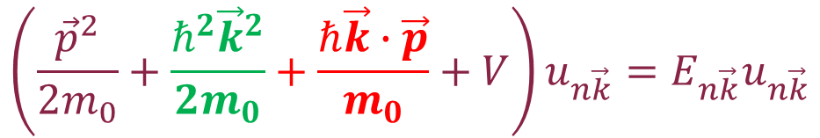
k·p theory (band structure method)
Schrödinger equation
Use Bloch’s theorem:
Solve equation for k=0.
Eliminate green free-electron term with substitution of variables (Kane 1957).
Then treat red term in perturbation theory.
Works very well for semiconductors with local V(r) potentials.
$$HΦ_{n\vec{k}}=\left(\frac{{\vec{p}}^{2}}{2m_{0}}+V\right)Φ_{n\vec{k}}=E_{n\vec{k}}Φ_{n\vec{k}}$$
$$Φ_{n\vec{k}}\left(\vec{r}\right)=e^{i\vec{k}∙\vec{r}}u_{n\vec{k}}\left(\vec{r}\right)$$
Product rule
$${\left(fg\right)}^{′′}=f^{′′}g+2f^{′}g^{′}+fg^{′′}$$
$$\left(\frac{{\vec{p}}^{2}}{2m_{0}}+\frac{ℏ^{2}{\vec{k}}^{2}}{2m_{0}}+\frac{ℏ\vec{k}∙\vec{p}}{m_{0}}+V\right)u_{n\vec{k}}=E_{n\vec{k}}u_{n\vec{k}}$$
Yu & Cardona, Fundamentals of Semiconductors
Kane, J. Phys. Chem. Solids 1, 249 (1957). Kane 1966.
Stefan Zollner, 2023, AFRL Lectures Series 3
24

Slide 25
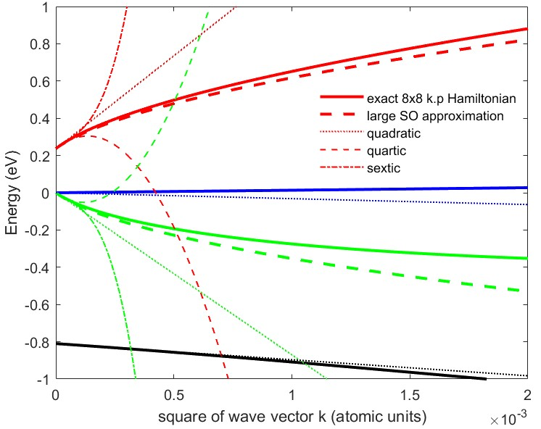
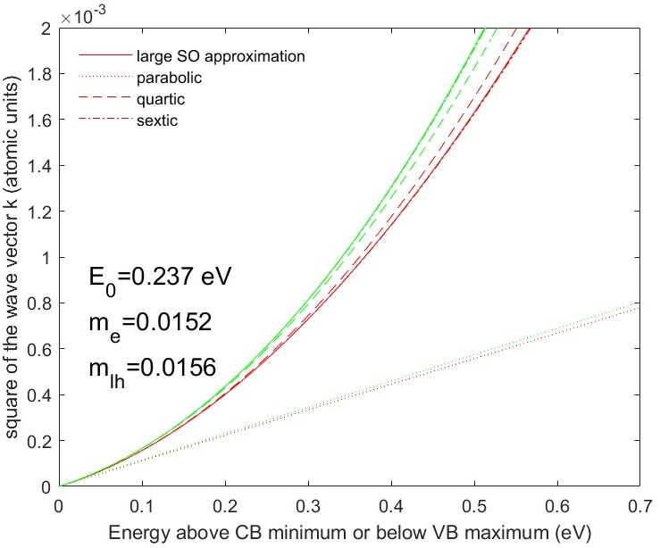



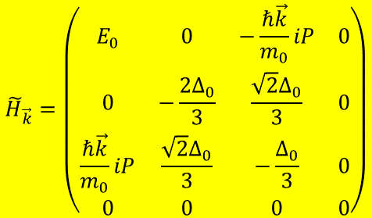
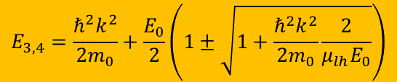
Nonparabolicity of InSb conduction band from k·p theory
Kane 8x8 k·p Hamiltonian:
$${\tilde{H}}_{\vec{k}}=\left(\begin{matrix}E_{0} & 0 & −\frac{ℏ\vec{k}}{m_{0}}iP & 0 \\ 0 & −\frac{2Δ_{0}}{3} & \frac{\sqrt{2}Δ_{0}}{3} & 0 \\ \frac{ℏ\vec{k}}{m_{0}}iP & \frac{\sqrt{2}Δ_{0}}{3} & −\frac{Δ_{0}}{3} & 0 \\ 0 & 0 & 0 & 0\end{matrix}\right)$$
Energy versus k
Cubic characteristic equation:
Density of CB states
$$\tilde{E}\left(\tilde{E}−E_{0}\right)\left(\tilde{E}+Δ_{0}\right)−\frac{ℏ^{2}k^{2}E_{P}}{2m_{0}}\left(\tilde{E}+\frac{2Δ_{0}}{3}\right)=0$$
$$\frac{ℏ^{2}k^{2}}{2m_{0}m^{∗}}=ε\left(1+αε+βε^{2}\right)$$
Large spin-orbit approximation:
$$E_{3,4}=\frac{ℏ^{2}k^{2}}{2m_{0}}+\frac{E_{0}}{2}\left(1±\sqrt{1+\frac{ℏ^{2}k^{2}}{2m_{0}}\frac{2}{μ_{lh}E_{0}}}\right)$$
$$α=\frac{{\left(1−m^{∗}\right)}^{2}}{E_{0}}$$
Kane, J. Phys. Chem. Solids 1, 249 (1957).
25

Slide 26
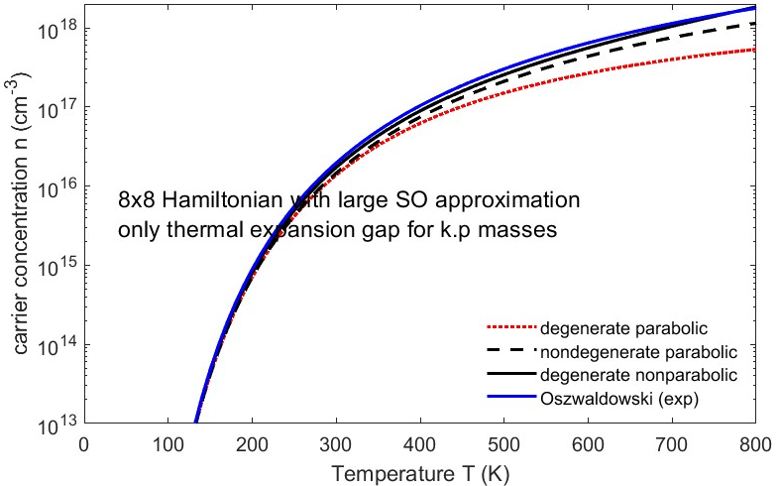
Thermal excitations of electron-hole pairs in InSb
n=2x10¹⁸ cm⁻³ at 800 K
k_{B}T=E_{g}/4 at 600 K
Fermi level above
conduction band edge above 450 K.
Thermal Burstein-Moss shift
Drude response of free carriers
Reduction of absorption coefficient
M. Rivero Arias et al., JVSTB 41, 022203 (2023).
Oswaldowski/Zimpel, J. Phys. Chem. Solids 49, 1179 (1988).
D. L. Rode, Phys. Rev. B 3, 3287 (1971).
26

Slide 27
Optical constants model: screened excitons
$$ε_{2}\left(E\right)=\frac{2πA\sqrt{R}}{E^{2}}\left\{\sum_{n=1}^{\sqrt{g}}{\frac{2R}{n}\left(\frac{1}{n^{2}}−\frac{n^{2}}{g^{2}}\right)δ\left[E−E_{0}+\frac{R}{n^{2}}{\left(1−\frac{n^{2}}{g}\right)}^{2}\right]+\frac{\text{sinh}\left(πgk\right)\text{H}\left(E−E_{0}\right)}{\text{cosh}\left(πgk\right)−\text{cosh}\left(πg\sqrt{k^{2}−\frac{4}{g}}\right)}}\right\}\left[f_{h}\left(E\right)−f_{e}\left(E\right)\right]$$
Absorption by screened excitons (Hulthen potential)
Degenerate Fermi-Dirac statistics to calculate f_{h} and f_{e}.
Numerical Kramers-Kronig transform (need occupation factors)
Two terms for light and heavy excitons
Non-parabolicity and temperature-dependent mass included from k.p theory
k-dependent matrix element P.
Screening parameter g=12/π²a_{R}k_{TF} (large: no screening) Sommerfeld enhancement persists well above the Mott density.
Only two free parameters: Band gap E₀ and broadening Γ
Amplitude A and exciton binding energy R from k.p theory and effective masses
Christian Tanguy, Phys. Rev. B 60, 10660 (1999).
Jose Menendez, Phys. Rev. B 101, 195204 (2020).
Carola Emminger, J. Appl. Phys. 131, 165701 (2022).

Slide 28
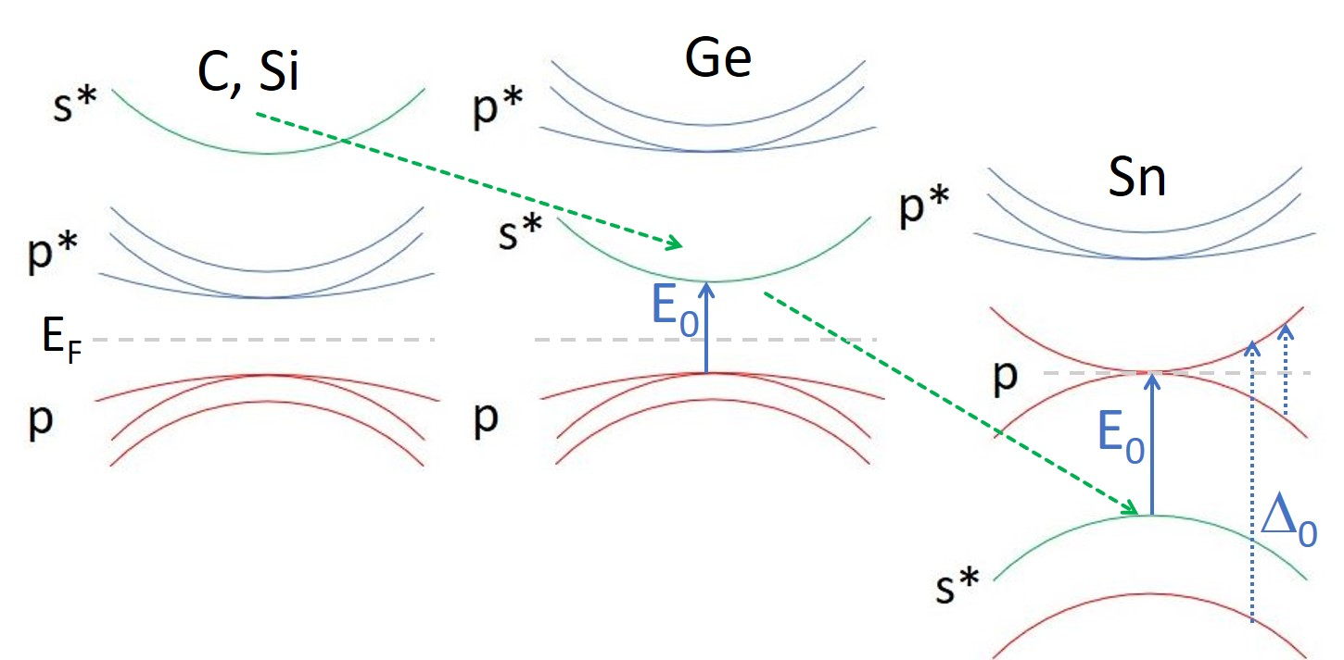
Relativistic Effects: Darwin Shift: C, Si, Ge, Sn
j=3/2
The s* band moves down, as the elements get heavier.
In α-tin, the s* band moves into the p-band manifold, between the j=1/2 and j=3/2 states.
This makes α-tin an (inverted) gapless semiconductor.
p
j=1/2

Slide 29
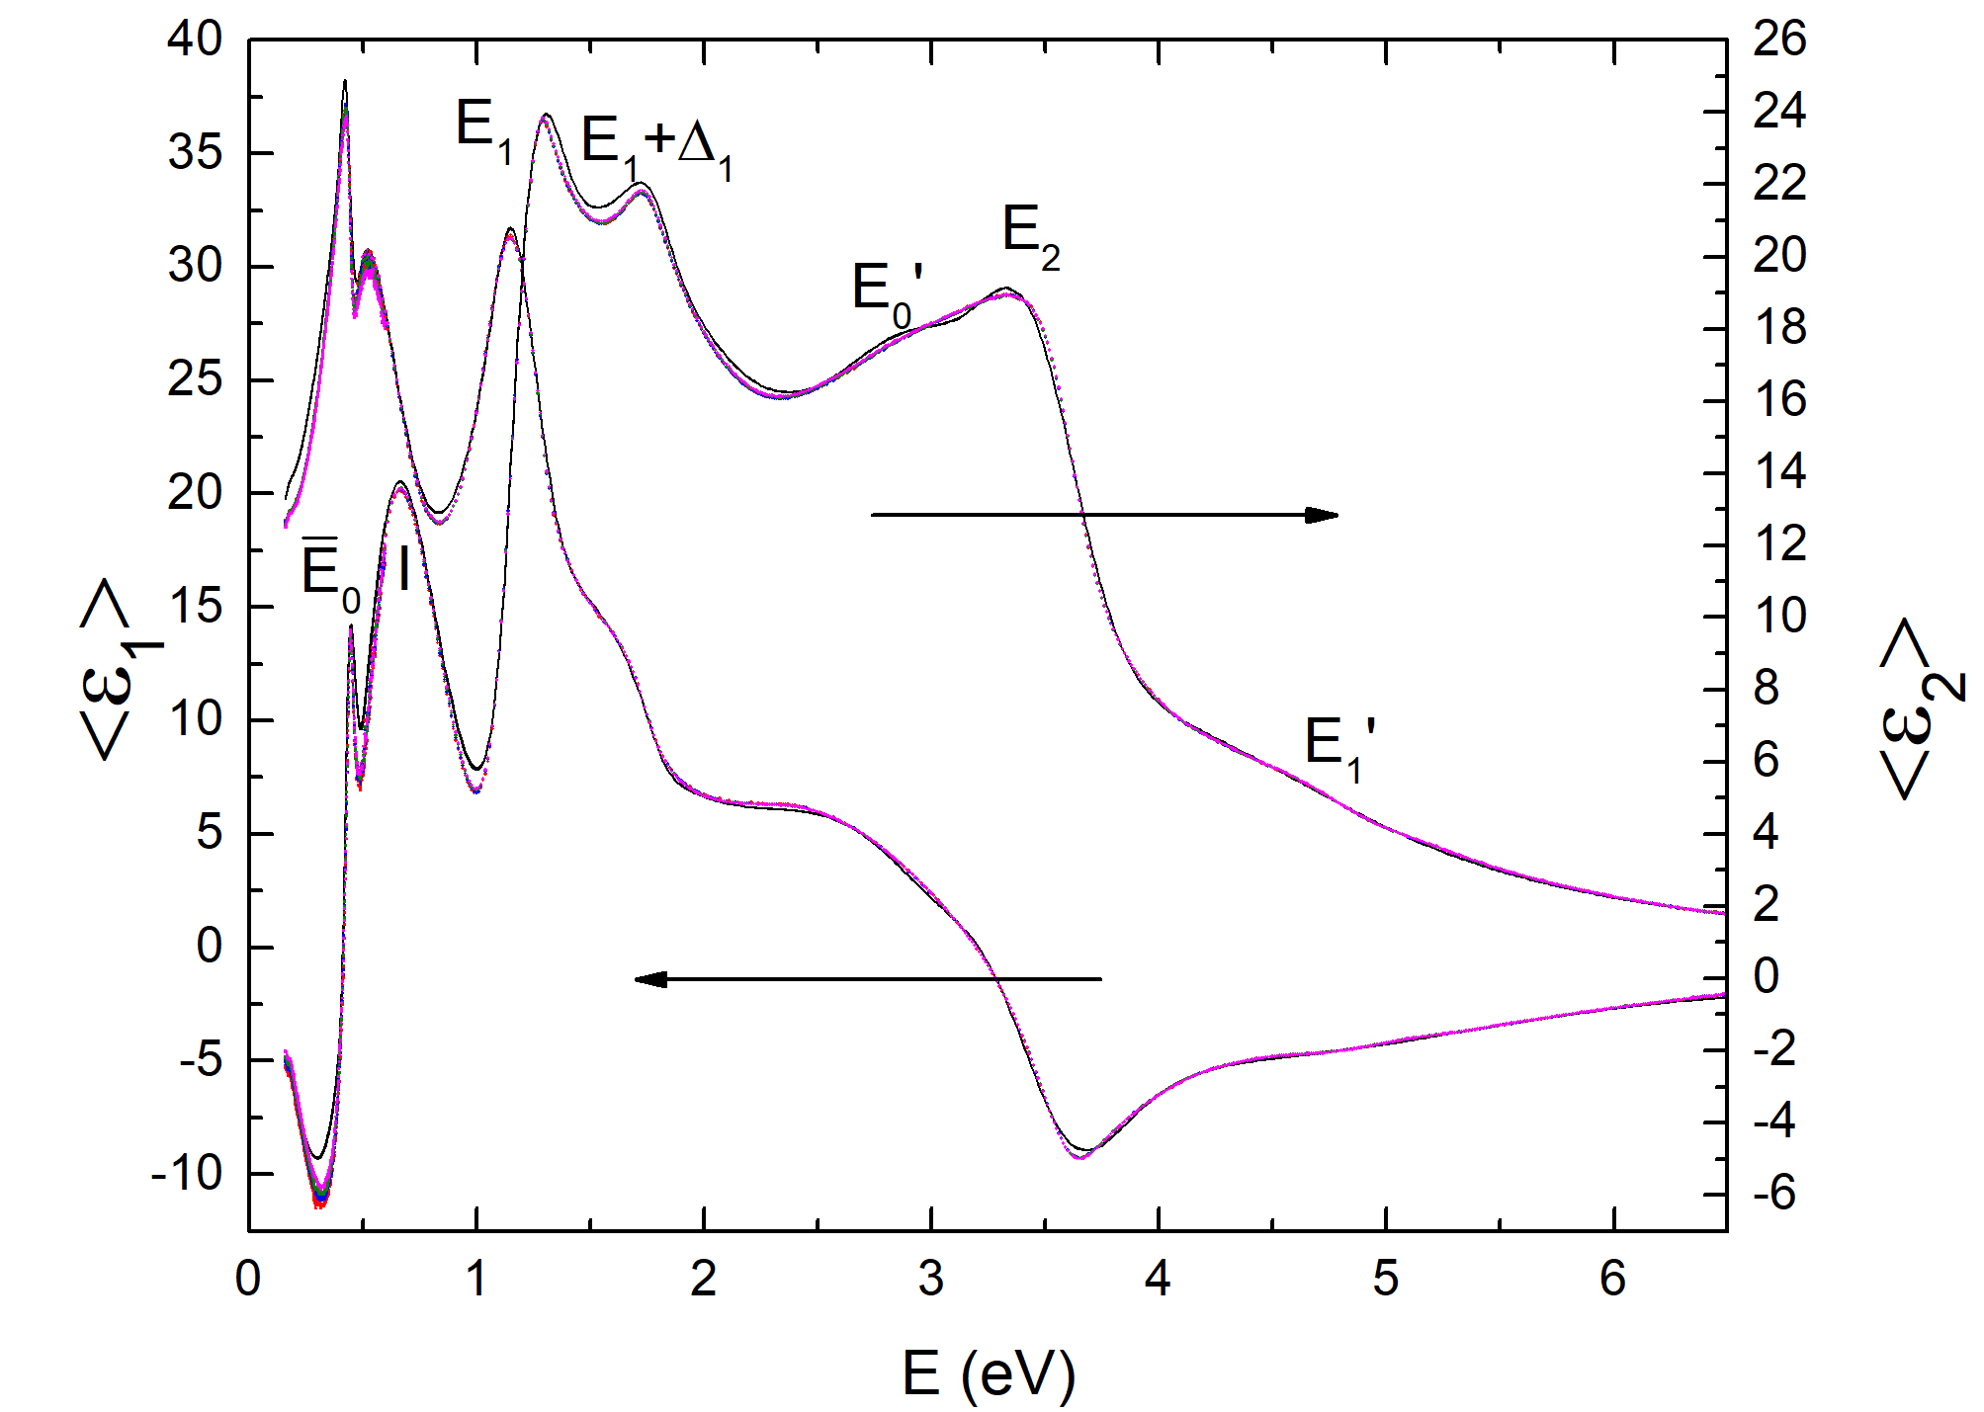
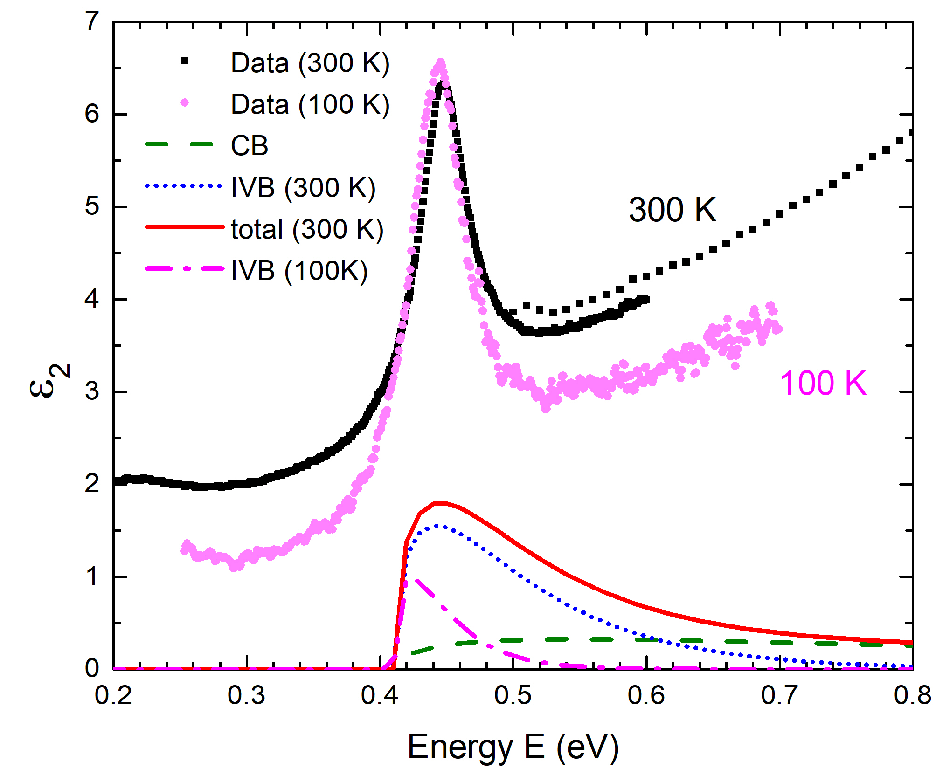
Intravalence band absorption in gapless topological insulators (α-tin)
looks like an exciton
R.A. Carrasco, APL 113, 232104 (2018).
All gapless (inverted) semiconductors should have this peak.
Theory with same model as Ge IVB (Kaiser 1953, Kahn 1955).

Slide 30
Excitonic intravalence band absorption in gapless topological insulators (α-tin)
Interband transitions without excitonic effects.
Screened excitons included, parabolic bands.
Agreement with experiment is not good.

Slide 31
(2) Highly doped Ge (n-type, with phosphorus)
Electrons pile up at the L-point.
Transitions in red region blocked.
Phase filling singularity
No good model for
2D exciton screening
Phase shift
Xu et al., PRL 118, 267402 (2017)
Xu et al., JAP 125, 085704 (2019)
31

Slide 32
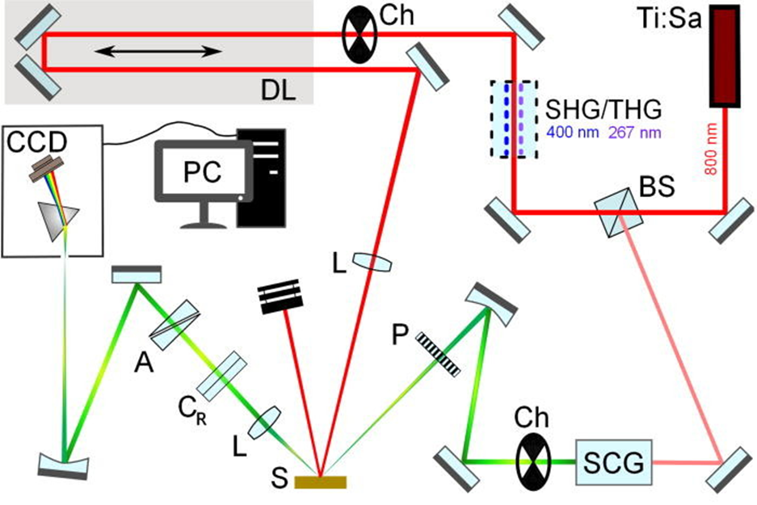
(3) Set-up: Femtosecond pump-probe ellipsometry
Ch: Chopper (500 Hz, 250 Hz)
A: Analyzer
P: Polarizer
C_{R}: Rotating compensator
L: Lens
S: Sample
DL: Delay Line (~6.67 ns pump-probe delay and 3 fs resolution)
BS: Beam splitter
SHG/THG: 2nd/3rd harmonic generation
SCG: Super-continuum generation
CCD: Charge-coupled device detector
Espinoza et al., APL 115, 052105 (2019).
32

Slide 33
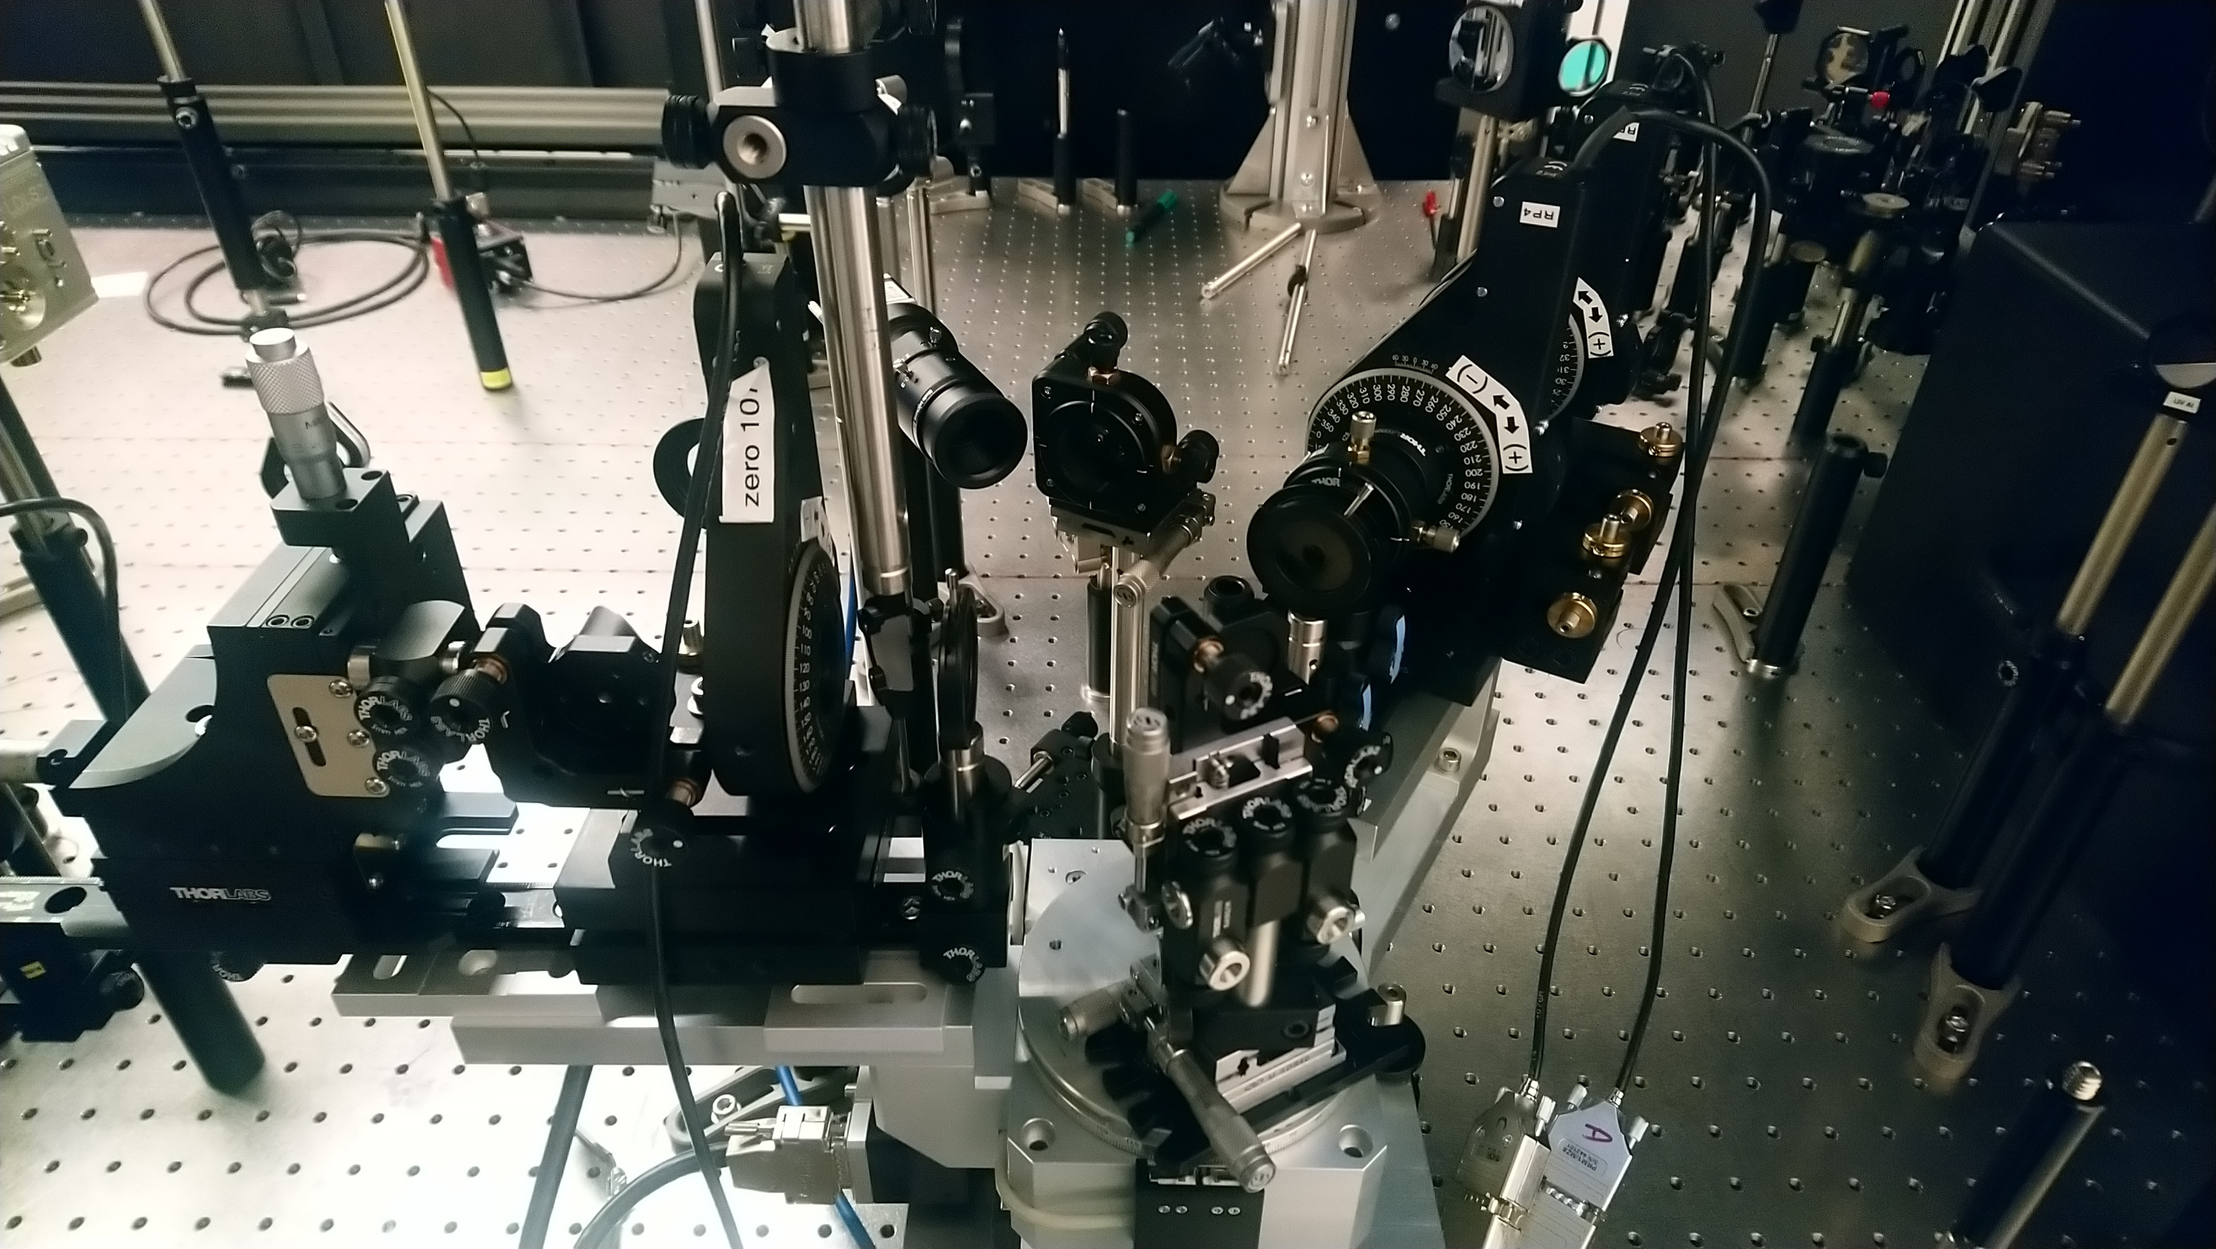
Set-up: Femtosecond pump-probe ellipsometry
Rotating compensator ellipsometer:
Compensator was rotated in steps of 10º for a total of 55-65 angles.
Probe beam of 350-750 nm at 60º incidence angle.
P-polarized pump beam: 35 fs pulses of 800 nm wavelength at 1 kHz repetition rate.
Delay time from -10 to 50 ps.
Time resolution of about 500 fs.
Pump Beam
Analyzer
Compensator
Polarizer
Sample Stage
Espinoza et al., APL 115, 052105 (2019).
33

Slide 34


ELI Beamlines: ELI ERIC. Dolní Břežany (near Prague)
Third user call was due October 16th, 2023: https://up.eli-laser.eu/
Contact Shirly Espinoza: shirly.espinoza@eli-beams.eu
Semiconductors
Metal oxides
Bulk and thin films
Etc.
34

Slide 35

Ultrafast processes in photoexcited Germanium
1.55 eV pump beam creates N=10²¹ cm⁻³ electron-hole pairs near Γ-point. 9 mW power.
Heavy, light, split-off bands.
Ignore diffusion (for 1.55 eV pump).
Ignore Auger recombination.
Thermalization: Fermi-Dirac distribution
Intervalley scattering: Γ→X→L
Electrons accumulate at L.
Holes remain near Γ.
Electrons at L block E₁ and E₁+Δ₁ transitions (Fermi-level singularity)
Bandgap renormalization: redshift expected
Lattice heating (25 K): redshift
Exciton screening
E_{F}
Espinoza et al., APL 115, 052105 (2019).

Slide 36

Ultrafast processes in photoexcited Germanium
1.55 eV pump beam creates N=4x10²¹ cm⁻³ electron-hole pairs near Γ-point.
The E₁ and E₁+Δ₁ peaks decrease within the first two picoseconds and then recover: Band filling, excitonic screening followed by diffusion, Auger, and radiative recombination.
Maybe a Fermi level singularity near 2.6 eV.
Detailed modeling is required (Tanguy 2-D excitonic line shapes, including Fermi level singularity.)
Carlos Armenta, February 2023, unpublished.

Slide 37

Ultrafast processes in photoexcited Germanium
1.55 eV pump beam creates N=4x10²¹ cm⁻³ electron-hole pairs near Γ-point.
The E₁ and E₁+Δ₁ peaks decrease within the first two picoseconds and then recover. (Band filling, excitonic screening followed by diffusion, Auger, and radiative recombination)
Maybe a Fermi level singularity near 2.6 eV.
It looks like there is a redshift, but we need a line shape analysis with derivatives.
Carlos Armenta, February 2023, unpublished.

Slide 38


Derivative analysis: critical point parameters
Extended Gauss filter
Filter width determined from Fourier coefficients
Carlos Armenta, February 2023, unpublished.
Emminger el al., PSS RRL 2022, 2200058.
Le, JVST B 37, 052903 (2019);

Slide 39




Coherent acoustic phonon oscillations
~5 meV
~19.5 meV
redshift
Fermi singularity or strain ???
blueshift
$$T≈\frac{λ}{2vn}=9−11 \text{ps}$$
Carlos Armenta, February 2023, unpublished.
Emminger el al., PSS RRL 2022, 2200058.

Slide 40



Critical point parameters for E₁ and E₁+Δ₁
~5 meV
Phase shift
~19.5 meV
No red shift: phase angle changes. Where is BGR?
Carlos Armenta, February 2023, unpublished.
Emminger el al., PSS RRL 2022, 2200058.

Slide 41


Thickness dependence of excitonic absorption
ZnO on Si with different thicknesses.
This might be an electric field effect.
(Samarasingha, Sudeshna Chattopadhyay, SZ, JVSTB 2020)
Field ionization
Fox, Chapter 4

Slide 42
Conclusions
Quantitative modeling of low-density optical processes is possible with basic physics and matrix elements from k.p theory:
Photoluminescence in Ge
Indirect gap absorption in Ge
Direct gap absorption in Ge at low T
More work is needed at high temperatures and for materials other than Ge.
High carrier excitations:
High electron doping density in Ge
Thermal excitation of electron-hole pairs in InSb and α-tin.
Femtosecond laser generation of electron-hole pairs in Ge (ELI Beamlines)
Experimental data and qualitative explanations exist
We need more experiments and more detailed theory and simulations.
Notes:
Birstein-Moss shift

Slide 43
Thank you! Questions? Many students contributed to this project.

