Slide 1



Impact of Stress and Strain on Optical Spectra of Semiconductors
FA9550-20-1-0135
W911NF-2210130
Stefan Zollner
Department of Physics
New Mexico State University
Las Cruces, NM, USA
Email: zollner@nmsu.edu. WWW: http://femto.nmsu.edu.
Ask me about MS/Ph.D. student positions at NMSU..

Slide 2
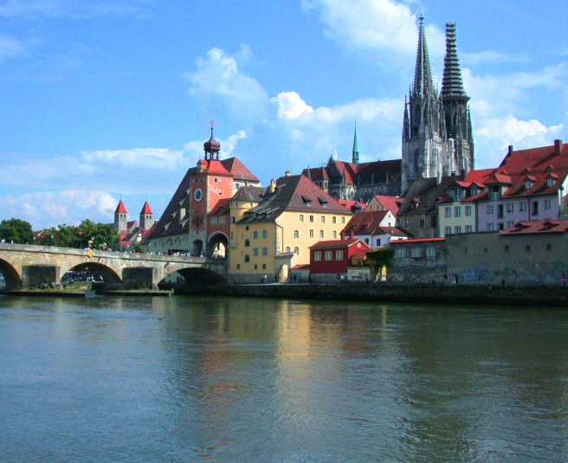



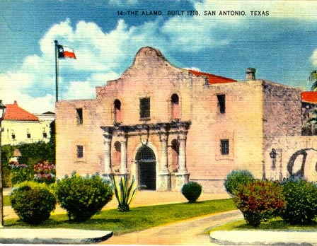
Biography
Motorola (Mesa, Tempe)
Arizona, 1997-2005
Regensburg/Stuttgart
Germany
Freescale, IBM
New York, 91-92;07-10
Las Cruces, NM
Since 2010
Motorola, Freescale
Texas, 2005-2007

Slide 3


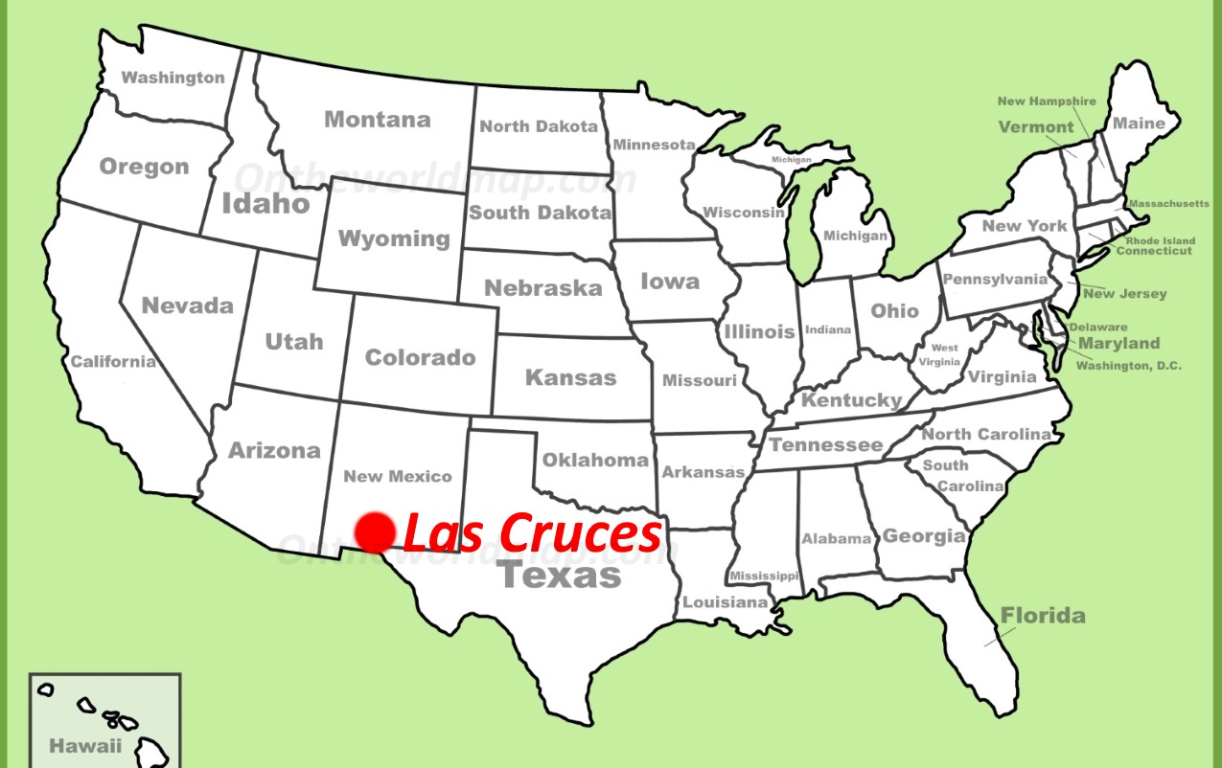

Where is Las Cruces, NM ???
White Sands NP

Slide 4
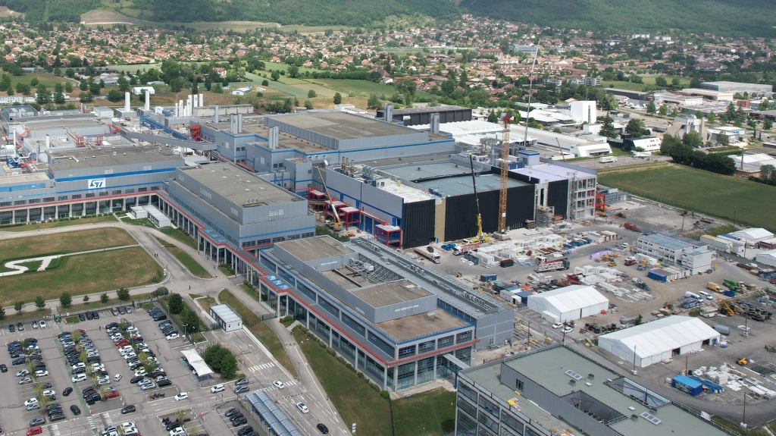



Finally in Grenoble
STM fab in Crolles
Dès 1972, une collaboration est engagée entre le SNCI et le Max-Plank-Institut für Festkörperforschung (MPI-FKF) de Stuttgart (avec Dransfeld). La puissance est portée à 10 MW en 1974, ce qui permet d’atteindre en 1982 des champs de 25T dans un diamètre de 50 mm, avec les premières polyhélices construites par Hans Schneider-Muntau. C’est dans les champs intenses de Grenoble que Klaus von Klitzing découvre l’effet Hall quantique entier dans la nuit du 4 au 5 février 1980, qui lui vaut le prix Nobel de physique en 1985.
Dr. Maria Spies
Universite Grenoble Alpes
Now a physics postdoc in Pisa.

Slide 5
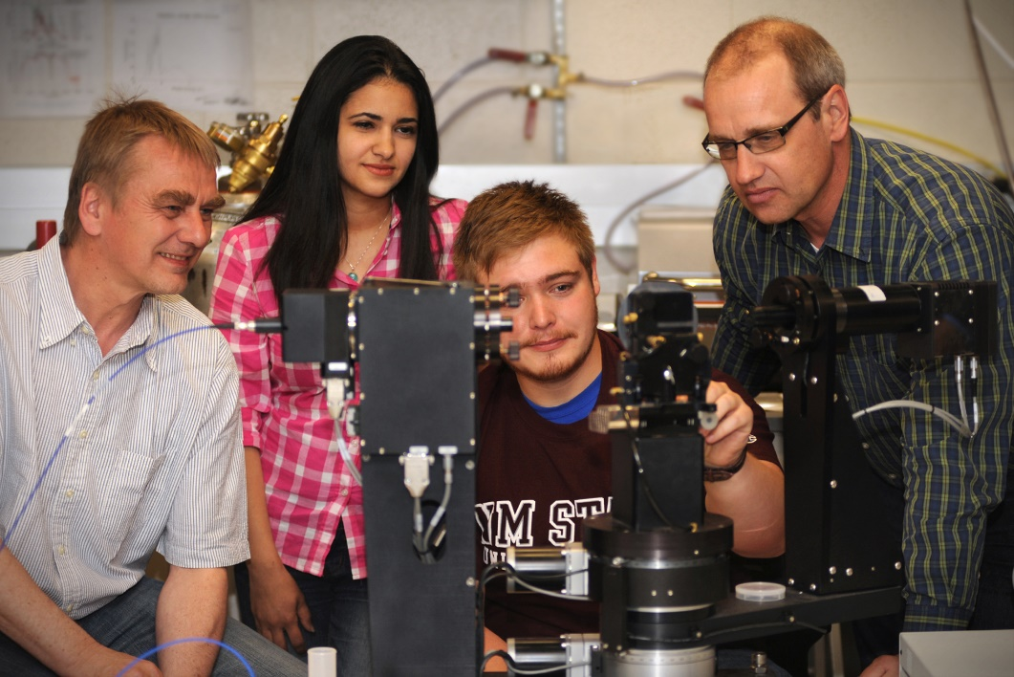
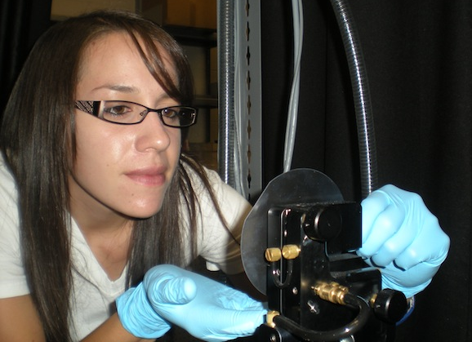
Outline: tutorial on stress and strain
Hooke’s Law
Stress and strain tensors
Elasticity and compliance tensors
Examples of stress along one, two, and three directions
Strain measurements using high-resolution x-ray diffraction
Impact of strain on phonon energies (Raman spectra)
Impact of strain on band energies with CMOS applications
Impact of strain on optical spectra of semiconductors
Example: Pseudomorphic Ge-Sn alloy layer on GaAs
Stefan Zollner, 2023, Grenoble

Slide 6
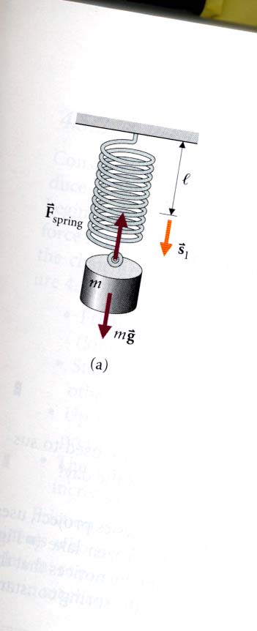


Hooke’s Law
$$F=mg=ks_{l}$$
In one dimension, the stress is the force (measured in N).
The strain is the relative length change (dimensionless).
k is the spring constant (elasticity constant).
Let’s rewrite this:
r Length of unstretched spring (m)
r’ Length of stretched spring (m)
u=r’-r Displacement of spring (m)
ε=u/r Strain (relative displacement), dimensionless
c=kr Elasticity constant (N)
F=cε Hooke’s Law in one dimension
$$F=cε$$
Stefan Zollner, 2023, Grenoble
Young & Freedman, University Physics.

Slide 7
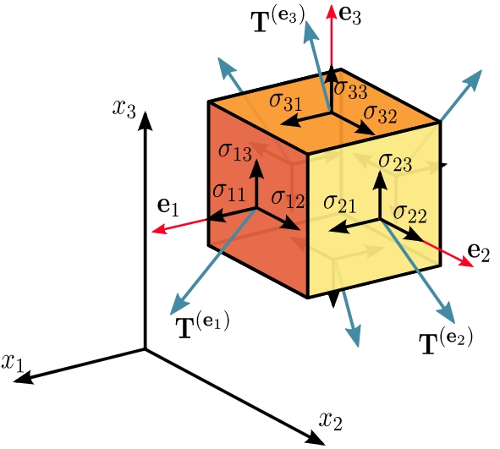
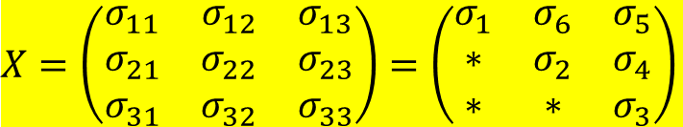
Stress tensor
Stress defined as force per unit area.
Measured in units of MPa or GPa.
Sum of all forces (net force) must be zero.
Forces show inversion symmetry at opposite faces of the cell.
Net torque must be zero: Stress tensor symmetric.
$X=\left(\begin{matrix}σ_{11} & σ_{12} & σ_{13} \\ σ_{21} & σ_{22} & σ_{23} \\ σ_{31} & σ_{32} & σ_{33}\end{matrix}\right)$ $=\left(\begin{matrix}σ_{1} & σ_{6} & σ_{5} \\ ∗ & σ_{2} & σ_{4} \\ ∗ & ∗ & σ_{3}\end{matrix}\right)$
Landau-Lifshitz, Vol. 7, Elasticity Theory.
Wikipedia

Slide 8
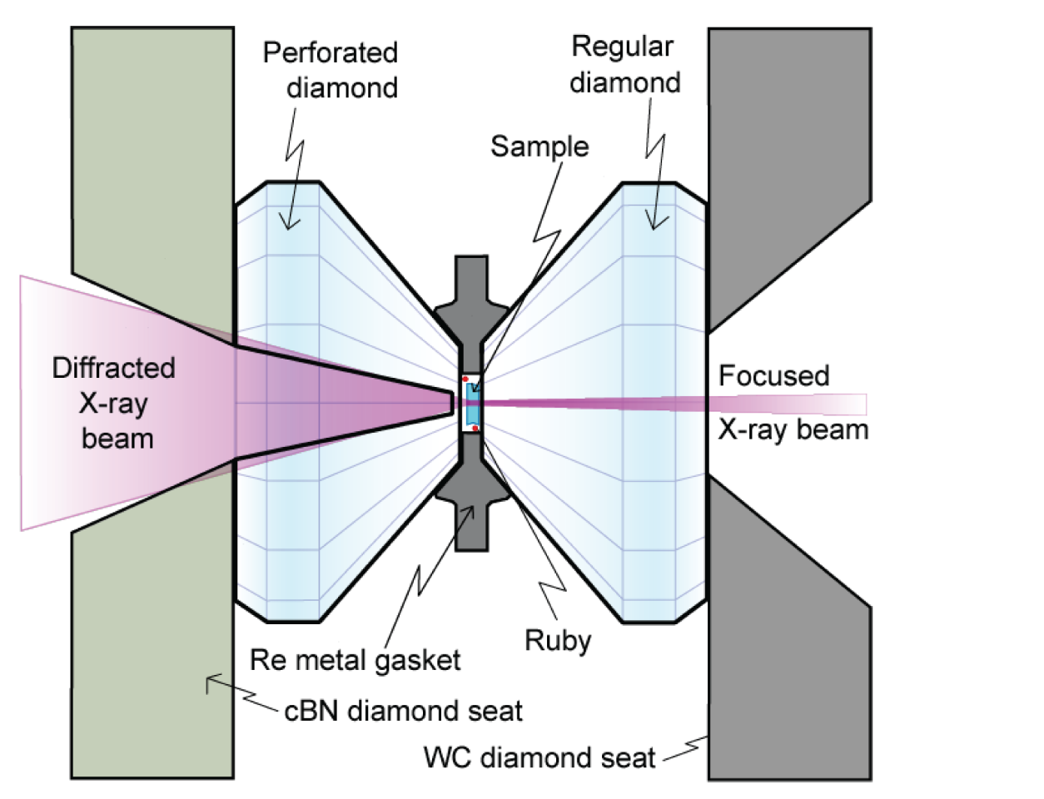
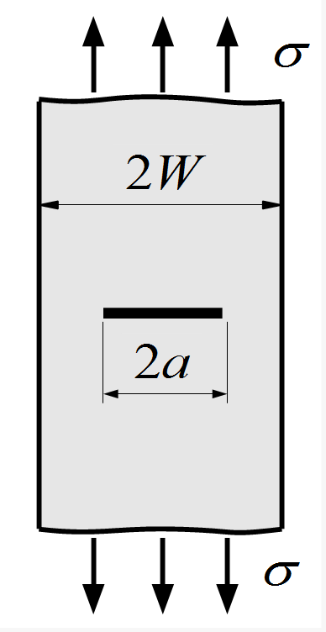
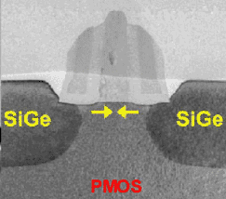
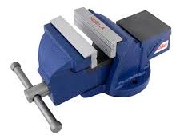
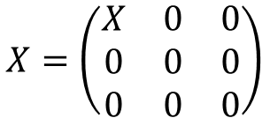
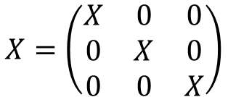
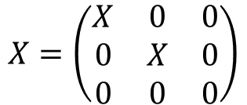
Examples of stress tensors
Hydrostatic pressure
Uniaxial stress
Biaxial stress
$$X=\left(\begin{matrix}X & 0 & 0 \\ 0 & X & 0 \\ 0 & 0 & X\end{matrix}\right)$$
$$X=\left(\begin{matrix}X & 0 & 0 \\ 0 & 0 & 0 \\ 0 & 0 & 0\end{matrix}\right)$$
$$X=\left(\begin{matrix}X & 0 & 0 \\ 0 & X & 0 \\ 0 & 0 & 0\end{matrix}\right)$$
Relaxed Si
Strained Si
Relaxed SiGe
Relaxed SiGe
Diamond anvil cell
Thin rod in a vise
Pseudomorphic epitaxial layer
Landau-Lifshitz, Vol. 7, Elasticity Theory.
Google images

Slide 9
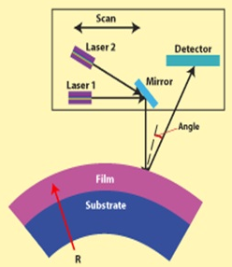
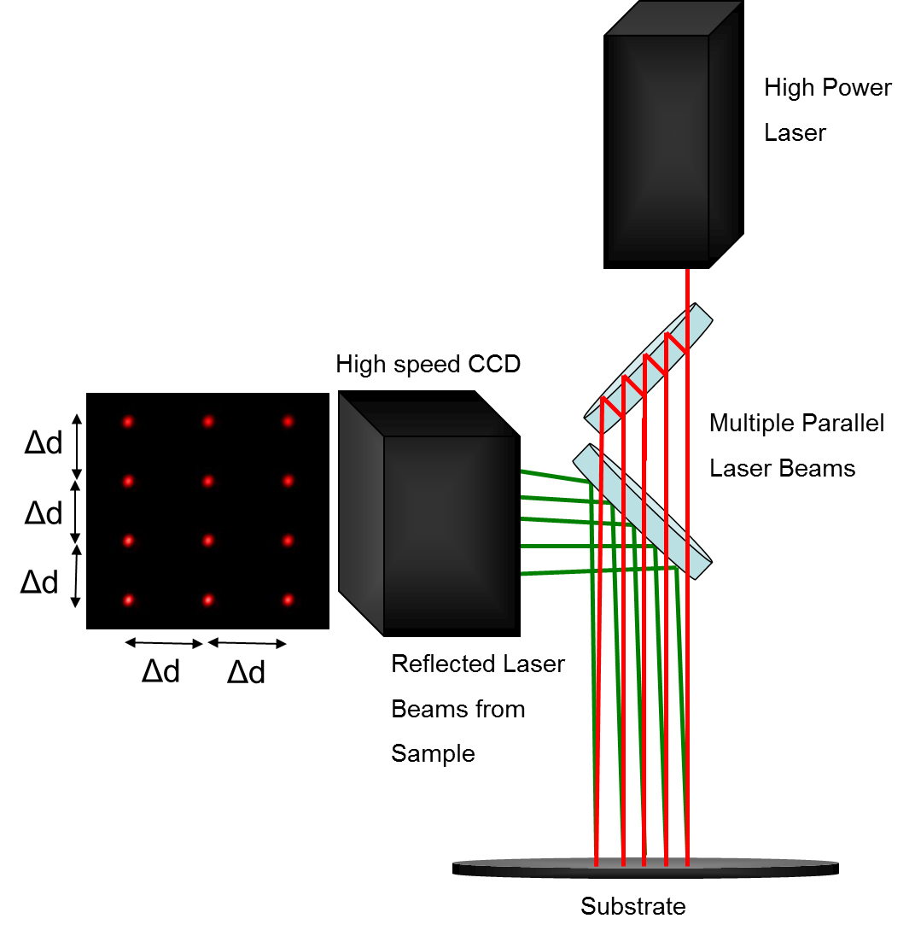
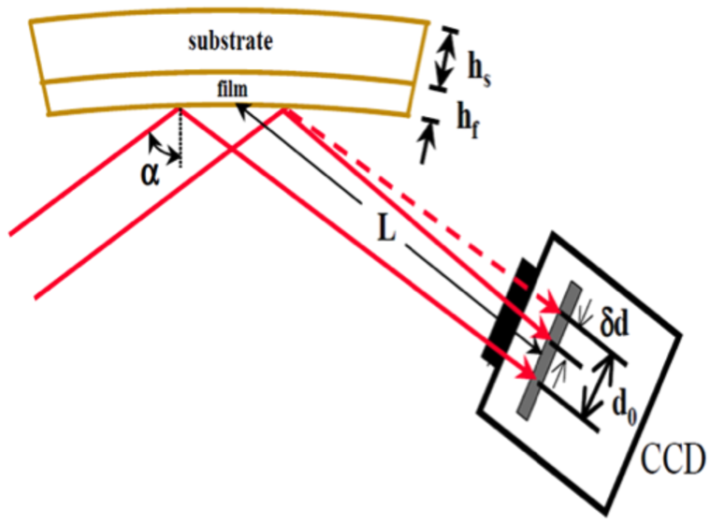
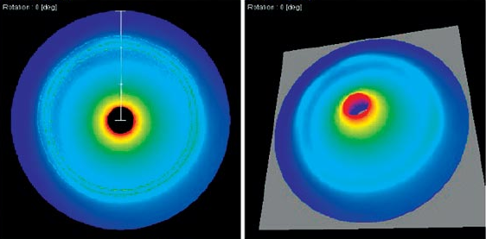

Measurement of wafer curvature (stress)
Stoney’s Equation:
$$σ=\frac{T^{2}}{6Rt}\frac{E}{1−ν}$$
Flexus 2320-S
Dektak XT (stylus)
k-Space Associates, Inc.
Measurement of stress with x-rays
Wikipedia

Slide 10

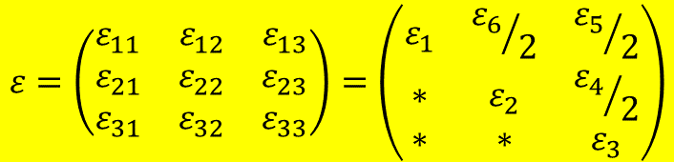
Strain tensor
r Position of the unstrained point
r’ Position of the strained point
u(r)=r’-r Displacement (vector field)
The strain tensor ε(r) is defined by
u(r)=ε(r)r
This is a tensor field.
We assume a homogeneous strain ε(r)=ε.
Volume change:
ΔV/V=Tr(ε)
Poisson ratio: (0<ν<0.5)
$$ε=\left(\begin{matrix}ε_{11} & ε_{12} & ε_{13} \\ ε_{21} & ε_{22} & ε_{23} \\ ε_{31} & ε_{32} & ε_{33}\end{matrix}\right)=\left(\begin{matrix}ε_{1} & {ε_{6}}/2 & {ε_{5}}/2 \\ ∗ & ε_{2} & {ε_{4}}/2 \\ ∗ & ∗ & ε_{3}\end{matrix}\right)$$
Sign convention:
Positive ε: Tensile strain
Negative ε: Compressive strain
Onsager principle:
The strain tensor is symmetric.
It can be diagonalized (principal axes).
Determinant usually non-zero (Poisson ratio).
$$ν=−\frac{ε_{11}}{ε_{33}}$$
Landau-Lifshitz, Vol. 7, Elasticity Theory.

Slide 11
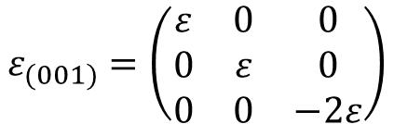
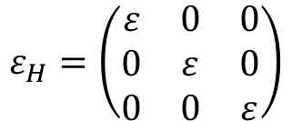

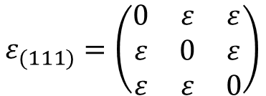
Examples of strain tensors
Group theory:
An arbitrary strain has a unique decomposition into a hydrostatic and (100) and (111) pure shear components.
Hydrostatic strain
(001) uniaxial shear strain
(111) uniaxial shear strain
$$ε_{H}=\left(\begin{matrix}ε & 0 & 0 \\ 0 & ε & 0 \\ 0 & 0 & ε\end{matrix}\right)$$
$$ε_{(001)}=\left(\begin{matrix}ε & 0 & 0 \\ 0 & ε & 0 \\ 0 & 0 & −2ε\end{matrix}\right)$$
$$ε_{(111)}=\left(\begin{matrix}0 & ε & ε \\ ε & 0 & ε \\ ε & ε & 0\end{matrix}\right)$$
Traceless: No volume change
Pressure P
Bulk modulus B (GPa)
In practical experimental geometries (uniaxial or biaxial stress) we usually find both hydrostatic and uniaxial shear components.
$$B=−V{\left(\frac{∂V}{∂P}\right)}_{T}=\frac{P}{3ε}$$
P.Y. Yu and M. Cardona,
Fundamentals of Semiconductors.

Slide 12
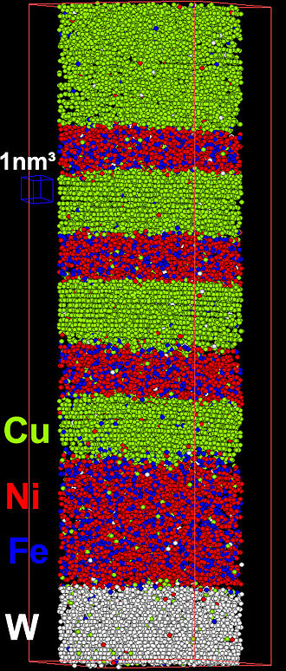
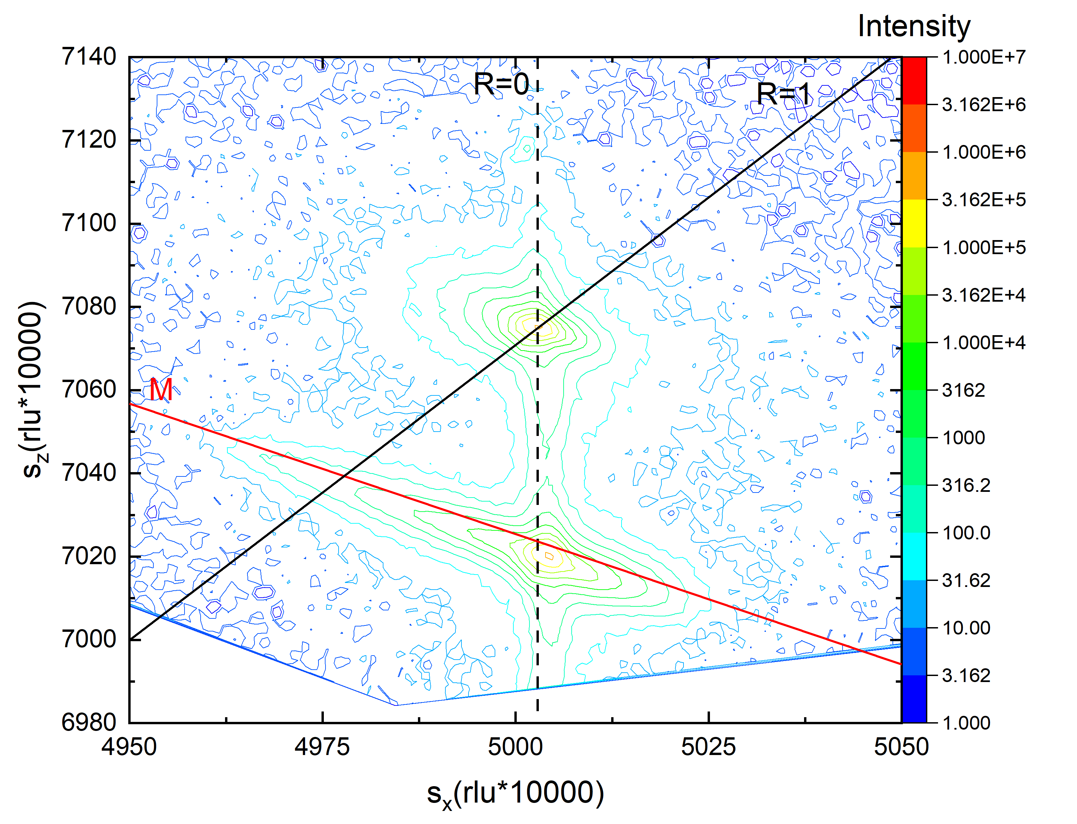
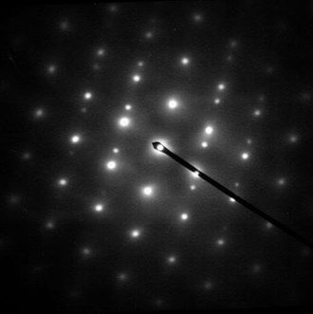
Strain measurements
Ge_{1-y}Sn_{y} on GaAs (y=2.6%)
Transmission electron microscopy:
Selected area diffraction
Asymmetric (224) grazing incidence reciprocal space map (XRD)
Atom probe tomography
Stefan Zollner, 2023, Grenoble

Slide 13
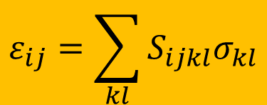
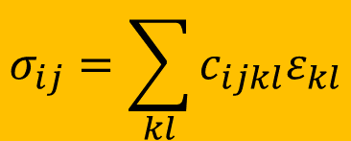
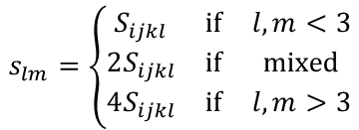
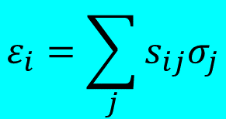
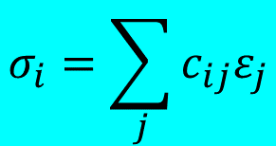
Elasticity and compliance tensors (Hooke’s Law)
Elasticity (stiffness) tensor c_{ijkl}
Compliance tensor S_{ijkl}
$$σ_{ij}=\sum_{kl}{c_{ijkl}ε_{kl}}$$
$$ε_{ij}=\sum_{kl}{S_{ijkl}σ_{kl}}$$
k,l=1..3
These are fourth rank-tensors with 81 elements.
Stress and strain tensors are symmetric, therefore only 21 elements are needed for c and S.
$$σ_{i}=\sum_{j}{c_{ij}ε_{j}}$$
$$s_{lm}=\left\{\begin{matrix}S_{ijkl} & \text{if} & l,m<3 \\ 2S_{ijkl} & \text{if} & \text{mixed} \\ 4S_{ijkl} & \text{if} & l,m>3\end{matrix}\right.$$
$$ε_{i}=\sum_{j}{s_{ij}σ_{j}}$$
No factors of 2,4 for c_{ij}.
i,j=1..6
i,j=1..6
6x6 matrices are symmetric: 21 elements
Landau-Lifshitz, Vol. 7, Elasticity Theory.

Slide 14
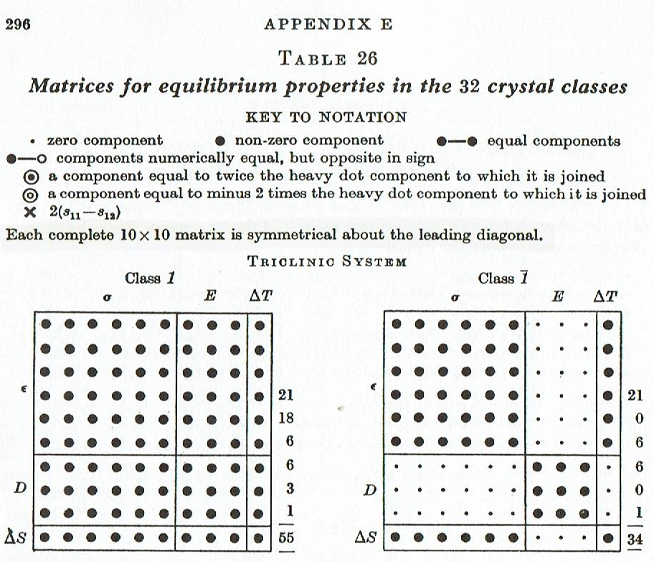
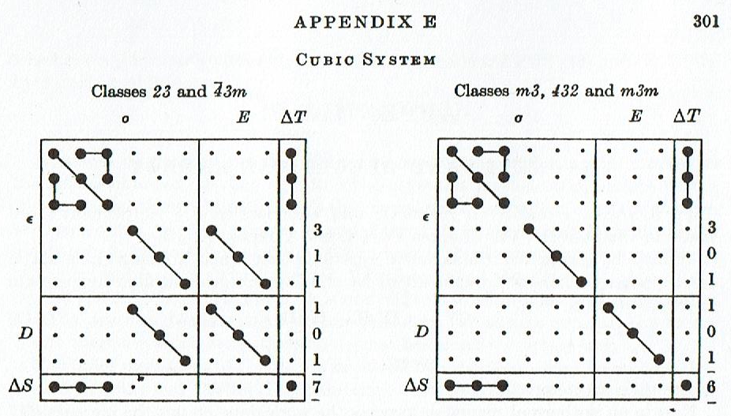
Compliance tensors for different symmetries
The number of independent elements of the compliance tensor is reduced further by crystal symmetry.
Triclinic system: 21 elements
Cubic system: We only have three elements: s₁₁, s₁₂, s₄₄
Cubic point groups
Nye, Physical Properties of Crystals, Appendix E.

Slide 15
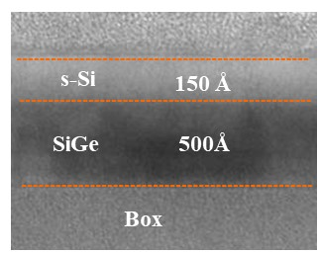
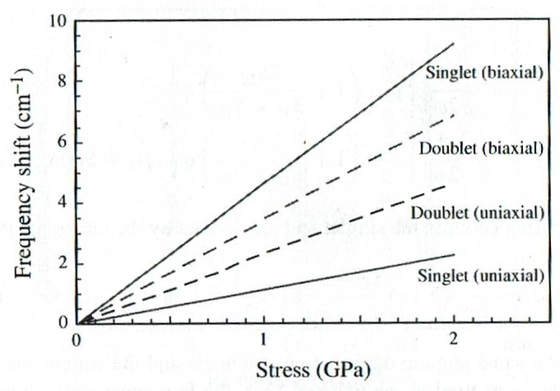
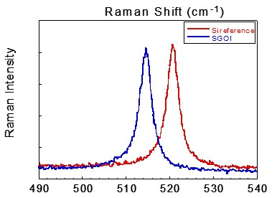

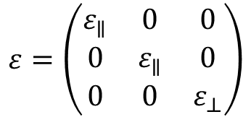

Phonon spectra under uniaxial strain
Uniaxial strain splits the three-fold degenerate Raman phonon in Si into a singlet and a triplet.
$$ε=\left(\begin{matrix}ε_{∥} & 0 & 0 \\ 0 & ε_{∥} & 0 \\ 0 & 0 & ε_{⊥}\end{matrix}\right)$$
Silicon (001)
For this strain tensor, the stress could be uniaxial or biaxial along (100).
$$Ω_{s}=ω_{0}+\frac{1}{2ω_{0}}\left(pε_{⊥}+2qε_{∥}\right)$$
$$Ω_{d}=ω_{0}+\frac{1}{2ω_{0}}\left[pε_{∥}+q\left(ε_{∥}+ε_{⊥}\right)\right]$$
Only the singlet is observable in conventional backscattering geometry.
R. Liu and N. Cave in Pantelides and Zollner: Silicon-Germanium-Carbon Alloys.

Slide 16
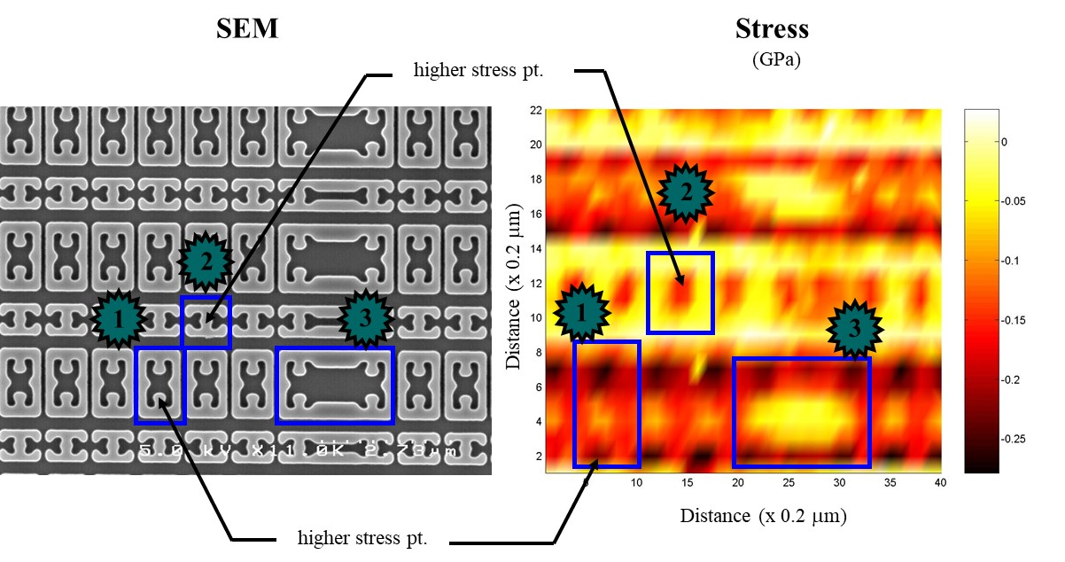
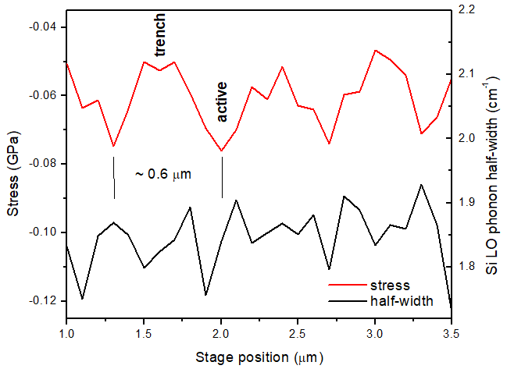
UV Raman stress mapping in Si devices
90nm node
325 nm He-Cd laser, 0.4 μm spot size
UV-enhanced spectrometer
Useful for devices with half-pitch greater than 0.13 μm
Obsolete since around 2002.
R. Liu, Freescale Semiconductor

Slide 17

UV Raman stress measurements in group-IV alloys
Raman spectroscopy is useful to determine the composition of Si-Ge-Tin alloys, but strain must be subtracted in the analysis.
Jean-Michel Hartmann, CEA-LETI, Grenoble

Slide 18
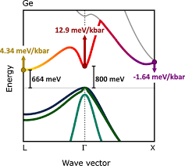
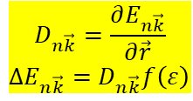
Electronic bands under hydrostatic strain
$$D_{n\vec{k}}=\frac{∂E_{n\vec{k}}}{∂\vec{r}}$$
${ΔE}_{n\vec{k}}=$ $D_{n\vec{k}}f\left(ε\right)$
Deformation potential:
Valence bands remain about the same.
(Deformation potential a_{V} is small.)
Conduction bands:
Γ-point moves up fast (a_{C}=−10 eV).
L-point also moves up (Ge becomes more indirect).
X-point moves down (GaAs becomes indirect at 41 kbar).
Paul’s rule:
Deformation potentials do not vary much between semiconductor materials for the same band or transition.
Stefan Zollner, 2023, Grenoble

Slide 19
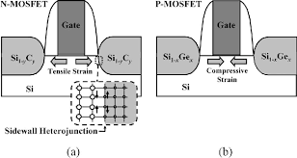
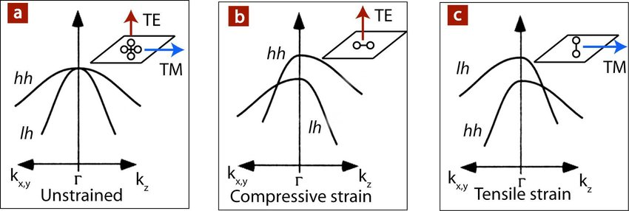
Valence bands of Si under (001) stress
A uniaxial compressive stress is created by embedded Si-Ge source-drain stressors.
Under compressive uniaxial stress, the hole mobility increases.
This technology is used for most high-performance PMOS transistors.
Pantelides and Zollner,
Silicon-Germanium-Carbon Alloys.

Slide 20
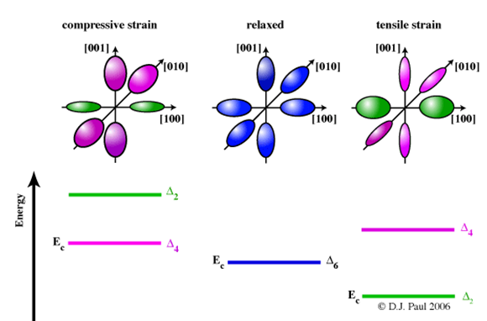
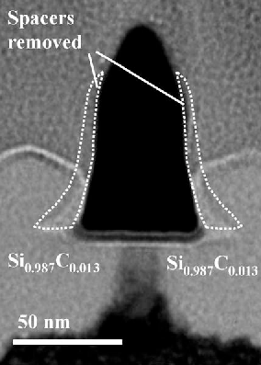
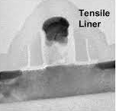
Conduction bands of Si under (001) stress
A uniaxial compressive stress splits the six-fold degenerate conduction band valleys of Si.
This reduces the f- and g-intervalley scattering and also changes the effective masses.
This can be achieved with tensile nitride stress liners or with embedded Si-C alloy stressors.
Pantelides and Zollner,
Silicon-Germanium-Carbon Alloys.

Slide 21
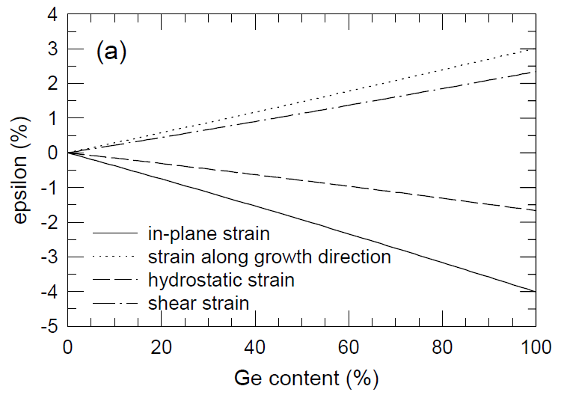

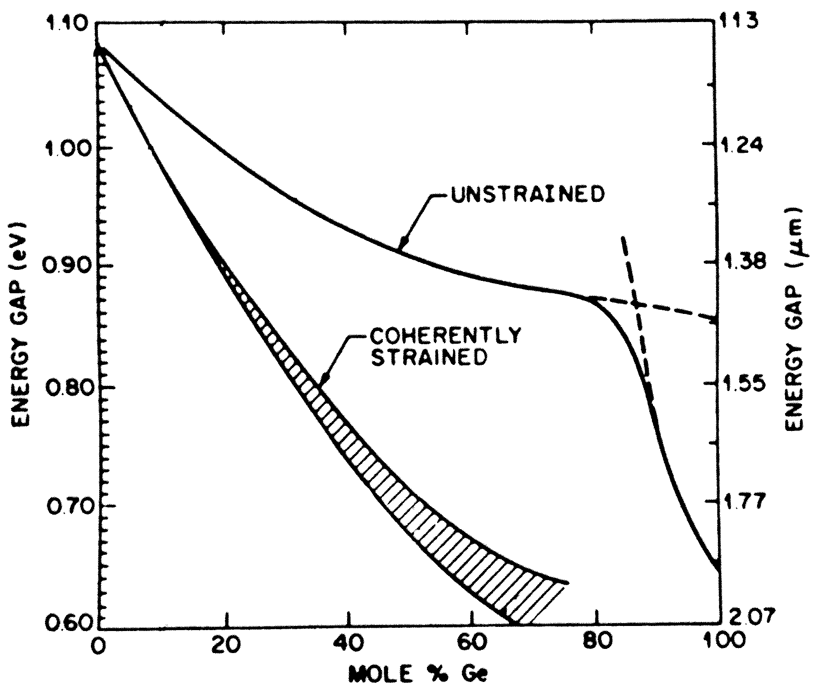
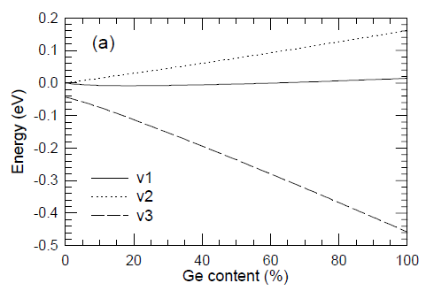
Photoluminescence of Si_{1-x}Ge_{x} alloys on Si
Pseudomorphic growth of Si_{1-x}Ge_{x} alloy on Si (001)
Pantelides and Zollner,
Silicon-Germanium-Carbon Alloys.

Slide 22



Strain splitting of E₁ and E₁+Δ₁ transitions
E₁
Large shear approximation
(small spin-orbit splitting)
Small shear approximation
(large spin-orbit splitting)
Pantelides and Zollner,
Silicon-Germanium-Carbon Alloys.

Slide 23





Spectroscopic ellipsometry
$$ρ=\frac{r_{p}}{r_{s}}=\tan{Ψ}e^{iΔ}$$
UHV cryostat
& V-VASE ellipsometer
femto.nmsu.edu

Slide 24
Ellipsometry instrumentation
Broadband versus scanning monochromator
FTIR and near-IR/VIS/near-UV
Compensator is crucial for small Δ
Dual rotating compensators: Full Mueller matrix
Option: Phase-modulation ellipsometry
Equidistant energies or wavelengths
Spot size: 10 mm or 30 μm on 1 μm (imaging)
UHV cryostat
& V-VASE ellipsometer
femto.nmsu.edu
Stefan Zollner, 2023, Grenoble

Slide 25

Penetration depth
The penetration depth is the inverse of the absorption coefficient, which can be measured with spectroscopic ellipsometry.
Below the direct band gap (0.8 eV for Ge, 3.4 eV for Si), the penetration depth is very large (many microns).
The penetration depth is smallest at the E₂ peak in the UV, about 10 nm.

Slide 26



Critical points in the dielectric function of Ge
Structures in the dielectric function
Due to interband transitions
P.Y. Yu and M. Cardona,
Fundamentals of Semiconductors.

Slide 27

Piezo-optics of Si, Ge, GaAs under (001) strain
Elasto-optical constants of Si
P. Etchegoin, J. Kircher, and M. Cardona
Phys. Rev. B 47, 10292 (1993).
Piezo-optics of GaAs
P. Etchegoin, J. Kircher, M. Cardona, C. Grein, and E. Bustarret
Phys. Rev. B 46, 15139 (1992).
Piezo-optical response of Ge in the visible–uv range
P. Etchegoin, J. Kircher, M. Cardona, and C. Grein
Phys. Rev. B 45, 11721 (1992).
Piezo-optics of InP in the visible-ultraviolet range
D. Rönnow, P. Santos, M. Cardona, E. Anastassakis, and M. Kuball
Phys. Rev. B 57, 4432 (1998: E: 1999).
Etienne Bustarret

Slide 28




Tensile biaxial stress in Ge layers on Si
1 meV accuracy for E₁ energy measurement.
Stefan Zollner, 2023, Grenoble

Slide 29


Optical and X-Ray Characterization of Ge_{1-y}Sn_{y} alloys on GaAs
Haley B. Woolf,¹ Matt Kim,² Carola Emminger,¹
Carlos A. Armenta,¹ Stefan Zollner¹
Department of Physics, New Mexico State University, Las Cruces, NM, USA
QuantTera, Scottsdale, AZ, USA
2022 AVS International Symposium,
Pittsburgh, PA, USA. November 2023.
This work was supported by Air Force Office of Scientific Research under award number FA9550-20-1-0135.
29

Slide 30

Outline
Introduction
X-ray diffraction data:
  Omega scans (rocking curves), and reciprocal space maps
  on (004), (224), & $\left(\overline{2}\overline{2}4\right)$ reflections
Composition and lattice constant
Optical data:
  Pseudodielectric function, optical constants, and second derivative spectra
  Photoluminescence data: dependence of E₀ on tin content
Dependence of E₁ and E₁+Δ₁ on tin content (ellipsometry)
Conclusion
Haley B. Woolf et al., 2022 AVS Symposium,
Pittsburgh, PA, USA. November 2023.
30

Slide 31

Introduction
GeSn alloys with tunable bandgaps are of interest for mid infrared lasers and detectors.
They can be integrated with common semiconductor substrates (Si, Ge, GaAs).
Two Ge_{1-y}Sn_{y} layers were grown on GaAs by chemical vapor epitaxy with different amounts of tin. The tin content is found with (004) omega rocking curves and reciprocal space maps.
The tin contents were found to be 1.2% and 2.6% with thicknesses of 1600 Å and 1150 Å, respectively.
Asymmetric $\left(224\right)$ grazing incidence and $\left(\overline{2}\overline{2}4\right)$ grazing exit reciprocal space maps were used to determine the strain and relaxation of the epitaxial layer.
From the dielectric function and the tin content, we can compare the E₁ and E₁+Δ₁ energies with continuum elasticity theory. When the tin content increases, the energies decrease.
Photoluminescence data was taken of both samples and compared to bulk Ge to observe the change in E₀. Using continuum elasticity theory for E₀, we see that when the tin content increases, the energies decrease.
Haley B. Woolf et al., 2022 AVS Symposium,
Pittsburgh, PA, USA. November 2023.
31

Slide 32



(004) Rocking Curves: Strained or relaxed ???
ω Scan Open Detector:
ω-2θ Scan Open Detector:
FWHM
GaAs 0.010°
GeSn 0.016°
GaAs 0.010°
GeSn 0.017°
Bulk GaAs 0.0078°
Bulk Ge 0.0074°
FWHM
GaAs 0.010°
GeSn 0.016°
GaAs 0.010°
GeSn 0.017°
Bulk GaAs 0.0077°
Bulk Ge 0.0074°
Vertical Lattice Constants:
GaAs: 5.652 Å
GeSn: 5.679 Å
GaAs: 5.652 Å
GeSn: 5.699 Å
Bulk GaAs: 5.653 Å
Bulk Ge: 5.658 Å
Taken at 2θ = 66.4240°
Even the GaAs substrate is broader if an epilayer has been grown
(dislocations may penetrate from the epilayer into the substrate).
Haley B. Woolf et al., 2022 AVS Symposium,
Pittsburgh, PA, USA. November 2023.
32
Notes:
004 is symmetric scan. Using braggs law and the angle of reflection we can find the d-spacings of the samples. The epitaxial layer on the receiving slit graph are missing because of the width of the detector.

Slide 33







(004) Reciprocal Space Maps
GeSn on GaAs 1.2%
Bulk GaAs
Bulk Ge
GeSn on GaAs 2.6%
$$sx=\frac{qx}{2π}=\frac{1}{λ}[\cos\left(ω\right)−\cos\left(2θ−ω\right)]$$
Dashed line drawn through substrate peak
M-Mosaic Spread (Relaxation Line)
$$sz=\frac{qz}{2π}=\frac{1}{λ}[\sin\left(ω\right)+\sin\left(2θ−ω\right)]$$
No tilt between epilayer and substrate.
$$λ=1.5406 \text{Å}$$
33

Slide 34



$\left(\overline{2}\overline{2}4\right)$ & $\left(224\right)$ Rocking Curve (Open Detector)
($\overline{2}\overline{2}4$) Grazing Exit
(224) Grazing Incidence
FWHM
GaAs: 0.017°
GeSn: 0.022°
GaAs: 0.013°
GeSn: 0.013°
Bulk GaAs: 0.011°
Bulk Ge: 0.011°
FWHM
GaAs: 0.022°
GeSn: 0.028°
GaAs: 0.033°
GeSn: 0.041°
Bulk GaAs: 0.013°
Bulk Ge: 0.015°
$$Δω$$
$$Δω$$
X-ray tube
Detector
$$ω$$
Detector
X-ray tube
$$ω$$
Haley B. Woolf et al., 2022 AVS Symposium,
Pittsburgh, PA, USA. November 2023.
34
Notes:
224 RSM are asymmetrical scans using xrd. Since delta omega on both sides are not equal, this tells us that the samples are not fully relaxed.

Slide 35






(224) Grazing Incidence RSM
GeSn on GaAs 1.2%
Bulk GaAs
Bulk Ge
GaAs
GeSn
GeSn on GaAs 2.6%
W-Wavelength Streak
M-Mosaic Spread (Relaxation Line)
Black line drawn from origin (Relaxed)
Dashed line drawn through substrate peak (Pseudomorphic)
$$sx=\frac{qx}{2π}=\frac{1}{λ}[\cos\left(ω\right)−\cos\left(2θ−ω\right)]$$
$$sz=\frac{qz}{2π}=\frac{1}{λ}[\sin\left(ω\right)+\sin\left(2θ−ω\right)]$$
$$λ=1.5406 \text{Å}$$
35

Slide 36






Lattice Constants
Bragg’s Law:
Lattice Constants:
$$nλ=2d\sin{θ}$$
$a$_{GeSn}= 5.679 Å $a$_{Sn}= 6.489 Å
$a$_{GeSn}= 5.699 Å $a$_{Ge}= 5.658 Å
$a$_{GaAs} = 5.653 Å
$$a_{GeSn}=4d$$
Vegard’s Law:
$$aRelaxed(y)=aSny +aGe\left(1−y\right)$$
$a$|| $=$ $a$_{substrate}= 5.653 Å
(Pseudomorphic Condition)
$$a_{⊥}=\left(1+ε_{⊥}\right)aRelaxed\left(y\right)$$
$$ε_{⊥}=−\frac{2v}{1−v}ε_{||}$$
Poisson Ratio:
$$v=0.3$$
$$ε_{||}=\frac{a_{||}}{aRelaxed(y)}−1 <0$$
If layers is fully relaxed, the % Sn is 2.6% and 5.0%
If layers is fully strained, the % Sn is 1.2% and 2.6%
Haley B. Woolf et al., 2022 AVS Symposium,
Pittsburgh, PA, USA. November 2023.
36
Notes:
With Vegard’s law and continuum elasticity theory, the tin content of the Ge_{1-y}Sn_{y} layer can be found with the measured and known lattice constants of GaAs, Ge, and Sn.

Slide 37

Pseudodielectric function before/after cleaning: 1.2%
 | Oxide Thickness
As Received (May 20th): | 43.66 Å
Before Cleaning (June 14th): | 72.07 Å
After Cleaning (June 14th): | 26.50 Å
After 2nd Cleaning (June 15th): | 25.90 Å
The Ge_{1-y}Sn_{y} on GaAs sample was cleaned ultrasonically with water and then isopropanol for 15 mins each to remove organic layers and most of the native oxide.
Haley B. Woolf et al., 2022 AVS Symposium,
Pittsburgh, PA, USA. November 2023.
37

Slide 38


Pseudodielectric Function
GeSn on GaAs 1.2%
GeSn on GaAs 2.6%
Oxide
Ge_{1-y}Sn_{y}
GaAs
Haley B. Woolf et al., 2022 AVS Symposium,
Pittsburgh, PA, USA. November 2023.
38

Slide 39

Ge_{1-y}Sn_{y} optical constants
Oxide
Ge_{1-y}Sn_{y}
GaAs
Haley B. Woolf et al., 2022 AVS Symposium,
Pittsburgh, PA, USA. November 2023.
39

Slide 40


2nd Derivative of the dielectric Function: 2.6% tin
$$\frac{d^{2}ε}{{dω}^{2}}=\frac{Ae^{iφ}}{{\left(−Eg−ⅈΓ+ω\right)}^{2}}$$
Critical Points of GeSn 2.6% (Blue)
CP | E (eV) | A | Φ (deg) | Γ (meV) | n
E₁ | 2.066 | 6.701 | 225.0 | 0.0769 | 0
E₁+Δ₁ | 2.285 | 2.958 | 225.0 | 0.0862 | 0
E’₀ | 3.138 | 2.669 | 314.9 | 0.2027 | 0
E’₀+Δ’₀ | 3.299 | 0.060 | 189.3 | 0.0485 | 0
E₂ | 4.339 | 10.72 | 232.9 | 0.1148 | 0
Critical Points of Ge (Orange)
CP | E (eV) | A | Φ (deg) | Γ (meV) | n
E₁ | 2.113 | 5.32 | 246 | 0.050 | 0
E₁+Δ₁ | 2.314 | 3.53 | 246 | 0.066 | 0
E’₀ | 3.099 | 1.33 | 175 | 0.102 | 0
E’₀+Δ’₀ | 3.344 | 0.486 | 266 | 0.139 | 0
E₂ | 4.354 | 11.2 | 318 | 0.097 | 0
Haley B. Woolf et al., 2022 AVS Symposium,
Pittsburgh, PA, USA. November 2023.
40
Notes:
By fitting the 2nd derivative of the dielectric function, the critical point parameters were found. This includes energy, amplitude, phase angle, broadening, and the line shape. The phase angle for E₁ and E₁+Δ₁ were fixed to be the same.

Slide 41











Dependence of E₁ & E₁+Δ₁ energies on tin content
Relaxed:
$$E_{1}^{GeSn}=yE_{1}^{Sn}+\left(1−y\right)E_{1}^{Ge}−b_{GeSn}y(1−y)$$
$${\left(E_{1}+∆_{1}\right)}^{GeSn}=y{\left(E_{1}+∆_{1}\right)}^{Sn}+\left(1−y\right){\left(E_{1}+∆_{1}\right)}^{Ge}−b_{GeSn}y(1−y)$$
$$b_{GeSn}=1.350 eV$$
Strained:
$$E_{1}^{GeSn}=E_{1}^{Relaxed}+{∆E}_{H}−\frac{∆E_{s}^{2}}{∆_{1}}$$
small shear approximation
$${∆E}_{s}≪∆_{1}$$
$${\left(E_{1}+∆_{1}\right)}^{GeSn}={{(E}_{1}+∆_{1})}^{Relaxed}+{∆E}_{H}+\frac{∆E_{s}^{2}}{∆_{1}}$$
$${∆E}_{H}=\sqrt{3}\left[{yD}_{1}^{1 Sn}+\left(1−y\right)D_{1}^{1 Ge}\right]ε_{H}$$
$D_{1}^{1 Sn}=−5.4$ eV,
$D_{1}^{1 Ge}=−8.7$eV,
$$ε_{H}=\frac{ε_{⊥}+{2ε}_{||}}{3}$$
$${∆E}_{S}=\sqrt{6}\left[{{yD}_{3}^{3 Sn}+\left(1−y\right)D}_{3}^{3 Ge}\right]ε_{S}$$
$D_{3}^{3 Sn}=−3.8$ eV,
$D_{3}^{3 Ge}=−5.6$ eV,
$$ε_{S}=\frac{ε_{⊥}−ε_{||}}{3}$$
Haley B. Woolf et al., 2022 AVS Symposium,
Pittsburgh, PA, USA. November 2023.
41
Notes:
The marked squares are the measured energies of bulk Ge and the Ge_{1-y}Sn_{y} epitaxial layer. The Ge_{1-y}Sn_{y} energy for the E₁ is slightly higher.

Slide 42

Photoluminescence spectra of Ge-Sn alloys at 300K
Indirect Direct
Bandgap (eV) Bandgap (eV)
Bulk Ge: 0.679 0.772
GeSn (1.2%): 0.657 0.748
GeSn (2.6%): 0.651 0.705
Haley B. Woolf et al., 2022 AVS Symposium,
Pittsburgh, PA, USA. November 2023.
42

Slide 43









Dependence of direct bandgap E₀ on tin content
$$E_{0}^{GeSn}=E_{0}^{Relaxed}+{∆E}_{H}+{∆E}_{S}+2{∆E}_{S}\left(\frac{{∆E}_{S}}{∆_{0}}\right)−{ΔE}_{V1}+{ΔE}_{C}^{Γ}$$
Relaxed:
$$E_{0}^{GeSn}=yE_{0}^{Sn}+\left(1−y\right)E_{0}^{Ge}−b_{GeSn}y(1−y)$$
$$b_{GeSn}=2.46 eV$$
Strained:
A
$$E_{0}^{GeSn}=E_{0}^{Relaxed}+\frac{Δ_{0}}{2}+\frac{3}{2}{bε}_{S}+\frac{1}{2}\sqrt{Δ_{0}^{2}+6Δ_{0}{bε}_{s}+{\left(9{bε}_{s}\right)}^{2}}+{ΔE}_{V2}+{ΔE}_{C}^{Γ}$$
B
$E_{0}^{GeSn}=E_{0}^{Relaxed}$ $+{ΔE}_{V2}+{ΔE}_{C}^{Γ}$
$${ΔE}_{c}^{Γ}=3\left[ya^{Sn}+\left(1−y\right)a^{Ge}\right]ε_{H}$$
$a^{Sn}=−9.75$ eV,
$a^{Ge}=−9.75$ eV,
$$ε_{H}=\frac{ε_{⊥}+{2ε}_{||}}{3}$$
$${∆E}_{V2}=3\left[yb^{Sn}+\left(1−y\right)b^{Ge}\right]ε_{S}$$
$b^{Sn}=−2.3$ eV,
$b^{Ge}=−2.3$ eV,
$$ε_{S}=\frac{ε_{⊥}−ε_{||}}{3}$$
Haley B. Woolf et al., 2022 AVS Symposium,
Pittsburgh, PA, USA. November 2023.
43

Slide 44
Conclusion
The (224) reciprocal space maps showed that the GeSn epitaxial layer was grown pseudomorphically on both samples.
Using Vegard’s Law, continuum elasticity theory, and the (004) reciprocal space map, the tin content is found to be y=0.012 and y=0.026.
After cleaning the sample, the thickness of the oxide was reduced to 26 Å and 23 Å.
Using the ellipsometry data, the fitted GeSn dielectric function was similar to bulk Ge most likely because of the low tin content.
The fit second derivative of the dielectric function helped find the critical point parameters and compared to bulk Ge.
Haley B. Woolf et al., 2022 AVS Symposium,
Pittsburgh, PA, USA. November 2023.
44

Slide 45
Conclusions
Hooke’s Law
Stress and strain tensors
Elasticity and compliance tensors
Examples of stress along one, two, and three directions
Strain measurements using high-resolution x-ray diffraction
Impact of strain on phonon energies (Raman spectra)
Impact of strain on band energies with CMOS applications
Impact of strain on optical spectra of semiconductors
Example: Germanium-tin alloys grown pseudomorphically on GaAs
Stefan Zollner, 2023, Grenoble
Notes:
Birstein-Moss shift

Slide 46
Thank you!
Questions?

Slide 47
New slide

