Slide 1


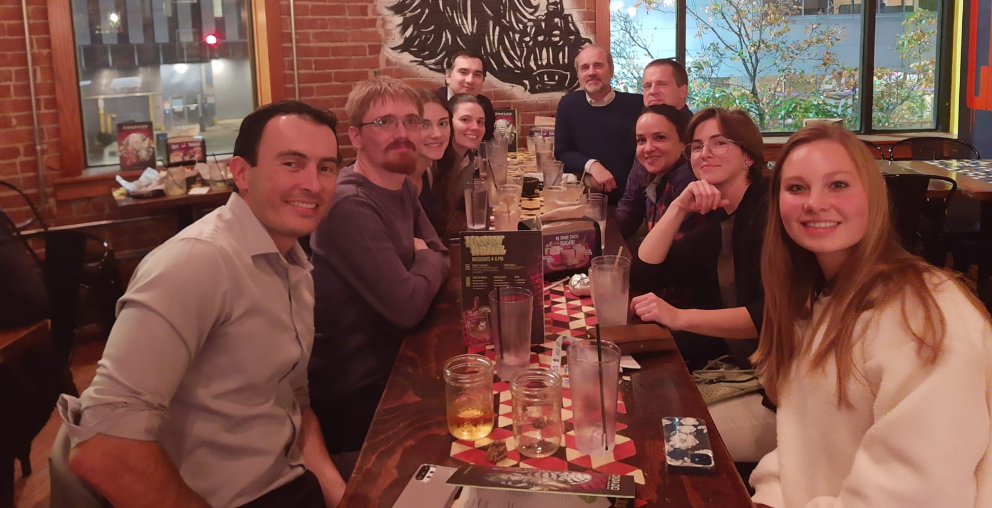
Spectroscopic Ellipsometry Studies of Optical Constants in Highly Excited Semiconductors
Sonderkolloquium TU Ilmenau, 24.3.2023
FA9550-20-1-0135
W911NF-2210130
Stefan Zollner
With: Carola Emminger, Jose Menendez, Carlos A. Armenta,
Melissa Rivero Arias, Jaden R. Love, Cesy M. Zamarripa, Sonam Yadav,
Shirly Espinoza, Mateusz Rebarz, Martin Zahradnik, Jakob Andreasson
AVS 2022, Pittsburgh, PA
Email: zollner@nmsu.edu. WWW: http://femto.nmsu.edu.
Ask me about MS/Ph.D. student positions at NMSU..
College of Arts and Sciences, Department of Physics
New Mexico State University, Las Cruces, NM, USA

Slide 2




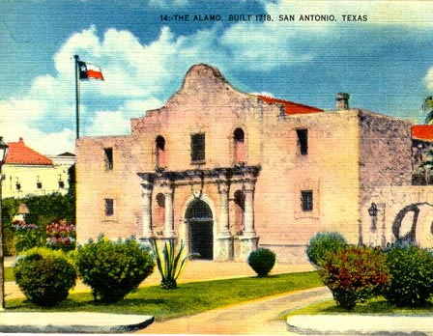
Biography
Motorola (Mesa, Tempe)
Arizona, 1997-2005
Regensburg/Stuttgart
Germany
Freescale, IBM
New York, 91-92;07-10
Las Cruces, NM
Since 2010
Motorola, Freescale
Texas, 2005-2007

Slide 3


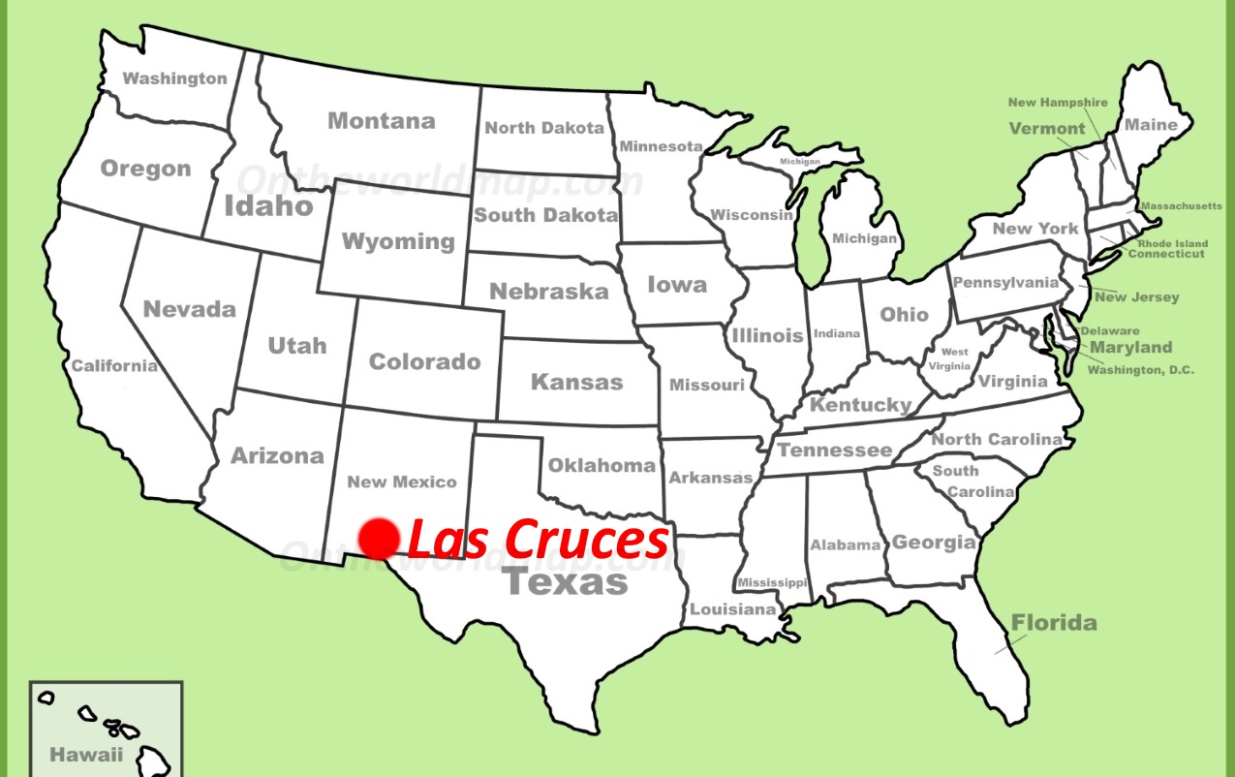

Where is Las Cruces, NM ???
White Sands NP

Slide 4
Problem Statement
(1) Achieve a quantitative understanding of absorption and emission processes.
Our qualitative understanding of such processes is 50-100 years old,
But insufficient for modeling of detectors and emitters.
(2) How are optical processes affected by high carrier concentrations (screening)?
High carrier densities can be achieved with
  In situ doping or
  ultrafast lasers or
  high temperatures.
Goal: CMOS-integrated mid-infrared camera (thermal imaging with a phone).
Future: How are optical processes affected by an electric field (pin diode or thin layer)?

Slide 5
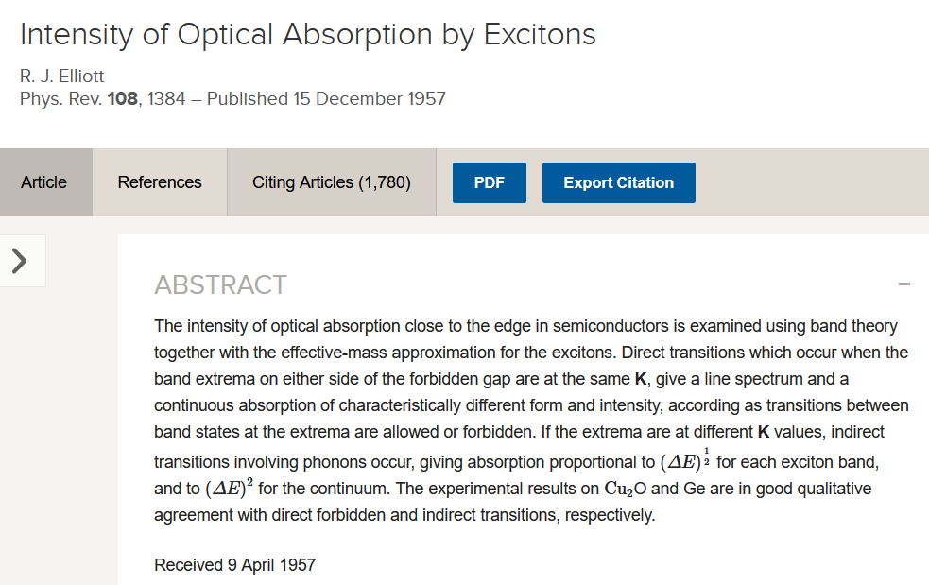
5

Slide 6
Example 1: Photoluminescence in Germanium
Qualitative:
Quantitative:
Roosbroeck-Shockley equation (PR 94, 1558, 1954).
Complete failure above 200 K and at RT.
Menendez, Poweleit, Tilton, PRB 101, 195204 (2020).

Slide 7
Example 2: Indirect Absorption in Germanium
R. J. Elliott, Phys. Rev. 108, 1384 (1957).
Menendez, Lockwood, Zwinkels, Noel, PRB 98, 165207 (2018).

Slide 8
Optical Constants of Highly Excited Semiconductors
Einstein coefficients, Fermi’s Golden Rule, Elliott-Tanguy excitons
Direct gap absorption in germanium from 10 to 800 K
Optical constants of highly excited semiconductors
  Direct gap absorption in InSb from 10 to 800 K
  Optical constants of highly excited germanium
  (femtosecond ellipsometry at ELI Beamlines in Prague)
Conclusion and Outlook

Slide 9
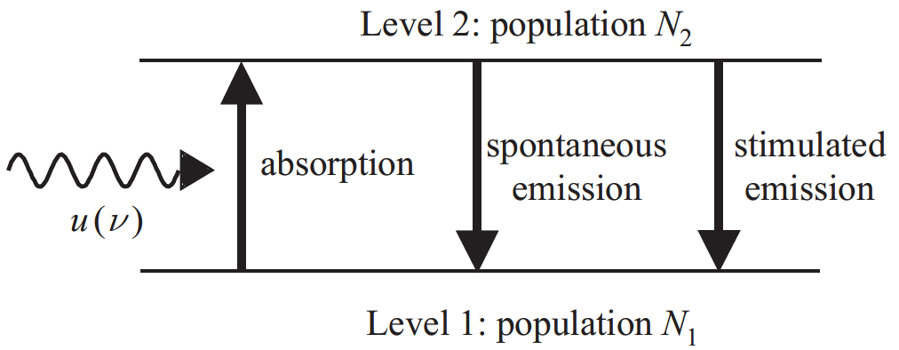

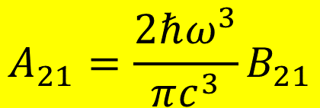

Einstein Coefficients
One coefficient is sufficient:
B₁₂
A₂₁
B₂₁
$$g_{1}B_{12}=g_{2}B_{21}$$
$$A_{21}=\frac{2ℏω^{3}}{πc^{3}}B_{21}$$
In equilibrium: N₁, N₂ constant.
Absorption and emission balance.
Black-body radiation
Use Fermi’s Golden Rule to calculate B₁₂
$$u\left(ℏω\right)$$
$$B_{12}N_{1}u\left(ℏω\right)=A_{21}N_{2}+B_{21}N_{2}u\left(ℏω\right)$$
Albert Einstein, Strahlungs-Emission und Absorption nach der Quantentheorie, DPG Verh. 18, 318 (1916); Phys. Z. 18, 121 (1917).

Slide 10
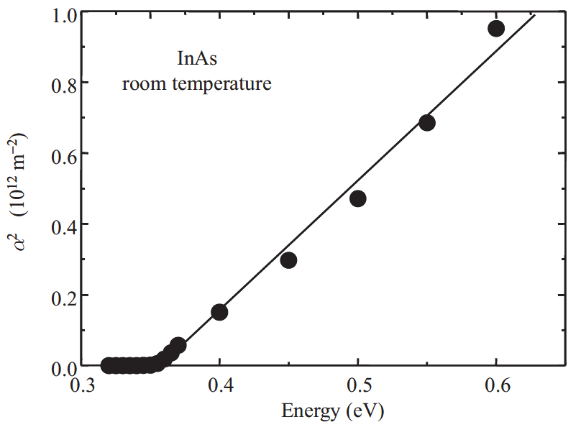
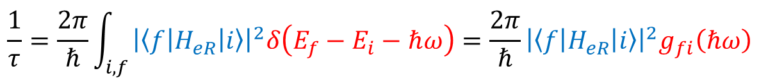
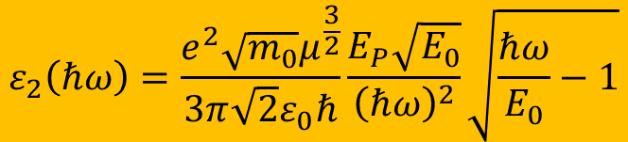
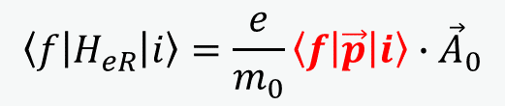
Fermi’s Golden Rule: Tauc Plot
Direct band gap absorption
constant k·p matrix element
$$\frac{1}{τ}=\frac{2π}{ℏ}\int_{i,f}{{\left|\left\langle f | H_{eR} | i\right\rangle \right|}^{2}δ\left(E_{f}−E_{i}−ℏω\right)}=\frac{2π}{ℏ}{\left|\left\langle f | H_{eR} | i\right\rangle \right|}^{2}g_{fi}\left(ℏω\right)$$
Joint DOS
$$\left\langle f | H_{eR} | i\right\rangle =\frac{e}{m_{0}}\left\langle f | \vec{p} | i\right\rangle ∙{\vec{A}}_{0}$$
Use k·p matrix element P: E_{P}=2P²/m₀
$$ε_{2}\left(ℏω\right)=\frac{e^{2}\sqrt{m_{0}}μ^{\frac{3}{2}}}{3π\sqrt{2}ε_{0}ℏ}\frac{E_{P}\sqrt{E_{0}}}{{\left(ℏω\right)}^{2}}\sqrt{\frac{ℏω}{E_{0}}−1}$$
Fox, Chapter 3

Slide 11
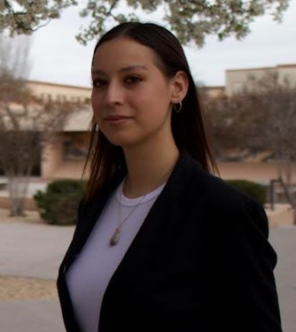
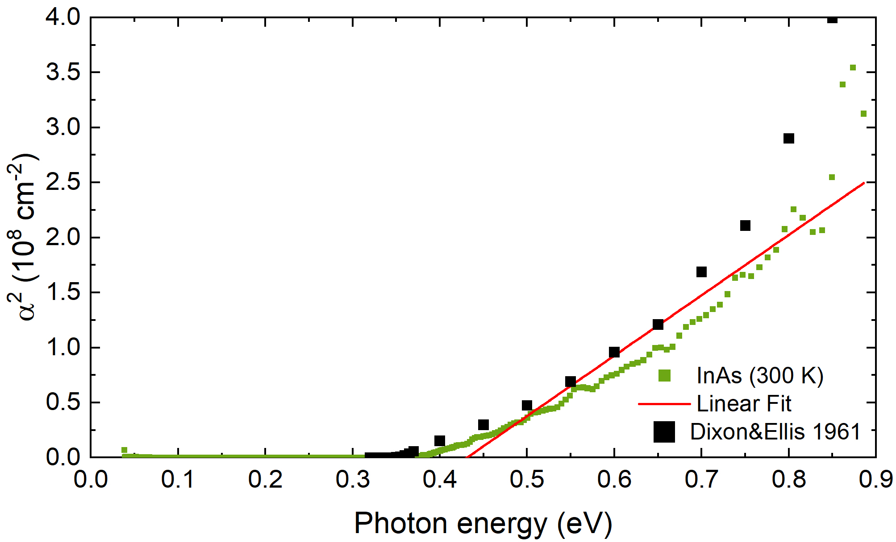

Fermi’s Golden Rule: Tauc Plot
Direct band gap absorption
$$\frac{1}{τ}=\frac{2π}{ℏ}\int_{i,f}{{\left|\left\langle f | H_{eR} | i\right\rangle \right|}^{2}δ\left(E_{f}−E_{i}−ℏω\right)}=\frac{2π}{ℏ}{\left|\left\langle f | H_{eR} | i\right\rangle \right|}^{2}g_{fi}\left(ℏω\right)$$
$$\left\langle f | H_{eR} | i\right\rangle =\frac{e}{m_{0}}\left\langle f | \vec{p} | i\right\rangle ∙{\vec{A}}_{0}$$
The Tauc plot is wishful thinking.
No linear region:
Broadening.
1/E² denominator.
excitons
Melissa Rivero Arias
Use k·p matrix element P: E_{P}=2P²/m₀
$$ε_{2}\left(ℏω\right)=\frac{e^{2}\sqrt{m_{0}}μ^{\frac{3}{2}}}{3π\sqrt{2}ε_{0}ℏ}\frac{E_{P}\sqrt{E_{0}}}{{\left(ℏω\right)}^{2}}\sqrt{\frac{ℏω}{E_{0}}−1}$$

Slide 12
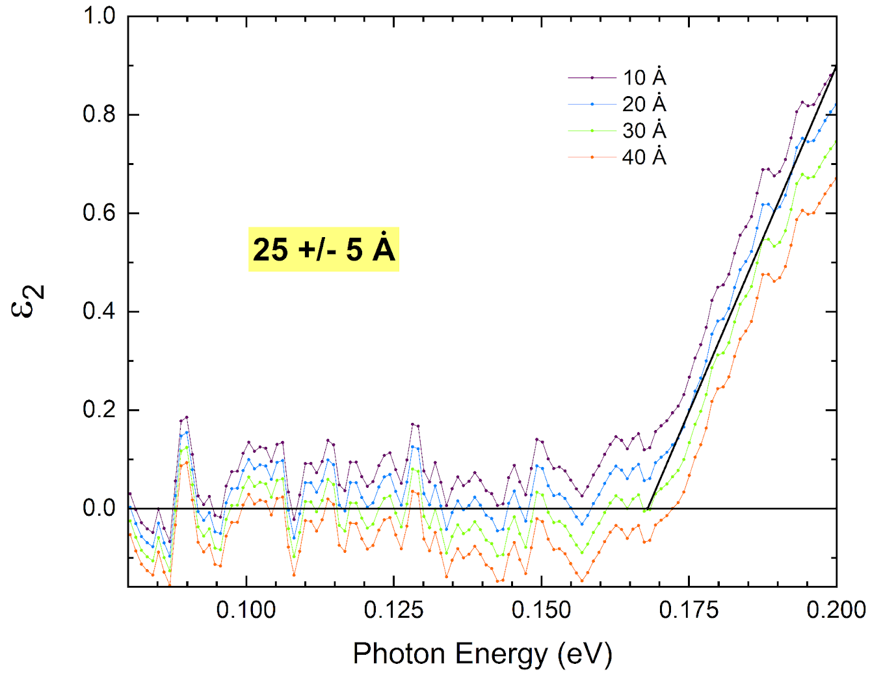
Practical Tip: Oxide or Surface Correction
InSb
Jellison-Sales Method for Transparent Glasses:
How thick is the surface region?
Optical constants for anodic oxide of InSb:
ε∞≈3.8
Mattausch, PRB 23, 1896 (1981).
Zollner, APL 63, 2523 (1993).
Below the band gap, ε₂ must be exactly zero for a bulk insulator (not positive, not negative).
This method requires a compensator to measure Δ exactly near 0 or 180 degrees.
(Also change JAW software settings to allow negative ε₂ values.)
G.E. Jellison and B.C. Sales, Determination of the optical functions of transparent glasses by using spectroscopic ellipsometry, Appl. Opt. 30, 4310 (1991).

Slide 13
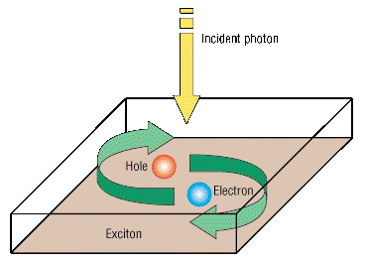
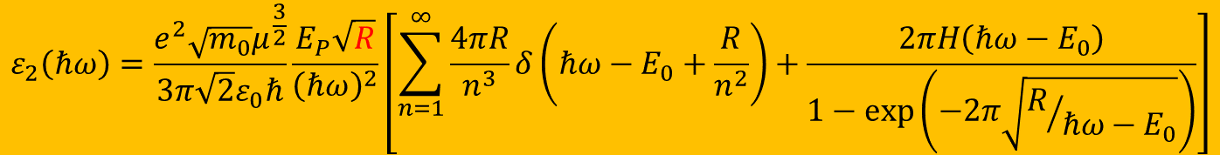
Elliott-Tanguy Exciton Absorption
Direct band gap absorption
Excitonic binding energy: R=R_{H}×μ_{h}/ε_{s}²
$$ε_{2}\left(ℏω\right)=\frac{e^{2}\sqrt{m_{0}}μ^{\frac{3}{2}}}{3π\sqrt{2}ε_{0}ℏ}\frac{E_{P}\sqrt{R}}{{\left(ℏω\right)}^{2}}\left[\sum_{n=1}^{∞}{\frac{4πR}{n^{3}}δ\left(ℏω−E_{0}+\frac{R}{n^{2}}\right)+\frac{2πH\left(ℏω−E_{0}\right)}{1−\text{exp}\left(−2π\sqrt{R/{ℏω−E_{0}}}\right)}}\right]$$
bound excitons
exciton continuum enhancement
Tanguy’s contributions:
Add Lorentzian broadening
Kramers-Kronig transform to get the real part.
×
R. J. Elliott, Phys. Rev. 108, 1384 (1957).
Christian Tanguy, Phys. Rev. Lett. 75, 4090 (1995) + (E)

Slide 14
Calculation of Absorption Spectrum from k.p Theory
Can we calculate the absorption spectrum?
Yes, we can for Ge in the low carrier density limit.
It does not work for other III/V compounds.
How can we calculate the absorption for high carrier densities?
Carola Emminger et al., JAP 131, 165701 (2022).

Slide 15
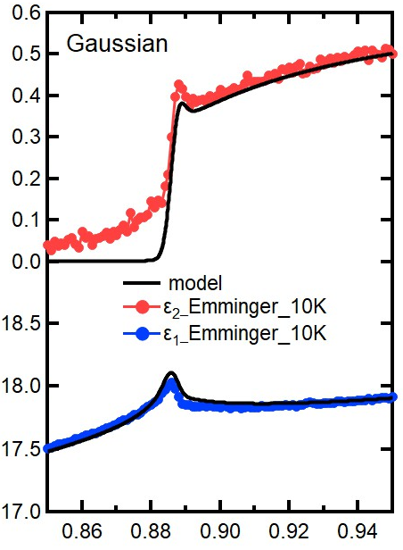
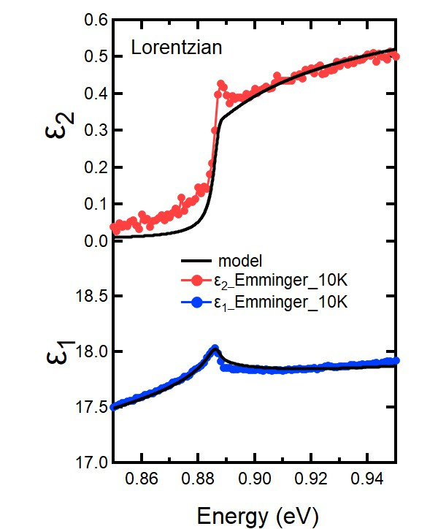
Elliott-Tanguy theory applied to Ge
Fixed parameters:
  Electron and hole masses (temperature dependent)
  Excitonic binding energy R
  Amplitude A (derived from matrix element P)
Adjustable parameters:
  Broadening Γ: 2.3 meV
  Band gap E₀
  Linear background A₁ and B₁
  (contribution from E₁ to real part of ε)
ε₂
Ge
Quantitative agreement
ε₁
Carola Emminger et al., JAP 131, 165701 (2022).
15

Slide 16
Elliott-Tanguy theory applied to Ge
Good agreement at low temperatures.
Model also describes second derivatives.
Potential problems:
Matrix element k-dependent
Nonparabolicity
Resonant indirect absorption
??? at high T.
Ge
Ge
Carola Emminger et al., JAP 131, 165701 (2022).
16

Slide 17
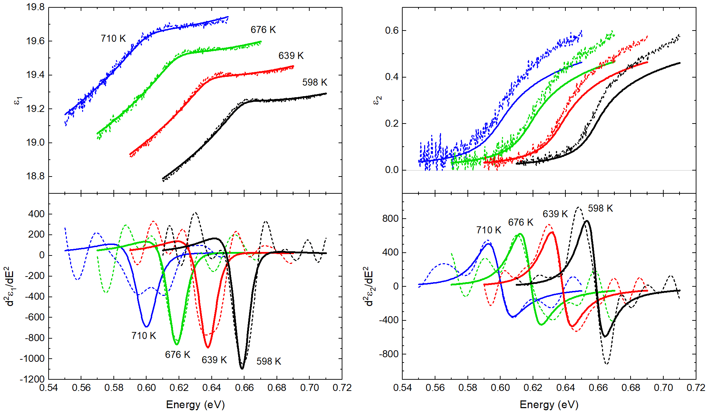
Elliott-Tanguy theory: Problems for Ge at high T
Good agreement at low temperatures.
Model also describes second derivatives.
Potential problems:
Matrix element k-dependent
Nonparabolicity
Resonant indirect absorption
??? at high T.
Measurement error ??
Ge
Ge
Carola Emminger et al., JAP 131, 165701 (2022).
17

Slide 18
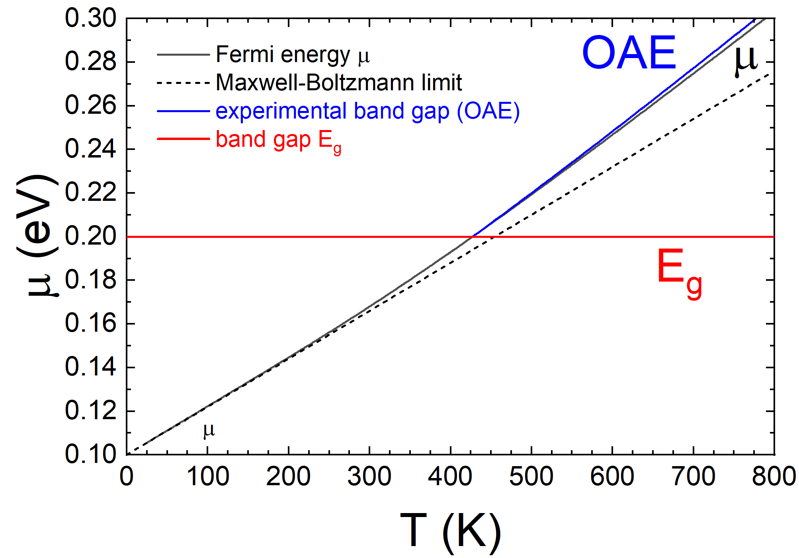
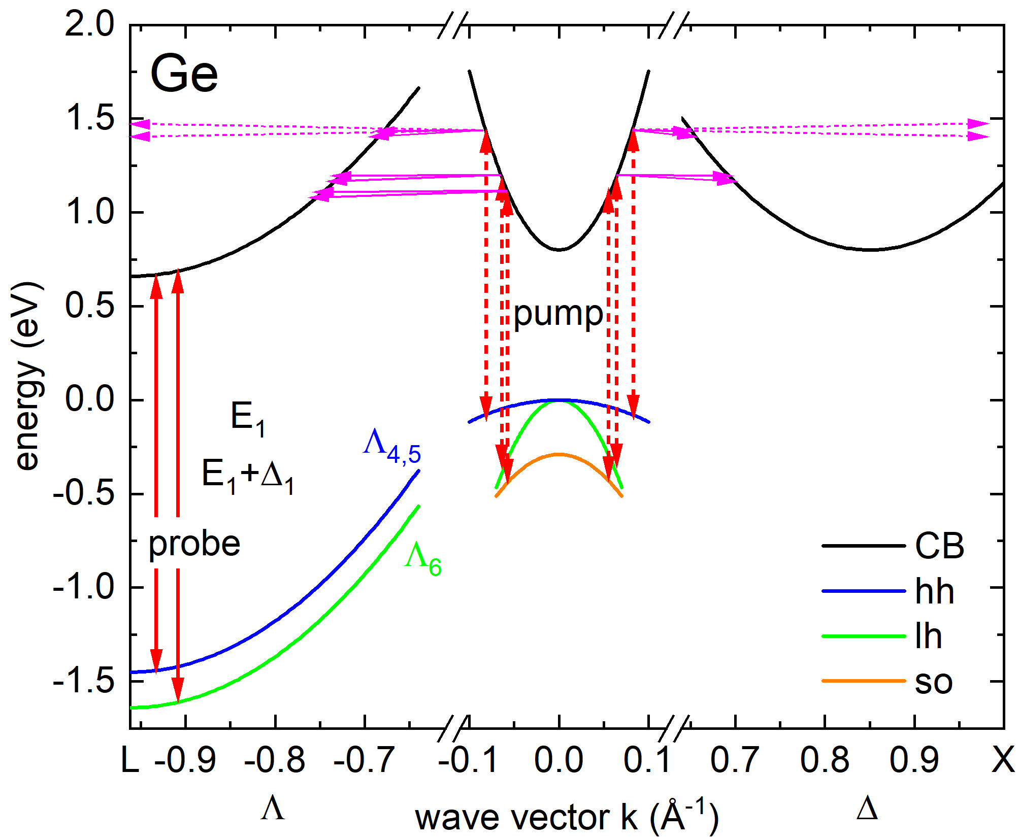
Optical Absorption at High Carrier Densities
InSb
High temperature
(thermal excitation of e-h pairs)
constant m and E_{g}
Intense femtosecond laser excitation (ELI Beamlines)
(electrons pile at L-point)
High n-doping of Ge with P
(free electrons pile up at L-point)
Rivero, JVSTB 41, 022203 (2023)
Xu et al., PRL 118, 267402 (2017)
Espinoza, APL 115, 052105 (2019)
18

Slide 19
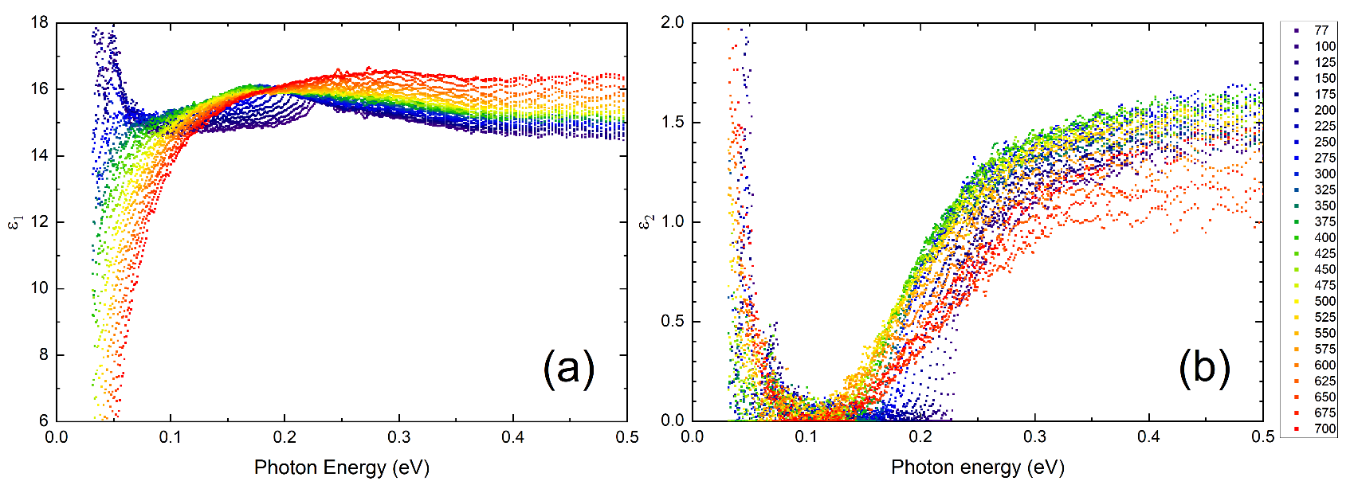
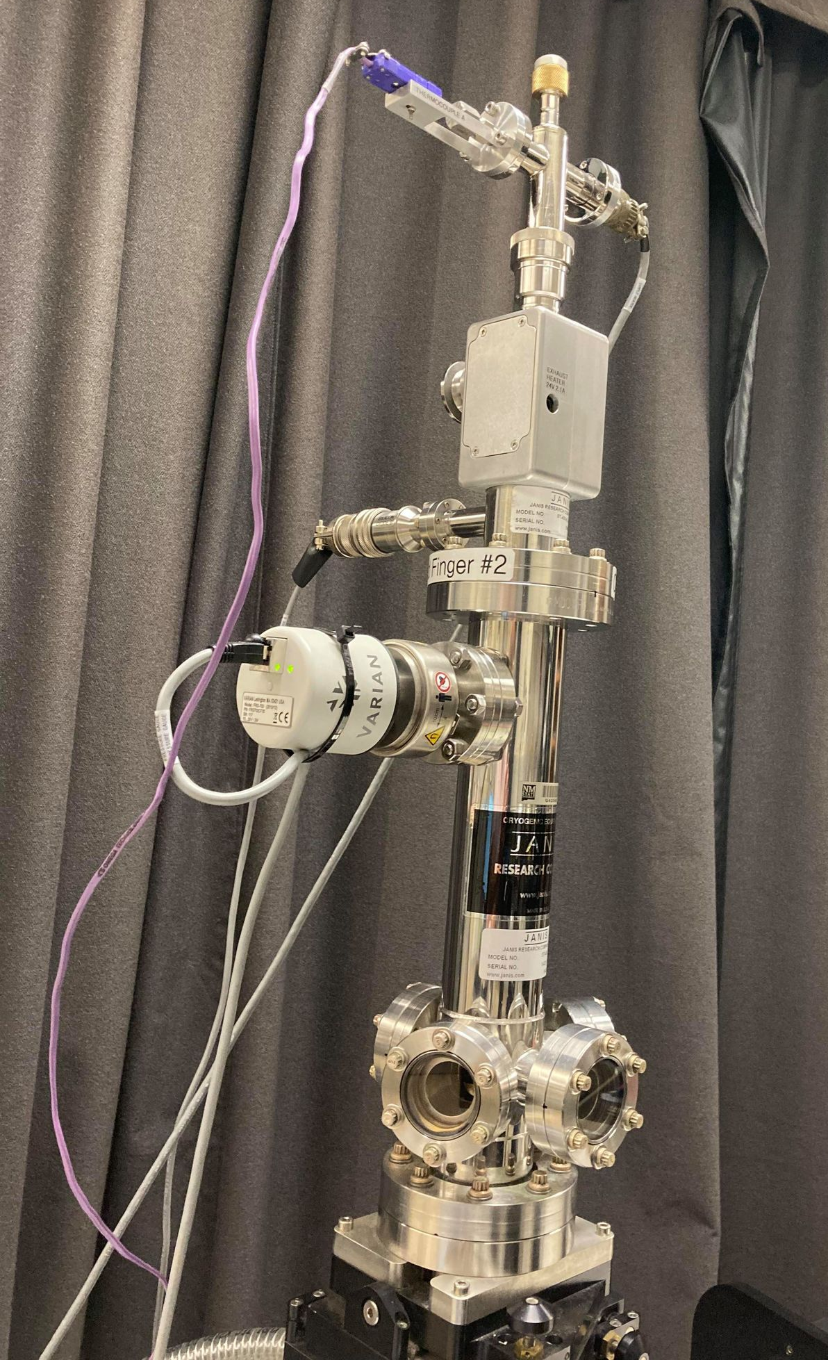
(1) Dielectric function of InSb from 80 to 800 K
InSb
InSb
Band gap changes with temperature (but only below 500 K).
Amplitude reduction at high temperatures (Pauli blocking, bleaching)
Drude response at high temperatures (thermally excited carriers).
Depolarization artifacts at long wavelengths (below 300 K).
Woollam FTIR-VASE
cryostat with CVD diamond windows
Rivero Arias, JVSTB 41, 022203 (2023)
19

Slide 20
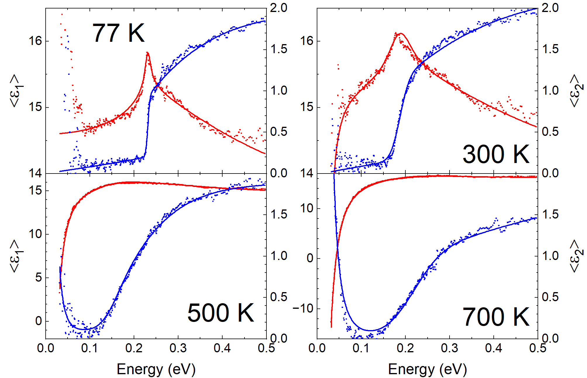
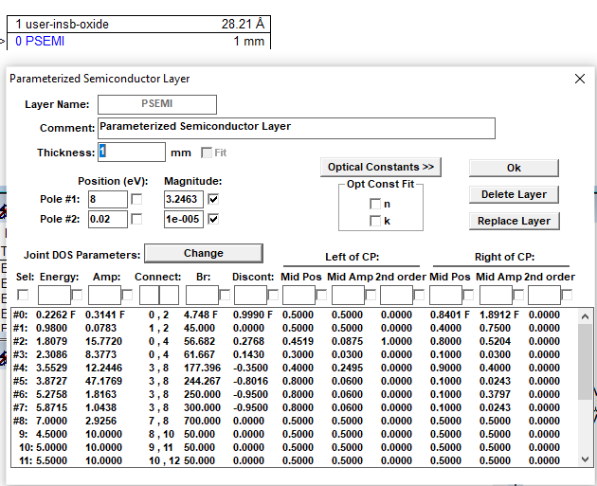
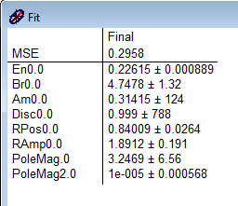
Band gap analysis for InSb
How does the band gap of InSb change with temperature?
Parametric-Semiconductor Model:
Also vary
“shape parameters”.
Asymmetric peak shape poorly described.
Try Tanguy oscillator for excitonic line shape.
InSb
C. M. Herzinger, B. Johs, et al., J. Appl. Phys. 83, 3323 (1998)
Rivero Arias, JVSTB 41, 022203 (2023)
20

Slide 21
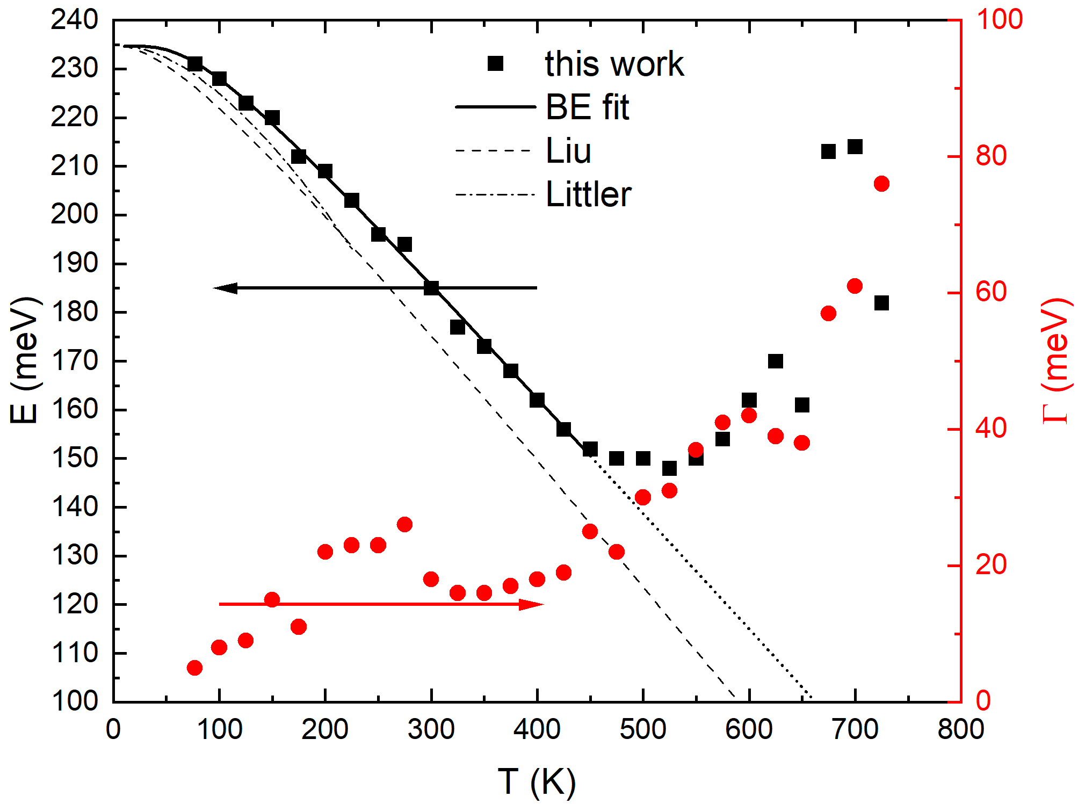
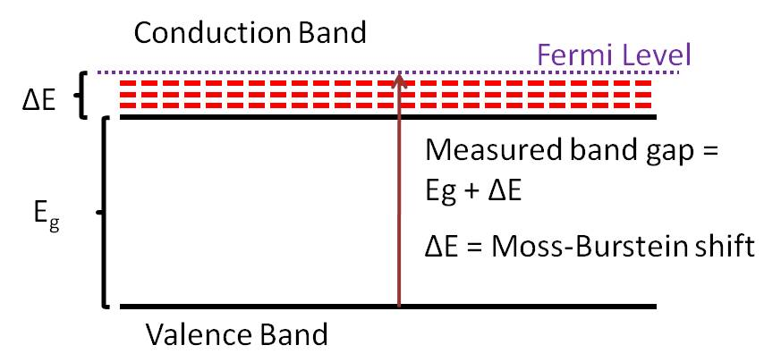

Band gap of InSb from 80 to 800 K
InSb
Bose-Einstein Model
$E_{g}\left(T\right)=a−b [1+\frac{2}{e^{\frac{θ}{T}}−1}$]
Band gap changes with temperature (but only below 500 K)
Described by Bose-Einstein model below 500 K: Logothetidis, PRB 31, 947 (1985).
No redshift above 500 K: Thermal Burstein-Moss shift
T.S. Moss, Proc. Phys. Soc. 67, 775 (1954).
E. Burstein, Phys. Rev. 93, 632 (1954).
21

Slide 22
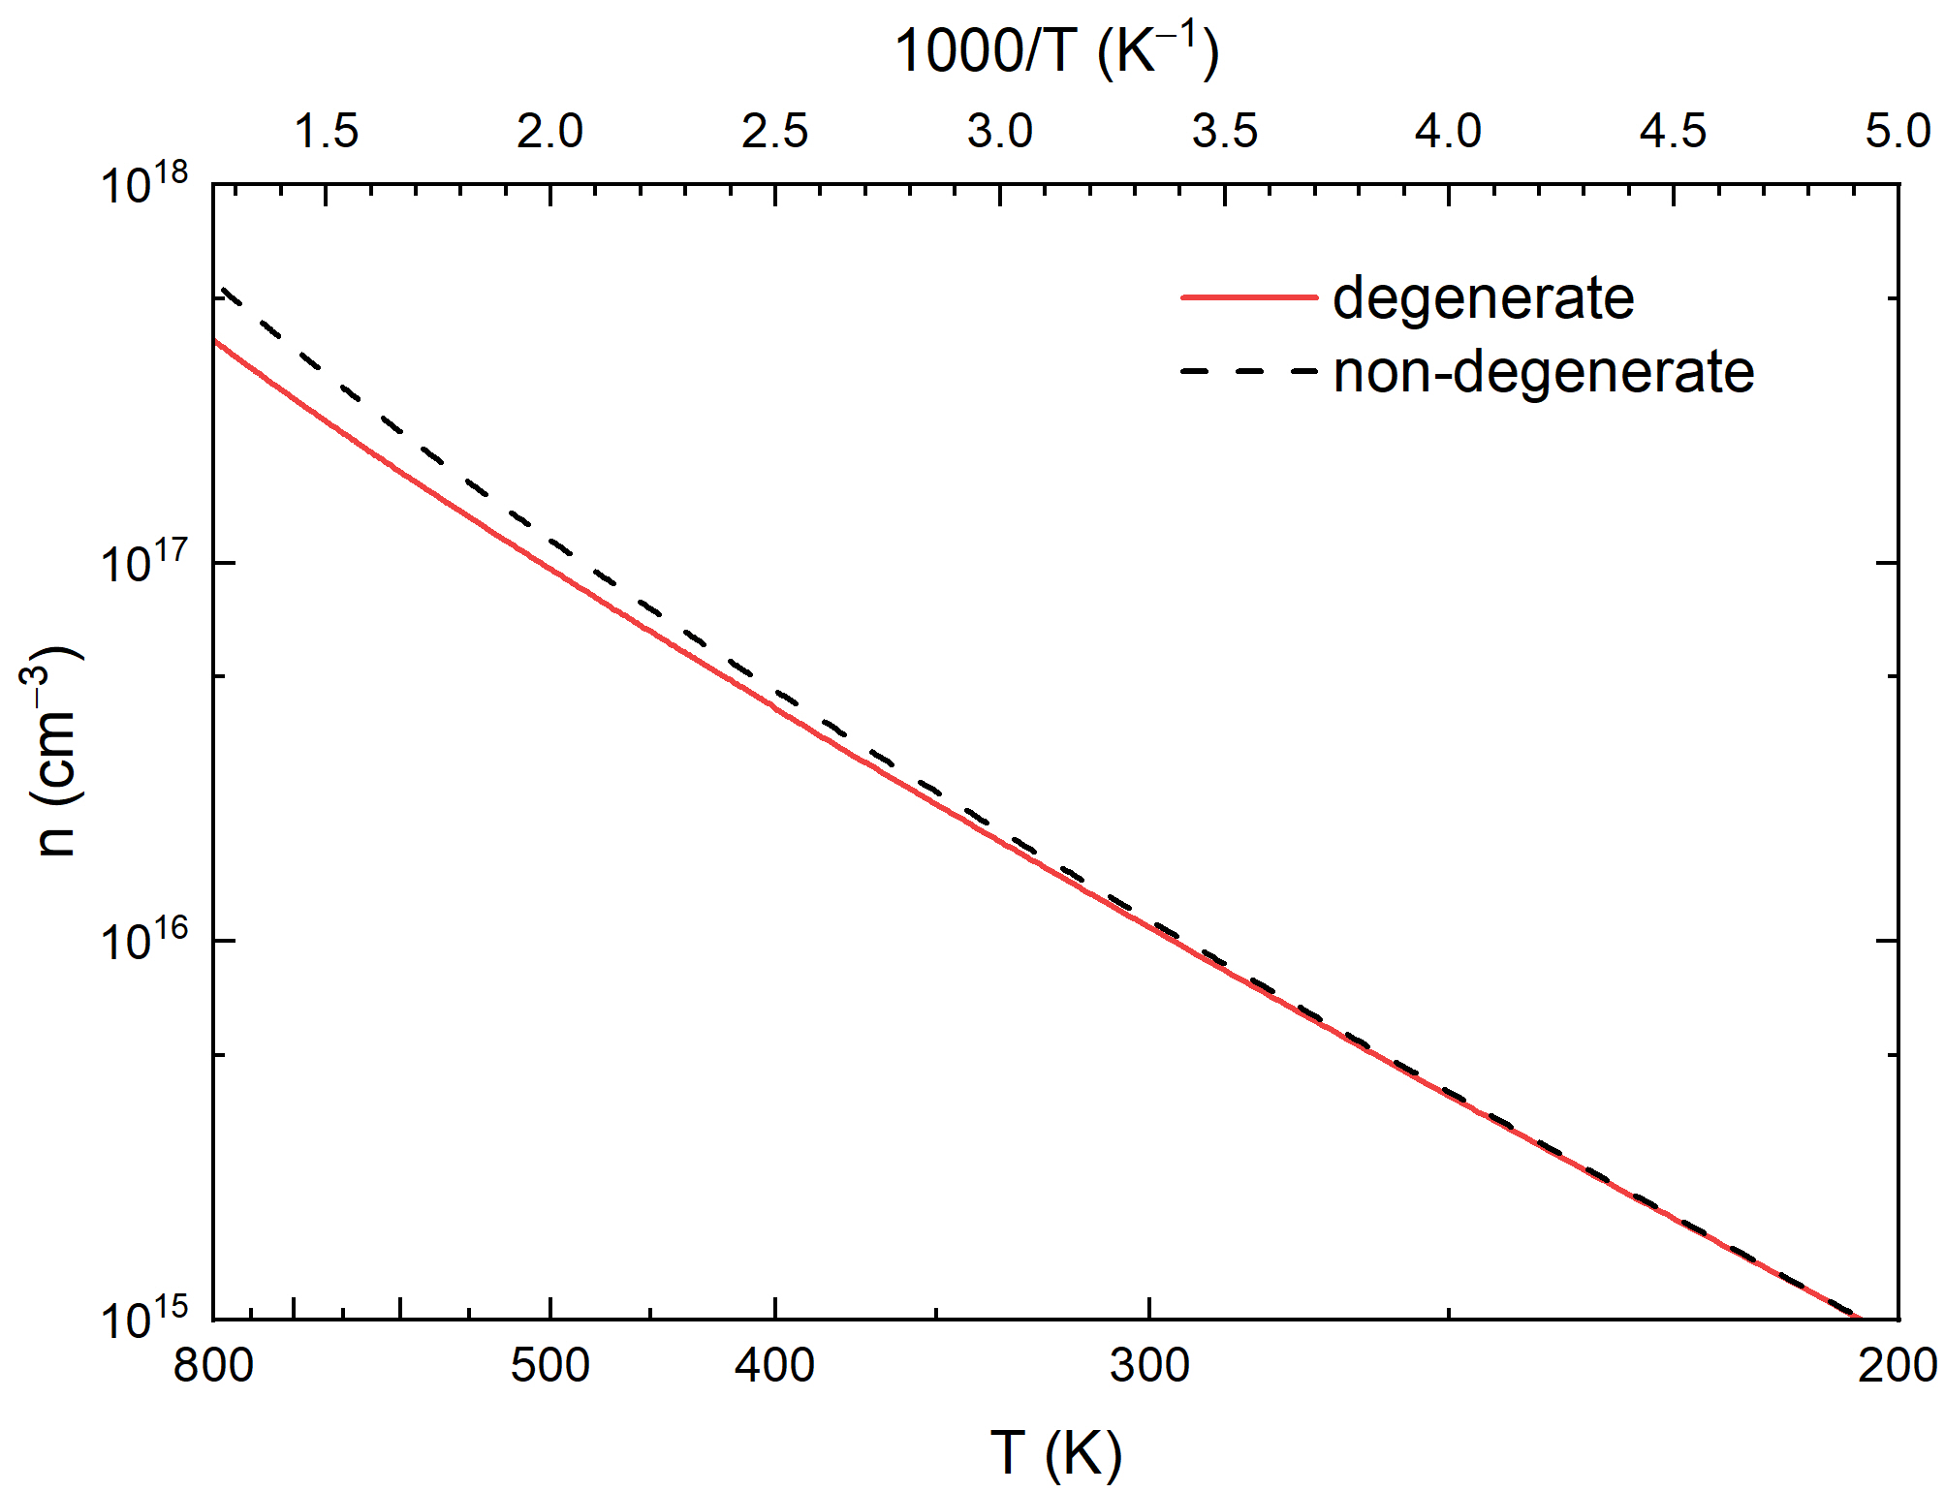
Thermal excitations of electron-hole pairs in InSb
n=4x10¹⁷ cm⁻³ at 800 K
InSb
(simple model)
Calculated for constant mass and band gap.
Thermal Burstein-Moss shift
Drude response of free carriers
Reduction of absorption coefficient
k_{B}T=E_{g}/4 at 600 K
Fermi level above the conduction band edge above 450 K.
(Calculated for constant m and E_{g}⁾
Rivero Arias, JVSTB 41, 022203 (2023)
22

Slide 23
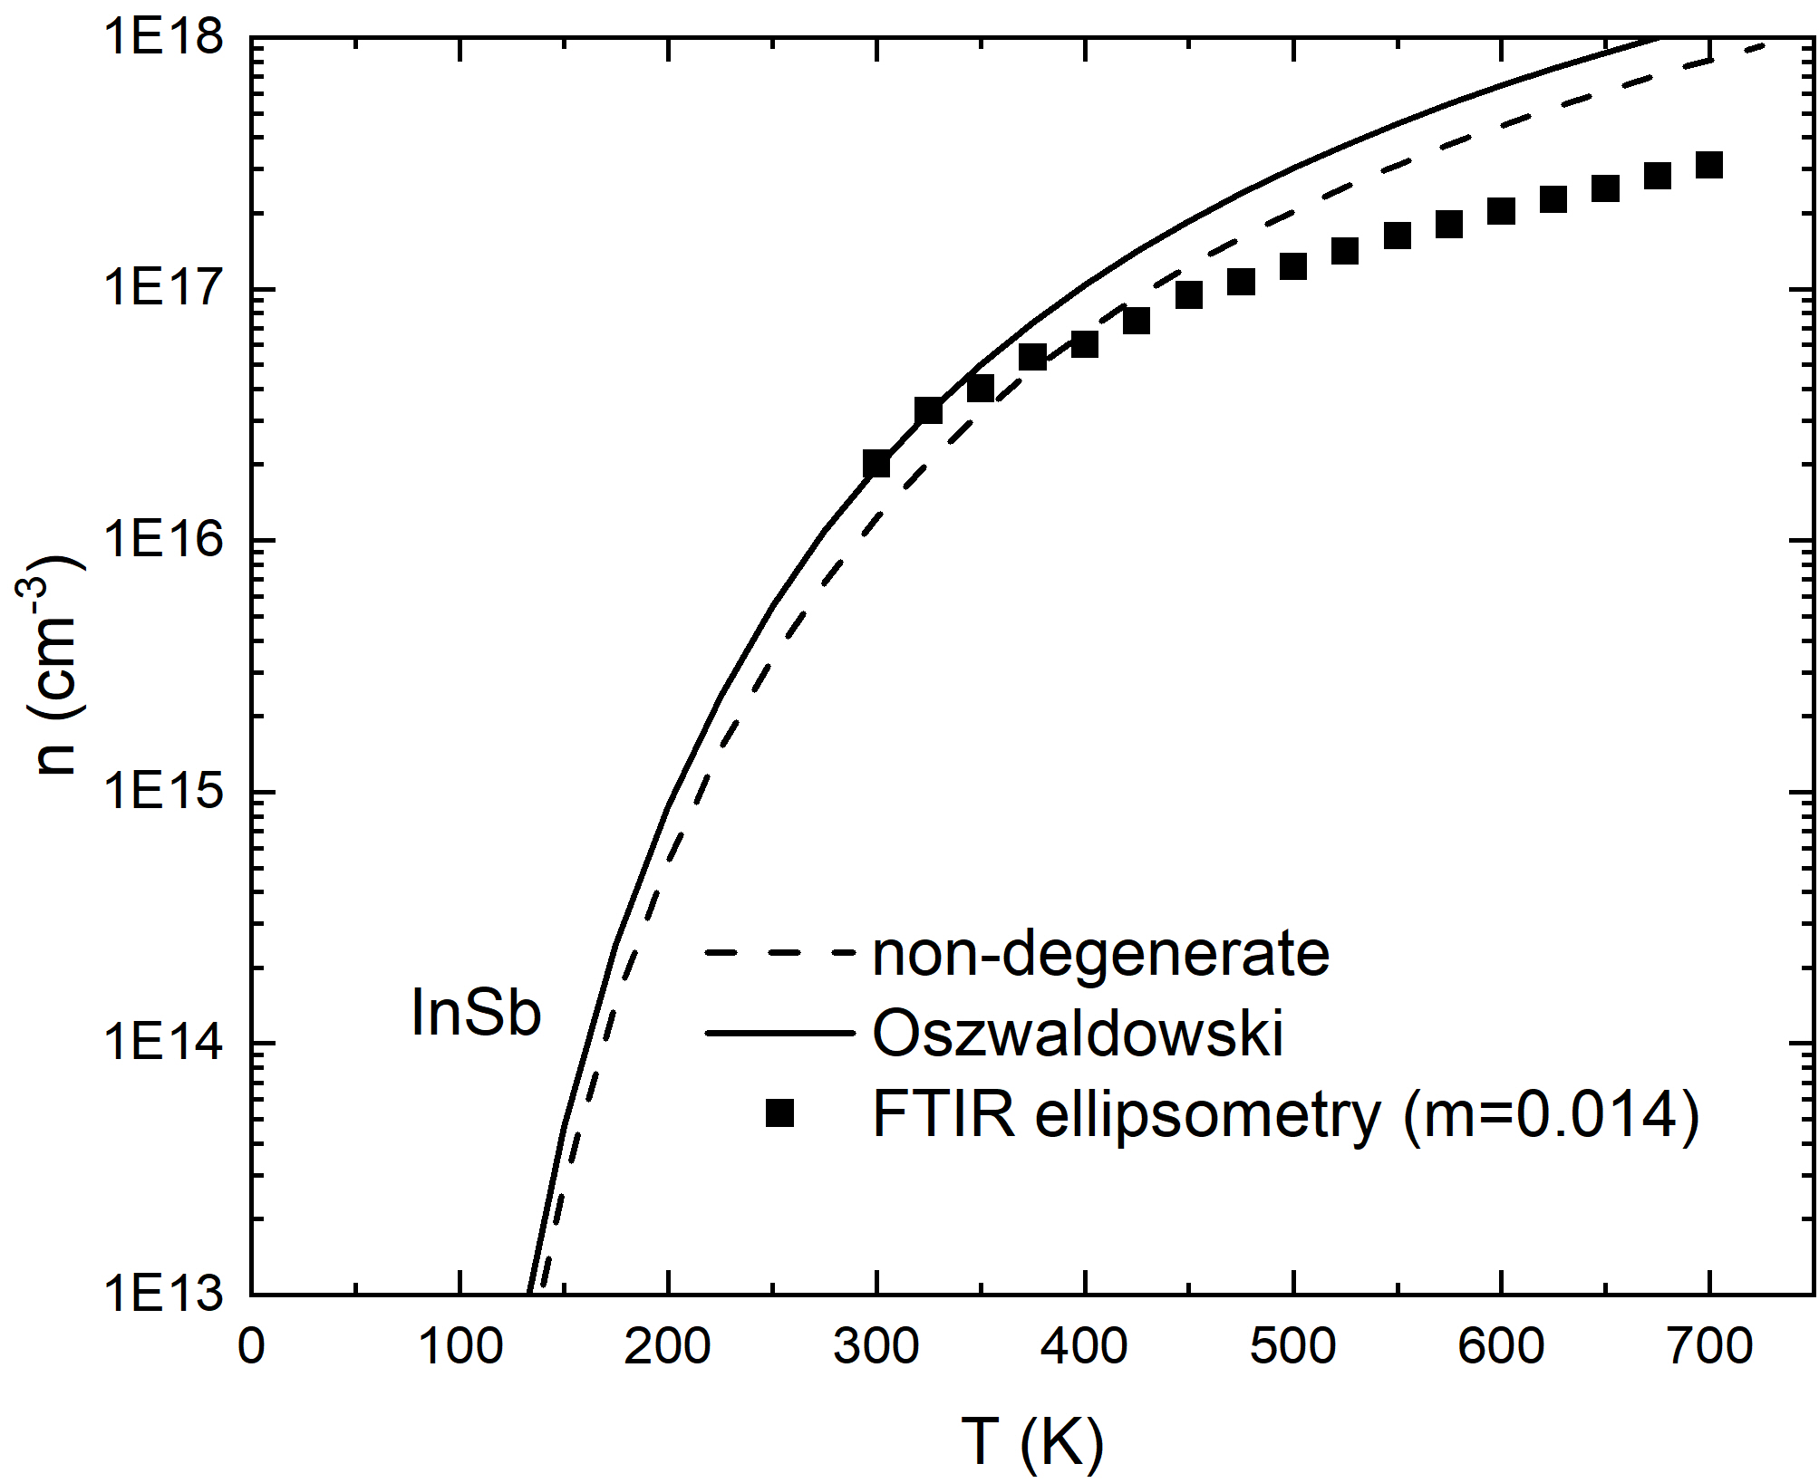
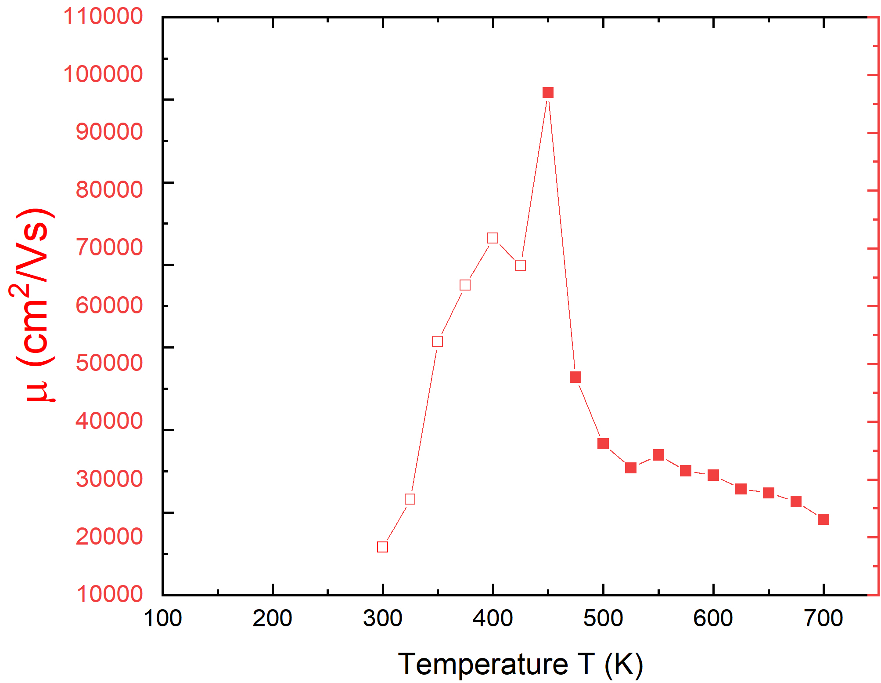
Carrier concentration and mobility from 80 to 800 K
To model the Drude response, we make some really simple assumptions:
Parabolic bands (ignore non-parabolicity)
Effective mass constant m_{e}=0.014 (independent of temperature)
Drude mobility of InSb
Carrier concentration
of InSb
Reasonable agreement with Hall measurements.
Large errors below 400 K (depolarization).
Oswaldowski/Zimpel, J. Phys. Chem. Solids 49, 1179 (1988).
D. L. Rode, Phys. Rev. B 3, 3287 (1971).
23

Slide 24
Required model improvements: Screened Excitons
$$ε_{2}\left(E\right)=\frac{2πA\sqrt{R}}{E^{2}}\left\{\sum_{n=1}^{\sqrt{g}}{\frac{2R}{n}\left(\frac{1}{n^{2}}−\frac{n^{2}}{g^{2}}\right)δ\left[E−E_{0}+\frac{R}{n^{2}}{\left(1−\frac{n^{2}}{g}\right)}^{2}\right]+\frac{\text{sinh}\left(πgk\right)\text{H}\left(E−E_{0}\right)}{\text{cosh}\left(πgk\right)−\text{cosh}\left(πg\sqrt{k^{2}−\frac{4}{g}}\right)}}\right\}\left[f_{h}\left(E\right)−f_{e}\left(E\right)\right]$$
Absorption by screened excitons (Hulthen potential)
Kramers-Kronig transform following Tanguy (includes broadening Γ)
Degenerate Fermi-Dirac statistics to calculate f_{h} and f_{e}.
Two terms for light and heavy excitons
Non-parabolicity and temperature-dependent mass included from k.p theory
k-dependent matrix element P.
Screening parameter g=12/π²a_{R}k_{TF} (large: no screening)
Only two free parameters: Band gap E₀ and broadening Γ
Amplitude A and exciton binding energy R from k.p theory and effective masses
Christian Tanguy, Phys. Rev. B 60, 10660 (1999).
Jose Menendez, Phys. Rev. B 101, 195204 (2020).
Carola Emminger, J. Appl. Phys. 131, 165701 (2022).

Slide 25
(2) Highly doped Ge (n-type, with phosphorus)
Electrons pile up at the L-point.
Transitions in red region blocked.
Phase filling singularity
Phase shift
Xu et al., PRL 118, 267402 (2017)
Xu et al., JAP 125, 085704 (2019)
25

Slide 26
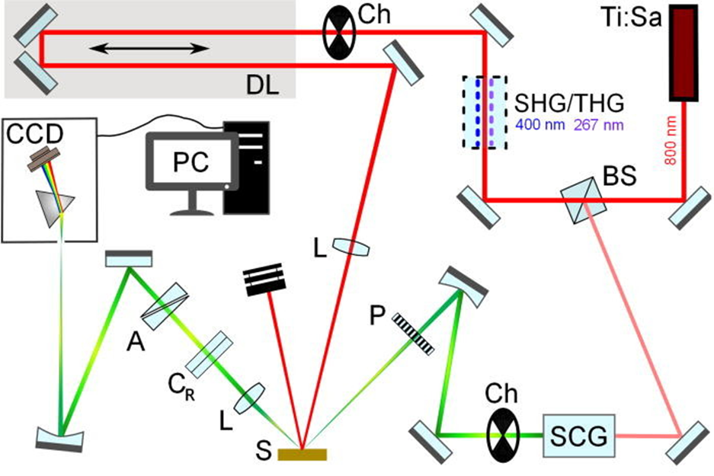
(3) Set-up: Femtosecond pump-probe ellipsometry
Ch: Chopper (500 Hz, 250 Hz)
A: Analyzer
P: Polarizer
C_{R}: Rotating compensator
L: Lens
S: Sample
DL: Delay Line (~6.67 ns pump-probe delay and 3 fs resolution)
BS: Beam splitter
SHG/THG: 2nd/3rd harmonic generation
SCG: Super-continuum generation
CCD: Charge-coupled device detector
Espinoza et al., APL 115, 052105 (2019).
26

Slide 27
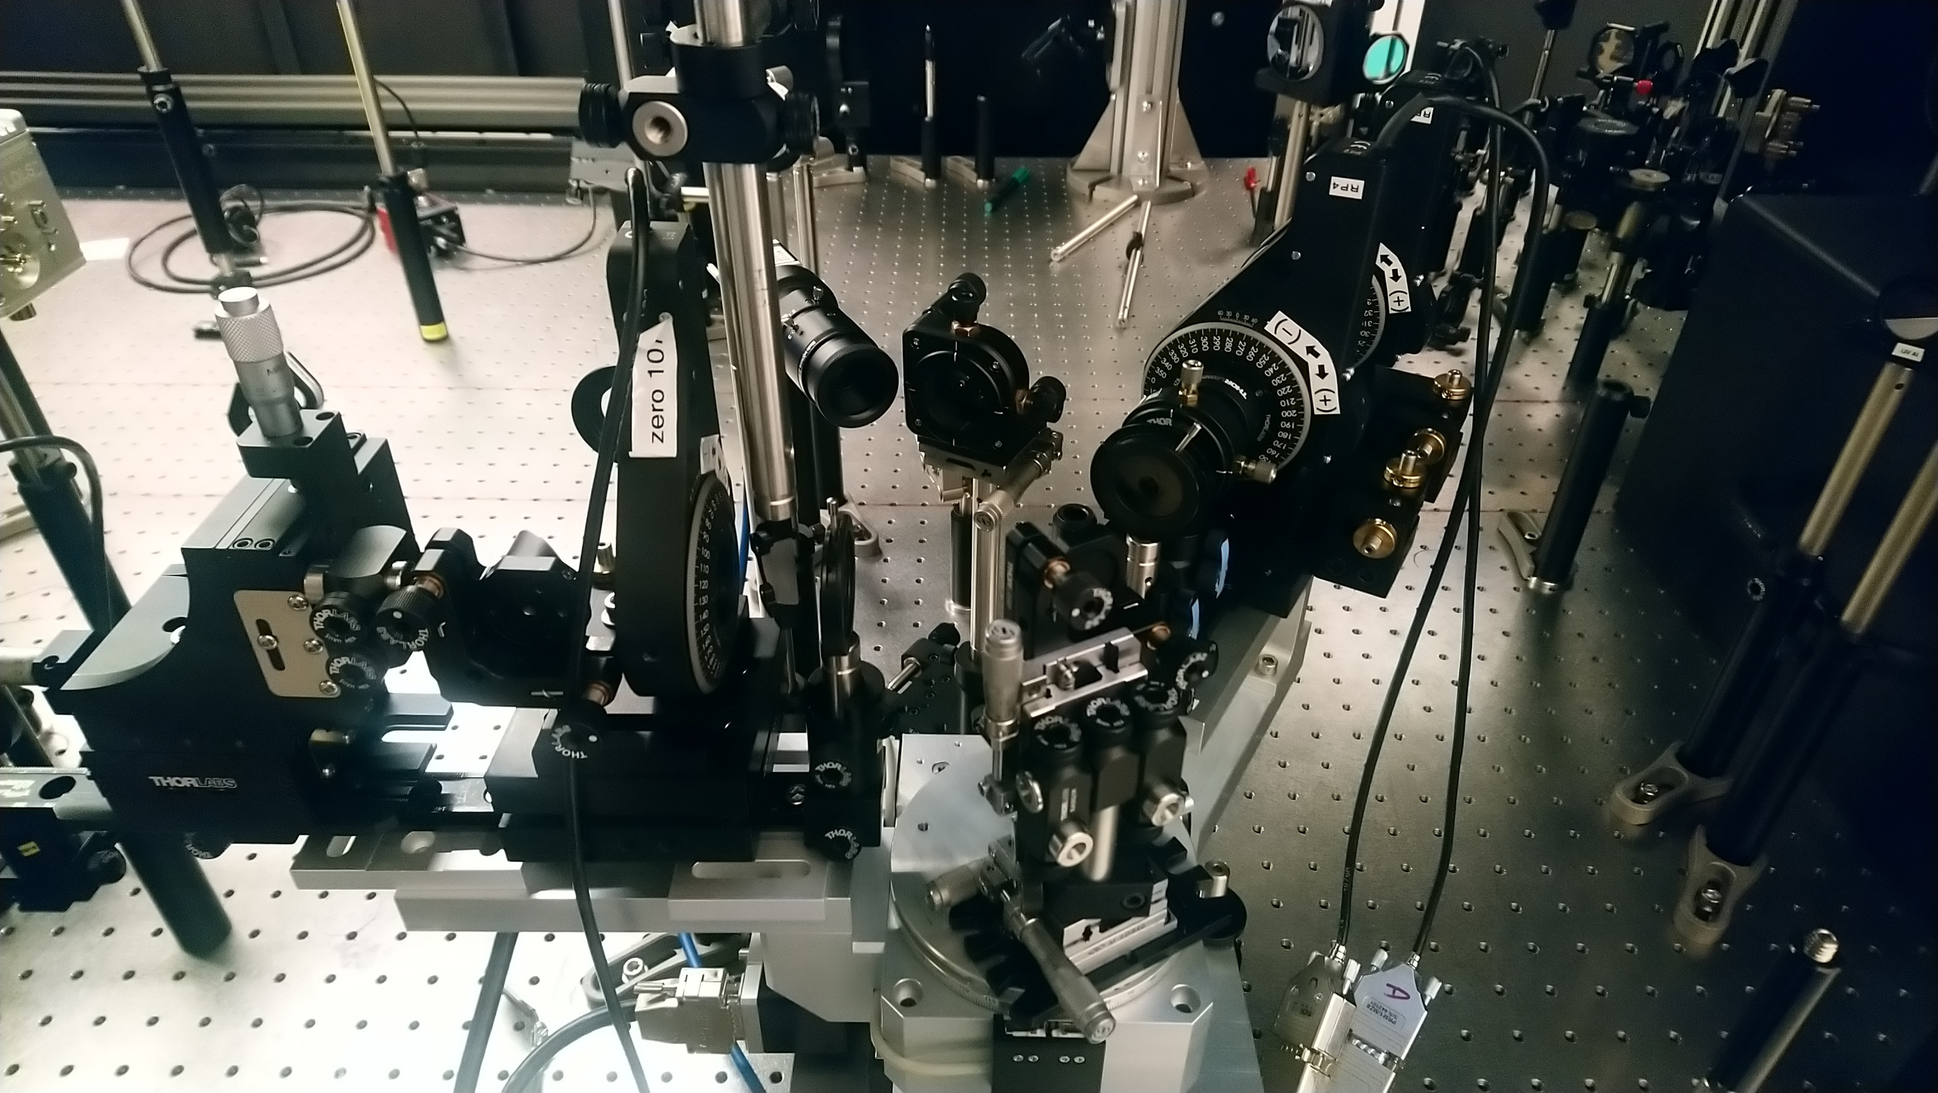
Set-up: Femtosecond pump-probe ellipsometry
Rotating compensator ellipsometer:
Compensator was rotated in steps of 10º for a total of 55-65 angles.
Probe beam of 350-750 nm at 60º incidence angle.
P-polarized pump beam: 35 fs pulses of 800 nm wavelength at 1 kHz repetition rate.
Delay time from -10 to 50 ps.
Time resolution of about 500 fs.
Pump Beam
Analyzer
Compensator
Polarizer
Sample Stage
Espinoza et al., APL 115, 052105 (2019).
27

Slide 28
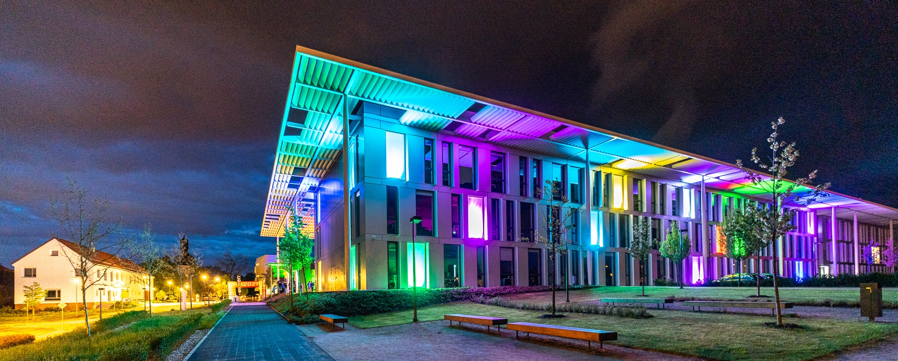
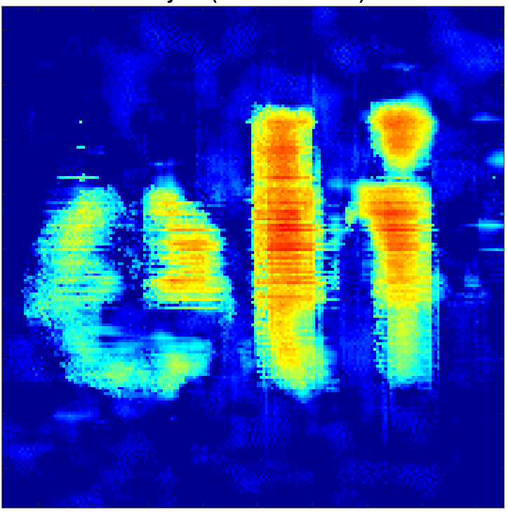
ELI Beamlines: ELI ERIC. Dolní Břežany (near Prague)
Second user call due April 25th, 2023: https://up.eli-laser.eu/
Contact Shirly Espinoza: shirly.espinoza@eli-beams.eu
Semiconductors
Metal oxides
Bulk and thin films
Etc.
28

Slide 29
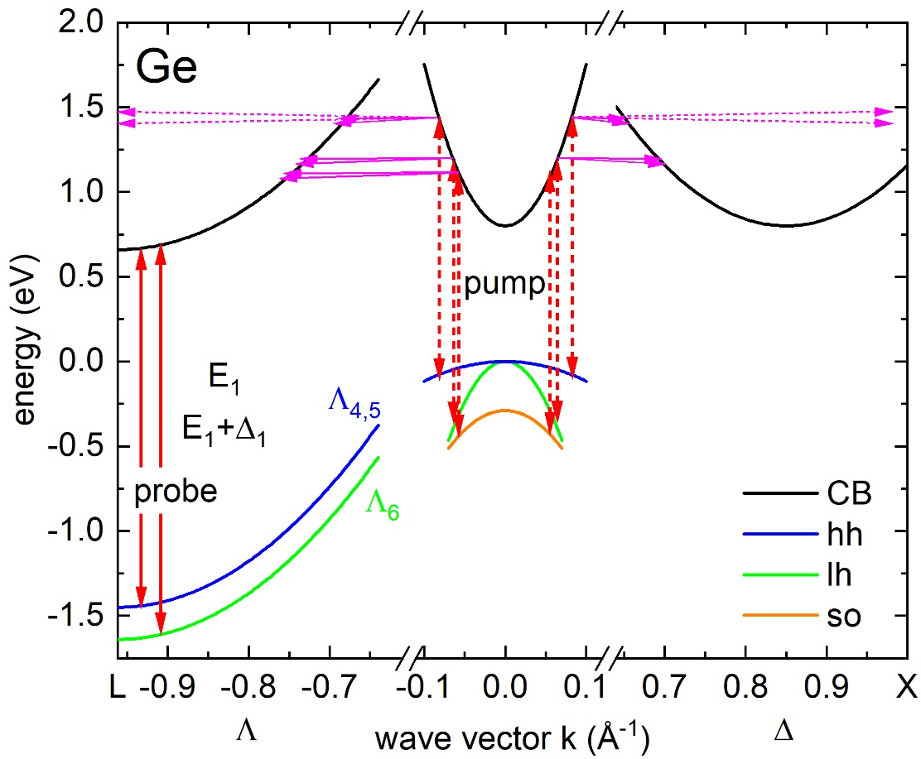
Ultrafast processes in photoexcited Germanium
1.55 eV pump beam creates N=10²¹ cm⁻³
electron-hole pairs near Γ-point. 9 mW power.
Heavy, light, split-off bands.
Ignore diffusion (for 1.55 eV pump).
Ignore Auger recombination.
Thermalization: Fermi-Dirac distribution
Intervalley scattering: Γ→X→L
Electrons accumulate at L.
Holes remain near Γ.
Electrons at L block E₁ and E₁+Δ₁ transitions
(Fermi-level singularity)
Bandgap renormalization:
redshift expected
Lattice heating (25 K): redshift
Exciton screening
E_{F}
Espinoza et al., APL 115, 052105 (2019).

Slide 30
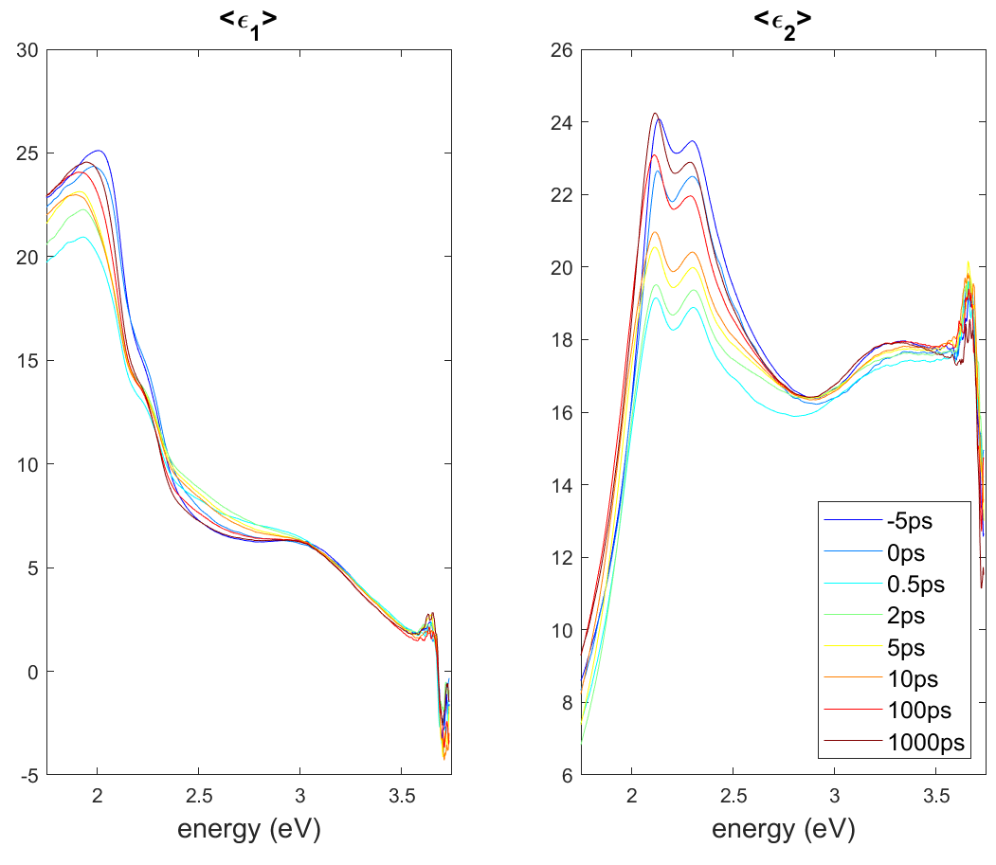
Ultrafast processes in photoexcited Germanium
1.55 eV pump beam creates N=4x10²¹ cm⁻³
electron-hole pairs near Γ-point.
The E₁ and E₁+Δ₁ peaks decrease within the first two picoseconds and then recover:
Band filling, excitonic screening followed by diffusion, Auger, and radiative recombination.
Maybe a Fermi level singularity near 2.6 eV.
Detailed modeling is required
(Tanguy 2-D excitonic line shapes, including Fermi level singularity.)
Carlos Armenta, February 2023, unpublished.

Slide 31
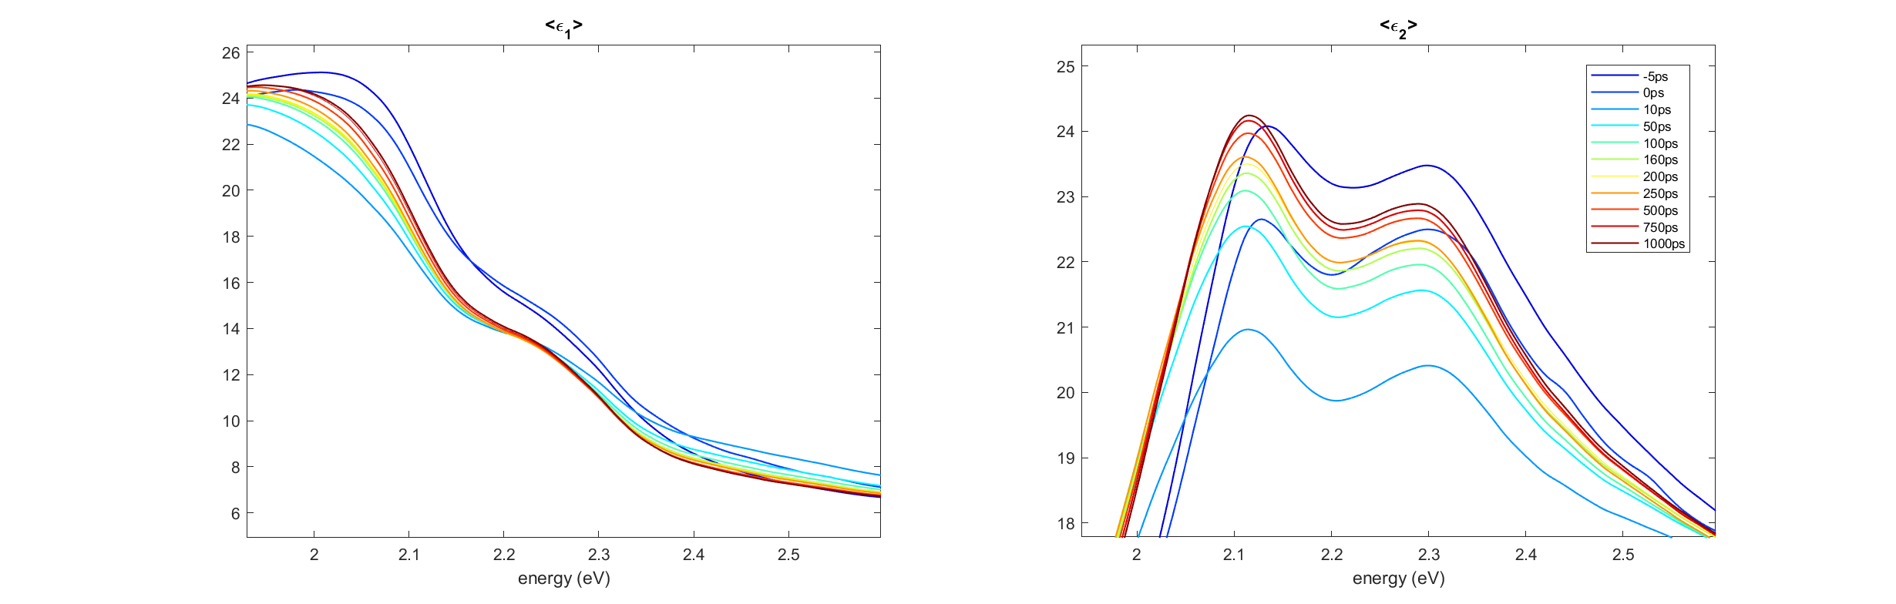
Ultrafast processes in photoexcited Germanium
1.55 eV pump beam creates N=4x10²¹ cm⁻³
electron-hole pairs near Γ-point.
The E₁ and E₁+Δ₁ peaks decrease within the first two picoseconds and then recover.
(Band filling, excitonic screening followed by diffusion, Auger, and radiative recombination)
Maybe a Fermi level singularity near 2.6 eV.
It looks like there is a redshift, but we need a line shape analysis with derivatives.
Carlos Armenta, February 2023, unpublished.

Slide 32
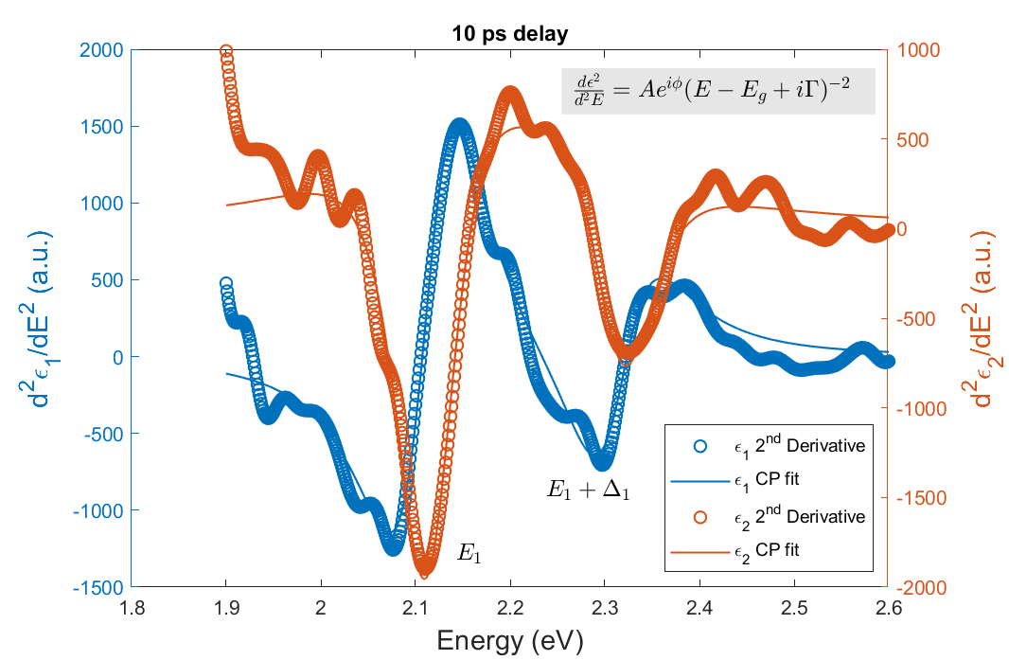
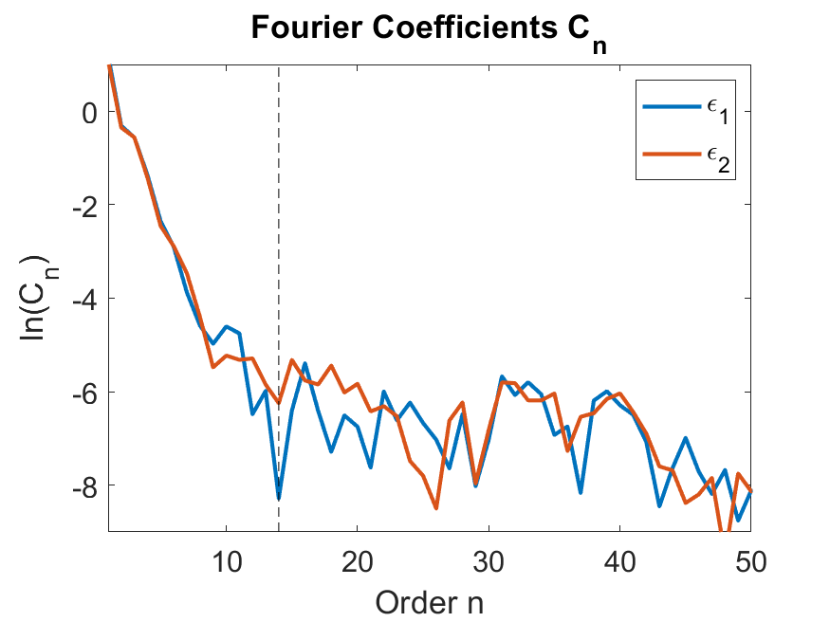
Derivative analysis: critical point parameters
Extended Gauss filter
Filter width determined from Fourier coefficients
Carlos Armenta, February 2023, unpublished.
Emminger el al., PSS RRL 2022, 2200058.
Le, JVST B 37, 052903 (2019);

Slide 33
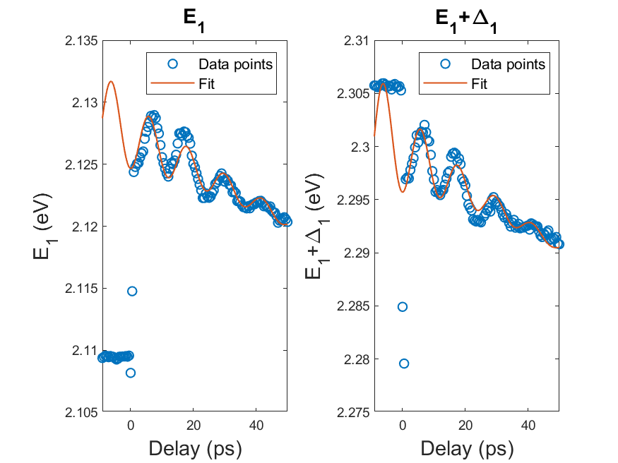
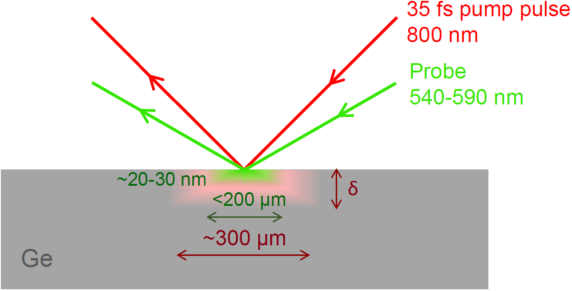
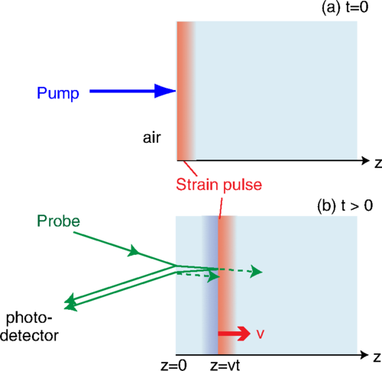

Coherent acoustic phonon oscillations
~5 meV
~19.5 meV
redshift
Fermi singularity or strain ???
blueshift
$$T≈\frac{λ}{2vn}=9−11 \text{ps}$$
Carlos Armenta, February 2023, unpublished.
Emminger el al., PSS RRL 2022, 2200058.

Slide 34
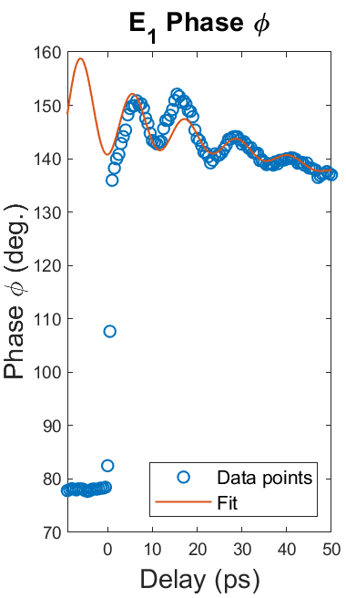
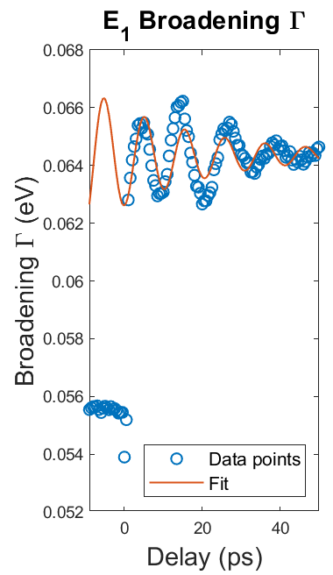
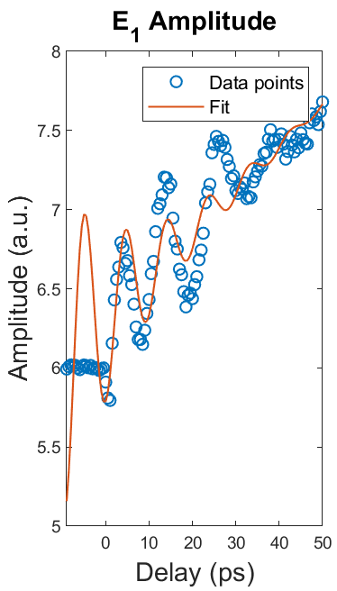
Critical point parameters for E₁ and E₁+Δ₁
~5 meV
Phase shift
~19.5 meV
No red shift: phase angle changes. Where is BGR?
Carlos Armenta, February 2023, unpublished.
Emminger el al., PSS RRL 2022, 2200058.

Slide 35
Conclusions
Quantitative modeling of low-density optical processes is possible with basic physics and matrix elements from k.p theory:
  Photoluminescence in Ge
  Indirect gap absorption in Ge
  Direct gap absorption in Ge at low T
  More work is needed at high temperatures and for materials other than Ge.
High carrier excitations:
  High electron doping density in Ge
  Thermal excitation of electron-hole pairs in InSb
  Femtosecond laser generation of electron-hole pairs in Ge (ELI Beamlines)
  Experimental data and qualitative explanations exist
We need more experiments and more detailed theory and simulations.
Notes:
Birstein-Moss shift

Slide 36
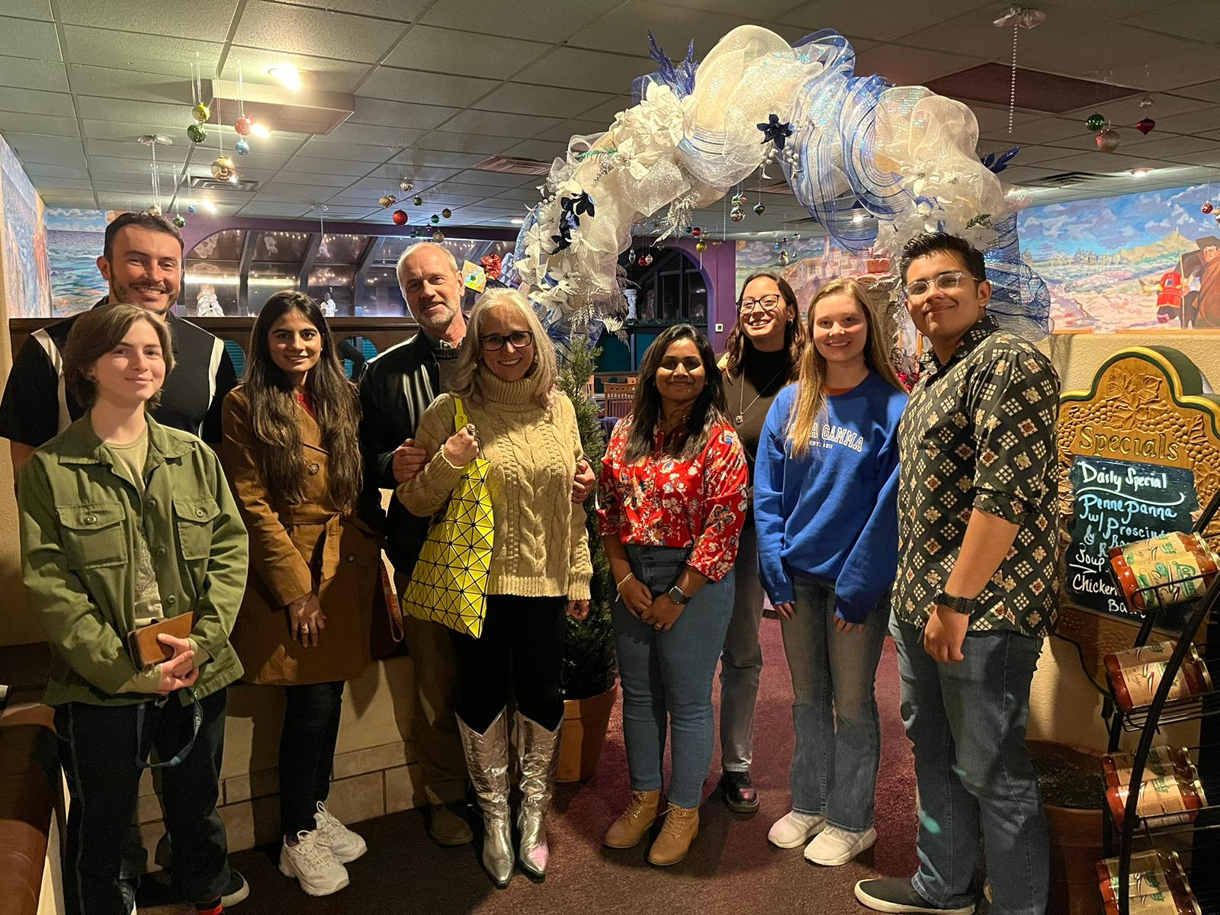
Thank you!
Questions?

Slide 37
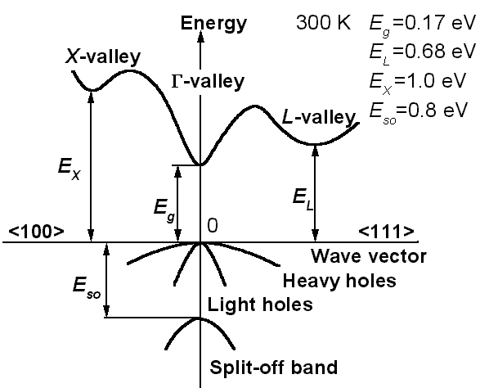
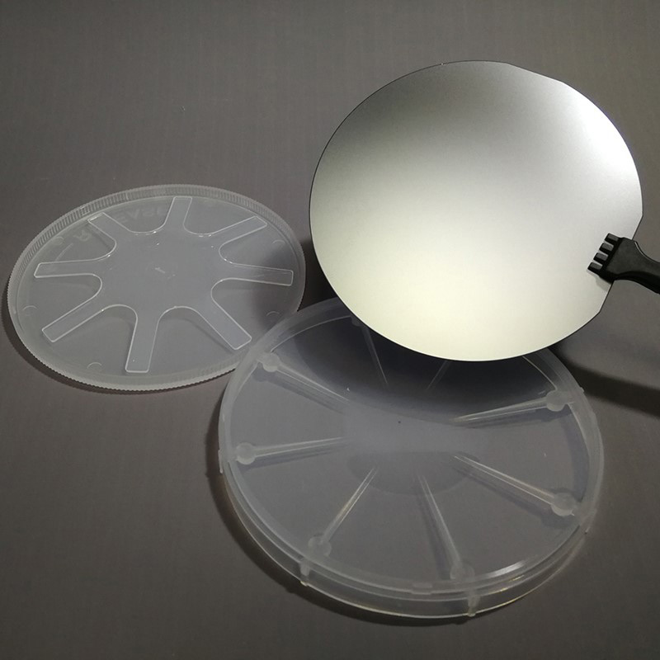
Direct band gap of InSb from 80 to 700 K
Measurement of the dielectric function of bulk InSb from 80 to 700 K near the direct band gap (E₀)
Bulk InSb: Commercial (MTI),
(100) orientation, undoped, n-type, rough back side
Direct Bandgap at 300 K: 0.17 eV

Slide 38
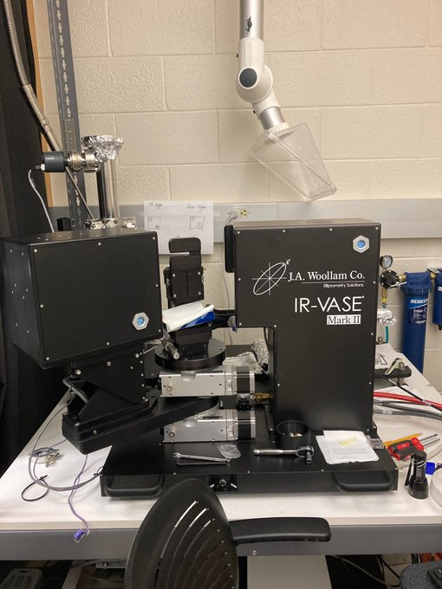
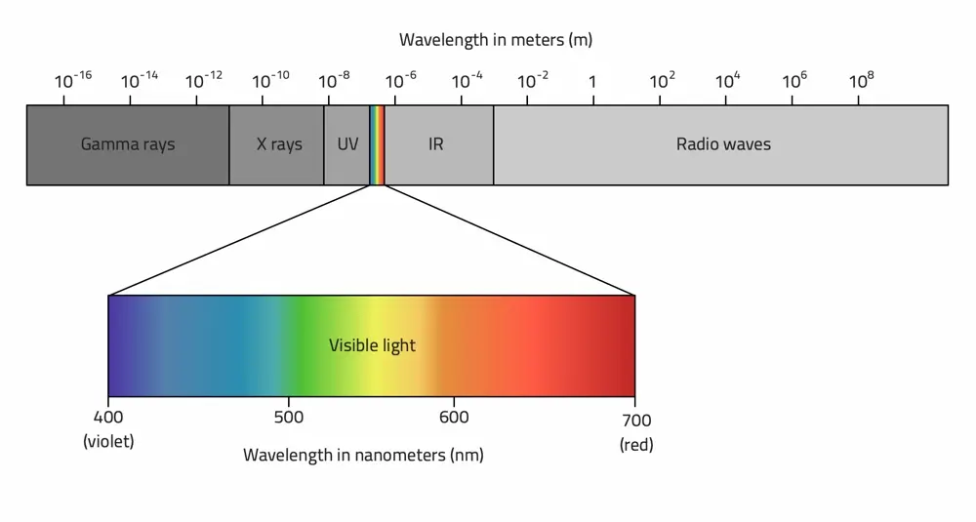

Ellipsometry from 190 nm to 40,000 nm
Two different instruments are used for measurements from the mid-infrared to the deep ultraviolet spectral range.
J.A. Woollam IR-VASE
SZ, Spectroscopic Ellipsometry from 10 to 700 K, Adv. Opt. Technol. 11, 117 (2022).
J.A. Woollam V-VASE

Slide 39

Temperature-dependent ellipsometry: 80-700 K
Using FTIR spectroscopic ellipsometry in an ultra-high vacuum (UHV) cryostat with CVD diamond windows (Janis ST-400, Diamond Materials GmbH, Freiburg).
Why diamond? Large transparency range and good vacuum seals, but expensive and high reflection losses.
Energies: 30-40 meV to 1 eV
VIS-UV and FTIR spectra (dielectric functions) After oxide correction (25 Å)
Compare:
Aspnes, PRB 27, 985 (1983)
Logothetidis, PRB 31, 947 (1985).
Schaefer, JAP 127, 165705 (2020).
J.A. Woollam IR-VASE
Cryostat with CVD diamond windows
E₀
SZ, Adv. Opt. Technol. 11, 117 (2022).

Slide 40


InSb (100) sample preparation (cleaning)
The InSb (100) sample was cleaned using water and isopropanol on the ultrasonic cleaner for 15 min on each to remove organic layers before the temperature dependent ellipsometry measurements.
Also: Anneal sample at 450 K in UHV overnight (degas)
Not used: BrM, HCl-methanol
(Aspnes/Studna 1983)
 | Oxide Thickness (Å)
Before Clean | 28.2
After Clean | 22.5
Oxide and organic layers
InSb

Slide 41
InSb (100): Initial attempt was promising
Multiple experimental issues:
InSb sample cracks, melts, reacts with the Cu sample holder.
Adhesive (carbon nanoparticles, silver paint) expands, evaporates, redeposits on the windows.
Beam larger than sample: Depolarization from sample holder reflections.
Black-body radiation, heat shield.
Cryostat leaks, thermocouple breaks.
Initial result: Clear redshift with increasing temperature (up to 450 K).
Strange things happen above 450 K.

Slide 42






Data and oxide corrections (4 years later)
InSb pseudo-dielectric Functions (“raw” data) from 80 to 800 K
$$E_{0}$$
$$E_{0}$$
$$E_{0}$$
$E_{0}$= Bandgap
Band gap reduced with increasing temperature (but only below 500 K)
Drude response at high temperatures (thermally excited carriers)
Depolarization artifacts at long wavelengths (below 300 K)
SZ, Spectroscopic Ellipsometry from 10 to 700 K, Adv. Opt. Technol. 11, 117 (2022).

Slide 43




Band gap analysis
How does the band gap of InSb change with temperature?
Tauc Plot:
Parametric-Semiconductor Model:
Need linear region, not possible
$$α\left(E\right)=A\sqrt{E−E_{g}}$$
*manual extrapolation*
*Based on oscillator model*
C. M. Herzinger, B. Johs, et al., J. Appl. Phys. 83, 3323 (1998).

Slide 44
Conclusions
Dielectric function of InSb measured from 80 to 700 K (with oxide correction of 25±5 Å)
Band gap is difficult to determine from a Tauc plot.
Parametric semiconductor model shows great results for the band gap.
Band gap shrinks with increasing temperature, but only up to 500 K.
Band gap stays constant near 550 K and then increases again to 700 K.
Drude tail due to thermal excitation of electron-hole pairs.
Carrier concentration and mobility is reasonable (compared to Hall measurements).
Detailed modeling requires Tanguy-Elliott theory of absorption by screened excitons, non-parabolicity, degenerate Fermi-Dirac statistics, k.p theory (in progress).
InSb would behave as a topological insulator above melting point. Not possible.
M. Rivero Arias et al., JVST B (submitted).
Notes:
Birstein-Moss shift

Slide 45


Sad ending
Unfortunately, the InSb sample melted at 750 K, but melting point is 800 K…
Cannot become a topological insulator because it melts.
Before
After
Future work:
Repeat experiment at high temperatures (below 750 K).
Increasing and decreasing temperature scans.
M. Rivero Arias et al., JVST B (submitted).

