Slide 1
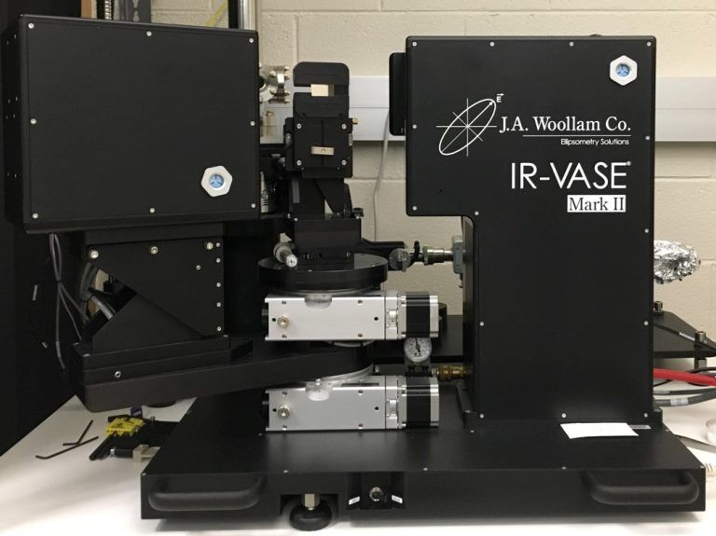
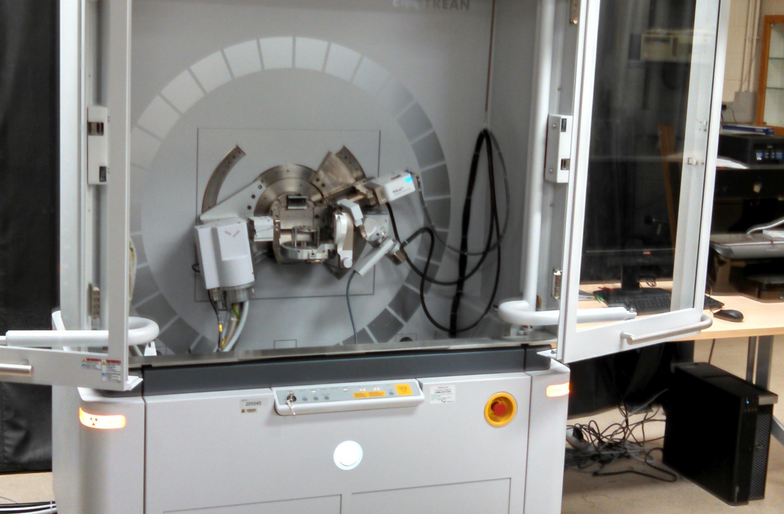
Thin-Film and Powder Characterization with X-rays and Polarized Light
Stefan Zollner
Head, Department of Physics, New Mexico State University, Las Cruces, NM
Email: zollner@nmsu.edu. WWW: http://femto.nmsu.edu or http://research.nmsu.edu/ResearchCores/XRAY.html
PANalytical Empyrean XRD

Slide 2
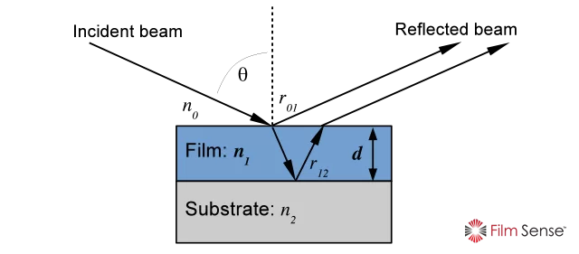
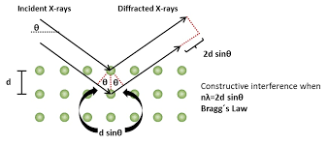
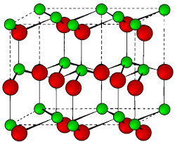
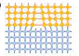
Thin Film and Powder Characterization
How thick is my film?
What are the film properties?
Thickness, density, roughness (XRR)
Band gap (Ellipsometry)
Refractive index and absorption coefficient
Infrared vibrations
Strain and stress, alloy composition
Lattice constants, crystal structure, position of the atoms in the cell
Orientation, epitaxial alignment
Temperature dependence of properties (10 to 800 K)
Powder and single-crystal characterization:
Chemical identification from diffraction patterns (PDF data base)
Lattice constants, crystal structure, position of the atoms in the cell
Rietfeld refinement
Oxide
Ge_{1-y}Sn_{y}
GaAs
2

Slide 3
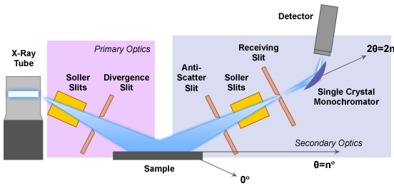
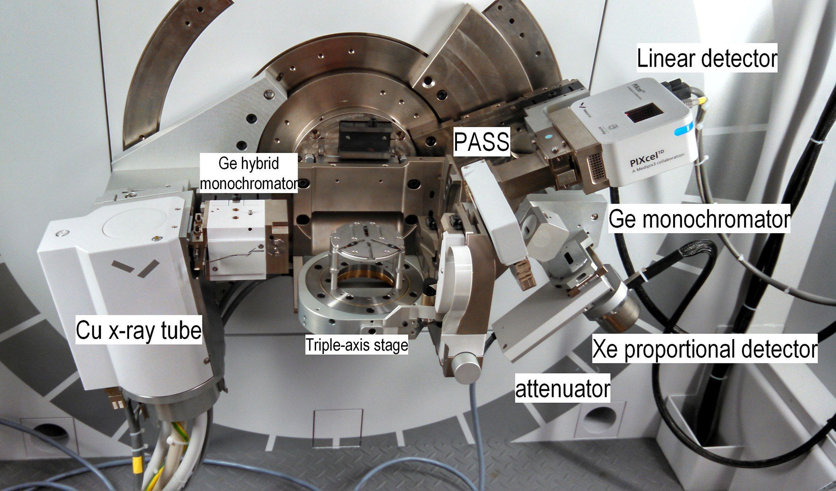
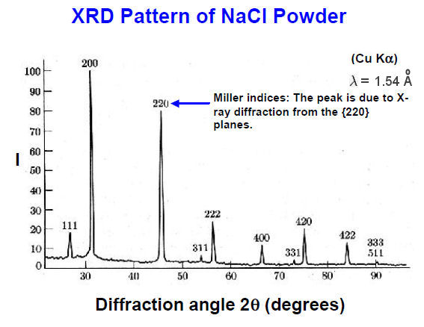
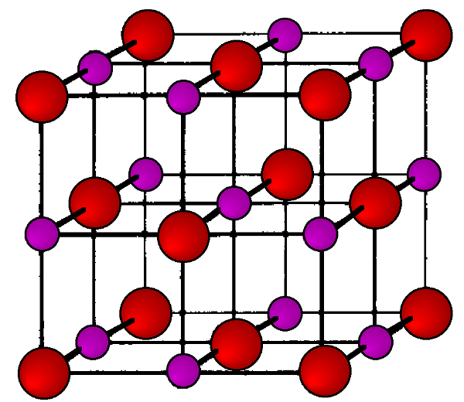

Powder X-ray Diffraction (XRD)
Bragg’s Law
$$2d\sin{θ=nλ}$$
3

Slide 4
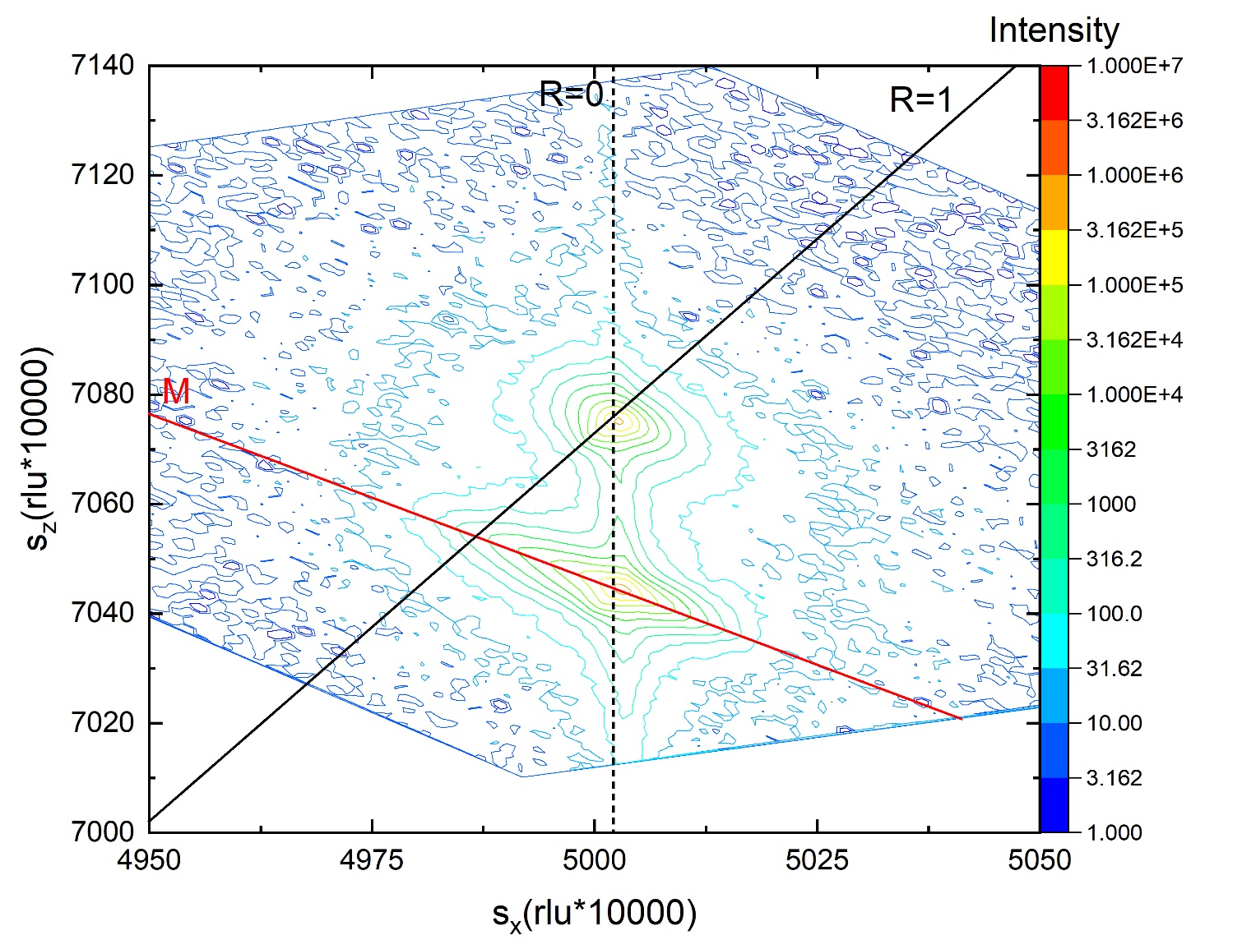
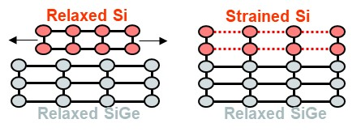
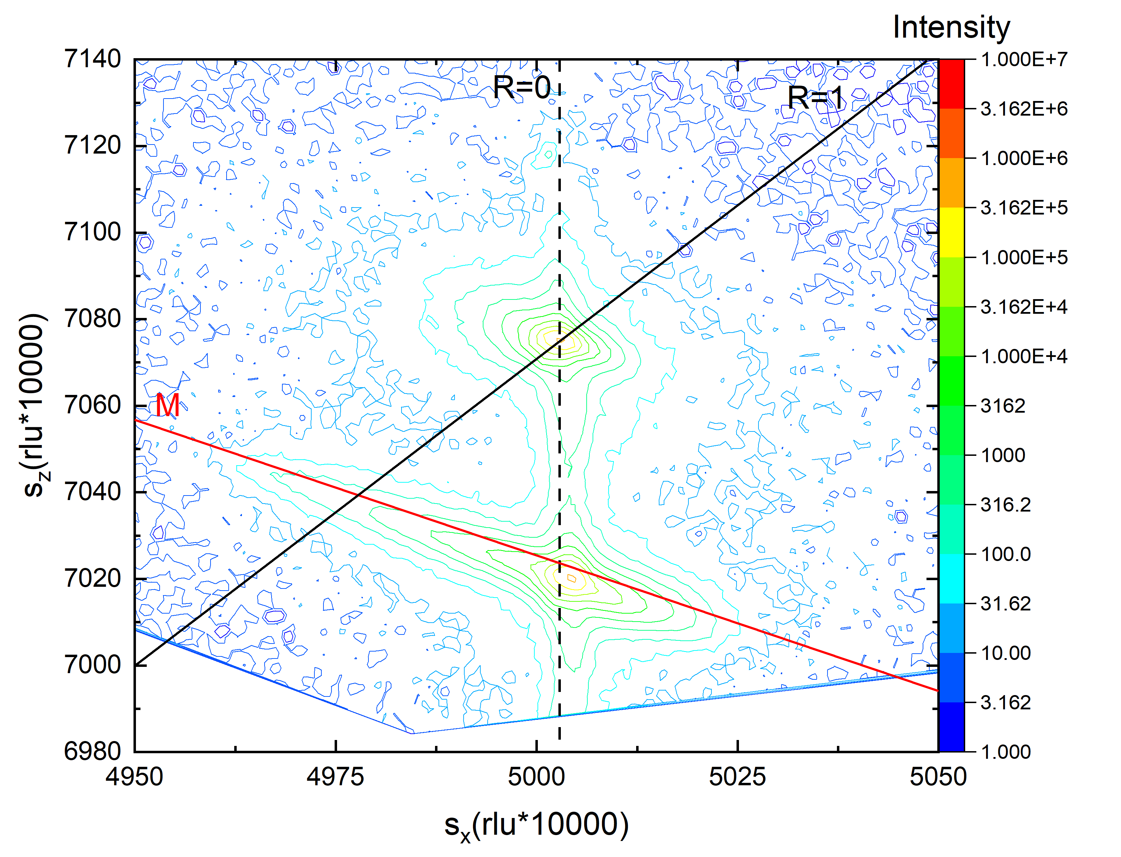
High-Resolution and Single-Crystal X-ray Diffraction (HR-XRD)
High-Resolution Diffraction: Requires monochromatic and parallel x-ray beam
Suitable for highly crystalline epitaxial layers.
Symmetric and asymmetric reciprocal space maps
Example: Germanium-tin alloy on GaAs
Measure strain, lattice constant, and composition
1.2% Sn
GaAs
GeSn
2.6% Sn
GaAs
GeSn
4

Slide 5
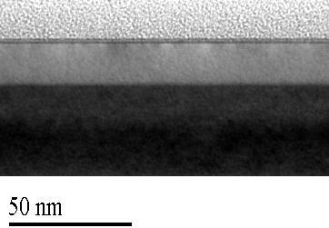
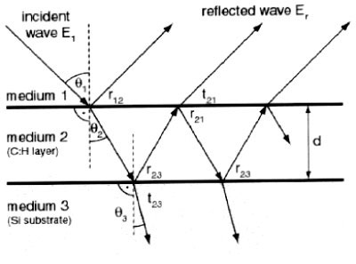
X-ray Reflectivity (XRR): Thickness, density, roughness
Oxide: 1.4 nm thick, 71% density, 0.4 nm rms
Si: 17.2 nm thick, 100% density (fixed), 3 nm rms
SiGe: 26% Ge (fixed), 95% density, 0.5 nm rms
Transmission electron micrograph
epoxy
Si
TEM: 16-17 nm thick. SIMS: 26% Ge. Raman: 75% strained.
For this smooth sample (0.6 nm rms) XRR gives excellent results.
SiGe
5

Slide 6
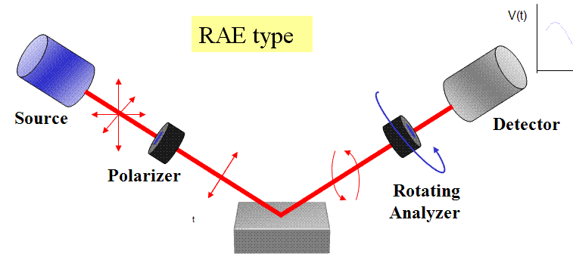
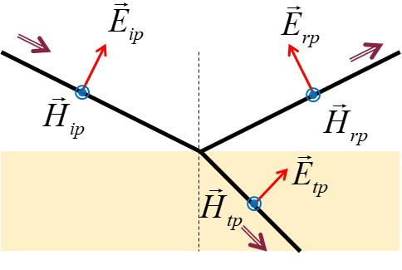
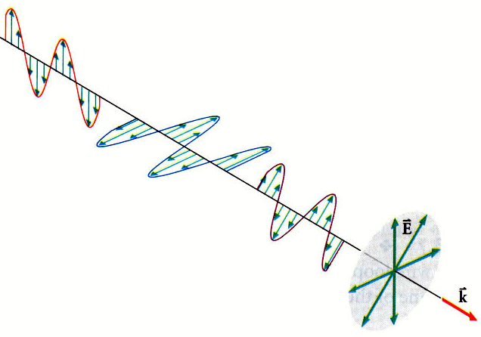
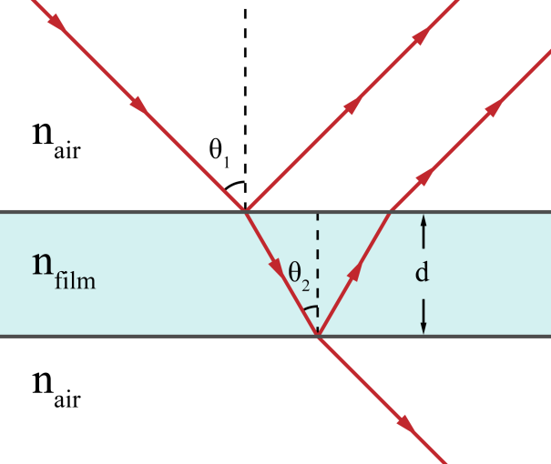
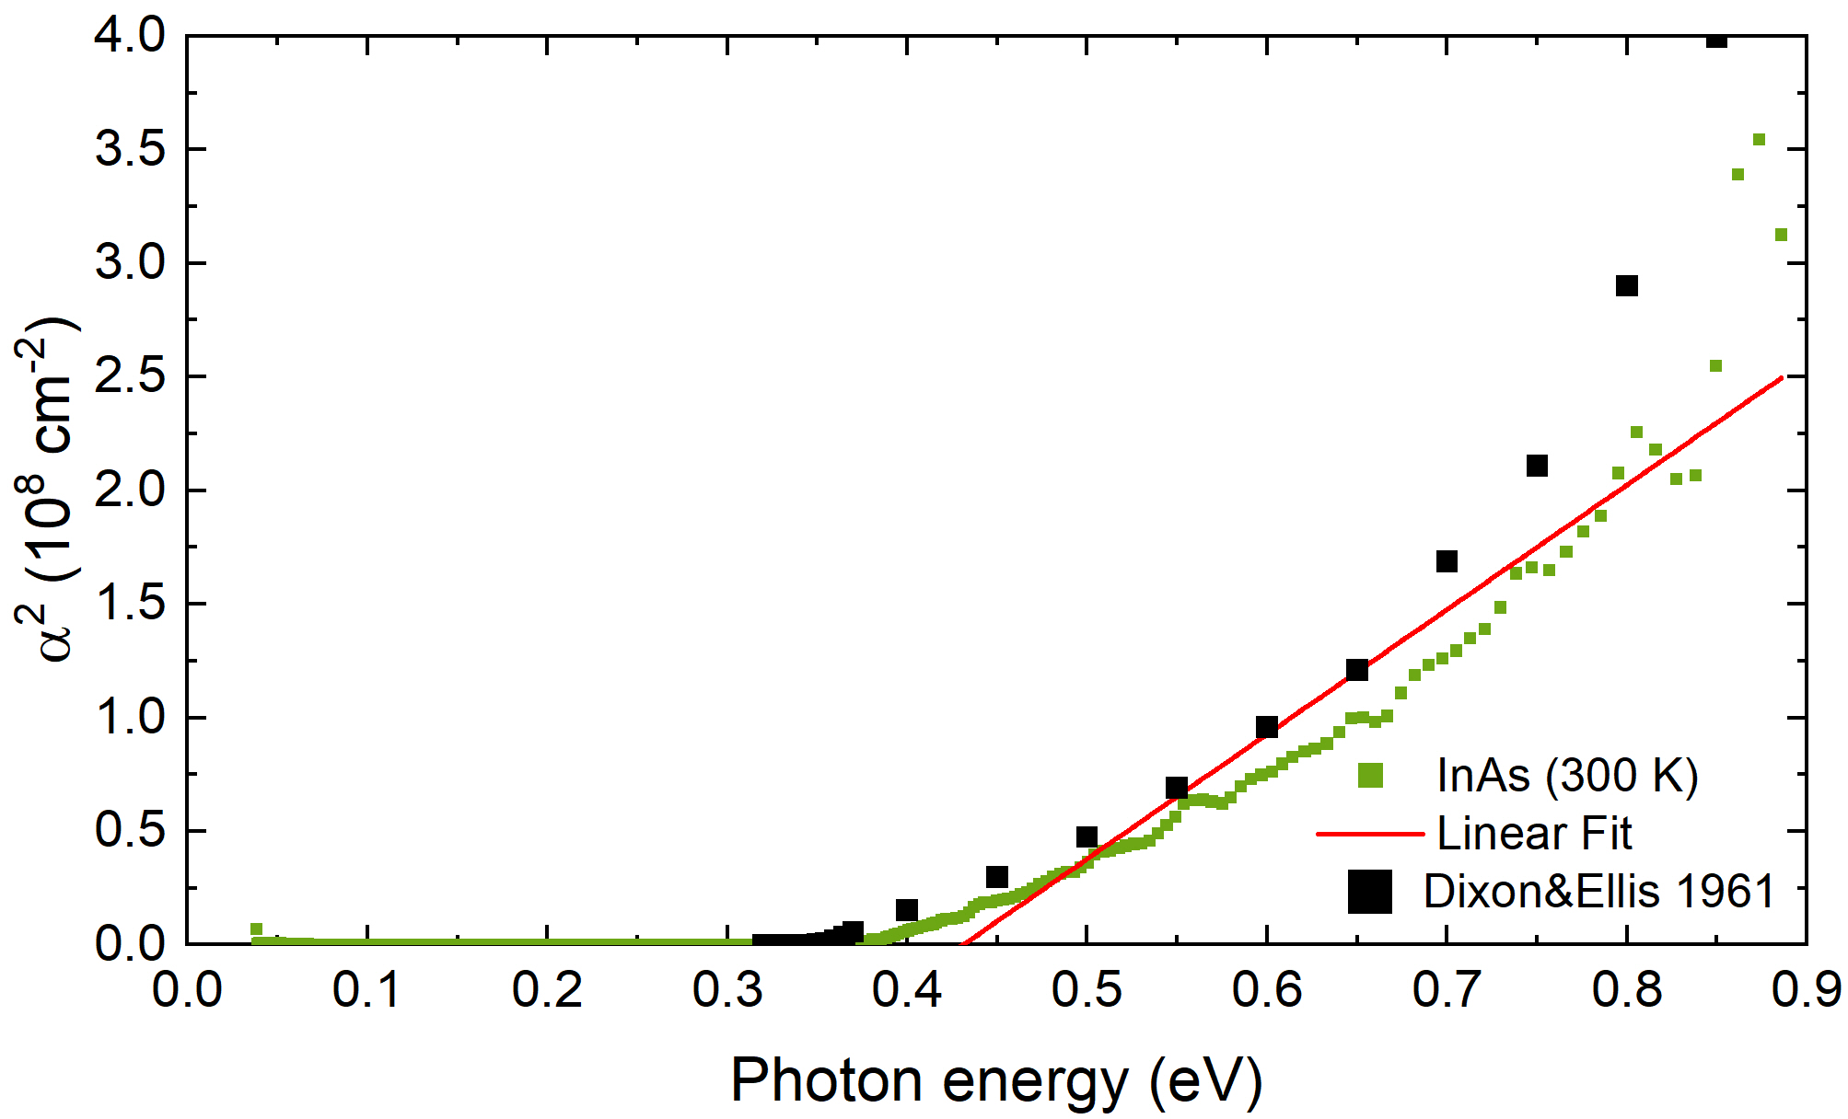
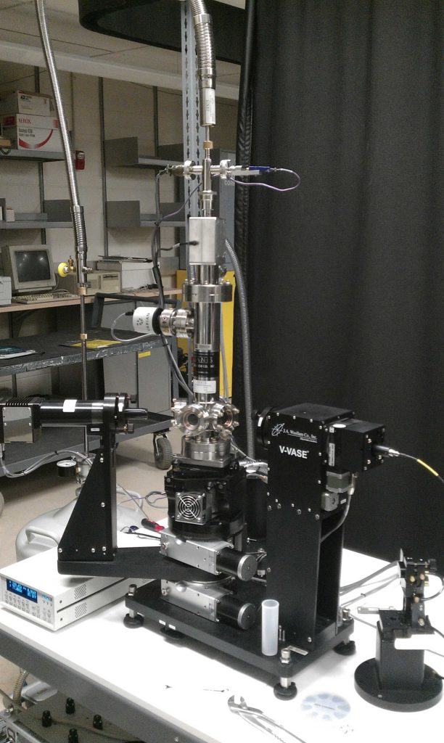
Ellipsometry and Infrared Ellipsometry
Band gap of InAs
Infrared lattice vibrations in gallium phosphide
Temperature: 4-800 K
6

Slide 7
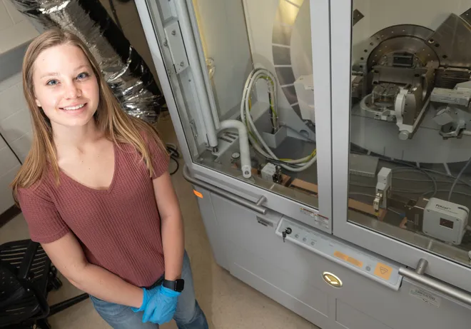
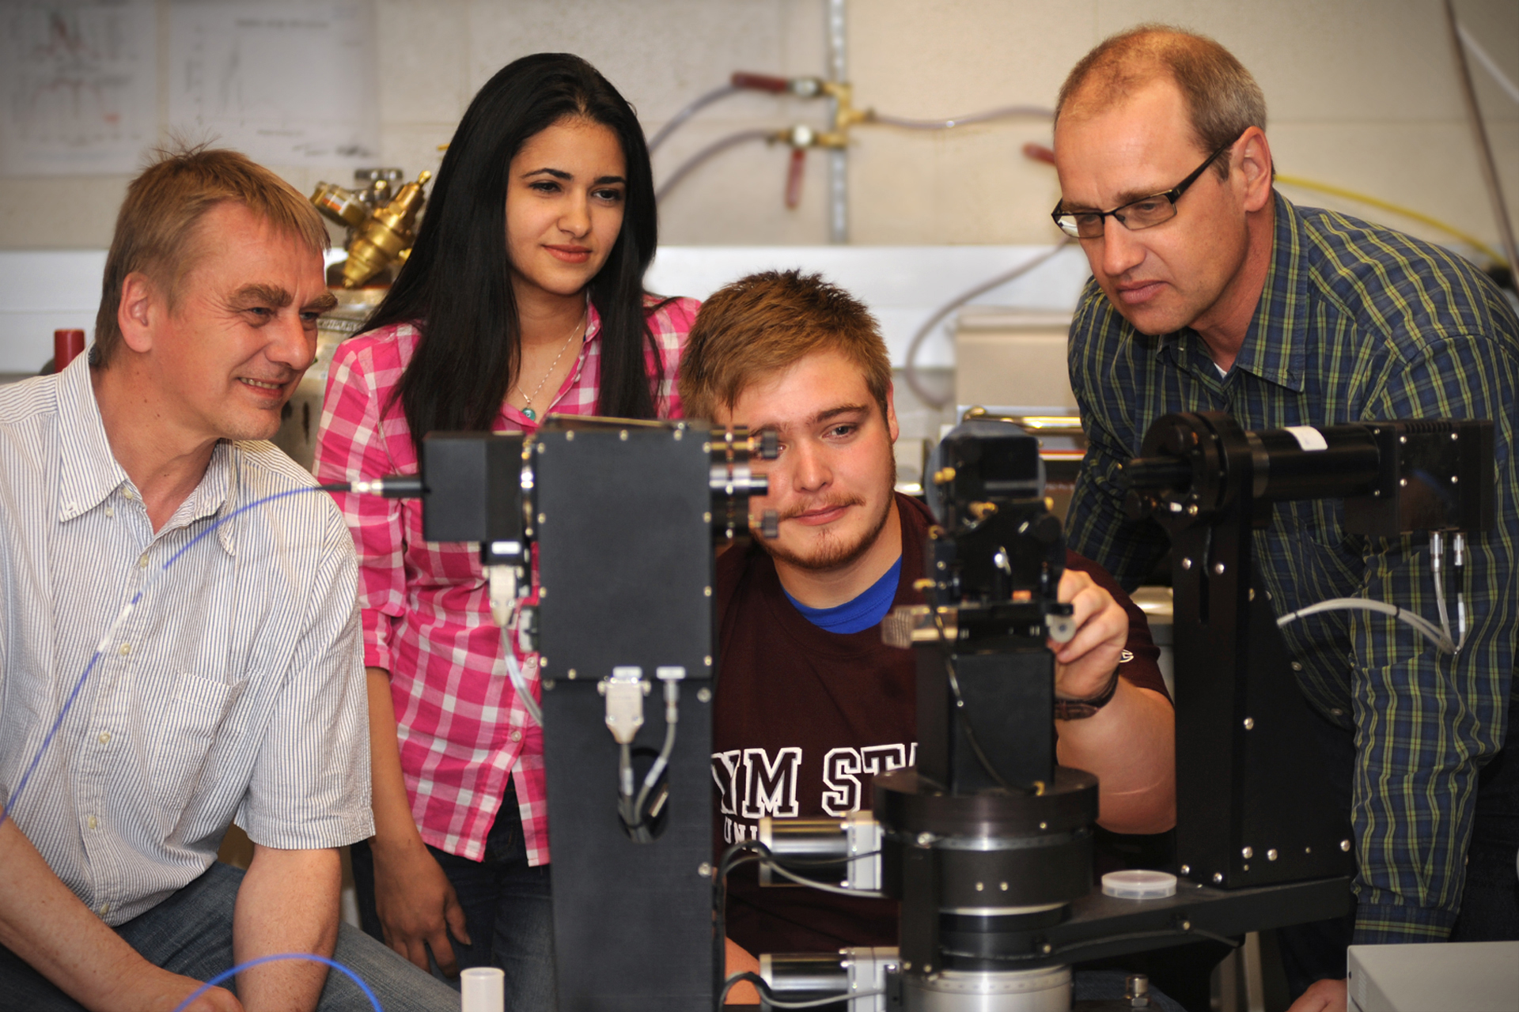
Training and Education
Is it difficult to learn how to do this? No, but it takes practice (like violin or piano).
Interdisciplinary courses offered at NMSU
PHYS 468/568: Elements of XRD
PHYS 489/589: Modern Materials
PHYS 471/571: Experimental Optics
Intended for students from other majors with STEM background (C E, CHME, MAE).
Safety training by NMSU EHS&RM
Individual training by your research group.
7

Slide 8
Thank you
Questions?

