Slide 1


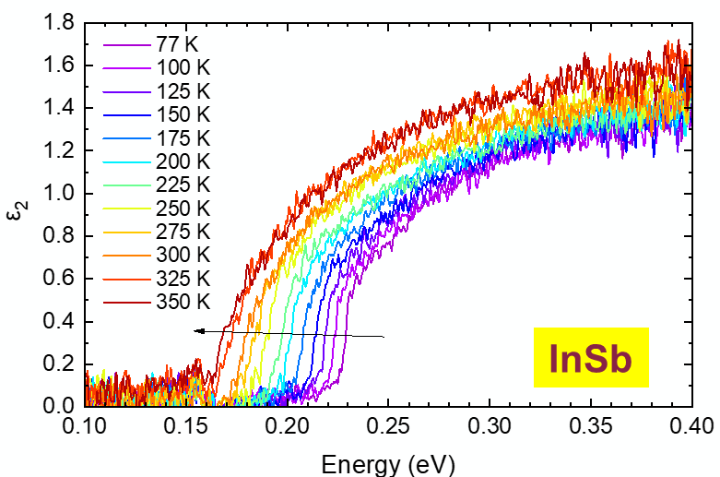
Matrix elements and excitonic effects in the direct gap absorption of semiconductors
LXVII Congreso Nacional de Física
Sociedad Mexicana de Física
Chihuahua, Mexico, 09 October 2024
FA9550-20-1-0135 AFOSR
FA9550-24-1-0061 AFOSR
NSF DMR-2235447 NSF
Stefan Zollner
in collaboration with:
Carola Emminger, Carlos A. Armenta, Sonam Yadav, Melissa Rivero Arias, Jaden Love (NMSU),
Jose Mendendez (Arizona State)
Department of Physics, New Mexico State University, Las Cruces, NM, USA
Email: zollner@nmsu.edu. WWW: http://femto.nmsu.edu.

Slide 2
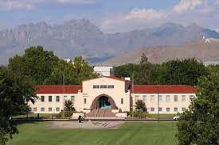
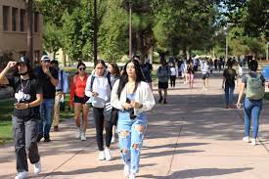
New Mexico State University, Las Cruces
Land grant institution, Carnegie R2 (soon to be R1)
Comprehensive: Arts and Sciences, Education, Business, Agriculture
Ph.D. programs in sciences, engineering, agriculture; Ag extension;
Chile Pepper Institute
12,700 students (11,000 UG, 1,700 GR), 1000 faculty
Minority-serving, Hispanic-serving (60% Hispanic/NA, 26% White)
Small-town setting (111,000)
Military-friendly institution (Army and Air Force ROTC programs)
Community engagement classification
(first-generation students, Pell grant recipients)
Physics: BS/BA, MS, PhD degrees. 67 UG and 39 GR students.
11 faculty (HE Nuclear and Materials Physics), 2.4 M$ expenditures.
ABET-accredited BS in Physics and BS in Engineering Physics
Stefan Zollner, SMF Congress, October 2024

Slide 3

Problem statement: Optical constants
(1) Achieve a quantitative understanding of photon absorption and emission processes.
Our qualitative understanding of excitonic absorption is 50-100 years old (Einstein coefficients),
But insufficient for modeling of detectors and emitters.
(2) How are optical processes affected by high carrier concentrations (screening)?
High carrier densities can be achieved with
  In situ doping
  ultrafast (femtosecond) lasers, see talk by Carlos Armenta today at 4:30pm
  high temperatures (narrow-gap or gapless semiconductors)
Application: CMOS-integrated mid-infrared camera (thermal imaging with a phone).

Slide 4
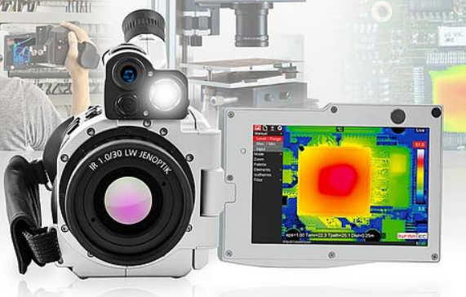
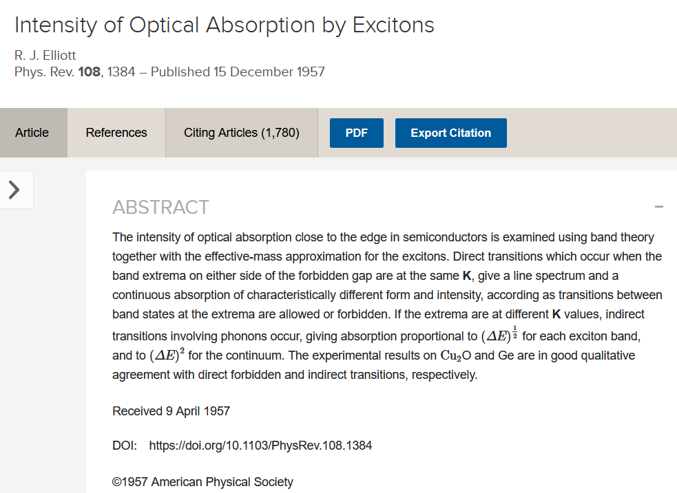
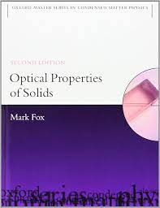
Application:
Midwave Infrared Detectors
Germanium-Tin Alloys
4

Slide 5
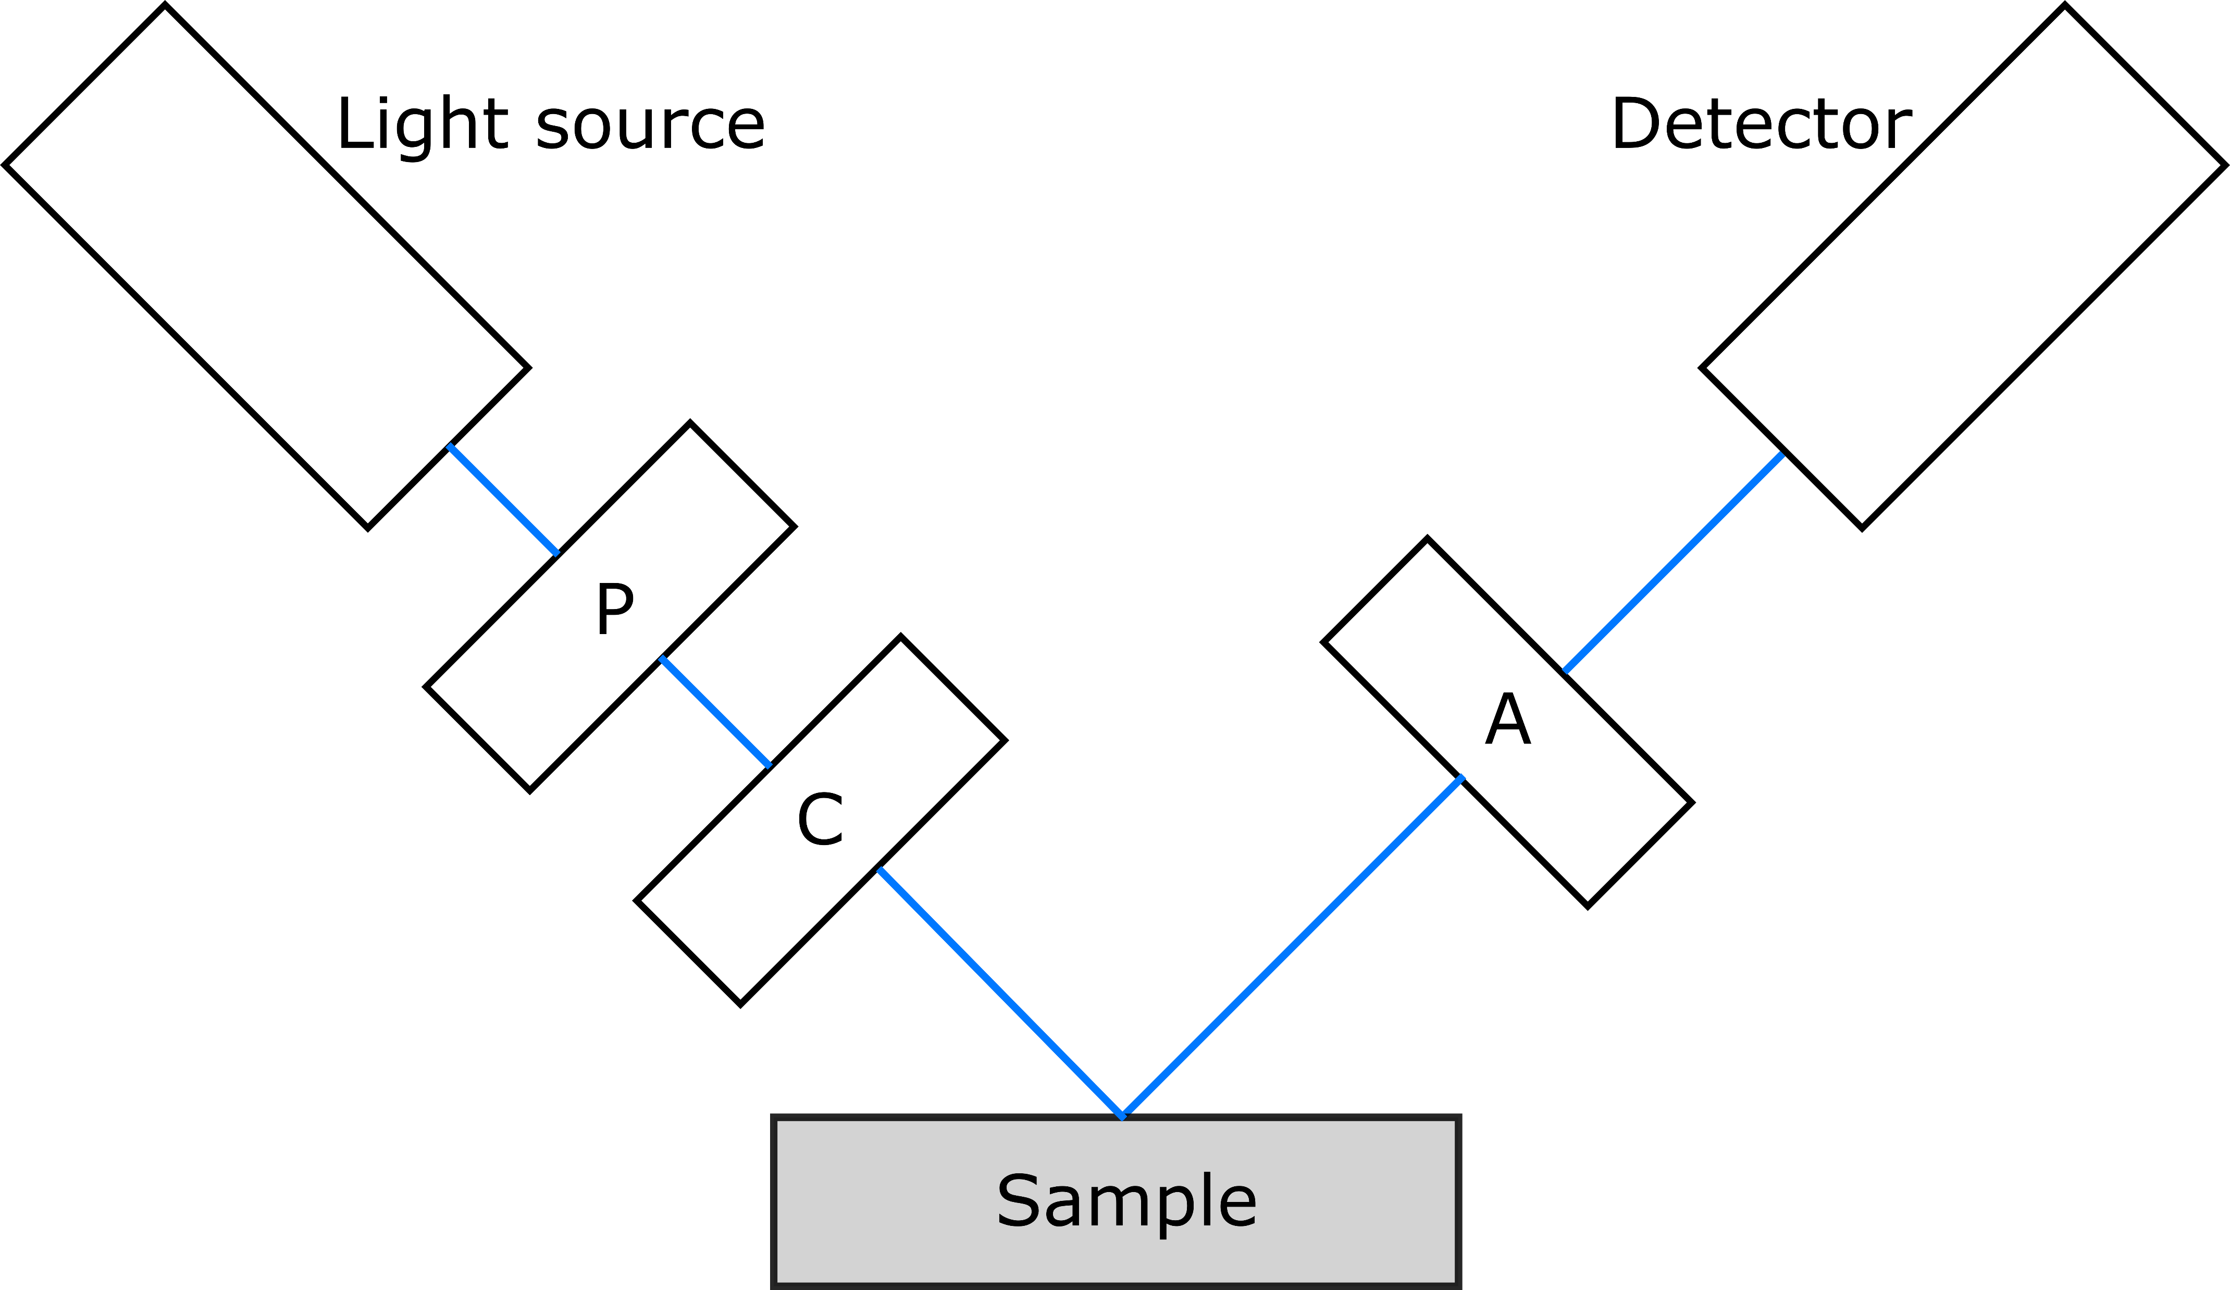
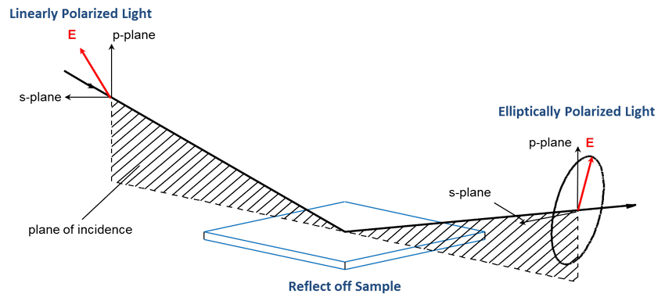
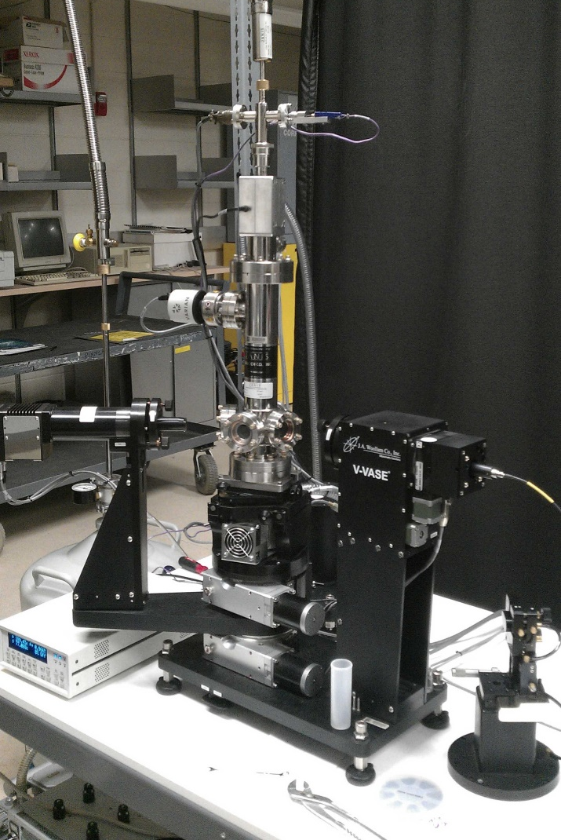
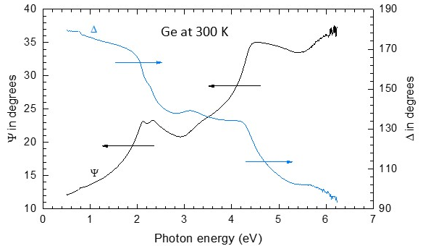
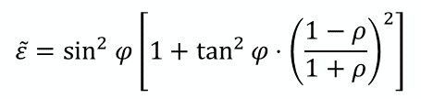

Spectroscopic ellipsometry
ellipsometric angles ψ, Δ
refractive index n+ik
dielectric function ε
$$ρ=\frac{r_{p}}{r_{s}}=\tan{Ψ}e^{iΔ}$$
$$\tilde{ε}=\sin^{2}{φ}\left[1+\tan^{2}{φ}⋅{\left(\frac{1−ρ}{1+ρ}\right)}^{2}\right]$$
UHV cryostat
& V-VASE ellipsometer
Tompkins & Hilfiker, Spectroscopic Ellipsometry (2016)
femto.nmsu.edu

Slide 6
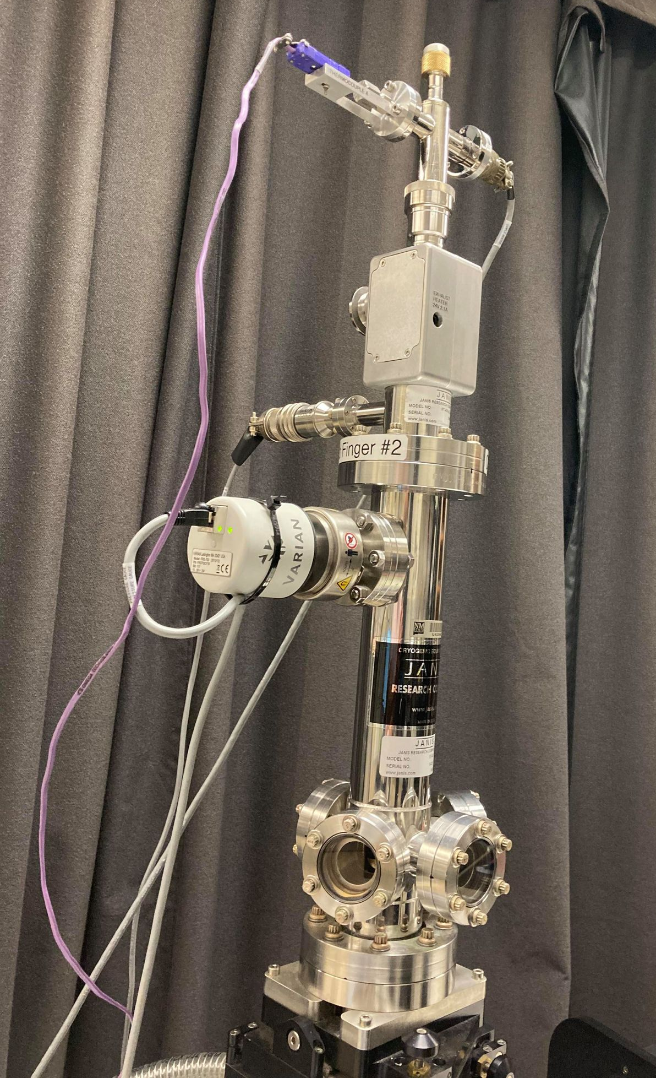
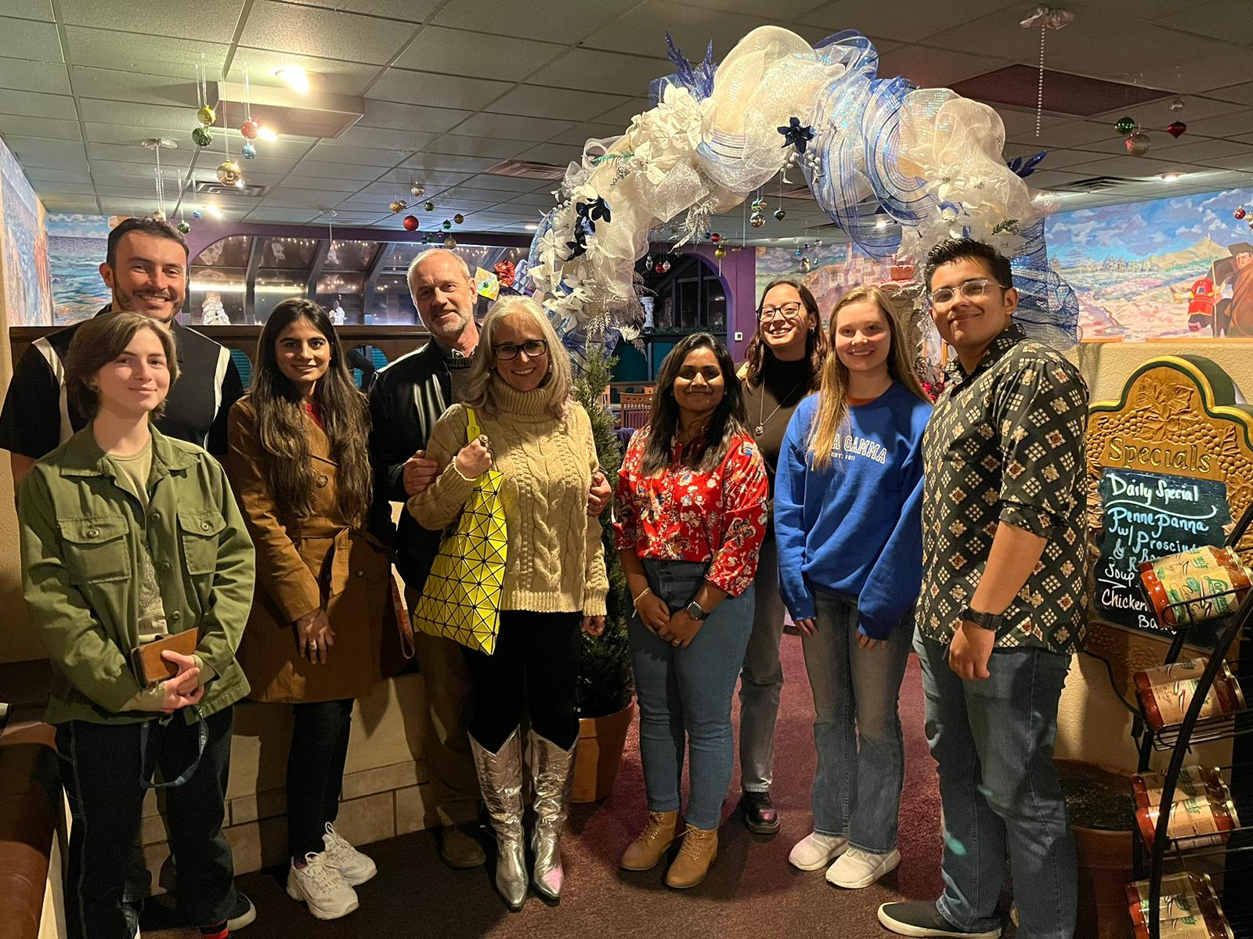
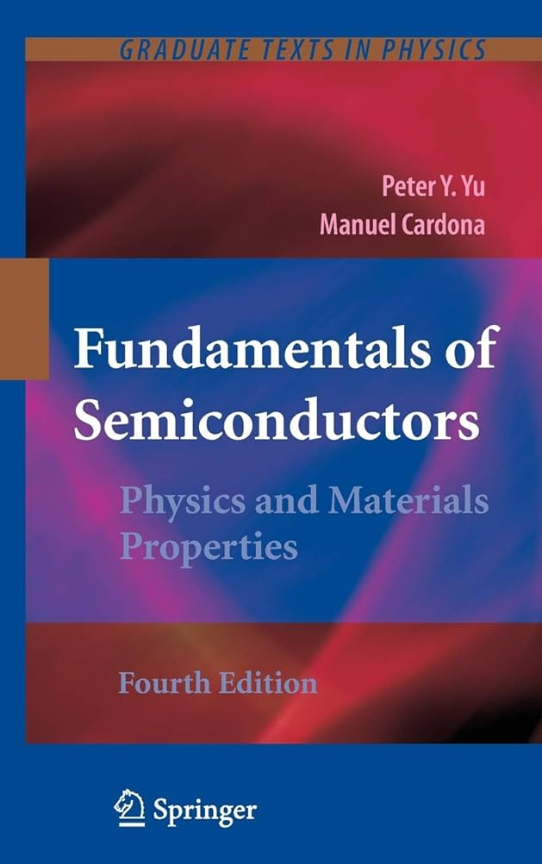
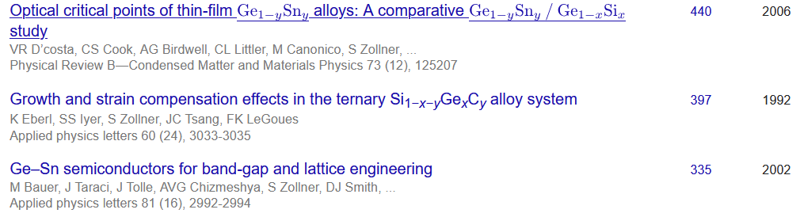
Ellipsometry at NMSU
diamond windows
closed-cycle He cooler
Ellipsometry on anything (inorganic, 3D)
Metals, insulators, semiconductors
Mid-IR to vacuum UV (150 nm to 40 μm)
10 to 800 K, ultrafast ellipsometry
Ellipsometry tells us a lot about materials quality (not necessarily what we want to know).
http://femto.nmsu.edu
Stefan Zollner, 2023

Slide 7
Matrix elements and excitonic effects in the direct gap absorption of semiconductors
Einstein coefficients, Fermi’s Golden Rule, Elliott-Tanguy excitons
Direct gap absorption in germanium from 10 to 800 K
Optical constants of highly excited semiconductors
  Direct gap absorption in InSb from 10 to 800 K
  Intravalence band absorption in topological insulators (α-tin)
  Optical constants of highly excited germanium
  (femtosecond ellipsometry at ELI Beamlines in Prague) – Carlos Armenta: 4:30pm.
Conclusion and Outlook
Stefan Zollner, SMF Congress, October 2024

Slide 8
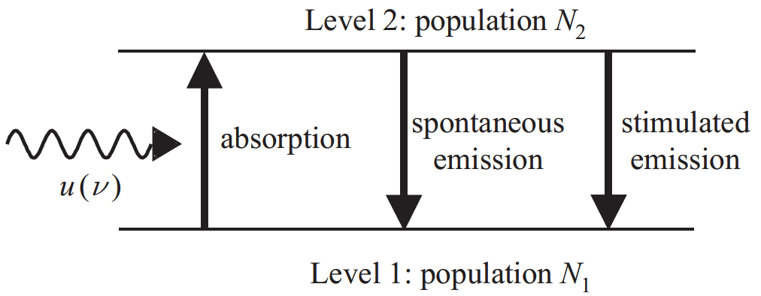

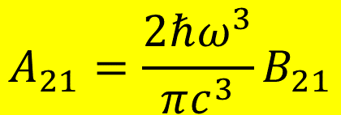

Einstein coefficients
One coefficient is sufficient:
B₁₂
A₂₁
B₂₁
$$g_{1}B_{12}=g_{2}B_{21}$$
$$A_{21}=\frac{2ℏω^{3}}{πc^{3}}B_{21}$$
In equilibrium: N₁, N₂ constant.
Absorption and emission balance.
Black-body radiation
Use Fermi’s Golden Rule to calculate B₁₂
$$u\left(ℏω\right)$$
$$B_{12}N_{1}u\left(ℏω\right)=A_{21}N_{2}+B_{21}N_{2}u\left(ℏω\right)$$
Albert Einstein, Strahlungs-Emission und Absorption nach der Quantentheorie, DPG Verh. 18, 318 (1916); Phys. Z. 18, 121 (1917). See also Mark Fox.

Slide 9
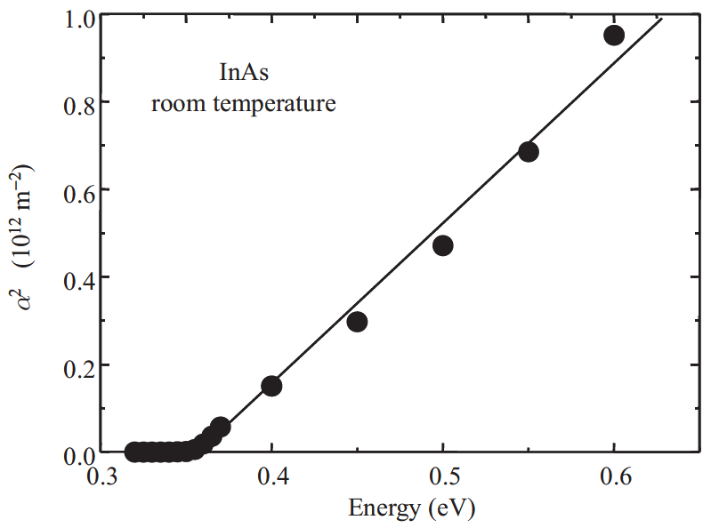
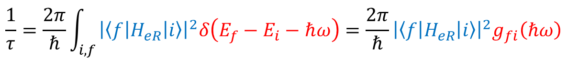
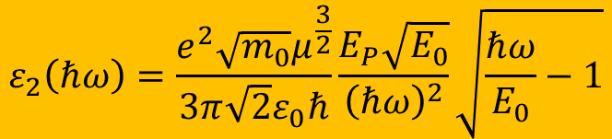
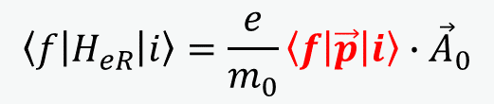
Fermi’s Golden Rule: Tauc plot
Direct band gap absorption
constant k·p matrix element
$$\frac{1}{τ}=\frac{2π}{ℏ}\int_{i,f}{{\left|\left\langle f | H_{eR} | i\right\rangle \right|}^{2}δ\left(E_{f}−E_{i}−ℏω\right)}=\frac{2π}{ℏ}{\left|\left\langle f | H_{eR} | i\right\rangle \right|}^{2}g_{fi}\left(ℏω\right)$$
Joint DOS
parabolic bands
$$\left\langle f | H_{eR} | i\right\rangle =\frac{e}{m_{0}}\left\langle f | \vec{p} | i\right\rangle ∙{\vec{A}}_{0}$$
Use k·p matrix element P: E_{P}=2P²/m₀
$$ε_{2}\left(ℏω\right)=\frac{e^{2}\sqrt{m_{0}}μ^{\frac{3}{2}}}{3π\sqrt{2}ε_{0}ℏ}\frac{E_{P}\sqrt{E_{0}}}{{\left(ℏω\right)}^{2}}\sqrt{\frac{ℏω}{E_{0}}−1}$$
Fox, Chapter 3

Slide 10
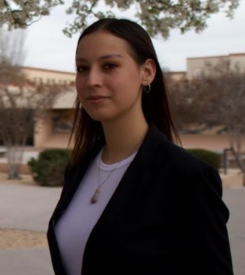
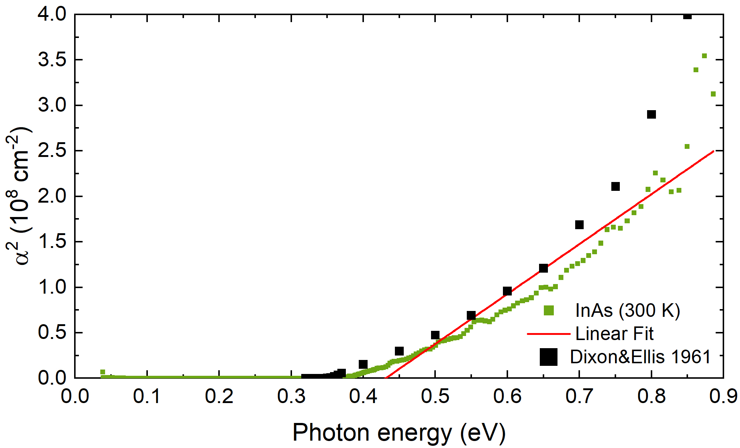

Fermi’s Golden Rule: Tauc plot
Direct band gap absorption
$$\frac{1}{τ}=\frac{2π}{ℏ}\int_{i,f}{{\left|\left\langle f | H_{eR} | i\right\rangle \right|}^{2}δ\left(E_{f}−E_{i}−ℏω\right)}=\frac{2π}{ℏ}{\left|\left\langle f | H_{eR} | i\right\rangle \right|}^{2}g_{fi}\left(ℏω\right)$$
$$\left\langle f | H_{eR} | i\right\rangle =\frac{e}{m_{0}}\left\langle f | \vec{p} | i\right\rangle ∙{\vec{A}}_{0}$$
The Tauc plot is wishful thinking.
No linear region:
Conduction band nonparabolicity
Broadening
1/E² denominator.
excitons
Melissa Rivero Arias
Use k·p matrix element P: E_{P}=2P²/m₀
$$ε_{2}\left(ℏω\right)=\frac{e^{2}\sqrt{m_{0}}μ^{\frac{3}{2}}}{3π\sqrt{2}ε_{0}ℏ}\frac{E_{P}\sqrt{E_{0}}}{{\left(ℏω\right)}^{2}}\sqrt{\frac{ℏω}{E_{0}}−1}$$

Slide 11
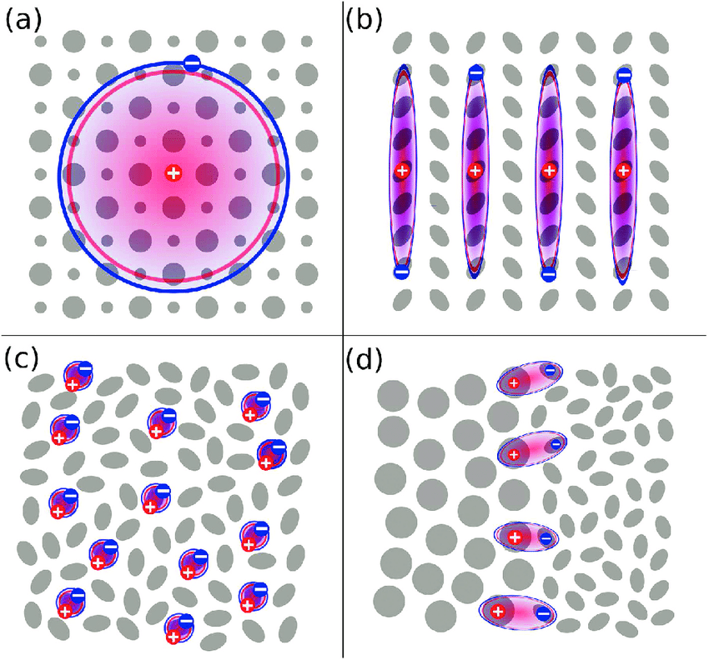
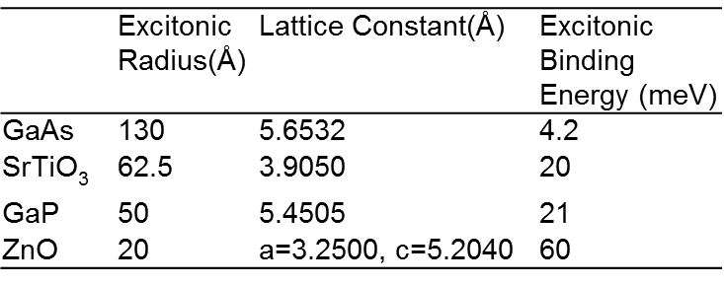
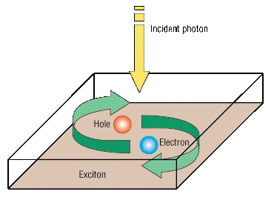
Exciton concept: Bound Electron-Hole Pair
Energy
Conduction Band
Excitons in semiconductors
E_{f}
R
hω
E_{g}
Large radius
(larger than atomic spacing)
Weakly bound
Semiconductor Picture
e
E_{i}
Conduction band
Valence Band
e
Bohr model for exciton
Valence band
Ground State
Exciton
Fox, Chapter 4

Slide 12
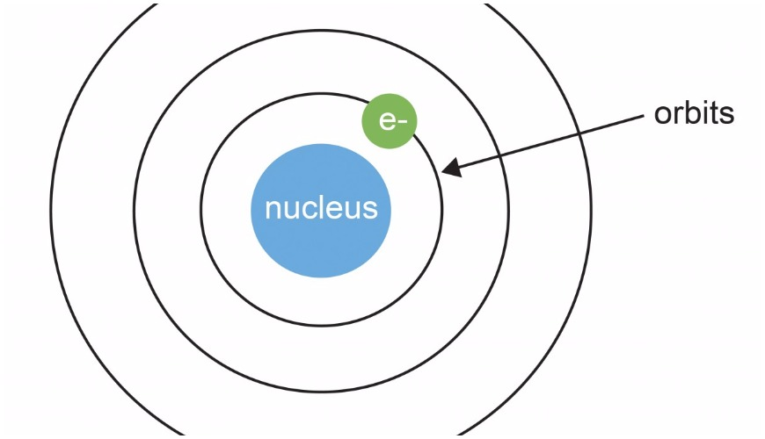
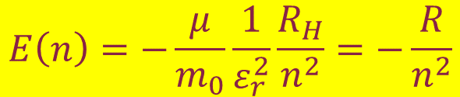


Bohr model for free excitons
Reduced electron/hole mass
(optical mass)
Static screening with static dielectric constant ε_{r}.
Exciton radius:
a_{H}=0.53 Å
Excitons stable if R>>kT
Exciton momentum is zero.
Exciton enhancement important even if R<<kT (high temperature).
$$\frac{1}{μ}=\frac{1}{m_{e}}+\frac{1}{m_{h}}$$
Electron and hole form a bound state with binding energy.
R_{H}=13.6 eV Rydberg energy.
QM mechanical treatment easy.
$$a_{n}=\frac{m_{0}}{μ}ε_{r}n^{2}a_{H}$$
$$E\left(n\right)=−\frac{μ}{m_{0}}\frac{1}{ε_{r}^{2}}\frac{R_{H}}{n^{2}}=−\frac{R}{n^{2}}$$
Fox, Chapter 4

Slide 13
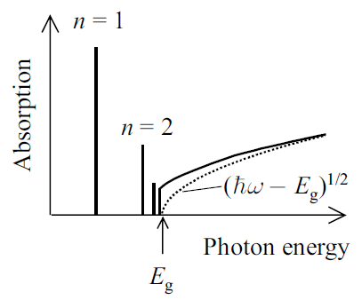
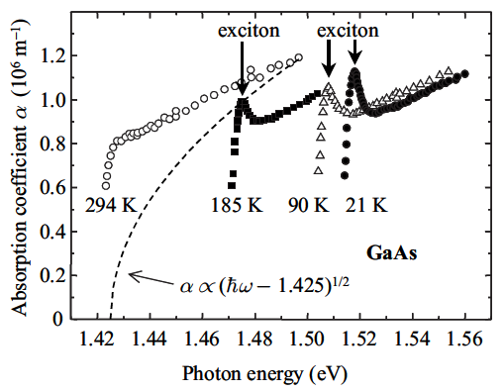
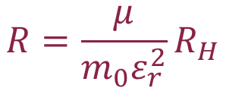

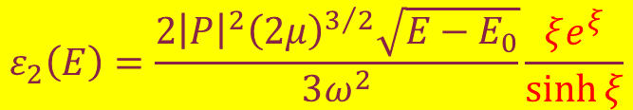
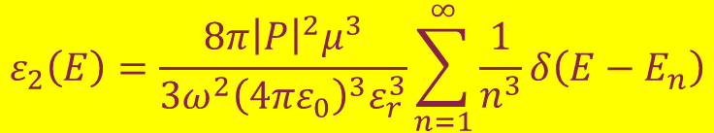
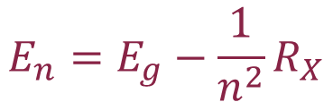
Sommerfeld enhancement
Excitonic Rydberg
energy
Discrete states
Discrete absorption
Continuum absorption
$$R=\frac{μ}{{m_{0}ε}_{r}^{2}}R_{H}$$
$$E_{n}=E_{g}−\frac{1}{n^{2}}R_{X}$$
$$ε_{2}\left(E\right)=\frac{8π{\left|P\right|}^{2}μ^{3}}{{3ω}^{2}{\left(4πε_{0}\right)}^{3}ε_{r}^{3}}\sum_{n=1}^{∞}{\frac{1}{n^{3}}δ\left(E−E_{n}\right)}$$
$$ε_{2}\left(E\right)=\frac{2{\left|P\right|}^{2}{\left(2μ\right)}^{3/2}\sqrt{E−E_{0}}}{3ω^{2}}\frac{ξe^{ξ}}{\sinh{ξ}}$$
$$ξ=π\sqrt{R/{E−E_{0}}}$$
Use Bohr wave functions to calculate ε₂.
Toyozawa discusses broadening.
R. J. Elliott, Phys. Rev. 108, 1384 (1957)
Yu & Cardona; Fox, Chapter 4

Slide 14
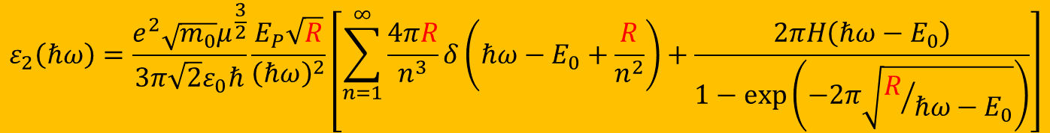
Elliott-Tanguy exciton absorption
Direct band gap absorption
Excitonic binding energy: R=R_{H}×μ_{h}/ε_{s}²
$$ε_{2}\left(ℏω\right)=\frac{e^{2}\sqrt{m_{0}}μ^{\frac{3}{2}}}{3π\sqrt{2}ε_{0}ℏ}\frac{E_{P}\sqrt{R}}{{\left(ℏω\right)}^{2}}\left[\sum_{n=1}^{∞}{\frac{4πR}{n^{3}}δ\left(ℏω−E_{0}+\frac{R}{n^{2}}\right)+\frac{2πH\left(ℏω−E_{0}\right)}{1−\text{exp}\left(−2π\sqrt{R/{ℏω−E_{0}}}\right)}}\right]$$
bound excitons
exciton continuum enhancement
Tanguy’s contributions:
Add Lorentzian broadening
Kramers-Kronig transform to get the real part.
×
R. J. Elliott, Phys. Rev. 108, 1384 (1957).
Christian Tanguy, Phys. Rev. Lett. 75, 4090 (1995) + (E)

Slide 15
Calculation of absorption spectrum from k·p theory
Can we calculate the absorption spectrum?
Yes, we can for Ge in the low carrier density limit.
It does not work for other III/V compounds.
Carola Emminger et al., JAP 131, 165701 (2022).

Slide 16
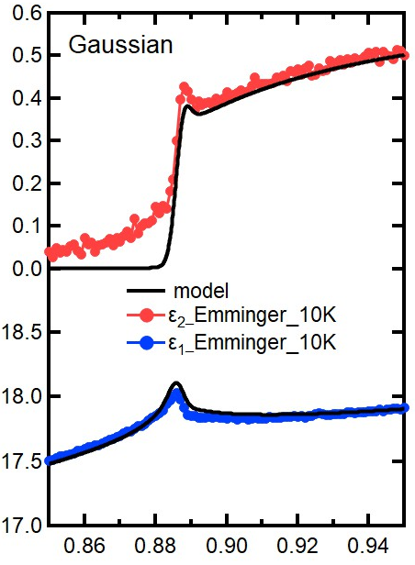
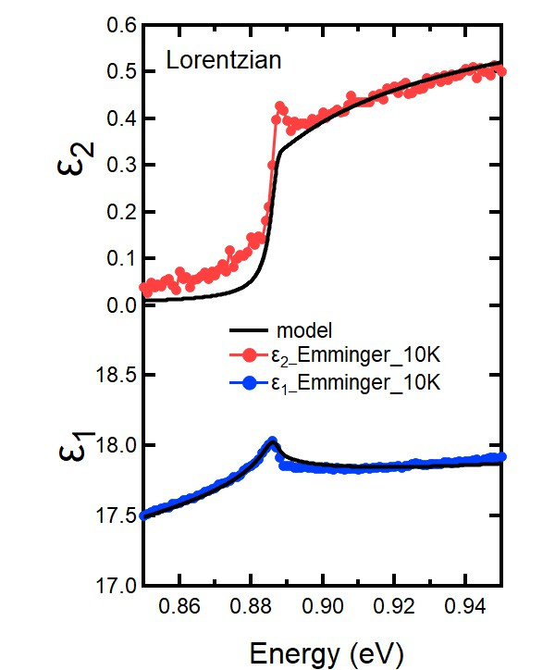
Elliott-Tanguy theory applied to Ge
Fixed parameters:
  Electron and hole masses (temperature dependent)
  Excitonic binding energy R
  Amplitude A (derived from matrix element P)
Adjustable parameters:
  Broadening Γ: 2.3 meV
  Band gap E₀
  Linear background A₁ and B₁
  (contribution from E₁ to real part of ε)
  Problems:
  Broadening below the gap (band tail, oxide correction)
ε₂
Ge
10 K
Quantitative agreement
ε₁
Carola Emminger et al., JAP 131, 165701 (2022).
16

Slide 17
Elliott-Tanguy theory applied to Ge
Good agreement at low temperatures.
Model also describes second derivatives.
Potential problems:
Matrix element k-dependent
Nonparabolicity
Resonant indirect absorption
??? at high T.
Ge
Ge
Carola Emminger et al., JAP 131, 165701 (2022).
17

Slide 18
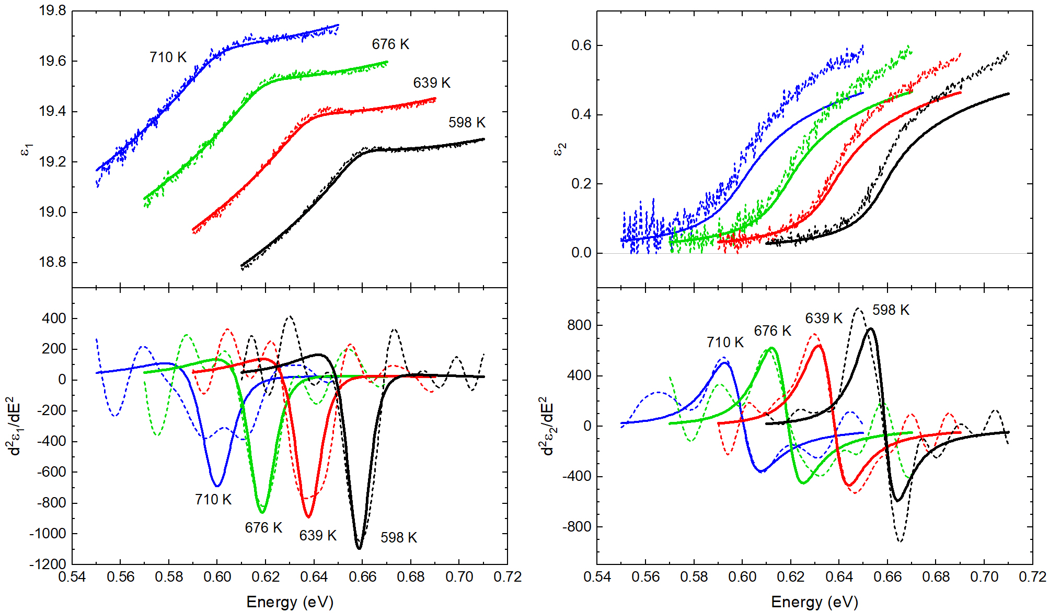
Elliott-Tanguy theory: problems for Ge at high T
Good agreement at low temperatures.
Model also describes second derivatives.
Potential problems:
Matrix element k-dependent
Nonparabolicity
Resonant indirect absorption
Temperature dependence of the effective mass.
Ge
Ge
Carola Emminger et al., JAP 131, 165701 (2022).
18

Slide 19
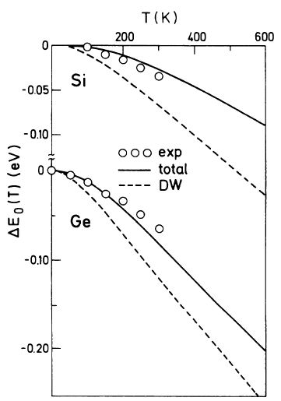
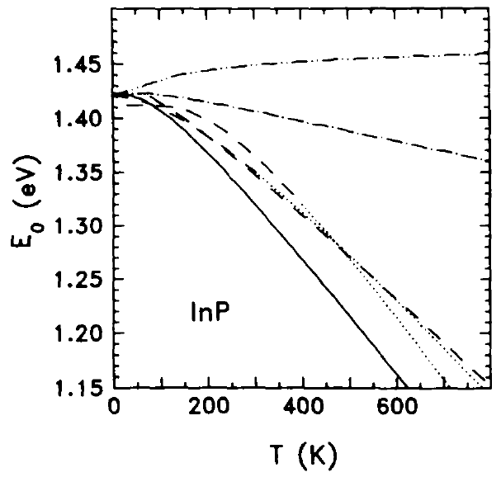
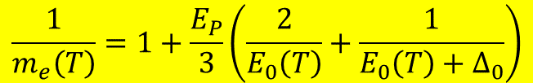
Temperature dependence of the effective mass
Effective electron mass given by k·p theory
Temperature dependence of the direct band gap has two contributions:
  Thermal expansion of the lattice
  Electron-phonon interaction (Debye-Waller term and self-energy)
“Mass band gap” should only include the thermal expansion.
E₀: direct band gap
k·p matrix element P: E_{P}=2P²/m₀
$$\frac{1}{m_{e}\left(T\right)}=1+\frac{E_{P}}{3}\left(\frac{2}{E_{0}\left(T\right)}+\frac{1}{E_{0}\left(T\right)+Δ_{0}}\right)$$
Self-energy
InSb
Thermal expansion
Total
Experiment
SZ, Solid State Commun. 77, 485 (1991).
P.B. Allen and M. Cardona, Phys. Rev. B 27 4760 (1983).
19

Slide 20
Problem statement: Optical constants
(1) Achieve a quantitative understanding of photon absorption and emission processes.
Our qualitative understanding of excitonic absorption is 50-100 years old (Einstein coefficients),
But insufficient for modeling of detectors and emitters.
(2) How are optical processes affected by high carrier concentrations (screening)?
High carrier densities can be achieved with
  In situ doping
  ultrafast (femtosecond) lasers, see talk by Carlos Armenta today at 4:30pm
  high temperatures (narrow-gap or gapless semiconductors)
Application: CMOS-integrated mid-infrared camera (thermal imaging with a phone).

Slide 21
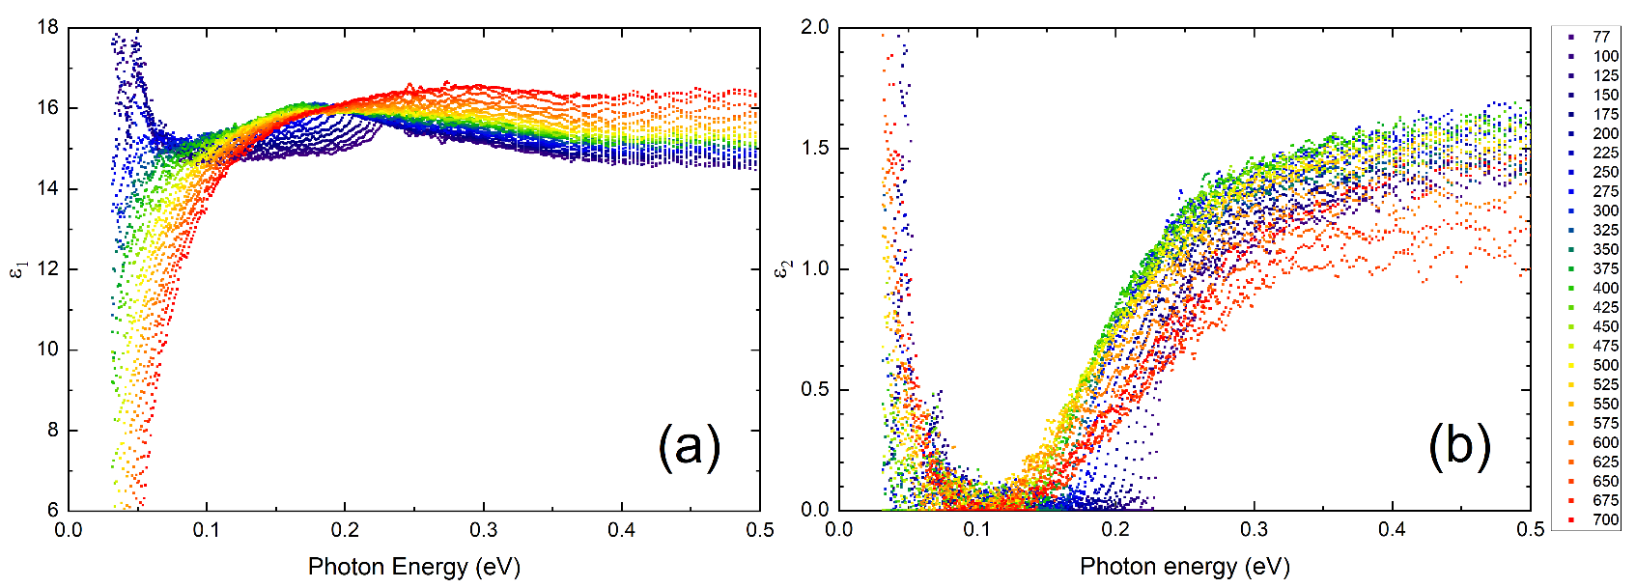
Dielectric function of InSb from 80 to 800 K
InSb
InSb
Band gap changes with temperature (but only below 500 K).
Amplitude reduction at high temperatures (Pauli blocking, bleaching)
Drude response at high temperatures (thermally excited carriers).
Depolarization artifacts at long wavelengths (below 300 K).
Woollam FTIR-VASE
cryostat with CVD diamond windows
Melissa Rivero Arias, JVSTB 41, 022203 (2023)
21

Slide 22
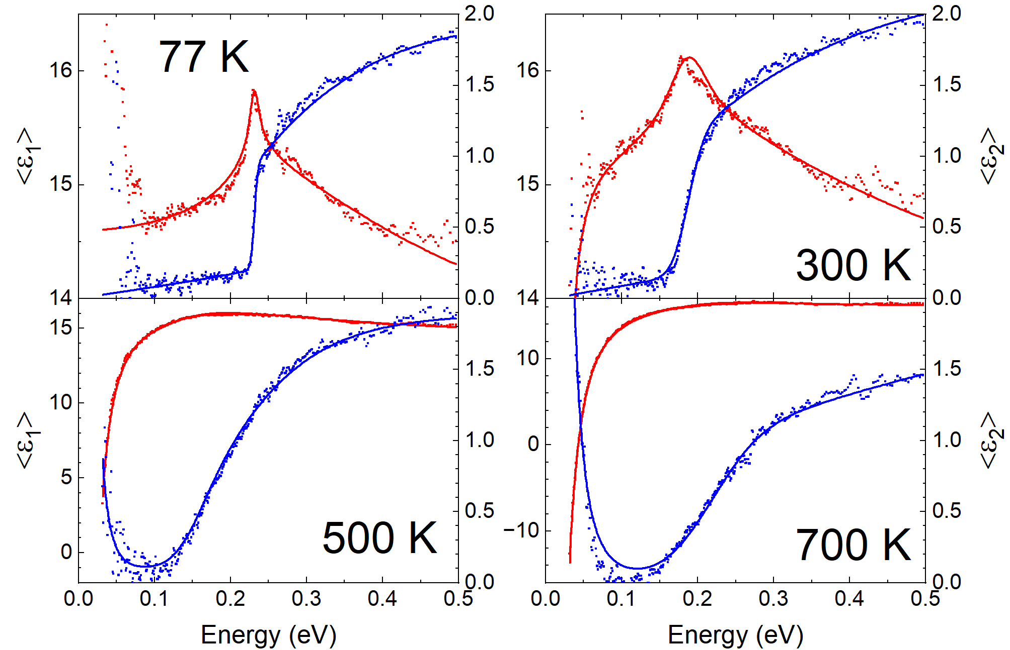
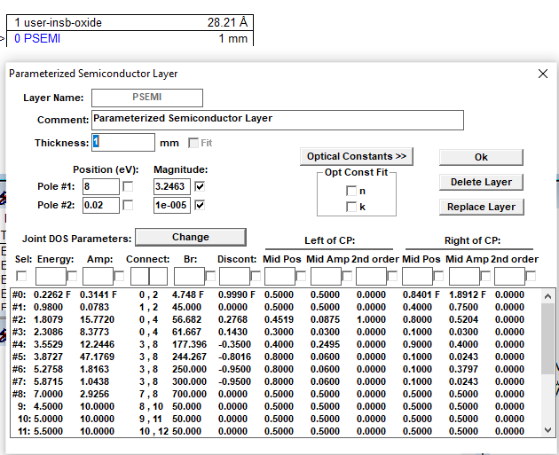
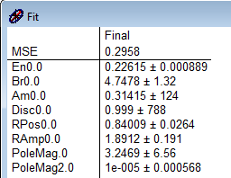
Band gap analysis for InSb
How does the band gap of InSb change with temperature?
Parametric-Semiconductor Model:
Also vary
“shape parameters”.
Asymmetric peak shape poorly described.
Try Tanguy oscillator for excitonic line shape.
InSb
C. M. Herzinger, B. Johs, et al., J. Appl. Phys. 83, 3323 (1998)
Rivero Arias, JVSTB 41, 022203 (2023)
22

Slide 23
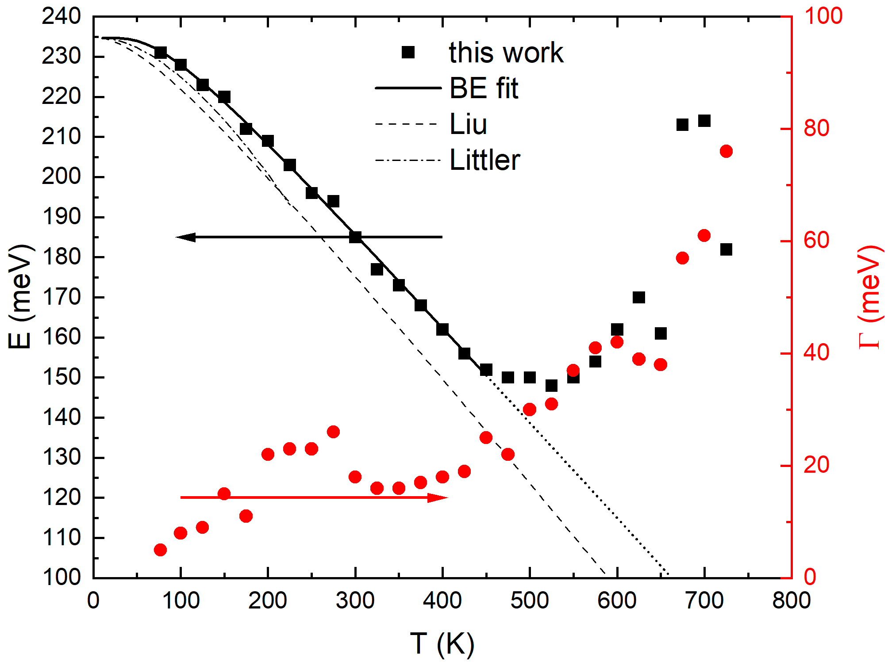
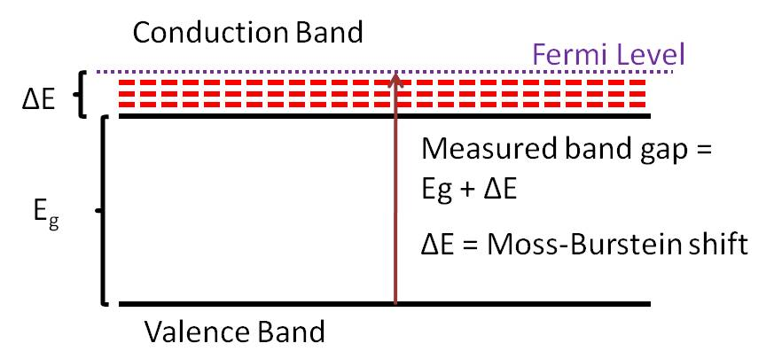
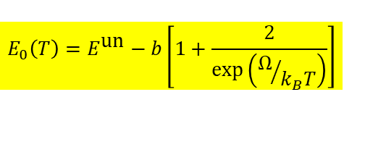
Band gap of InSb from 80 to 800 K
InSb
Bose-Einstein Model
$$E_{0}\left(T\right)=E^{\text{un}}−b\left[1+\frac{2}{\text{exp}\left(Ω/{k_{B}T}\right)}\right]$$
Band gap changes with temperature (but only below 500 K)
Described by Bose-Einstein model below 500 K: Logothetidis, PRB 31, 947 (1985).
No redshift above 500 K: Thermal Burstein-Moss shift
T.S. Moss, Proc. Phys. Soc. 67, 775 (1954).
E. Burstein, Phys. Rev. 93, 632 (1954).
23

Slide 24

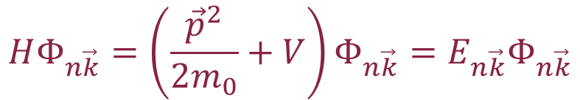


k·p theory (band structure method)
Schrödinger equation
Use Bloch’s theorem:
Solve equation for k=0.
Eliminate green free-electron term with substitution of variables (Kane 1957).
Then treat red term in perturbation theory.
Works very well for semiconductors with local V(r) potentials.
$$HΦ_{n\vec{k}}=\left(\frac{{\vec{p}}^{2}}{2m_{0}}+V\right)Φ_{n\vec{k}}=E_{n\vec{k}}Φ_{n\vec{k}}$$
$$Φ_{n\vec{k}}\left(\vec{r}\right)=e^{i\vec{k}∙\vec{r}}u_{n\vec{k}}\left(\vec{r}\right)$$
Product rule
$${\left(fg\right)}^{′′}=f^{′′}g+2f^{′}g^{′}+fg^{′′}$$
$$\left(\frac{{\vec{p}}^{2}}{2m_{0}}+\frac{ℏ^{2}{\vec{k}}^{2}}{2m_{0}}+\frac{ℏ\vec{k}∙\vec{p}}{m_{0}}+V\right)u_{n\vec{k}}=E_{n\vec{k}}u_{n\vec{k}}$$
Yu & Cardona, Fundamentals of Semiconductors
Kane, J. Phys. Chem. Solids 1, 249 (1957). Kane 1966.
Stefan Zollner, 2023, AFRL Lectures Series 3
24

Slide 25







Nonparabolicity of InSb conduction band from k·p theory
Kane 8x8 k·p Hamiltonian:
$${\tilde{H}}_{\vec{k}}=\left(\begin{matrix}E_{0} & 0 & −\frac{ℏ\vec{k}}{m_{0}}iP & 0 \\ 0 & −\frac{2Δ_{0}}{3} & \frac{\sqrt{2}Δ_{0}}{3} & 0 \\ \frac{ℏ\vec{k}}{m_{0}}iP & \frac{\sqrt{2}Δ_{0}}{3} & −\frac{Δ_{0}}{3} & 0 \\ 0 & 0 & 0 & 0\end{matrix}\right)$$
Energy versus k
(InSb)
Cubic characteristic equation:
Density of CB states
$$\tilde{E}\left(\tilde{E}−E_{0}\right)\left(\tilde{E}+Δ_{0}\right)−\frac{ℏ^{2}k^{2}E_{P}}{2m_{0}}\left(\tilde{E}+\frac{2Δ_{0}}{3}\right)=0$$
$$\frac{ℏ^{2}k^{2}}{2m_{0}m^{∗}}=ε\left(1+αε+βε^{2}\right)$$
Large spin-orbit approximation:
$$E_{3,4}=\frac{ℏ^{2}k^{2}}{2m_{0}}+\frac{E_{0}}{2}\left(1±\sqrt{1+\frac{ℏ^{2}k^{2}}{2m_{0}}\frac{2}{μ_{lh}E_{0}}}\right)$$
$$α=\frac{{\left(1−m^{∗}\right)}^{2}}{E_{0}}$$
Kane, J. Phys. Chem. Solids 1, 249 (1957).
25

Slide 26




Chemical potential in intrinsic InSb
Intrinsic condition: n=p.
Find chemical potential as a function of T.
S. Zollner and J. Menendez (unpublished).
26

Slide 27

Chemical potential in intrinsic InSb
Intrinsic condition: n=p.
Find chemical potential as a function of T.
Degenerate Fermi-Dirac statistics.
Nonparabolicity of conduction band.
S. Zollner and J. Menendez (unpublished).
27

Slide 28


Thermal excitations of electron-hole pairs in InSb
n=2x10¹⁸ cm⁻³ at 800 K
k_{B}T=E_{g}/4 at 600 K
Fermi level above
conduction band edge above 450 K.
Thermal Burstein-Moss shift
Drude response of free carriers
Reduction of absorption coefficient
M. Rivero Arias et al., JVSTB 41, 022203 (2023).
Oswaldowski/Zimpel, J. Phys. Chem. Solids 49, 1179 (1988).
D. L. Rode, Phys. Rev. B 3, 3287 (1971).
28

Slide 29



Condensation of excitons at high density
Mott transition (insulator-metal) when electron separation equals exciton radius.
Electron separation d for density N
Mott transition occurs at r_{s} near 1.
GaAs: n=10¹⁷ cm⁻³.
Biexciton, triexciton molecule formation.
Electron-hole droplets. Bose-Einstein condensation.
Exciton gas
$$d=\sqrt[3]{\frac{3}{4πn}}$$
$$r_{s}=\frac{d}{a_{X}}$$
dimensionless
Electron-hole liquid
Fox, Chapter 4

Slide 30






Excitons in doped or excited semiconductors
Need to include exciton screening due to doping.
Yukawa potential: Schrödinger equation not solvable.
Use Hulthen potential as an approximation
Coulomb
Yukawa
Hulthen
$$V\left(r\right)=−k\frac{1}{r}$$
$$k=\frac{e^{2}}{4πε_{0}ε_{r}}$$
Debye screening length
$$V\left(r\right)=−k\frac{\text{exp}\left(−r/{λ_{\text{D}}}\right)}{r}$$
$$λ_{D}=\sqrt{\frac{ε_{r}ε_{0}k_{B}T}{ne^{2}}}=\frac{1}{k_{D}}$$
$$V\left(r\right)=−k\frac{2/{ga_{X}}}{\text{exp}\left(\frac{2r}{ga_{X}}\right)−1}$$
Unscreened: g=∞
Fully screened: g=0
Mott criterion: g=1
$$g=\frac{λ_{D}}{a_{X}}$$
Hulthen exciton
C. Tanguy, Phys. Rev. 60, 10660 (1999).
Banyai & Koch, Z. Phys. B 63, 283 (1986).

Slide 31




Tanguy: Dielectric function of screened excitons
$$A=\frac{ℏ^{2}e^{2}}{6πε_{0}m_{0}^{2}}{\left(\frac{2μ}{ℏ^{2}}\right)}^{3/2}{\left|P\right|}^{2}$$
Bound exciton states (finite number):
$$ε_{2}\left(ω\right)=\frac{2πA\sqrt{R}}{E^{2}}\sum_{n=1}^{n^{2}<g}{2R\frac{1}{n}\left(\frac{1}{n^{2}}−\frac{n^{2}}{g^{2}}\right)δ\left[E−E_{0}+\frac{R}{n^{2}}{\left(1−\frac{n^{2}}{g}\right)}^{2}\right]}$$
Reduced Rydberg energy
exciton continuum:
$$ε_{2}\left(ω\right)=\frac{2πA\sqrt{R}}{E^{2}}\frac{\sinh{πgk}}{\cosh\left(πgk\right)−\cosh\left(πg\sqrt{k^{2}−\frac{4}{g}}\right)}θ\left(E−E_{0}\right)$$
$$k=π\sqrt{{\left(E−E_{0}\right)}/R}$$
Need to introduce Lorentzian broadening and perform numerical KK transform.
C. Tanguy, Phys. Rev. B 60, 10660 (1999)

Slide 32

Tanguy: Dielectric function of screened excitons
g=∞ (unscreened)
g=∞
g=0
(screened)
g=0
g=∞
g=∞
Small Broadening
g=1.5
Large Broadening
g=0
g=0
Stefan Zollner, 2023, AFRL Lectures Series 3
C. Tanguy, Phys. Rev. B 60, 10660 (1999)

Slide 33

Excitons in laser-excited GaAs
g=∞
GaAs 300 K
High laser excitation
Hulthen exciton
g small
Haug and Koch, Quantum Theory of Optical and Electronic Properties of Semiconductors
Y. H. Lee, Phys. Rev. Lett 57, 2446 (1986)

Slide 34
Optical constants model: screened excitons
$$ε_{2}\left(E\right)=\frac{2πA\sqrt{R}}{E^{2}}\left\{\sum_{n=1}^{\sqrt{g}}{\frac{2R}{n}\left(\frac{1}{n^{2}}−\frac{n^{2}}{g^{2}}\right)δ\left[E−E_{0}+\frac{R}{n^{2}}{\left(1−\frac{n^{2}}{g}\right)}^{2}\right]+\frac{\text{sinh}\left(πgk\right)\text{H}\left(E−E_{0}\right)}{\text{cosh}\left(πgk\right)−\text{cosh}\left(πg\sqrt{k^{2}−\frac{4}{g}}\right)}}\right\}\left[f_{h}\left(E\right)−f_{e}\left(E\right)\right]$$
Absorption by screened excitons (Hulthen potential)
Degenerate Fermi-Dirac statistics to calculate f_{h} and f_{e}.
Numerical Kramers-Kronig transform (need occupation factors)
Two terms for light and heavy excitons
Non-parabolicity and temperature-dependent mass included from k.p theory
k-dependent matrix element P.
Screening parameter g=12/π²a_{R}k_{TF} (large: no screening)
Sommerfeld enhancement persists well above the Mott density.
Only two free parameters: Band gap E₀ and broadening Γ
Amplitude A and exciton binding energy R from k.p theory and effective masses
Christian Tanguy, Phys. Rev. B 60, 10660 (1999).
Jose Menendez, Phys. Rev. B 101, 195204 (2020).
Carola Emminger, J. Appl. Phys. 131, 165701 (2022).

Slide 35

Relativistic Effects: Darwin Shift: C, Si, Ge, Sn
j=3/2
The s* band moves down, as the elements get heavier.
In α-tin, the s* band moves into the p-band manifold, between the j=1/2 and j=3/2 states.
This makes α-tin an (inverted) gapless semiconductor.
p
j=1/2

Slide 36


Intravalence band absorption in gapless topological insulators (α-tin)
looks like an exciton
R.A. Carrasco, APL 113, 232104 (2018).
All gapless (inverted) semiconductors should have this peak.
Theory with same model as Ge IVB (Kaiser 1953, Kahn 1955).

Slide 37



Simple 8x8 k·p band structure of α-tin (Kane)
Kane 8x8 k·p Hamiltonian:
$${\tilde{H}}_{\vec{k}}=\left(\begin{matrix}E_{0} & 0 & −\frac{ℏ\vec{k}}{m_{0}}iP & 0 \\ 0 & −\frac{2Δ_{0}}{3} & \frac{\sqrt{2}Δ_{0}}{3} & 0 \\ \frac{ℏ\vec{k}}{m_{0}}iP & \frac{\sqrt{2}Δ_{0}}{3} & −\frac{Δ_{0}}{3} & 0 \\ 0 & 0 & 0 & 0\end{matrix}\right)$$
α-tin
dashed: parabolic
solid: nonparabolic
Cubic characteristic equation:
$$\tilde{E}\left(\tilde{E}−E_{0}\right)\left(\tilde{E}+Δ_{0}\right)−\frac{ℏ^{2}k^{2}E_{P}}{2m_{0}}\left(\tilde{E}+\frac{2Δ_{0}}{3}\right)=0$$
S. Zollner, JVST B 42, 022203 (2024).

Slide 38





Excitonic intravalence band absorption in α-tin
Parabolic bands
nonparabolicity affects exciton radius (screening)
Screening:
without
excitons
$$r_{s}=\frac{1}{a_{x}}\sqrt[3]{\frac{3}{4πn}}$$
without
excitons
$$V\left(r\right)=−k\frac{\text{exp}\left(−r/{λ_{\text{D}}}\right)}{r}$$
with excitons
$$λ_{D}=\sqrt{\frac{ε_{r}ε_{0}k_{B}T}{pe^{2}}}=\frac{1}{k_{D}}$$
with excitons
S. Zollner, JVST B 42, 022203 (2024).

Slide 39
Conclusions
Quantitative modeling of low-density optical processes is possible with basic physics and matrix elements from k.p theory:
  Photoluminescence in Ge (Menendez)
  Indirect gap absorption in Ge (Menendez)
  Direct gap absorption in Ge at low T
  More work is needed at high temperatures and for materials other than Ge.
High carrier excitations:
  High electron doping density in Ge
  Thermal excitation of electron-hole pairs in InSb and α-tin.
  Femtosecond laser generation of electron-hole pairs in Ge (ELI Beamlines)
  Experimental data and qualitative explanations exist
We need more experiments and more detailed theory and simulations.
Notes:
Birstein-Moss shift

Slide 40
Thank you!
Questions?
Many students contributed to this project.
http://femto.nmsu.edu

Slide 41






Biography
Motorola (Mesa, Tempe)
Arizona, 1997-2005
Regensburg/Stuttgart
Germany
Ames, IA
Freescale, IBM
New York, 91-92; 07-10
NMSU
Las Cruces, NM
Since 2010
Motorola, Freescale
Texas, 2005-2007
41

Slide 42




Where is Las Cruces, NM ???
Organ Mountains/Desert Peaks NM
White Sands NP

Slide 43


Ge Band structure: where did this come from?
ψ₁−ψ₂
s²p²
sp³ hybrid
ψ₁+ψ₂
Darwin shift
Add kinetic energy
Works well for Ge, GaAs, etc.
Fox, Chapter 3

Slide 44




Critical points in the dielectric function of Ge
Peaks in the dielectric function
Due to interband transitions
from valence to conduction band
(electron-hole pairs)
$$ψ\left(\vec{r}\right)=e^{i\vec{k}∙\vec{r}}u_{n,\vec{k}}\left(\vec{r}\right)$$
P.Y. Yu and M. Cardona,
Fundamentals of Semiconductors.

Slide 45




Two-dimensional Bohr problem
$$H=−\frac{ℏ^{2}}{2μ_{⊥}}\left(\frac{∂^{2}}{∂x^{2}}+\frac{∂^{2}}{∂y^{2}}\right)−\frac{ℏ^{2}}{2μ_{∥}}\frac{∂^{2}}{∂z^{2}}−\frac{e^{2}}{ε_{r}r}$$
Assume that μ|| is infinite (separate term).
Use cylindrical coordinates.
Separate radial and polar variables.
Similar Laguerre solution as 3D Bohr problem.
2D critical point
$$a_{X}=\frac{{4πε_{0}ε}_{r}ℏ^{2}m_{0}}{μ_{⊥}μe^{2}}$$
$$R=\frac{μ_{⊥}e^{4}}{2ℏ^{2}{m_{0}\left({4πε_{0}ε}_{r}\right)}^{2}}$$
$$E_{n}=−\frac{R}{{\left(n−\frac{1}{2}\right)}^{2}}, n=1,2, …$$
Half-integral quantum numbers
M. Shinada and S. Sugano, J. Phys. Soc. Jpn. 21, 1936 (1966).

Slide 46





Two-dimensional saddle-point excitons (E₁, E₁+Δ₁)
$$ε\left(E\right)=\frac{A}{{\left(E+iΓ\right)}^{2}}\left\{g\left[ξ\left(E+iΓ\right)\right]+g\left[ξ\left(−E−iΓ\right)\right]−2g\left[ξ\left(0\right)\right]\right\}$$
$$g\left(ξ\right)=2ln(ξ)−2ψ(\frac{1}{2}−ξ)$$
$$ψ\left(z\right)=\frac{d\text{ln}Γ\left(z\right)}{dz}$$
$$ξ\left(z\right)=\sqrt{R/{E_{0}−z}}$$
$$A=\frac{μe^{2}}{3πε_{0}m_{0}^{2}}{\left|P\right|}^{2}$$
Strong excitonic contribution to E₁ critical point in Si (mot so much in Ge).
B. Velicky and J. Sak, phys. status solidi 16, 147 (1966)
C. Tanguy, Solid State Commun. 98, 65 (1996)
W. Hanke and L.J. Sham, Phys. Rev. B 21, 4656 (1980)

Slide 47


Comparison with experimental data
$$ε\left(E,E_{1},Γ,R,k_{max}\right)=\frac{k_{max}e^{2}{\overline{P}}^{2}μ_{⊥}^{(E_{1})}}{3ε_{0}m^{2}π{(E+iΓ)}^{2}}\left\{g_{a}\left[\sqrt{\frac{R}{E_{1}−\left(E+iΓ\right)}}\right]+g_{a}\left[\sqrt{\frac{R}{E_{1}−\left(−E−iΓ\right)}}\right]−2g_{a}\left[\sqrt{\frac{R}{E_{1}−\left(0\right)}}\right]\right\}$$
Experimental data:
Emminger (5 K),
JVST B 38, 012202 (2020).
Nunley (300 K),
JVST B 34,
061205 (2016)

