Slide 1


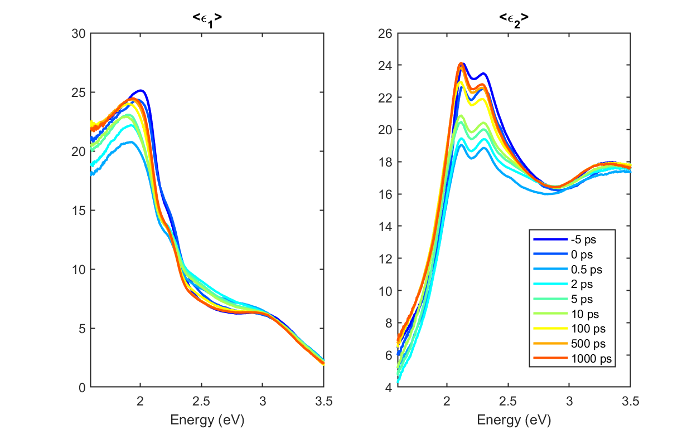
Accurate measurements and models of temperature-dependent optical constants for infrared detector materials
2024 IEEE Photonics Conference (IPC)
Rome, Italy, 10 - 14 Nov 2024
FA9550-20-1-0135 AFOSR
FA9550-24-1-0061 AFOSR
DMR-2235447 NSF
DMR-2423992 NSF
Ge
Stefan Zollner
With Carlos A. Armenta, Carola Emminger, Sonam Yadav, Melissa Rivero Arias, Jaden R. Love (NMSU), Jose Mendendez (Arizona State)
Department of Physics, New Mexico State University,
Las Cruces, NM, USA
Email: zollner@nmsu.edu. WWW: http://femto.nmsu.edu.

Slide 2

Precision measurements of optical constants
Bulk materials: Semiconductors, metals, insulators
SiC, SrTiO₃, AlSb, Ge, GaAs, GaP, GaSb, InSb, SiC (4H and 6H), Ni, Pt, Au,
MgAl₂O₄, NiO (excitons), LiF, LSAT, ZnGa₂O₄, LaAlO₃
Epitaxial layers (CVD, MBE, ALD):
NbO₂, Co₃O₄, SrTiO₃ (doped, quantum wells), BaSnO₃, ZnO, SnO₂,HfO₂, Gd_{x}Ga_{2-x}O₃, silicides,
SiGe:C, GeSn, GaAs_{1-x}P_{x}, alpha-tin on InSb and CdTe, native oxides on semiconductors (GeO₂)
Comparison with ab initio density functional theory and with k.p theory (Jose Menendez)
Ellipsometry measurements over a broad spectral range (30 meV to 9.5 eV)
and broad temperature range (4 K to 800 K). Also femtosecond time resolution (ELI Beamlines).
Applications: Microelectronics industry (CMOS, bipolar, III/V), mid-wave infrared detectors
WWW: http://femto.nmsu.edu

Slide 3
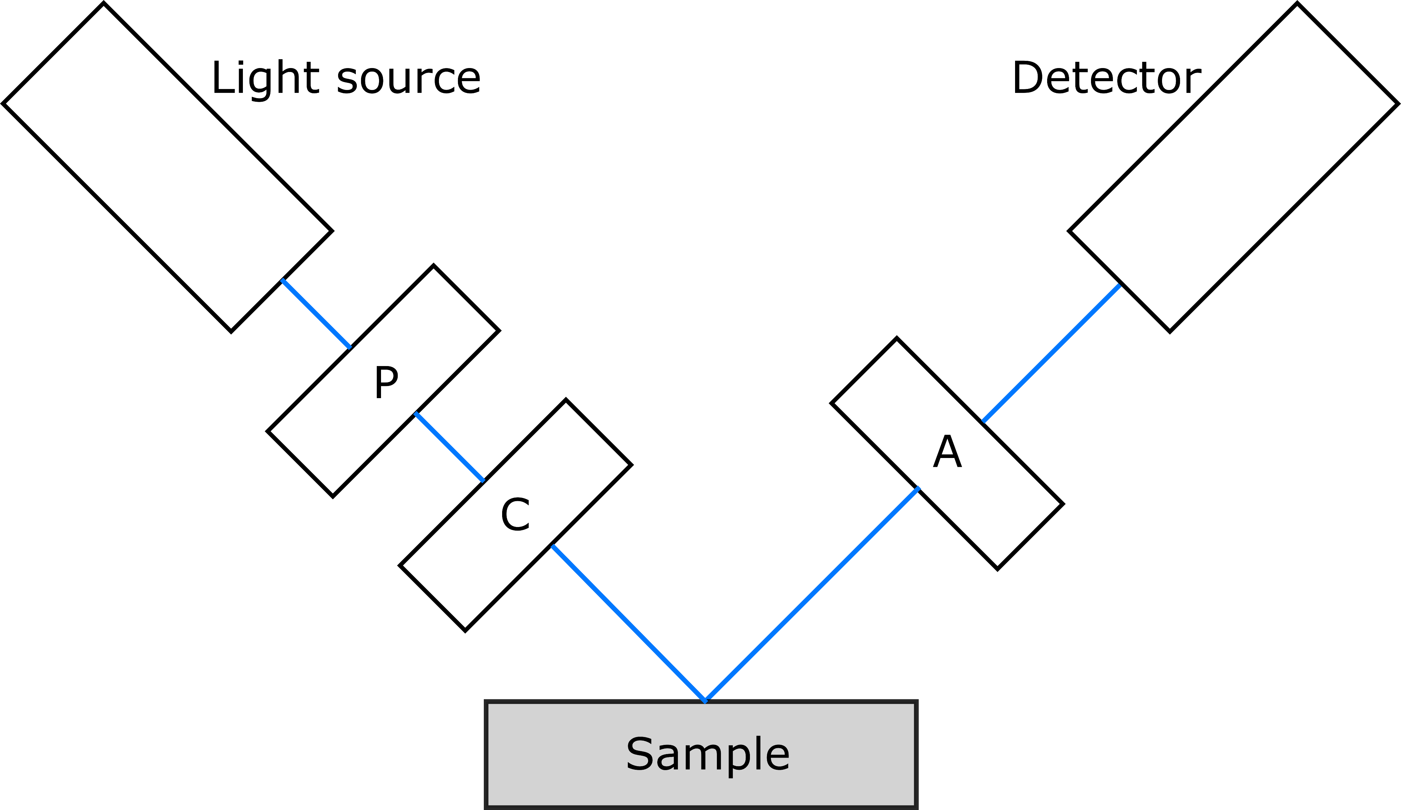
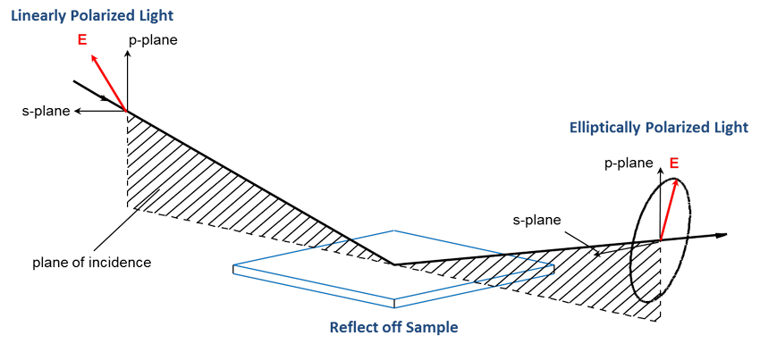
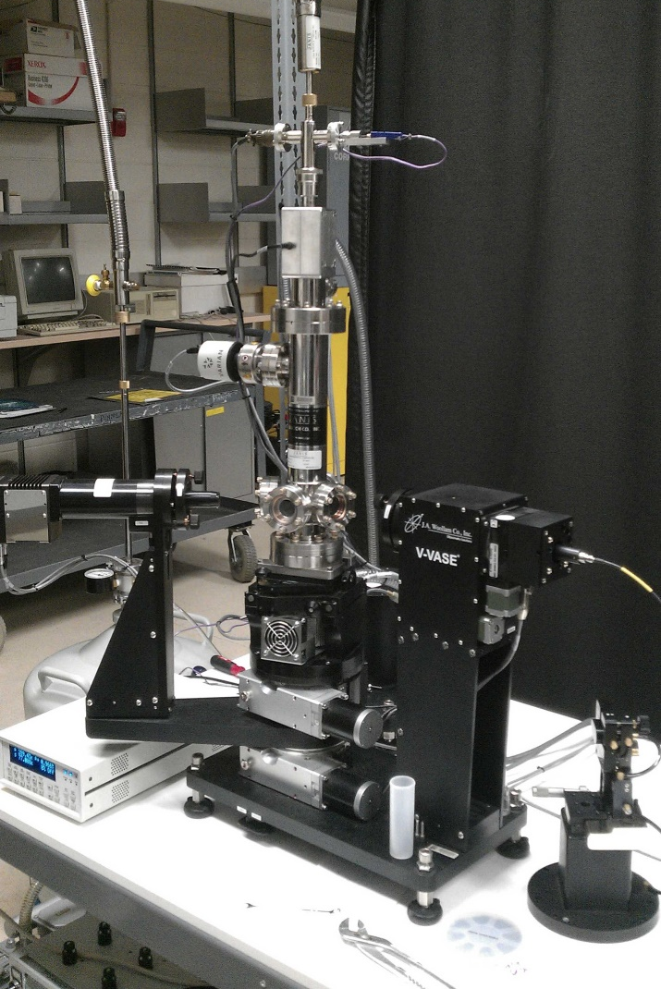
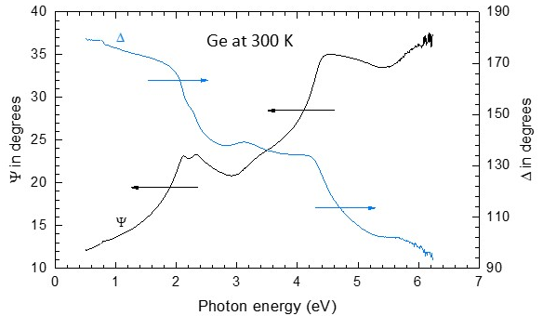
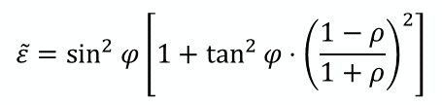

Spectroscopic ellipsometry
ellipsometric angles ψ, Δ
refractive index n+ik
dielectric function ε
$$ρ=\frac{r_{p}}{r_{s}}=\tan{Ψ}e^{iΔ}$$
$$\tilde{ε}=\sin^{2}{φ}\left[1+\tan^{2}{φ}⋅{\left(\frac{1−ρ}{1+ρ}\right)}^{2}\right]$$
UHV cryostat
& V-VASE ellipsometer
Tompkins & Hilfiker, Spectroscopic Ellipsometry (2016)
femto.nmsu.edu

Slide 4
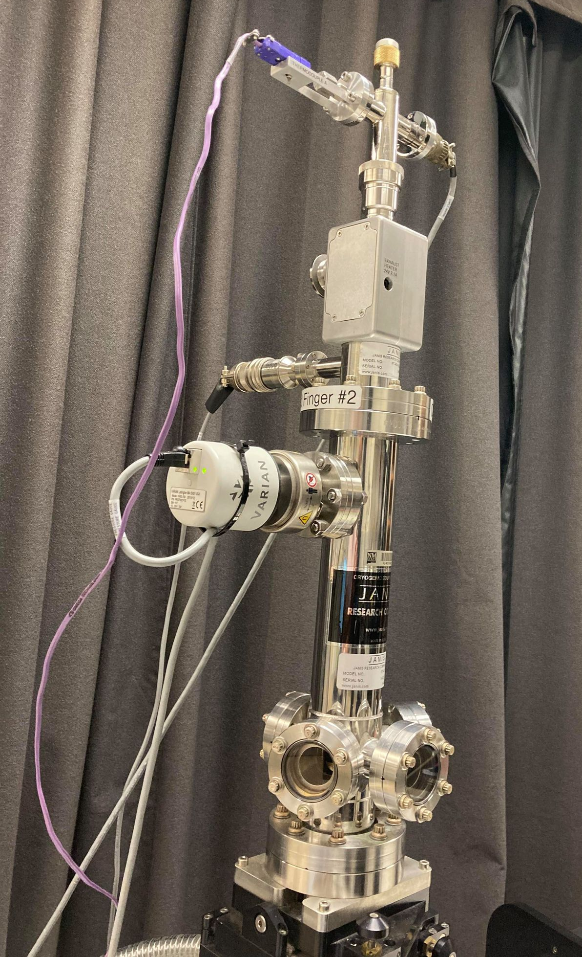
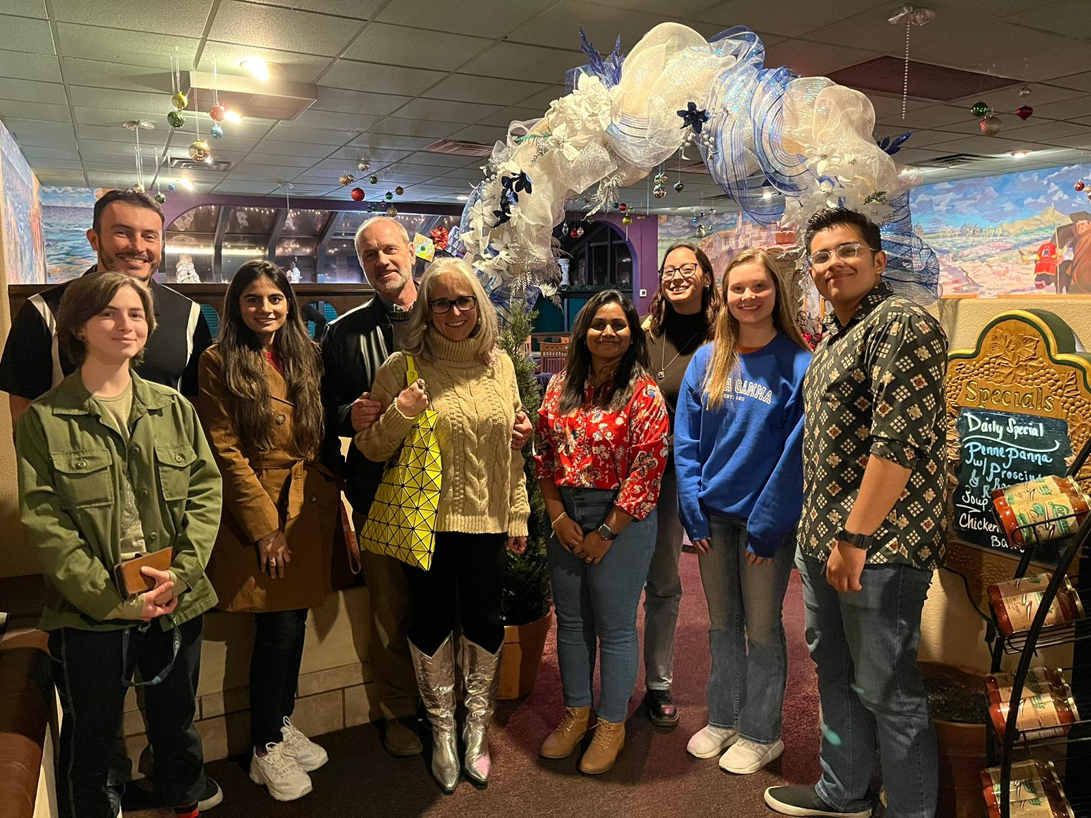
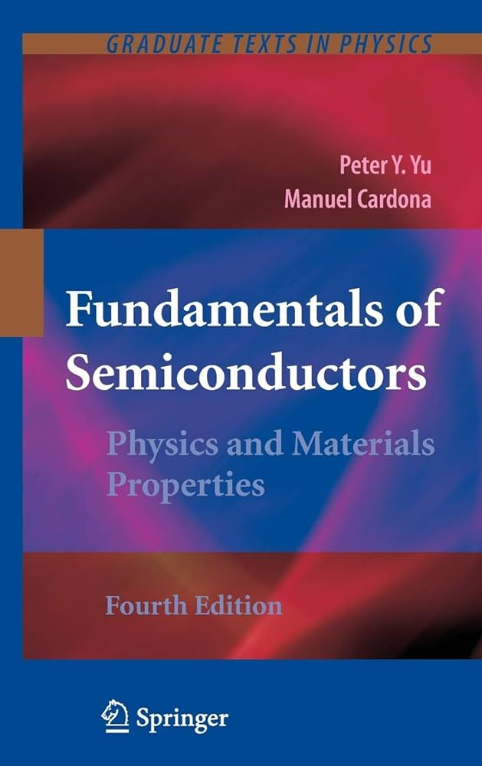
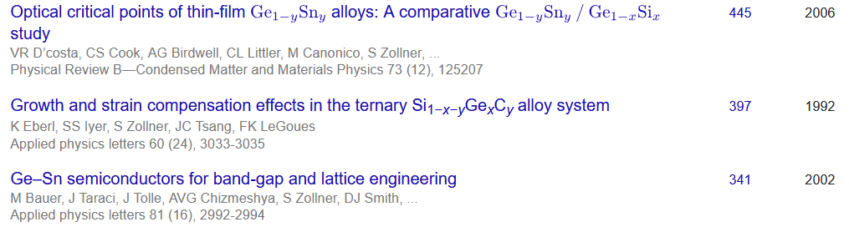
Ellipsometry at NMSU
diamond windows
closed-cycle He cooler
Ellipsometry on anything (inorganic, 3D)
Metals, insulators, semiconductors
Mid-IR to vacuum UV (150 nm to 40 μm)
10 to 800 K, ultrafast ellipsometry
Ellipsometry tells us a lot about materials quality (not necessarily what we want to know).
http://femto.nmsu.edu
Stefan Zollner, 2023

Slide 5
Problem statement: optical constants
(1) Achieve a quantitative understanding of photon absorption and emission processes.
Our qualitative understanding of excitonic absorption is 50-100 years old (Einstein coefficients),
But insufficient for modeling of detectors and emitters.
(2) How are optical processes affected by high carrier concentrations (screening)?
High carrier densities can be achieved with
  In situ doping (Menendez, Kouvetakis)
  high temperatures (narrow-gap or gapless semiconductors)
  ultrafast (femtosecond) lasers
Application: CMOS-integrated mid-infrared camera (thermal imaging with a phone).

Slide 6
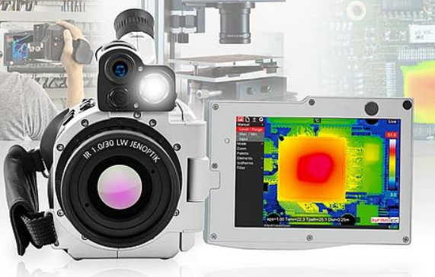
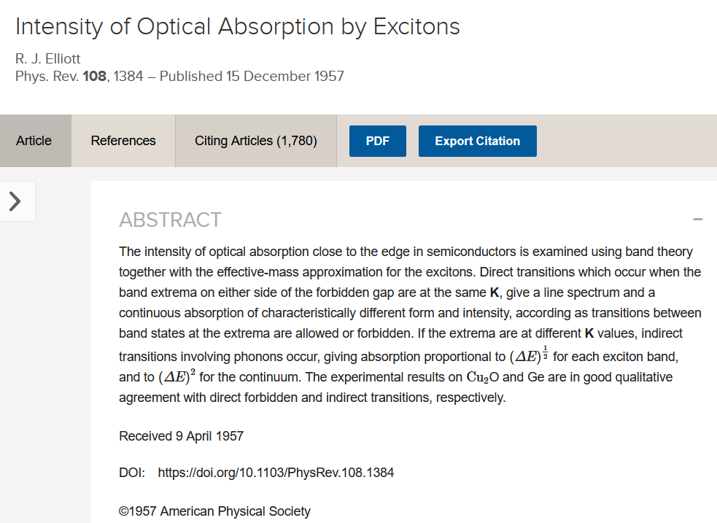

Application:
Midwave Infrared Detectors
Germanium-Tin Alloys
6

Slide 7
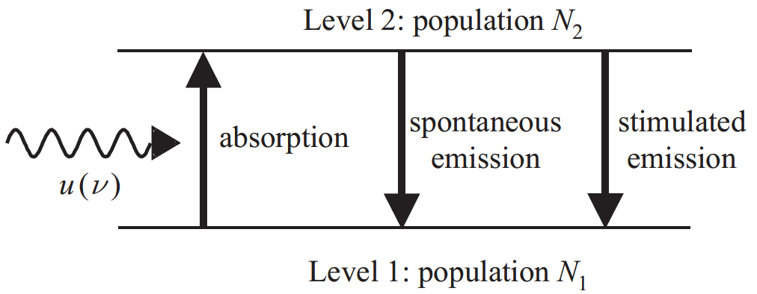

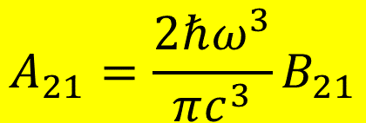

Einstein coefficients
One coefficient is sufficient:
B₁₂
A₂₁
B₂₁
$$g_{1}B_{12}=g_{2}B_{21}$$
$$A_{21}=\frac{2ℏω^{3}}{πc^{3}}B_{21}$$
In equilibrium: N₁, N₂ constant.
Absorption and emission balance.
Black-body radiation
Use Fermi’s Golden Rule to calculate B₁₂
$$u\left(ℏω\right)$$
$$B_{12}N_{1}u\left(ℏω\right)=A_{21}N_{2}+B_{21}N_{2}u\left(ℏω\right)$$
Albert Einstein, Strahlungs-Emission und Absorption nach der Quantentheorie, DPG Verh. 18, 318 (1916); Phys. Z. 18, 121 (1917). See also Mark Fox.

Slide 8
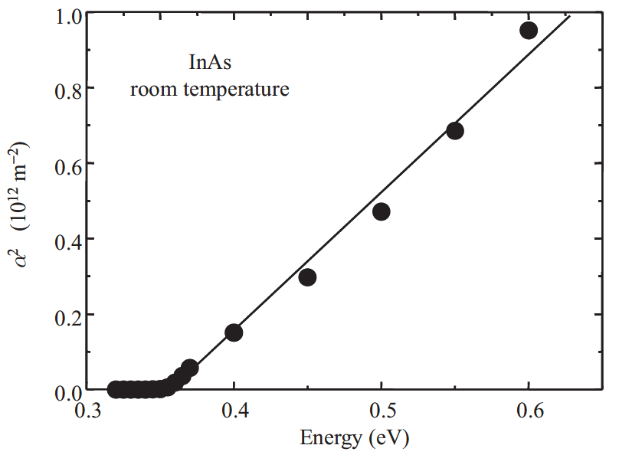
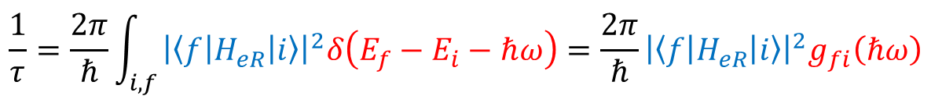
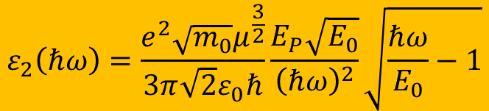
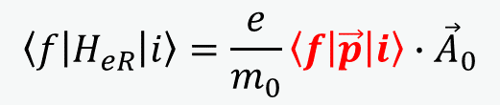
Fermi’s Golden Rule: Tauc plot
Direct band gap absorption
constant k·p matrix element
$$\frac{1}{τ}=\frac{2π}{ℏ}\int_{i,f}{{\left|\left\langle f | H_{eR} | i\right\rangle \right|}^{2}δ\left(E_{f}−E_{i}−ℏω\right)}=\frac{2π}{ℏ}{\left|\left\langle f | H_{eR} | i\right\rangle \right|}^{2}g_{fi}\left(ℏω\right)$$
Joint DOS
parabolic bands
$$\left\langle f | H_{eR} | i\right\rangle =\frac{e}{m_{0}}\left\langle f | \vec{p} | i\right\rangle ∙{\vec{A}}_{0}$$
Use k·p matrix element P: E_{P}=2P²/m₀
The Tauc plot is wishful thinking.
excitons
$$ε_{2}\left(ℏω\right)=\frac{e^{2}\sqrt{m_{0}}μ^{\frac{3}{2}}}{3π\sqrt{2}ε_{0}ℏ}\frac{E_{P}\sqrt{E_{0}}}{{\left(ℏω\right)}^{2}}\sqrt{\frac{ℏω}{E_{0}}−1}$$
Fox, Chapter 3

Slide 9
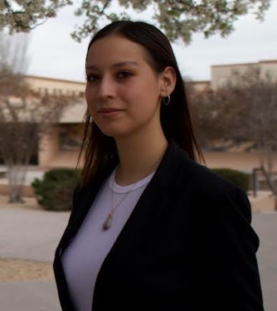
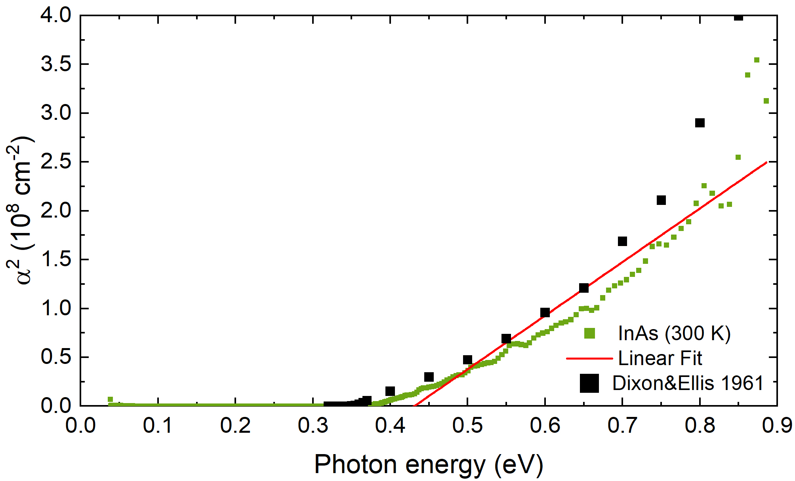

Fermi’s Golden Rule: Tauc plot
Direct band gap absorption
$$\frac{1}{τ}=\frac{2π}{ℏ}\int_{i,f}{{\left|\left\langle f | H_{eR} | i\right\rangle \right|}^{2}δ\left(E_{f}−E_{i}−ℏω\right)}=\frac{2π}{ℏ}{\left|\left\langle f | H_{eR} | i\right\rangle \right|}^{2}g_{fi}\left(ℏω\right)$$
$$\left\langle f | H_{eR} | i\right\rangle =\frac{e}{m_{0}}\left\langle f | \vec{p} | i\right\rangle ∙{\vec{A}}_{0}$$
Melissa Rivero Arias
The Tauc plot is wishful thinking.
No linear region:
Conduction band nonparabolicity
Broadening
1/E² denominator.
excitons
Use k·p matrix element P: E_{P}=2P²/m₀
$$ε_{2}\left(ℏω\right)=\frac{e^{2}\sqrt{m_{0}}μ^{\frac{3}{2}}}{3π\sqrt{2}ε_{0}ℏ}\frac{E_{P}\sqrt{E_{0}}}{{\left(ℏω\right)}^{2}}\sqrt{\frac{ℏω}{E_{0}}−1}$$

Slide 10
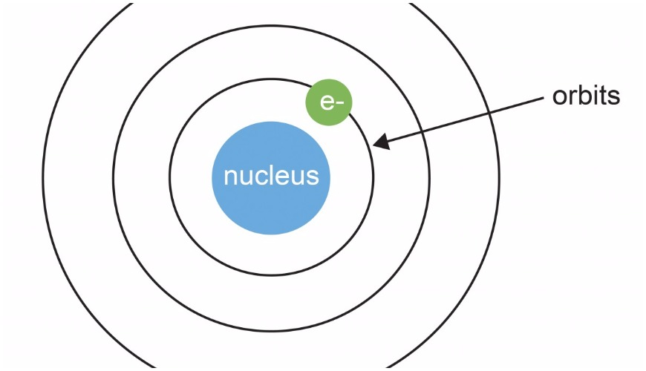
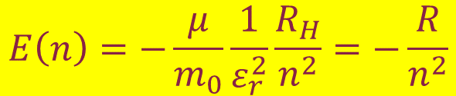


Bohr model for free excitons
Reduced electron/hole mass
(optical mass)
Static screening with static dielectric constant ε_{r}.
Exciton radius:
a_{H}=0.53 Å
Excitons stable if R>>kT
Exciton momentum is zero.
Exciton enhancement important even if R<<kT (high temperature).
$$\frac{1}{μ}=\frac{1}{m_{e}}+\frac{1}{m_{h}}$$
Electron and hole form a bound state with binding energy.
R_{H}=13.6 eV Rydberg energy.
QM mechanical treatment easy.
$$a_{n}=\frac{m_{0}}{μ}ε_{r}n^{2}a_{H}$$
$$E\left(n\right)=−\frac{μ}{m_{0}}\frac{1}{ε_{r}^{2}}\frac{R_{H}}{n^{2}}=−\frac{R}{n^{2}}$$
Fox, Chapter 4

Slide 11
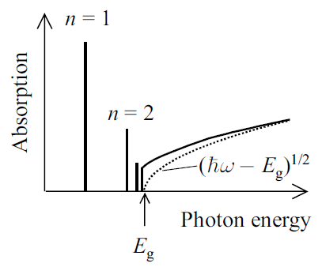
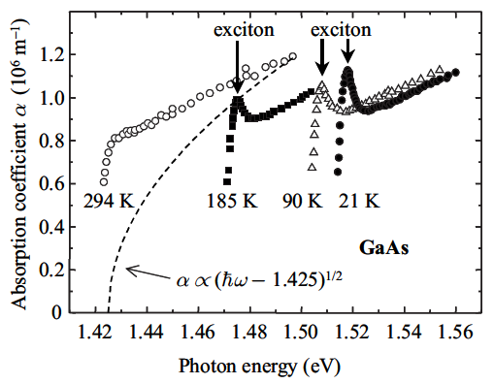
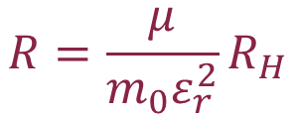

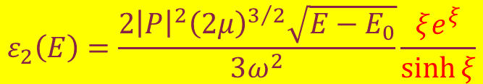
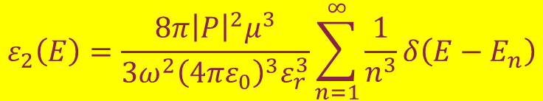
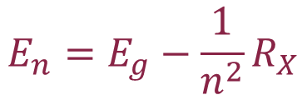
Sommerfeld enhancement (3D)
Excitonic Rydberg
energy
Discrete states
Discrete absorption
Continuum absorption
$$R=\frac{μ}{{m_{0}ε}_{r}^{2}}R_{H}$$
$$E_{n}=E_{g}−\frac{1}{n^{2}}R_{X}$$
$$ε_{2}\left(E\right)=\frac{8π{\left|P\right|}^{2}μ^{3}}{{3ω}^{2}{\left(4πε_{0}\right)}^{3}ε_{r}^{3}}\sum_{n=1}^{∞}{\frac{1}{n^{3}}δ\left(E−E_{n}\right)}$$
$$ε_{2}\left(E\right)=\frac{2{\left|P\right|}^{2}{\left(2μ\right)}^{3/2}\sqrt{E−E_{0}}}{3ω^{2}}\frac{ξe^{ξ}}{\sinh{ξ}}$$
$$ξ=π\sqrt{R/{E−E_{0}}}$$
Use Bohr wave functions to calculate ε₂.
Toyozawa discusses broadening.
R. J. Elliott, Phys. Rev. 108, 1384 (1957)
Yu & Cardona; Fox, Chapter 4; Tanguy 1995

Slide 12
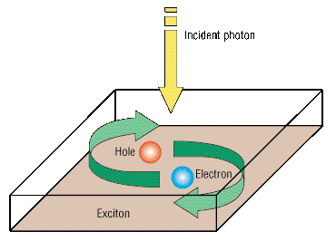
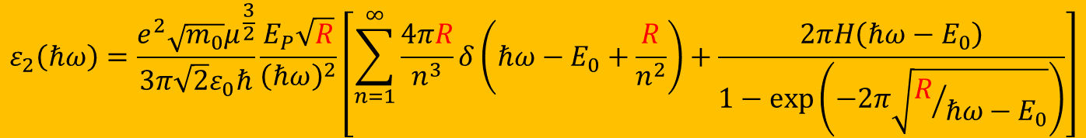
Elliott-Tanguy exciton absorption
Direct band gap absorption
Excitonic binding energy: R=R_{H}×μ_{h}/ε_{s}²
$$ε_{2}\left(ℏω\right)=\frac{e^{2}\sqrt{m_{0}}μ^{\frac{3}{2}}}{3π\sqrt{2}ε_{0}ℏ}\frac{E_{P}\sqrt{R}}{{\left(ℏω\right)}^{2}}\left[\sum_{n=1}^{∞}{\frac{4πR}{n^{3}}δ\left(ℏω−E_{0}+\frac{R}{n^{2}}\right)+\frac{2πH\left(ℏω−E_{0}\right)}{1−\text{exp}\left(−2π\sqrt{R/{ℏω−E_{0}}}\right)}}\right]$$
bound excitons
exciton continuum enhancement
Tanguy’s contributions:
Add Lorentzian broadening
Kramers-Kronig transform to get the real part.
×
R. J. Elliott, Phys. Rev. 108, 1384 (1957).
Christian Tanguy, Phys. Rev. Lett. 75, 4090 (1995) + (E)

Slide 13
13

Slide 14
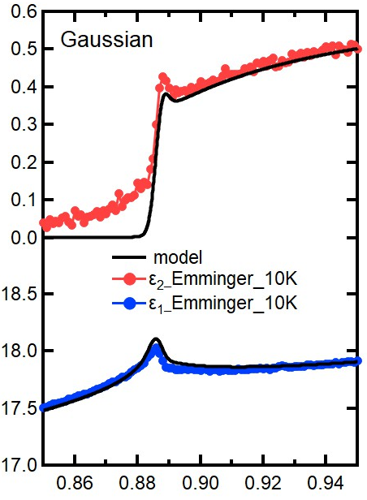
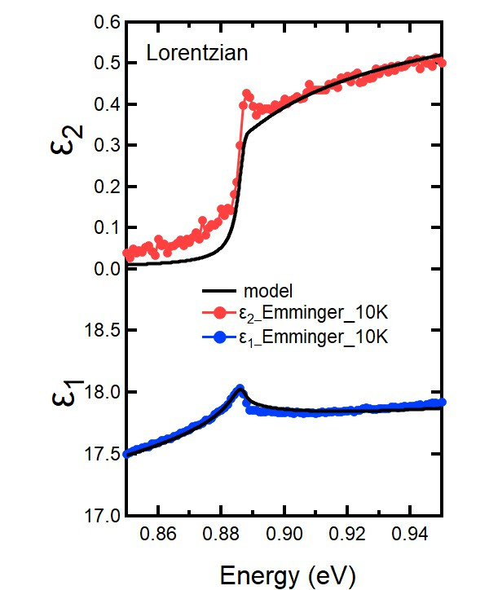
Elliott-Tanguy theory applied to Ge
Fixed parameters:
  Electron and hole masses (temperature dependent)
  Excitonic binding energy R
  Amplitude A (derived from matrix element P)
Adjustable parameters:
  Broadening Γ: 2.3 meV
  Band gap E₀
  Linear background A₁ and B₁
  (contribution from E₁ to real part of ε)
  Problems:
  Broadening below the gap (band tail, oxide correction)
ε₂
Ge
10 K
Quantitative agreement
ε₁
Carola Emminger et al., JAP 131, 165701 (2022).
14

Slide 15
Elliott-Tanguy theory applied to Ge
Good agreement at low temperatures.
Model also describes second derivatives.
Potential problems:
Matrix element k-dependent
Nonparabolicity
Resonant indirect absorption
??? at high T.
Ge
Ge
Carola Emminger et al., JAP 131, 165701 (2022).
15

Slide 16
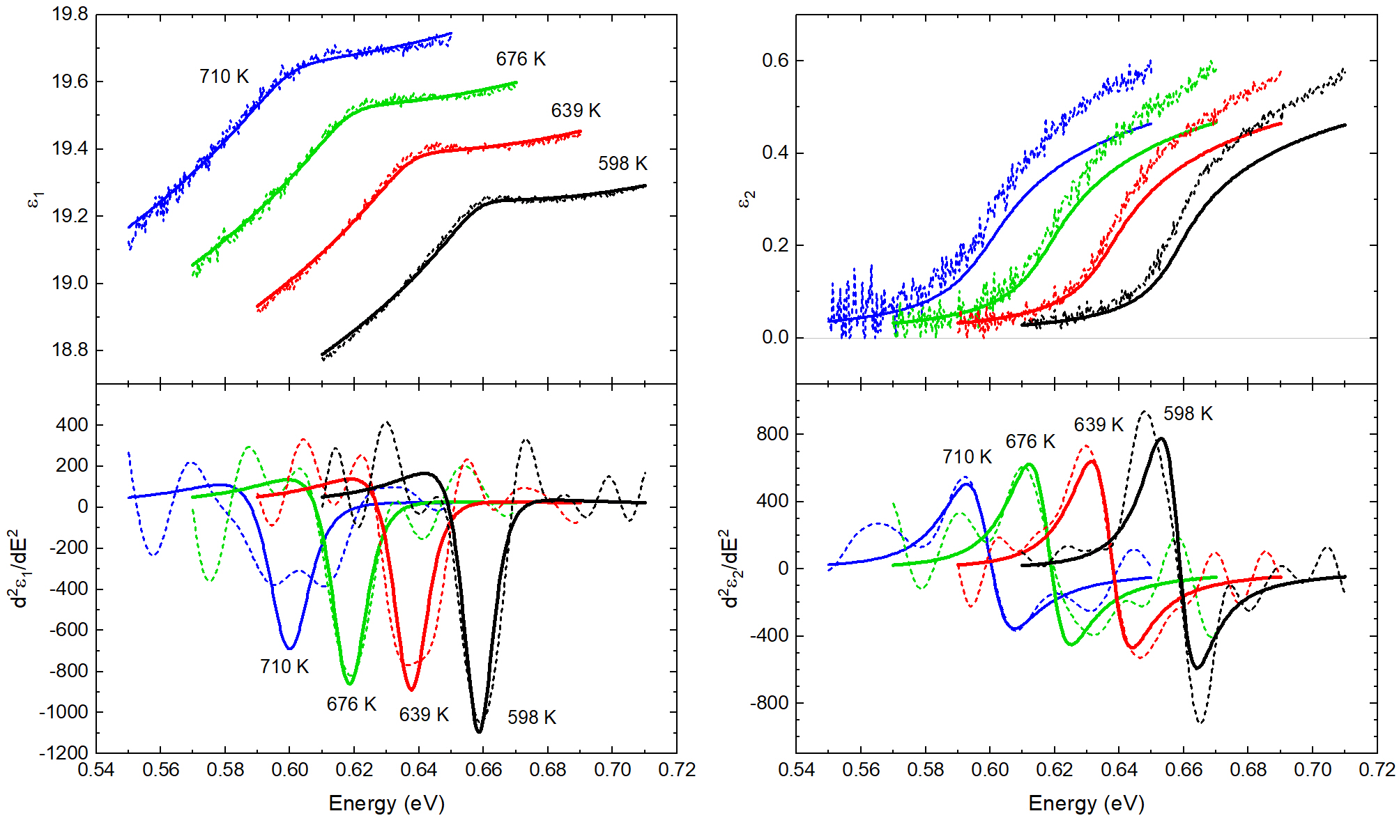
Elliott-Tanguy theory: problems for Ge at high T
Good agreement at low temperatures.
Model also describes second derivatives.
Potential problems:
Matrix element k-dependent
Nonparabolicity
Resonant indirect absorption
Temperature dependence of the effective mass.
Ge
Ge
Carola Emminger et al., JAP 131, 165701 (2022).
16

Slide 17
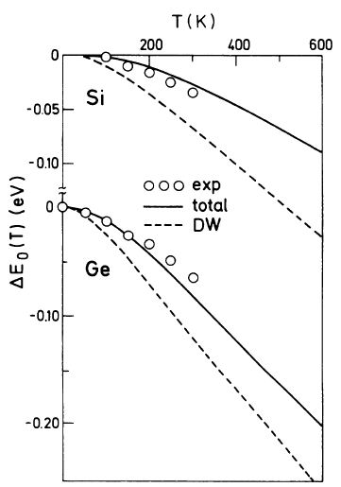
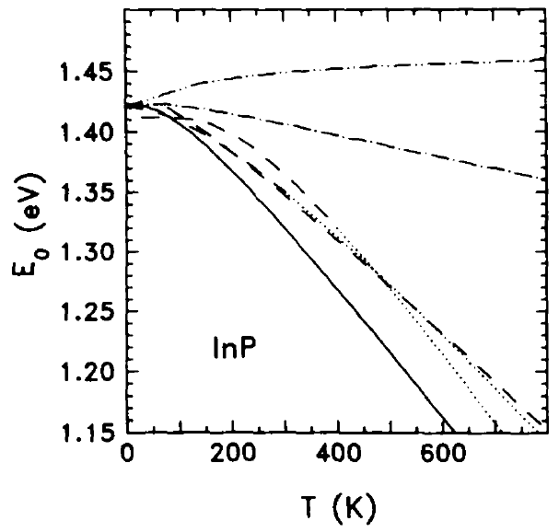
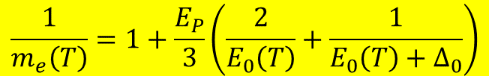
Temperature dependence of the effective mass
Effective electron mass given by k·p theory
Temperature dependence of the direct band gap has two contributions:
  Thermal expansion of the lattice
  Electron-phonon interaction (Debye-Waller term and self-energy)
“Mass band gap” should only include the thermal expansion.
E₀: direct band gap
k·p matrix element P: E_{P}=2P²/m₀
$$\frac{1}{m_{e}\left(T\right)}=1+\frac{E_{P}}{3}\left(\frac{2}{E_{0}\left(T\right)}+\frac{1}{E_{0}\left(T\right)+Δ_{0}}\right)$$
Self-energy
InSb
Thermal expansion
Total
Experiment
SZ, Solid State Commun. 77, 485 (1991).
P.B. Allen and M. Cardona, Phys. Rev. B 27 4760 (1983).
17

Slide 18
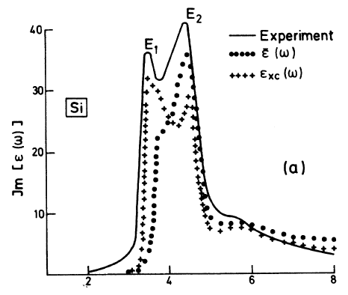
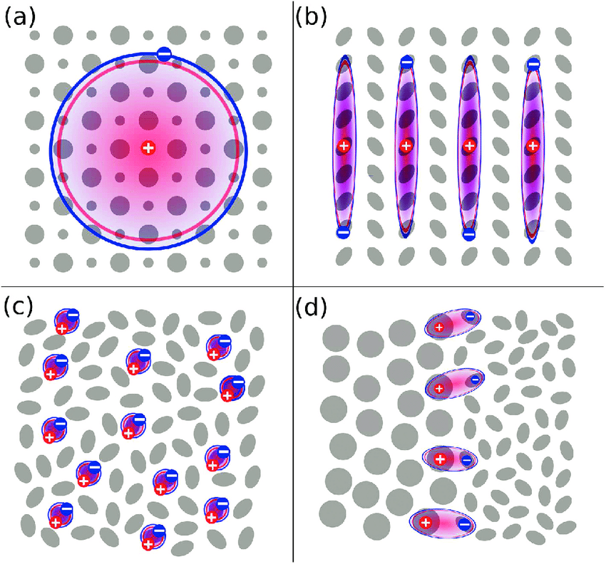
Two-dimensional saddle-point excitons (E₁, E₁+Δ₁)
$$ε\left(E\right)=\frac{A}{{\left(E+iΓ\right)}^{2}}\left\{g\left[ξ\left(E+iΓ\right)\right]+g\left[ξ\left(−E−iΓ\right)\right]−2g\left[ξ\left(0\right)\right]\right\}$$
$$g\left(ξ\right)=2ln(ξ)−2ψ(\frac{1}{2}−ξ)$$
$$ψ\left(z\right)=\frac{d\text{ln}Γ\left(z\right)}{dz}$$
$$ξ\left(z\right)=\sqrt{R/{E_{0}−z}}$$
$$A=\frac{μe^{2}}{3πε_{0}m_{0}^{2}}{\left|P\right|}^{2}$$
Strong excitonic contribution to E₁ critical point in Si (mot so much in Ge).
B. Velicky and J. Sak, phys. status solidi 16, 147 (1966)
W. Hanke and L.J. Sham, Phys. Rev. B 21, 4656 (1980)
C. Tanguy, Solid State Commun. 98, 65 (1996)

Slide 19
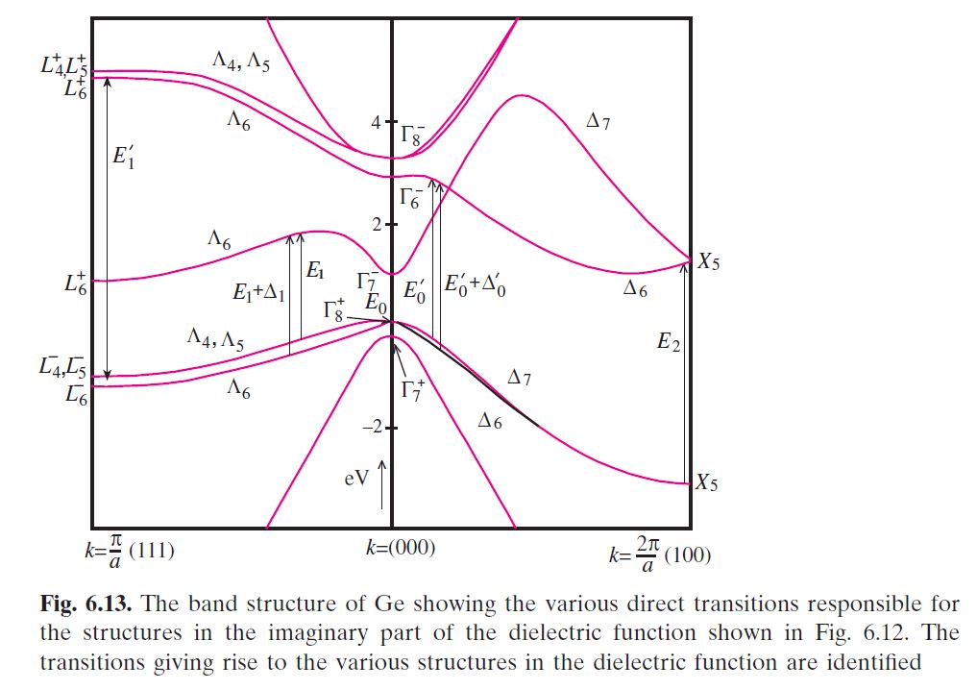
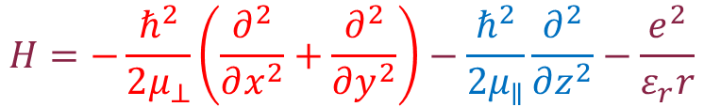
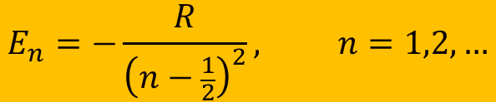

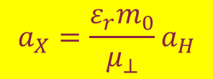
Two-dimensional Bohr problem
$$H=−\frac{ℏ^{2}}{2μ_{⊥}}\left(\frac{∂^{2}}{∂x^{2}}+\frac{∂^{2}}{∂y^{2}}\right)−\frac{ℏ^{2}}{2μ_{∥}}\frac{∂^{2}}{∂z^{2}}−\frac{e^{2}}{ε_{r}r}$$
Assume that μ|| along (111) is infinite (separate term).
Use cylindrical coordinates.
Separate radial and polar variables.
Similar Laguerre solution as 3D Bohr problem.
2D critical point
$$a_{X}=\frac{ε_{r}m_{0}}{μ_{⊥}}a_{H}$$
$$R=\frac{μ_{⊥}}{m_{0}ε_{r}^{2}}R_{H}$$
(same as in 3D)
$$E_{n}=−\frac{R}{{\left(n−\frac{1}{2}\right)}^{2}}, n=1,2, …$$
Half-integral quantum numbers
M. Shinada and S. Sugano, J. Phys. Soc. Jpn. 21, 1936 (1966).
Flügge (Rechenmethoden QM, 1952).

Slide 20
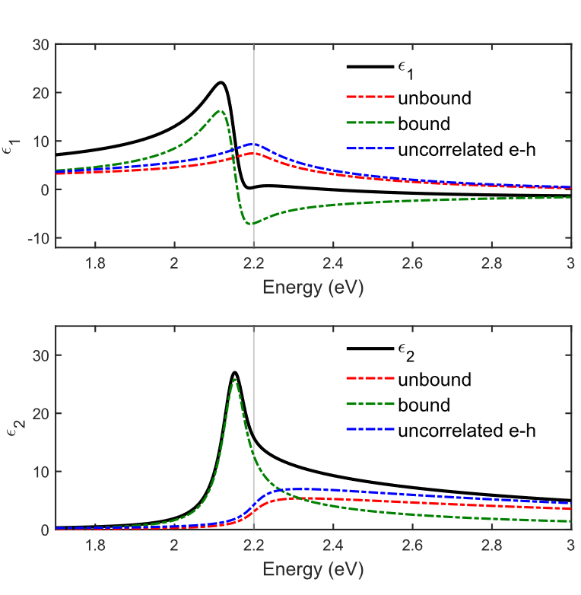
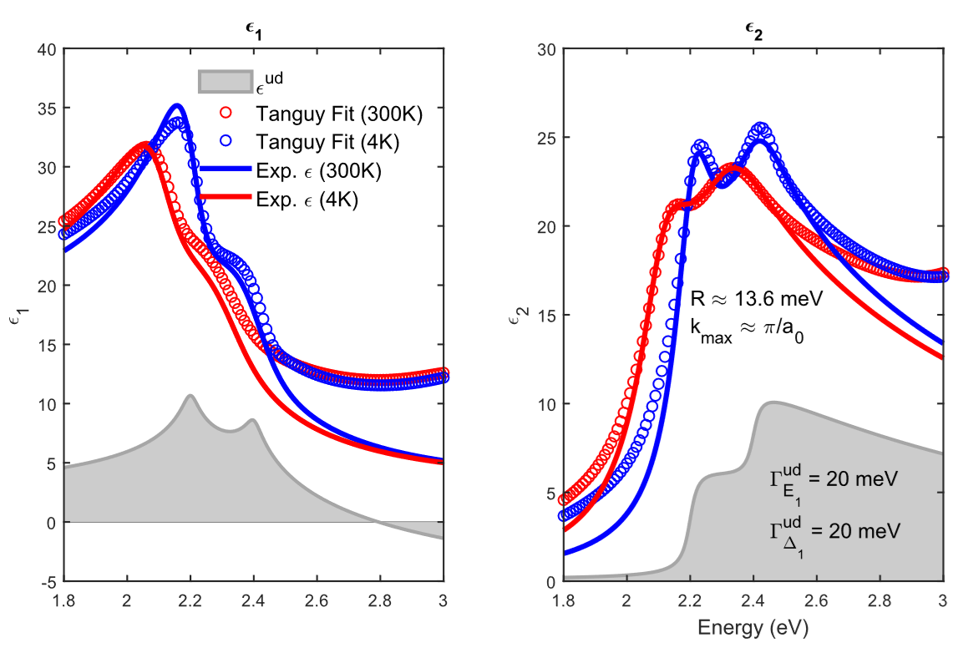



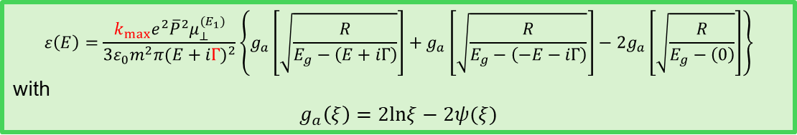
Two-dimensional excitons at E₁ critical points of Ge
$$ε\left(E\right)=\frac{k_{max}e^{2}{\overline{P}}^{2}μ_{⊥}^{(E_{1})}}{3ε_{0}m^{2}π{(E+iΓ)}^{2}}\left\{g_{a}\left[\sqrt{\frac{R}{E_{g}−\left(E+iΓ\right)}}\right]+g_{a}\left[\sqrt{\frac{R}{E_{g}−\left(−E−iΓ\right)}}\right]−2g_{a}\left[\sqrt{\frac{R}{E_{g}−\left(0\right)}}\right]\right\}$$
with
$$g_{a}\left(ξ\right)=2lnξ−2ψ(ξ)$$
Peak at $n=0$ for
$$E_{g}−4R$$
$E_{1}$
$E_{1}+Δ_{1}$
preliminary
C. Tanguy, SSC 98, 65 (1996).

Slide 21
Problem statement: optical constants
(1) Achieve a quantitative understanding of photon absorption and emission processes.
Our qualitative understanding of excitonic absorption is 50-100 years old (Einstein coefficients),
But insufficient for modeling of detectors and emitters.
(2) How are optical processes affected by high carrier concentrations (screening)?
High carrier densities can be achieved with
  In situ doping (Menendez, Kouvetakis; Arizona State University)
  high temperatures (narrow-gap or gapless semiconductors)
  ultrafast (femtosecond) lasers
Application: CMOS-integrated mid-infrared camera (thermal imaging with a phone).

Slide 22
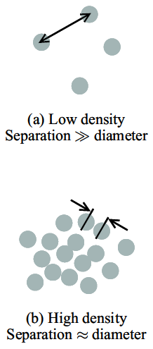


Condensation of excitons at high density
Mott transition (insulator-metal) when electron separation equals exciton radius.
Electron separation d for density N
Mott transition occurs at r_{s} near 1.
GaAs: n=10¹⁷ cm⁻³.
Biexciton, triexciton molecule formation.
Electron-hole droplets. Bose-Einstein condensation.
Exciton gas
$$d=\sqrt[3]{\frac{3}{4πn}}$$
$$r_{s}=\frac{d}{a_{X}}$$
dimensionless
Electron-hole liquid
Fox, Chapter 4

Slide 23
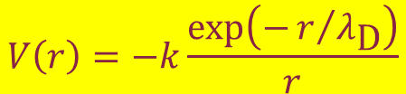





Excitons in doped or excited semiconductors
Need to include exciton screening due to doping.
Yukawa potential: Schrödinger equation not solvable.
Use Hulthen potential as an approximation
Coulomb
Yukawa
Hulthen
$$V\left(r\right)=−k\frac{1}{r}$$
$$k=\frac{e^{2}}{4πε_{0}ε_{r}}$$
Debye screening length
$$V\left(r\right)=−k\frac{\text{exp}\left(−r/{λ_{\text{D}}}\right)}{r}$$
$$λ_{D}=\sqrt{\frac{ε_{r}ε_{0}k_{B}T}{ne^{2}}}=\frac{1}{k_{D}}$$
$$V\left(r\right)=−k\frac{2/{ga_{X}}}{\text{exp}\left(\frac{2r}{ga_{X}}\right)−1}$$
Unscreened: g=∞
Fully screened: g=0
Mott criterion: g=1
$$g=\frac{λ_{D}}{a_{X}}$$
Hulthen exciton
C. Tanguy, Phys. Rev. 60, 10660 (1999).
Banyai & Koch, Z. Phys. B 63, 283 (1986). Haug & Koch (2009).

Slide 24




Tanguy: Dielectric function of screened excitons
$$A=\frac{ℏ^{2}e^{2}}{6πε_{0}m_{0}^{2}}{\left(\frac{2μ}{ℏ^{2}}\right)}^{3/2}{\left|P\right|}^{2}$$
Bound exciton states (finite number):
$$ε_{2}\left(ω\right)=\frac{2πA\sqrt{R}}{E^{2}}\sum_{n=1}^{n^{2}<g}{2R\frac{1}{n}\left(\frac{1}{n^{2}}−\frac{n^{2}}{g^{2}}\right)δ\left[E−E_{0}+\frac{R}{n^{2}}{\left(1−\frac{n^{2}}{g}\right)}^{2}\right]}$$
Reduced Rydberg energy
exciton continuum:
$$ε_{2}\left(ω\right)=\frac{2πA\sqrt{R}}{E^{2}}\frac{\sinh{πgk}}{\cosh\left(πgk\right)−\cosh\left(πg\sqrt{k^{2}−\frac{4}{g}}\right)}θ\left(E−E_{0}\right)$$
$$k=π\sqrt{{\left(E−E_{0}\right)}/R}$$
Need to introduce Lorentzian broadening and perform numerical KK transform.
C. Tanguy, Phys. Rev. B 60, 10660 (1999)

Slide 25

Tanguy: Dielectric function of screened excitons
g=∞ (unscreened)
g=∞
g=0
(screened)
g=0
g=∞
g=∞
Small Broadening
Low Temp
g=1.5
Large Broadening
High Temp
g=0
g=0
Stefan Zollner, 2023, AFRL Lectures Series 3
C. Tanguy, Phys. Rev. B 60, 10660 (1999)

Slide 26




k·p theory (band structure method)
Schrödinger equation
Use Bloch’s theorem:
Solve equation for k=0.
Eliminate green free-electron term with substitution of variables (Kane 1957).
Then treat red term in perturbation theory.
Works very well for semiconductors with local V(r) potentials.
$$HΦ_{n\vec{k}}=\left(\frac{{\vec{p}}^{2}}{2m_{0}}+V\right)Φ_{n\vec{k}}=E_{n\vec{k}}Φ_{n\vec{k}}$$
$$Φ_{n\vec{k}}\left(\vec{r}\right)=e^{i\vec{k}∙\vec{r}}u_{n\vec{k}}\left(\vec{r}\right)$$
Product rule
$${\left(fg\right)}^{′′}=f^{′′}g+2f^{′}g^{′}+fg^{′′}$$
$$\left(\frac{{\vec{p}}^{2}}{2m_{0}}+\frac{ℏ^{2}{\vec{k}}^{2}}{2m_{0}}+\frac{ℏ\vec{k}∙\vec{p}}{m_{0}}+V\right)u_{n\vec{k}}=E_{n\vec{k}}u_{n\vec{k}}$$
Yu & Cardona, Fundamentals of Semiconductors
Kane, J. Phys. Chem. Solids 1, 249 (1957). Kane 1966.
Stefan Zollner, 2023, AFRL Lectures Series 3
26

Slide 27

Relativistic Effects: Darwin Shift: C, Si, Ge, Sn
j=3/2
The s* band moves down, as the elements get heavier.
In α-tin, the s* band moves into the p-band manifold, between the j=1/2 and j=3/2 states.
This makes α-tin an (inverted) gapless semiconductor.
p
j=1/2

Slide 28


Intravalence band absorption in gapless topological insulators (α-tin)
looks like an exciton
R.A. Carrasco, APL 113, 232104 (2018).
All gapless (inverted) semiconductors should have this peak.
Theory with same model as Ge IVB (Kaiser 1953, Kahn 1955).

Slide 29



Simple 8x8 k·p band structure of α-tin (Kane)
Kane 8x8 k·p Hamiltonian:
$${\tilde{H}}_{\vec{k}}=\left(\begin{matrix}E_{0} & 0 & −\frac{ℏ\vec{k}}{m_{0}}iP & 0 \\ 0 & −\frac{2Δ_{0}}{3} & \frac{\sqrt{2}Δ_{0}}{3} & 0 \\ \frac{ℏ\vec{k}}{m_{0}}iP & \frac{\sqrt{2}Δ_{0}}{3} & −\frac{Δ_{0}}{3} & 0 \\ 0 & 0 & 0 & 0\end{matrix}\right)$$
α-tin
dashed: parabolic
solid: nonparabolic
Cubic characteristic equation:
$$\tilde{E}\left(\tilde{E}−E_{0}\right)\left(\tilde{E}+Δ_{0}\right)−\frac{ℏ^{2}k^{2}E_{P}}{2m_{0}}\left(\tilde{E}+\frac{2Δ_{0}}{3}\right)=0$$
S. Zollner, JVST B 42, 022203 (2024).

Slide 30





Excitonic intravalence band absorption in α-tin
Parabolic bands
nonparabolicity affects exciton radius (screening)
Screening:
without
excitons
$$r_{s}=\frac{1}{a_{x}}\sqrt[3]{\frac{3}{4πn}}$$
without
excitons
$$V\left(r\right)=−k\frac{\text{exp}\left(−r/{λ_{\text{D}}}\right)}{r}$$
with excitons
$$λ_{D}=\sqrt{\frac{ε_{r}ε_{0}k_{B}T}{pe^{2}}}=\frac{1}{k_{D}}$$
with excitons
S. Zollner, JVST B 42, 022203 (2024).

Slide 31

Dielectric function of InSb from 80 to 800 K
InSb
InSb
~0.2 eV band gap
Band gap changes with temperature (but only below 500 K).
Amplitude reduction at high temperatures (Pauli blocking, bleaching)
Drude response at high temperatures (thermally excited carriers).
Depolarization artifacts at long wavelengths (below 300 K).
Woollam FTIR-VASE
cryostat with CVD diamond windows
Melissa Rivero Arias, JVSTB 41, 022203 (2023)
31

Slide 32

Optical constants model: screened excitons
$$ε_{2}\left(E\right)=\frac{2πA\sqrt{R}}{E^{2}}\left\{\sum_{n=1}^{\sqrt{g}}{\frac{2R}{n}\left(\frac{1}{n^{2}}−\frac{n^{2}}{g^{2}}\right)δ\left[E−E_{0}+\frac{R}{n^{2}}{\left(1−\frac{n^{2}}{g}\right)}^{2}\right]+\frac{\text{sinh}\left(πgk\right)\text{H}\left(E−E_{0}\right)}{\text{cosh}\left(πgk\right)−\text{cosh}\left(πg\sqrt{k^{2}−\frac{4}{g}}\right)}}\right\}\left[f_{h}\left(E\right)−f_{e}\left(E\right)\right]$$
Absorption by screened excitons (Hulthen potential)
Degenerate Fermi-Dirac statistics to calculate f_{h} and f_{e}.
Numerical Kramers-Kronig transform (need occupation factors)
Two terms for light and heavy excitons
Non-parabolicity and temperature-dependent mass included from k.p theory
k-dependent matrix element P.
Screening parameter g=12/π²a_{R}k_{TF} (large: no screening)
Sommerfeld enhancement persists well above the Mott density.
Only two free parameters: Band gap E₀ and broadening Γ
Amplitude A and exciton binding energy R from k.p theory and effective masses
Christian Tanguy, Phys. Rev. B 60, 10660 (1999).
Jose Menendez, Phys. Rev. B 101, 195204 (2020).
Carola Emminger, J. Appl. Phys. 131, 165701 (2022).

Slide 33



Band gap analysis for InSb
How does the band gap of InSb change with temperature?
Parametric-Semiconductor Model:
Also vary
“shape parameters”.
Asymmetric peak shape poorly described.
Try Tanguy oscillator for excitonic line shape.
InSb
C. M. Herzinger, B. Johs, et al., J. Appl. Phys. 83, 3323 (1998)
Melissa Rivero Arias, JVSTB 41, 022203 (2023)
33

Slide 34



Band gap of InSb from 80 to 800 K
InSb
Bose-Einstein Model
$$E_{0}\left(T\right)=E^{\text{un}}−b\left[1+\frac{2}{\text{exp}\left(Ω/{k_{B}T}\right)}\right]$$
Band gap changes with temperature (but only below 500 K)
Described by Bose-Einstein model below 500 K: Logothetidis, PRB 31, 947 (1985).
No redshift above 500 K: Thermal Burstein-Moss shift
T.S. Moss, Proc. Phys. Soc. 67, 775 (1954).
E. Burstein, Phys. Rev. 93, 632 (1954).
34

Slide 35







Nonparabolicity of InSb conduction band from k·p theory
Kane 8x8 k·p Hamiltonian:
$${\tilde{H}}_{\vec{k}}=\left(\begin{matrix}E_{0} & 0 & −\frac{ℏ\vec{k}}{m_{0}}iP & 0 \\ 0 & −\frac{2Δ_{0}}{3} & \frac{\sqrt{2}Δ_{0}}{3} & 0 \\ \frac{ℏ\vec{k}}{m_{0}}iP & \frac{\sqrt{2}Δ_{0}}{3} & −\frac{Δ_{0}}{3} & 0 \\ 0 & 0 & 0 & 0\end{matrix}\right)$$
Energy versus k
(InSb)
Cubic characteristic equation:
Density of CB states
$$\tilde{E}\left(\tilde{E}−E_{0}\right)\left(\tilde{E}+Δ_{0}\right)−\frac{ℏ^{2}k^{2}E_{P}}{2m_{0}}\left(\tilde{E}+\frac{2Δ_{0}}{3}\right)=0$$
$$\frac{ℏ^{2}k^{2}}{2m_{0}m^{∗}}=ε\left(1+αε+βε^{2}\right)$$
Large spin-orbit approximation:
$$E_{3,4}=\frac{ℏ^{2}k^{2}}{2m_{0}}+\frac{E_{0}}{2}\left(1±\sqrt{1+\frac{ℏ^{2}k^{2}}{2m_{0}}\frac{2}{μ_{lh}E_{0}}}\right)$$
$$α=\frac{{\left(1−m^{∗}\right)}^{2}}{E_{0}}$$
Kane, J. Phys. Chem. Solids 1, 249 (1957).
35

Slide 36

Femtosecond Pump-Probe Ellipsometry
Pump
Non-linear effects in germanium induced by photoexcited carriers:
Screening (many-body)
Carrier-carrier scattering.
Carrier-phonon scattering.
Intervalley scattering.
Momentum and energy relaxation of hot carriers.
$$Δt$$
Probe
$$ω$$
H. Kalt, Semiconductor Optics 2 (2024).
Tompkins & Hilfiker, Spectroscopic Ellipsometry (2016)
1

Slide 37


Experimental setup: pump-probe ellipsometry
1.55 eV pump beam path
Ch: Chopper (500 Hz, 250 Hz)
A: Analyzer
P: Polarizer
C_{R}: Rotating Compensator
L: Lens
S: Sample
DL: Delay Line
(~6.67 ns pump-probe delay, 3 fs resolution)
BS: Beam Splitter
SCG: Super-continuum Generation
CCD: Charge-coupled device detector
35 fs
White light probe beam path
Eli Beamlines
Dolni Brezany, Czech Republic
S. Richter, Rev. Sci. Instrum. 92, 033104 (2021).
S. Espinoza, Appl. Phys. Lett. 115, 052105 (2019).

Slide 38

Set-up: Femtosecond pump-probe ellipsometry
Pump
Rotating compensator ellipsometer:
Compensator was rotated in steps of 10º for a total of 55-65 angles.
Probe beam of 350-750 nm at 60º incidence angle.
P-polarized pump beam: 35 fs pulses of 800 nm wavelength at 1 kHz repetition rate.
Delay time from -10 to 50 ps.
Time resolution of about 500 fs.
Focusing lens
Probe
Analyzer
Compensator
Polarizer
Sample Stage
Eli Beamlines
Dolni Brezany, Czech Republic
Espinoza et al., APL 115, 052105 (2019).

Slide 39

Pseudo-dielectric constant as function of delay time
$$E_{1}$$
500 fs
$$E_{1}+∆_{1}$$
Rapid decrease of ε within first 500 fs.
Recovery takes 1 ns or longer.
Carlos A. Armenta, Shirly J. Espinoza (unpublished)

Slide 40



2D excitons with band filling - no screening
$$ε_{2}\left(E\right)=\frac{e^{2}μ_{⊥}^{(E_{1})}{\overline{P}}^{2}}{{6ε}_{0}m^{2}π}Im\left\{\frac{\left\{g_{a}\left[ξ\left(E+iΓ\right)\right]+g_{a}\left[ξ\left(−E−iΓ\right)\right]−2g_{a}[ξ(0)]\right\}}{{(E+iΓ)}^{2}}\right\}\int_{−k_{max}}^{k_{max}}{\left\{1−f\left[E_{c}\left(E,k_{z}^{2}\right)\right]\right\}dk_{z}}$$
No screening included for 2D excitons

Slide 41





Band-filling effects
$n={10}^{20}$ cm⁻³
We combine Tanguy’s line shape for 2D excitons with Xu’s band-filling model:
$$ε_{2}\left(E\right)=\frac{e^{2}μ_{⊥}^{(E_{g})}{\overline{P}}^{2}}{{6ε}_{0}m^{2}π}Im\left\{\frac{\left\{g_{a}\left[ξ\left(E+iΓ\right)\right]+g_{a}\left[ξ\left(−E−iΓ\right)\right]−2g_{a}[ξ(0)]\right\}}{{(E+iΓ)}^{2}}\right\}\int_{−k_{max}}^{k_{max}}{\left\{1−f\left[E_{c}\left(E,k_{z}^{2}\right)\right]\right\}dk_{z}}$$
$n=5×{10}^{19}$ cm⁻³
Simulation of the chemical potential as a function of temperature for different carrier densities.
No screening included for 2D excitons
C. Xu, J. Appl. Phys. 125, 085704 (2019).
C. Xu, Phys. Rev. Lett. 118, 267402 (2017).
Carlos A. Armenta, Shirly J. Espinoza (unpublished)

Slide 42
Summary: Screening of excitons
Excitonic direct gap absorption: 3D hydrogen problem with Coulomb potential
treated in every quantum mechanics course
Sommerfeld enhancement of the absorption.
Screened exciton absorption: 3D hydrogen problem with Yukawa potential
Not solvable analytically, use Hulthen potential (Banyai & Koch, Haug & Koch)
Sommerfeld enhancement persists well above the Mott transition.
Excitonic direct gap absorption in 2D materials or E₁ excitons
2D hydrogen problem with Coulomb potential (Flügge: Rechenmethoden der QM)
Excitonic 2D-transitions at E₁ with screening (femtosecond ellipsometry)
No known solution for screened Sommerfeld enhancement in 2D.

Slide 43
Conclusions
Quantitative modeling of low-density optical processes is possible with basic physics and matrix elements from k.p theory:
  Photoluminescence in Ge (Menendez)
  Indirect gap absorption in Ge (Menendez)
  Direct gap absorption in Ge at low T (excitons in 3D); E₁ critical points in Ge (excitons in 2D)
  More work is needed at high temperatures and for materials other than Ge.
High carrier excitations:
  High electron doping density in Ge
  Thermal excitation of electron-hole pairs in InSb and α-tin (3D screening and band filling).
  Femtosecond laser generation of electron-hole pairs in Ge (2D screening)
  Experimental data and qualitative explanations exist
We need more experiments and more detailed theory and simulations.
Notes:
Birstein-Moss shift

Slide 44
Thank you!
Questions?
Many students contributed to this project.
http://femto.nmsu.edu

Slide 45






Biography
Motorola (Mesa, Tempe)
Arizona, 1997-2005
Regensburg/Stuttgart
Germany
Ames, IA
Freescale, IBM
New York, 91-92; 07-10
NMSU
Las Cruces, NM
Since 2010
Motorola, Freescale
Texas, 2005-2007
45

Slide 46




Where is Las Cruces, NM ???
Organ Mountains/Desert Peaks NM
White Sands NP

Slide 47


Ge Band structure: where did this come from?
ψ₁−ψ₂
s²p²
sp³ hybrid
ψ₁+ψ₂
Darwin shift
Add kinetic energy
Works well for Ge, GaAs, etc.
Fox, Chapter 3

Slide 48



Critical points in the dielectric function of Ge
Peaks in the dielectric function
Due to interband transitions
from valence to conduction band
(electron-hole pairs)
$$ψ\left(\vec{r}\right)=e^{i\vec{k}∙\vec{r}}u_{n,\vec{k}}\left(\vec{r}\right)$$
P.Y. Yu and M. Cardona,
Fundamentals of Semiconductors.

Slide 49



Two-dimensional Bohr problem
$$H=−\frac{ℏ^{2}}{2μ_{⊥}}\left(\frac{∂^{2}}{∂x^{2}}+\frac{∂^{2}}{∂y^{2}}\right)−\frac{ℏ^{2}}{2μ_{∥}}\frac{∂^{2}}{∂z^{2}}−\frac{e^{2}}{ε_{r}r}$$
Assume that μ|| is infinite (separate term).
Use cylindrical coordinates.
Separate radial and polar variables.
Similar Laguerre solution as 3D Bohr problem.
2D critical point
$$a_{X}=\frac{{4πε_{0}ε}_{r}ℏ^{2}m_{0}}{μ_{⊥}μe^{2}}$$
$$R=\frac{μ_{⊥}e^{4}}{2ℏ^{2}{m_{0}\left({4πε_{0}ε}_{r}\right)}^{2}}$$
$$E_{n}=−\frac{R}{{\left(n−\frac{1}{2}\right)}^{2}}, n=1,2, …$$
Half-integral quantum numbers
M. Shinada and S. Sugano, J. Phys. Soc. Jpn. 21, 1936 (1966).

Slide 50




Two-dimensional saddle-point excitons (E₁, E₁+Δ₁)
$$ε\left(E\right)=\frac{A}{{\left(E+iΓ\right)}^{2}}\left\{g\left[ξ\left(E+iΓ\right)\right]+g\left[ξ\left(−E−iΓ\right)\right]−2g\left[ξ\left(0\right)\right]\right\}$$
$$g\left(ξ\right)=2ln(ξ)−2ψ(\frac{1}{2}−ξ)$$
$$ψ\left(z\right)=\frac{d\text{ln}Γ\left(z\right)}{dz}$$
$$ξ\left(z\right)=\sqrt{R/{E_{0}−z}}$$
$$A=\frac{μe^{2}}{3πε_{0}m_{0}^{2}}{\left|P\right|}^{2}$$
Strong excitonic contribution to E₁ critical point in Si (mot so much in Ge).
B. Velicky and J. Sak, phys. status solidi 16, 147 (1966)
C. Tanguy, Solid State Commun. 98, 65 (1996)
W. Hanke and L.J. Sham, Phys. Rev. B 21, 4656 (1980)

Slide 51


Comparison with experimental data
$$ε\left(E,E_{1},Γ,R,k_{max}\right)=\frac{k_{max}e^{2}{\overline{P}}^{2}μ_{⊥}^{(E_{1})}}{3ε_{0}m^{2}π{(E+iΓ)}^{2}}\left\{g_{a}\left[\sqrt{\frac{R}{E_{1}−\left(E+iΓ\right)}}\right]+g_{a}\left[\sqrt{\frac{R}{E_{1}−\left(−E−iΓ\right)}}\right]−2g_{a}\left[\sqrt{\frac{R}{E_{1}−\left(0\right)}}\right]\right\}$$
Experimental data:
Emminger (5 K),
JVST B 38, 012202 (2020).
Nunley (300 K),
JVST B 34,
061205 (2016)

Slide 52


Optical Absorption at High Carrier Densities
InSb
High temperature
(thermal excitation of e-h pairs)
constant m and E₀
Intense femtosecond laser excitation (ELI Beamlines)
(electrons pile at L-point)
High n-doping of Ge with P
(free electrons pile up at L-point)
Rivero, JVSTB 41, 022203 (2023)
Xu et al., PRL 118, 267402 (2017)
Espinoza, APL 115, 052105 (2019)
52

