Slide 1


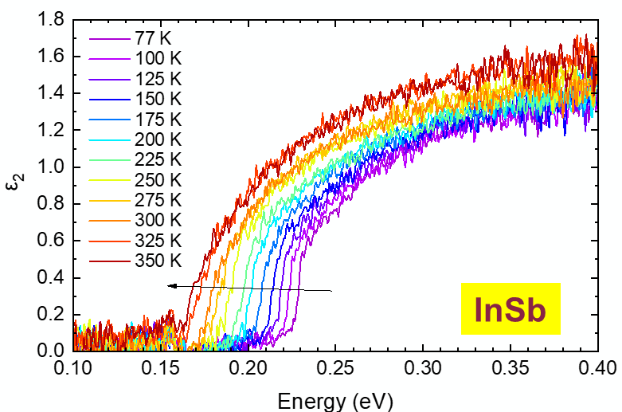
Matrix elements and excitonic effects in the direct gap absorption of semiconductors
2024 Nebraska Ellipsometry Lecture Mini Series
FA9550-20-1-0135 AFOSR
NSF DMR-2235447 NSF
Stefan Zollner
with:
Carola Emminger (Uni Leipzig and HU Berlin, Germany)
Jose Menendez (Arizona State University, Tempe, AZ)
Email: zollner@nmsu.edu. WWW: http://femto.nmsu.edu.
College of Arts and Sciences, Department of Physics
New Mexico State University, Las Cruces, NM, USA

Slide 2
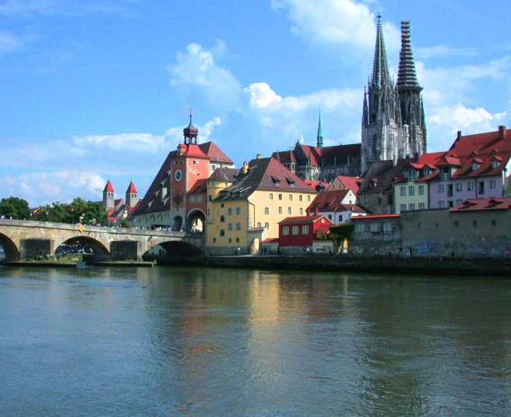


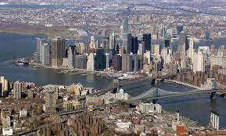

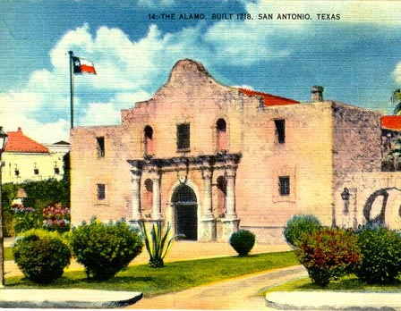
Biography
Motorola (Mesa, Tempe)
Arizona, 1997-2005
Regensburg/Stuttgart
Germany
Freescale, IBM
New York, 91-92; 07-10
NMSU
Las Cruces, NM
Since 2010
Motorola, Freescale
Texas, 2005-2007
2

Slide 3


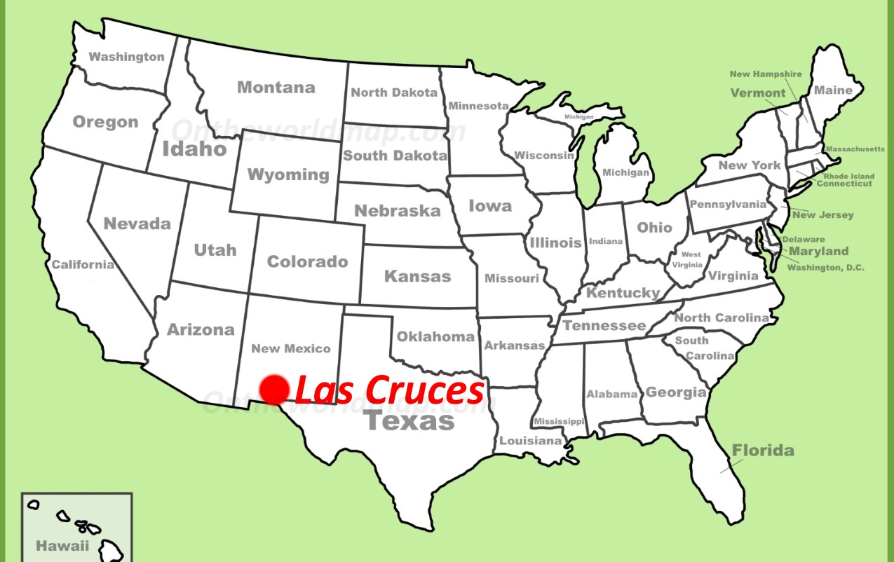

Where is Las Cruces, NM ???
White Sands NP

Slide 4
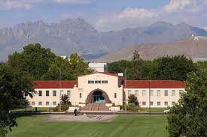
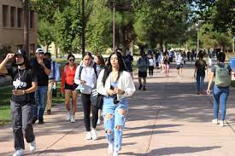
New Mexico State University, Las Cruces
Land grant institution, Carnegie R2 (soon to be R1)
Comprehensive: Arts and Sciences, Education, Business, Agriculture
Ph.D. programs in sciences, engineering, agriculture; Ag extension
14,000 students (11,500 UG, 2,500 GR), 1000 faculty
Minority-serving, Hispanic-serving (60% Hispanic/NA, 26% White)
Small-town setting
Military-friendly institution (Army and Air Force ROTC programs)
Community engagement classification
(first-generation students, Pell grant recipients)
Physics: BS/BA, MS, PhD degrees. 71 UG and 37 GR students.
12 faculty (HE Nuclear and Materials Physics), 1.7 M$ expenditures.
ABET-accredited BS in Physics and BS in Engineering Physics
Stefan Zollner, 2023

Slide 5
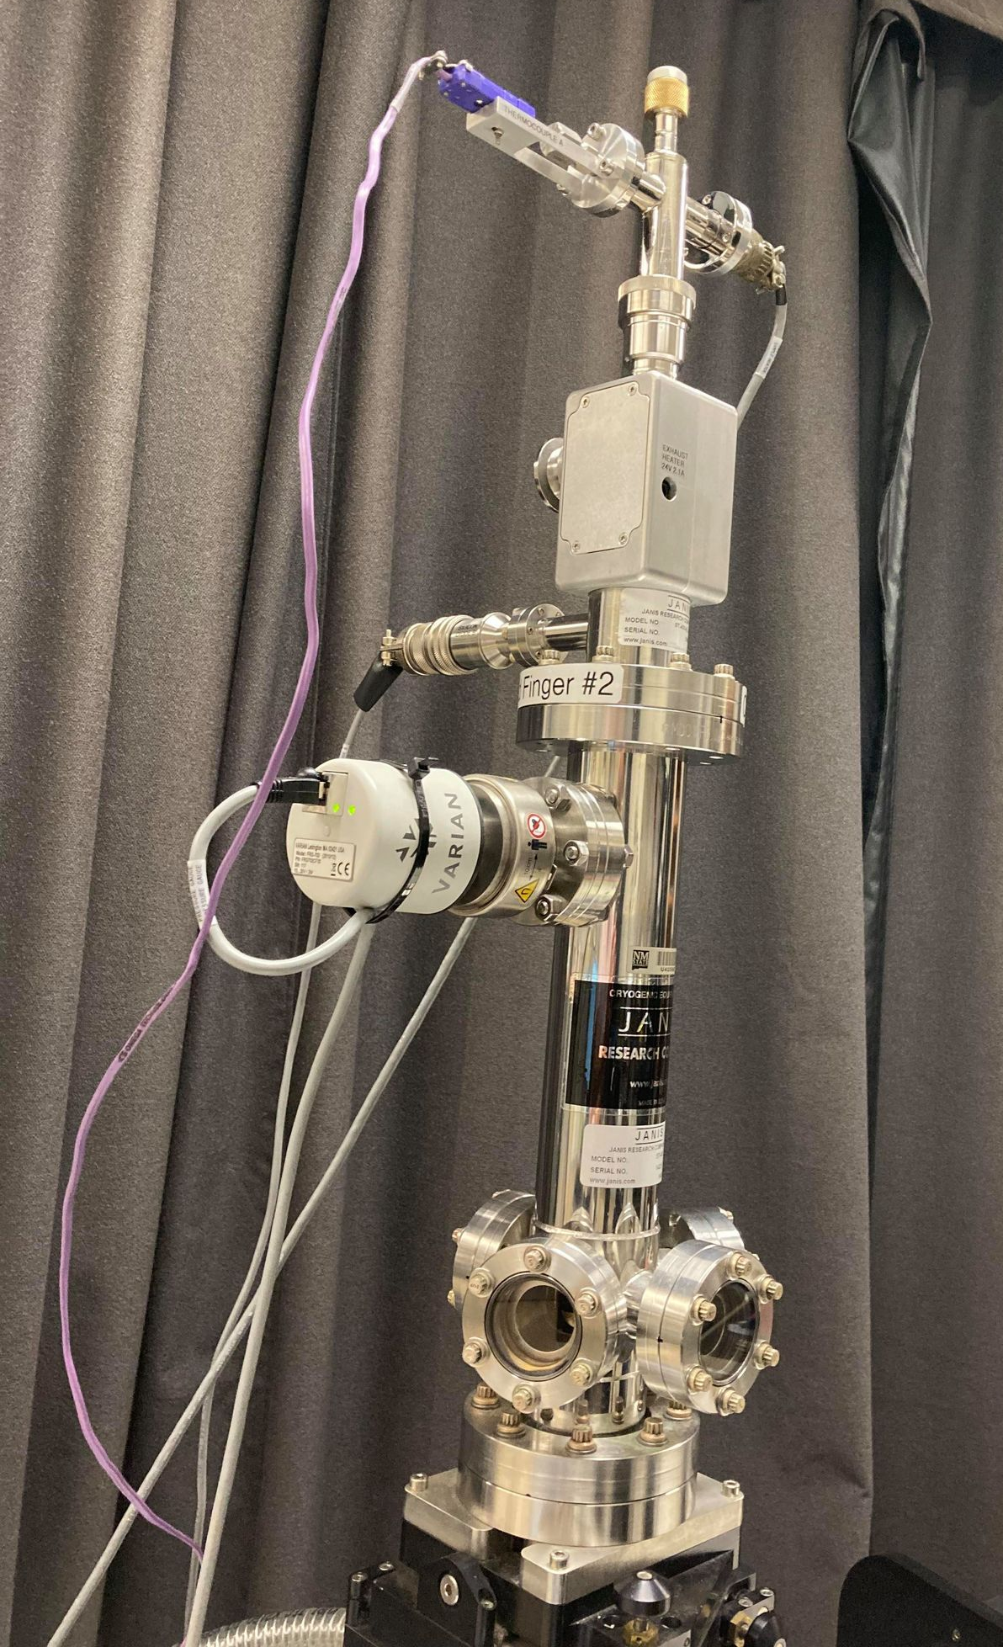
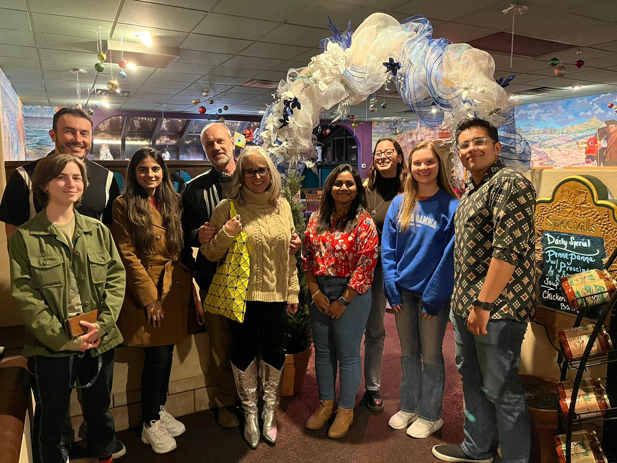
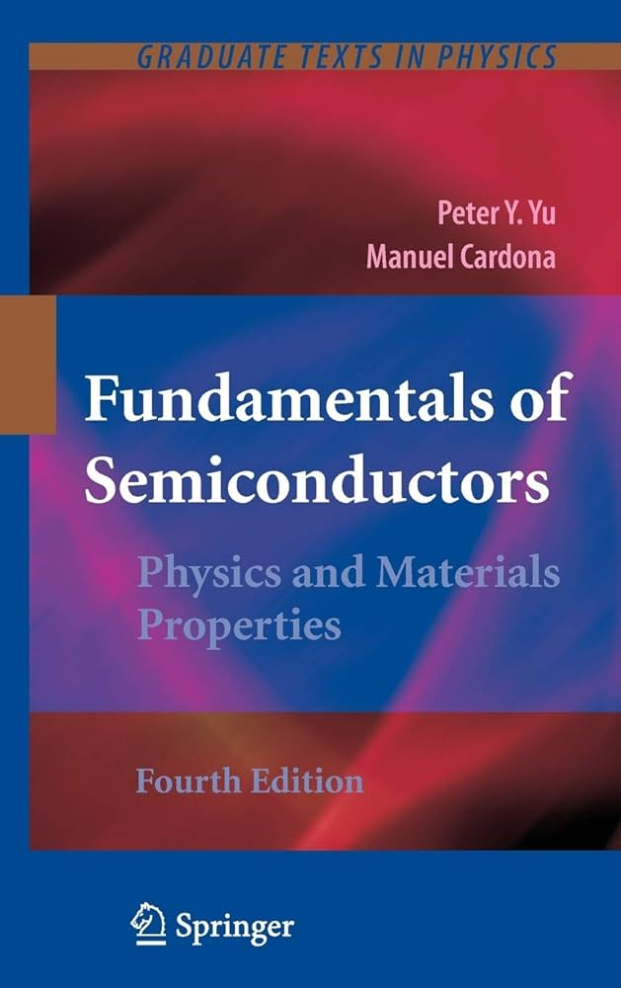
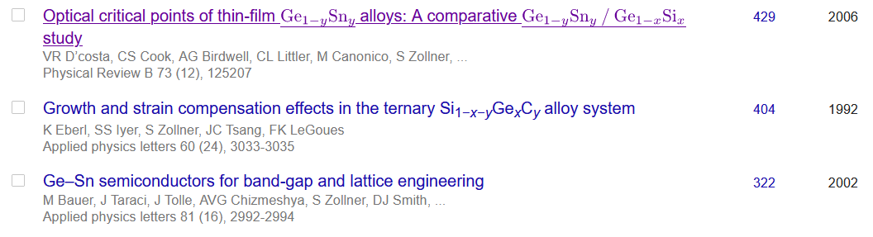
Ellipsometry at NMSU
diamond windows
closed-cycle He
Ellipsometry on anything (inorganic, 3D)
Metals, insulators, semiconductors
Mid-IR to vacuum UV
10 to 800 K
Ellipsometry tells us a lot about materials quality (not necessarily what we want to know).
Stefan Zollner, 2023

Slide 6
Problem statement
(1) Achieve a quantitative understanding of absorption and emission processes.
Our qualitative understanding of excitonic absorption is 50-100 years old,
But insufficient for modeling of detectors and emitters.
(2) How are optical processes affected by high carrier concentrations (screening)?
High carrier densities can be achieved with
  In situ doping or
  ultrafast (femtosecond) lasers or
  high temperatures (narrow-gap or gapless semiconductors)
Goal: CMOS-integrated mid-infrared camera (thermal imaging with a phone).
Future: How are optical processes affected by an electric field (pin diode or thin layer)?
Stefan Zollner, Fall 2023 MRS Meeting

Slide 7
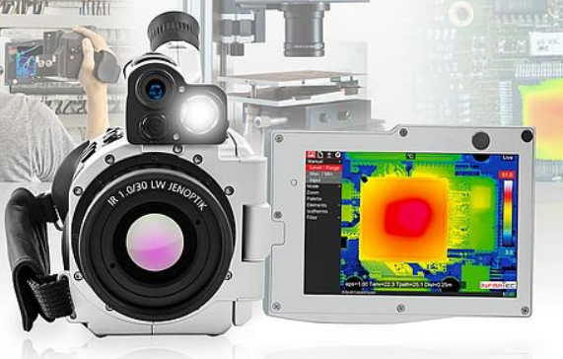
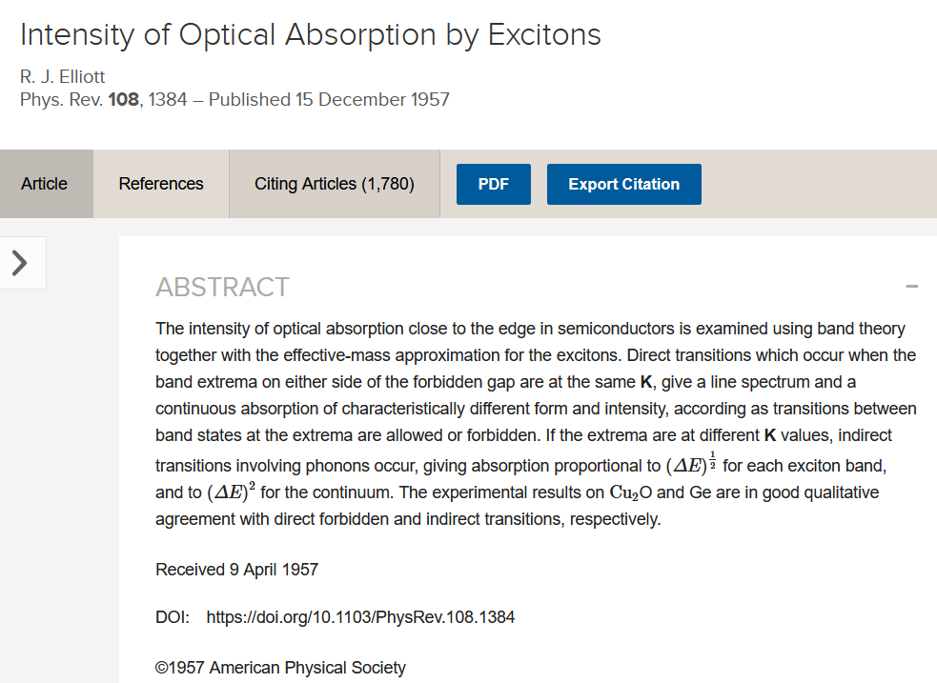
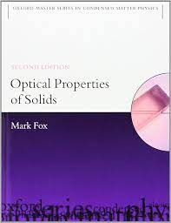
7

Slide 8
Matrix elements and excitonic effects in the direct gap absorption of semiconductors
Einstein coefficients, Fermi’s Golden Rule, Elliott-Tanguy excitons
Direct gap absorption in germanium from 10 to 800 K
Optical constants of highly excited semiconductors
  Direct gap absorption in InSb from 10 to 800 K
  Intravalence band absorption in topological insulators (α-tin)
  Optical constants of highly excited germanium
  (femtosecond ellipsometry at ELI Beamlines in Prague) – Carlos Armenta F’24.
Conclusion and Outlook
Stefan Zollner, Fall 2023 MRS Meeting

Slide 9
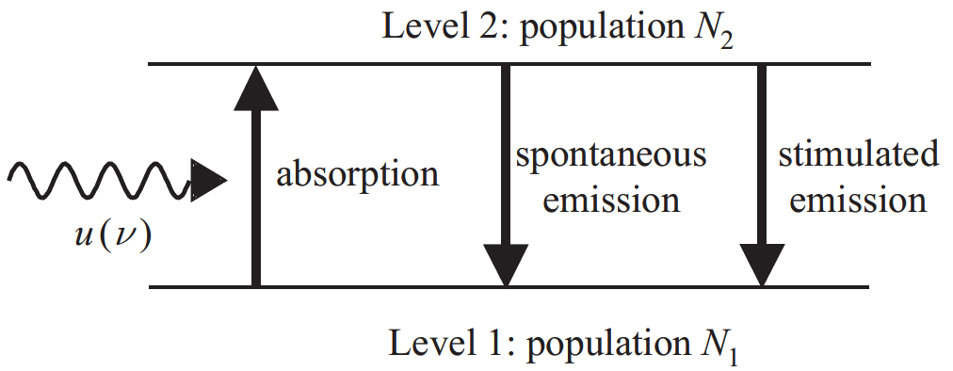

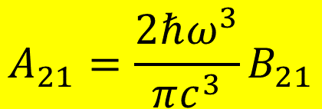

Einstein coefficients
One coefficient is sufficient:
B₁₂
A₂₁
B₂₁
$$g_{1}B_{12}=g_{2}B_{21}$$
$$A_{21}=\frac{2ℏω^{3}}{πc^{3}}B_{21}$$
In equilibrium: N₁, N₂ constant.
Absorption and emission balance.
Black-body radiation
Use Fermi’s Golden Rule to calculate B₁₂
$$u\left(ℏω\right)$$
$$B_{12}N_{1}u\left(ℏω\right)=A_{21}N_{2}+B_{21}N_{2}u\left(ℏω\right)$$
Albert Einstein, Strahlungs-Emission und Absorption nach der Quantentheorie, DPG Verh. 18, 318 (1916); Phys. Z. 18, 121 (1917). See also Mark Fox.

Slide 10
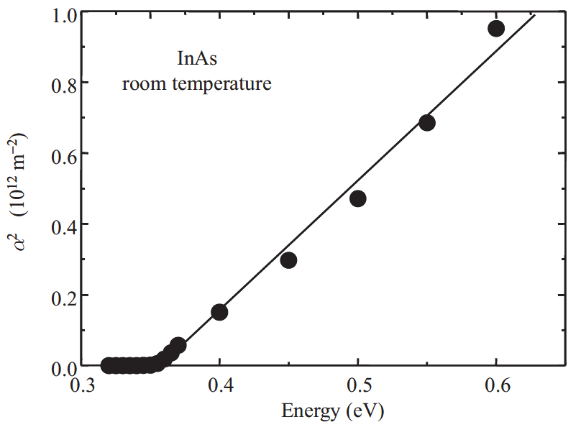
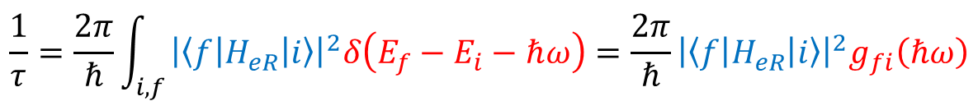
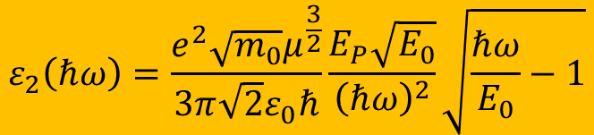
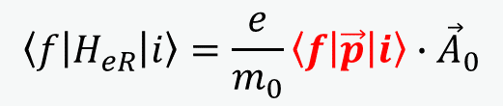
Fermi’s Golden Rule: Tauc plot
Direct band gap absorption
constant k·p matrix element
$$\frac{1}{τ}=\frac{2π}{ℏ}\int_{i,f}{{\left|\left\langle f | H_{eR} | i\right\rangle \right|}^{2}δ\left(E_{f}−E_{i}−ℏω\right)}=\frac{2π}{ℏ}{\left|\left\langle f | H_{eR} | i\right\rangle \right|}^{2}g_{fi}\left(ℏω\right)$$
Joint DOS
parabolic bands
$$\left\langle f | H_{eR} | i\right\rangle =\frac{e}{m_{0}}\left\langle f | \vec{p} | i\right\rangle ∙{\vec{A}}_{0}$$
Use k·p matrix element P: E_{P}=2P²/m₀
$$ε_{2}\left(ℏω\right)=\frac{e^{2}\sqrt{m_{0}}μ^{\frac{3}{2}}}{3π\sqrt{2}ε_{0}ℏ}\frac{E_{P}\sqrt{E_{0}}}{{\left(ℏω\right)}^{2}}\sqrt{\frac{ℏω}{E_{0}}−1}$$
Fox, Chapter 3

Slide 11
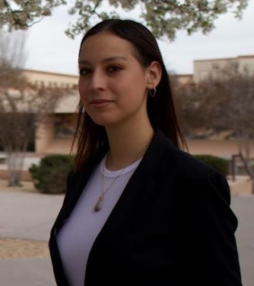
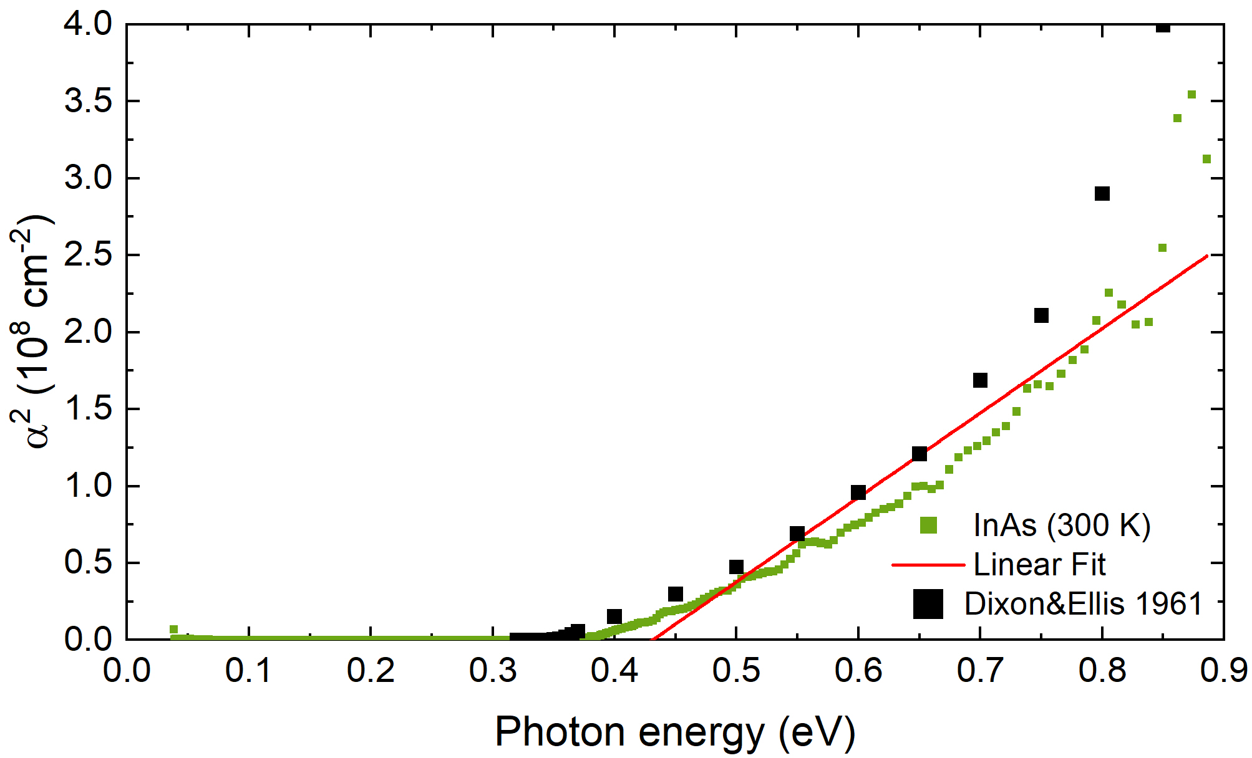

Fermi’s Golden Rule: Tauc plot
Direct band gap absorption
$$\frac{1}{τ}=\frac{2π}{ℏ}\int_{i,f}{{\left|\left\langle f | H_{eR} | i\right\rangle \right|}^{2}δ\left(E_{f}−E_{i}−ℏω\right)}=\frac{2π}{ℏ}{\left|\left\langle f | H_{eR} | i\right\rangle \right|}^{2}g_{fi}\left(ℏω\right)$$
$$\left\langle f | H_{eR} | i\right\rangle =\frac{e}{m_{0}}\left\langle f | \vec{p} | i\right\rangle ∙{\vec{A}}_{0}$$
The Tauc plot is wishful thinking.
No linear region:
Conduction band nonparabolicity
Broadening
1/E² denominator.
excitons
Melissa Rivero Arias
Use k·p matrix element P: E_{P}=2P²/m₀
$$ε_{2}\left(ℏω\right)=\frac{e^{2}\sqrt{m_{0}}μ^{\frac{3}{2}}}{3π\sqrt{2}ε_{0}ℏ}\frac{E_{P}\sqrt{E_{0}}}{{\left(ℏω\right)}^{2}}\sqrt{\frac{ℏω}{E_{0}}−1}$$

Slide 12
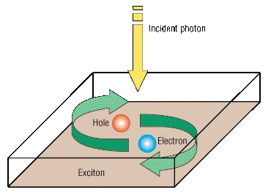
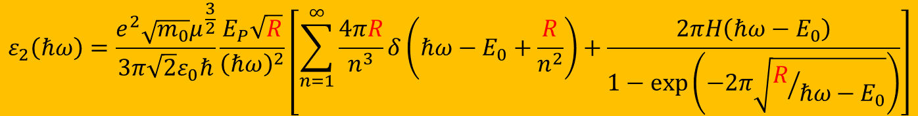
Elliott-Tanguy exciton absorption
Direct band gap absorption
Excitonic binding energy: R=R_{H}×μ_{h}/ε_{s}²
$$ε_{2}\left(ℏω\right)=\frac{e^{2}\sqrt{m_{0}}μ^{\frac{3}{2}}}{3π\sqrt{2}ε_{0}ℏ}\frac{E_{P}\sqrt{R}}{{\left(ℏω\right)}^{2}}\left[\sum_{n=1}^{∞}{\frac{4πR}{n^{3}}δ\left(ℏω−E_{0}+\frac{R}{n^{2}}\right)+\frac{2πH\left(ℏω−E_{0}\right)}{1−\text{exp}\left(−2π\sqrt{R/{ℏω−E_{0}}}\right)}}\right]$$
bound excitons
exciton continuum enhancement
Tanguy’s contributions:
Add Lorentzian broadening
Kramers-Kronig transform to get the real part.
×
R. J. Elliott, Phys. Rev. 108, 1384 (1957).
Christian Tanguy, Phys. Rev. Lett. 75, 4090 (1995) + (E)

Slide 13
Calculation of absorption spectrum from k·p theory
Can we calculate the absorption spectrum?
Yes, we can for Ge in the low carrier density limit.
It does not work for other III/V compounds.
Carola Emminger et al., JAP 131, 165701 (2022).

Slide 14
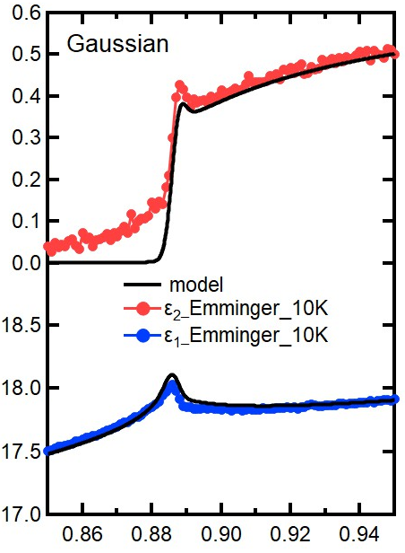
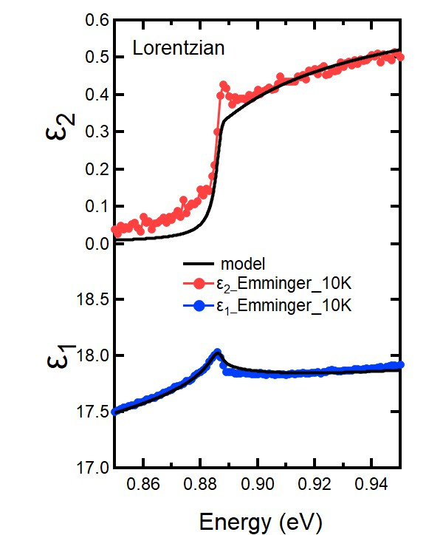
Elliott-Tanguy theory applied to Ge
Fixed parameters:
  Electron and hole masses (temperature dependent)
  Excitonic binding energy R
  Amplitude A (derived from matrix element P)
Adjustable parameters:
  Broadening Γ: 2.3 meV
  Band gap E₀
  Linear background A₁ and B₁
  (contribution from E₁ to real part of ε)
  Problems:
  Broadening below the gap (band tail, oxide correction)
ε₂
Ge
Quantitative agreement
ε₁
Carola Emminger et al., JAP 131, 165701 (2022).
14

Slide 15
Elliott-Tanguy theory applied to Ge
Good agreement at low temperatures.
Model also describes second derivatives.
Potential problems:
Matrix element k-dependent
Nonparabolicity
Resonant indirect absorption
??? at high T.
Ge
Ge
Carola Emminger et al., JAP 131, 165701 (2022).
15

Slide 16
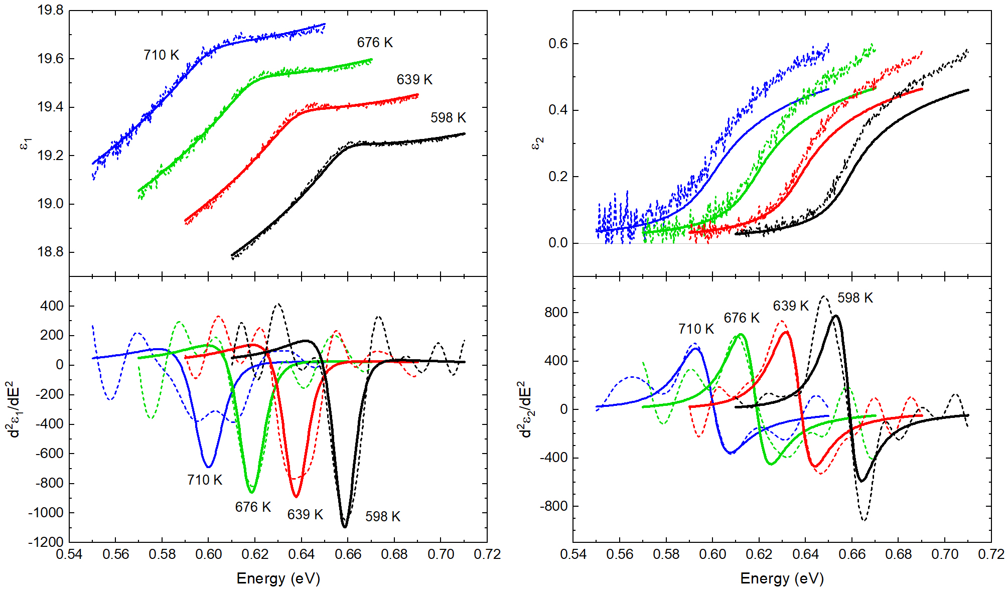
Elliott-Tanguy theory: problems for Ge at high T
Good agreement at low temperatures.
Model also describes second derivatives.
Potential problems:
Matrix element k-dependent
Nonparabolicity
Resonant indirect absorption
Temperature dependence of the effective mass.
Ge
Ge
Carola Emminger et al., JAP 131, 165701 (2022).
16

Slide 17
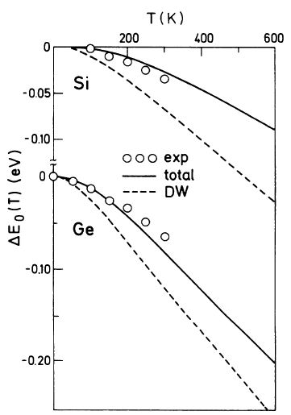
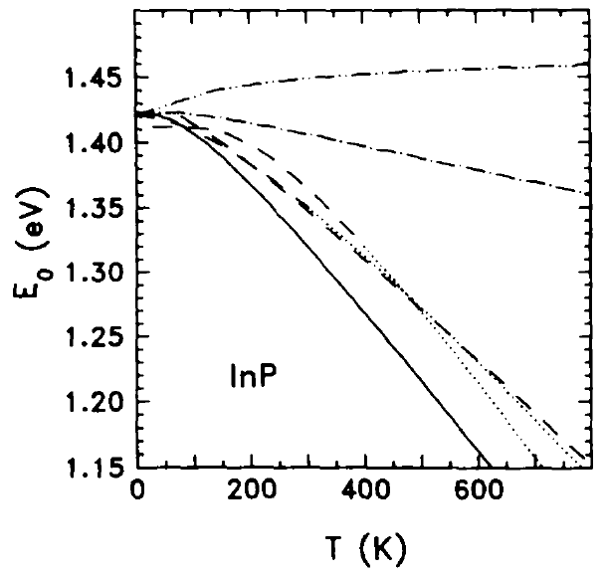
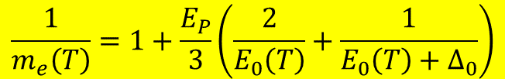
Temperature dependence of the effective mass
Effective electron mass given by k·p theory
Temperature dependence of the direct band gap has two contributions:
  Thermal expansion of the lattice
  Electron-phonon scattering (Debye-Waller term and self-energy)
“Mass band gap” should only include the thermal expansion.
TBD: Polaron effects on effective mass in III/V materials.
E₀: direct band gap
k·p matrix element P: E_{P}=2P²/m₀
$$\frac{1}{m_{e}\left(T\right)}=1+\frac{E_{P}}{3}\left(\frac{2}{E_{0}\left(T\right)}+\frac{1}{E_{0}\left(T\right)+Δ_{0}}\right)$$
Self-energy
InSb
Thermal expansion
Total
Experiment
SZ, Solid State Commun. 77, 485 (1991).
P.B. Allen and M. Cardona, Phys. Rev. B 27 4760 (1983).
17

Slide 18
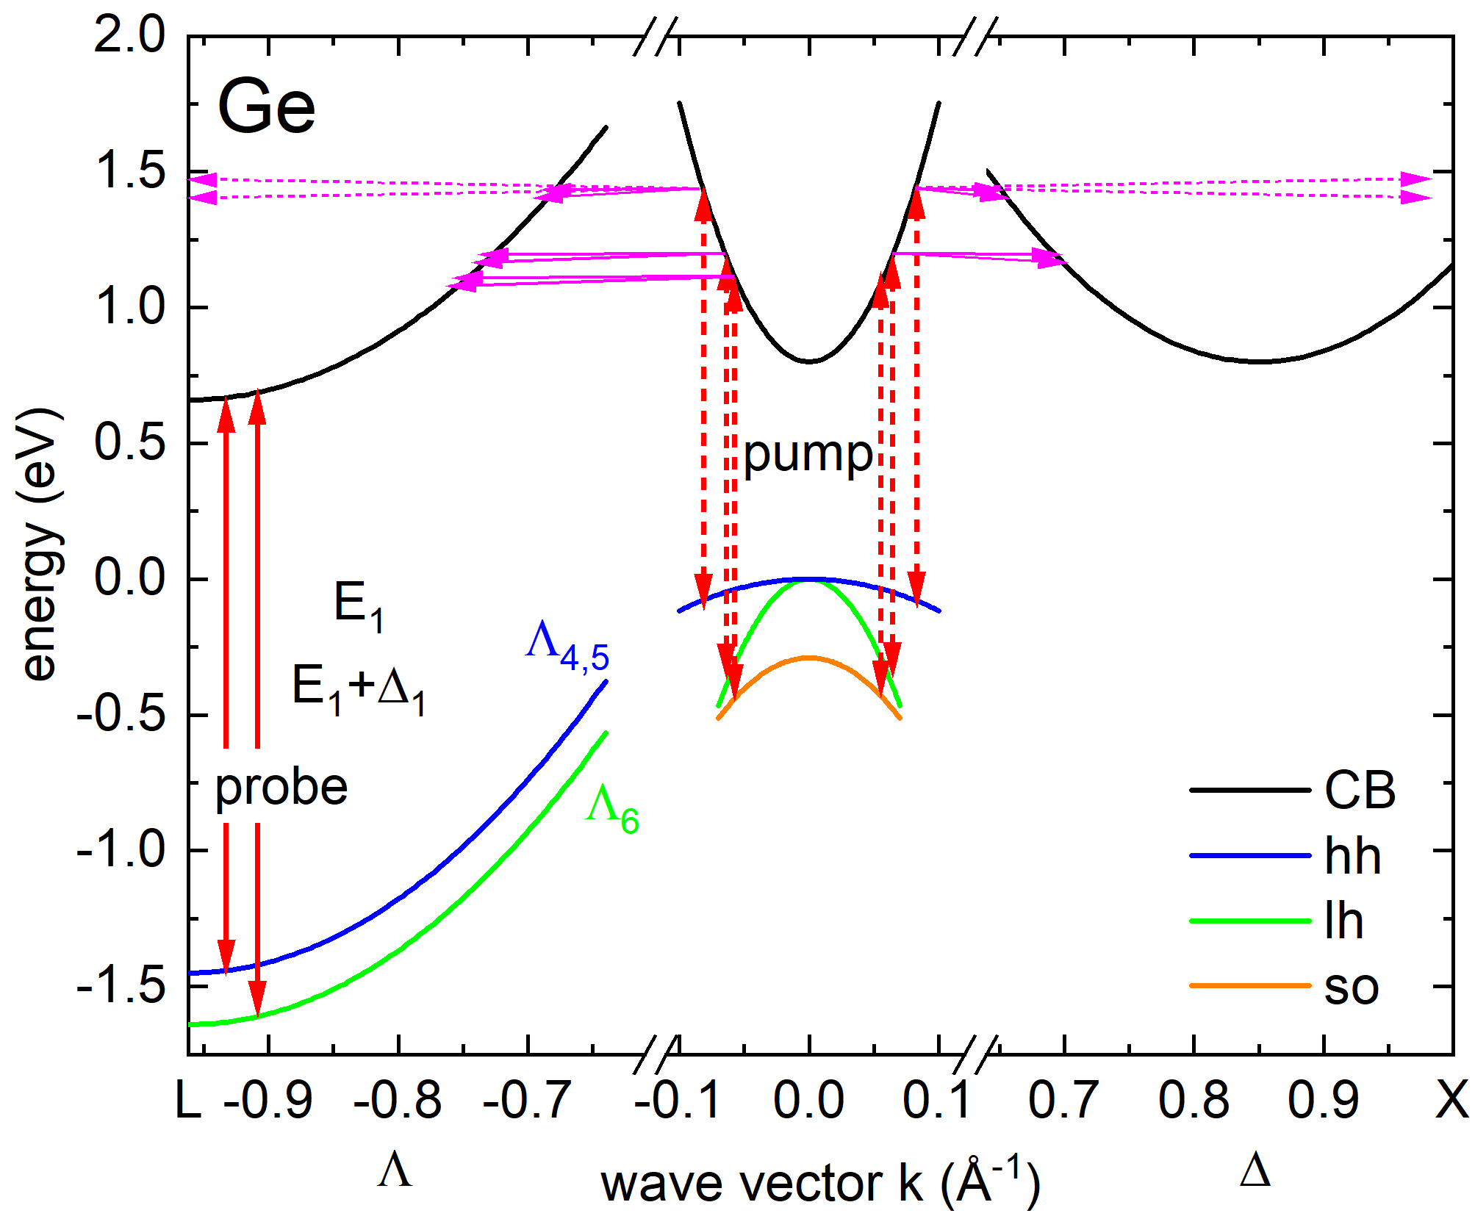
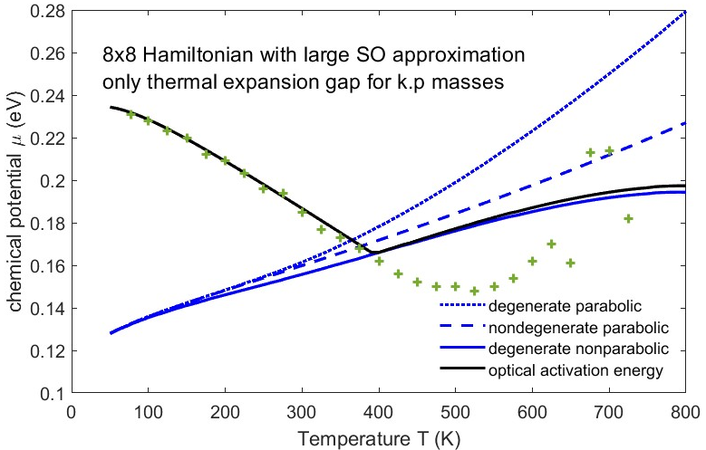
Optical Absorption at High Carrier Densities
InSb
High temperature
(thermal excitation of e-h pairs)
constant m and E₀
Intense femtosecond laser excitation (ELI Beamlines)
(electrons pile at L-point)
High n-doping of Ge with P
(free electrons pile up at L-point)
Rivero, JVSTB 41, 022203 (2023)
Xu et al., PRL 118, 267402 (2017)
Espinoza, APL 115, 052105 (2019)
Stefan Zollner, Fall 2023 MRS Meeting
18

Slide 19
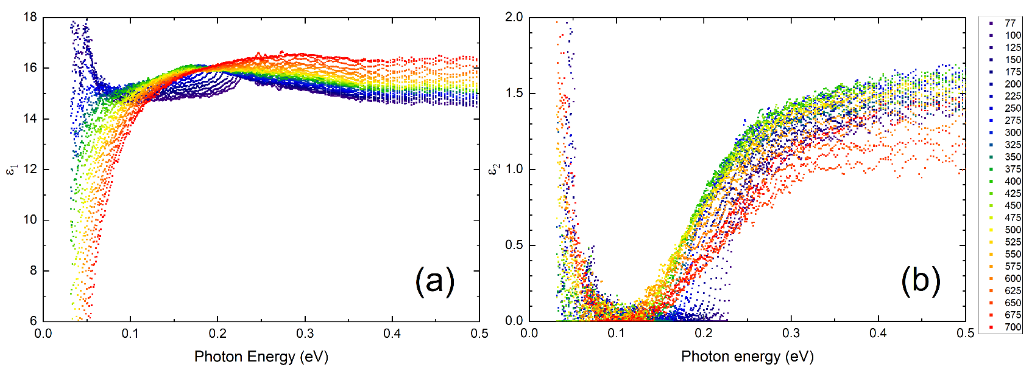
(1) Dielectric function of InSb from 80 to 800 K
InSb
InSb
Band gap changes with temperature (but only below 500 K).
Amplitude reduction at high temperatures (Pauli blocking, bleaching)
Drude response at high temperatures (thermally excited carriers).
Depolarization artifacts at long wavelengths (below 300 K).
Woollam FTIR-VASE
cryostat with CVD diamond windows
Rivero Arias, JVSTB 41, 022203 (2023)
19

Slide 20
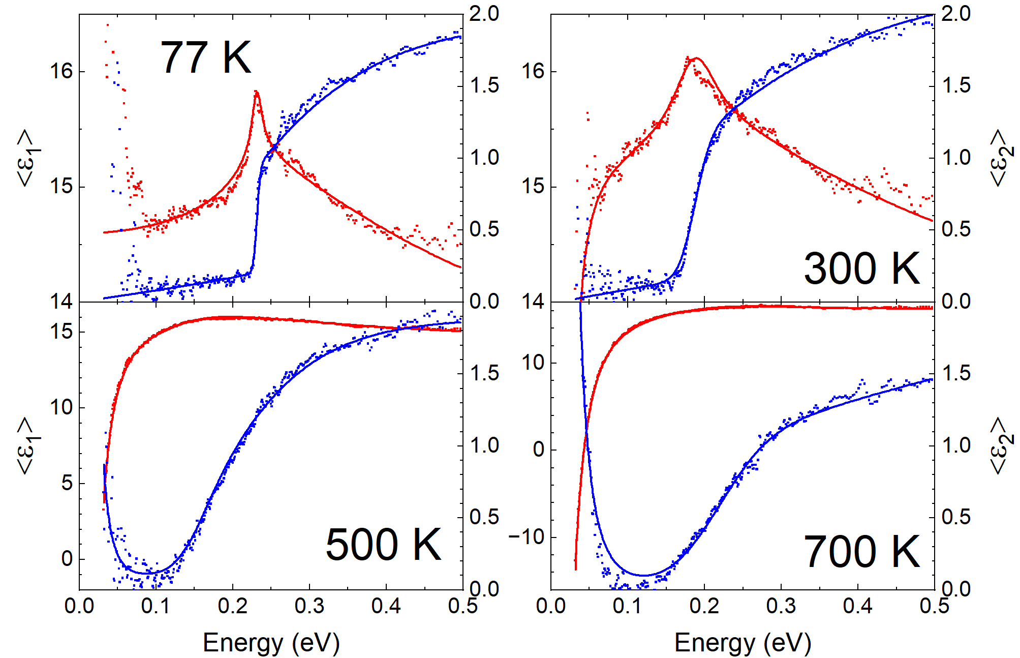
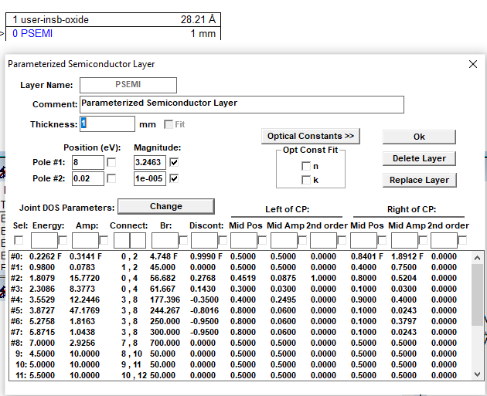
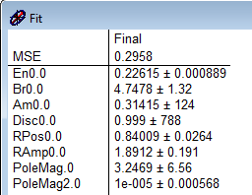
Band gap analysis for InSb
How does the band gap of InSb change with temperature?
Parametric-Semiconductor Model:
Also vary
“shape parameters”.
Asymmetric peak shape poorly described.
Try Tanguy oscillator for excitonic line shape.
InSb
C. M. Herzinger, B. Johs, et al., J. Appl. Phys. 83, 3323 (1998)
Rivero Arias, JVSTB 41, 022203 (2023)
20

Slide 21
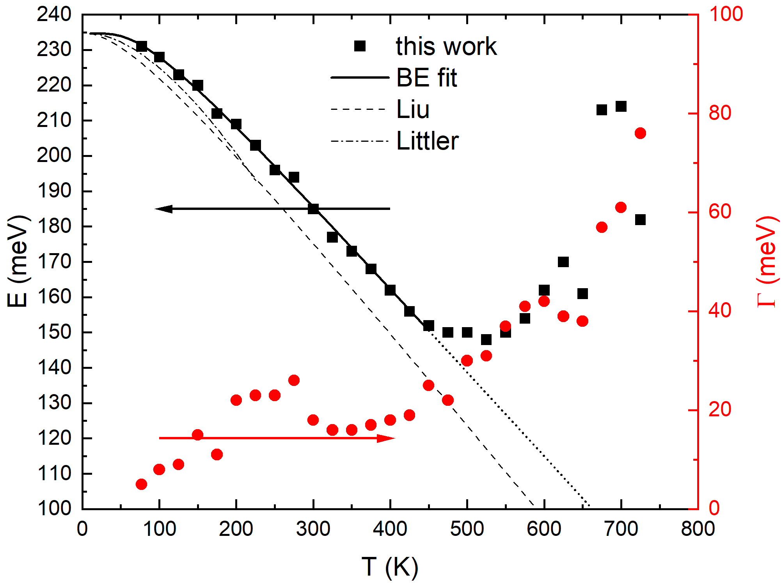
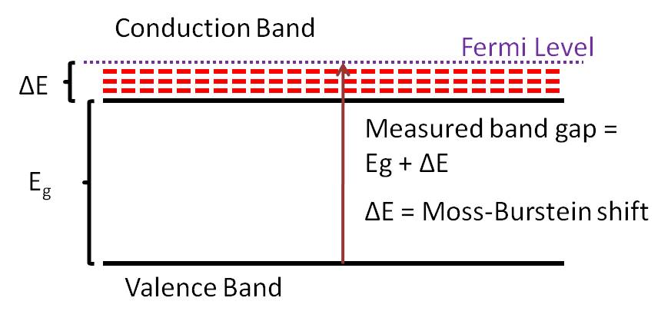
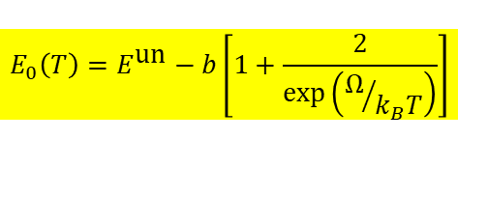
Band gap of InSb from 80 to 800 K
InSb
Bose-Einstein Model
$$E_{0}\left(T\right)=E^{\text{un}}−b\left[1+\frac{2}{\text{exp}\left(Ω/{k_{B}T}\right)}\right]$$
Band gap changes with temperature (but only below 500 K)
Described by Bose-Einstein model below 500 K: Logothetidis, PRB 31, 947 (1985).
No redshift above 500 K: Thermal Burstein-Moss shift
T.S. Moss, Proc. Phys. Soc. 67, 775 (1954).
E. Burstein, Phys. Rev. 93, 632 (1954).
21

Slide 22

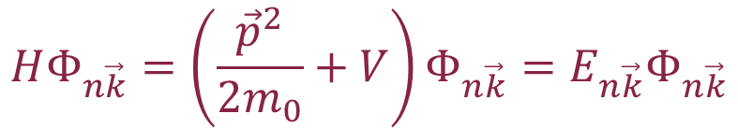

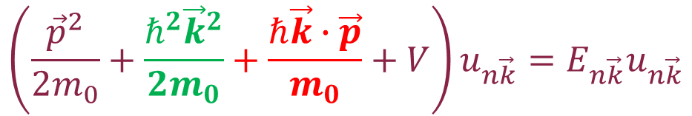
k·p theory (band structure method)
Schrödinger equation
Use Bloch’s theorem:
Solve equation for k=0.
Eliminate green free-electron term with substitution of variables (Kane 1957).
Then treat red term in perturbation theory.
Works very well for semiconductors with local V(r) potentials.
$$HΦ_{n\vec{k}}=\left(\frac{{\vec{p}}^{2}}{2m_{0}}+V\right)Φ_{n\vec{k}}=E_{n\vec{k}}Φ_{n\vec{k}}$$
$$Φ_{n\vec{k}}\left(\vec{r}\right)=e^{i\vec{k}∙\vec{r}}u_{n\vec{k}}\left(\vec{r}\right)$$
Product rule
$${\left(fg\right)}^{′′}=f^{′′}g+2f^{′}g^{′}+fg^{′′}$$
$$\left(\frac{{\vec{p}}^{2}}{2m_{0}}+\frac{ℏ^{2}{\vec{k}}^{2}}{2m_{0}}+\frac{ℏ\vec{k}∙\vec{p}}{m_{0}}+V\right)u_{n\vec{k}}=E_{n\vec{k}}u_{n\vec{k}}$$
Yu & Cardona, Fundamentals of Semiconductors
Kane, J. Phys. Chem. Solids 1, 249 (1957). Kane 1966.
Stefan Zollner, 2023, AFRL Lectures Series 3
22

Slide 23
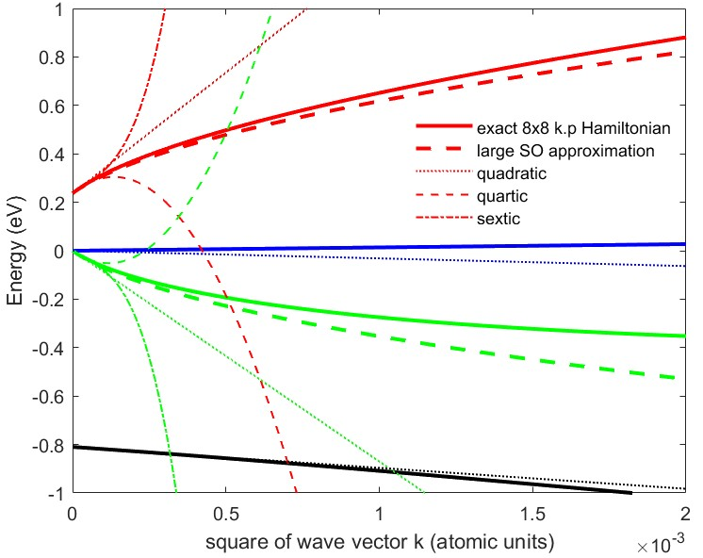
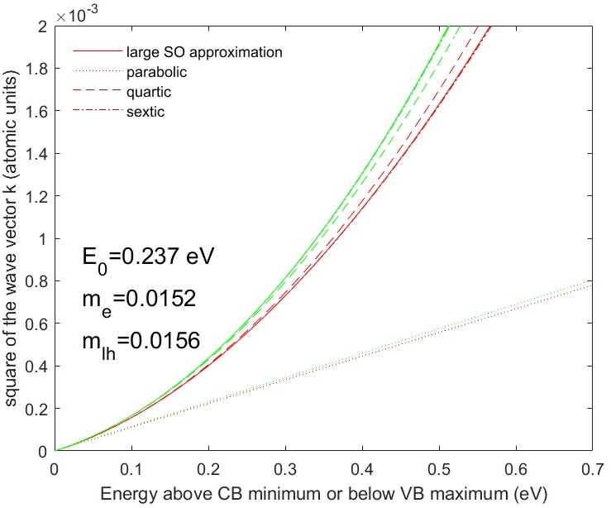



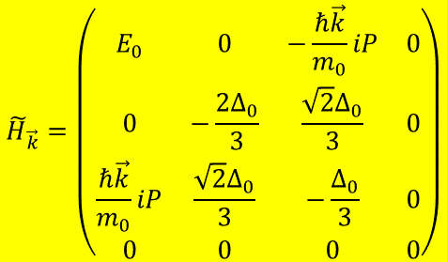
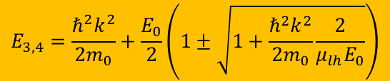
Nonparabolicity of InSb conduction band from k·p theory
Kane 8x8 k·p Hamiltonian:
$${\tilde{H}}_{\vec{k}}=\left(\begin{matrix}E_{0} & 0 & −\frac{ℏ\vec{k}}{m_{0}}iP & 0 \\ 0 & −\frac{2Δ_{0}}{3} & \frac{\sqrt{2}Δ_{0}}{3} & 0 \\ \frac{ℏ\vec{k}}{m_{0}}iP & \frac{\sqrt{2}Δ_{0}}{3} & −\frac{Δ_{0}}{3} & 0 \\ 0 & 0 & 0 & 0\end{matrix}\right)$$
Energy versus k
Cubic characteristic equation:
Density of CB states
$$\tilde{E}\left(\tilde{E}−E_{0}\right)\left(\tilde{E}+Δ_{0}\right)−\frac{ℏ^{2}k^{2}E_{P}}{2m_{0}}\left(\tilde{E}+\frac{2Δ_{0}}{3}\right)=0$$
$$\frac{ℏ^{2}k^{2}}{2m_{0}m^{∗}}=ε\left(1+αε+βε^{2}\right)$$
Large spin-orbit approximation:
$$E_{3,4}=\frac{ℏ^{2}k^{2}}{2m_{0}}+\frac{E_{0}}{2}\left(1±\sqrt{1+\frac{ℏ^{2}k^{2}}{2m_{0}}\frac{2}{μ_{lh}E_{0}}}\right)$$
$$α=\frac{{\left(1−m^{∗}\right)}^{2}}{E_{0}}$$
Kane, J. Phys. Chem. Solids 1, 249 (1957).
23

Slide 24
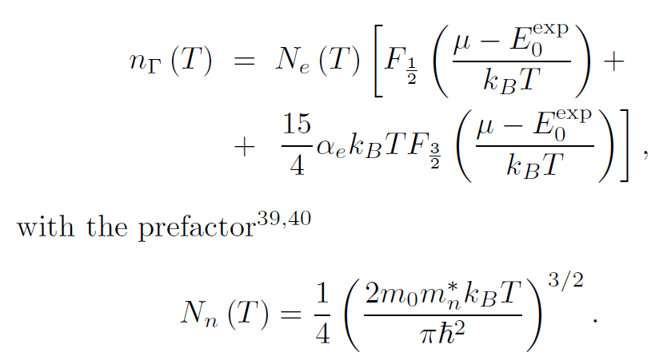
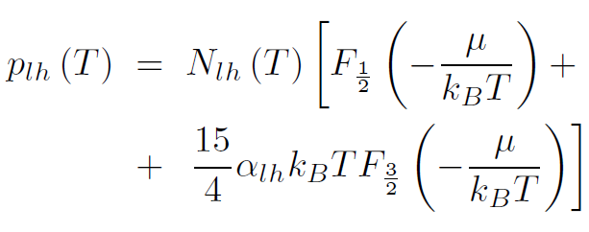
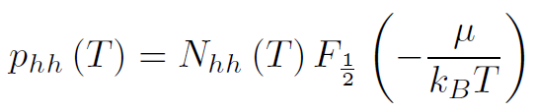
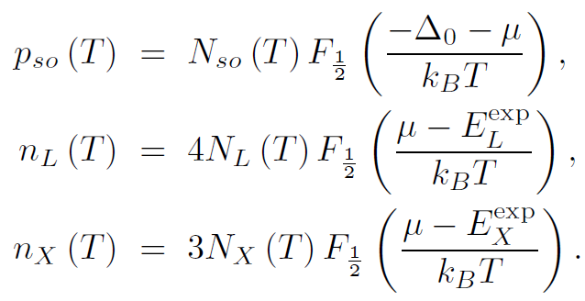
Chemical potential in intrinsic InSb
Intrinsic condition: n=p.
Find chemical potential as a function of T.
S. Zollner and J. Menendez (unpublished).
24

Slide 25
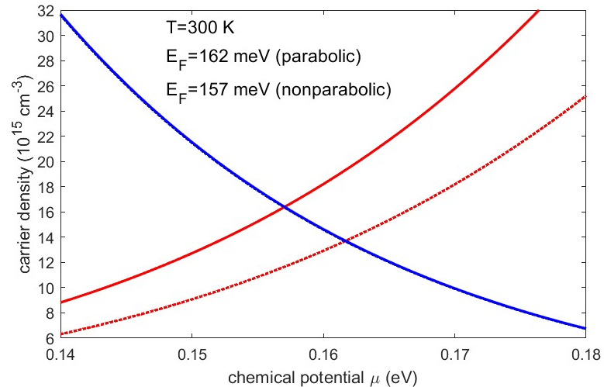
Chemical potential in intrinsic InSb
Intrinsic condition: n=p.
Find chemical potential as a function of T.
Degenerate Fermi-Dirac statistics.
Nonparabolicity of conduction band.
S. Zollner and J. Menendez (unpublished).
25

Slide 26

Thermal excitations of electron-hole pairs in InSb
n=2x10¹⁸ cm⁻³ at 800 K
k_{B}T=E_{g}/4 at 600 K
Fermi level above
conduction band edge above 450 K.
Thermal Burstein-Moss shift
Drude response of free carriers
Reduction of absorption coefficient
M. Rivero Arias et al., JVSTB 41, 022203 (2023).
Oswaldowski/Zimpel, J. Phys. Chem. Solids 49, 1179 (1988).
D. L. Rode, Phys. Rev. B 3, 3287 (1971).
26

Slide 27
Optical constants model: screened excitons
$$ε_{2}\left(E\right)=\frac{2πA\sqrt{R}}{E^{2}}\left\{\sum_{n=1}^{\sqrt{g}}{\frac{2R}{n}\left(\frac{1}{n^{2}}−\frac{n^{2}}{g^{2}}\right)δ\left[E−E_{0}+\frac{R}{n^{2}}{\left(1−\frac{n^{2}}{g}\right)}^{2}\right]+\frac{\text{sinh}\left(πgk\right)\text{H}\left(E−E_{0}\right)}{\text{cosh}\left(πgk\right)−\text{cosh}\left(πg\sqrt{k^{2}−\frac{4}{g}}\right)}}\right\}\left[f_{h}\left(E\right)−f_{e}\left(E\right)\right]$$
Absorption by screened excitons (Hulthen potential)
Degenerate Fermi-Dirac statistics to calculate f_{h} and f_{e}.
Numerical Kramers-Kronig transform (need occupation factors)
Two terms for light and heavy excitons
Non-parabolicity and temperature-dependent mass included from k.p theory
k-dependent matrix element P.
Screening parameter g=12/π²a_{R}k_{TF} (large: no screening)
Sommerfeld enhancement persists well above the Mott density.
Only two free parameters: Band gap E₀ and broadening Γ
Amplitude A and exciton binding energy R from k.p theory and effective masses
Christian Tanguy, Phys. Rev. B 60, 10660 (1999).
Jose Menendez, Phys. Rev. B 101, 195204 (2020).
Carola Emminger, J. Appl. Phys. 131, 165701 (2022).

Slide 28

Relativistic Effects: Darwin Shift: C, Si, Ge, Sn
j=3/2
The s* band moves down, as the elements get heavier.
In α-tin, the s* band moves into the p-band manifold, between the j=1/2 and j=3/2 states.
This makes α-tin an (inverted) gapless semiconductor.
p
j=1/2

Slide 29


Intravalence band absorption in gapless topological insulators (α-tin)
looks like an exciton
R.A. Carrasco, APL 113, 232104 (2018).
All gapless (inverted) semiconductors should have this peak.
Theory with same model as Ge IVB (Kaiser 1953, Kahn 1955).

Slide 30



Simple 8x8 k·p band structure of α-tin (Kane)
Kane 8x8 k·p Hamiltonian:
$${\tilde{H}}_{\vec{k}}=\left(\begin{matrix}E_{0} & 0 & −\frac{ℏ\vec{k}}{m_{0}}iP & 0 \\ 0 & −\frac{2Δ_{0}}{3} & \frac{\sqrt{2}Δ_{0}}{3} & 0 \\ \frac{ℏ\vec{k}}{m_{0}}iP & \frac{\sqrt{2}Δ_{0}}{3} & −\frac{Δ_{0}}{3} & 0 \\ 0 & 0 & 0 & 0\end{matrix}\right)$$
α-tin
dashed: parabolic
solid: nonparabolic
Cubic characteristic equation:
$$\tilde{E}\left(\tilde{E}−E_{0}\right)\left(\tilde{E}+Δ_{0}\right)−\frac{ℏ^{2}k^{2}E_{P}}{2m_{0}}\left(\tilde{E}+\frac{2Δ_{0}}{3}\right)=0$$
S. Zollner, JVST 2024 (in print).

Slide 31





Excitonic intravalence band absorption in α-tin
Screening:
without
excitons
without
excitons
$$r_{s}=\frac{1}{a_{x}}\sqrt[3]{\frac{3}{4πn}}$$
$$V\left(r\right)=−k\frac{\text{exp}\left(−r/{λ_{\text{D}}}\right)}{r}$$
with excitons
$$λ_{D}=\sqrt{\frac{ε_{r}ε_{0}k_{B}T}{pe^{2}}}=\frac{1}{k_{D}}$$
with excitons
Parabolic bands
nonparabolicity affects exciton radius (screening)
S. Zollner, JVST 2024 (in print).

Slide 32


Thickness dependence of excitonic absorption
ZnO on Si with different thicknesses.
This might be an electric field effect.
(Samarasingha, Sudeshna Chattopadhyay, SZ, JVSTB 2020)
Field ionization
Fox, Chapter 4

Slide 33
Conclusions
Quantitative modeling of low-density optical processes is possible with basic physics and matrix elements from k.p theory:
  Photoluminescence in Ge (Menendez)
  Indirect gap absorption in Ge (Menendez)
  Direct gap absorption in Ge at low T
  More work is needed at high temperatures and for materials other than Ge.
High carrier excitations:
  High electron doping density in Ge
  Thermal excitation of electron-hole pairs in InSb and α-tin.
  Femtosecond laser generation of electron-hole pairs in Ge (ELI Beamlines)
  Experimental data and qualitative explanations exist
We need more experiments and more detailed theory and simulations.
Notes:
Birstein-Moss shift

Slide 34
Thank you!
Questions?
Many students contributed to this project.

