Slide 1
Temperature Dependence of the Optical Constants of Tantalum Nitride formed by Atomic Layer Deposition on 300 mm wafers
MASTER’S DEFENSE
Aaron Lopez Gonzalez
College of Arts and Sciences
Department of Physics
Notes:
Good morning, everyone. My name is Aaron Lopez Gonzalez, and today I’ll be presenting my research titled “Temperature Dependence Of The Optical Constants of Tantalum Nitride Formed by Atomic Layer Deposition on 300 Mm Wafers.”

Slide 2



Acknowledgements
COMMITTEE:
Dr. Stefan Zollner
Dr. Matthew Sievert
Dr. Jason Jackiewicz
RESEARCH PEERS:
Yoshitha Hettige
Carlos Armenta
Sonam Yadav
Jaden Love
Haley Woolf
Gabriel Ruiz
COLLABORATORS:
Ekta Bhatia, NY CREATES
Tuan Vo, NY CREATES
Satyavolu Papa Rao, NY CREATES
FUNDING:
Louis Stokes Alliance for Minority Participation
(HRD 1826758)
Air Force Office of Scientific Research
(FA9550-20-1-0135, FA9550-24-1-0061)
Air Force Research Laboratory, Rome, NY
(FA8750-19-1-0031, FA8649-21-P-0773)
Notes:
I would like to thank the committee members, Dr. Zollner, Dr. Sievert, and Dr. Jackiewicz, for being present, as well as everyone else who took the time out of their schedules to participate in my defense.
I also want to mention my research peers, Yoshitha, Carlos, Sonam, Jaden, Haley, and Gabriel, who were very supportive, helping me whenever I had a question.
I am grateful to our collaborators at NY CREATES for providing us with the samples for this research, and to all the organizations that helped us fund this work.

Slide 3
Vita:
Posters:
Presentation:
2022-2024: Peer mentor
NMSU - STAR Program
2022-2024: Undergraduate Research
Assistant
NMSU
2023: REU Astrophysics
Villanova University/LIGO
2024: B.S. Engineering Physics
NMSU
2024-2025: Graduate Teaching
Assistant
NMSU
2025: Graduate Research Assistant
NMSU
A. Lopez Gonzalez, and S. Zollner, Standard error measurements of Si, SiO2, and TaN wafers for band gap determination, URCAS 2023, Las Cruces, NM, USA, April 14th, 2023.
A. Lopez Gonzalez, and A. L. Stuver, The Impact of Gravity Spy Glitch Classes on a Search for Burst Gravitational Waves, AstroPhilly23, Villanova, PA, USA, July 27th, 2023.
A. Lopez Gonzalez, and S. Zollner, Optical constants of Tantalum Nitride from 0.03 eV to 6.5 eV at different temperatures, 2023 NM AMP Student Research Conference, Las Cruces, NM, USA, October 13th, 2023.
A. Lopez Gonzalez, Y. Hettige, J. R. Love, S. Zollner, E. Bhatia, T. Vo, and S. P. Rao, Dielectric function of Tantalum Nitride formed by atomic layer deposition on 300 mm wafers, AVS 69th International Symposium & Exhibition, Portland, OR, USA, November 7th, 2023.
A. Lopez Gonzalez, and A. L. Stuver, The Impact of Gravity Spy Glitch Classes on a Search for Burst Gravitational Waves, 243rd AAS meeting, New Orleans, LA, USA, January 6th, 2024.
A. Lopez Gonzalez, Y. Hettige, J. R. Love, S. Zollner, E. Bhatia, T. Vo, and S. P. Rao, Temperature Dependence of the Dielectric Function of Tantalum Nitride Formed by Atomic Layer Deposition, 10th International Conference on Spectroscopic Ellipsometry, Boulder, CO, USA, June 12th, 2025.
A. Lopez Gonzalez, Y. Hettige, J. R. Love, S. Zollner, E. Bhatia, T. Vo, and S. P. Rao, Dielectric Function of Tantalum Nitride Formed by Atomic Layer Deposition on 300 mm Wafers for Josephson Junction Applications
APS Global Physics Summit 2025, Anaheim, CA, USA
March 19th, 2025.
Awards
J.A. Woollam Co., Inc. Outstanding Undergraduate Student Poster Presentation
“Dielectric function of Tantalum Nitride formed by atomic layer deposition on 300 mm wafers”
AVS 69th International Symposium & Exhibition
November 7th, 2023
Notes:
Here you can learn a little about me and see some of the poster presentations I’ve done in the past, as well as the Outstanding Student Poster award we obtained in 2023 for this very same project.

Slide 4
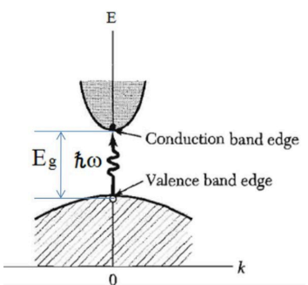
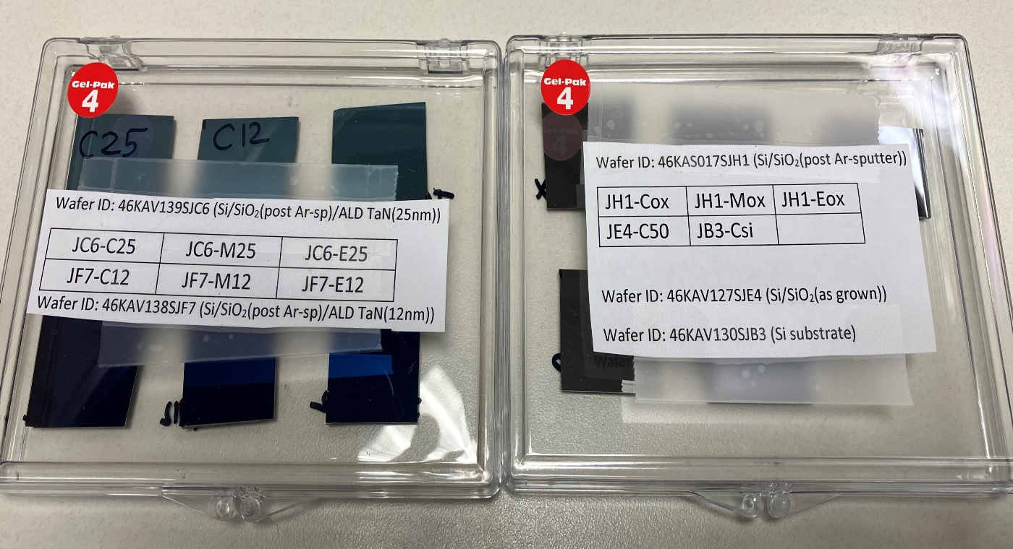
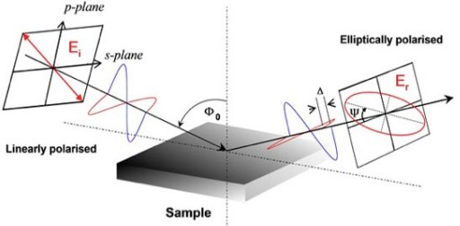
Outline
General theory and methods
Electronic Band Structure
Theory of Spectroscopic Ellipsometry
Instrumentation
Data analysis method
Measurement of tantalum nitride on Si/SiO₂ using X-Ray reflectance
Methods
Results
Temperature-dependent dielectric function of tantalum nitride formed by atomic layer deposition for tunnel barriers in Josephson Junctions
Results and Discussion
Conclusion
Outlook and Summary
Center
Middle
Edge
300 mm wafer
Notes:
The thesis is organized into three main parts:
Theoretical and experimental framework, where I describe how optical constants are linked to electronic band structure and how spectroscopic ellipsometry is used to measure them.
X-ray reflectivity measurements, used to confirm the film’s structural quality.
Temperature-dependent optical analysis, which provides the main results of this research.

Slide 5
Motivation
We report the dielectric functions of insulating tantalum nitride (TaN) films, deposited using atomic layer deposition (ALD) on 300 mm Si/SiO₂ substrates, to demonstrate their suitability as tunnel barriers in tantalum-based Josephson junctions for superconducting quantum circuits.
Compared to aluminum oxide barriers, we expect ALD TaN to show improved thermal stability and resistance to aging.
The lower band gap of TaN suggests the possibility of fabricating Josephson junctions with thicker barriers while achieving critical current densities required for qubits, better control of thickness and composition, and reduced defect densities.
These characteristics show the potential of ALD TaN as a Josephson junction tunnel barrier that can improve the reliability and performance of superconducting quantum computing circuits.
Ellipsometric measurements on these TaN films allows us to measure the band gap and optical constants.
Notes:
Let me start with the motivation… This project focuses on tantalum nitride, or TaN, a material that can behave as metallic, semiconducting, or even insulating, depending on how it’s fabricated. In particular, I studied thin films of TaN grown using Atomic Layer Deposition, or ALD, on 300 mm silicon wafers. Now, why TaN? In microelectronics, metallic TaN is commonly used as a diffusion barrier between copper and dielectric layers. However, its potential as an insulating tunnel barrier — especially for Josephson junctions in superconducting qubits — has only recently gained attention.
Conventional junctions use aluminum oxide layers, which tend to suffer from uncontrolled oxidation and thickness variability. In contrast, ALD tantalum nitride provides atomic-level thickness control, excellent uniformity across large wafers, and compatibility with semiconductor fabrication tools — making it an attractive alternative for quantum computing applications.
The primary objective of this thesis is to determine the optical constants and the temperature-dependent dielectric function of ALD TaN thin films.
The secondary goals include:
Verifying the thickness, roughness, and density of the films using X-ray reflectivity,
Correlating those physical parameters with the optical and structural properties, and
Exploring whether ALD TaN truly behaves as an insulating tunnel barrier suitable for superconducting quantum circuits.
In short, this work aims to answer a key question: Can ALD TaN serve as a reliable, temperature-stable, and optically insulating material for quantum technologies?

Slide 6
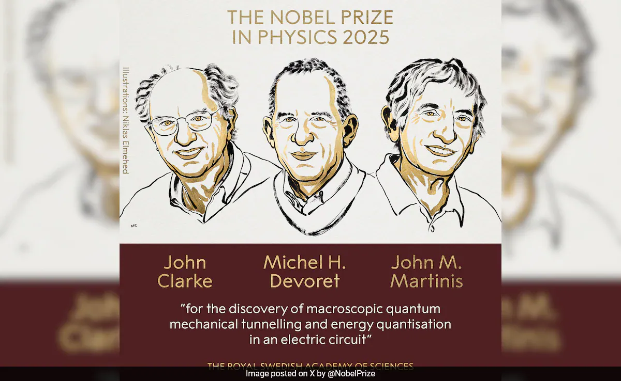
Notes:
Let me start with the motivation… This project focuses on tantalum nitride, or TaN, a material that can behave as metallic, semiconducting, or even insulating, depending on how it’s fabricated. In particular, I studied thin films of TaN grown using Atomic Layer Deposition, or ALD, on 300 mm silicon wafers. Now, why TaN? In microelectronics, metallic TaN is commonly used as a diffusion barrier between copper and dielectric layers. However, its potential as an insulating tunnel barrier — especially for Josephson junctions in superconducting qubits — has only recently gained attention.
Conventional junctions use aluminum oxide layers, which tend to suffer from uncontrolled oxidation and thickness variability. In contrast, ALD tantalum nitride provides atomic-level thickness control, excellent uniformity across large wafers, and compatibility with semiconductor fabrication tools — making it an attractive alternative for quantum computing applications.
The primary objective of this thesis is to determine the optical constants and the temperature-dependent dielectric function of ALD TaN thin films.
The secondary goals include:
Verifying the thickness, roughness, and density of the films using X-ray reflectivity,
Correlating those physical parameters with the optical and structural properties, and
Exploring whether ALD TaN truly behaves as an insulating tunnel barrier suitable for superconducting quantum circuits.
In short, this work aims to answer a key question: Can ALD TaN serve as a reliable, temperature-stable, and optically insulating material for quantum technologies?

Slide 7
General theory and methods
Notes:
Now, let’s move to the theoretical and methodological backbone of this work.

Slide 8
Introduction
For TaN thin films, ellipsometry allows characterization of how the refractive index and extinction coefficient vary with wavelength and temperature. Since TaN is of interest for electronic, optical, and protective applications, understanding its optical constants is essential for device design and for understanding its fundamental electronic structure.
We’ll briefly touch on four main sections:
The electronic band structure,
The theory of spectroscopic ellipsometry,
The instrumentation used, and
The sample preparation and data analysis methods.
Notes:
This chapter presents both the theoretical concepts and experimental methods that make the study possible. We’ll briefly touch on four main sections:
The electronic band structure,
The theory of spectroscopic ellipsometry,
The instrumentation used, and
The sample preparation and data analysis methods.

Slide 9
Electronic band structure
To understand a material’s optical properties, we must first look at its electronic band structure. In a single atom, electrons occupy discrete energy levels. But when many atoms come together to form a solid, these levels broaden into energy bands — separated by band gaps where no electronic states exist.
Metals have partially filled bands — hence they conduct electricity easily.
Semiconductors and insulators have band gaps. If the gap is small, around 1–3 eV, we call it a semiconductor. If it’s larger, typically above 4 eV, it behaves as an insulator.
This framework explains how light absorption and electronic transitions occur in Tantalum nitride.
A band gap is the energy difference between the top of the valence band and the bottom of the conduction band in a solid, with ħω being the energy required to excite an electron from the valence band to the conduction band.
I. Kaplan, (John Wiley & Sons, Chichester, 2017) pp. 25, 27.
M.H. Saleh, Study of Structural, Optical and… (2011).
J. Gusakova, B.K. Tay, and V. Gusakov, Phys. Status Solidi A, 1–4 (2016).

Slide 10


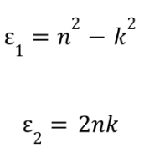

Optical properties and Band structure
The optical constants of a material, namely the refractive index n and the extinction coefficient k, are intimately related to its electronic band structure. The n and k are the real and imaginary parts of the complex refractive index ñ:
This ñ relates to the complex dielectric function ε̃(ω):
So, the optical constants n and k are derived directly from the dielectric response of the material, and this dielectric function ε̃(ω) describes how the material’s electrons respond to an electromagnetic field (light). It has two main components related to the electronic band structure:
1. Interband Transitions — electrons absorb photons and jump between the
valence and conduction bands.
2. Intraband (Free Carrier) Transitions — conduction electrons respond to
low-energy fields (dominant in metals).
A.R. Forouhi, I. Bloomer, HOCSi, 2, 151-175 (1997).

Slide 11
Optical properties and Band structure pt.2
The refractive index n and extinction coefficient k form what’s known as the complex refractive index, represented as n + ik. These are directly related to the complex dielectric function, which tells us how electrons in a material respond to light.
In essence:
The real part (n) describes how fast light travels through the material, and
The imaginary part (k) describes how much light is absorbed.
By measuring n and k across different photon energies and temperatures, we can learn about the band gap, transition energies, and even the degree of disorder in the TaN films.
A.R. Forouhi, I. Bloomer, HOCSi, 2, 151-175 (1997).

Slide 12
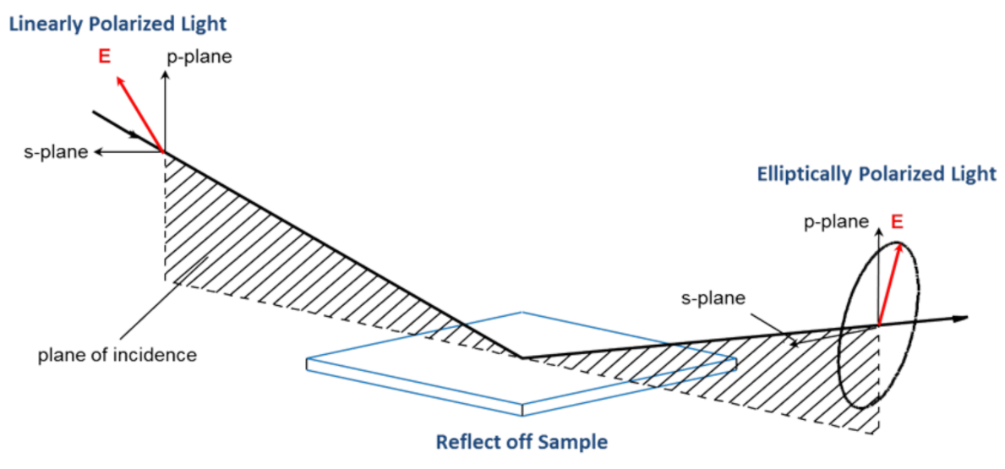

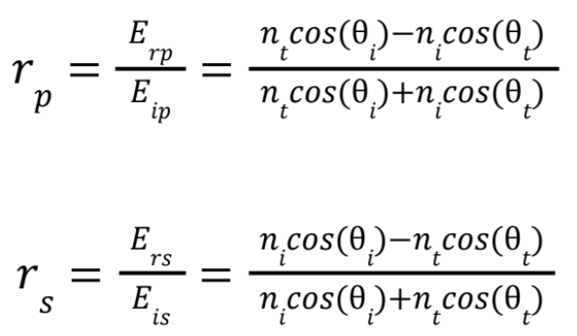


Principles of Ellipsometry
Ellipsometry is based in the understanding that light is an electromagnetic wave interacting with materials. Because of this, it provides an optical technique used to determine the dielectric properties (complex refractive index or dielectric function) of thin films. Ellipsometry measures changes in the polarization state of light after reflection from or transmission through a material.
K. Vedam, Thin Solid Films 313–314, 1–9 (1998).
G.E. Jellison, Thin Solid Films, 234, 416-422 (1993).
J.A. Woollam, Ellipsometry FAQ, website (Accessed July 20, 2025).

Slide 13

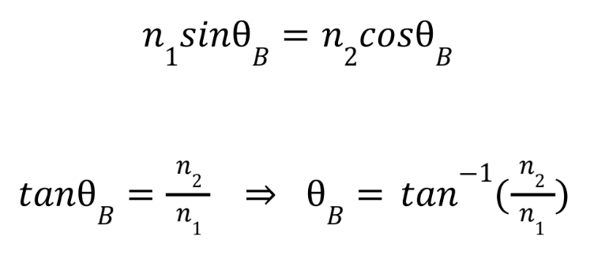
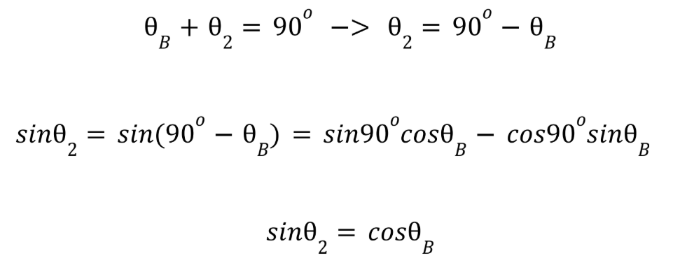
Principles of Ellipsometry pt. 2
Ellipsometry measures the ratio of the amplitude reflection coefficients r_{p}/r_{s}, and since the difference between r_{p} and r_{s} is maximized at the Brewster angle, sensitivity for the measurement also increases at this angle.
The Brewster angle is the specific angle at which the light completely polarizes. When unpolarized light is incident on a flat surface, the reflected light partially polarizes to the plane of the refractive index. This complete polarization with the Brewster angle occurs when the reflected and refracted rays are perpendicular to one another. This can be explained by using Snell’s law:
The brewster angle and index of refraction of TaN was unknown, so we took ellipsometric measurements at room temperature for incident angles of 50º to 80º to account for the known brewster angles of Si and SiO₂, which are approximately 75º and 55º, respectively.
H. Fujiwara, Spectroscopic Ellipsometry… (John Wiley & Sons, Chichester, 2007) pp. 37, 40.
D. Amrani, J. Sci. Educ., 23 (1), 41 (2022).
Notes:
To achieve high sensitivity, measurements are often taken around the Brewster angle — the angle where reflected light is completely polarized. For silicon and silicon dioxide, this occurs around 75° and 55°, respectively. In our setup, we measured across a range of angles from 50° to 80° to ensure coverage, and at a fixed angle of 70° for temperature-dependent studies due to cryostat limitations.

Slide 14
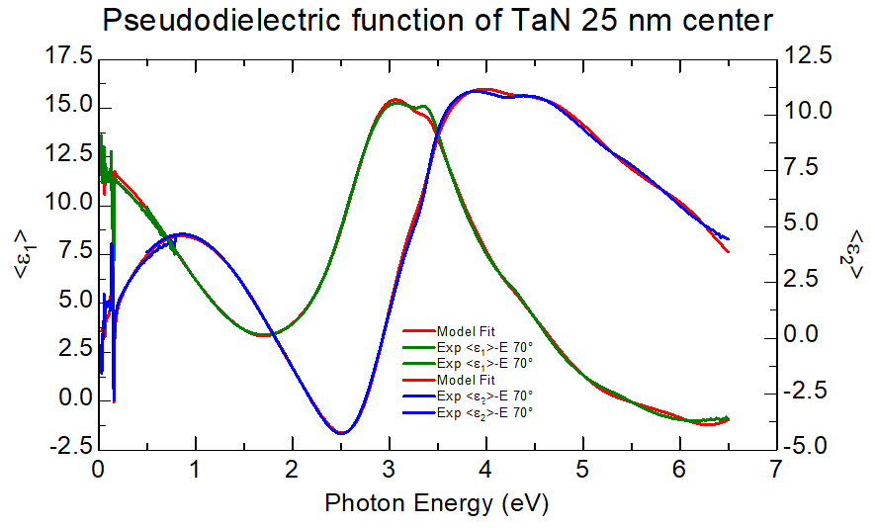
Spectroscopic Ellipsometry
In spectroscopic ellipsometry, measurements are taken across a broad wavelength or photon energy range, typically from the ultraviolet (UV) to the infrared (IR). This spectral information provides insight into the electronic transitions, absorption edges, and dispersion behavior of the material.
Advantages:
High sensitivity to film thicknesses
Ability to characterize both n and k
Non-destructive and contactless procedure
Disadvantages:
Does not provide optical constants directly
Does not measure film thickness for thin layers
Requires model-based analysis with assumptions
G.E. Jellison, Thin Solid Films, 234, 416-422 (1993).
Notes:
Spectroscopic ellipsometry, or SE, is a non-destructive optical technique used to determine the dielectric properties of thin films. It measures how polarized light changes after reflecting off a surface — specifically the amplitude ratio and phase shift between p- and s-polarized light components.
This information gives us two parameters, Psi (Ψ) and Delta (Δ), from which we can model the dielectric function. One great advantage of SE is its sensitivity — it can detect film thicknesses on the order of sub-nanometers.

Slide 15
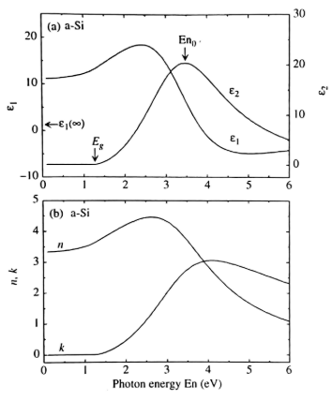

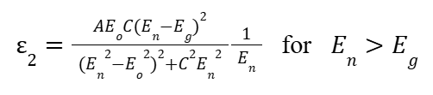

Dielectric function models - Tauc-Lorentz
Mathematical formula that describes the optical properties of amorphous materials like semiconductors. It is used to fit the complex refractive index of amorphous materials at frequencies greater that their optical band gap. It includes both a sharp optical absorption edge and a tail below the band gap, so it accounts for sub-bandgap absorption (band tail), unlike Lorentz model which is symmetric.
The Tauc joint density of states (JDOS) model relates the material's absorption coefficient (𝛼) to the available energy states for electron transitions. Accounts for band-to-band absorptions.
The classical Lorentz oscillator model is a physical model that describes the optical response of a material by treating its electrons as damped harmonic oscillators - the absorption peaks in a material.
A is amplitude
Eo is peak transition energy
Subscript j indicates jth oscillator
E is the energy at that point
is the damping coefficient
A is amplitude
Eo is peak transition energy
Eg is band gap energy
C is broadening term for the model
𝛼 - absorption coefficient
hw - photon energy
B - material constant
n - exponent that characterizes type of electronic transition
n=2 for allowed direct transitions; n=½ for allowed indirect transitions
(top) Dielectric function and (bottom) (n, k) spectra of an amorphous silicon calculated from Tauc-Lorentz model.
G.E. Jellison, Thin Solid Films, 234, 416-422 (1993).
Notes:
Spectroscopic ellipsometry, or SE, is a non-destructive optical technique used to determine the dielectric properties of thin films. It measures how polarized light changes after reflecting off a surface — specifically the amplitude ratio and phase shift between p- and s-polarized light components.
This information gives us two parameters, Psi (Ψ) and Delta (Δ), from which we can model the dielectric function. One great advantage of SE is its sensitivity — it can detect film thicknesses on the order of sub-nanometers.

Slide 16
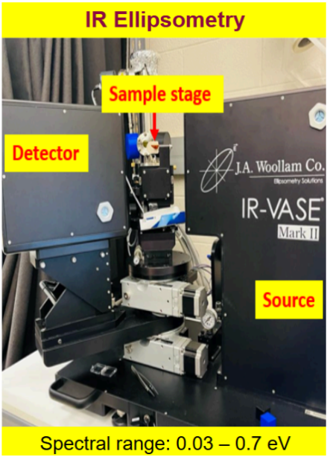
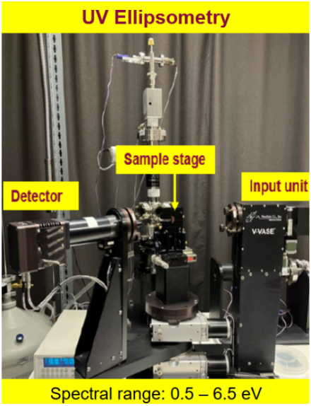
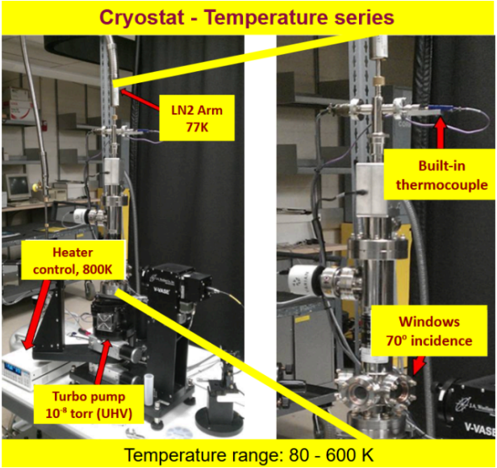
Instrumentation
This IR ellipsometer has the ability to probe vibrational modes and free carrier absorption in material, as well as having high accuracy in determining optical constants in the mid-IR region.
Capable of detecting interband electronic transitions and absorption edges with high sensitivity, obtaining high spectral resolution across a broad UV-Vis-NIR range, measuring ultrathin films and multilayer structures.
Precise temperature control down to ~10 K with optical access for measurements. Its UHV design minimize contamination, and its window ports enable broad spectral measurements, making it ideal for studying the temperature-dependent optical properties of thin films.
J.A. Woollam, IR-VASE Mark II Ellipsometer, website (Accessed July 21, 2025).
J.A. Woollam, VASE Ellipsometer, website (Accessed July 21, 2025).
Lake Shore Cryotronics, ST-400 Series ultra-high vacuum cryostats, website (Accessed July 22, 2025).

Slide 17

Data analysis methods
Experimental data
1. Acquire Ψ and ∆ spectra from both the IR-VASE and
VASE instruments using W-VASE software.
2. Import the measured data into W-VASE for initial model
fitting and parameter extraction.
3. Once the best model was created following the ε₁ and ε₂
data, export processed data to Microsoft Excel for tabular organization and for the expression of graph points.
4. Use OriginPro to generate publication-quality plots.
Create the model
Fiting = Generated data
Analysis
J.A. Woollam, WVASE, website (Accessed July 22, 2025).

Slide 18
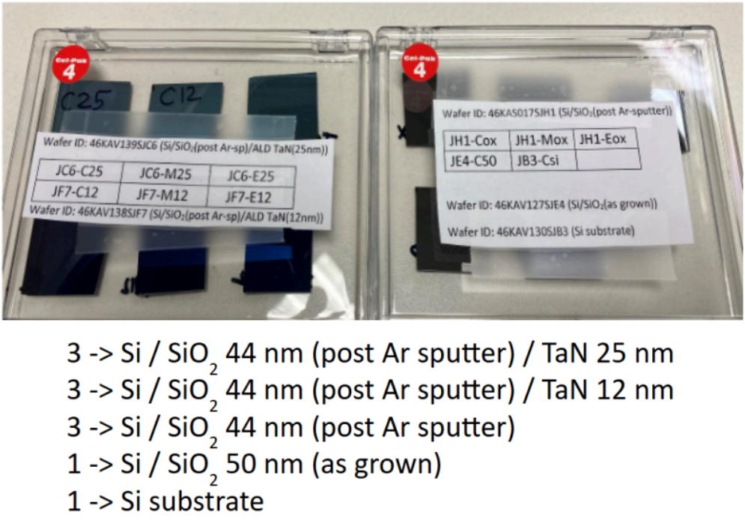

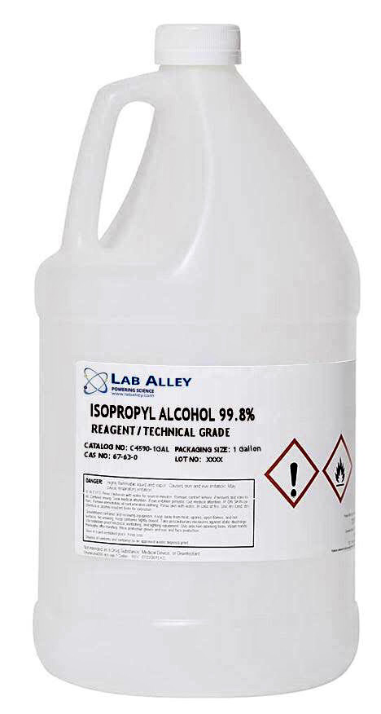
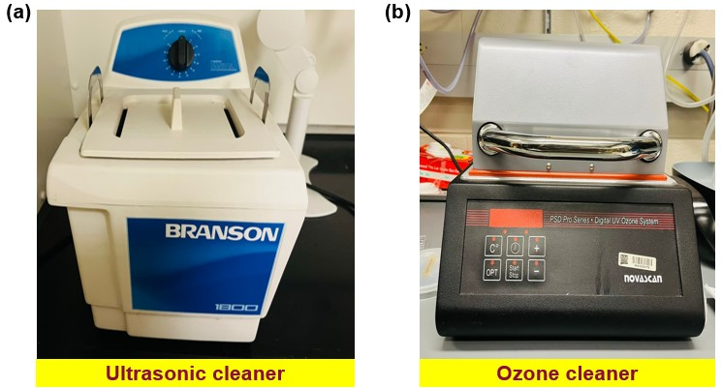
Sample preparation methods
Middle
Edge
Center
300 mm wafer

Slide 19
Conclusion
The electronic band structure of solids provides the foundation for understanding the optical response of materials, while spectroscopic ellipsometry offers a powerful means of experimentally probing these optical constants across broad spectral ranges.
The instrumentation used, IR-VASE and VASE ellipsometers controlled via W-VASE software, enabled precise measurements.
Data was further organized in Excel and presented graphically using OriginPro.
Careful sample preparation was performed to ensure reliable measurements, including ultrasonic cleaning and sandblasting to remove back-side reflections. This project used a set of 11 samples with different configurations of TaN and SiO₂ layers on Si substrates prepared by ALD.
Together, these theoretical and methodological elements form the basis for the investigation of the optical constants and temperature dependence of tantalum nitride thin films, presented in the following chapters.
Notes:
To summarize, this first part established the scientific motivation, theoretical background, and experimental framework for this research.
We learned that:
The optical properties of TaN are key to understanding its suitability as a quantum device material.
Spectroscopic ellipsometry provides a precise, non-destructive way to extract those properties.
And the combination of advanced instrumentation, rigorous modeling, and careful sample preparation ensures reliable results.

Slide 20
Measurement of tantalum nitride on Si/SiO₂ using X-Ray reflectance
Notes:
This section focuses on how we used X-ray Reflectivity, or XRR, to determine the structural parameters of our tantalum nitride thin films — including thickness, density, and surface roughness — which were crucial for validating the optical models used later in the project.

Slide 21



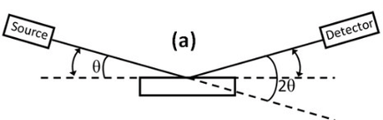
Introduction
Thickness, density and roughness of layers on a substrate can be determined via X-Ray Reflectance (XRR), which basically detects the reflections of X-Rays as the incident angle changes. Total external reflection for angles small enough.
The index of refraction of the sample is: where beta is the attenuation of the material and delta the dielectric polarization:
At critical angle, X-Rays are refracted parallel to the interface of air and material, reducing Snell’s law to the cos(alpha)=n. After Taylor expansion:
Z - atomic number, A - mass of element, p - mass density
An X-ray beam is directed at a sample at very low angles, called “grazing angles”:
E. Chason and T. M. Mayer, CRSSMS, 22 (1), 1-67 (1997).
A. Gibaud et al, “X-Ray Reflectivity”, Surface Science Techniques (pp. 191-216), Heidelberg, 2013.
A. Gibaud and S. Hazra, Current Science, 78 (12), 1467-1477 (2000).
Notes:
So, what exactly is XRR, and why did we use it?
X-Ray Reflectivity is a non-destructive analytical technique that characterizes thin films and multilayer structures by measuring how X-rays reflect from their surfaces at very shallow, or grazing, angles. In simple terms, it tells us how “flat,” “dense,” and “thick” our films are — with precision down to fractions of a nanometer.
This is particularly important for our atomic layer deposited TaN films, since we need to ensure uniform, well-defined interfaces between the tantalum nitride, the silicon dioxide layer, and the silicon substrate.
When an X-ray beam hits a smooth surface, part of it is reflected and part is refracted. Below a specific angle — called the critical angle — the X-rays are totally reflected. As we increase the incident angle, the beam starts to penetrate the sample, and we observe oscillations in the reflected intensity.
These oscillations are known as Kiessig fringes, and they come from interference between X-rays reflected at different interfaces — for instance, between the TaN/SiO₂ boundary and the SiO₂/Si boundary. By analyzing the spacing and amplitude of these fringes, we can extract the layer thickness, roughness, and density of each material.
And I always like to say — XRR is like “listening” to the echoes of X-rays inside the film; the spacing of those echoes tells us how thick the film is.

Slide 22
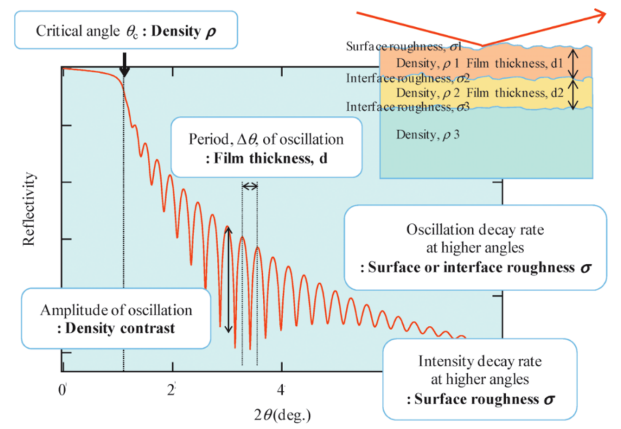

Introduction pt. 2
Constructive: Bragg’s law is satisfied: n𝜆=2dsin𝜃 when the length difference of reflected waves is an integer multiple of the X-ray wavelength (n𝜆).
Destructive: Reflected waves cancel each other when their length difference is a half-integer multiple of the X-ray wavelength ((n+1/2)𝜆).
At each interface where there is a change in electron density, a portion of the X-ray beam is reflected, and another is refracted and transmitted to the next layer
The reflected beams from these interfaces travel different path lengths before reaching the detector
The phase difference between these reflected waves determines if they interfere constructively or destructively
Constructive and destructive interference are what produce the characteristic oscillation patterns in the measured data, called Kiessig fringes
We can relate the frequency of these oscillations to the thickness by looking at the period of 2π completed by each oscillation
The thickness of the layer expressed in reciprocal space is given by:
M. Yasaka, The Rigaku Journal, 26 (2), 1-9 (2010).
J. P. Sauro, J. Bindell, and N. Wainfan, Phys. Rev., 143 (2), 439-443 (1966).
M. R. Sardela, Practical Materials Characterization (pp. 1-41), Media New York, 2014.

Slide 23
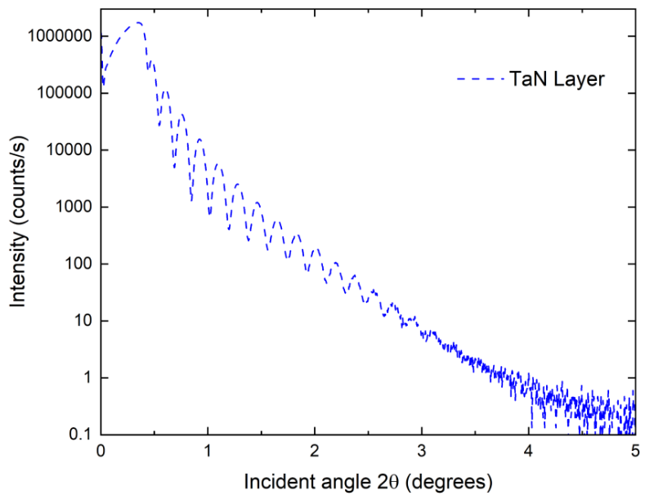
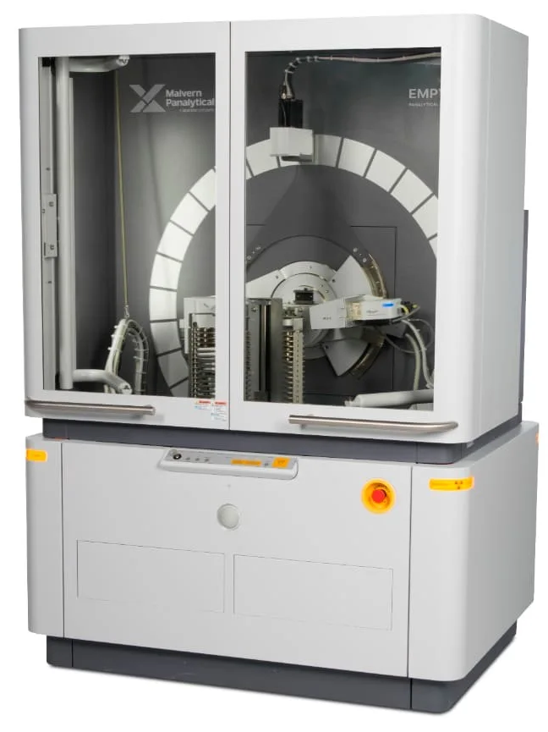
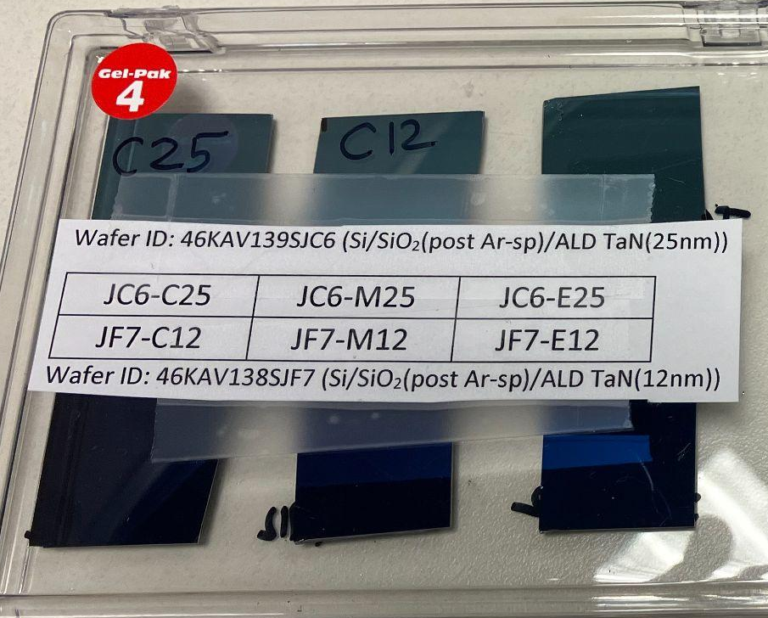
Methods
To determine the range of 2θ to be used, a fast scan was performed on the sample.
This scan showed that a range of 0º to 5º was the best option since the first range selected (0º to 3º) was not showing the entire XRR pattern.
Once we knew the range of 2θ we needed to use, we ran a long scan.
Hybrid monochromator 2xGe(200) for Cu
Fixed divergence slit of 1/32º
Fixed mask of 10 mm
Parallel plate collimator slit
Soller slits 0.04 rad
Xenon proportional detector
Nickel beam attenuator of 0.125 mm
Parallel plate collimator of 0.27º
Si/SiO₂/TaN films from 300 mm wafer
PANalytical Empyrean Powder Diffractometer (for XRR)
Malvern Panalytical, Empyrean, https://www.malvernpanalytical.com/empyrean
M. Yasaka, The Rigaku Journal, 26 (2), 1-9 (2010).
M. R. Sardela, Practical Materials Characterization (pp. 1-41), Media New York, 2014.
Notes:
Here you can see the raw XRR data collected from the measurement. The intensity is plotted versus the incident angle, and as you can see, we have a series of clear oscillations — those Kiessig fringes I mentioned earlier.
The first sharp drop in intensity corresponds to the critical angle, which depends on the electron density of the material.
For our sample, this critical angle was approximately 0.415 degrees, indicating a dense, high-quality TaN film.

Slide 24
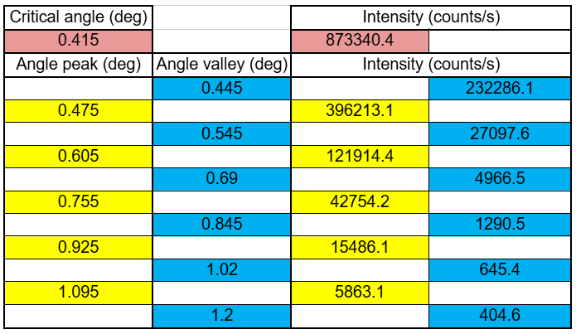

Methods pt. 2
Since the software did not have a layer for TaN, we had to create it from scratch, editing a layer and adding Tantalum and Nitrogen with the default settings for each of them.
Experimental data
Create the model
Fiting = Generated data
Analysis
Malvern Panalytical, Empyrean, https://www.malvernpanalytical.com/empyrean
M. Yasaka, The Rigaku Journal, 26 (2), 1-9 (2010).
M. R. Sardela, Practical Materials Characterization (pp. 1-41), Media New York, 2014.
Notes:
To interpret this data, we used X’Pert Reflectivity software, where we built a multilayer model consisting of:
The silicon substrate,
A silicon dioxide layer (initially estimated around 40 nm),
And a TaN layer (initially estimated around 25 nm).
Since TaN was not in the software’s built-in material database, we manually created a new layer, combining the elemental scattering factors of tantalum and nitrogen.

Slide 25
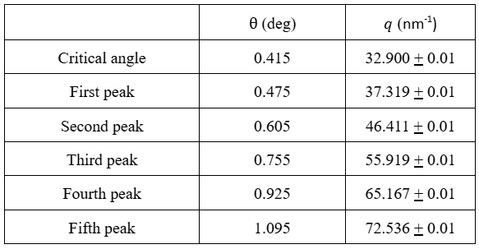

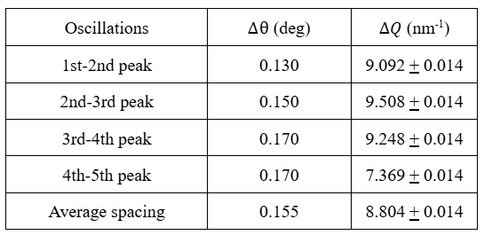

Methods pt. 3
reciprocal space coordinate
Malvern Panalytical, Empyrean, https://www.malvernpanalytical.com/empyrean
M. Yasaka, The Rigaku Journal, 26 (2), 1-9 (2010).
M. R. Sardela, Practical Materials Characterization (pp. 1-41), Media New York, 2014.
Notes:
To interpret this data, we used X’Pert Reflectivity software, where we built a multilayer model consisting of:
The silicon substrate,
A silicon dioxide layer (initially estimated around 40 nm),
And a TaN layer (initially estimated around 25 nm).
Since TaN was not in the software’s built-in material database, we manually created a new layer, combining the elemental scattering factors of tantalum and nitrogen.

Slide 26



Results
Electron density was calculated as: 3.7919 + 0.0029*10²⁴ cm⁻³, considering the value for delta as 2.621 + 0.002*10⁻⁵.
The molar mass, A, of TaN is 194.955 + 0.00022 g/mol.
The sum of its atomic number is 80 (73 for Ta + 7 for N).
The mass density of the TaN layer is 9.9643 + 0.0076 g/cm³.
The average spacing between the first four oscillations was 0.155º or 0.002705 radians.
The thickness for the TaN layer was calculated to be 28.52 + 0.02 nm.
While roughness causes the decay of the XRR signal at higher angles, the exact rate of decay is dependent on a complex interplay of other factor apart from the slope, so it requires a specialized software for analysis.
Notes:
After optimization, the best fit matched the experimental curve extremely well, producing the following results.
These values are not only consistent with our expectations but also in excellent agreement with the later ellipsometric measurements.
This level of consistency between techniques is an important validation of both the ALD process quality and the accuracy of our modeling approach.
So, what do these results tell us?
First, the XRR model matched the experimental data almost perfectly, which indicates that the films were uniform, continuous, and free from significant interfacial defects. The low surface roughness — below 0.4 nanometers — demonstrates the exceptional smoothness achievable with atomic layer deposition.
Second, the measured density of 9.78 g/cm³ is very close to the theoretical density for stoichiometric TaN, confirming that our film was compact and of high quality.
Finally, the oscillation frequency and intensity behavior confirmed that the TaN and SiO₂ interfaces were sharp and well-defined, which is critical for optical modeling and for the function of TaN as a tunnel barrier in later superconducting device applications.

Slide 27

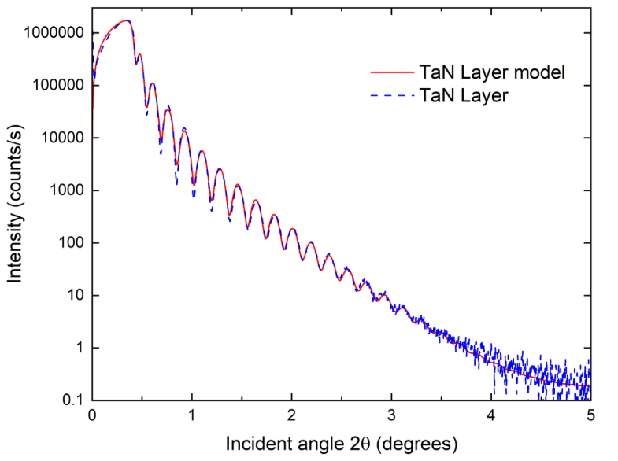
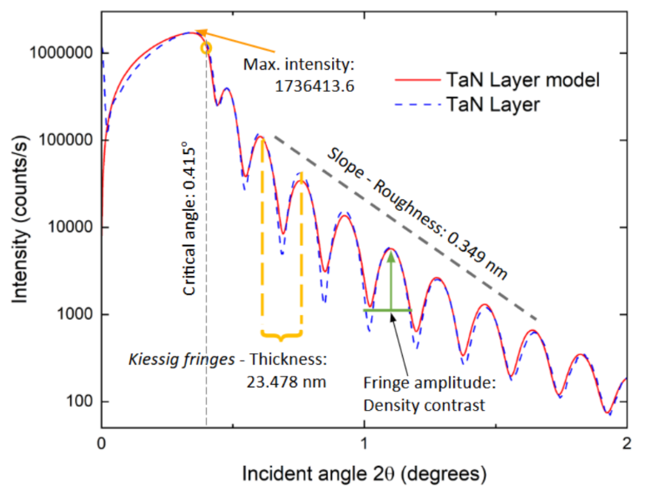
Results pt. 2
Notes:
After optimization, the best fit matched the experimental curve extremely well, producing the following results.
These values are not only consistent with our expectations but also in excellent agreement with the later ellipsometric measurements.
This level of consistency between techniques is an important validation of both the ALD process quality and the accuracy of our modeling approach.
So, what do these results tell us?
First, the XRR model matched the experimental data almost perfectly, which indicates that the films were uniform, continuous, and free from significant interfacial defects. The low surface roughness — below 0.4 nanometers — demonstrates the exceptional smoothness achievable with atomic layer deposition.
Second, the measured density of 9.78 g/cm³ is very close to the theoretical density for stoichiometric TaN, confirming that our film was compact and of high quality.
Finally, the oscillation frequency and intensity behavior confirmed that the TaN and SiO₂ interfaces were sharp and well-defined, which is critical for optical modeling and for the function of TaN as a tunnel barrier in later superconducting device applications.

Slide 28
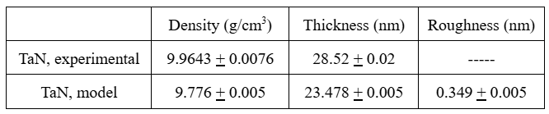
Conclusion
Note: Although this thesis includes this XRR chapter before the ellipsometric measurements, the work done with XRR was performed at the very end of the project.
For the density of the layer, there is a difference of 0.1883 + 0.009 g/cm³, which shows a good coherence of the model to describe the experimental data.
For the thickness of the layer there is a difference of 5.042 + 0.021 nm, which represents a not too large but still noticeable variation in layer thickness that can be attributed to the limited use of fringes when manually calculating the average fringe spacing.
Critical angle = 0.415º
The angle range of 0.7º to 1.7º of the XRR pattern shows a slight difference in amplitude between the experimental data and the model, which can be attributed to the sample having more than one layer. This is something that can be worked on in a future experiment, trying to fit a model, and adding more layers for TaN.
Notes:
After optimization, the best fit matched the experimental curve extremely well, producing the following results.
These values are not only consistent with our expectations but also in excellent agreement with the later ellipsometric measurements.
This level of consistency between techniques is an important validation of both the ALD process quality and the accuracy of our modeling approach.
So, what do these results tell us?
First, the XRR model matched the experimental data almost perfectly, which indicates that the films were uniform, continuous, and free from significant interfacial defects. The low surface roughness — below 0.4 nanometers — demonstrates the exceptional smoothness achievable with atomic layer deposition.
Second, the measured density of 9.78 g/cm³ is very close to the theoretical density for stoichiometric TaN, confirming that our film was compact and of high quality.
Finally, the oscillation frequency and intensity behavior confirmed that the TaN and SiO₂ interfaces were sharp and well-defined, which is critical for optical modeling and for the function of TaN as a tunnel barrier in later superconducting device applications.

Slide 29
Temperature-dependent dielectric function of tantalum nitride formed by atomic layer deposition for tunnel barriers in Josephson Junctions

Slide 30
Introduction
Superconducting qubits, such as those based on Josephson junctions, rely heavily on the quality of their insulating tunnel barriers. Traditionally, these barriers are made using AlO_{x}, but that approach faces challenges — especially with uncontrolled oxidation, variability in stoichiometry, and limitations in scaling.
Here’s where ALD TaN comes in: This material offers atomic-level control during deposition, excellent uniformity across large wafers, and compatibility with CMOS fabrication — all crucial for scalable quantum devices.
However, despite TaN’s established use in microelectronics as a diffusion barrier, its optical and dielectric properties at different temperatures had not been fully characterized — and that’s exactly what this research set out to explore.
Morten Kjaergaard et al., Annual Rev. of Cond. Mat. Phys., 11, 369–395 (2020).
W. D. Oliver, and P. B. Welander, MRS Bulletin 38, 816-825 (2013).
G.Wendin and V. S. Shumeiko, Low Temp. Phys., 33, 724–744 (2007).
J. M. Martinis et al., Physical Review Letters, 95, 210503 (2005).
A. P. M. Place et al., Nature Communications 12, 1779 (2021).
Notes:
Superconducting qubits, such as those based on Josephson junctions, rely heavily on the quality of their insulating tunnel barriers. Traditionally, these barriers are made using aluminum oxide, but that approach faces challenges — especially with uncontrolled oxidation, variability in stoichiometry, and limitations in scaling.
Here’s where ALD TaN comes in. This material offers atomic-level control during deposition, excellent uniformity across large wafers, and compatibility with CMOS fabrication — all crucial for scalable quantum devices.
However, despite TaN’s established use in microelectronics as a diffusion barrier, its optical and dielectric properties at different temperatures had not been fully characterized — and that’s exactly what this research set out to explore.

Slide 31
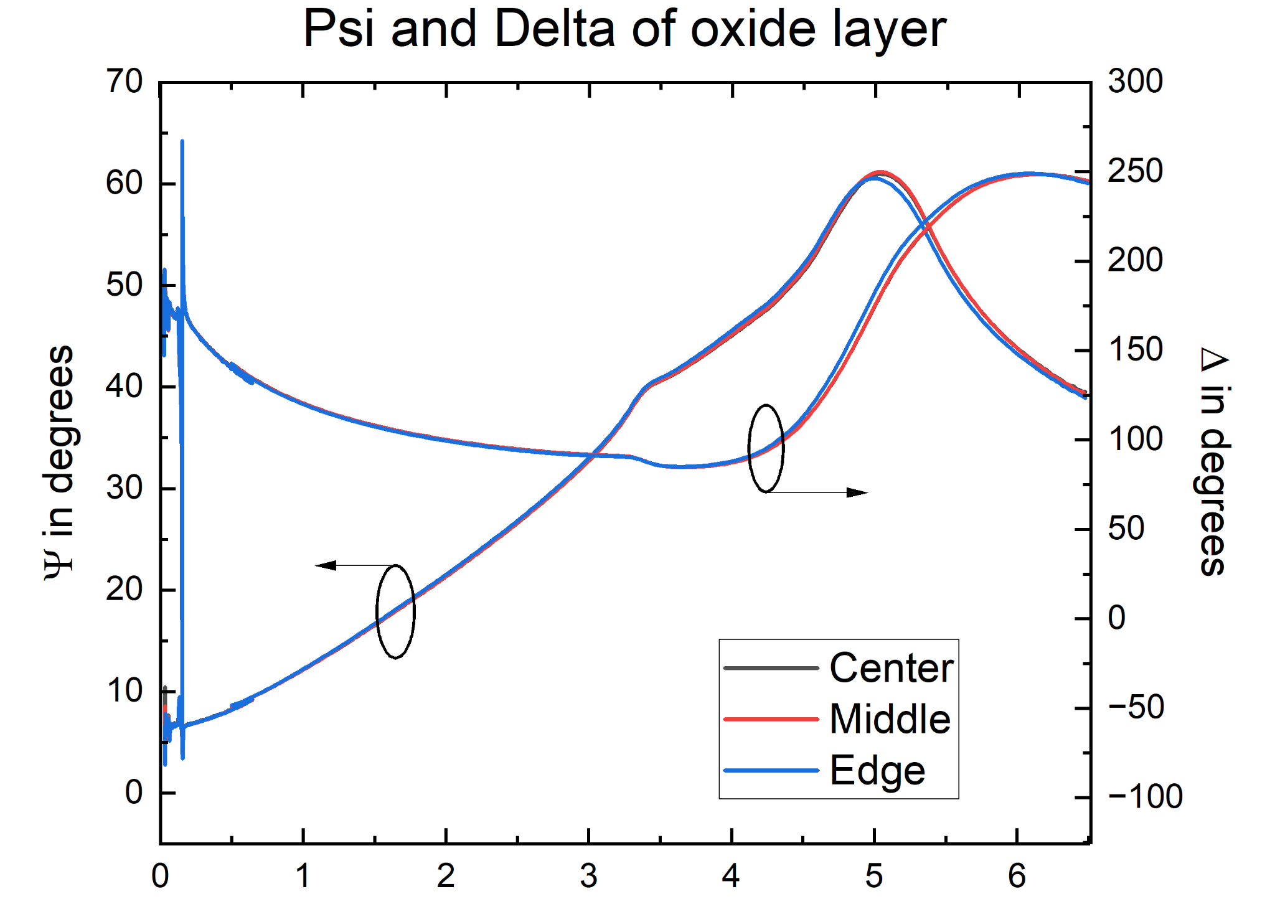
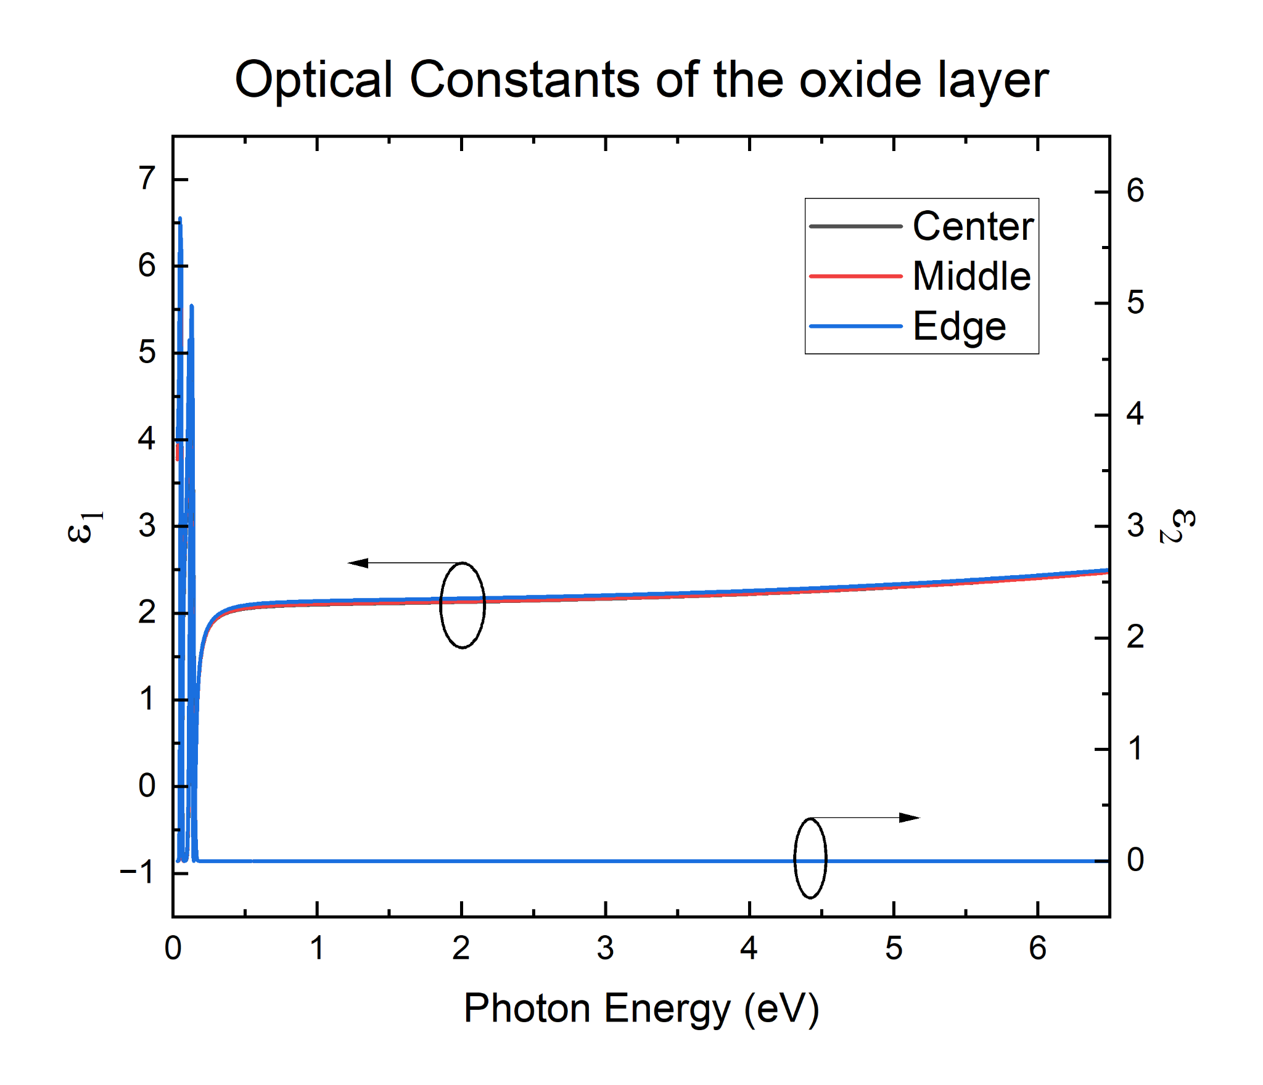
Psi and Delta of SiO₂
Ellipsometric angles Psi and Delta as a function of Photon Energy for the center, middle, and edge sections of the wafer at 300 K before ALD TaN.
The angle of incidence was limited to 70º
Layer thickness in all sections: 44 nm
Create a layer model for the oxide of the thin
film to fix it when fitting the model for the TaN surface layer.
The model for the SiO₂/Si layer was made using
2 Gaussian oscillators around 0.05 and 0.12 eV.
The models for all 3 sections of the wafers are basically identical.
G. E. Jellison, Jr., and F. A. Modine, Appl. Phys.
Lett. 69, 371 (1996); 69, 2137 (1996) (E).

Slide 32
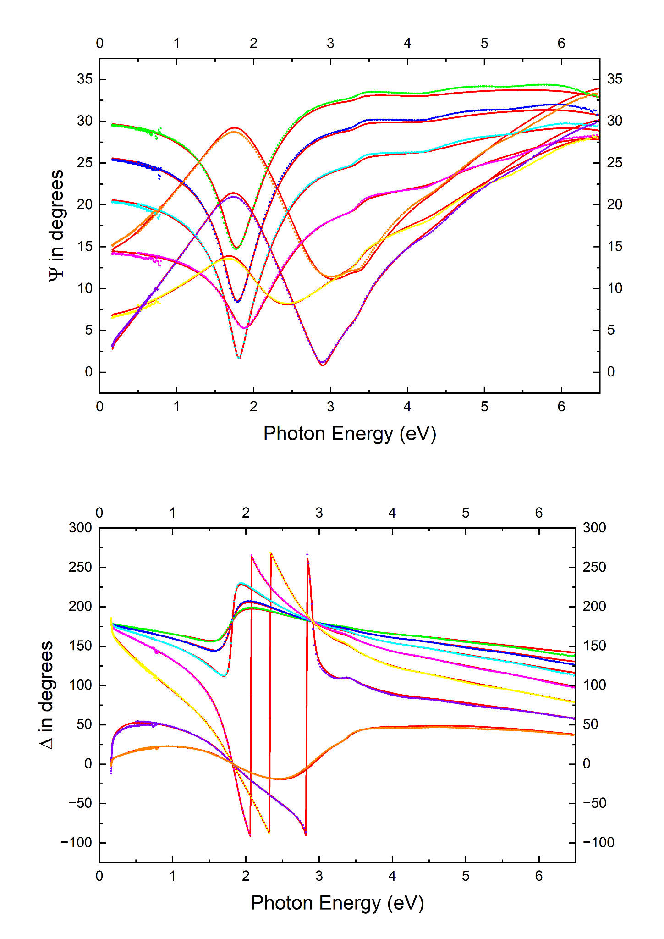
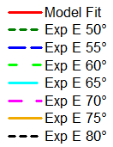
Psi and Delta of TaN
Ellipsometric angles Psi and Delta as a function of Photon Energy for the 25 nm TaN center sample at room temperature (300 K)
Range of angles: 50º to 80º, step size: 5º
+ polarizer angles
Brewster angles:
Si: 75º SiO₂: 55º
IR (0.03 to 0.7 eV):
Resolution: 8 cm⁻¹
UV (0.5 to 6.5 eV):
Energy step size: 0.02 eV
G. E. Jellison, Jr., and F. A. Modine, Appl. Phys. Lett. 69, 371 (1996); 69, 2137 (1996) (E).

Slide 33
Pseudo dielectric functions of TaN
Angle of incidence fixed at 70º
IR:
Resolution: 8 cm⁻¹
UV:
Energy step size: 0.02 eV
TaN layer model:
-1 Tauc-Lorentz oscillator at 3.2 eV
-2 Gaussians at 0.44 and 4.8 eV
-Fixed thickness: 23 nm
Absorption peak: 2.5 - 6.5 eV
Interference fringe below 2.5 eV
-Half the size of absorption peak
G. E. Jellison, Jr., and F. A. Modine, Appl. Phys.
Lett. 69, 371 (1996); 69, 2137 (1996) (E).

Slide 34
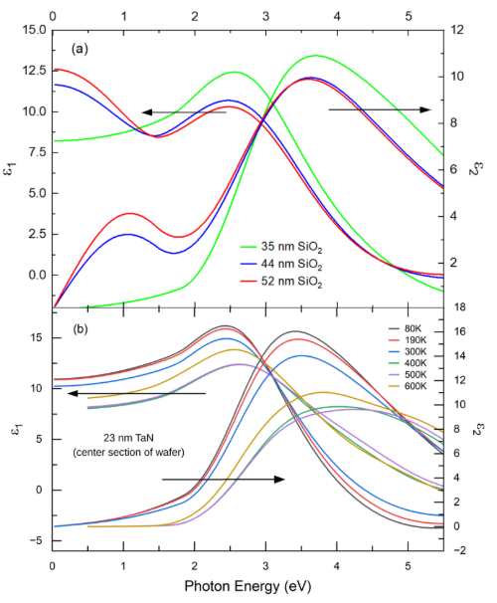
Diff. thicknesses assumed for SiO₂
Broad range of SiO₂ thicknesses ranging from 35 to 52 nm.
An SiO₂ thickness of 44 nm yields leads to a peak in the
dielectric function of TaN near 1.2 eV.
The magnitude of this peak increases if we assume an SiO₂
thickness of 52 nm.
It nearly disappears for a SiO₂ thickness of 35 nm.
The strong dependence of the peak at 1.2 eV on the SiO₂ thickness in our fit is suspicious. Most likely, this peak is an artifact that stems from an incomplete removal of interference effects.
Since this peak disappears if we assume an SiO₂ thickness of 35 nm, this is the most likely scenario and we fix it in our subsequent analysis work.
G. E. Jellison, Jr., and F. A. Modine, Appl. Phys. Lett. 69, 371 (1996); 69, 2137 (1996) (E).

Slide 35
Temperature dependence of TaN
The temperature dependence of the dielectric function of TaN is small. The band gap of TaN (more precisely, the Tauc gap extracted from our Tauc-Lorentz oscillator model) decreases from 1.8 eV at 80 K to 1.5 eV at 600 K.
Furthermore, as expected, the broadening of the main peak around 3.5 eV increases with increasing temperature.
The imaginary part of ε remains small at all temperatures, indicative of the insulating properties of the TaN layer.
S. Zollner et al., Advanced Optical Technologies 11, 117-135 (2022).
D. Franta et al., Appl. Surf. Sci. B 421, 405 (2017).
D. Franta, P. Franta, J. Vohánka, M. Čermák, and I. Ohlídal, J. App. Phys. 123, 185707 (2018).
Notes:
Now, let’s move to the main findings — the temperature-dependent dielectric function of ALD TaN.
First, the ellipsometry data revealed no evidence of free-carrier absorption in the infrared region, even up to 600 K. This absence of Drude-like behavior indicates that ALD TaN behaves as an insulator across the studied temperature range.
Second, the band gap extracted from the Tauc-Lorentz model ranged between 1.5 eV and 1.8 eV, showing a slight narrowing as temperature increased — a well-known effect in many semiconductors and insulators due to thermal expansion and electron–phonon interactions.
Third, the dielectric function exhibited minimal variation with temperature, which highlights TaN’s excellent thermal stability — a critical property for devices operating under cryogenic or fluctuating conditions.
Furthermore, the optical constants were remarkably uniform across the 300 mm wafer. This demonstrates that the ALD process yields highly reproducible and uniform films, which is essential for scalable quantum device fabrication.
In simpler terms, these results confirm that ALD TaN can act as a stable, uniform, and insulating tunnel barrier, capable of maintaining its electronic and optical integrity across a wide range of temperatures.

Slide 36
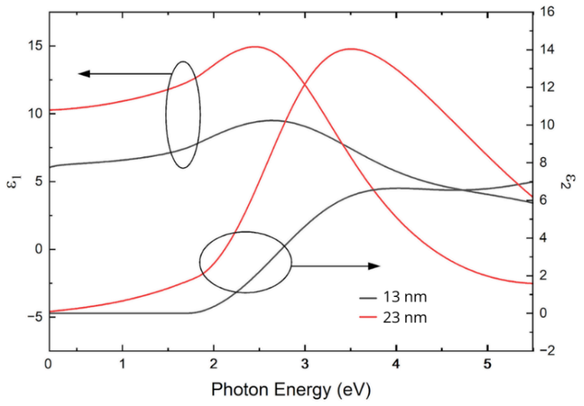

Dielectric functions of TaN in diff. thicknesses
Beer-Lambert law: the decrease in the intensity of light as it passes through a medium is an exponential function of the distance it travels.
Because the thinner sample’s film thickness is approximately
half of the thicker sample, the absorbance was also halved while
the absorption coefficient remained the same.
The 13 nm sample could be almost completely oxidized forming some type of TaxOx which made its absorption coefficient different, therefore, changing its dielectric functions.
Excitonic enhancement, which is where excitons, bound states of electrons and holes, significantly modify a material’s optical properties, like the absorption coefficient, due to the attractive Coulomb interaction between the electron and hole.

Slide 37
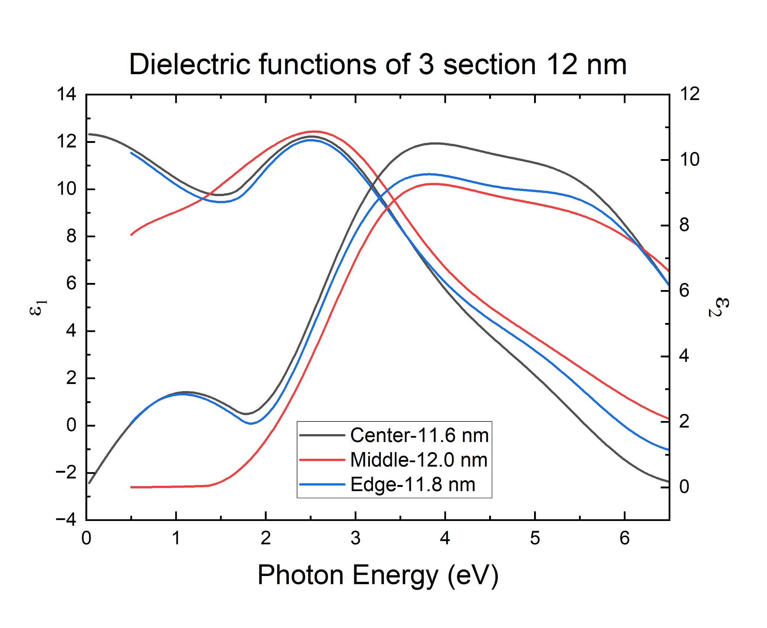
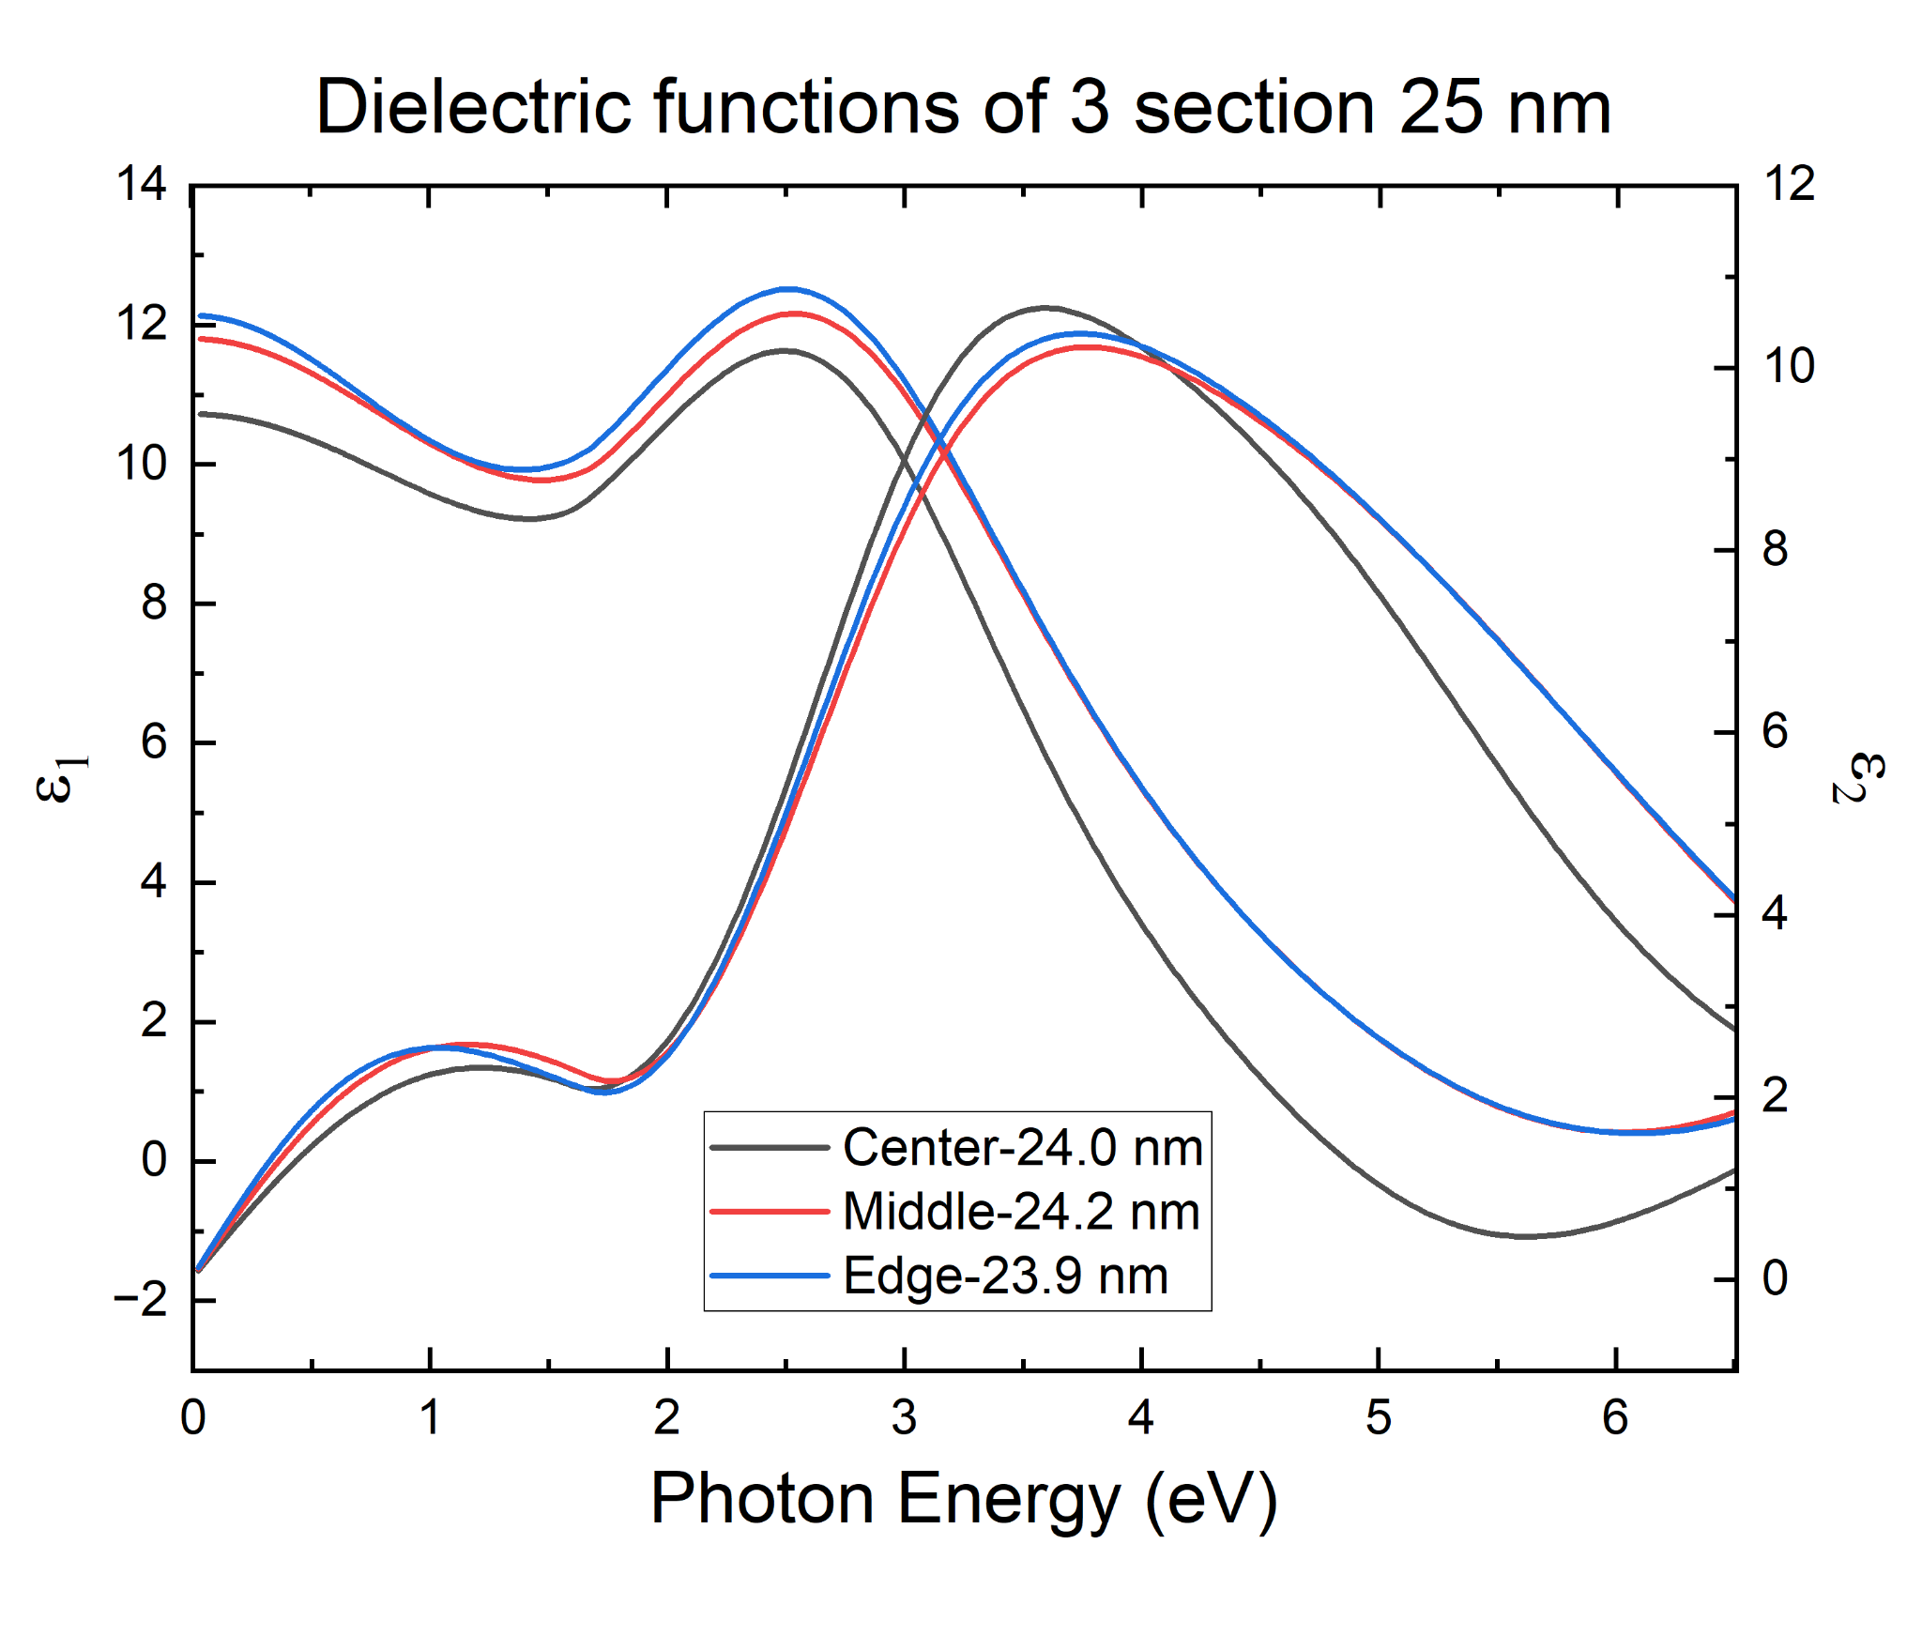
Comparison of diff. sections of TaN wafers
(a)
(b)
- - - - - - - - - - - - - - - - - - - - - - - - - - - - - - -- - - - - - -
- - - - - - - - - - - - - - - - - - - - - - - - - - - - - - -- - - - - - -
Band gap of TaN: 〜1.7 eV
The imaginary part of the dielectric function of the three sections in both graphs shows a band gap near 1.7 eV at room temperature, which confirms the desired objective of maintaining uniform optical constants throughout the wafer.
Since these two graphs were made using a TaN model on top of an SiO₂ model that considered a thickness of 40 nm instead of 35 nm, it is possible these peaks are due to an artifact caused by an incomplete removal of the interference fringe.

Slide 38
Conclusion
We explored the application of ALD TaN films for tunnel barriers in Josephson junctions for superconducting quantum circuits.
The ALD TaN band gap was determined to be 1.5-1.8 eV varying with temperature. This showed:
No evidence for free-carrier absorption in the infrared region (consistent with the insulating nature of the ALD TaN film)
Its advantages over traditional aluminum oxide barriers of higher band gap used in tunnel barriers
That the smaller barrier height allows for thicker films to be utilized for the same magnitude of Josephson tunneling current, improving process control margin.
The excellent surface roughness and band gap uniformity across the 300 mm wafer that illustrates ALD TaN as a potential material for Josephson junctions to achieve thermally stable, reliable, and repeatable superconducting qubit devices.
Future work will focus on the determination of dielectric loss in ALD TaN and its integration as tunnel barriers into Josephson junctions and the determination of coherence times of superconducting qubit devices made from these Josephson junctions.
Notes:
So, what does this mean for superconducting technology?
The findings establish ALD TaN as a promising alternative to Al₂O₃ for Josephson junctions. Its moderate band gap and insulating nature can potentially lead to thicker, more stable tunnel barriers, reducing defect formation and improving qubit reproducibility.
Because TaN interfaces well with α-phase tantalum — the superconducting phase desirable for quantum devices — this material system could enable next-generation superconducting qubits with higher coherence times and better fabrication control.
The work also contributes to the broader understanding of TaN’s intrinsic optical and thermal properties, paving the way for its integration not just in quantum computing, but also in high-performance microelectronics and optoelectronics.

Slide 39
Outlook and Summary

Slide 40
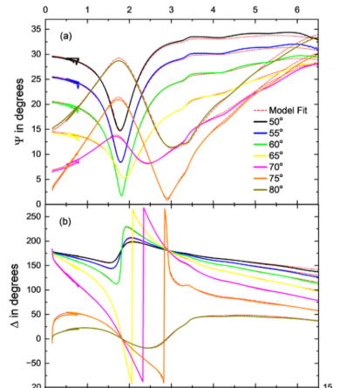

Slide 41
Outlook and Summary
XRR on ALD TaN showed a critical angle of 0.415º, a layer thickness of 23.478 nm, a surface roughness of 0.349 nm, and a layer density of 9.776 g/cm³.
The band gap for the ALD TaN thin film was found from 1.8 eV to 1.5 eV varying with temperature from 80 K to 600 K.
ALD TaN has some variation in its optical constants due to temperature, especially around the energies corresponding to the absorption peaks (3.5 and 5 eV).
Leveling the parallel abrupt interfaces with well known thicknesses will improve the measured SE data.
Notes:
Looking forward, future research should focus on exploring defect-related states within the TaN band gap and on fabricating complete Josephson junctions using these ALD TaN barriers to evaluate their real-world performance in qubit circuits.
This next step will bridge the gap between material-level characterization and device-level implementation, moving us closer to achieving high-coherence superconducting quantum technologies.
To conclude, this study demonstrated that ALD TaN thin films are optically insulating, compositionally uniform, and thermally stable — exactly the qualities required for reliable tunnel barriers in quantum computing applications.

Slide 42

Thank you!
Notes:
Thank you very much for your attention.

Slide 43
Questions?
Notes:
I’ll be happy to take any questions.

