Slide 1
ULTRAFAST DYNAMICS OF CARRIERS IN GERMANIUM PROBED BY BROADBAND FEMTOSECOND SPECTROSCOPIC ELLIPSOMETRY
Ph.D. dissertation defense
Carlos Antonio Armenta
July 9, 2025
Department of physics
Notes:
Good afternoon. Thanks to everyone for coming to my thesis defense. The subject of this dissertation the ultrafast dynamics of carriers in germanium probed by time-resolved ellipsometry.

Slide 2





Acknowledgments
Thesis advisor:
Dr. Stefan Zollner
Thesis committee
Dr. Igor Vasiliev
Dr. Michael Engelhardt
Dr. R. T. James McAteer
Research group (current)
Jaden R. Love
Haley Woolf
Sonam Yadav
Yoshitha Hettige
Aaron López
Gabriel Ruiz
Research group (former)
Carola Emminger
Nuwanjula Samarasingha
ELI Eric group
Dr. Shirly Espinoza
Dr. Martín Zahradník
Dr. Mateusz Rebarz
Dr. Saul Vázquez-Miranda
Dr. Jakob Andreasson
Arizona State University
Dr. José Menéndez
Funding agencies
Air Force Office of Scientific Research under award number FA9550-20-1-0135 and FA9453-23-2-0001.
Department of Energy, National Nuclear Security Administration under award number DE-NA0004103.
National Science Foundation under award number DMR-2423992.
J. A. Woollam foundation.
Notes:
Before anything, I would like to do some acknowledgments. I would like to thank my advisor Dr. Stefan Zollner. The committee member for giving up their valuable time. The past and present members of our research group. The measurements for the principal part of this work, were performed at ELI ERIC in the Czech Republic with the ellipsometry team listed here. I want to also acknowledge our consulting theorist, José Menéndez from ASU and finally our funding agencies.

Slide 3

Vita
Oral presentations
AVS 68th International Symposium & Exhibit. Pittsburgh, PA, November 8, 2022.
APS March Meeting 2023, Las Vegas, NV, March 7, 2023.
12th Workshop on Spectroscopic Ellipsometry. Prague, Czech Republic, September 19, 2023
AVS 69th International Symposium & Exhibit. Portland, OR, November 6, 2023.
IEEE 2024 Summer Topical Meeting Series. Bridgetown, Barbados, July 16, 2024.
LXVI Congreso Nacional de Física. Chihuahua, México, October 9, 2024.
AVS 70th International Symposium & Exhibit. Tampa, FL, November 8, 2024.
10th International Conference on Spectroscopic Ellipsometry. Boulder, CO, June 13, 2024.
Invited talk: AVS 71st International Symposium & Exhibit. Charlotte, NC, September 21, 2025.
Future position: IBM Research
Publications
M. R. Arias, C. A. Armenta, C. Emminger, C. M. Zamarripa, N. S. Samarasingha, J. R. Love, S. Yadav, and S. Zollner, J. Vac. Sci. Technol. B 41, 022203 (2023).
C. A. Armenta, M. Zahradník, M. Rebarz, C. Emminger, S. Espinoza, S. Vazquez-Miranda, J. Andreasson, and S. Zollner, 2024 IEEE Photonics Society Summer Topicals Meeting Series (SUM), Bridgetown, Barbados, 2024, pp. 01-02.
S. Zollner, C. A. Armenta, S. Yadav, and J. Menéndez, J. Vac. Sci. Technol. A 43, 012801 (2025).
C. A. Armenta and S. Zollner, J. Appl. Phys. 137, 245701 (2025).
C. A. Armenta, M. Zahradník, M. Rebarz, C. Emminger, S. Espinoza, S. Vazquez-Miranda, J. Andreasson, and S. Zollner, (in preparation).
Notes:
Here is a list of our publications so far. I will not talk about InSb in this presentation. However, some of the calculations related to charge carrier statistics in this paper are used for this work.
This is a list of the conferences where I have presented and also an invited talk. Lastly, I was fortunate enough that IBM needed an ellipsometry person. So I will start a new position at IBM research shortly.

Slide 4
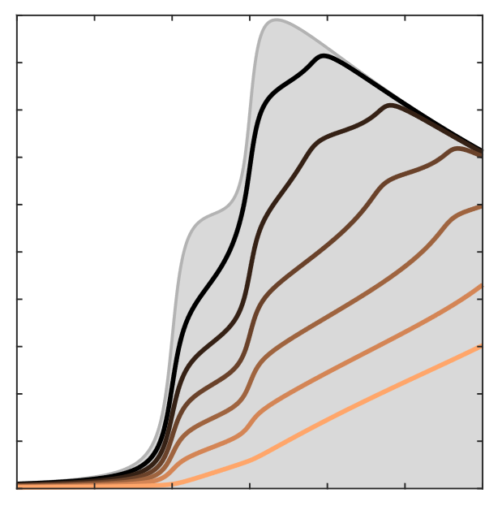


Outline
$$Δt$$
Pump
Probe
Introduction
Problem statement
Dielectric function range
Steady-state dielectric function
Critical points E₁ and E₁+Δ₁
Excitons
Spectroscopic ellipsometry
Results
Ultrafast dynamics
Femtosecond ellipsometry
Scattering and relaxation of carriers
Carrier statistics
Modeling of dielectric function
Fit of data
Conclusion
$$ω$$
Ultrafast dynamics
$$ε_{2}$$
Notes:
Just a quick outline of the presentation: In the introduction I will discuss what is it that we are trying to measure and what we are hoping to get out of it. Also, a quick view at the spectral range where we are probing.
Next, we will see how we can model the steady-state dielectric function of Ge within our specific spectral range, a review of ellipsometry, and the results.
After this, ultrafast measurements. The experimental set up and carrier statistics. Next, we will look at how we model the dielectric function, along the how it comperes with experimental data. After this, we will look at how we can improve the model. And finally, conclusion and work to be done.

Slide 5
Introduction

Slide 6
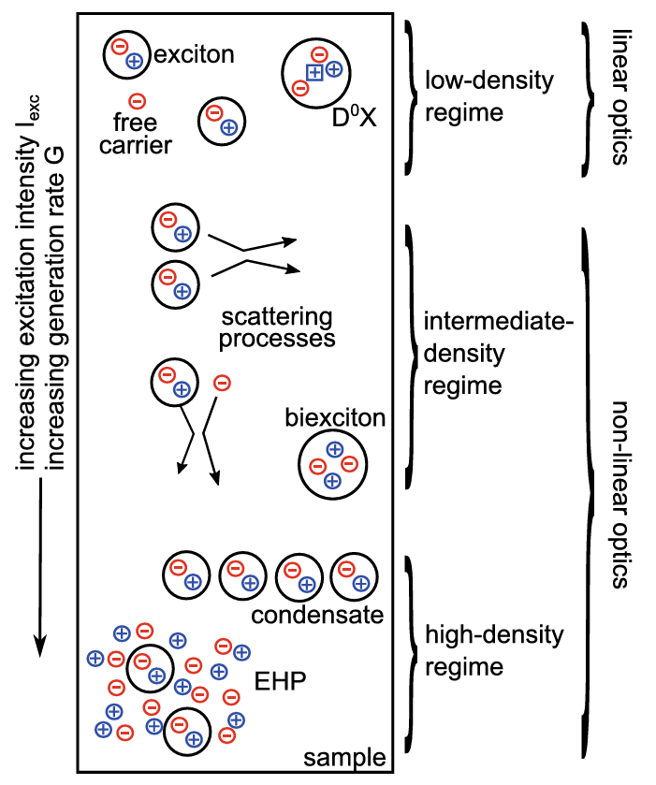





Problem statement
Pump
$$Δt$$
The study of non-linear effects in germanium induced by photoexcited carriers by using time resolve ellipsometry:
Carrier-carrier scattering.
Carrier-phonon scattering.
Intervalley scattering.
Momentum and energy relaxation of hot carriers.
$$ω$$
Probe
$$p$$
$$E$$
$$s$$
$$E$$
$$φ$$
Plane of incidence
Sample
H. Kalt, C. F. Klingshirn, Semiconductor Optics 2 (Springer, 2024).
H. G. Tompkins and J. N. Hilfiker, Spectroscopic Ellipsometry (Momentum Press, 2016).
Notes:
The goal of this work is to study the optical properties of Germanium in the high carrier density regime. It is in this regime where we can observe non-linear optical effects, such as the scattering and relaxation of carriers. As stated before, we do this via time-resolve ellipsometry by employing pump-probe technique. We study Ge, not because we are particularly interested in the material, but because is an ideal prototype for studying the properties of other semiconductors. We want to give a qualitative understanding of the ultrafast dynamics of the carrier and eventually translate these results to other materials that we have measured such as GeSn alloys.

Slide 7
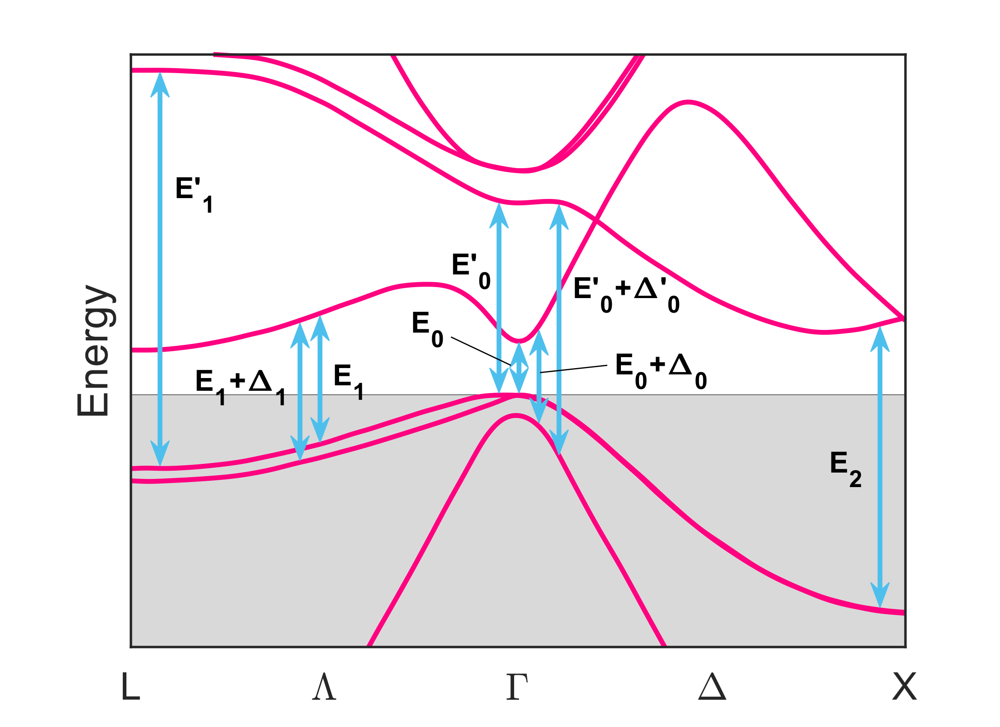
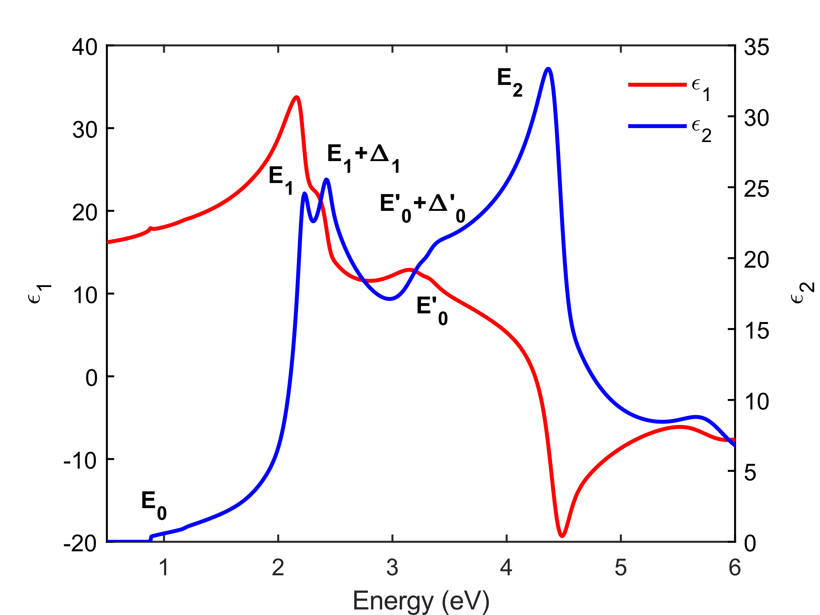
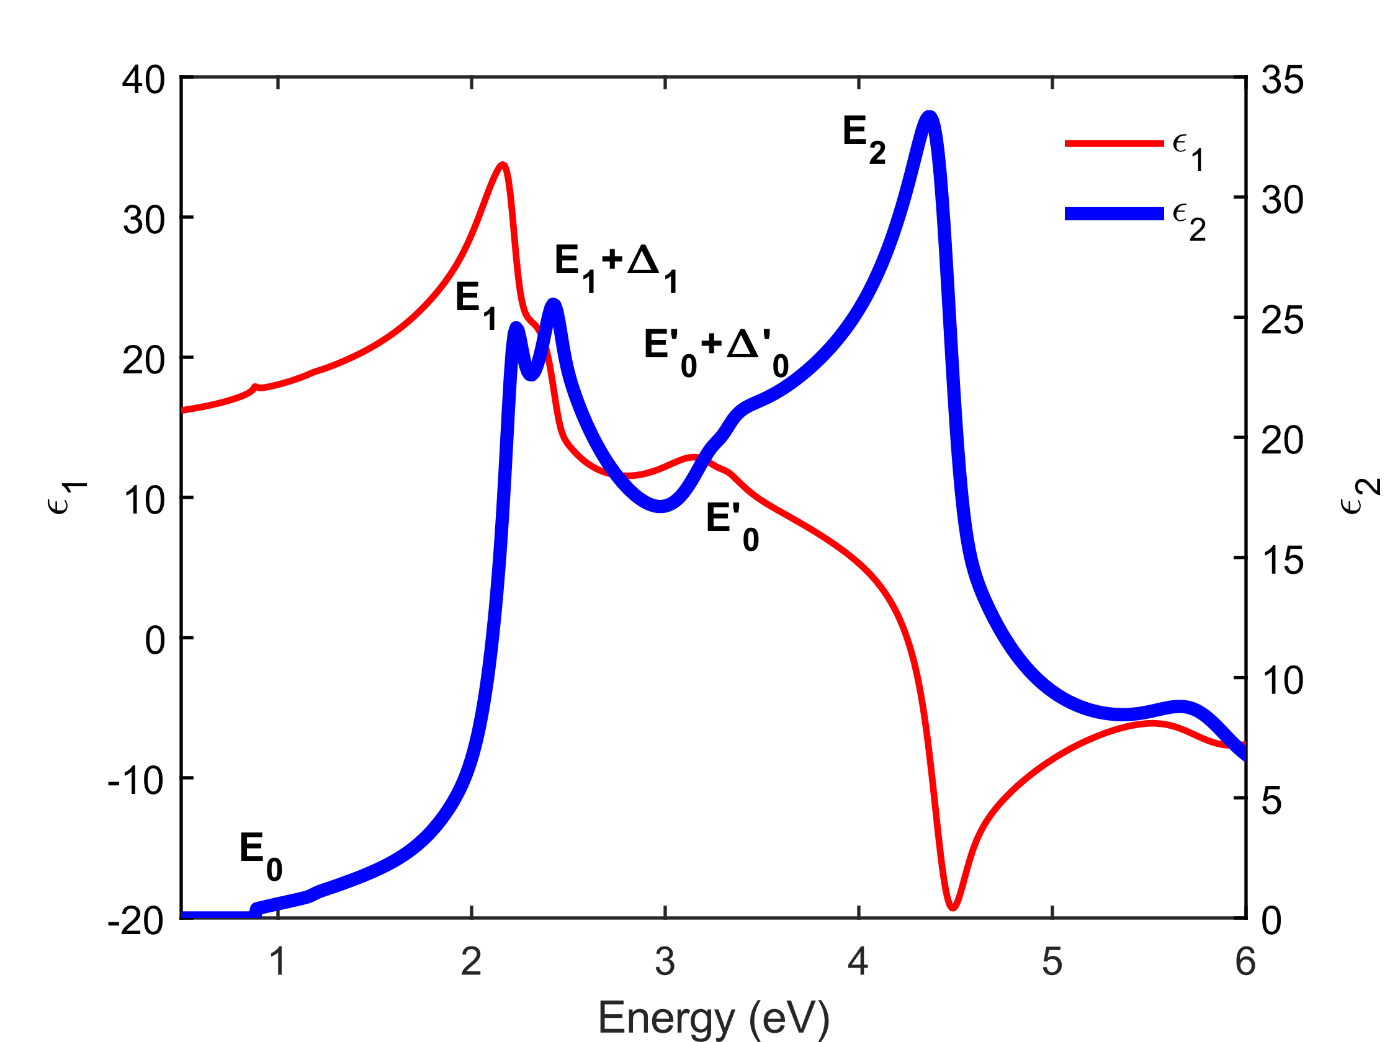
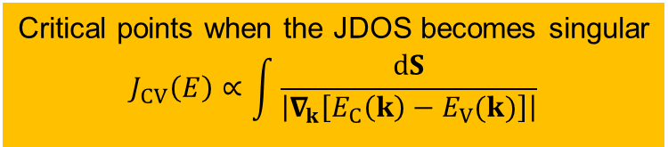
Dielectric function of Ge
Probing range
E_{ind}
Band Structure of Ge
Dielectric Function of Ge
Critical points when the JDOS becomes singular
$$J_{CV}\left(E\right)∝\int{\frac{dS}{\left|∇_{k}\left[E_{C}\left(k\right)−E_{V}(k)\right]\right|}}$$
Dielectric Function of Ge
P. Yu and M. Cardona, Fundamentals of Semiconductors (Springer, Berlin, 1996).
C. Emminger et al., J. Vac. Sci. Technol. B 38, 012202 (2020).
Notes:
Here is a schematic of the band diagram of Ge. What is within the grey area are the valence bands, and the rest are the conduction bands. It is bit difficult to see, but we have the indirect bandgap at the L point. We also have these arrows indicating other interband transitions. These transitions are critical points that happen when the JDOS becomes singular (when the derivative of the conduction band minus the valence band is close to zero). At these points, absorption is high and is much easier see them if we focus on the imaginary part of the dielectric function. The blue line is ε₂, where we can see a distinct absorption peak for every critical point in the band structure. We see the direct bandgap E₀, the E₁ and E₁+Δ₁ peaks, E₂, etc.
For this particular work, we are probing between 1.5 and 3.5 eV. It is this are where we find the E₁ and E₁+Δ₁ CPs.

Slide 8
Steady state dielectric function
Notes:
The first step for this work is to provide a better description of the dielectric function of Ge near the of the E₁ and E₁+Δ₁ critical points.

Slide 9
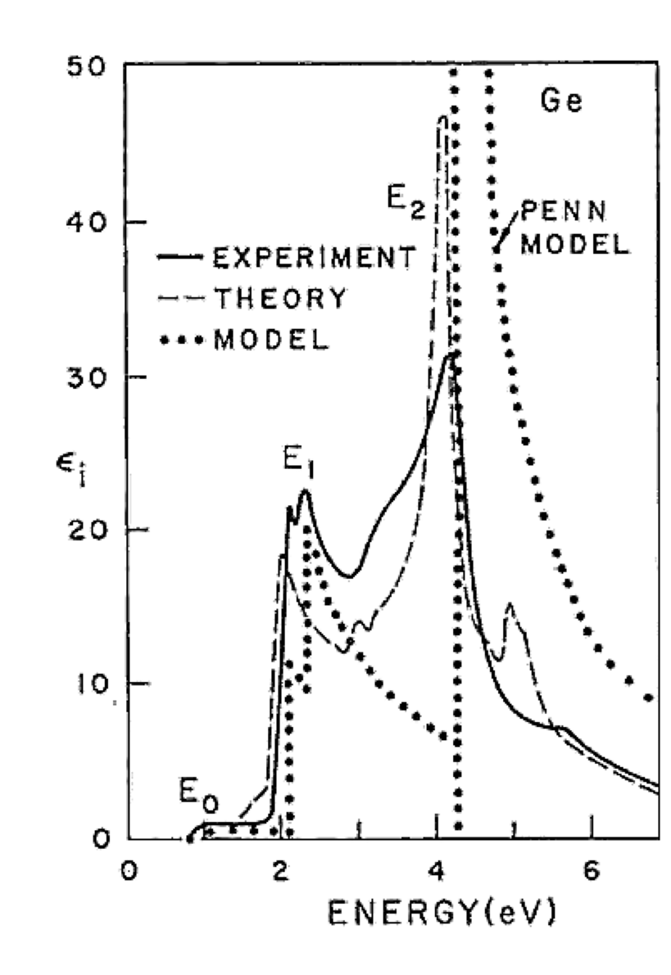
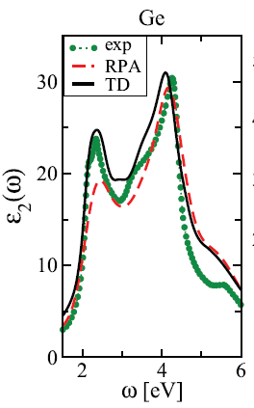
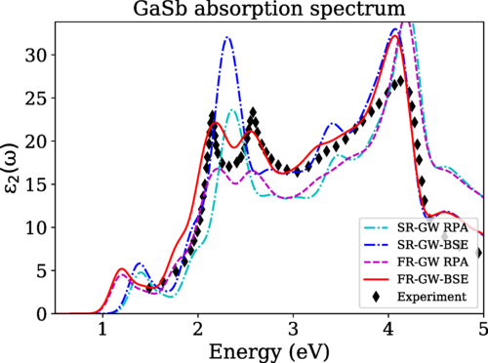
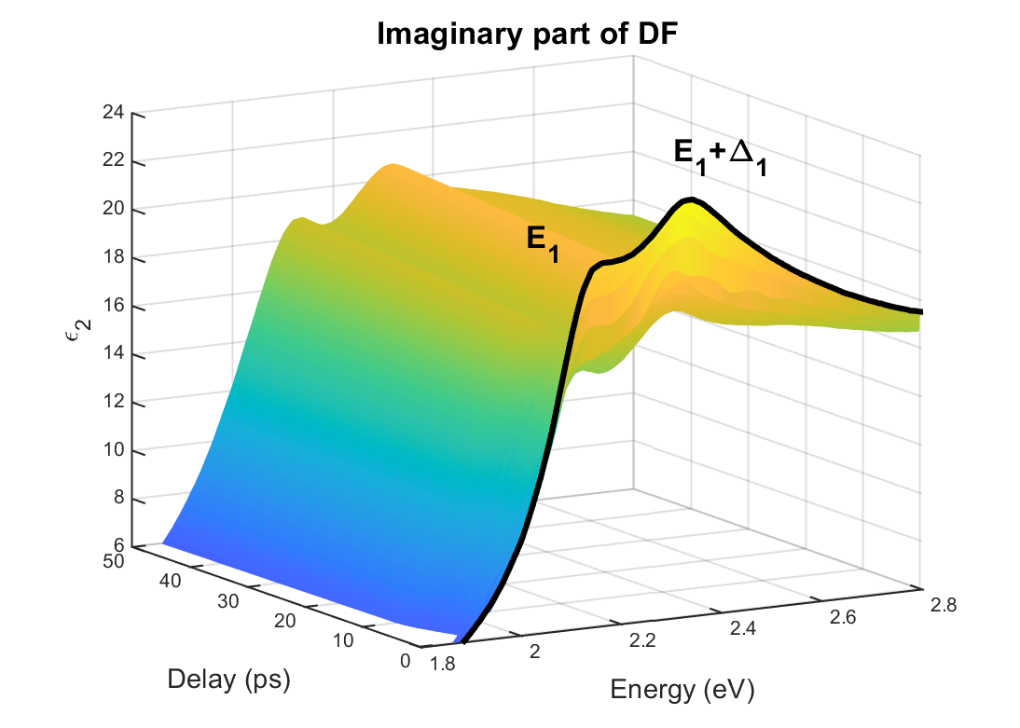
Dielectric function of Ge
The shape of the dielectric function near the critical points E₁ and E₁+Δ₁ requires a better description.
Existing ab initio expressions are inadequate due to the omission of excitonic effects.
Recent efforts that employ more sophisticated techniques are still not ideal.
A closed form model can help us understand other physics such as ultrafast phenomena.
M. Cardona and F. H. Pollak, in The Physics of Optoelectronic Materials, edited by W. Alberts (Academic, New York 1971), p. 81.
P. E. Trevisanutto et al., Phys. Rev. B 87, 205143 (2013).
B. A. Barker et al., Phys. Rev. B 106, 115127 (2022).
Notes:
The problem is that previous ab initio calculations have only been able to provided a qualitative description of the dielectric function, as can be seen in this figure by Cardona and Pollak where the interaction between electron-hole pairs is ignored.
More recent work using time-dependent density functional theory, which includes exchange-correlation effects, has led to a calculated dielectric function that matches experimental results more closely. Moreover, state-of-the-art methods calculations such as GW+Bethe–Salpeter equation have provided calculations able to resolve the E₁ and E₁+Δ₁ critical points (at least for GaSb). Unfortunately, these calculations not only require a significant amount of computing power but still fall short of a good quantitative description of the DF.
In following section, we aim to provide a close form expression for the DF that is not only much more computationally efficient but provides better results than previous efforts. Furthermore, given the compact form of the theory, it can easily be adapted to other materials of interest and more importantly for us, it provides a better understanding of ultrafast phenomena.

Slide 10
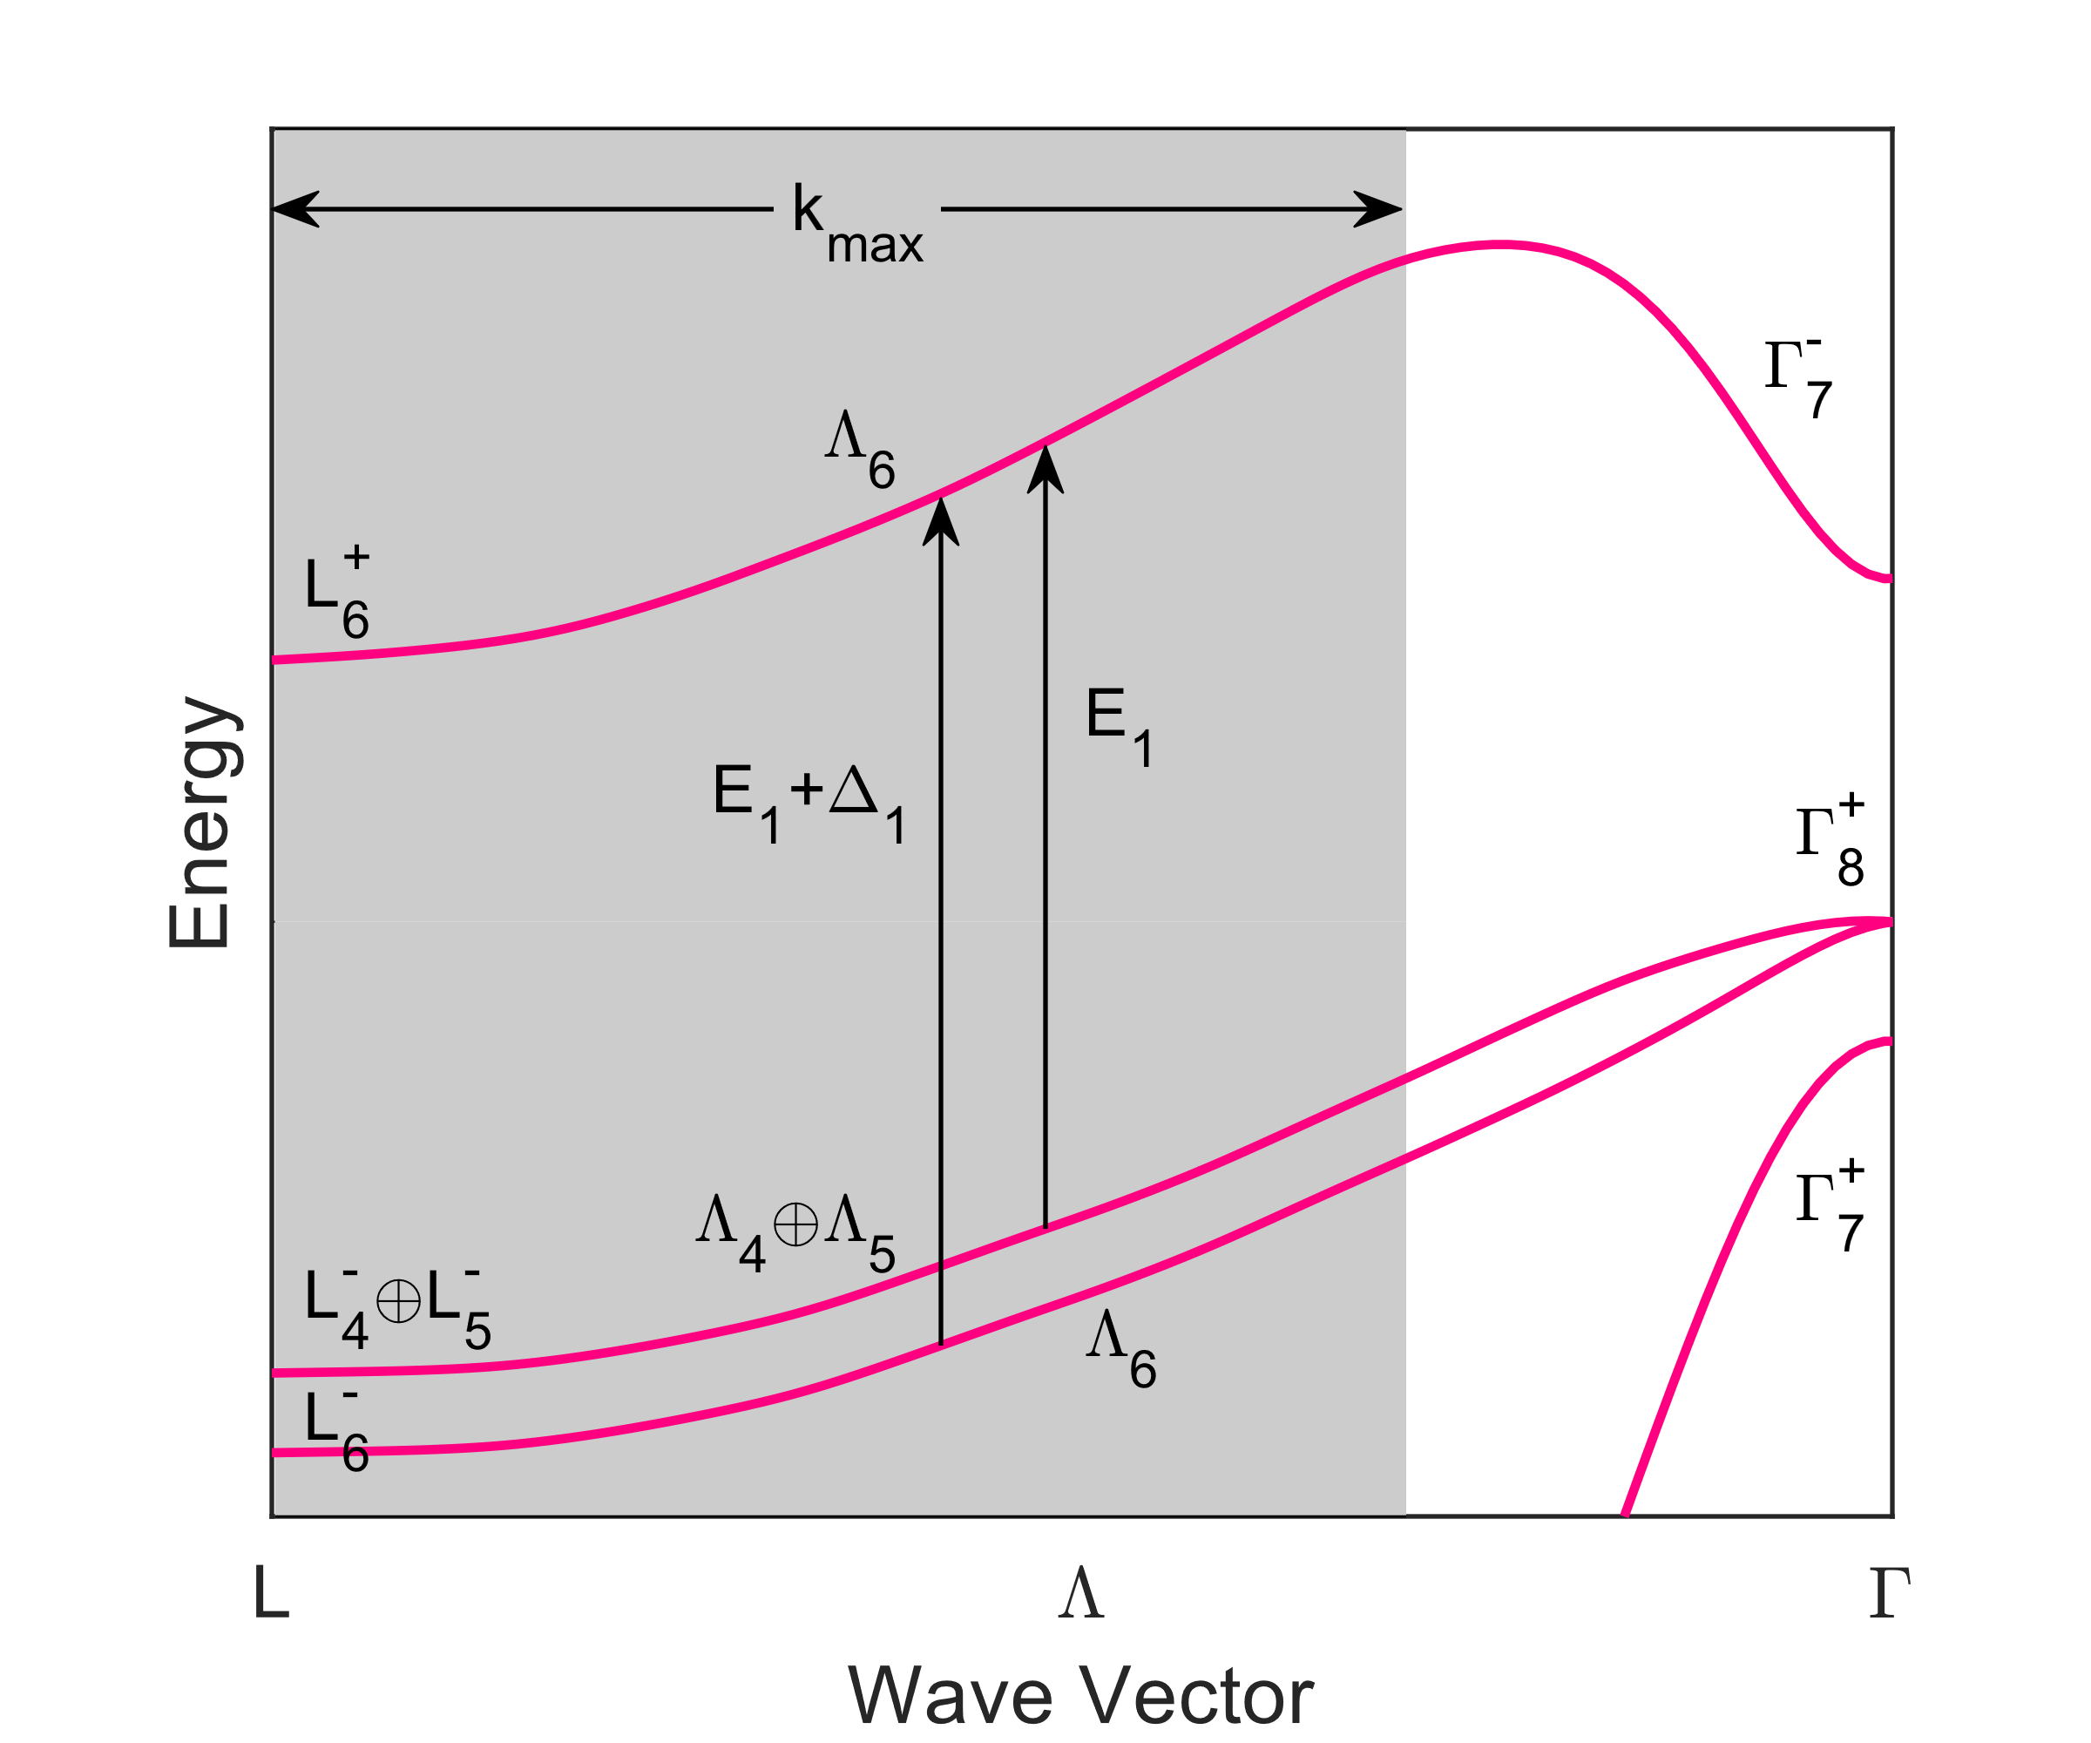
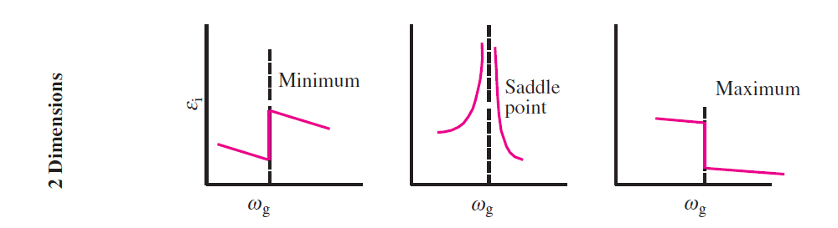
E₁ and E₁+Δ₁ critical points
2D van Hove singularities
In the parabolic approximation and with bands at the L-valley ($L_{6}^{+}$ and $L_{4}^{−}⊕L_{5}^{−}$), the dielectric function in cylindrical coordinates is
$$ε_{2}\left(E\right)=\left(\frac{1}{4πε_{0}}\right)\frac{4π^{2}e^{2}ℏ^{2}{\overline{P}}^{2}}{3m_{0}^{2}E^{2}}\iiint{\frac{k_{ρ}dk_{ρ}dk_{φ}dk_{z}}{4π^{3}}δ\left[E_{1}+\frac{ℏ^{2}k_{ρ}^{2}}{2μ_{⊥}}+\frac{ℏ^{2}k_{z}^{2}}{2μ_{ ∥}}−E\right]}$$
Now we integrate up to the value in the BZ where $μ_{∥}→∞$ holds ($k_{max}$). We also multiply by the valley degeneracy (4 for the L-valley).
2D $M_{0}$
minimum
Kramers-Kronig transformation:
$$ε_{1}^{(E_{1})}\left(E\right)=−\left(\frac{1}{4πε_{0}}\right)\frac{16e^{2}{\overline{P}}^{2}μ_{⊥}k_{max}}{3m_{0}^{2}E^{2}}ln\left(\frac{E_{1}^{2}−E^{2}}{E_{1}^{2}}\right)$$
$$ε_{2}^{(E_{1})}\left(E\right)=\left(\frac{1}{4πε_{0}}\right)\frac{16e^{2}{\overline{P}}^{2}μ_{⊥}k_{max}}{3m_{0}^{2}E^{2}}H(E_{1}−E)$$
Without broadening!
P. Yu and M. Cardona, Fundamentals of Semiconductors (Springer, Berlin, 1996).
M. Cardona, in Atomic Structure and Properties of Solids, edited by E. Burstein (Academic, New York, 1972), p. 514.
Notes:
The E₁ and E₁+Δ₁ critical points occur in the [111]-direction (or the Λ-direction) or the Brillouin zone. They are typically categorized as a M₀ minimum van Hove singularities in 2-dimensions. The shape of the dielectric function for these type of singularities have a step-like form.
We can calculate the dielectric function for transitions at the bottom of the L-valley using Fermi’s golden rule. If we do this, we obtain the expected Heaviside step function for ε₂. Its real part can be calculated with a Kramer-Kronig transformation, shown in this expression. Unfortunately, this expression completely ignores the interaction between electron-hole pairs. It ignores excitonic effects.
As a small sidenote: While we are integrating over k_{max}, (the grey region), the reduced masses we are using are the ones at the bottom of the L-valley, which might not necessarily be the same in the Λ-direction, where inter-band transitions also take place.

Slide 11
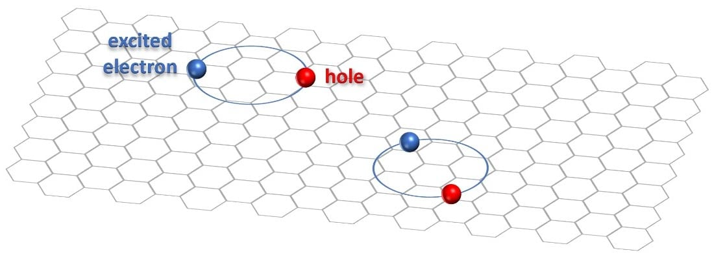
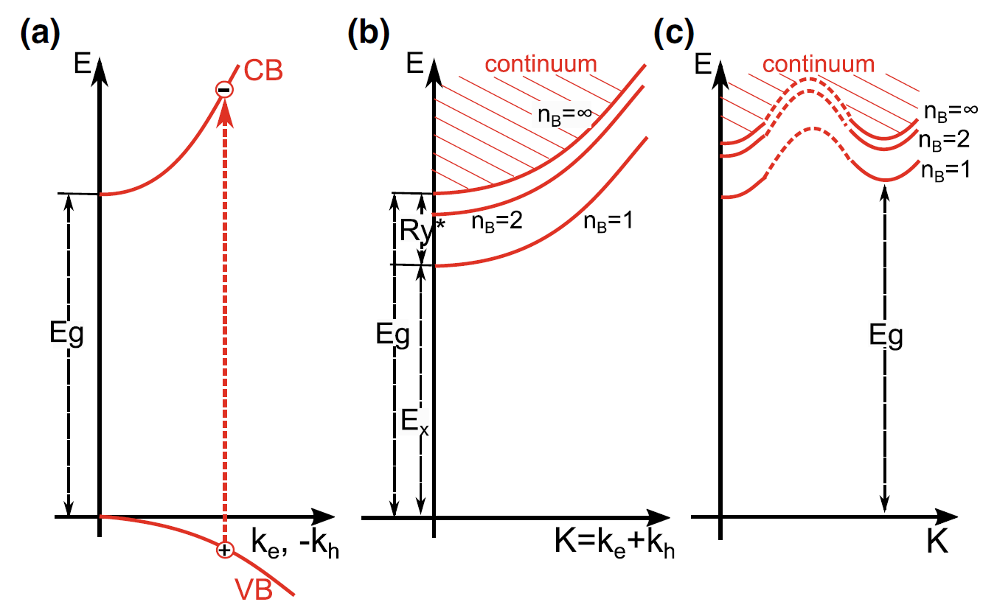
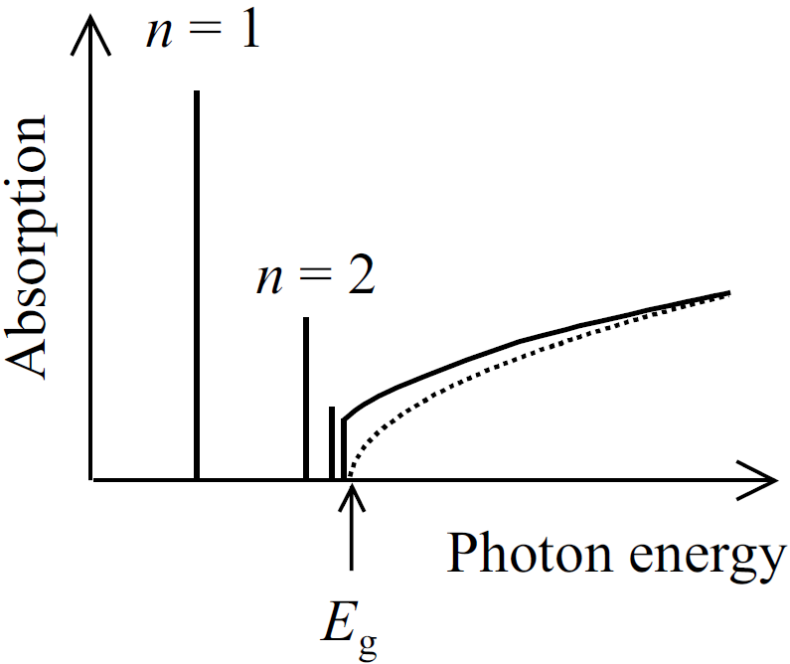
Wannier excitons
$$E_{ex}=E_{g}−\frac{R}{n^{2}}+\frac{ℏ^{2}{\vec{K}}^{2}}{2M}$$
$$M=m_{e}+m_{h}$$
$$\frac{1}{μ}=\frac{1}{m_{e}}+\frac{1}{m_{h}}$$
$$\vec{K}={\vec{k}}_{e}+{\vec{k}}_{h}$$
Dispersion relation of the excitons:
The formation of a quasi-particle of an electron and a hole bound together in a hydrogen-like system.
$$ε_{2}^{(3D)}\left(E\right)=\frac{A}{E^{2}}\left[\underset{Discrete}{\underbrace{\sum_{n=1}^{∞}{\frac{4πR^{3/2}}{n^{3}}δ\left(E−E_{g}+\frac{R}{n^{2}}\right)}}}+\underset{Continuum}{\underbrace{\frac{2π\sqrt{R}H\left(E−E_{g}\right)}{1−e^{−2π\sqrt{R/(E−E_{g})}}}}}\right]$$
$$ε_{2}^{(2D)}\left(E\right)=\frac{A}{E^{2}}\left[\underset{Discrete}{\underbrace{\sum_{n=0}^{∞}{\frac{4R}{{(n+1/2)}^{3}}δ\left(E−E_{g}+\frac{R}{{(n+1/2)}^{2}}\right)}}}+\underset{Continuum}{\underbrace{\frac{2H\left(E−E_{g}\right)}{1−e^{−2π\sqrt{R/(E−E_{g})}}}}}\right]$$
Binding energy of the exciton:
$$R^{(3D)}=\frac{μ}{ε_{st}^{2}}Ry$$
$$R^{(2D)}=\frac{4μ}{ε_{st}^{2}}Ry$$
Direct gap Semiconductor
Indirect gap Semiconductor
R. J. Elliot, Phys. Rev. 108, 1384 (1957).
M. Shinado & S. Sugano, J. Phys. Soc. Jpn. 21, 1936 (1966).
H. Kalt, C. F. Klingshirn, Semiconductor Optics 1 (Springer, 2019).
Notes:
Just for a bit of context, excitons are electron-hole pairs bound together in a hydrogen-like system. And, just like a hydrogen atom, excitons have a set of discrete states. In this case, however, its binding energy gets modified by the masses of the electrons and holes (which are used to calculated the reduced effective mass), as well as the high dielectric constant of the medium (or the static dielectric constant). Excitons have two distinct states: discrete and continuum states. This figure shows the discrete states absorption below the bandgap and the continuum absorption.
Here we see the expressions for the optical response for excitons. The upper one is for 3D excitons, first published by Elliot in 57’. For 2D excitons was published by Shinado & Sugano in 66’ (shown below). They have similar forms, where a shared amplitude multiplies both absorption states: the discrete and continuum. With the main difference being the good quantum number.

Slide 12
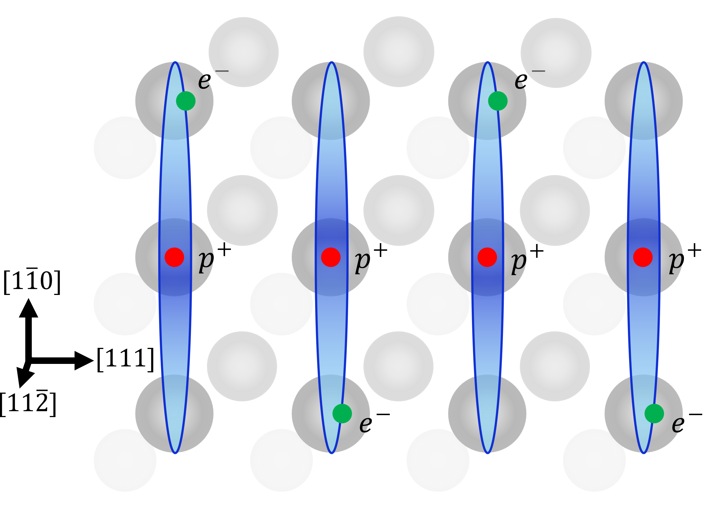
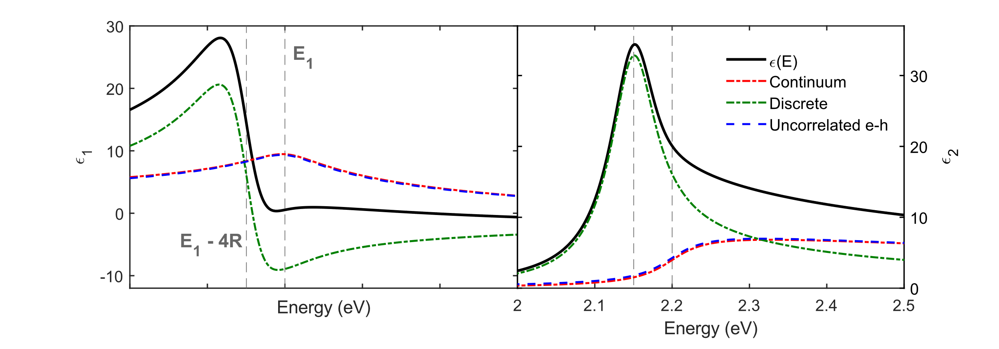
2D Excitons
$$0$$
2D JDOS:
$$E_{CV}\left(\vec{k}\right)=E_{g}+\frac{ℏ^{2}}{2}\left(\frac{k_{x}^{2}+k_{y}^{2}}{μ_{⊥}}+\frac{k_{z}^{2}}{μ_{∥} }\right)$$
Adding broadening to the uncorrelated electron-hole pair DF:
$$ε^{un}(E)=\frac{A^{(E_{g})}}{E^{2}}ln\left[\frac{2\left(E_{g}−iΓ−E\right)}{E_{g}−iΓ}\right]$$
Tanguy 2D exciton DF:
$$ε^{2D}\left(E\right)=\frac{A^{(E_{g})}}{π{\left(E+iΓ\right)}^{2}}\left\{g_{a}\left[ξ(E+iΓ)\right]+g_{a}\left[ξ(E+iΓ)\right]−2g_{a}\left[ξ(0)\right]\right\}$$
$$ξ\left(z\right)=\sqrt{R/(E_{g}−z)} , g_{a}\left(ξ\right)=2lnξ−2ψ\left(1/2−ξ\right)$$
Binding energy:
$$R=\frac{4μ_{⊥}}{ε_{st}^{2}}Ry$$
Continuum absorption and uncorrelated e-h overlap.
J, Humlíček, Phys. Stat. Solid. (b) 77, 731 (1976).
C. Tanguy, Solid State Commun. 98, 65 (1996).
Notes:
In the case of the critical points E₁ and E₁+Δ₁, given the large longitudinal reduced mass of these transitions, the excitons are confined to a 2D plane. Therefore, we need the optical response of 2D excitons. For excitons in 2D, Tanguy was able to provide a close form expression for the dielectric function by incorporating broadening to the previous expression by Shinado & Sugano.
Shown below are the real and imaginary parts of the dielectric function. In black is Tanguy’s expression for 2D excitons. In green is its corresponding discrete state absorption and in red is the continuum state absorption. Notice the overlap between this continuum state and the dielectric function for uncorrelated electron-hole pairs. From here, all is left is to find the amplitude and binding energy corresponding to germanium.

Slide 13
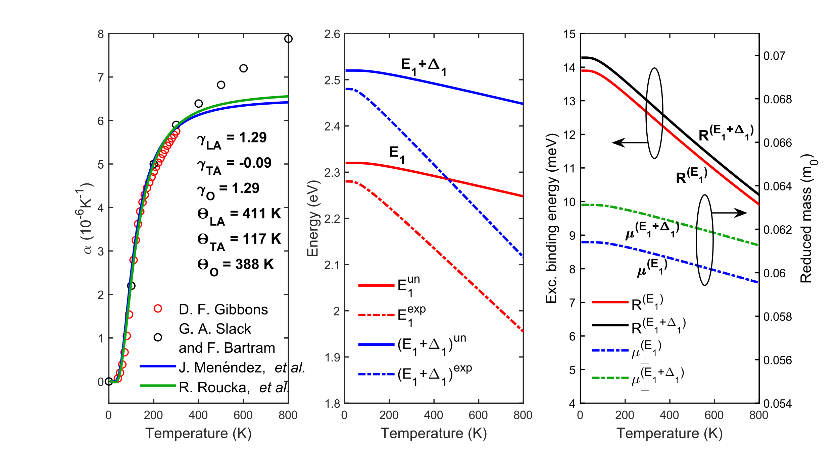
Amplitude and binding energy
Reduced masses come from a 6 band $k⋅p$-theory model.
The amplitude for the critical points are:
$$A^{(E_{1})}=\frac{4e^{2}{\overline{P}}^{2}μ_{⊥}^{(E_{1})}k_{max}}{3πε_{0}m_{0}^{2}}, A^{(E_{1}+Δ_{1})}=\frac{4e^{2}{\overline{P}}^{2}μ_{⊥}^{(E_{1}+Δ_{1})}k_{max}}{3πε_{0}m_{0}^{2}}$$
In the parabolic approximation
$$\frac{1}{μ_{⊥}^{(E_{1})}}=\frac{{\overline{P}}^{2}}{m_{0}}\left[\frac{2}{E_{1}^{u}}+\frac{1}{{\left(E_{1}+Δ_{1}\right)}^{u}}\right], \frac{1}{μ_{⊥}^{(E_{1}+Δ_{1})}}=\frac{{\overline{P}}^{2}}{m_{0}}\left[\frac{1}{E_{1}^{u}}+\frac{2}{{\left(E_{1}+Δ_{1}\right)}^{u}}\right]$$
and amplitudes are
$$A^{(E_{1})}=\frac{4e^{2}E_{1}^{u}{\left(E_{1}+Δ_{1}\right)}^{u}k_{max}}{3πε_{0}\left[2E_{1}^{u}{\left(E_{1}+Δ_{1}\right)}^{u}+E_{1}^{u}\right]}$$
$$A^{(E_{1}+Δ_{1})}=\frac{4e^{2}E_{1}^{u}{\left(E_{1}+Δ_{1}\right)}^{u}k_{max}}{3πε_{0}\left[E_{1}^{u}{\left(E_{1}+Δ_{1}\right)}^{u}+2E_{1}^{u}\right]}$$
We must use unrenormalized energy
$$E_{E_{1},E_{1}+Δ_{1}}^{u}\left(T\right)=E_{E_{1},E_{1}+Δ_{1}}^{exp}\left(0 K\right)−3B{\left(\frac{∂E_{E_{1},E_{1}+Δ_{1}}^{exp}}{∂p}\right)}_{T}\int_{0}^{T}{α\left(θ\right)dθ}$$
Thermal expansion coefficient $α(T)$
$$α\left(T\right)=\frac{1}{a_{0}\left(T\right)}\frac{da_{0}\left(T\right)}{dT}.$$
Binding energy of the exciton:
$$R=\frac{4μ_{⊥}^{u}}{ε_{st}^{2}(T)}Ry$$
C. Emminger et al., J. Appl. Phys. 131, 165701 (2022).
S. Zollner et al., J. Vac. Sci. Technol. A 43, 012801 (2025).
J. Menéndez et al., Phys. Rev. B 98, 165207 (2018)
R. Roucka et al., Phys. Rev. B 81, 245214 (2010).
Notes:
The parameters specific to the material are the average matrix element P² and the reduced masses of the transitions. Since the values of the effective hole masses are unknown at the L-valley, we use this definition obtained from 6 band k.p theory calculation. If we use this definition, the matrix element cancels out and we only need the energy of the critical points. However, we must use the unrenormalized energy, rather than the experimental one. Using the unrenormalized energy incorporates the redshift due to thermal expansion, but not the self-energy due to the deformation-potential electron-phonon coupling. We obtain the unrenormalized energy with this expression. If we know the unrenormalized energies, then we know the reduced masses, the amplitude of the dielectric function, and the binding energy of the excitons. This is all we need to model the experimental data.

Slide 14
Experimental data & results

Slide 15
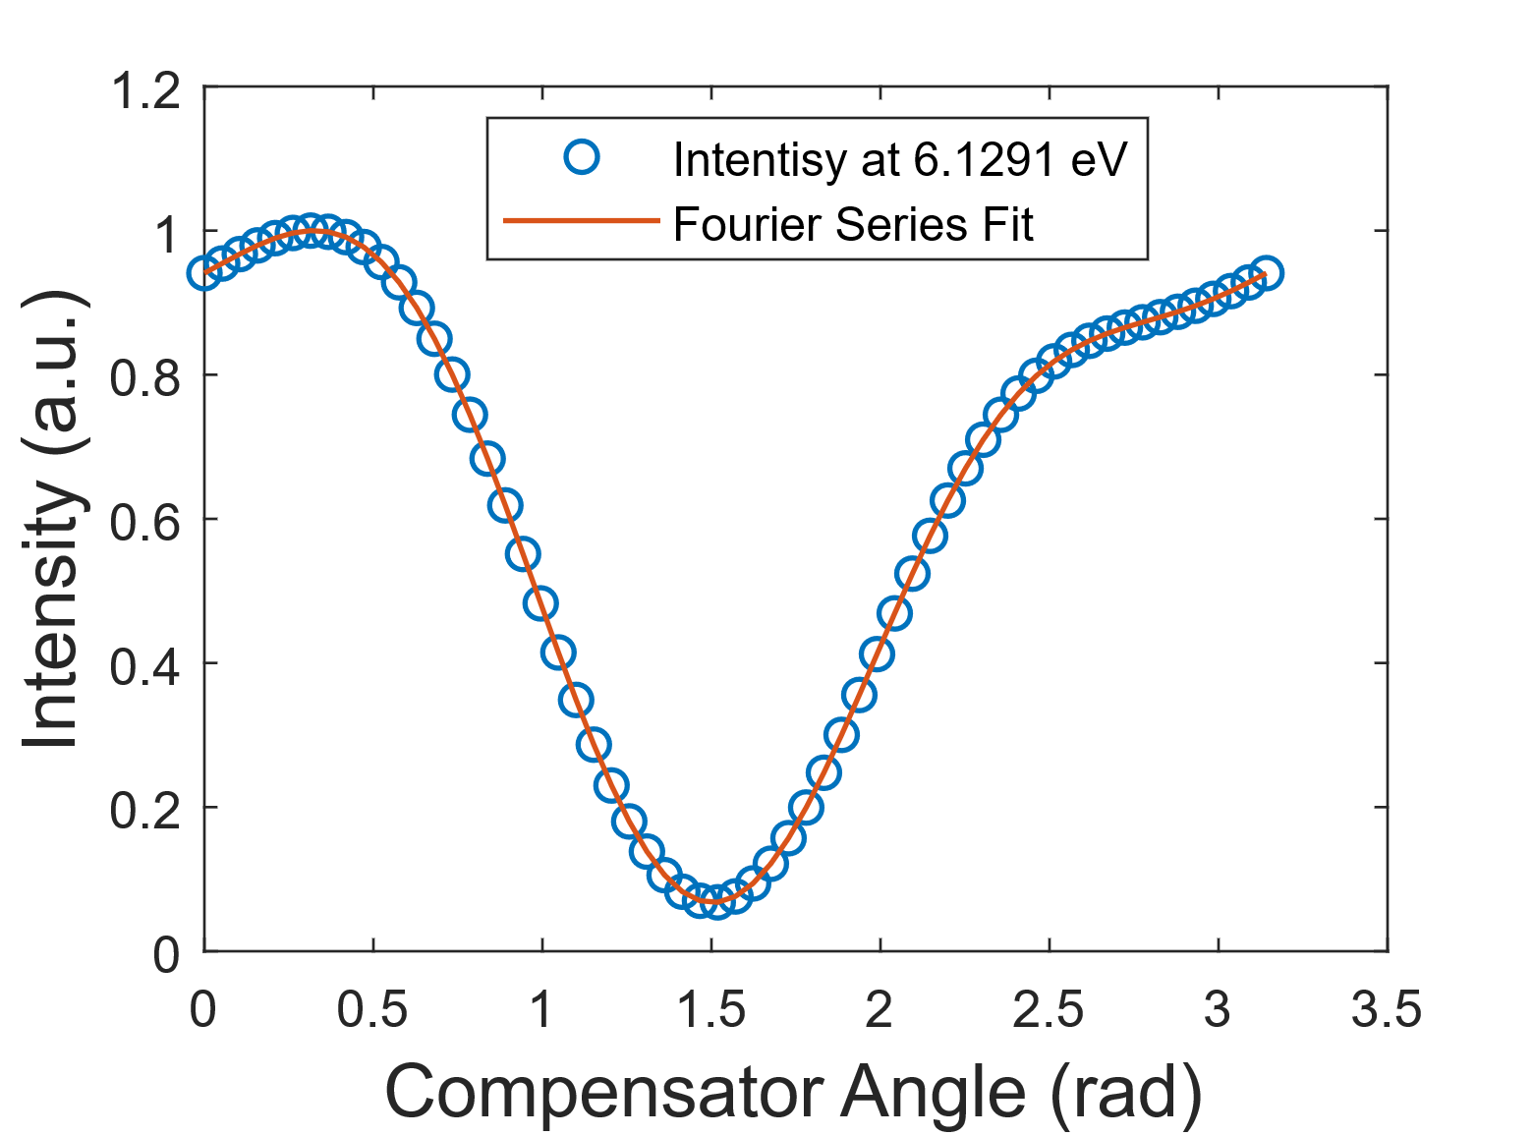
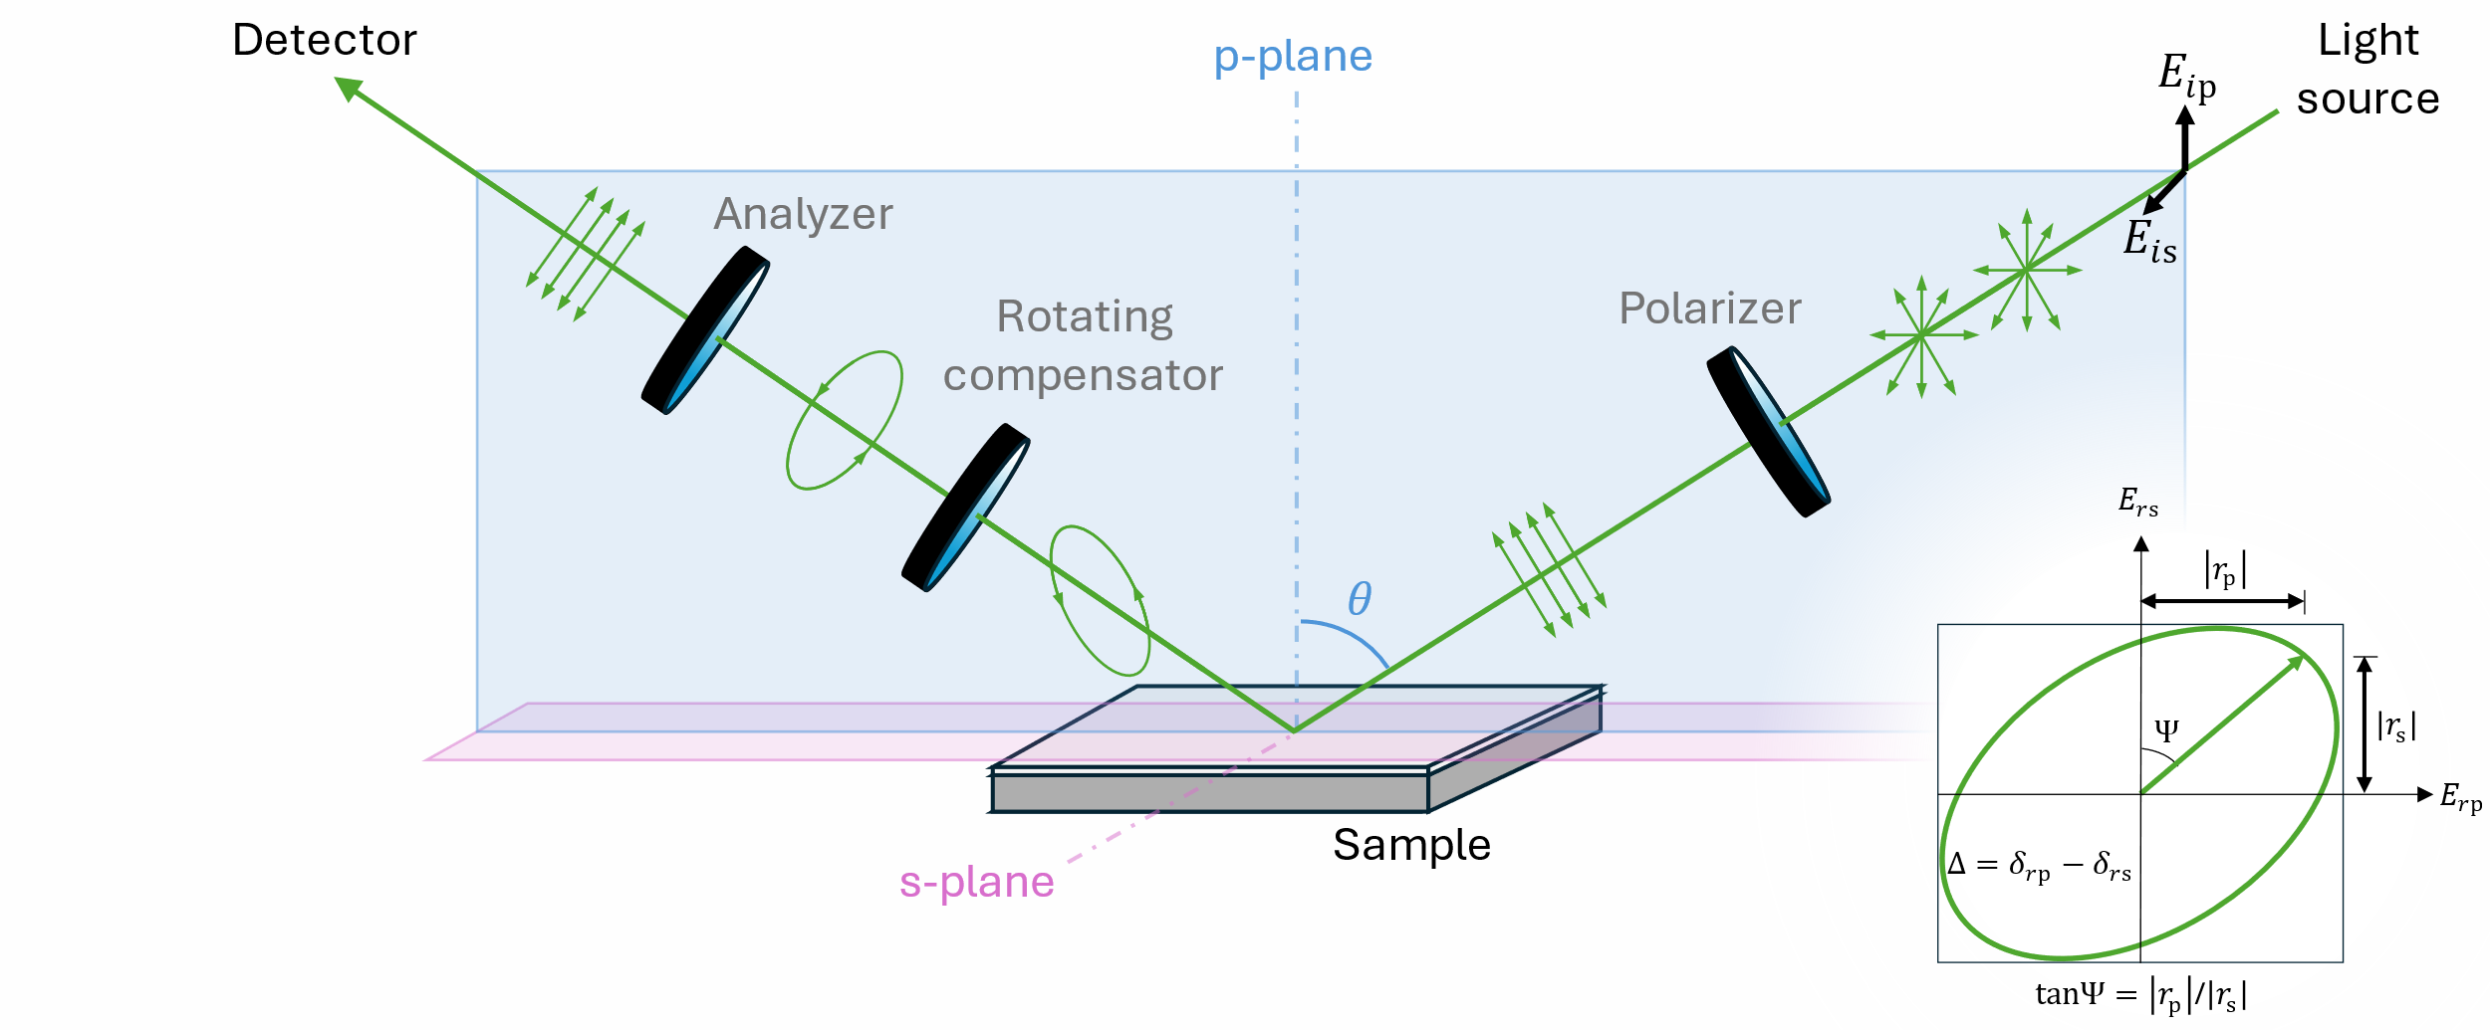


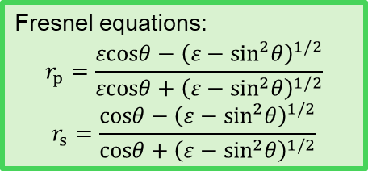
Spectroscopic ellipsometry
Fundamental equation of ellipsometry:
$$ρ=tanΨe^{iΔ}=\frac{r_{p}}{r_{s}}$$
Complex pseudo-dielectric function:
$$\left\langle ε\right\rangle =\sin^{2}θ\left[1+\tan^{2}θ\left(\frac{1−ρ}{1+ρ}\right)\right]$$
Fresnel equations:
$$r_{p}=\frac{εcosθ−{\left(ε−\sin^{2}θ\right)}^{1/2}}{εcosθ+{\left(ε−\sin^{2}θ\right)}^{1/2}}$$
$$r_{s}=\frac{cosθ−{\left(ε−\sin^{2}θ\right)}^{1/2}}{cosθ+{\left(ε−\sin^{2}θ\right)}^{1/2}}$$
RCE in Jones matrix/vector formalism:
$$L_{out}=AR(−A)R(C)CR(−C)SR(−P)PL_{in}$$
$$I\left(C\right)=I_{0}\left(α_{0}+α_{2}cos2C+β_{2}sin2C+α_{4}cos4C+β_{4}sin4C\right)$$
Ellipsometric angles:
$$tan2Ψ=−\frac{\sqrt{\frac{\left(α_{2}^{2}+β_{2}^{2}\right){\left(1−cosδ\right)}^{2}}{\sin^{2}δ}+4{\left(−α_{4}sin2P+β_{4}cos2P\right)}^{2}}}{2\left(α_{4}cos2P+β_{4}sin2P\right)}$$
$$tan2Δ=\left(\frac{1−cosδ}{2sinδ}\right)\frac{α_{2}sin2P−β_{2}cos2P}{2\left(α_{4}cos2P+β_{4}sin2P\right)}$$
H. Fujiwara, Spectroscopic Ellipsometry (John Wiley & Sons, 2007).
R. Kleim et al., J. Opt. Soc. Am. A 11, 2550 (1994).
Notes:
We need to measure the dielectric function of the material. To do this, we used spectroscopic ellipsometry. This technique consists of measuring the reflection coefficients of the material at an angle θ while modulating the polarization of both, the incident and reflected light.
In this particular configuration, the incident unpolarized light at a specific wavelength is sent through a polarizer. The component that is polarized in the plane of incidence is called p-ploarized, and parallel to this plane are s-polarized. After light reflects off the sample, it then goes through a retarder which we call a compensator, and another polarizer, which we call the analyzer. There needs to be a rotating optical component, which in this case is the compensator.
In the end, we measure an intensity as a function of the compensator angle. If we fit this intensity with a Fourier series, and obtain the Fourier coefficients, we can use them to obtain the ellipsometric angles Ψ and Δ. These ellipsometric angles are related to the reflection coefficients for s- and p-polarized waves through what is known as the fundamental equation of ellipsometry.
Dielectric function can be obtained from the reflection coefficients through Fresnel’s equations. However, what is obtained is a pseudo-dielectric function, rather than the actual dielectric function. The reason for this is that the obtained reflection comes from the sample as a whole. It does not distinguish if the sample is multilayered, if there is surface roughness, or if there are backside reflections. To extract the actual dielectric function some modeling is required.

Slide 16
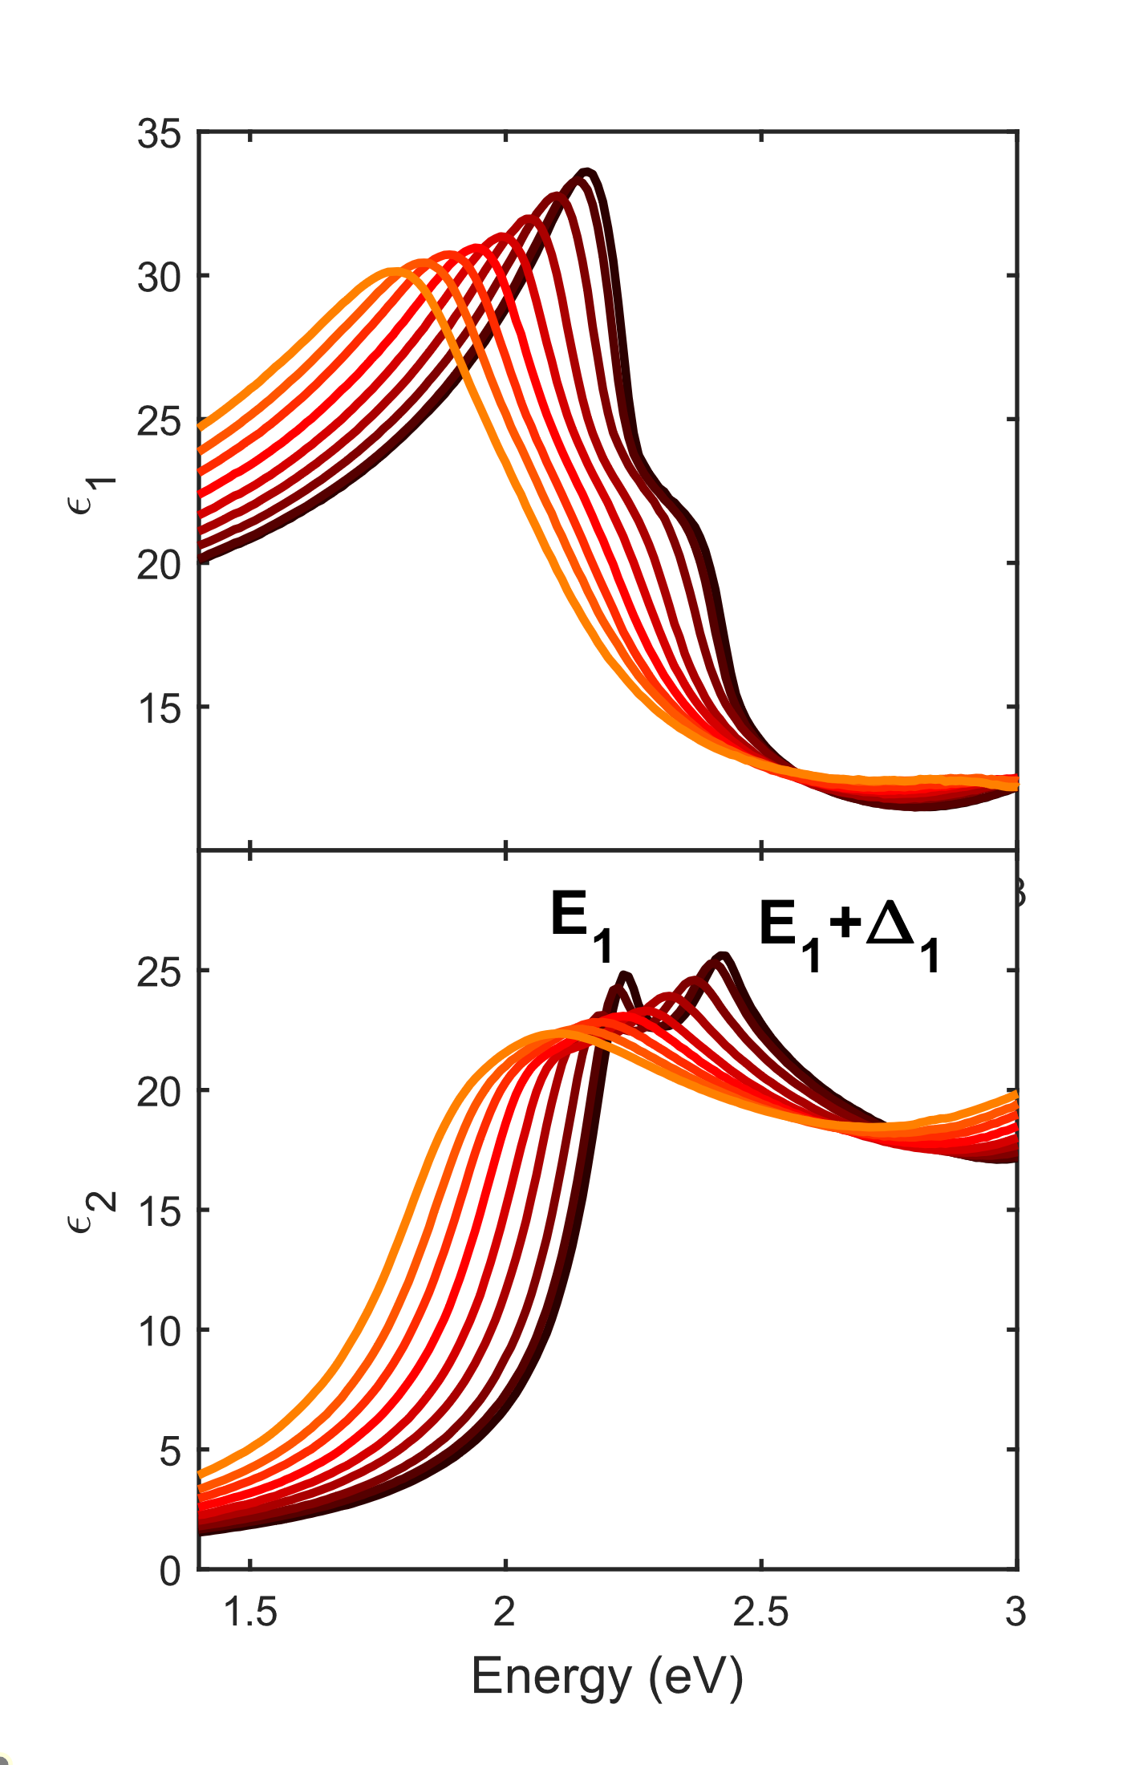
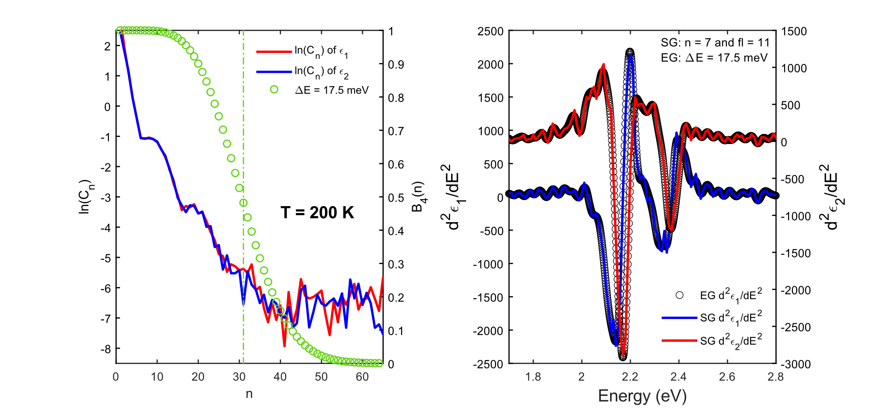
2nd Derivative fit
To fit energy and broadening, we performed a 2nd derivative analysis with a Savitzky-Golay and extended Gaussian digital filter.
Pt-by-pt fit to remove native oxide layer.
Temperature series from 4 K to 800 K
Fitting parameters:
$$\left[E_{1},Δ_{1},Γ^{\left(E_{1}\right)},Γ^{\left(E_{1}+Δ_{1}\right)},ε_{off}\right]$$
C. Emminger et al., J. Vac. Sci. Technol. B 38, 012202 (2020).
T. N. Nunley et al., J. Vac. Sci. Technol. B 34, 061205 (2016).
V. L. Le et al., J. Vac. Sci. Technol. B 37, 052903 (2019).
A. Savitzky and M. J. E. Golay, Anal. Chem. 36, 1627 (1964).
Notes:
To model the steady-state dielectric function, we used a temperature series measurement from 4 K to 800 K. To account for the native oxide layer, we used a GeO₂ model previously published to do a point-by-point fit and obtain the dielectric function of Ge.
To find the energy and broadening of the critical points, we fitted the second derivative of the model and experimental data. To obtain the derivative of the data, we used a digital filter with the extended Gauss kernel. To select the filter width, we decompose the original signal into its Fourier coefficients and we select the order according to the noise onset (higher order coefficients preserve the signal and riding the lower ones suppresses the noise).
We can also do the same derivative with a Savitzky-Golay filter. However, the extended Gauss filter has the advantage that it is not limited to the number of points of the experimental data.

Slide 17
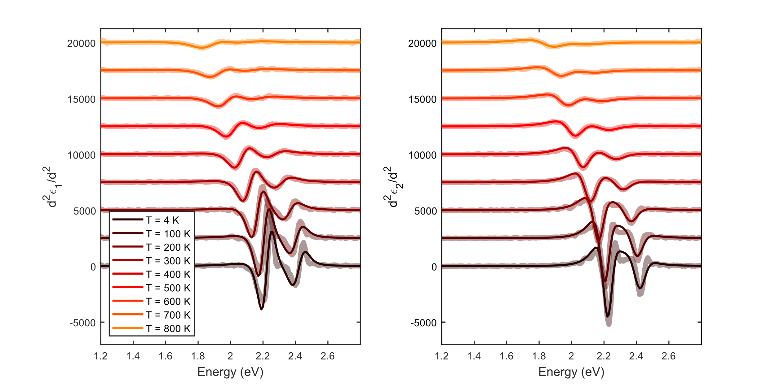
2nd Derivative fit
To fit energy and broadening, we performed a 2nd derivative analysis with a Savitzky-Golay and extended Gaussian digital filter.
Pt-by-pt fit to remove native oxide layer.
Temperature series from 4 K to 800 K
Fitting parameters:
$$\left[E_{1},Δ_{1},Γ^{\left(E_{1}\right)},Γ^{\left(E_{1}+Δ_{1}\right)},ε_{off}\right]$$
C. Emminger et al., J. Vac. Sci. Technol. B 38, 012202 (2020).
T. N. Nunley et al., J. Vac. Sci. Technol. B 34, 061205 (2016).
V. L. Le et al., J. Vac. Sci. Technol. B 37, 052903 (2019).
Notes:
Here are the fitted measurements from 4 K to 800 K, with five fitting parameters: energies, broadenings, and a ε₁ offset, to account for non-resonant contributions to the real part. The figure shows a good agreement with the experimental data.

Slide 18
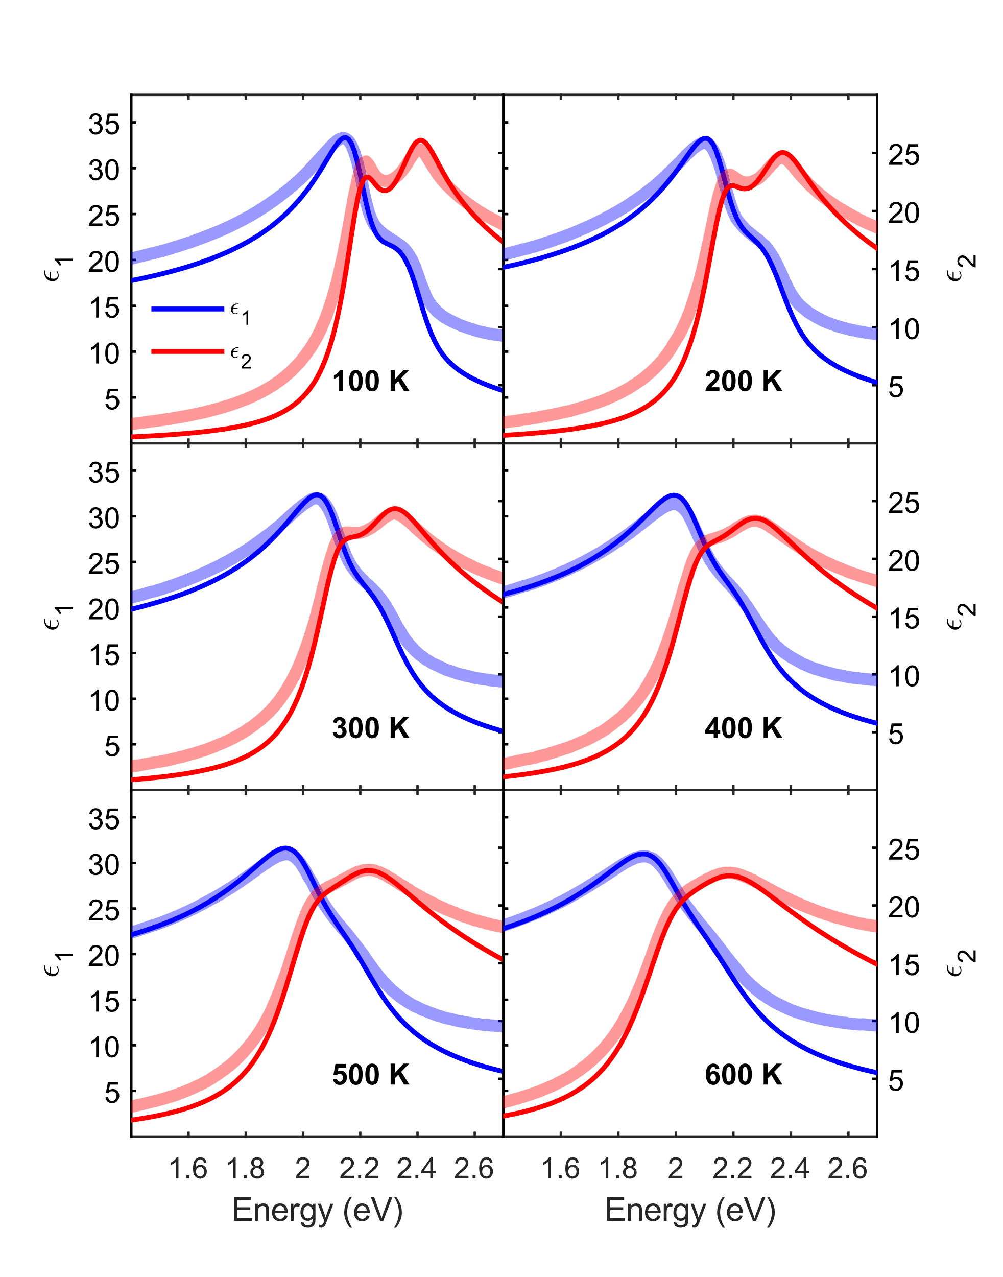
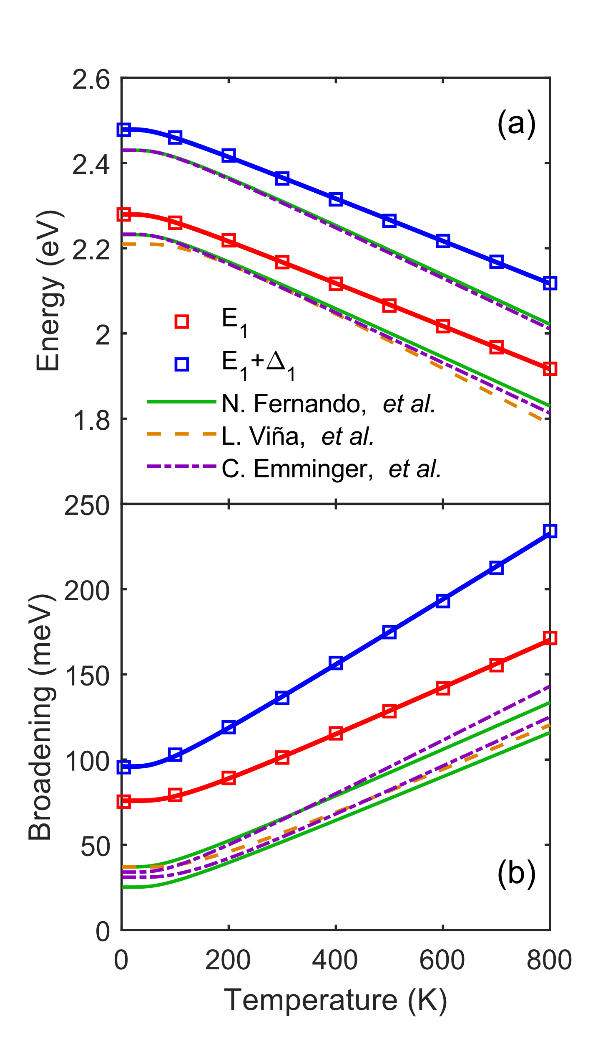
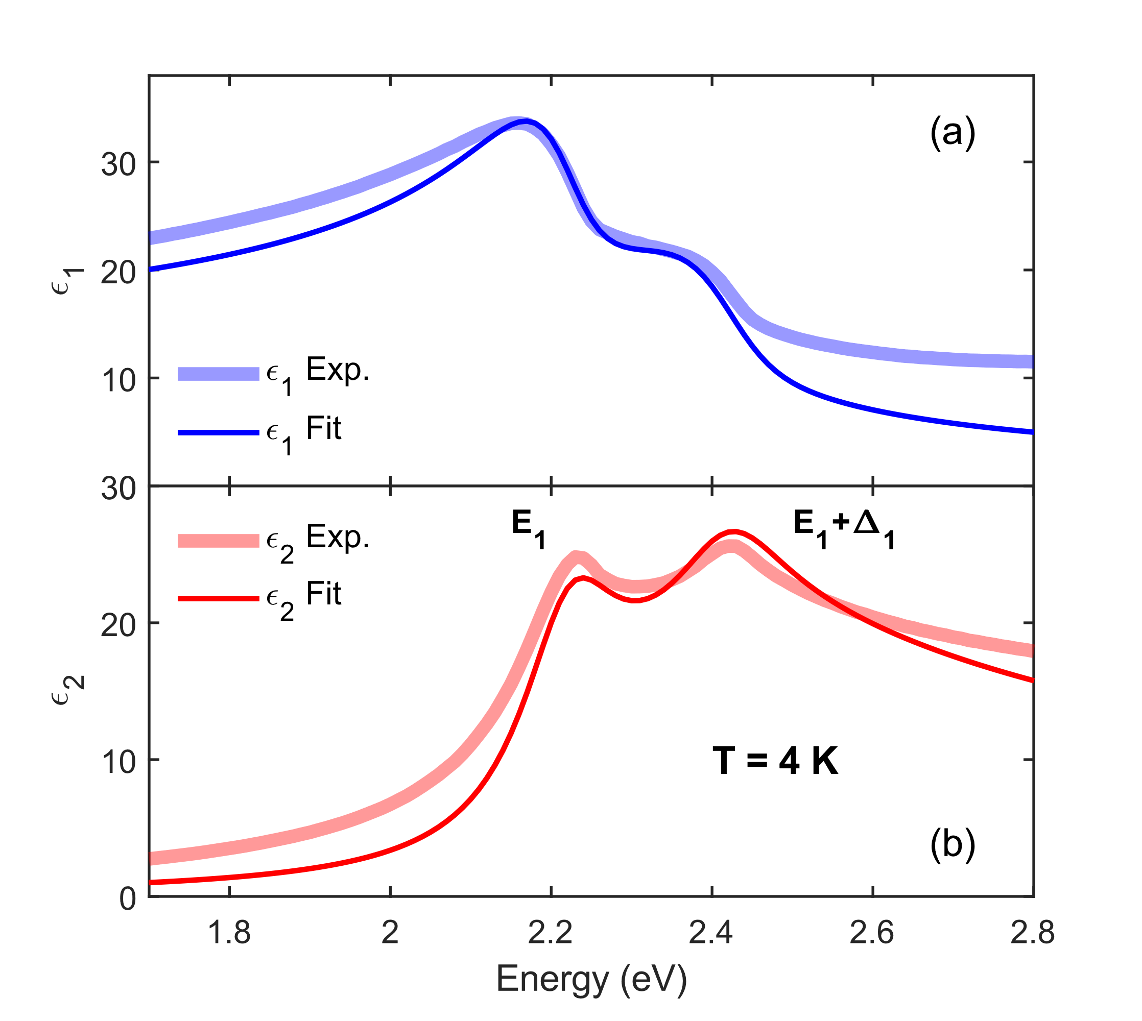
Dielectric function
Maximum absorption occurs at $E_{1}−4R$.
Offset added to the real part to account for additional CPs
Amplitude of ε₂ at E₁ is underestimated, whereas for E₁+Δ₁ is overestimated.
Mismatch of theory and model could be due to surface effects, $k_{max}$, or $μ^{(E_{1},E_{1}+Δ_{1})}$.
Missing E₀ CP at low energies
Missing E₀’ and E₂ CPs at high energies
C. Emminger et al., J. Vac. Sci. Technol. B 38, 012202 (2020).
L. Viña et al., Phys. Rev. B 30, 1979 (1984).
N. S. Fernando et al., Appl. Surf. Sci. 421, 905 (2017)
Notes:
Here are the results. It is evident from the figures that the model is in excellent agreement with the data near the critical points at all temperatures. The closed form expression for 2D excitons captures the shape and strength of the E₁ and E₁+Δ₁ absorption peaks very well.
We also obtained higher energies that previous characterizations of the critical points. This is because, in our model, the maximum absorption peak occurs at E₁ minus 4 times the binding energy. NOT at the transition energy.
At low and high energies, ε₂ is missing the contribution of other critical points, which explain the mismatch. At E₁, the amplitude of ε₂ seems to be smaller than it should be. Conversely, at E₁+Δ₁ the amplitude is larger. We attribute these shortcomings of the theory primarily to the reduced masses of the transitions.

Slide 19
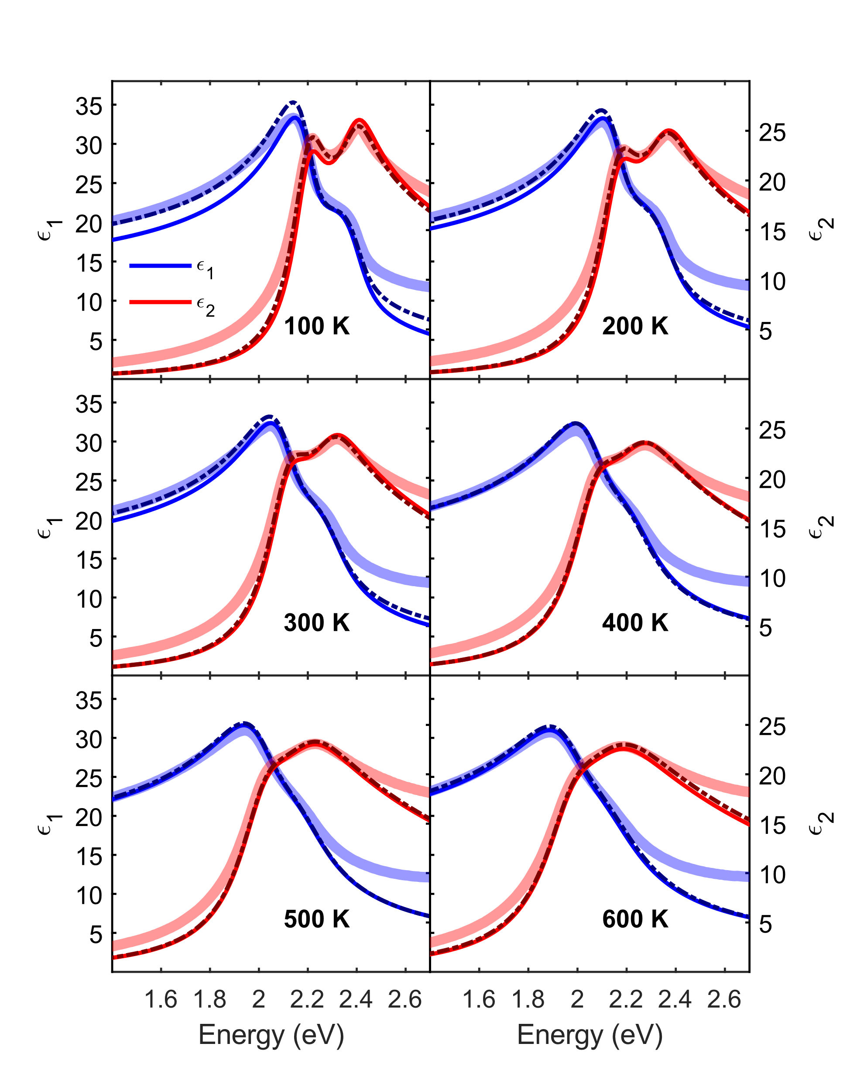
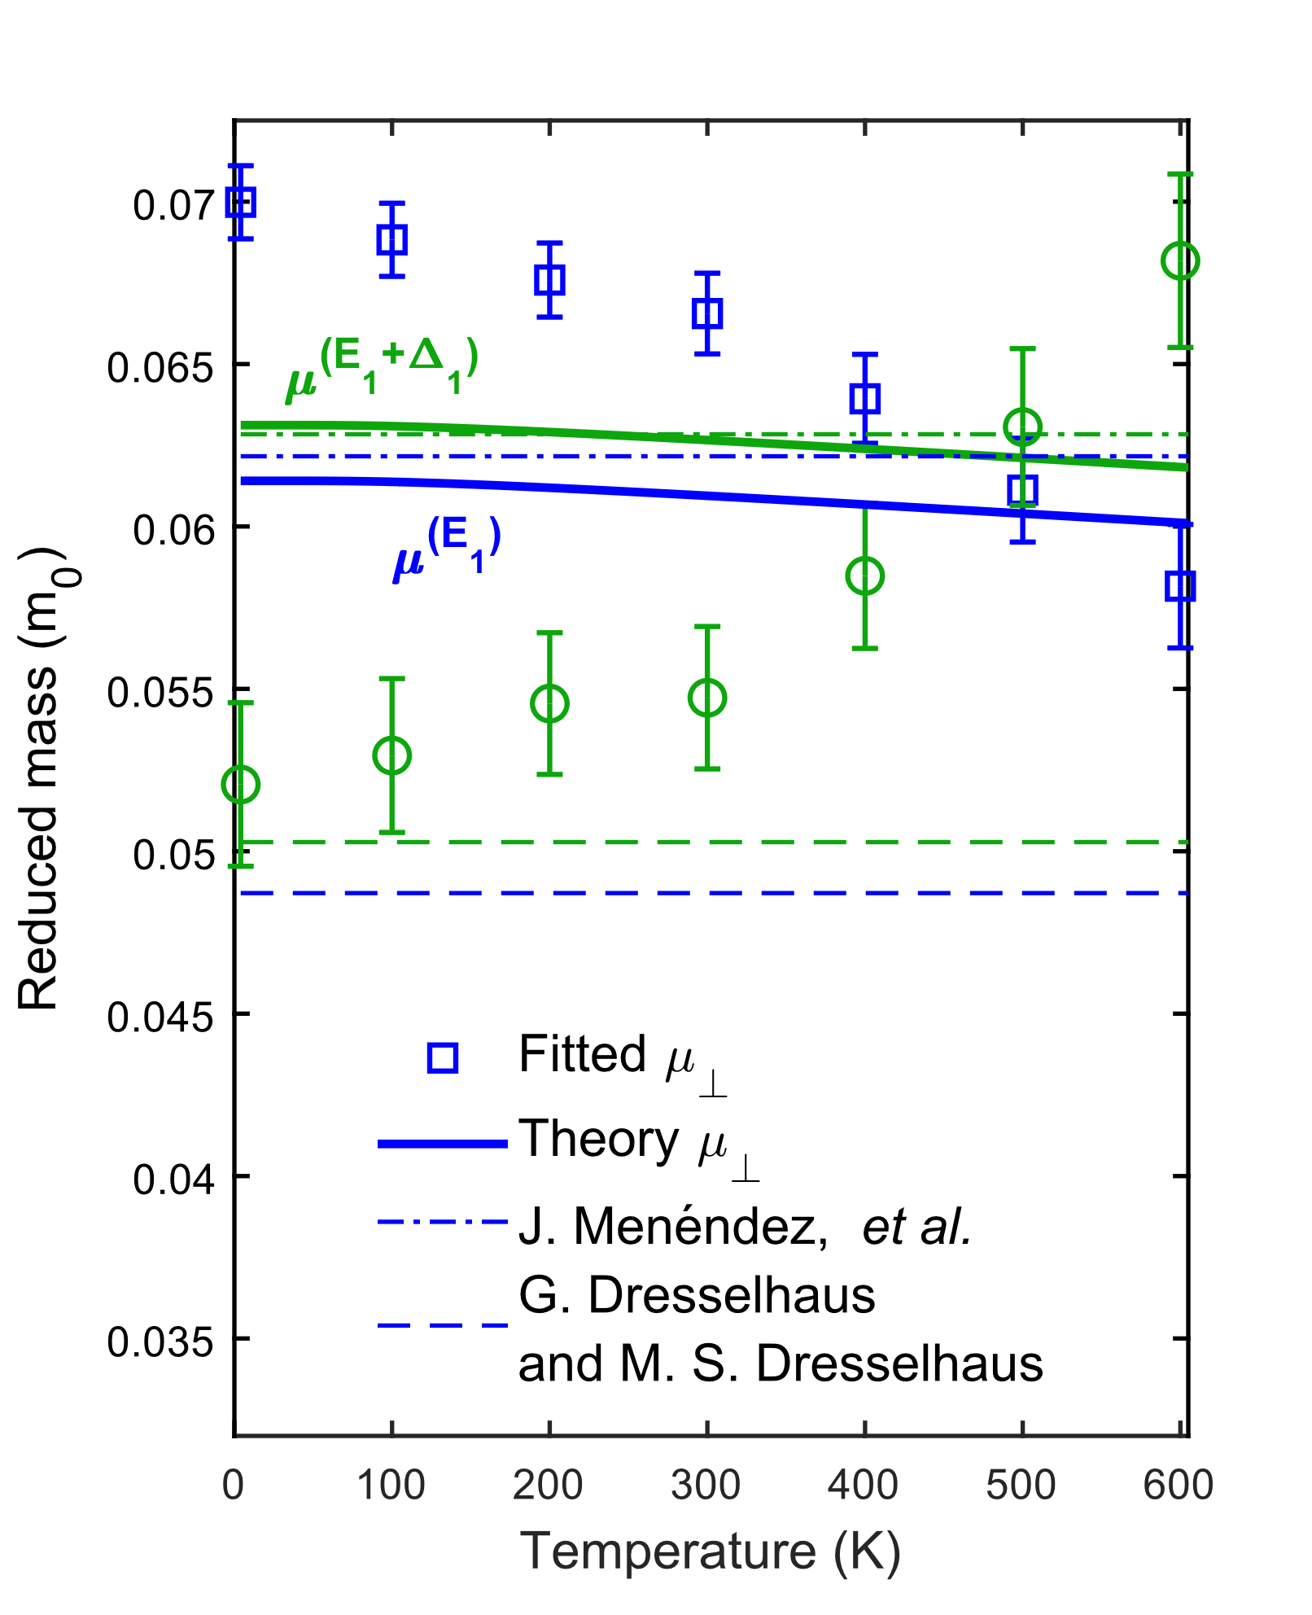
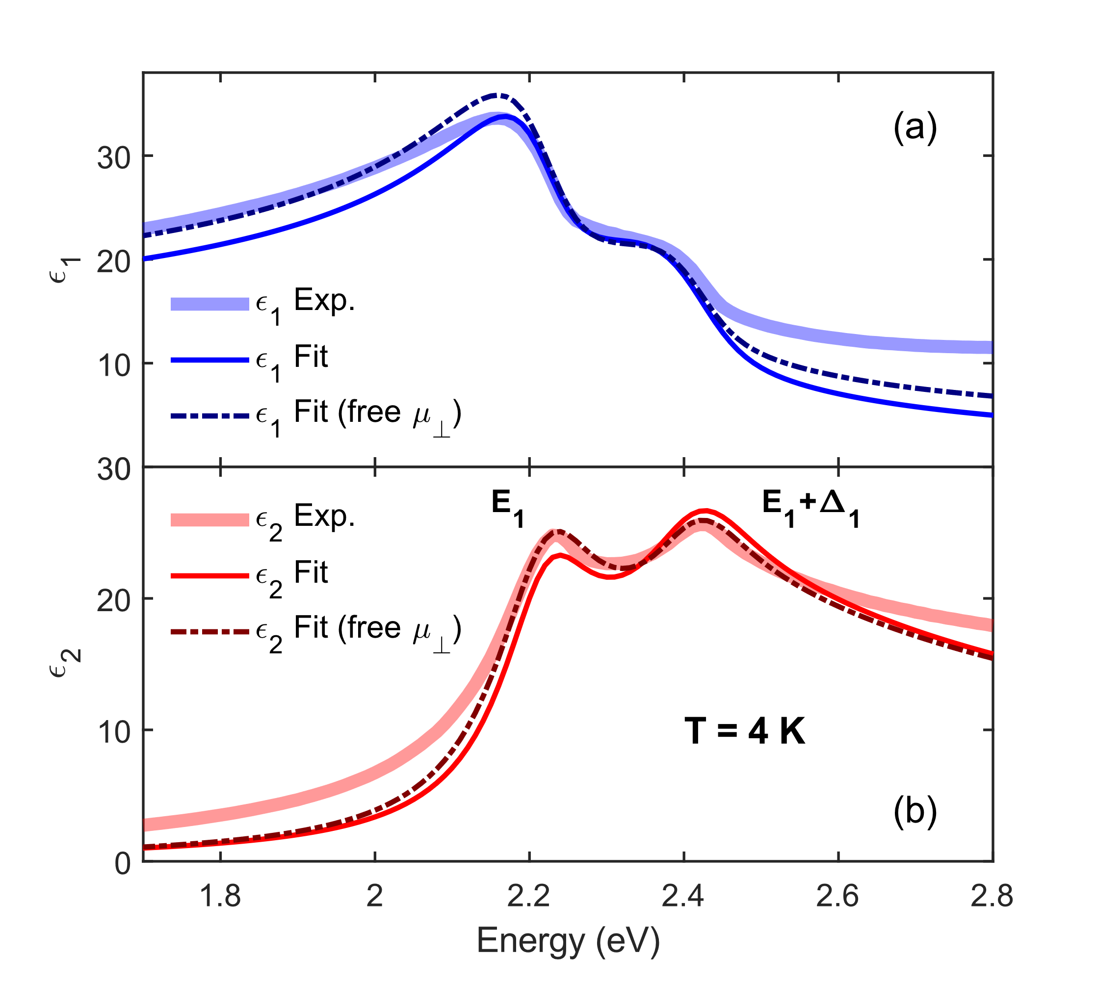
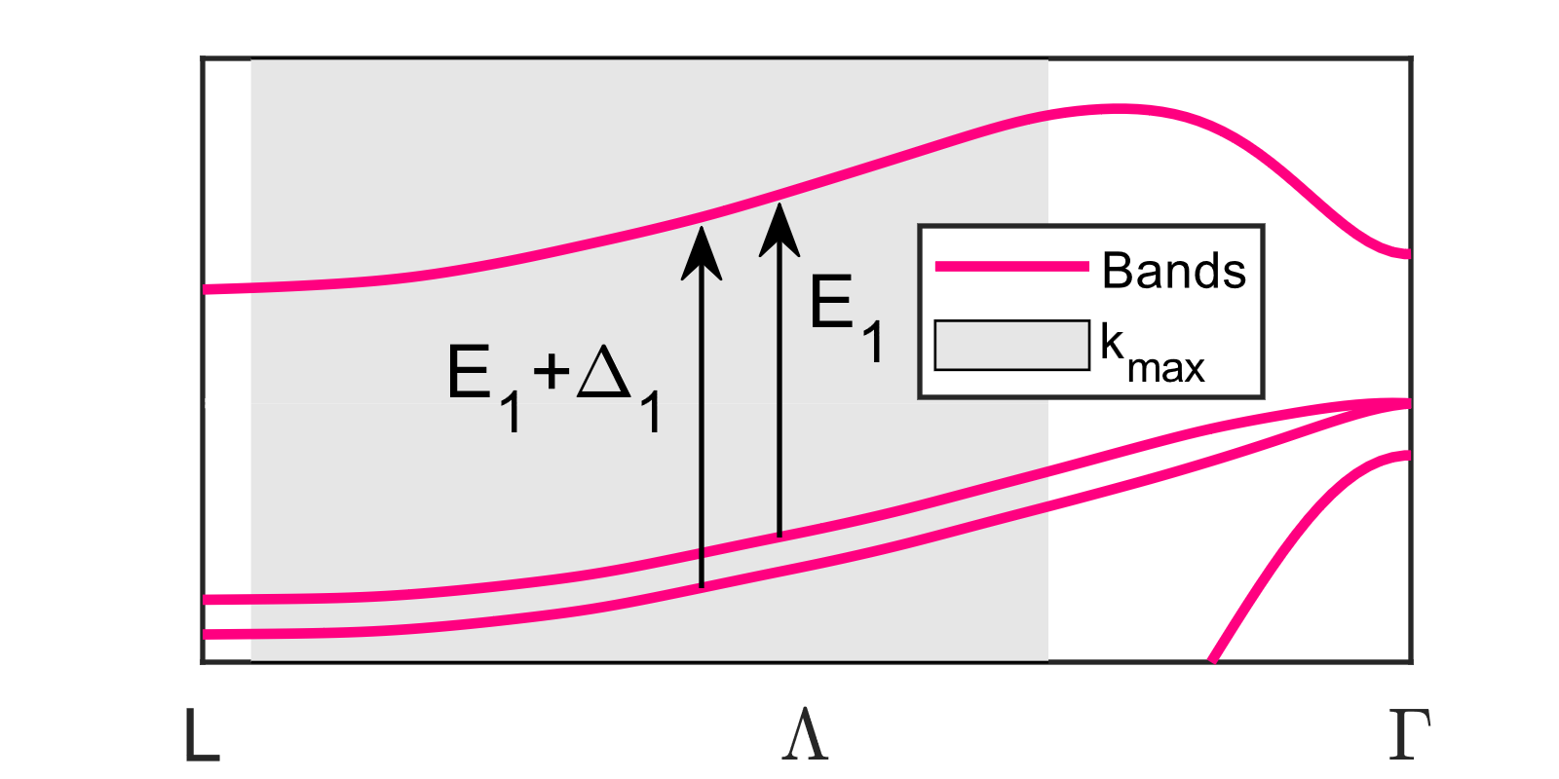
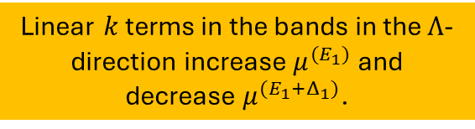
Dielectric function (fitted mass)
$μ^{(E_{1})}$is larger than $μ^{(E_{1}+Δ_{1})}$!
Linear $k$ terms in the bands in the $Λ$-direction increase $μ^{(E_{1})}$ and decrease $μ^{(E_{1}+Δ_{1})}$.
Fit can be improved if $μ^{(E_{1},E_{1}+Δ_{1})}$ is set as a fitting parameter.
G. Dresselhaus and M. S. Dresselhaus, Phys. Rev. 160, 649 (1967).
J. Menéndez et al., Phys Rev. B 98, 165207 (2018).
M. Cardona, Phys. Rev. B 15,5999 (1977).
Notes:
We can treat the reduced masses as free parameters and then refit the data. If we do this, the model agrees almost perfectly with the data. However, the reduced masses seem to be in disagreement with the literature values. More importantly, the mass of E₁ seems to be larger than for E₁+Δ₁, which is not what we see on previously published values.
Cardona had previously suggested that including linear k terms in the bands increases the mass for E₁ and decreases the mass of E₁+Δ₁. Especially in the Λ-direction, but not yet at the L-point. It is important to emphasize that the fitted values of the masses are purely empirical parameters and should not be overinterpreted. Future work should investigate the effects of these linear terms on the reduced masses.

Slide 20
Ultrafast measurements

Slide 21
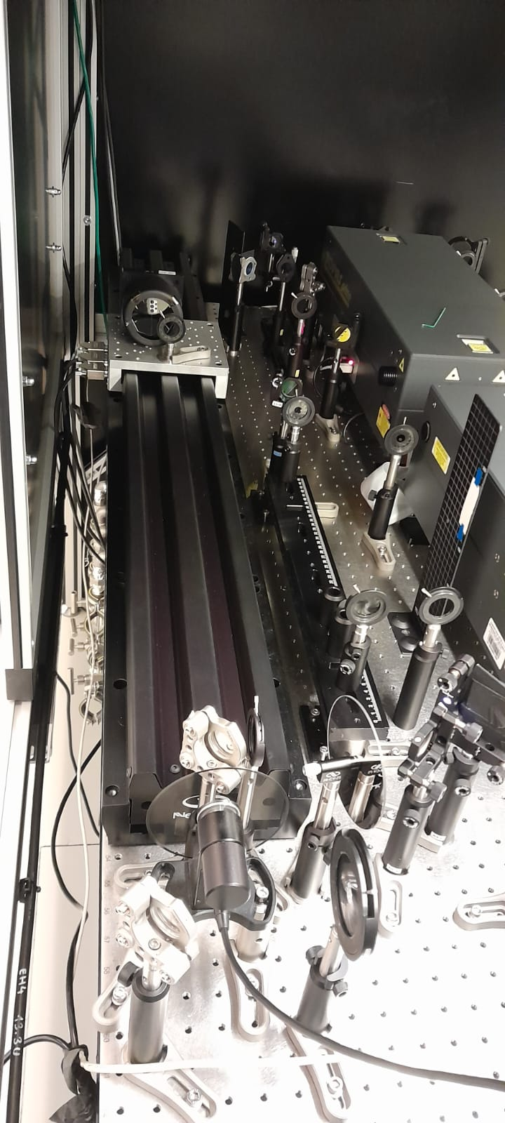
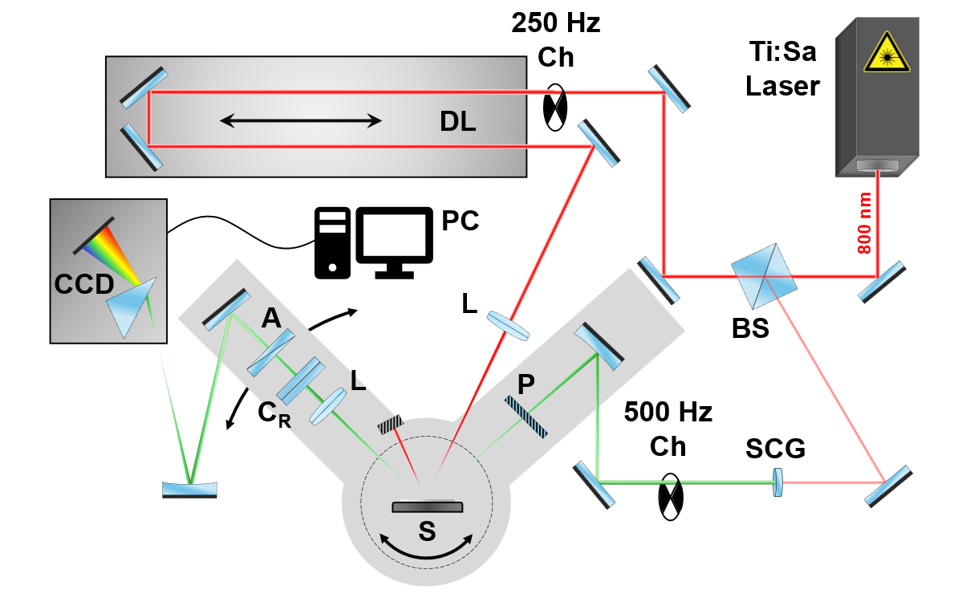

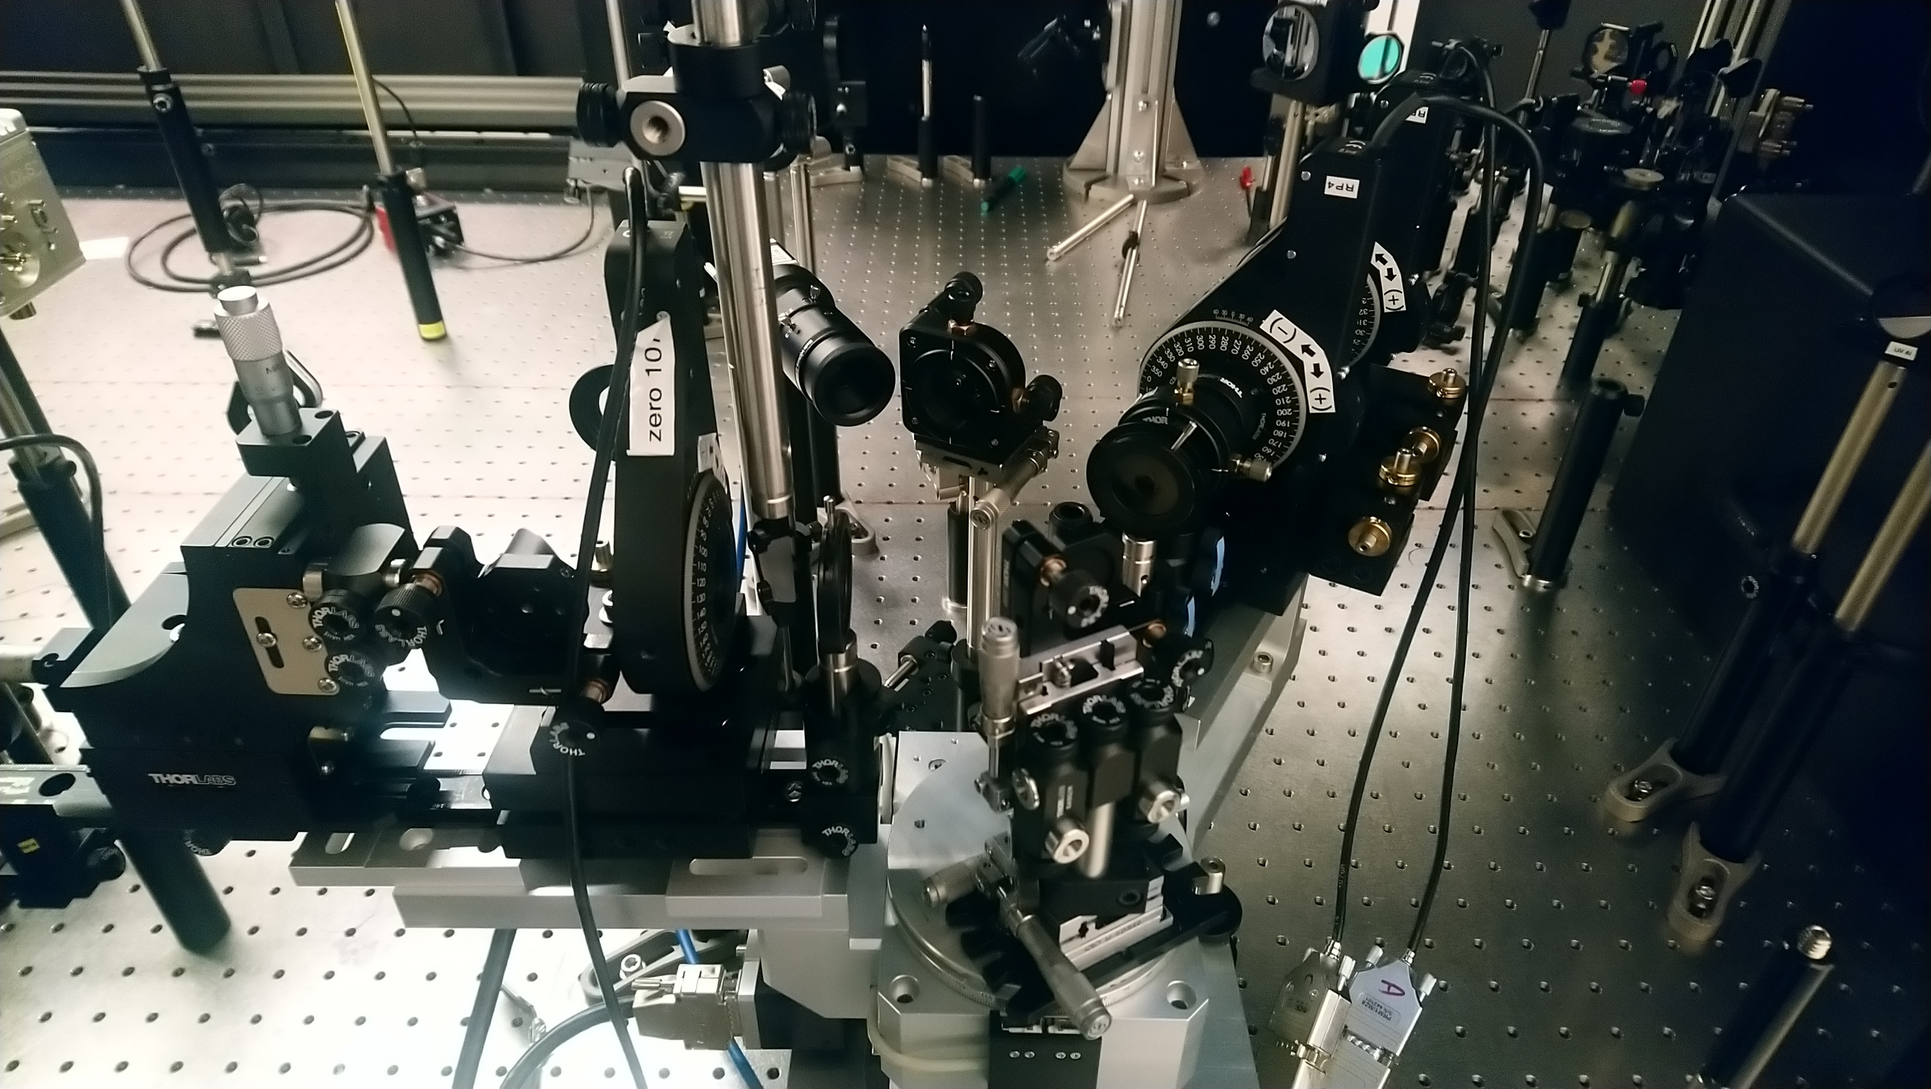
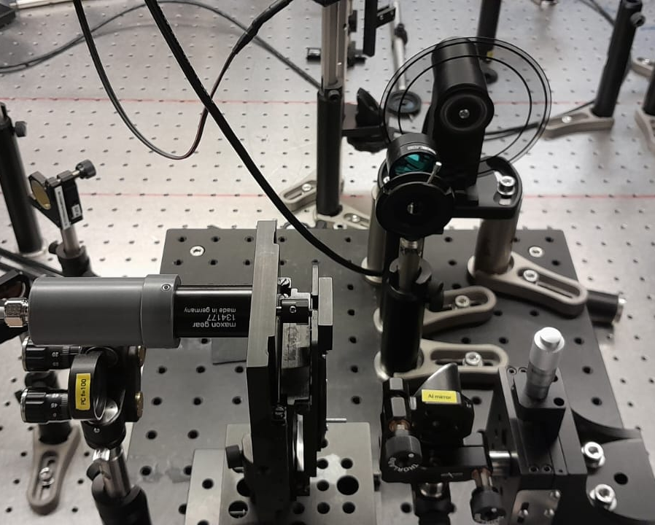
Experimental set-up
Ch: Chopper (500 Hz, 250 Hz)
A: Analyzer
P: Polarizer
C_{R}: Rotating compensator
L: Lens
S: Sample
DL: Delay line (~6.67 ns pump-probe delay and 3 fs resolution)
BS: Beam splitter
SCG: Super-continuum generation
CCD: Charge-coupled device detector
35 fs
Pump
Probe
Focusing lens
Delay line
Analyzer
Compensator
CaF₂ plate
Polarizer
Sample stage
Chopper
S. Richter et al., Rev. Sci. Instrum. 92, 033104 (2021).
S. Espinoza et al., Appl. Phys. Lett. 115, 052105 (2019).
Notes:
Here is a schematic of the time-resolved ellipsometry set up. The coherent Astrella laser emits 35 fs pulses with at 800 nm wavelength and 1 kHz repetition rate. This beam is split into the pump used to photo-excite the sample and the probe, the beam used for conventional ellipsometry. The probe beam is converted into white light via supercontinuum generation light by focusing it using a lens onto a CaF₂ plate. The probe is then passed through a 500 Hz chopper (more on this chopper later). After this chopper, the probe follows the conventional path of rotating compensator ellipsometry, as discussed before. Finally, the beam is dispersed by a prism before hitting the detector. Probe accounts for only a small fraction of the original beam pulse. Ther rest of it belongs to the pump beam which goes through a 250 Hz chopper and then onto a delay line which modulates the delay of the lagging time between the pulse of the pump and the probe.
Here are the images that highlight the important features in this setup, which are the ellipsometry stage, where the red line is the pump, and the green one is the probe, the delay line, and the supercontinuum generation.

Slide 22
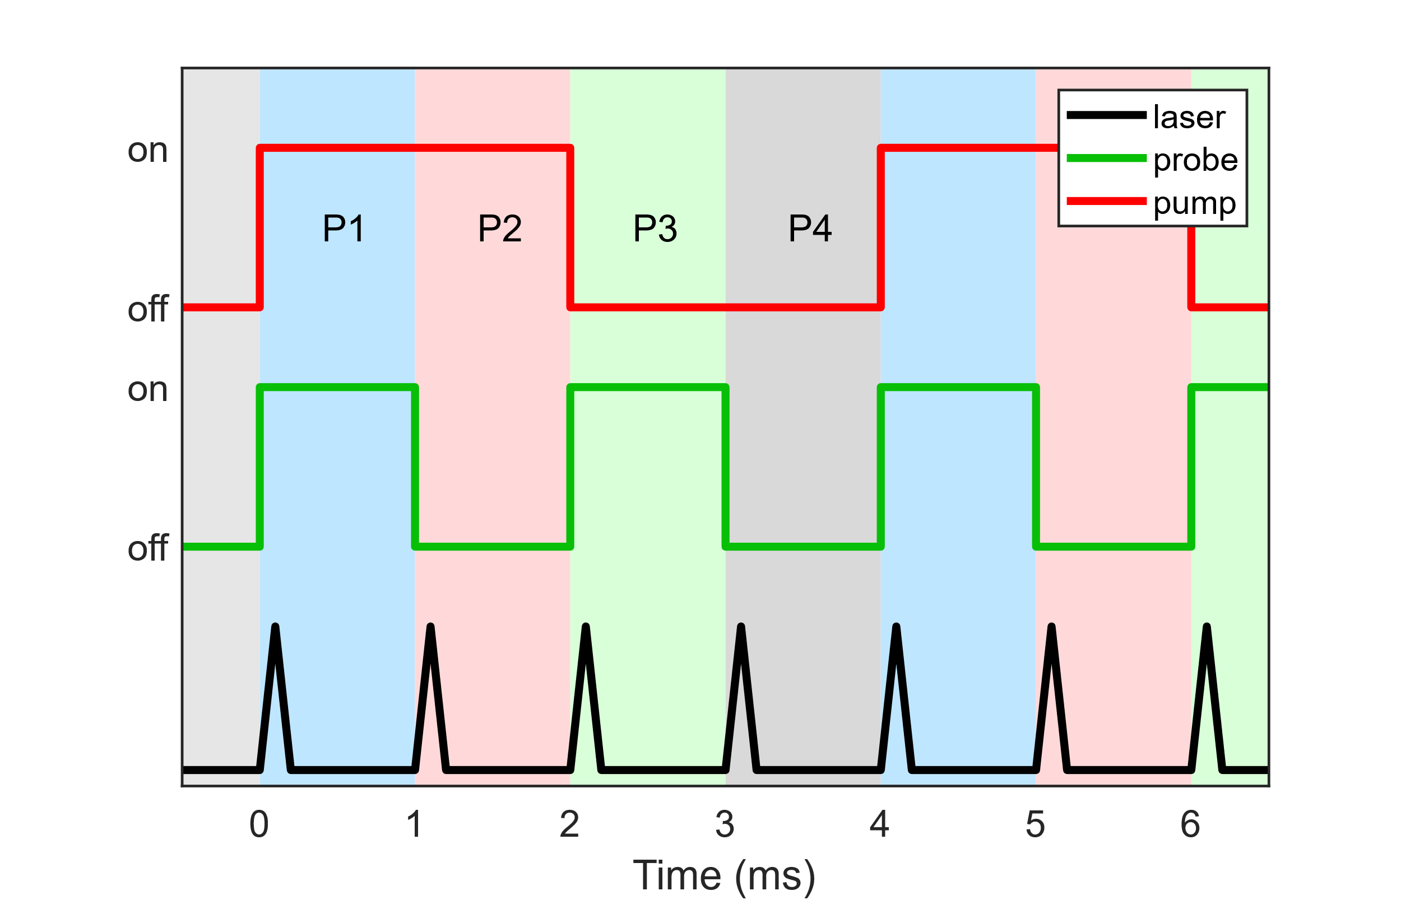
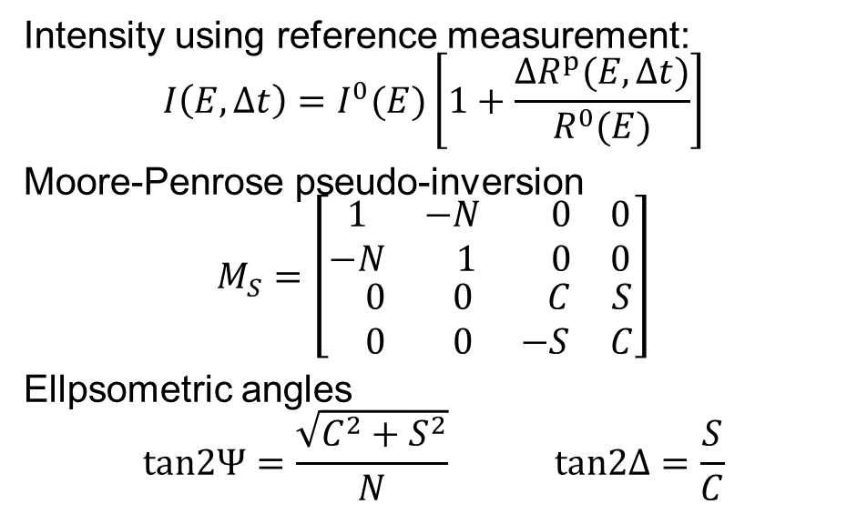

Data reduction
Intensity using reference measurement:
$$I\left(E,∆t\right)=I^{0}(E)\left[1+\frac{∆R^{p}(E,∆t)}{R^{0}(E)}\right]$$
Moore-Penrose pseudo-inversion
$$M_{S}=\left[\begin{matrix}\begin{matrix}1 & −N \\ −N & −1\end{matrix} & \begin{matrix}−0 & 0 \\ −0 & 0\end{matrix} \\ \begin{matrix}−0 & −0 \\ −0 & −0\end{matrix} & \begin{matrix}−C & S \\ −S & C\end{matrix}\end{matrix}\right]$$
Ellpsometric angles
$$tan2Ψ=\frac{\sqrt{C^{2}+S^{2}}}{N} tan2Δ=\frac{S}{C}$$
$$\frac{∆R^{p}(E,∆t)}{R^{0}(E)}=\frac{I_{P1}−I_{P2}}{I_{P3}−I_{P4}}−1$$
S. Richter et al., Rev. Sci. Instrum. 92, 033104 (2021).
S. Espinoza et al., Appl. Phys. Lett. 115, 052105 (2019).
Notes:
The choppers previously mentioned give 4 different measured intensities (or columns), pump plus probe, pump only, probe only, and dark where both beams are blocked. In the end, what we actually measure is the reflectance difference or transient signal, computed using this relation. This transient signal is measured at different compensator angles.
We can use the reflectance difference in combination with a reference measurement to obtain the Mueller matrix elements and finally the ellipsometric angles.

Slide 23
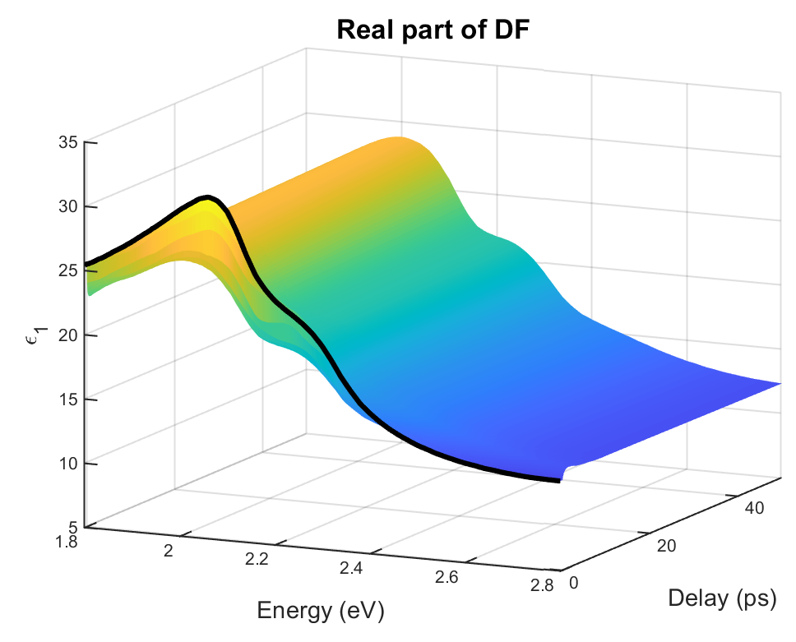
Dielectric constant as a function of delay time
After removing oxide layer.
Notes:
Here we can see the data after an oxide correction. These are the real and imaginary parts of the dielectric function. The data is displayed as a function of photon energy on this axis, with a range from 1.8 to 2.8 eV, where the E₁ and E₁+Δ₁ CPs are located. The delay time on the other axis ranges from 0 up to the first 50 ps. If we focus on ε₂, we can see an initial decrease in amplitude within the first picoseconds, after which it starts to recover its original form.

Slide 24
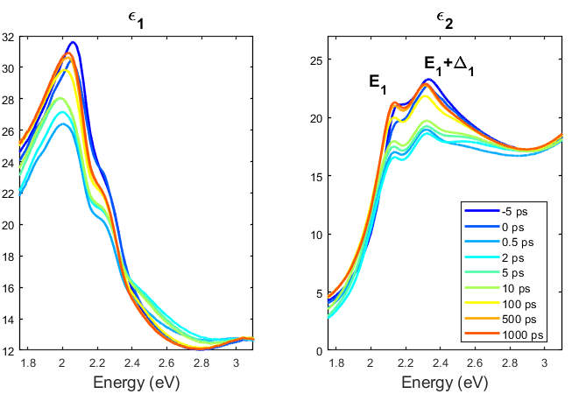
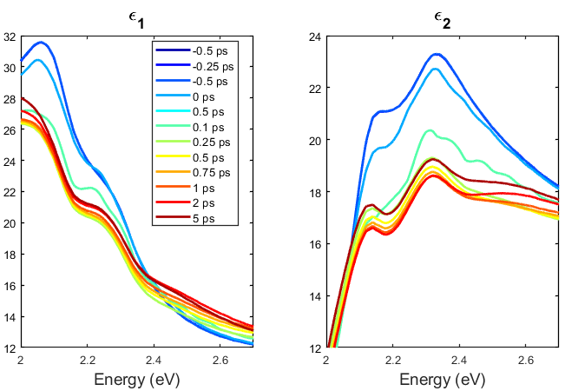
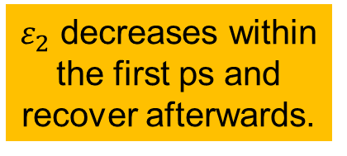

Dielectric constant as a function of delay time
$ε$ almost fully recovers after 100 ps.
$ε_{2}$ decreases within
the first ps and recover afterwards.
Notes:
This is another view of the same data. On the left, you can see from -5 ps to 1 ns. On the right, you can see from -0.5 ps up to the first 5 ps. Again, we see the initial reduction in the amplitude of ε₂, which reaches its maximum change at around 1 ps and then starts to recover. This time regime (the first ps) is where scattering and relaxation of carriers takes place and is where we will focus on to try to model the dielectric function.

Slide 25
Carrier statistics
Notes:
Before modeling, we need to look at the physical processes that take place throughout the measurement.

Slide 26
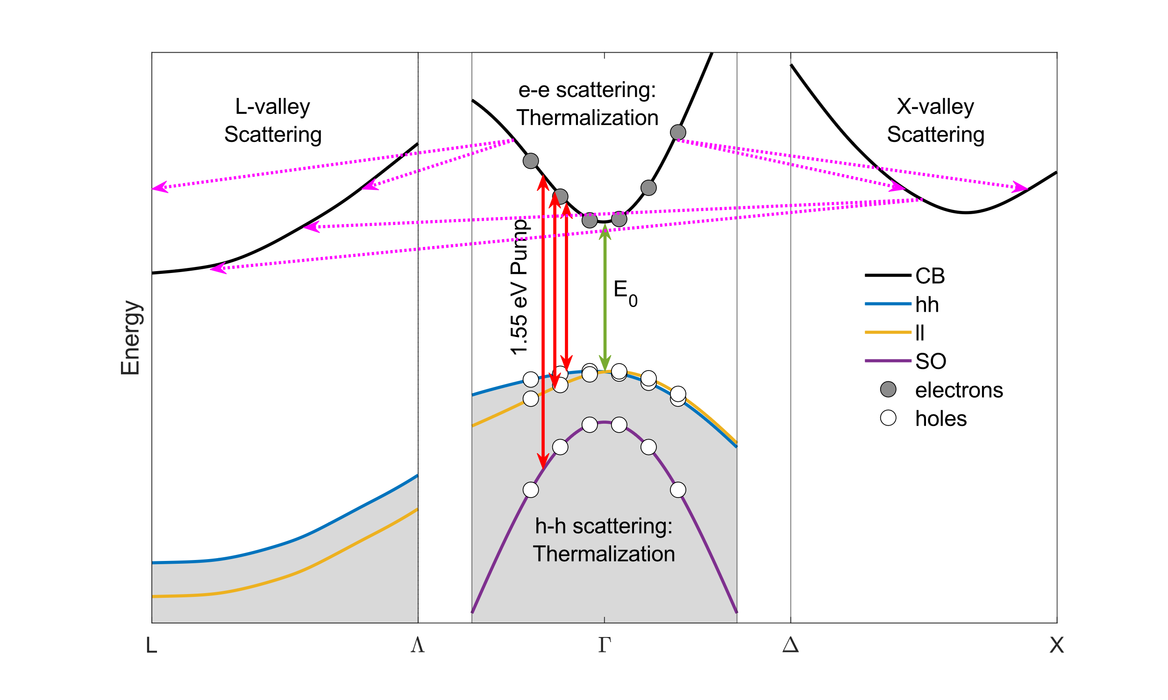
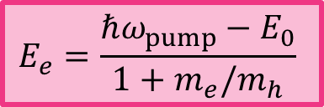
First 100s of femtoseconds
$$E_{e}=\frac{ℏω_{pump}−E_{0}}{1+m_{e}/m_{h}}$$
Intervalley scattering is more efficient than intravalley scattering.
H. Kalt, C. F. Klingshirn, Semiconductor Optics 2 (Springer, 2024). R. R. Alfano, Semiconductors Probed by Ultrafast Laser Spectroscopy I (Academic Press, 1984).
Notes:
To begin with, the initial pulse promotes electrons from all three valence bands to the conduction band at the center of the Brillouin zone. These initial carriers then thermalize to a distribution with a well-defined temperature. This thermalization process happens under a few fs and it happens via carrier-carrier scattering. These hot carriers are at a very high temperature (much greater than the lattice temperature) and have excess energy given by E_{e}, shown in this expression. As the carriers relax and cool down, they will scatter from the Г-valley to the satellite valleys and will eventually cluster at the L-valley (the lowest valley).

Slide 27
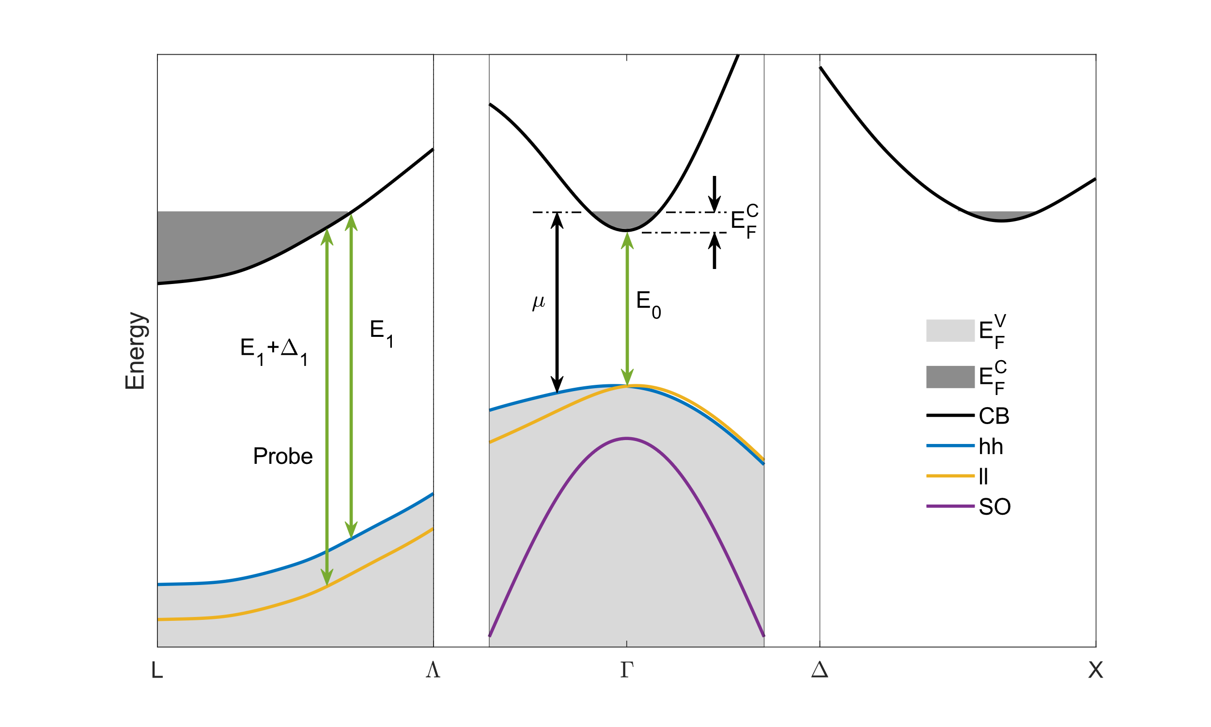



First picoseconds
$$E_{F}^{C(Γ)}=E_{F}^{C(L)}=E_{F}^{C(X)}$$
$$∆E=∆E_{str}+∆E_{BGR}+∆E_{BM}$$
$$μ=E_{F}^{C}+E_{g}$$
H. Kalt, C. F. Klingshirn, Semiconductor Optics 2 (Springer, 2024). P. Vashishta, Appl. Phys. Rev. B. 25, 6492 (1982).
Notes:
The presence of these hot carriers will then raise the quasi-Fermi energy of the conduction band. On a ps scale, we assume that Fermi energy is the same across all three valleys. This processes of filling the CB and lifting of Fermi energy are what affect the optical functions of the material, as well as the energy of the bandgap (or in our case, the energy of the CPs E₁ and E₁+Δ₁, which is where we are probing).
Therefore, if we want to model the dielectric function, the goal then becomes to calculate the change in the Fermi energy induced by these hot carriers.

Slide 28
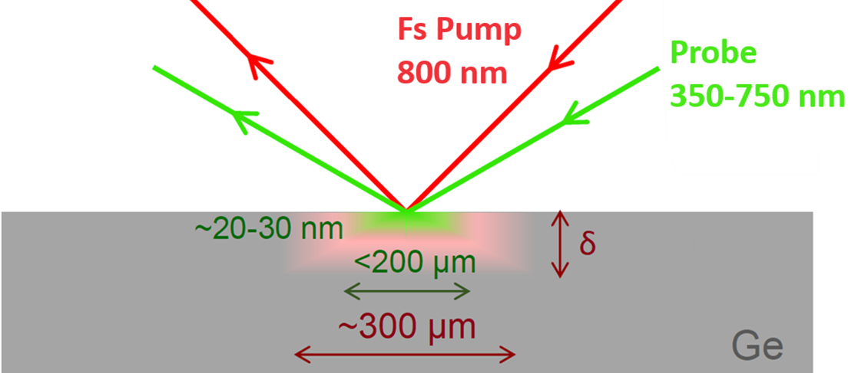
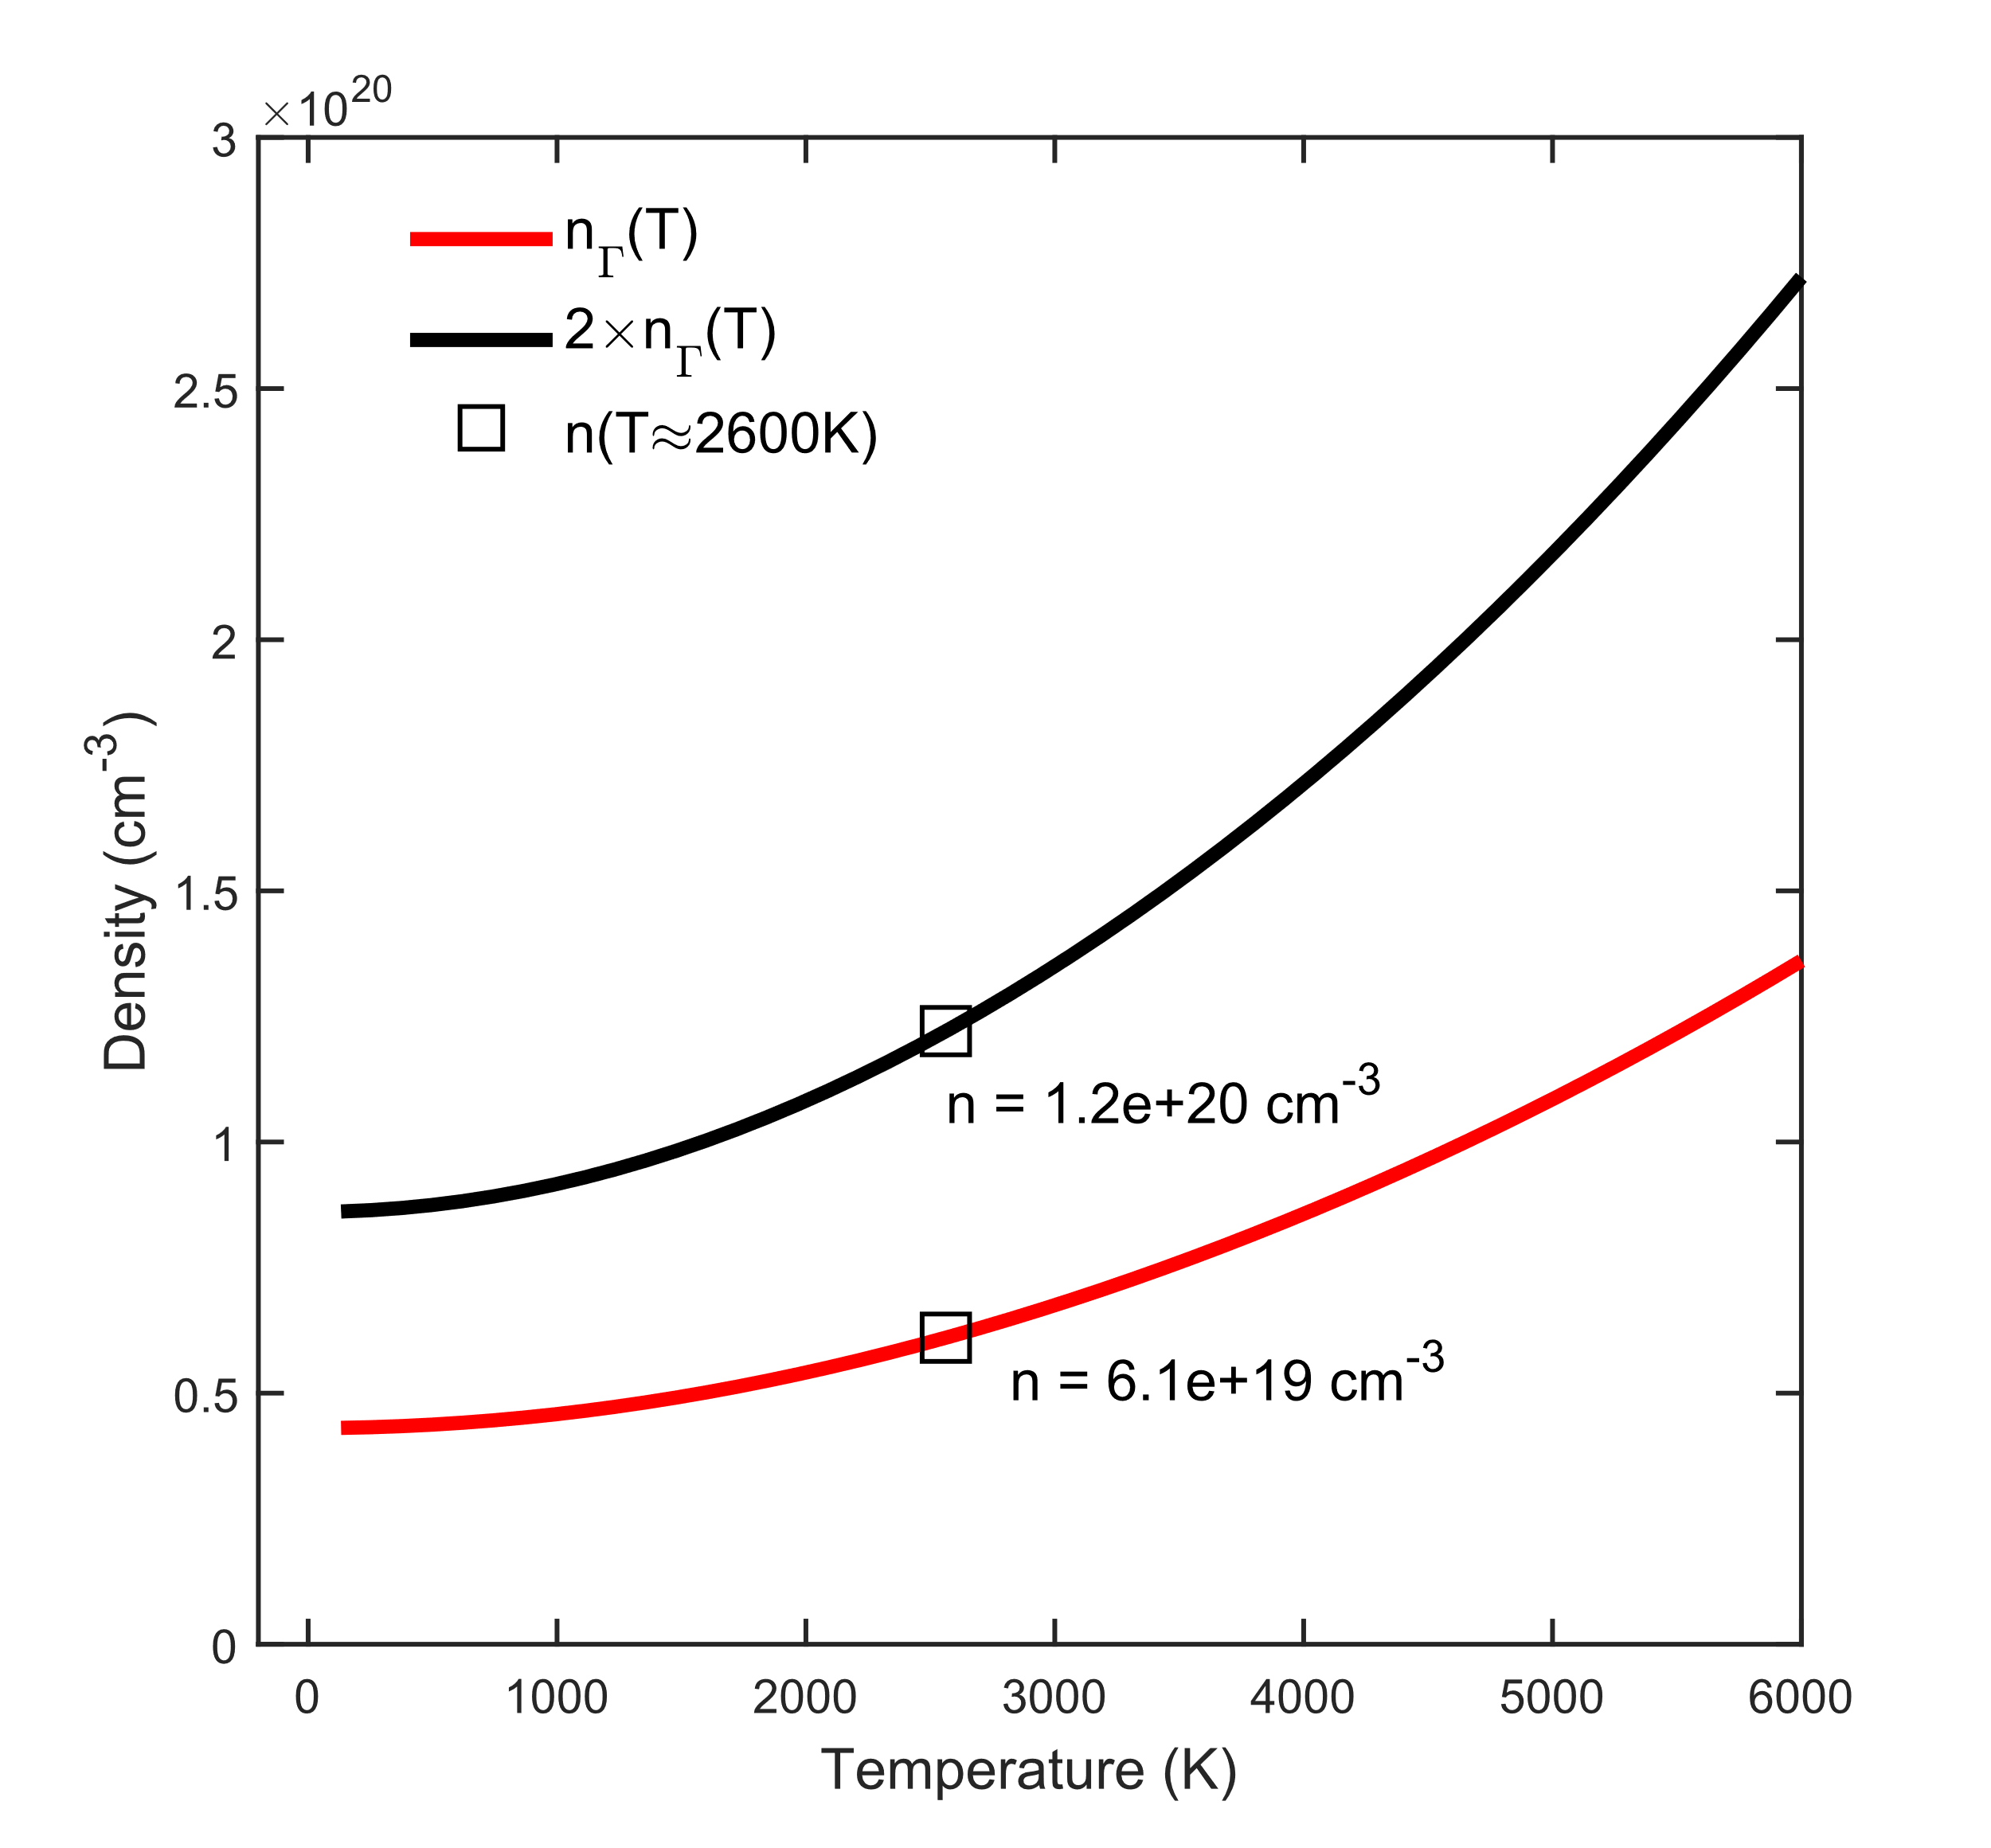


Charge carrier concentration
Plasma temperature:
$$T_{c}≈\frac{E_{e}}{3k_{B}}$$
Using pump power overestimates density.
Pump energy imposing the limit to the Fermi energy :
$$n_{Γ}\left(T\right)=\frac{1}{4}{\left(\frac{2m_{e,Γ}k_{B}T}{πℏ^{2}}\right)}^{3/2}F_{1/2}\left(\frac{E_{e}}{k_{B}T}\right)+N.P.,$$
Where N.P. stands for non-parabolicity. On the timescales of the pump-pulse, the carrier density is limited at the Г-valley.
A. L. Smirl, in Physics of Nonlinear Transport in Semiconductors, edited by Kerry, Barker, and Jacoboni (Plenum Press, 1980).
J. Menéndez et al., Phys. Rev. B. 101, 195204 (2020).
Notes:
Before that, however, we need an estimate of the initial carrier density at the central Г-valley. We can calculate it by using the power and beam diameter of the pump. However, this tends to overestimate the carrier density. Instead, we calculate the density as a function of temperature by imposing the excess energy of the carriers as the Fermi energy. The figure on the left shows two curves, the density of the Г-valley, and the same density multiplied by two, to allow for some intervalley scattering.
We also assume that the temperature is approximately that of an ideal electron-gas plasma, which is about 2600 K. At this temperature, we can see that the carrier density will fall between 5×10¹⁹ and 10²⁰ carriers cm⁻³.

Slide 29






Charge carrier concentration
$$n\left(T\right)=n_{L}\left(T\right)+n_{Γ}\left(T\right)+n_{X}(T)$$
$$\sim 55\%$$
$$\sim 45\%$$
Carriers locate at the satellite valleys.
$$\sim 0\%$$
A. L. Smirl, in Physics of Nonlinear Transport in Semiconductors, edited by Kerry, Barker, and Jacoboni (Plenum Press, 1980).
J. Menéndez et al., Phys. Rev. B. 101, 195204 (2020).
Notes:
Once we know the density, we allow for intervalley scattering by summing over the density across all three valleys and then solve for the Fermi energy as a function of temperature. The figure on the left shows the Fermi energy for both previously estimated densities. The figure on the right shows the relative valley population. We see that at high temperatures, about 55% of the carriers lie on the X-valley and the rest on the L-valley. As the temperature decreases, the carriers relocate to the L-valley more and more. The Γ- valley, on the other hand, remains close to zero at all temperatures.
This gives us the evolution of the Fermi energy and temperature of the carriers, and these are the parameters we need to model the dielectric function.

Slide 30
Dielectric function model
Notes:
How do we model the dielectric function?

Slide 31




2D Exciton model
$$g_{a}(ξ)=2lnξ−2ψ\left(1/2−ξ\right)$$
$$ε\left(E\right)=\frac{4k_{max}e^{2}{\overline{P}}^{2}μ_{⊥}^{(E_{1})}}{3ε_{0}m^{2}π^{2}{(E+iΓ)}^{2}}\left\{g_{a}\left[\sqrt{\frac{R}{E_{g}−\left(E+iΓ\right)}}\right]+g_{a}\left[\sqrt{\frac{R}{E_{g}−\left(−E−iΓ\right)}}\right]−2g_{a}\left[\sqrt{\frac{R}{E_{g}−\left(0\right)}}\right]\right\}$$
Fitting parameters:
$$E_{1},Δ_{1},Γ^{(E_{1})},Γ^{(E_{1}+Δ_{1})}$$
$$k_{max}=0.7\frac{π\sqrt{3}}{a_{0}}$$
C. Tanguy, Solid State Commun. 98, 65 (1996).
C. Emminger et al., J. Vac. Sci. Technol. B 38, 012202 (2020).
C. A. Armenta and S. Zollner, J. Appl. Phys. 137, 245101 (2025).
Notes:
We start with the steady state dielectric function of 2D excitons that we previously developed. This captures the critical point energies and broadenings.

Slide 32








Fermi singularity is more prominent as temperature decreases.
Band-filling model
$$ε_{2}(E)=\frac{2e^{2}{\overline{P}}^{2}μ_{⊥}}{3ε_{0}π^{2}{m^{2}E}^{2}}H(E−E_{1})\int_{−k_{max}}^{k_{max}}{1−f[E_{c}(E,k_{z}^{2})]dk_{z}}$$
$ε_{2}$ decreases as Fermi energy increases and temperature decreases.
No Burstein-Moss shift for 2D CP:
$$∆E_{BM}=0$$
C. Xu et al., J. Appl. Phys. 125, 085704 (2019).
C. Xu et al., Phys. Rev. Lett. 118, 267402 (2017).
Notes:
Next, we consider band-filling effects. For this, we used Xu and Menendez’s model given in this expression. The previously calculated temperature and Fermi energy are embedded in this integral. The figure on the left shows ε₂ at different points in the calculated Fermi energy curve for 10²⁰ cm⁻³. On the right is its corresponding 2nd derivative.
To point out some of the features, we can see that as the Fermi energy increases, the amplitude of ε₂ decreases, consistent with what we see on the data. More importantly, we see that the CP energies do not shift as the band fills up, concluding that the energy is not affected by band filling effects. We also do not expect to see a Fermi singularity (this feature seen at high energies). In the corner, we can see the same feature at constant Fermi energy and is shown to fade away at high temperatures.
Finally, the real part of the dielectric function is simply calculated by a Kramers-Kronig transformation. Displayed here is ε₁ and its corresponding second derivative.

Slide 33
Fitted data
Notes:
So, how does the model compare with the data?

Slide 34




Final model
2D exciton model with band filling effects:
$$ε_{2}\left(E\right)=\frac{2e^{2}μ_{⊥}^{(E_{g})}{\overline{P}}^{2}}{3ε_{0}m^{2}π}Im\left\{\frac{g_{a}\left[ξ\left(E+iΓ\right)\right]+g_{a}\left[ξ\left(−E−iΓ\right)\right]−2g_{a}[ξ(0)]}{{(E+iΓ)}^{2}}\right\}\int_{−k_{max}}^{k_{max}}{\left\{1−f\left[E_{c}\left(E,k_{z}^{2}\right)\right]\right\}dk_{z}}$$
Negative delays (steady state)
Dielectric function fitting parameters:
$$μ^{(E_{1})},μ^{\left(E_{1}+Δ_{1}\right)}$$
2nd derivative itting parameters:
$$E_{1},Δ_{1},Γ^{(E_{1})},Γ^{\left(E_{1}+Δ_{1}\right)}$$
Parameters $T_{c}$ and $n$ are at thermal equilibrium.
Notes:
The final model (shown in the expression above) combines both, 2D excitons and band-filling effects. We started the fitting procedure with the negative delays (steady state measurements). To fit the energies and broadenings, we fitted the second derivative. To get a better match in the dielectric function, we fitted the masses to the dielectric function. The values for the carrier density and temperature are held to their thermal equilibrium values. This masses were then held constant for the rest of the delays.

Slide 35




Final model
2D exciton model with band filling effects:
$$ε_{2}\left(E\right)=\frac{2e^{2}μ_{⊥}^{(E_{g})}{\overline{P}}^{2}}{3ε_{0}m^{2}π}Im\left\{\frac{g_{a}\left[ξ\left(E+iΓ\right)\right]+g_{a}\left[ξ\left(−E−iΓ\right)\right]−2g_{a}[ξ(0)]}{{(E+iΓ)}^{2}}\right\}\int_{−k_{max}}^{k_{max}}{\left\{1−f\left[E_{c}\left(E,k_{z}^{2}\right)\right]\right\}dk_{z}}$$
Fitting parameters:
$$E_{1},Δ_{1},Γ^{(E_{1})},Γ^{\left(E_{1}+Δ_{1}\right)},T_{c},n$$
Notes:
On the left is shown the fit at -1 ps (the steady state dielectric function), where the translucent curves are the experimental data, and the solid lines are the model. On the right we can see the data at 250 fs after the pump hits the sample. While the model is not perfect (broadening seems to be slightly off), it does seem to capture the reduction in the amplitude of ε₂ induced by the carrier dynamics.

Slide 36



Final model
2D exciton model with band filling effects:
$$ε_{2}\left(E\right)=\frac{2e^{2}μ_{⊥}^{(E_{g})}{\overline{P}}^{2}}{3ε_{0}m^{2}π}Im\left\{\frac{g_{a}\left[ξ\left(E+iΓ\right)\right]+g_{a}\left[ξ\left(−E−iΓ\right)\right]−2g_{a}[ξ(0)]}{{(E+iΓ)}^{2}}\right\}\int_{−k_{max}}^{k_{max}}{\left\{1−f\left[E_{c}\left(E,k_{z}^{2}\right)\right]\right\}dk_{z}}$$
Redshift due to bandgap renormalization.
Fermi singularity?
L. Viña and M. Cardona, Phys. Rev. B 29, 6739 (1984).
Notes:
Here are the results. On the left we see the data from -0.5 ps up to 2 ps. On the right, we see the fit for these delays, which seems to present a reasonable match. A feature that the model does not seem to capture is this bump next to the CPs, which looks like a Fermi singularity. We had previously stated that we didn’t expect to see this feature because of high temperatures. It could be that we are underestimating the rate of cooling of the carriers (carriers are cooling faster than previously calculated).
On the other hand, the fitted Fermi energy does seem to follow the previously calculated values (the dots are the fitted Fermi energy at different delays). The cooling of the carriers seems to walk along the red curve (the calculated Fermi energy for 10²⁰ cm⁻³). So the model looks promising.
At around 1 ps, the Fermi energy seems to remain constant (it seems that the carriers are not cooling anymore). This is likely because the original reduction of the amplitude of ε₂ is induced by other additional processes and not just band-filling effects. We would need a more sophisticated model to account for these additional effects.

Slide 37




Carrier relaxation
Phonons emitted every 4 to 18 fs, compared to the literature value of ~50 fs.
We approximated the overall energy relaxation to
$$\left\langle \frac{dE}{dt}\right\rangle =\frac{Ae^{−\frac{t}{τ}}}{τ}$$
At its highest relaxation rate, energy is being dissipated by emitting a phonon around every 4 to 18 femtoseconds.
$$T_{c}\left(t\right)=T_{0}−\frac{C}{3k_{B}}\int_{0}^{t}{\left|\left\langle \frac{dE}{dt}\right\rangle \right|dt}$$
J. Shah and R. F. Leheny, in Semiconductors Probed by Ultrafast Laser Spectroscopy Volume I, edited by R. R. Alfano (Academic Press, 1984).
J. Menéndez et al., Phys. Rev. B 101, 195204 (2020).
S. Zollner et al., Solid State Commun. 76, 877 (1990).
Notes:
As stated before, carriers relax energy by scattering to the satellite valleys. For L-valley scattering, only LA phonons are allowed, however, at room temperature, the forbidden TA and LO phonons dominate this scattering mechanism.
We don’t concern ourselves with the form the energy relaxation term. This can be quite complex and depends on the scattering processes. Instead, we approximate the energy relaxation with a single exponential decay that encompasses the all phonon emissions. If we do this, then at the highest relaxation rate, phonons are being emitted every 4 to 18 fs, depending on the type of phonon. This is very fast, but at least within the order of magnitude in the literature.

Slide 38
Modeling additional processes
Notes:
So, how does the model compare with the data?

Slide 39


Free carrier absorption and excitonic screening
Additional absorption processes:
Free carrier absorption (Drude model):
$$ε \left(E\right)=ε_{st}\left(1−\frac{ω_{p}^{2}}{ω^{2}+iΓω}\right)$$
Excitonic screening: Coulomb interaction between carrier in the exciton system is screened by the presence of additional carriers.
$$ε^{3D}\left(E\right)=\frac{A\sqrt{R}}{{(E+iΓ)}^{2}}\left\{\tilde{g}\left[ξ(E+iΓ)\right]+\tilde{g}\left[ξ(−E−iΓ)\right]−2\tilde{g}\left[ξ(0)\right]\right\}$$
$$ξ\left(z\right)=\frac{2}{\sqrt{\frac{E_{g}−z}{R}}+\sqrt{\frac{E_{g}−z}{R}+\frac{4}{g}}}$$
3D Exciton
Currently, no solution for excitonic screening in 2D exists.
C. Tanguy, Phys. Rev. B 60, 10660 (1999).
15
Notes:
At such high carrier densities and temperatures, we would expect to see free carrier absorption. This probably has a small effect and could be accounted for with a Drude model.
A more important effect is excitonic screening. The presence of so many charge carriers induce a dielectric screening (the electron and hole have a hard time seeing each other within the exciton system). Screening also reduces the amplitude of ε₂ and introduces another parameter to our model (this g parameter). Here we can see Tanguy’s model for the screening of excitons, as well as how it affects absorption. This model, however, is for 3D excitons and unfortunately, there is no screening model for excitons in 2D, which is what we need, and is where we need to move forward

Slide 40
Conclusion and future work
Significant changes in the dielectric function of bulk Ge were observed. We primarily focus on the decrease in amplitude of ε₂ within the first ps.
Carrier statistics provide the photoexcited carrier density, as well as the initial and evolution of the parameters of our model.
Band filling plus 2D exciton model looks reasonable when compared with the experimental dielectric function.
Bandgap renormalization is smaller than expected due to the only considering many-body effetcs. Carrier relaxation shows the emission of phonon every 4 to 18 fs.
The model neglects
Diffusion of carriers
Excitonic screening
Laser induced strain, local heating

Slide 41
Thank you!
QUESTIONS?

Slide 42

E₁ and E₁+Δ₁ critical points
2D $M_{0}$ minimum van Hove singularities
Use $\vec{k}∙\vec{p}$ theory and Bloch’s theorem:
Only similar spins will couple. If the only non-zero elements are
$$\overline{P}=−i\left\langle Z | p_{x} | X\right\rangle =−i\left\langle Z | p_{y} | Y\right\rangle ,$$
Then the Hamiltonian diagonalizes as:
$$0=det\left(H_{0}+H_{\vec{k}}−\tilde{E}\right)=det\left|\begin{matrix}E_{1}−\tilde{E} & \frac{iℏ\overline{P}}{m_{0}\sqrt{2}}k_{⊥} & \frac{iℏ\overline{P}}{m_{0}\sqrt{2}}k_{⊥} \\ −\frac{iℏ\overline{P}}{m\sqrt{2}}k_{⊥} & −\tilde{E} & 0 \\ −\frac{iℏ\overline{P}}{m_{0}\sqrt{2}}k_{⊥} & 0 & −Δ_{1}−\tilde{E}\end{matrix}\right|$$
Where $\tilde{E}=E−\frac{ℏ^{2}k^{2}}{2m_{0}}$. The characteristic equation is
$${\tilde{E}}^{3}−\left(E_{1}−Δ_{1}\right){\tilde{E}}^{2}−\left(E_{1}Δ_{1}+\frac{ℏ^{2}{\overline{P}}^{2}}{m_{0}^{2}}k_{⊥}^{2}\right)\tilde{E}−\frac{ℏ^{2}{\overline{P}}^{2}Δ_{1}}{2m_{0}^{2}}k_{⊥}^{2}=0.$$
$$\left(\underset{H_{0}}{\underbrace{\frac{p^{2}}{2m_{0}}+V}}+\underset{H_{\vec{k}}}{\underbrace{\frac{ℏ\vec{k}∙\vec{p}}{m_{0}}}}+\frac{ℏ^{2}k^{2}}{2m_{0}}\right)u_{n\vec{k}}=E_{n\vec{k}}u_{n\vec{k}}$$
Basis:
$$L_{6}^{+}:\left|\left.Z↑\right\rangle \right.,\left|\left.Z↓\right\rangle \right.$$
$$L_{4}^{−}⊕L_{5}^{−}:\frac{1}{\sqrt{2}}\left|\left.(X+iY)↑\right\rangle \right.,\frac{1}{\sqrt{2}}\left|\left.(X−iY)↓\right\rangle \right.$$
$$L_{6}^{−}:\frac{1}{\sqrt{2}}\left|\left.(X+iY) ↓\right\rangle \right.,\frac{1}{\sqrt{2}}\left|\left.(X−iY)↑\right\rangle \right.$$
P. Yu, M. Cardona, Fundamentals of Semiconductors (Springer, Berlin, 1996).
E. O. Kane, J. Phys. Chem. Solids 1, 249 (1957).

Slide 43
Effective masses
For small $k_{⊥}$ (parabolic approximation),
$$E_{CB}(k_{⊥})=E_{1}+\frac{ℏ^{2}k_{⊥}^{2}}{2m_{0}}\underset{m_{⊥}^{(L_{6}^{+})}}{\underbrace{\left(1+\frac{{\overline{P}}^{2}}{m_{0}}\left[\frac{1}{E_{1}}+\frac{1}{E_{1}+Δ_{1}}\right]\right)}},$$
Reduced masses:
$$\frac{1}{μ_{⊥}^{(E_{1})}}=\frac{1}{m_{⊥}^{(L_{6}^{+})}}−\frac{1}{m_{⊥}^{\left(L_{4}^{−}⊕L_{5}^{−}\right)}}=\frac{{\overline{P}}^{2}}{m_{0}}\left(\frac{2}{E_{1}}+\frac{1}{E_{1}+Δ_{1}}\right)$$
$$\frac{1}{μ_{⊥}^{(E_{1}+Δ_{1})}}=\frac{1}{m_{⊥}^{(L_{6}^{+})}}−\frac{1}{m_{⊥}^{\left(L_{6}^{−}\right)}}=\frac{{\overline{P}}^{2}}{m_{0}}\left(\frac{1}{E_{1}}+\frac{2}{E_{1}+Δ_{1}}\right)$$
$$E_{hh}(k_{⊥})=\frac{ℏ^{2}k_{⊥}^{2}}{2m_{0}}\underset{m_{⊥}^{(L_{4}^{−}⊕L_{5}^{−})}}{\underbrace{\left(1−\frac{{\overline{P}}^{2}}{m_{0}E_{1}}\right)}},$$
$$E_{lh}\left(k_{⊥}\right)=−Δ_{1}+\frac{ℏ^{2}k_{⊥}^{2}}{2m_{0}}\underset{m_{⊥}^{\left(L_{6}^{−}\right)}}{\underbrace{\left(1−\frac{{\overline{P}}^{2}}{m_{0}\left(E_{1}+Δ_{1}\right)}\right)}}.$$
and
Basis:
$$L_{6}^{+}:\left|\left.Z↑\right\rangle \right.,\left|\left.Z↓\right\rangle \right.$$
$$L_{4}^{−}⊕L_{5}^{−}:\frac{1}{\sqrt{2}}\left|\left.(X+iY)↑\right\rangle \right.,\frac{1}{\sqrt{2}}\left|\left.(X−iY)↓\right\rangle \right.$$
$$L_{6}^{−}:\frac{1}{\sqrt{2}}\left|\left.(X+iY) ↓\right\rangle \right.,\frac{1}{\sqrt{2}}\left|\left.(X−iY)↑\right\rangle \right.$$
P. Yu, M. Cardona, Fundamentals of Semiconductors (Springer, Berlin, 1996).
E. O. Kane, J. Phys. Chem. Solids 1, 249 (1957).

Slide 44

L-valley non-parabolicity and extra terms
From $k∙p$ theory and for small $k_{⊥}$ in the L-valley (parabolic approximation):
E₁ and E₁+Δ₁ transitions happen over a $k_{max}$, not just at the L-valley.
$$E_{CB}(k_{⊥})=E_{1}+\frac{ℏ^{2}k_{⊥}^{2}}{2m_{0}}\left(1+\frac{{\overline{P}}^{2}}{m_{0}}\left[\frac{1}{E_{1}}+\frac{1}{E_{1}+Δ_{1}}\right]\right),$$
$$E_{hh}\left(k_{⊥}\right)=\frac{ℏ^{2}k_{⊥}^{2}}{2m_{0}}\left(1−\frac{{\overline{P}}^{2}}{m_{0}E_{1}}\right),$$
$$E_{lh}\left(k_{⊥}\right)=−Δ_{1}+\frac{ℏ^{2}k_{⊥}^{2}}{2m_{0}}\left(1−\frac{{\overline{P}}^{2}}{m_{0}\left(E_{1}+Δ_{1}\right)}\right).$$
Extra $k_{⊥}$ terms of the matrix element $E_{P}$ in the $Λ$-direction increase $μ_{⊥}^{(E_{1})}$and increase $μ_{⊥}^{(E_{1}+Δ_{1})}$.
C. Xu et al., Phys. Lett. 118, 267402 (2017).
M. Cardona, Phys. Rev. B 15 5999 (1977).
Notes:
At the critical points, it seems that the mismatch between theory and experiment could be due to an insufficiently accurate value for the reduced masses.
The theoretical values for the masses of the bands come from a k.p theory calculation at the L-valley. We are assuming that these masses are the same at different points in the [111]-direction. However, this is not necessarily the case. It has been suggested that including k terms in the bands increase the value of the E₁ reduced mass while decreasing for E₁+Δ₁, which is exactly what we seen in the fitted masses. Moreover, we could include non-parabolicity terms. However, this is yet to be published in the literature and needs a more thorough investigation.

Slide 45


Charge carrier concentration
$$n\left(T\right)=n_{L}\left(T\right)+n_{Γ}\left(T\right)+n_{X}(T)$$

Slide 46
Temperature of carriers
Carrier temperature can be calculated by setting the absorbed optical energy equal to the electron-hole distribution:
$$\sum_{C}{\sum_{\vec{k}}{E^{C}\left(\vec{k}\right)f_{e}\left(\vec{k}\right)}}+\sum_{V}{\sum_{\vec{k}}{E^{V}\left(\vec{k}\right)f_{h}\left(\vec{k}\right)}}=nℏω,$$
Which approximates to:
$$T≈\frac{1}{3k_{B}}(ℏω−E_{ind})$$
A. L. Smirl, The physics of nonlinear absorption and ultrafast carrier relaxation in semiconductors. (1980).

