Slide 1
Optical and Structural Characterization of Semiconductors for Mid-Wave Infrared Applications
Master’s defense
Haley B. Woolf
College of Arts and Sciences
Department of Physics

Slide 2


Acknowledgements
COMMITTEE:
Dr. Stefan Zollner
Dr. Rigo Carrasco
Dr. Michael Paolone
Dr. Miranda van Iersel
RESEARCH PEERS:
Jaden Love
Carlos Armeta
Danissa Ortega
Sonam Yadav
Yoshitha Hettige
Carola Emminger
Aaron Lopez Gonzalez
Gabriel Ruiz
COLLABORATORS:
Dr. Matt Kim, QuantTera
Dr. Preston Webster et al., Air Force Research Lab
Dr. Jose Menendez, Arizona State University
Dr. John Kouvetakis, Arizona State University
Matthew Mircovich, Arizona State University
FUNDING:
Air Force Research Laboratory
(FA9453-23-2-0001)
Air Force Office of Scientific Research
(FA9550-24-1-0061)
National Science Foundation
(DMR-2235447, DMR-2423992)
Scalable Asymmetric Lifecycle Engagement (W5P1J-22-9-3009)

Slide 3
Vita:
Posters:
Presentation:
2022: Engineering Intern
SVAD, WSMR
Secret Clearance Activated
2023: Optoelectronics Intern
MESA, SNL
2024: B.S. Engineering Physics
NMSU
2024: AFRL Scholar
RVSU, AFRL
2021-2025: Research Assistant
NMSU
H. B. Woolf, M. Kim, C. Emminger, C. Armenta, S. Zollner. Optical and X-Ray Characterization of Ge_{1-y}Sn_{y} alloy on GaAs. Presented at:
American Physical Society March Meeting, 14-18 March 2022, Chicago, IL.
D. Ortega, H. B. Woolf, A. Moses, C. Armenta, J. Love, S. Yadav, M. Mircovich, J. Kouvetakis, J. Menendez, S. Zollner. Optical and Structural Properties of Group-IV Oxides Produced by Rapid Thermal Oxidation. Presented at:
50th Conference on the Physics and Chemistry of Surfaces and Interfaces, 19-23 January 2025, Kailua-Kona, HI
10th International Conference on Spectroscopic Ellipsometry, 8-13 June 2025, Boulder CO.
H. B. Woolf, R. Carrasco, P. Webster, A. Newell, A. Duchane, C. Morath, D. Maestas. Temperature-Dependent Recombination Rate Analysis of the Minority Carrier Lifetime in Mid-Wave Infrared Antimonide-based Materials. Presented at:
50th Conference on the Physics and Chemistry of Surfaces and Interfaces, 19-23 January 2025, Kailua-Kona, HI.
H. B. Woolf, M. Kim, C. Emminger, C. Armenta, S. Zollner. Optical and X-Ray Characterization of Ge_{1-y}Sn_{y} alloy on GaAs. Presented at:
Undergraduate Research and Creative Arts Symposium, 29 April 2022, Las Cruces, NM
American Vacuum Society 67th International Symposium, 6-11 November 2022, Pittsburgh, PA.
Awards
Ken Hass Outstanding Poster Award – Forum on Industrial and Applied Physics (FIAP) Awarded at:
American Physical Society March Meeting, 14-18 March 2022, Chicago, IL.

Slide 4
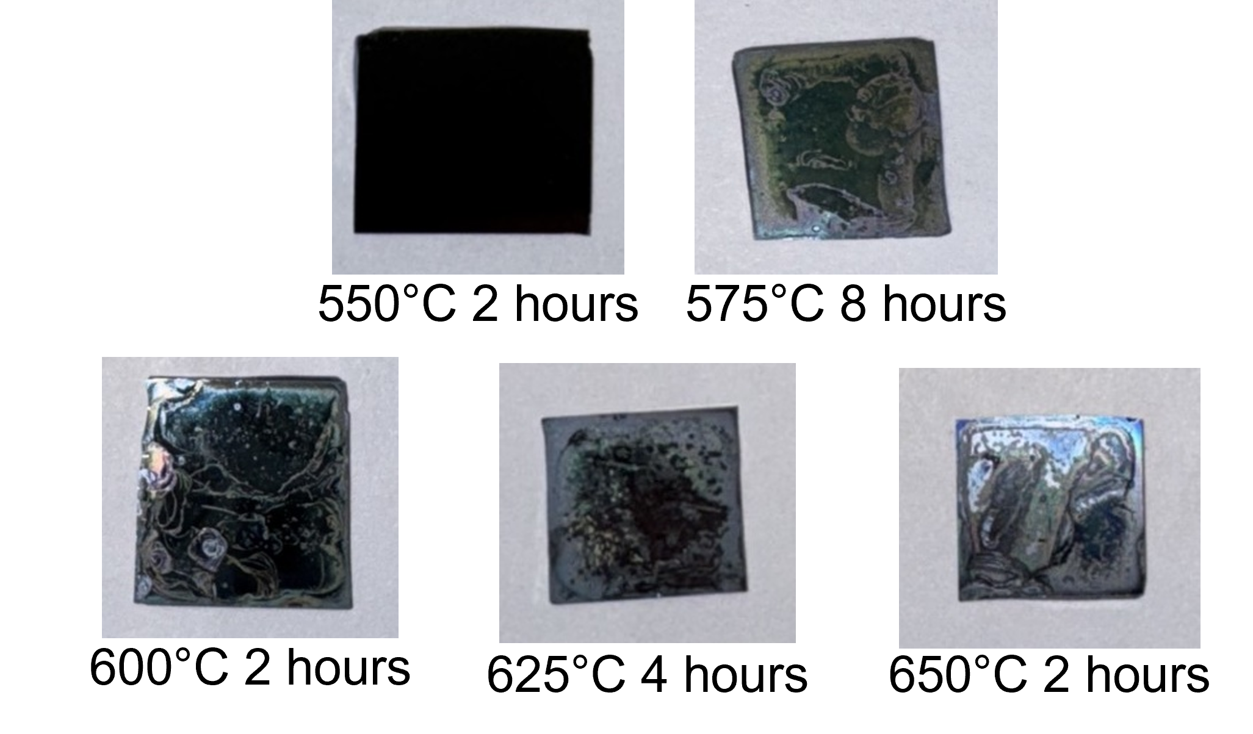
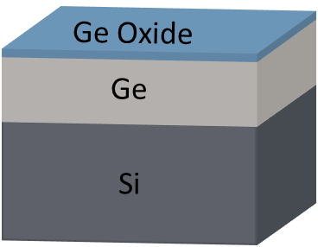
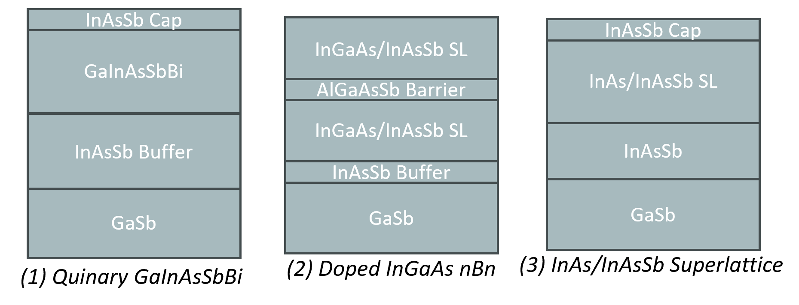
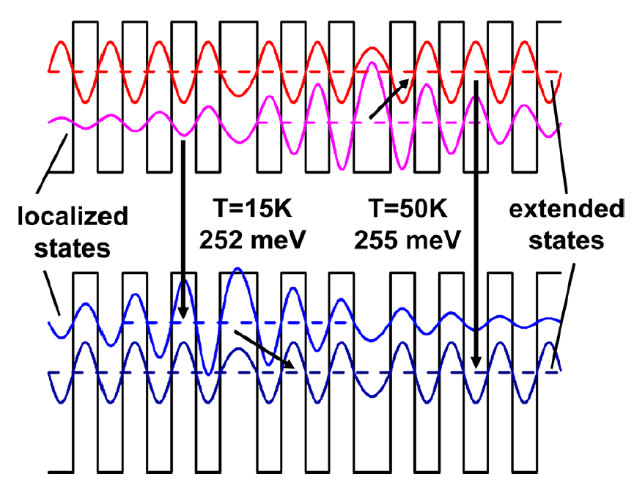
Outline
Optical and Structural Properties of Group-IV Oxides Produced by Rapid Thermal Annealing
Experimental Methods
Rapid Thermal Oxidation
Ge on Si Results
GeSn on Si Results
Temperature-Dependent Recombination Rate Analysis of Minority Carrier Lifetime in Mid-Wave Infrared Antimonide-Based Devices
Recombination
Previous Observations-Strain Engineering & Localization Effects
Methodology
Results

Slide 5
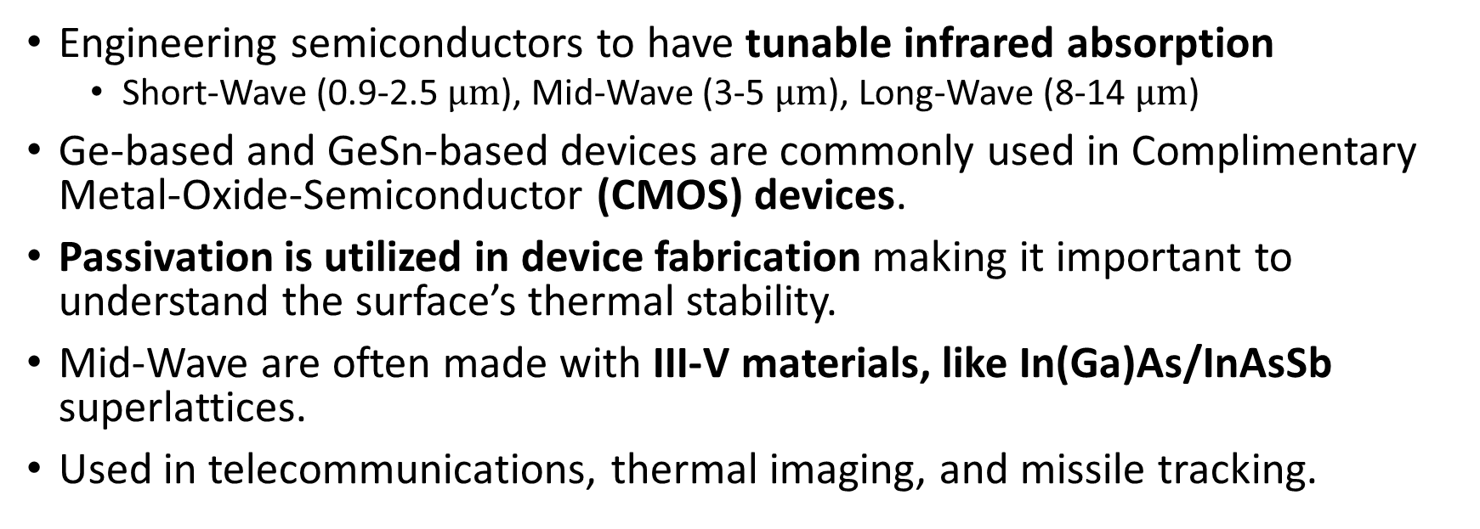
Motivation
Engineering semiconductors to have tunable infrared absorption
Short-Wave (0.9-2.5 $μm$), Mid-Wave (3-5 $μm$), Long-Wave (8-14 $μm$)
Ge-based and GeSn-based devices are commonly used in Complimentary Metal-Oxide-Semiconductor (CMOS) devices.
Passivation is utilized in device fabrication making it important to understand the surface’s thermal stability.
Mid-Wave are often made with III-V materials, like In(Ga)As/InAsSb superlattices.
Used in telecommunications, thermal imaging, and missile tracking.
O. Concepcion et al., Adv. Mater. 37, (2025)
W. Wang et al., Appl. Surf. Sci. 425, 95 (2017)
R. Carrasco et al., J. Appl. Phys. 129, 184501 (2021).

Slide 6
Optical and Structural Properties of Group-IV Oxides Produced by Rapid Thermal Annealing

Slide 7
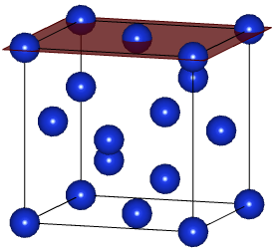
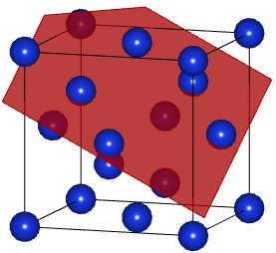





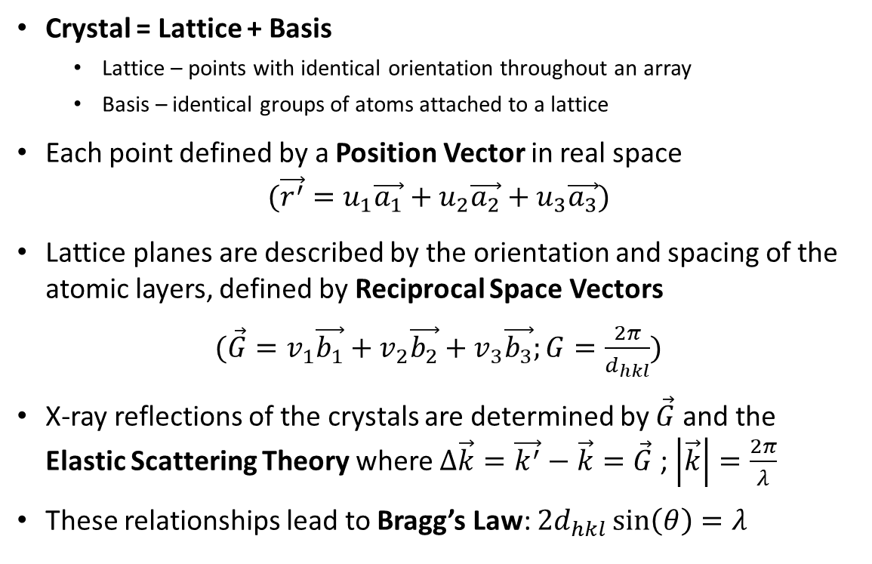






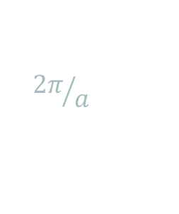
Reciprocal Space & Bragg’s Law
Real Space
Reciprocal Space
Crystal = Lattice + Basis
Lattice – points with identical orientation throughout an array
Basis – identical groups of atoms attached to a lattice
Each point defined by a Position Vector in real space
$$(\vec{r^{′}}=u_{1}\vec{a_{1}}+u_{2}\vec{a_{2}}+u_{3}\vec{a_{3}})$$
Lattice planes are described by the orientation and spacing of the atomic layers, defined by Reciprocal Space Vectors
$(\vec{G}=v_{1}\vec{b_{1}}+v_{2}\vec{b_{2}}+v_{3}\vec{b_{3}};G=\frac{2π}{d_{hkl}})$
X-ray reflections of the crystals are determined by $\vec{G}$ and the Elastic Scattering Theory where $Δ\vec{k}=\vec{k^{′}}−\vec{k}=\vec{G}$ ; $\left|\vec{k}\right|=\frac{2π}{λ}$
These relationships lead to Bragg’s Law: $2d_{hkl}\sin\left(θ\right)=λ$
$$\vec{a_{j}}$$
$$\vec{b_{j}}$$
$${2π}/a$$
$$\vec{a_{i}}$$
$$\vec{b_{i}}$$
hkl = (004) of Si
$${\vec{G}}_{hkl}$$
$$\vec{k′}$$
$$2θ$$
$$\vec{k}$$
$$θ$$
hkl = (224) of Si
$hkl$ plane
$$\vec{k}⋅\vec{G}=kG\sin\left(θ\right)$$
P. F. Fewster, X-Ray Scattering From Semiconductors and Other Materials, (World Scientific Pub. Co. 2015).
C. Kittel, Introduction to Solid State Physics, (Wiley, 1995).
G.S. Rohrer, Structure and Bonding in Crystalline Materials, (Cambridge Uni. Press, 2001).
U. Pietsch et. al., High-Resolution X-Ray Scattering, (Springer, 2004).

Slide 8
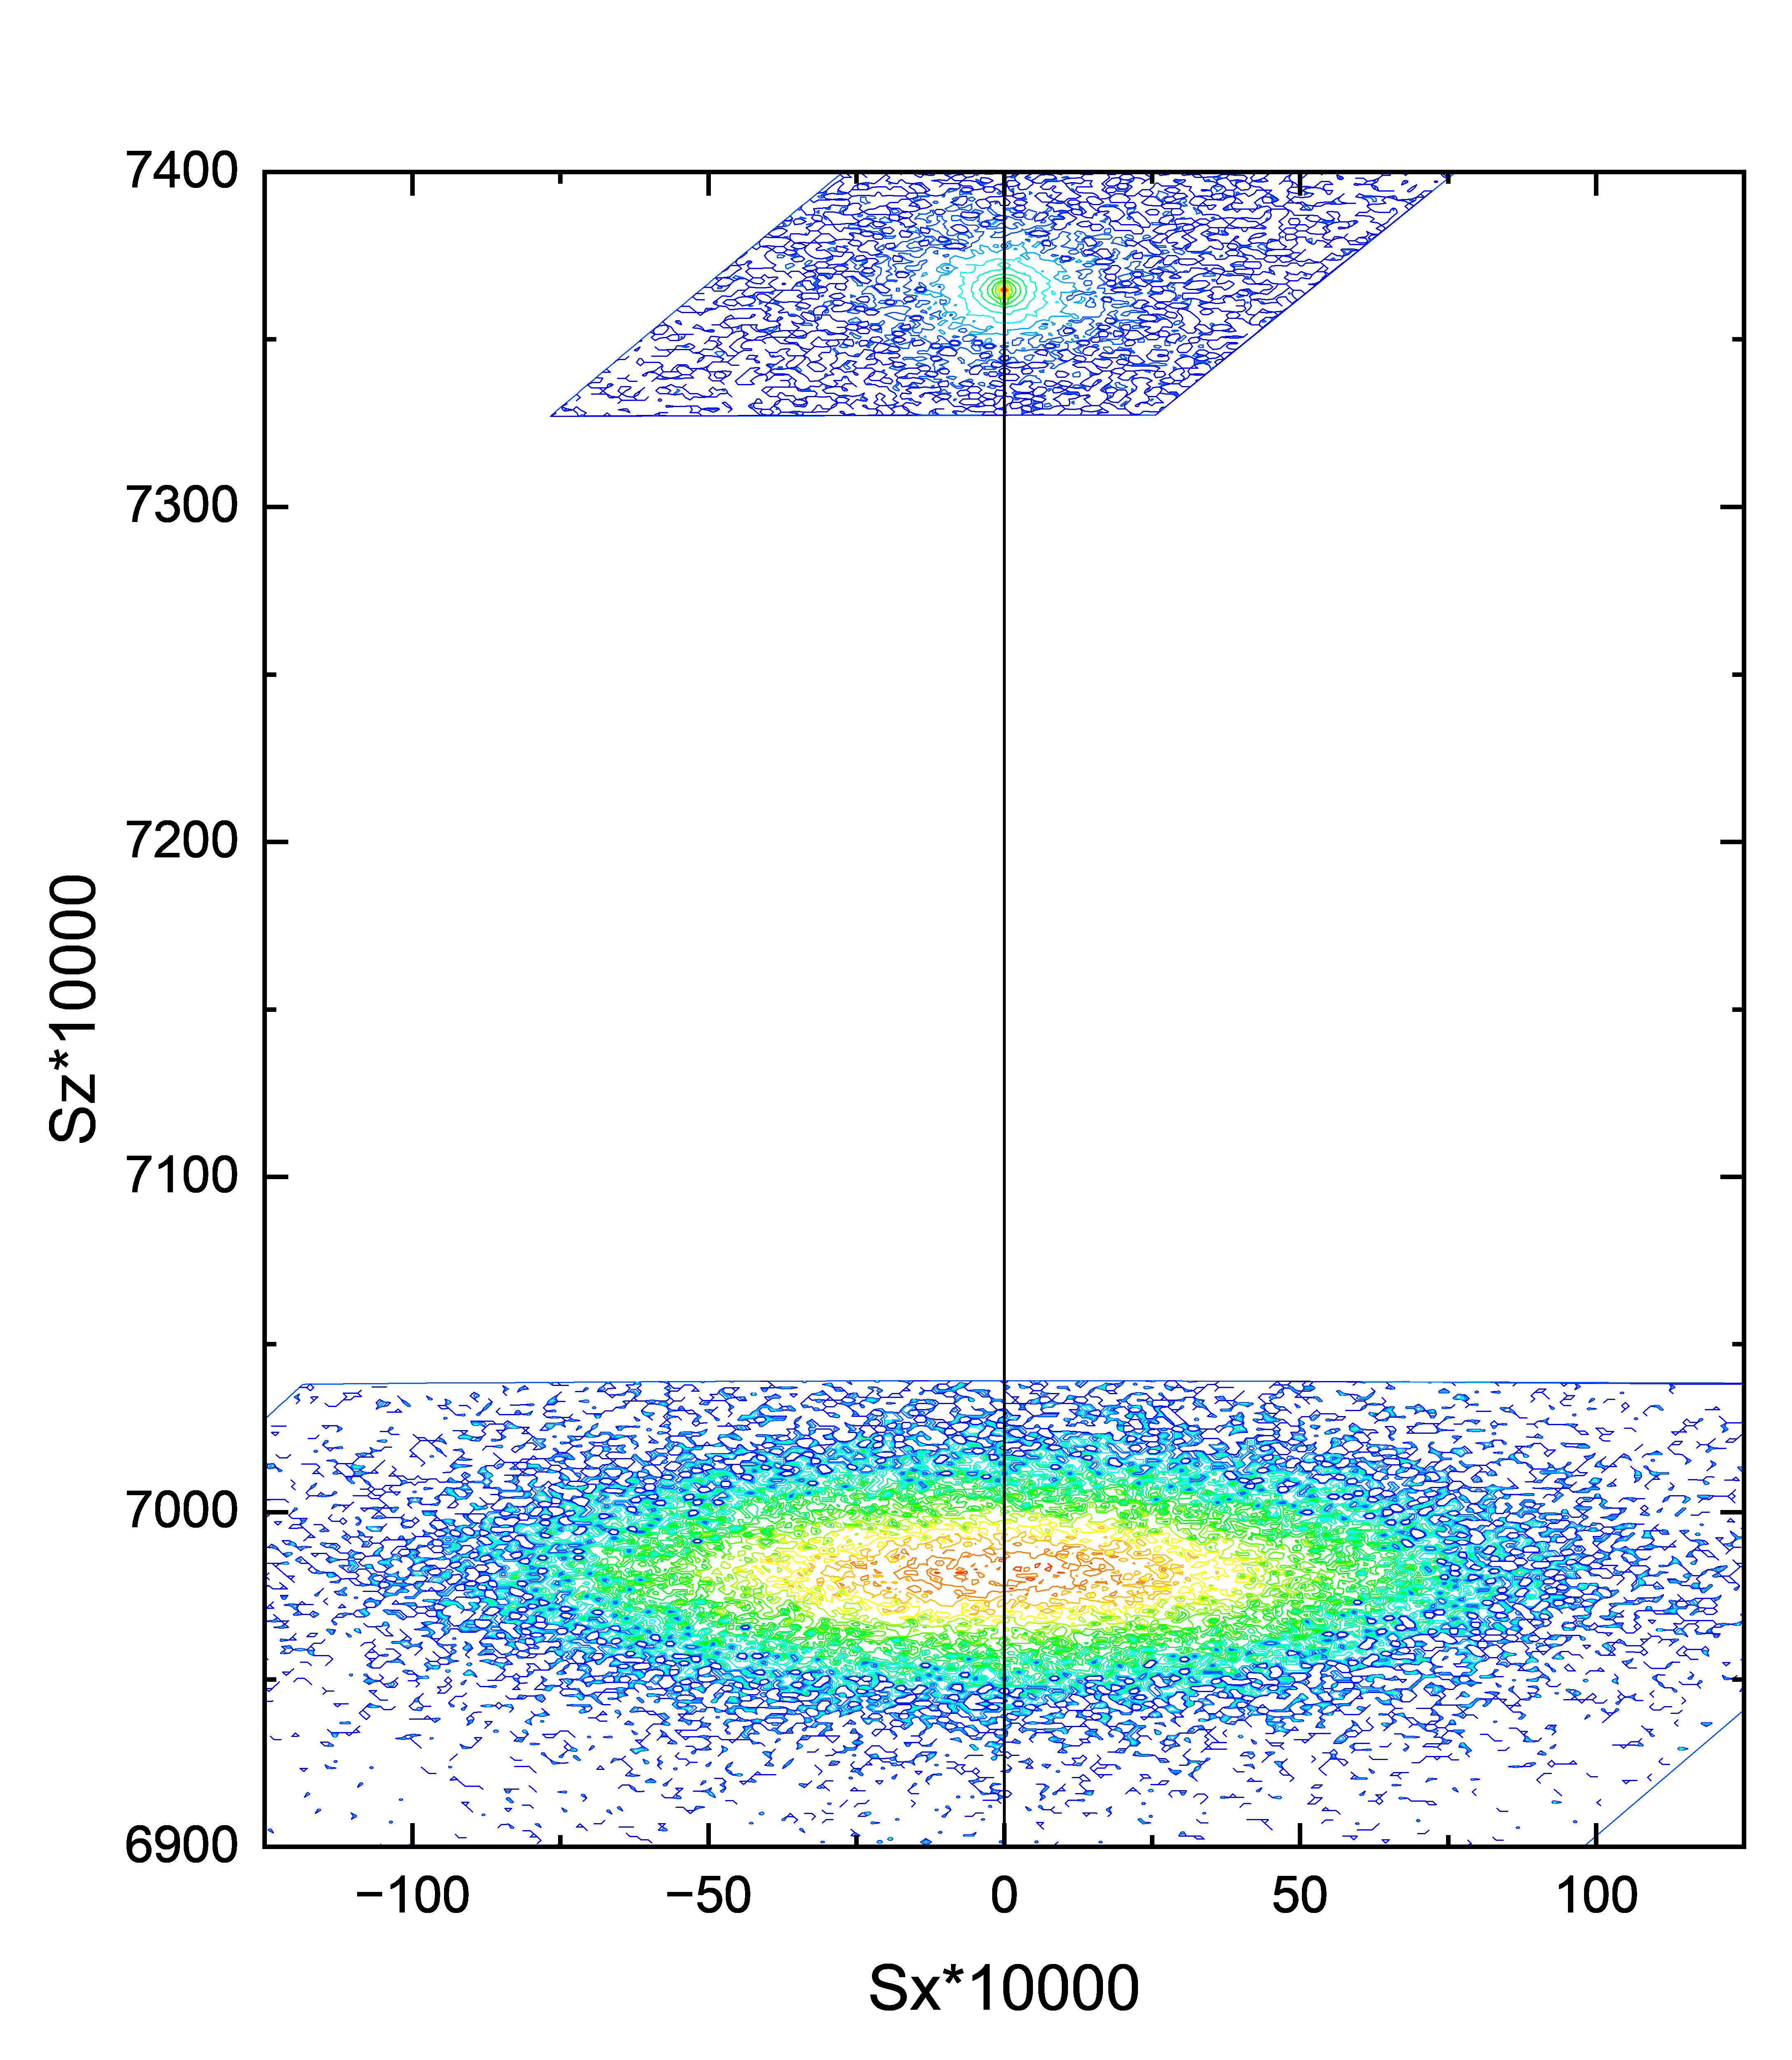
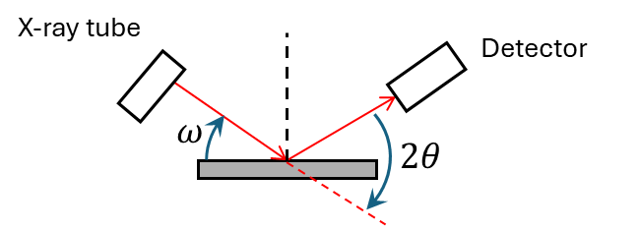
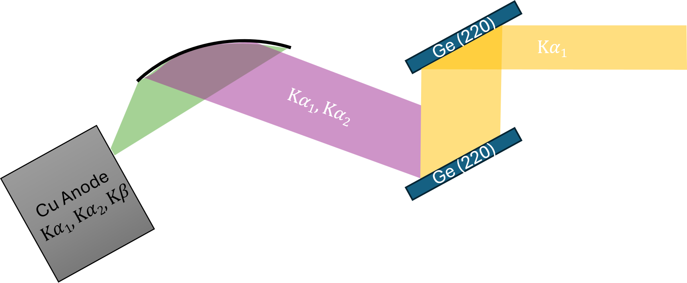
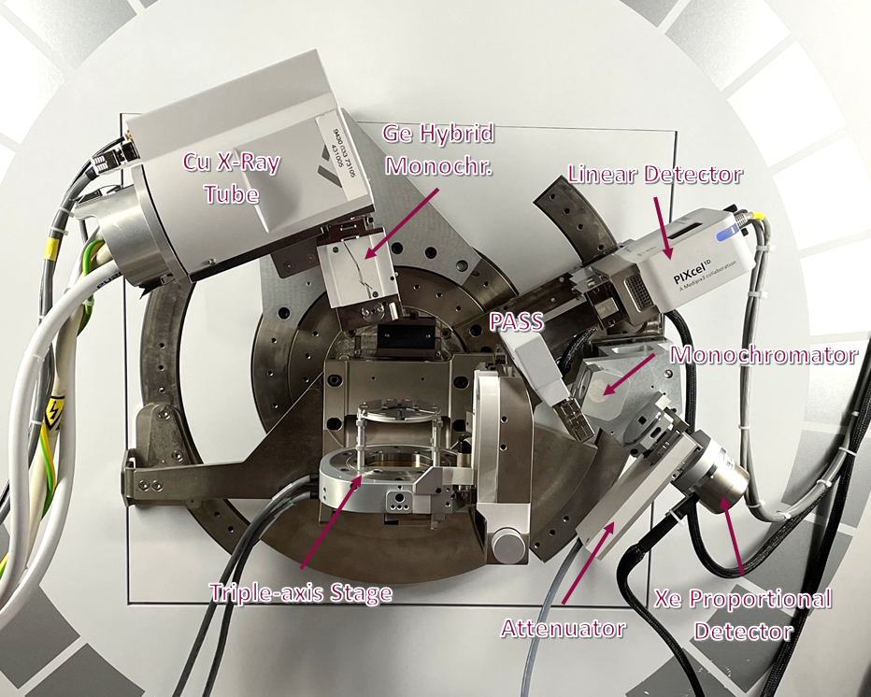

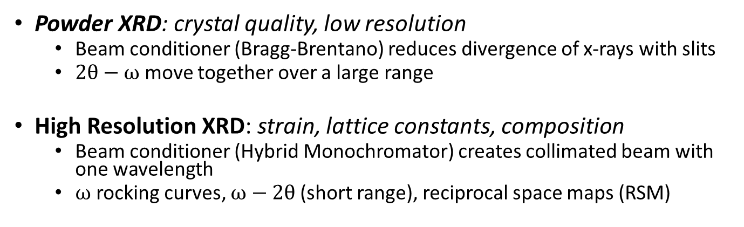
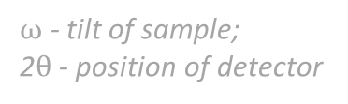

X-Ray Diffraction (XRD)
Powder XRD: crystal quality, low resolution
Beam conditioner (Bragg-Brentano) reduces divergence of x-rays with slits
$2θ−ω$ move together over a large range
High Resolution XRD: strain, lattice constants, composition
Beam conditioner (Hybrid Monochromator) creates collimated beam with one wavelength
$ω$ rocking curves, $ω−2θ$ (short range), reciprocal space maps (RSM)
(004) RSM of GeSn on Si
$$sx=\frac{qx}{2π}=\frac{1}{λ}[\cos\left(ω\right)−\cos\left(2θ−ω\right)]$$
$$sz=\frac{qz}{2π}=\frac{1}{λ}[\sin\left(ω\right)+\sin\left(2θ−ω\right)]$$
PANalytical Empyrean X-Ray Diffractometer
$ω$ - tilt of sample;
2$θ$ - position of detector
Hybrid Monochromator for HRXRD
P. F. Fewster, X-Ray Scattering From Semiconductors and Other Materials, (World Scientific Pub. Co. 2015).

Slide 9
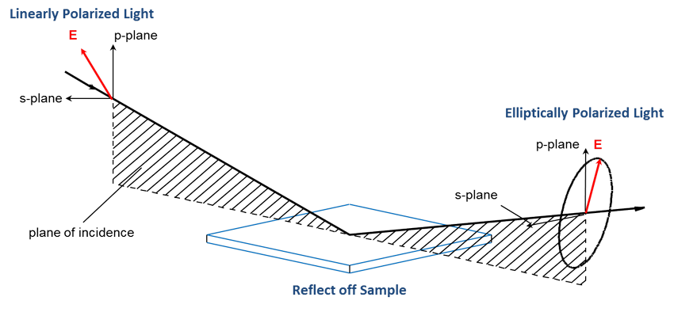
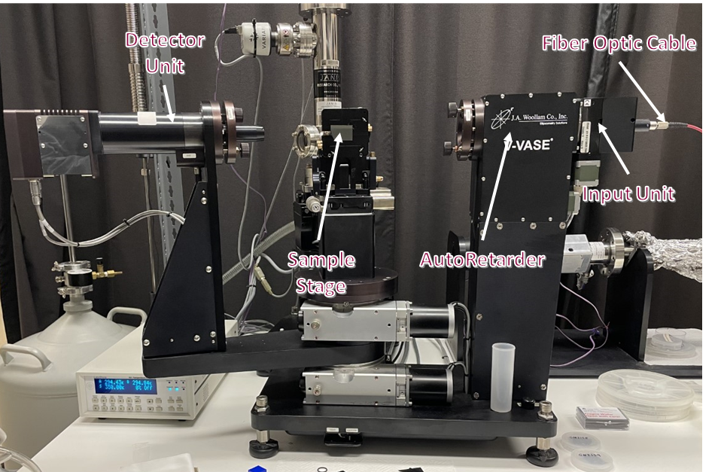
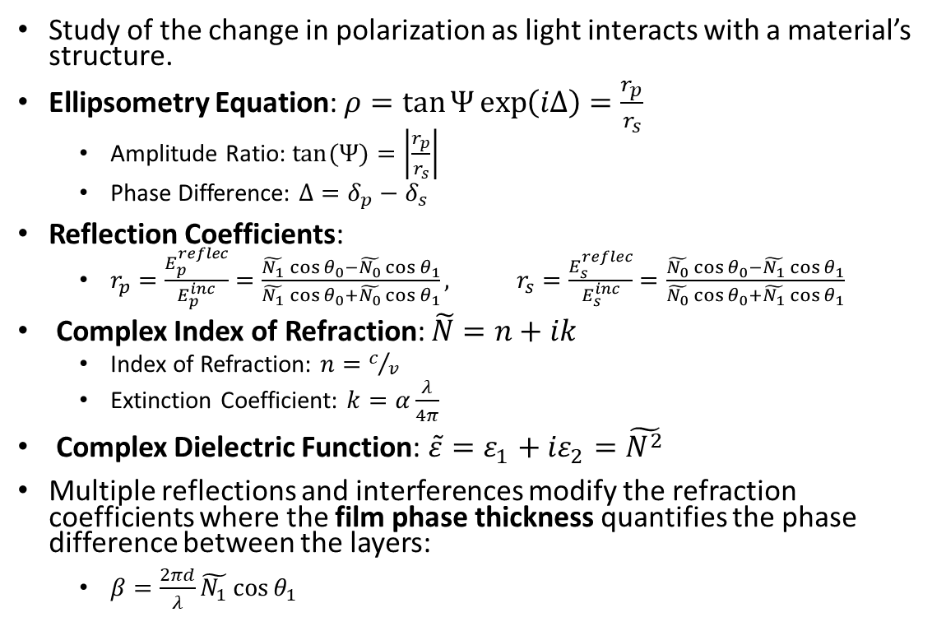
Ellipsometry
Study of the change in polarization as light interacts with a material’s structure.
Ellipsometry Equation: $ρ=\tan{Ψ}\exp\left(iΔ\right)=\frac{r_{p}}{r_{s}}$
Amplitude Ratio: $tan(Ψ)=\left|\frac{r_{p}}{r_{s}}\right|$
Phase Difference: $Δ=δ_{p}−δ_{s}$
Reflection Coefficients:
$r_{p}=\frac{E_{p}^{reflec}}{E_{p}^{inc}}=\frac{\tilde{N_{1}}\cos{θ_{0}}−\tilde{N_{0}}\cos{θ_{1}}}{\tilde{N_{1}}\cos{θ_{0}}+\tilde{N_{0}}\cos{θ_{1}}},$ $r_{s}=\frac{E_{s}^{reflec}}{E_{s}^{inc}}=\frac{\tilde{N_{0}}\cos{θ_{0}}−\tilde{N_{1}}\cos{θ_{1}}}{\tilde{N_{0}}\cos{θ_{0}}+\tilde{N_{1}}\cos{θ_{1}}}$
Complex Index of Refraction: $\tilde{N}=n+ik$
Index of Refraction: $n=c/v$
Extinction Coefficient: $k=α\frac{λ}{4π}$
Complex Dielectric Function: $\tilde{ε}=ε_{1}+{iε}_{2}=\tilde{N^{2}}$
Multiple reflections and interferences modify the refraction coefficients where the film phase thickness quantifies the phase difference between the layers:
$β=\frac{2πd}{λ}\tilde{N_{1}}\cos{θ_{1}}$
J.A. Woollam UV-VASE Ellipsometer
H. G. Tompkins and J. N. Hilfiker, Spectroscopic Ellipsometry (Momentum Press, 2016).
H. Fujiwara, Spectroscopic Ellipsometry (John Wiley & Sons, 2007).
J. A. Woollam Co., Guide to Using WVASE32 (2017).

Slide 10
Introduction
Ge(Sn) on Si samples, %Sn = 6.9%, grown by the group of Kouvetakis at ASU by chemical vapor deposition
GeO₂ is identified as a promising piezoelectric material, converts mechanical stress to electrical energy.
Ge has an indirect bandgap that transitions towards a direct bandgap with Sn incorporation.
Performance of these devices depend on the quality of the GeSn layer.
P. Armand et al., Mater. Res. Bull. 129, 110881 (2020).

Slide 11
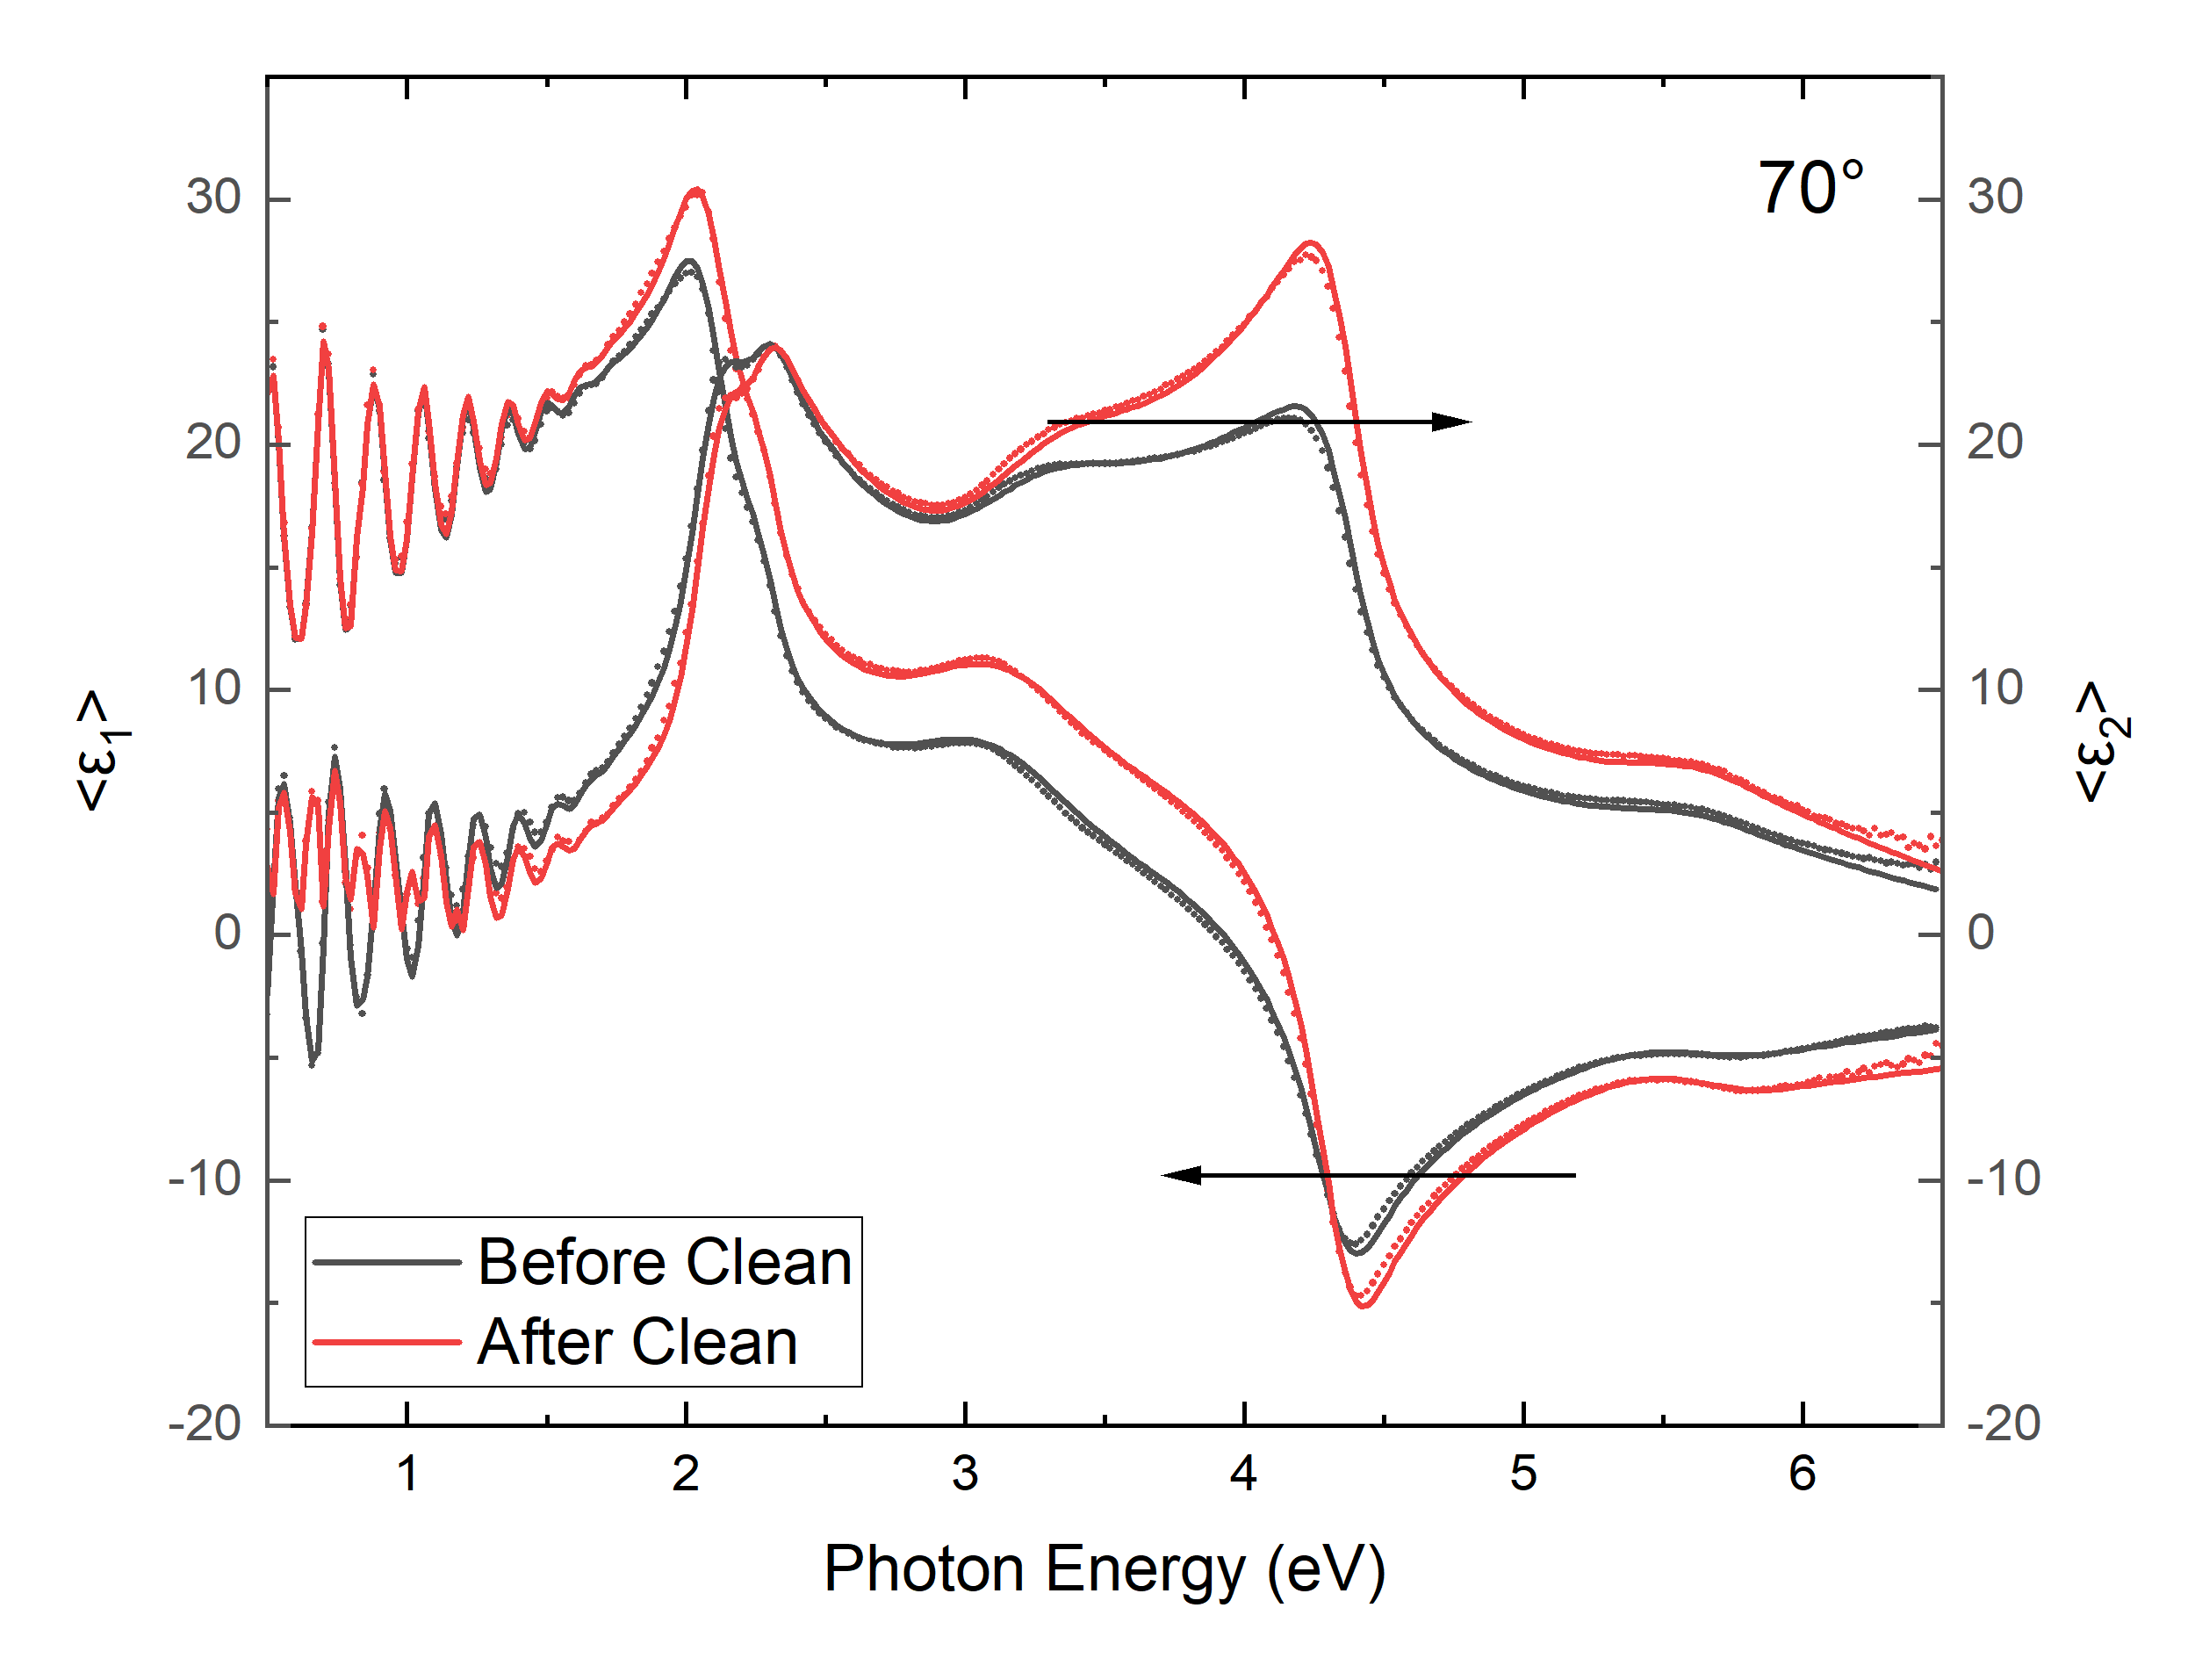
Rapid Thermal Oxidation Procedure
 | Avg. As-Received Oxide Thickness (Å) | Avg. After Clean Oxide Thickness (Å)
Ge on Si | 26 | 11
GeSn on Si | 38 | 25
Ultrasonically cleaned in deionized water for 15 mins, then dried with nitrogen gas
MILA-5000 Mini Lamp Annealer (ULVAC-RIKO, Inc.)
Oxygen Flow Rate: 0.2 L/min Pressure: 2.7 atm
Heats up:1 min, at temp:specific time, cools to room temp:20-30 mins
Ge on Si: 550°C-650°C for 2,4,8 hours
Ellipsometry was used to measure the thicknesses
Before Clean, Before Anneal;
After Clean, Before Anneal;
After Clean, After Anneal
Pseudodielectric function for Ge on Si before and after cleaning.

Slide 12
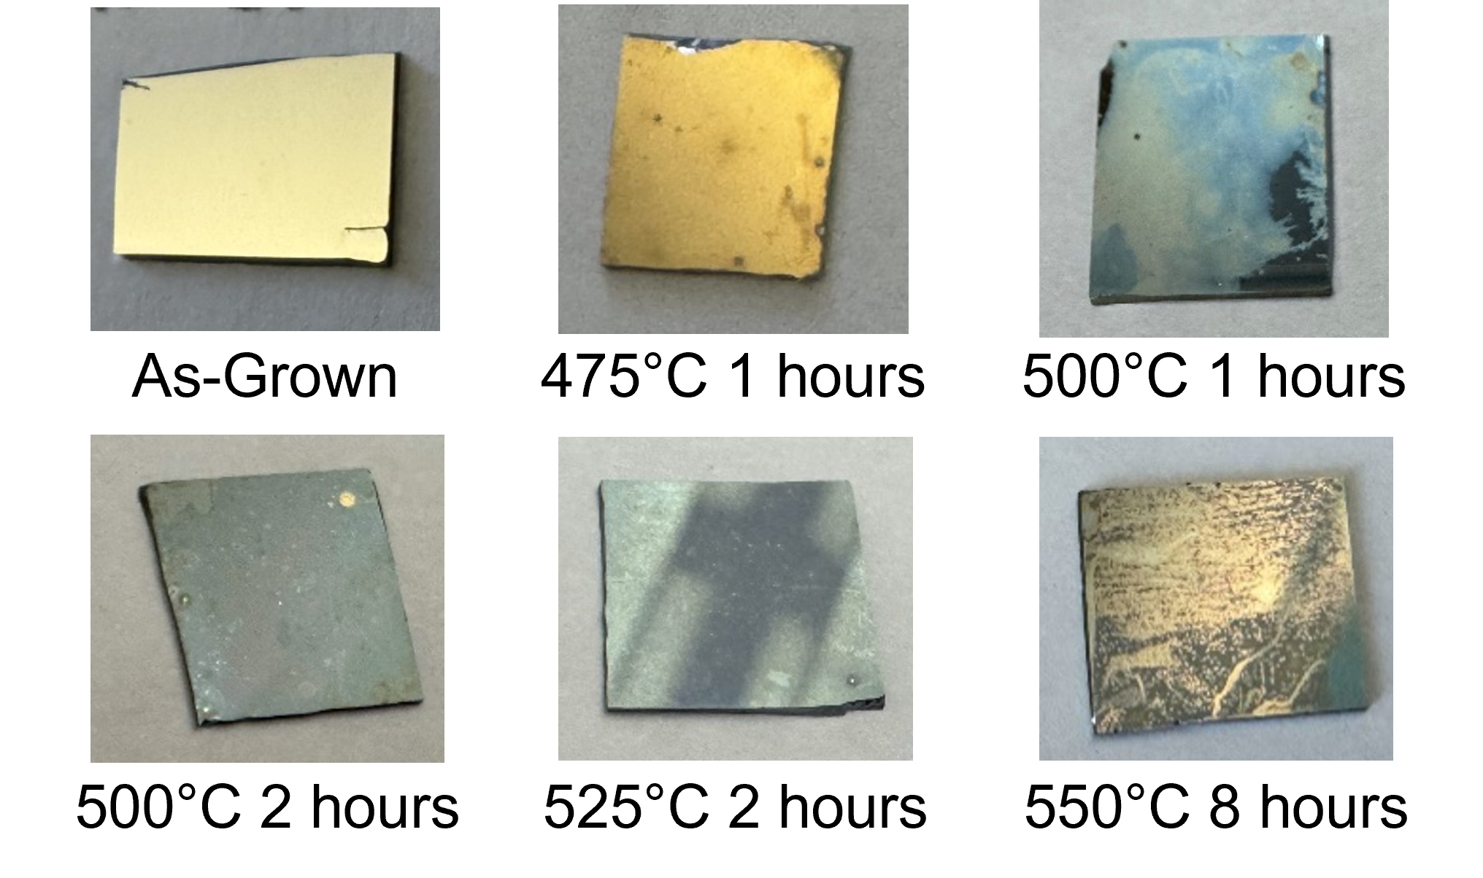
Surface Decolorization
Ge on Si
GeSn on Si

Slide 13
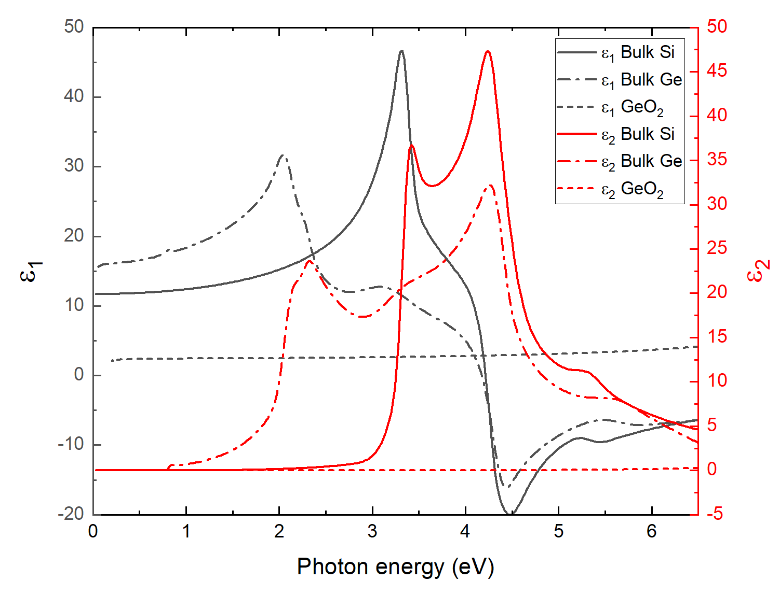
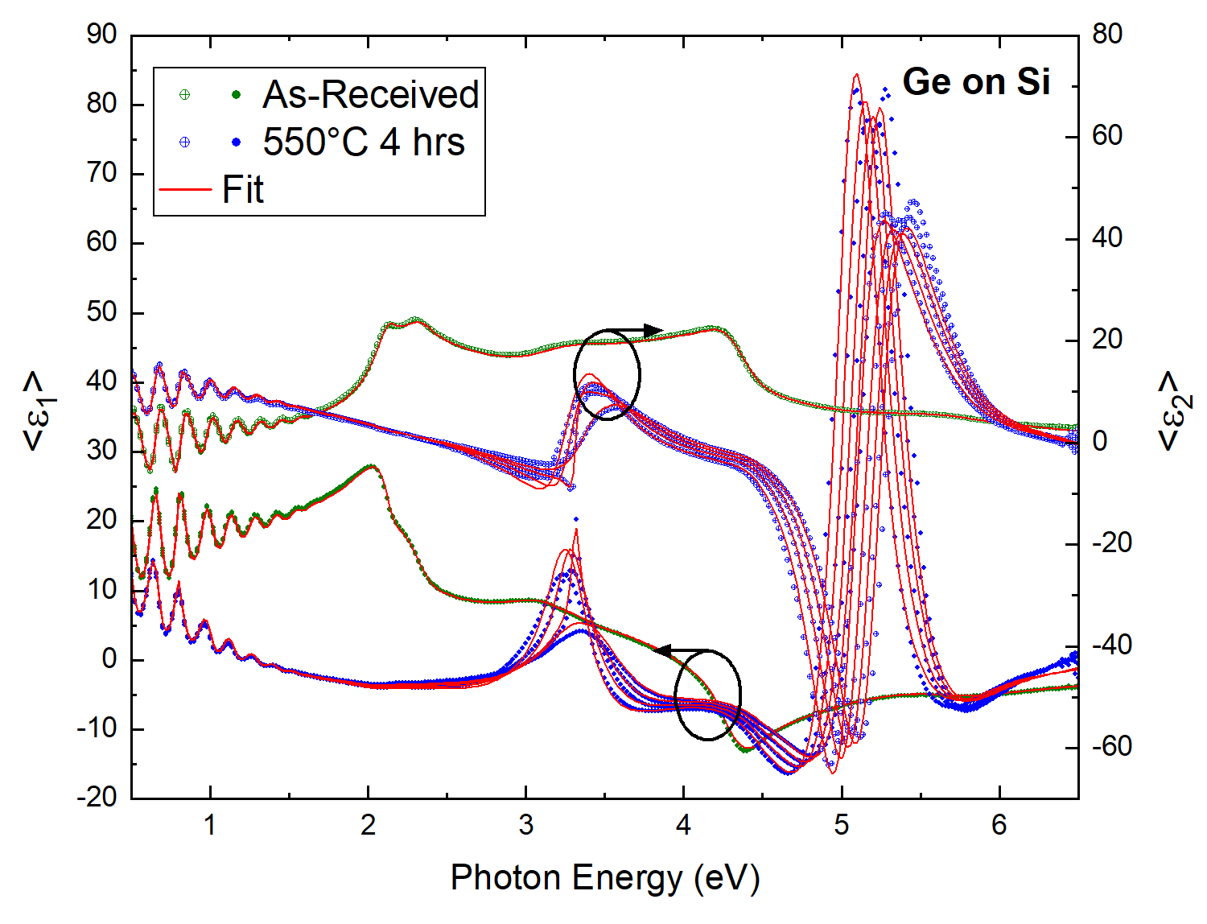
Ge on Si: Ellipsometry Model - UV
Optical constants for each layer are used to model the data to determine the thicknesses.
Modeling included non-uniformity in the Ge oxide layer
Ge Oxide
Ge
Si
Optical constants for bulk Si, bulk Ge, and GeO₂.
Pseudodielectric function for Ge on Si before clean and after annealing.
J. A. Woollam Co., Guide to Using WVASE32 (2017).
T. Nunley et al., J. Vacu. Sci. Technol. B 34, (2016).

Slide 14
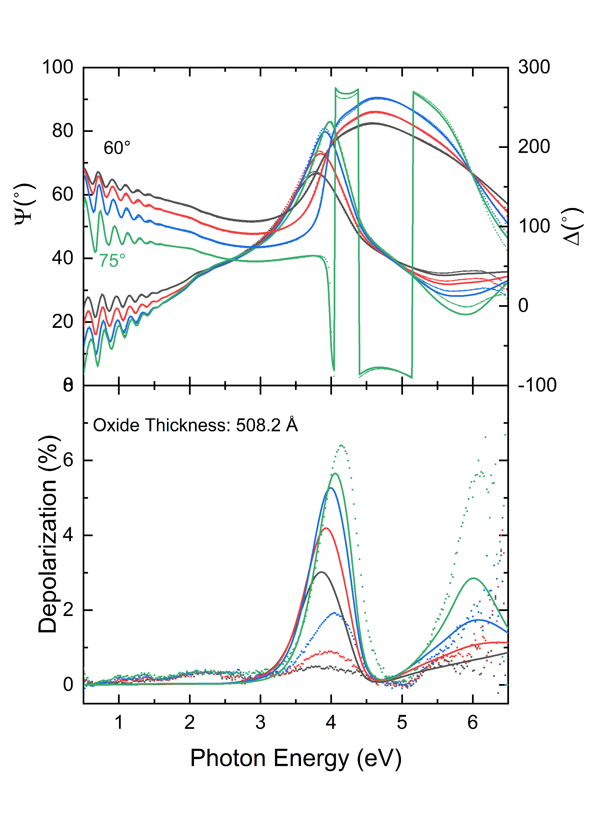
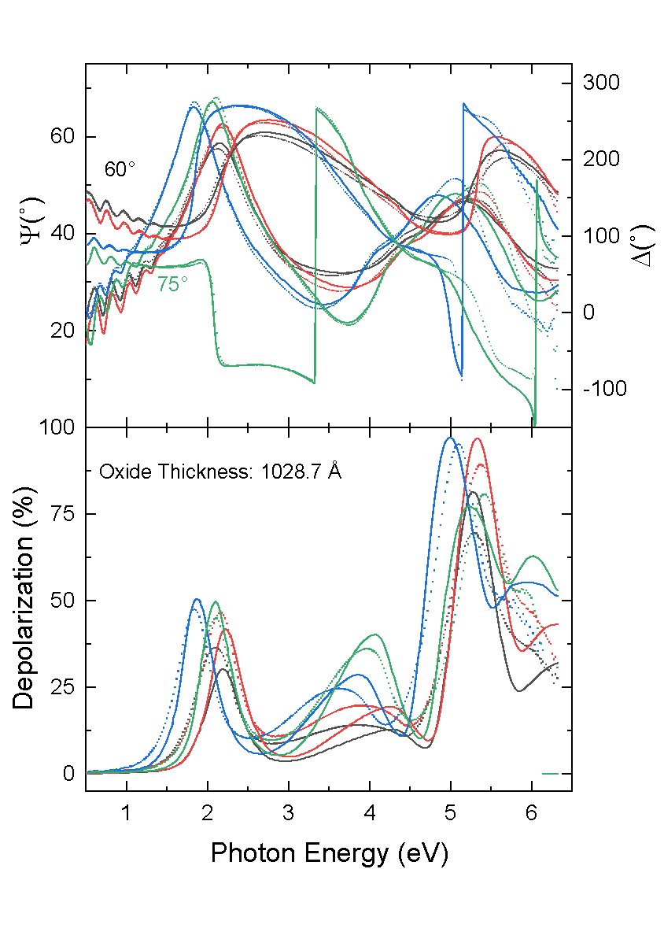
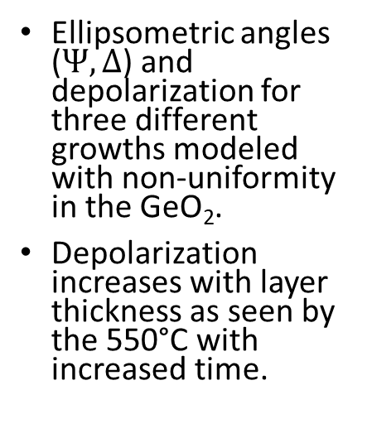
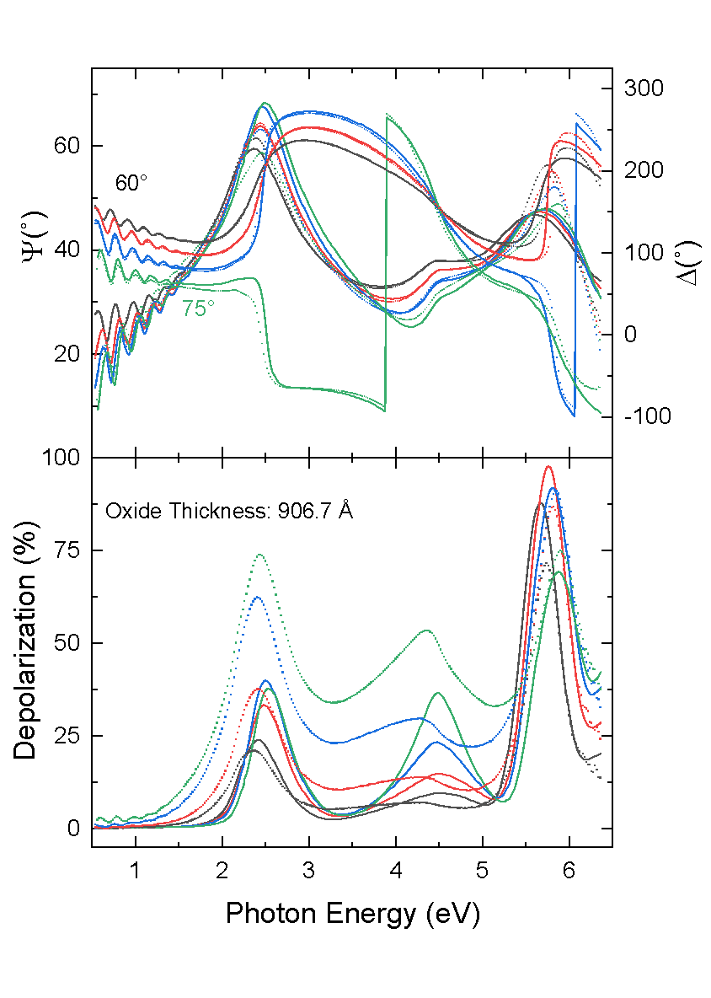
Ge on Si: Depolarization
550°C 2 hours
550°C 8 hours
575°C 2 hours
Ellipsometric angles ($Ψ,Δ$) and depolarization for three different growths modeled with non-uniformity in the GeO₂.
Depolarization increases with layer thickness as seen by the 550°C with increased time.
J. A. Woollam Co., Guide to Using WVASE32 (2017).
T. Nunley et al., J. Vacu. Sci. Technol. B 34, (2016).

Slide 15
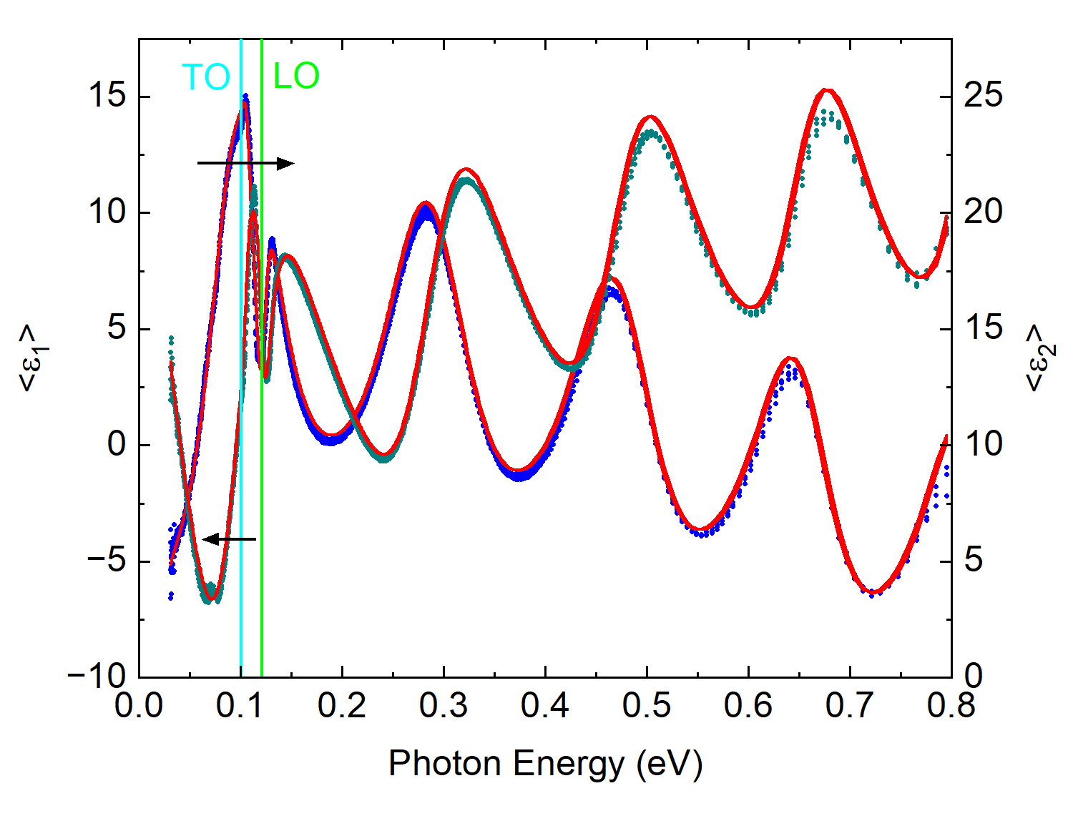
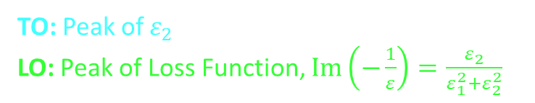
Ge on Si: Phonon Modes in IR
Samples were measured with IRVASE from 0.03-0.8 eV
Model: Dude superposition in the Bulk Si and Bulk Ge layers; Oxide with a general oscillator layer
Anneal at 550°C for 4 hrs,
Transverse Optical (TO) Phonon Frequency = 0.10 eV
Longitudinal Optical (LO) Phonon Frequencies = 0.12 eV
Armand et al. measured anisotropic trigonal GeO₂ modes from 0.105-0.124 eV
Pseudodielectric of Ge on Si annealed at 550°C for 4 hours with labeled TO and LO phonon frequencies.
TO: Peak of $ε_{2}$
LO: Peak of Loss Function, $Im\left(−\frac{1}{ε}\right)=\frac{ε_{2}}{ε_{1}^{2}+ε_{2}^{2}}$
J. A. Woollam Co., Guide to Using WVASE32 (2017).
T. Nunley et al., J. Vacu. Sci. Technol. B 34, (2016).
H. Fujiwara, Spectroscopic Ellipsometry (John Wiley & Sons, 2007).
S. Zollner et al., J. Vacu. Sci. Technol. B 37, (2019).
P. Armand et al., Mater. Res. Bull. 129, 110881 (2020).

Slide 16
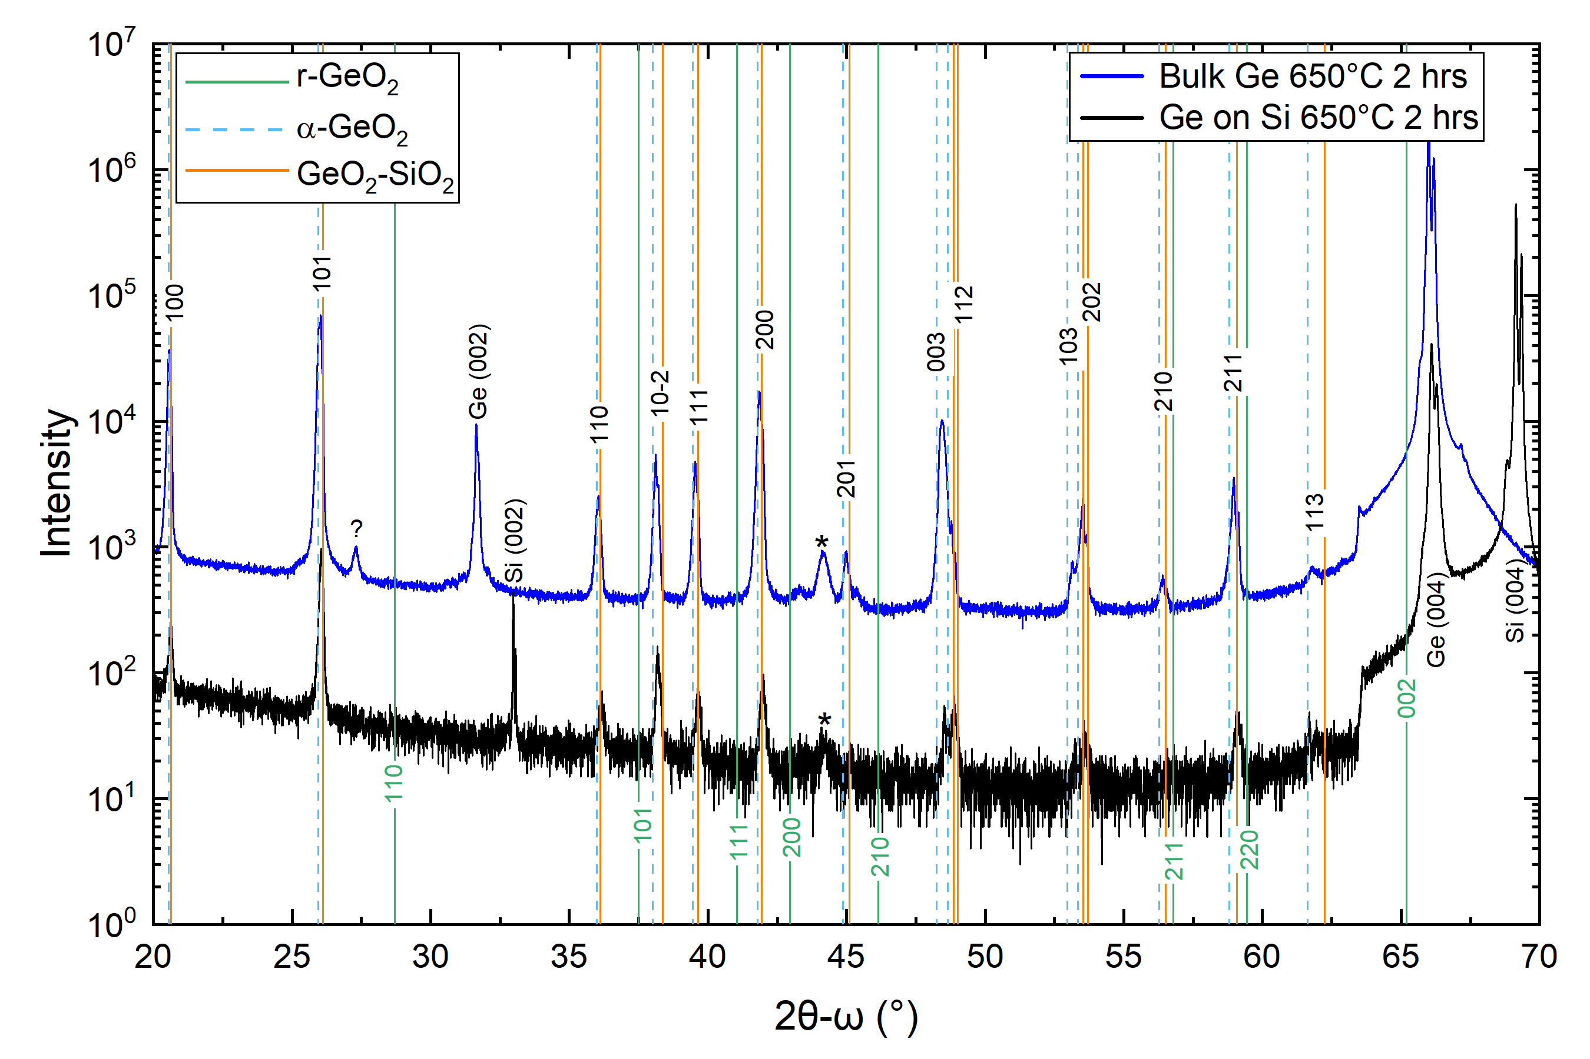
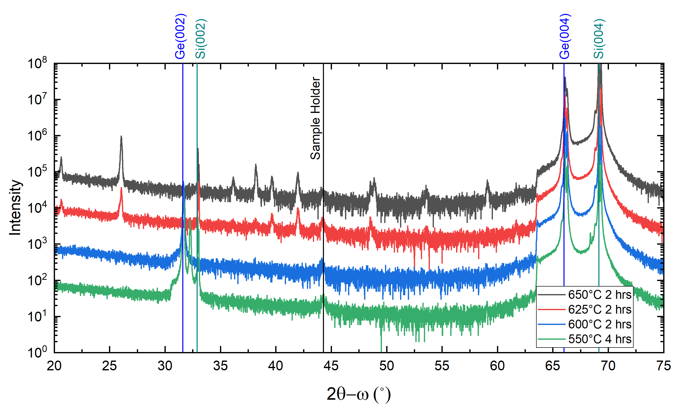
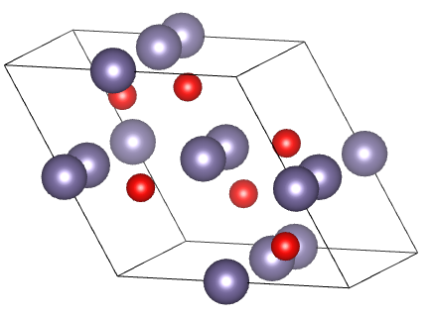
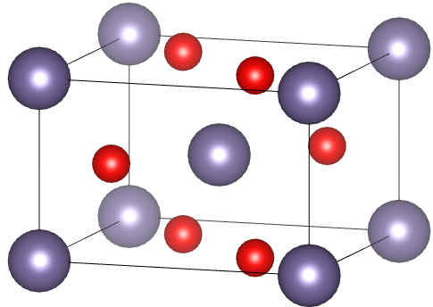
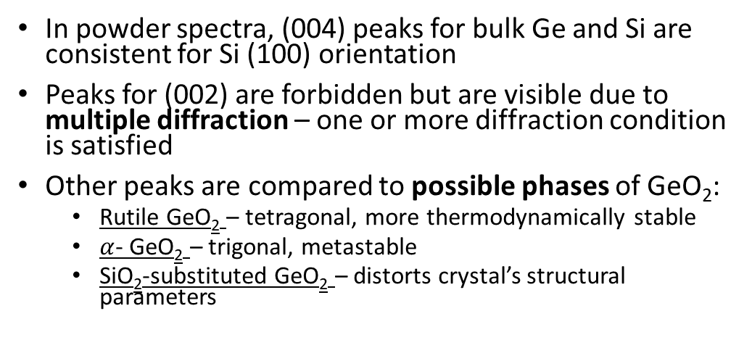

Ge on Si: After Anneal Powder XRD
In powder spectra, (004) peaks for bulk Ge and Si are consistent for Si (100) orientation
Peaks for (002) are forbidden but are visible due to multiple diffraction – one or more diffraction condition is satisfied
Other peaks are compared to possible phases of GeO₂:
Rutile GeO₂ – tetragonal, more thermodynamically stable
$α$- GeO₂ – trigonal, metastable
SiO₂-substituted GeO₂ – distorts crystal’s structural parameters
r-GeO₂
$α$-GeO₂
P. Zaumseil, J. Appl. Crystallogr. 48, 528–532 (2015).
I. Rahaman et al., Appl. Phys. Lett. 125, (2024).
A. Lignie et al., J. Appl. Crystallogr. 45, 272–278 (2012).

Slide 17
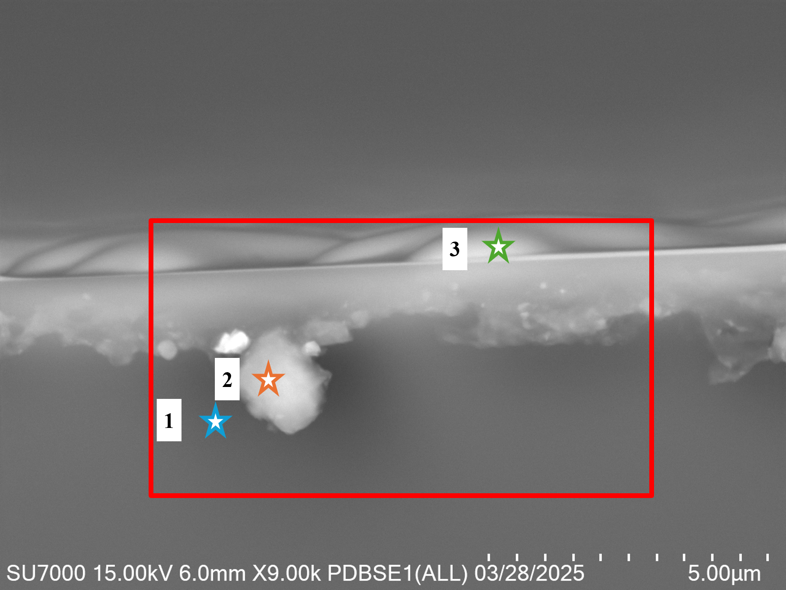
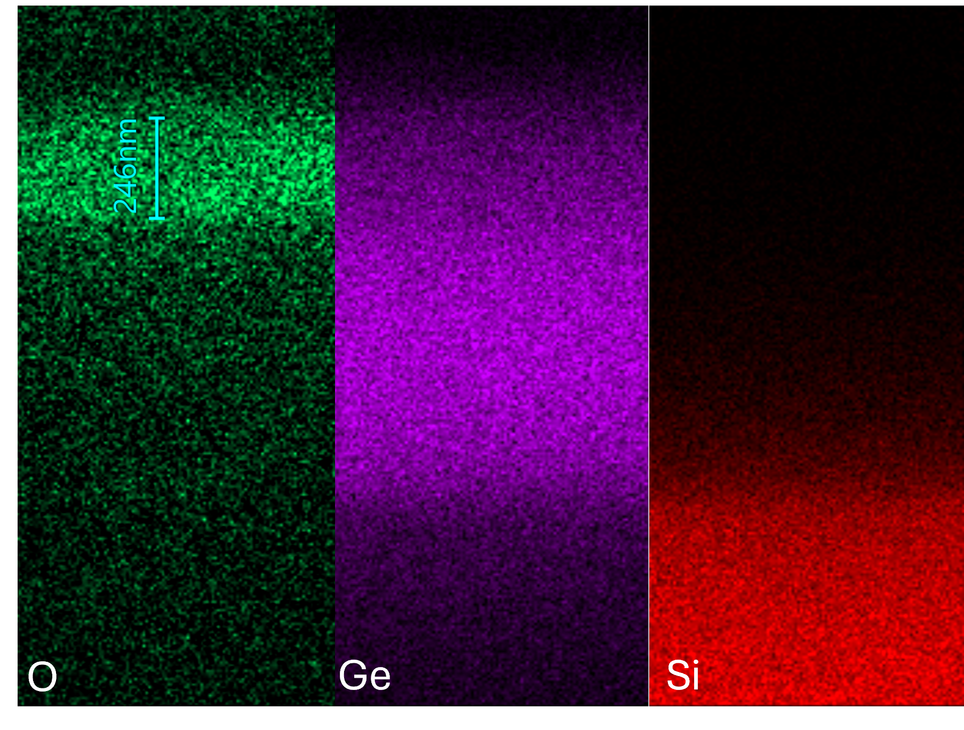
Ge on Si: Cross-Sectional EDX
(1) Si Substrate
(2) Unknown; Artifact from Cleave
(3) Sample’s Surface
Although, EDX may suggest Si is present in the oxide, the possibility is uncertain due to Si needing to migrate through the entire Ge layer.
FROM POWDER: Other possibility is that the oxide may be composed of only Ge showing a reduced lattice constant that increases density during annealing
Si (Wt%) | Ge | O | C | Other
96.8(0.4) | 0 | 0.5(0.1) | 2.7(10.4) | 0
Si (Wt%) | Ge | O | C | Other
47.1(0.3) | 0 | 25.4(0.2) | 20.1(0.5) | 7.45(0.3)
Cross-sectional SEM image of Ge on Si after 650°C for 2 hours.
Si (Wt%) | Ge | O | C | Other
20.0(0.1) | 41.0(0.2) | 29.4(0.2) | 9.62(0.3) | 0
EDX measurements of Ge on Si after 575°C for 8 hours. Oxide measured by EDX and ellipsometry were 2460 Å and 2409 Å.

Slide 18
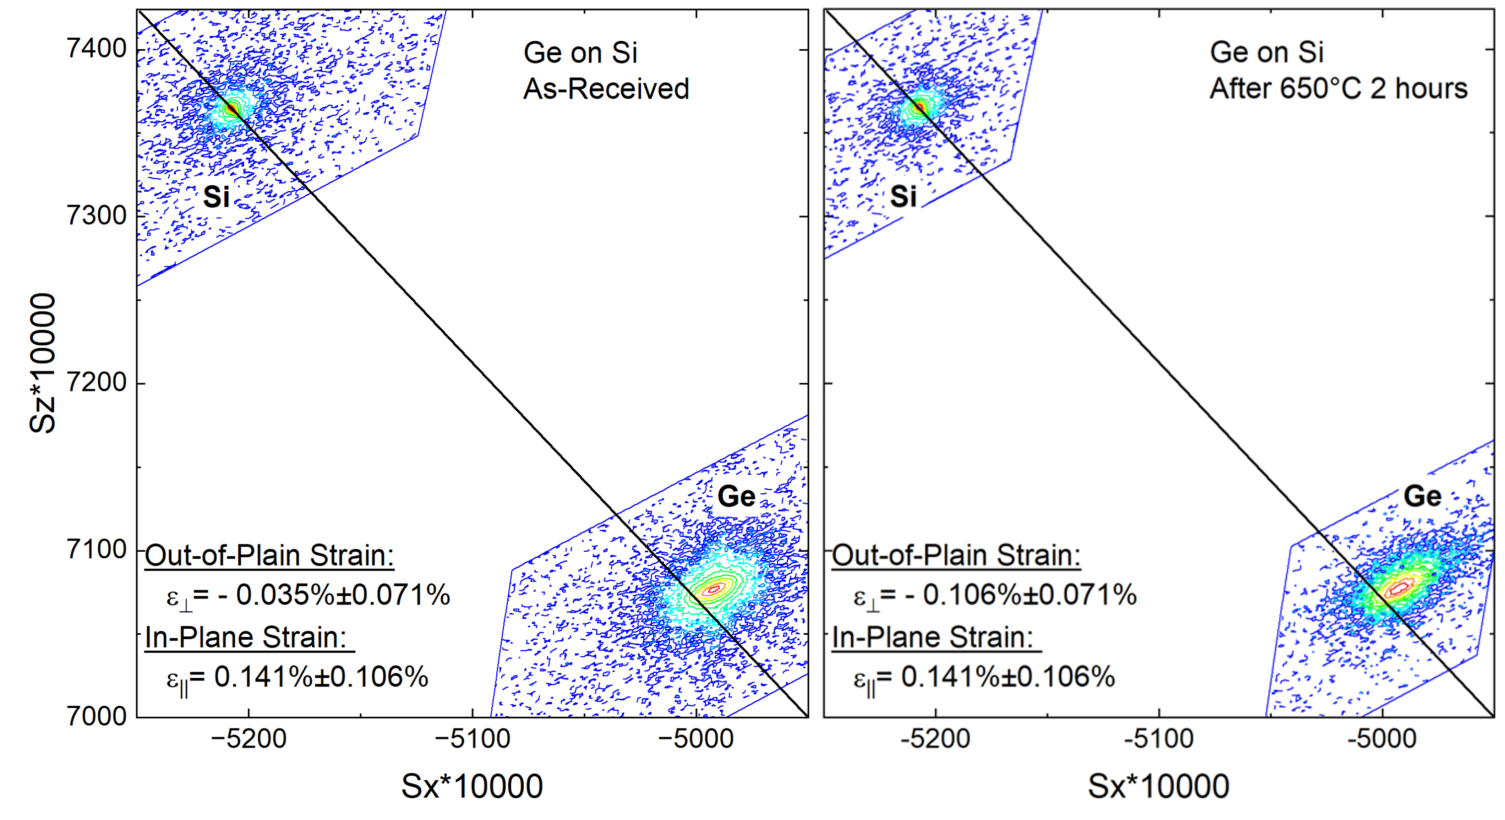
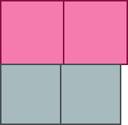



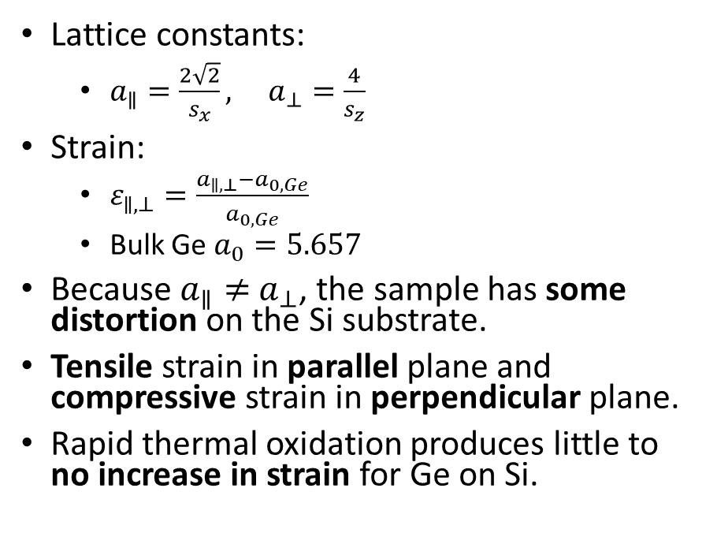
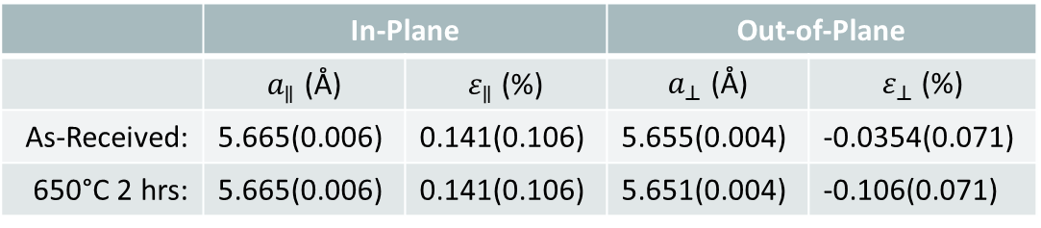

Ge on Si: High Resolution XRD
$$sx=\frac{qx}{2π}=\frac{1}{λ}[\cos\left(ω\right)−\cos\left(2θ−ω\right)]$$
$$sz=\frac{qz}{2π}=\frac{1}{λ}[\sin\left(ω\right)+\sin\left(2θ−ω\right)]$$
$a$||
Lattice constants:
$a_{∥}=\frac{2\sqrt{2}}{s_{x}}, a_{⊥}=\frac{4}{s_{z}}$
Strain:
$ε_{∥,⊥}=\frac{a_{∥,⊥}−a_{0,Ge}}{a_{0,Ge}}$
Bulk Ge $a_{0}=5.657$
Because $a_{∥}≠$ $a_{⊥}$, the sample has some distortion on the Si substrate.
Tensile strain in parallel plane and compressive strain in perpendicular plane.
Rapid thermal oxidation produces little to no increase in strain for Ge on Si.
$$a_{⊥}$$
Relaxation line
Relaxation line
 | In-Plane |  | Out-of-Plane
 | $a_{∥}$ (Å) | $ε_{∥}$ (%) | $a_{⊥}$ (Å) | $ε_{⊥}$ (%)
As-Received: | 5.665(0.006) | 0.141(0.106) | 5.655(0.004) | -0.0354(0.071)
650°C 2 hrs: | 5.665(0.006) | 0.141(0.106) | 5.651(0.004) | -0.106(0.071)
P. F. Fewster, X-Ray Scattering From Semiconductors and Other Materials, (World Scientific Pub. Co. 2015).
A. Navarro-Quezada et al., J. Cryst. Growth 291, 340 (2006).
W. Ni et al., J. Cryst. Growth 227–228, 756 (2001).

Slide 19
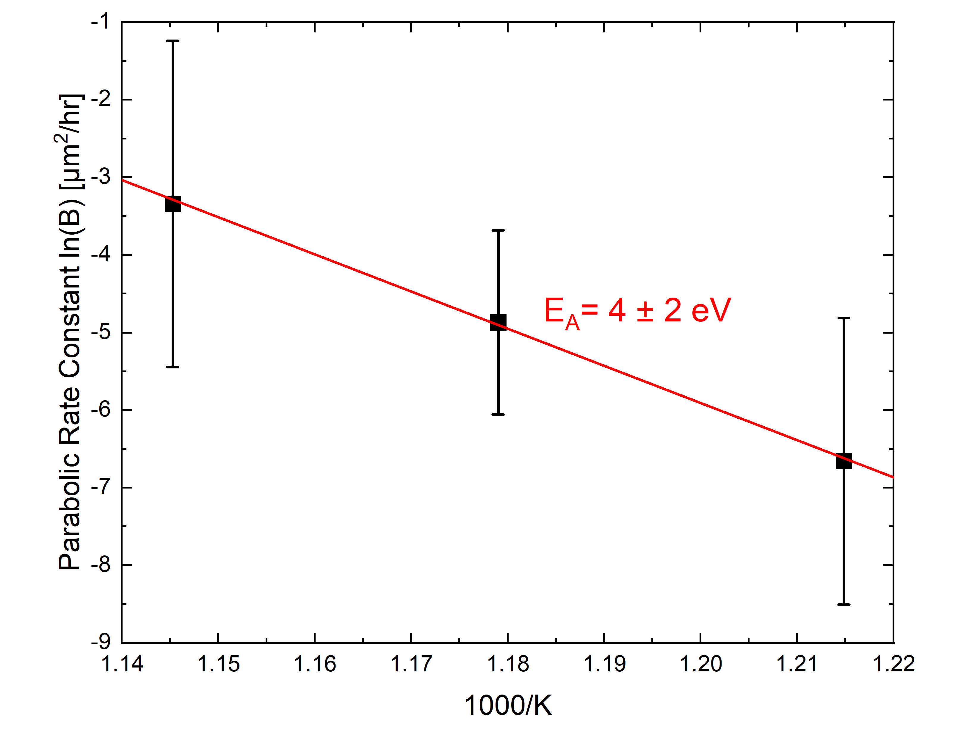
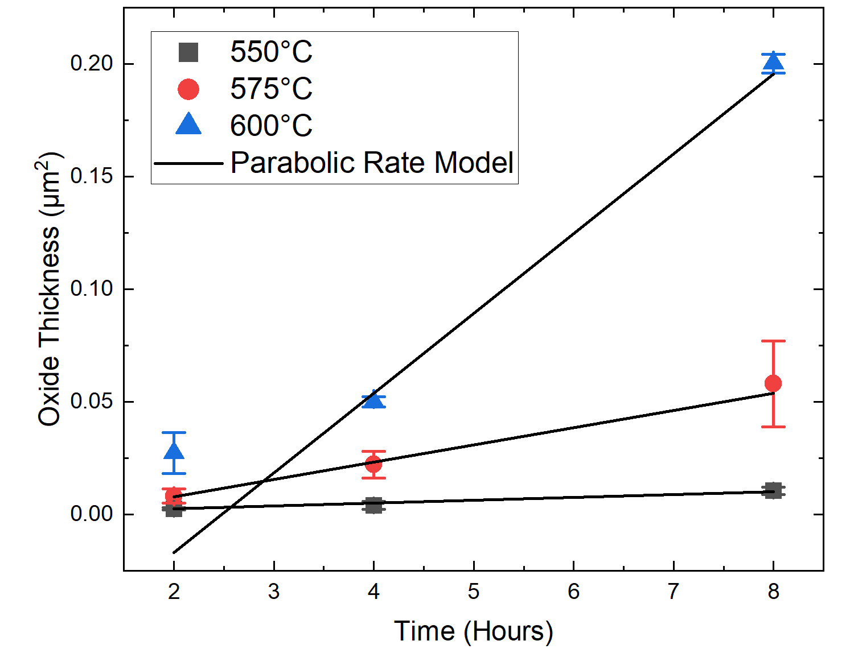
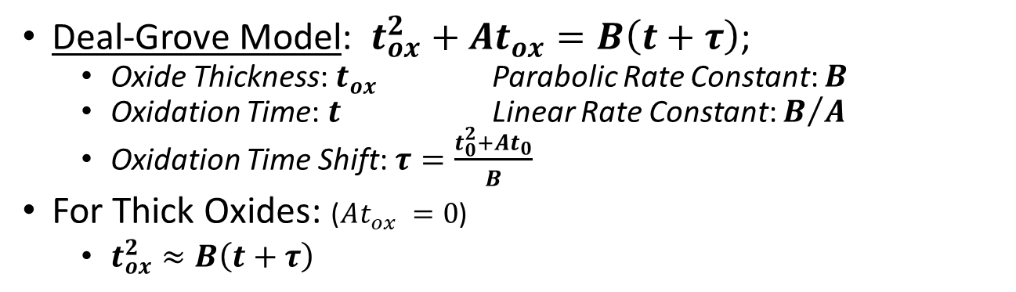
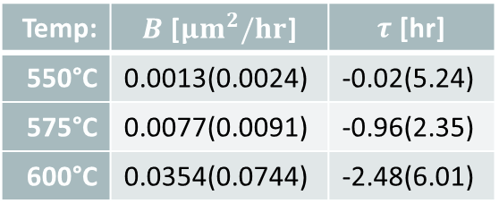
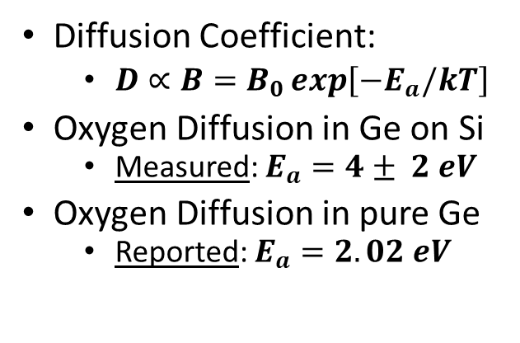
Ge on Si: Oxidation Kinetics
Deal-Grove Model: $t_{ox}^{2}+At_{ox}=B\left(t+τ\right)$;
Oxide Thickness: $t_{ox}$ Parabolic Rate Constant: $B$
Oxidation Time: $t$ Linear Rate Constant: $B/A$
Oxidation Time Shift: $τ=\frac{t_{0}^{2}+At_{0}}{B}$
For Thick Oxides: ($At_{ox} =0$)
$t_{ox}^{2}≈B\left(t+τ\right)$
Diffusion Coefficient:
$D∝B=B_{0}\exp\left[−E_{a}/kT\right]$
Oxygen Diffusion in Ge on Si
Measured: $E_{a}=4± 2 eV$
Oxygen Diffusion in pure Ge
Reported: $E_{a}=2.02 eV$
Temp: | $B$ [${μm}^{2}/hr$] | $τ$ [hr]
550°C | 0.0013(0.0024) | -0.02(5.24)
575°C | 0.0077(0.0091) | -0.96(2.35)
600°C | 0.0354(0.0744) | -2.48(6.01)
S. Campbell, The Science and Engineering of Microelectronic Fabrication (Oxford University Press, New York, NY, 1996).
B. Deal et al., J. Appl. Phys. 36, 3770 (1965).
C. Haas, J. Phys. Chem. Solids 15, 108 (1960).

Slide 20
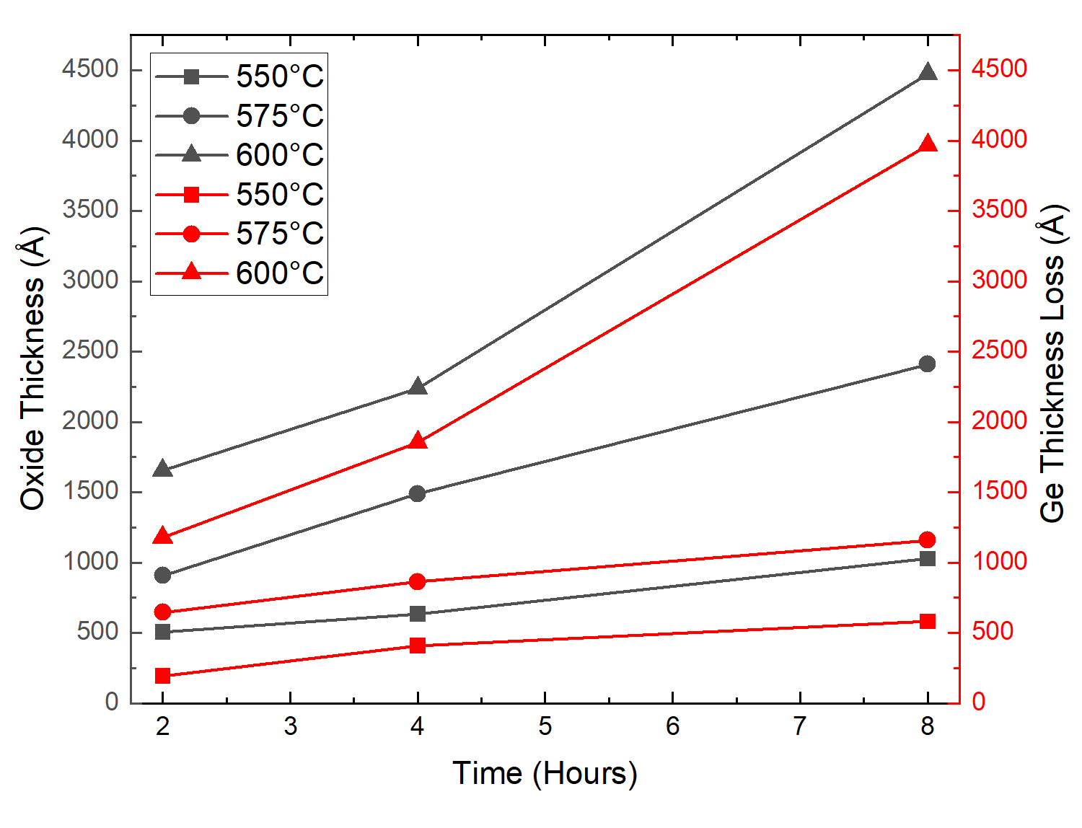
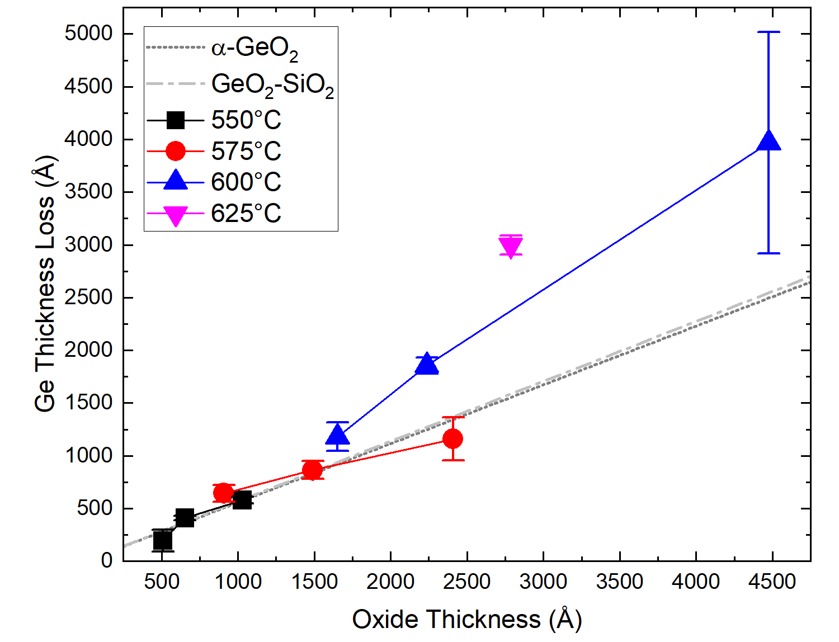
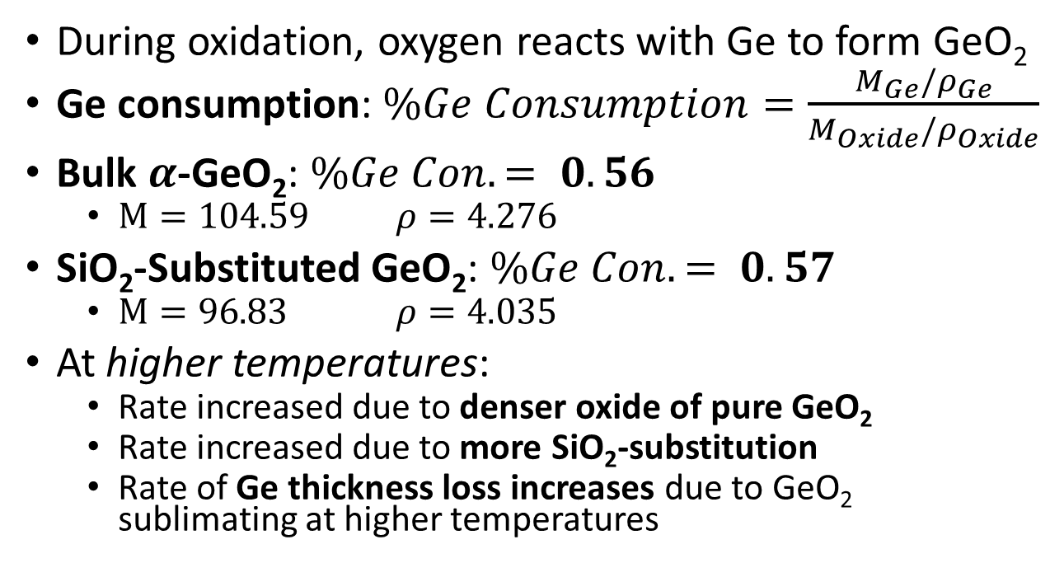
Ge on Si: Oxidation Kinetics
During oxidation, oxygen reacts with Ge to form GeO₂
Ge consumption: $\%Ge Consumption=\frac{M_{Ge}/ρ_{Ge}}{M_{Oxide}/ρ_{Oxide}}$
Bulk $α$-GeO₂: $\%Ge Con.= 0.56$
$M=104.59$ $ρ=4.276$
SiO₂-Substituted GeO₂: $\%Ge Con.= 0.57$
$M=96.83$ $ρ=4.035$
At higher temperatures:
Rate increased due to denser oxide of pure GeO₂
Rate increased due to more SiO₂-substitution
Rate of Ge thickness loss increases due to GeO₂ sublimating at higher temperatures
I. Rahaman et al., Appl. Phys. Lett. 125 (2024).
A. Lignie et al., J. Appl. Crystallogr. 45, 272 (2012).

Slide 21
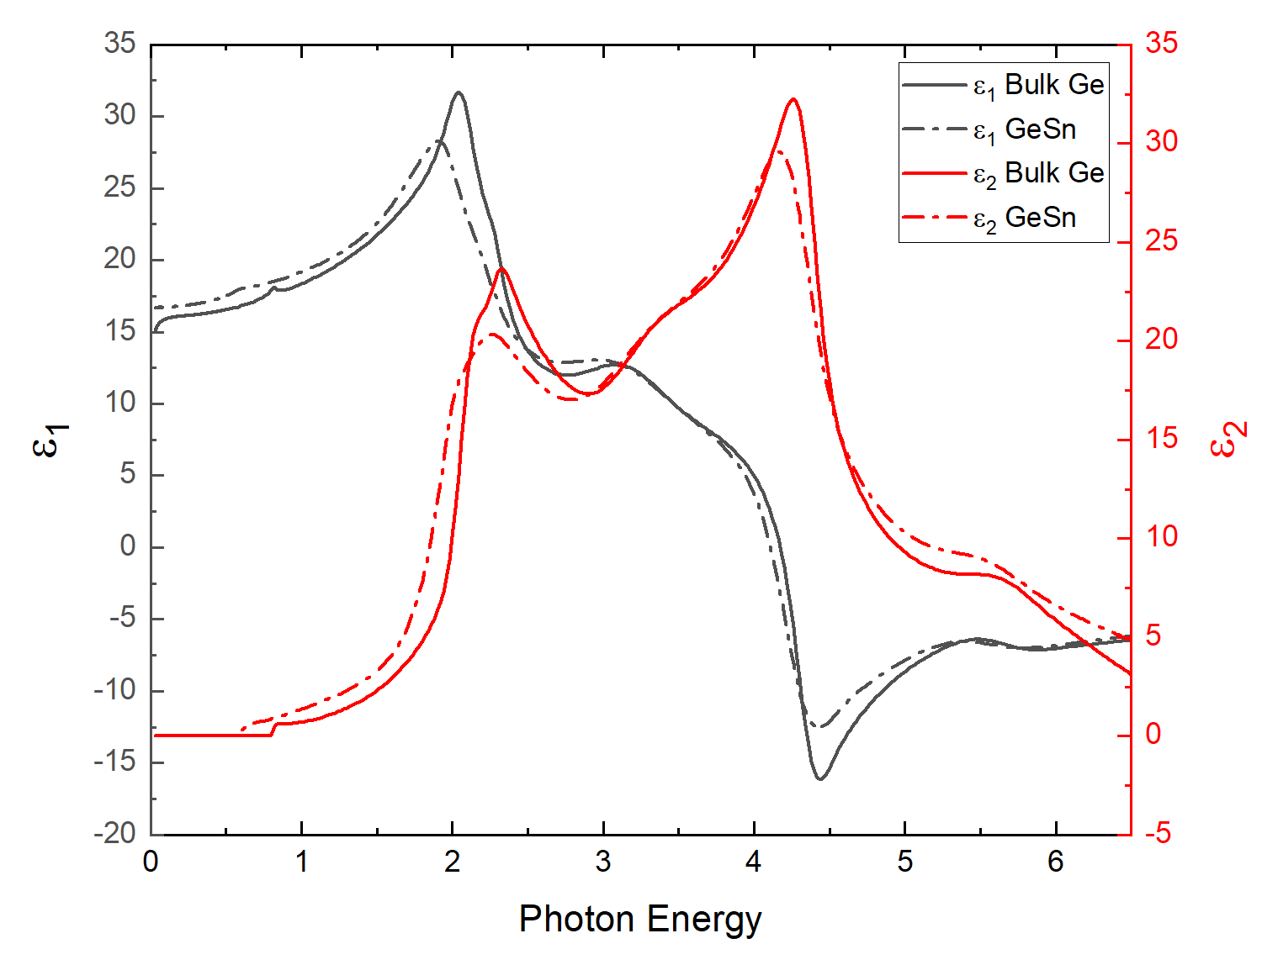
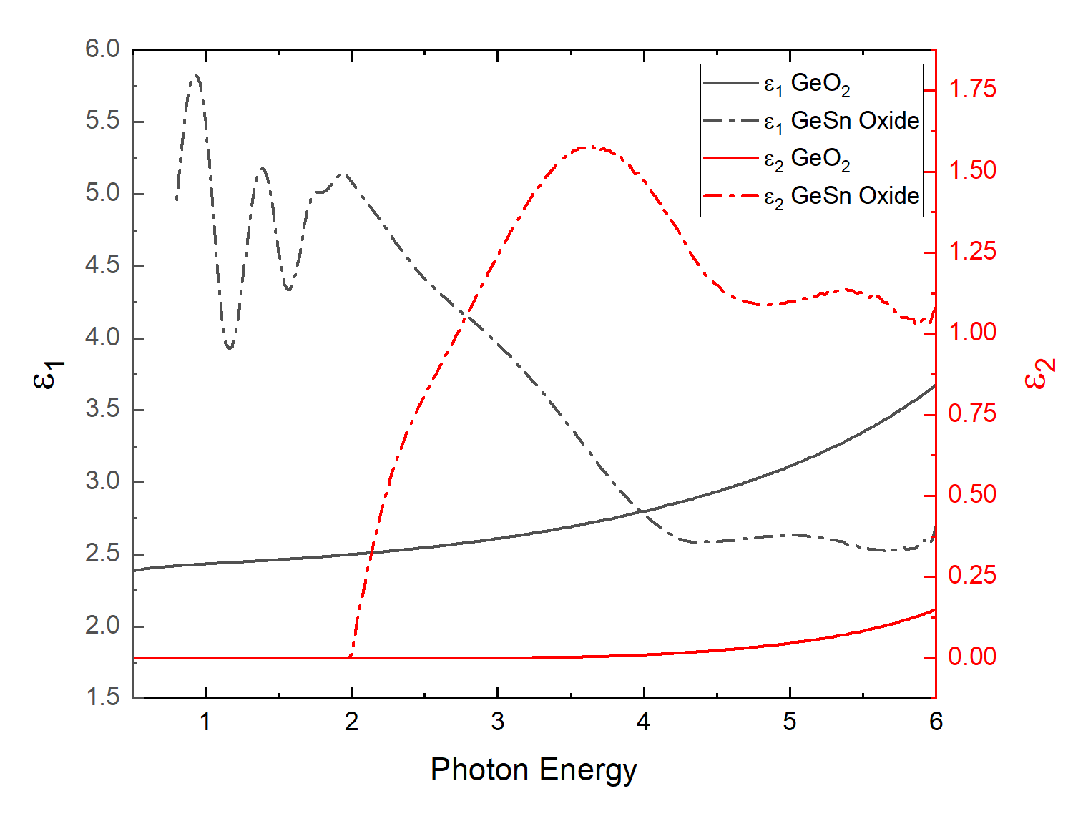
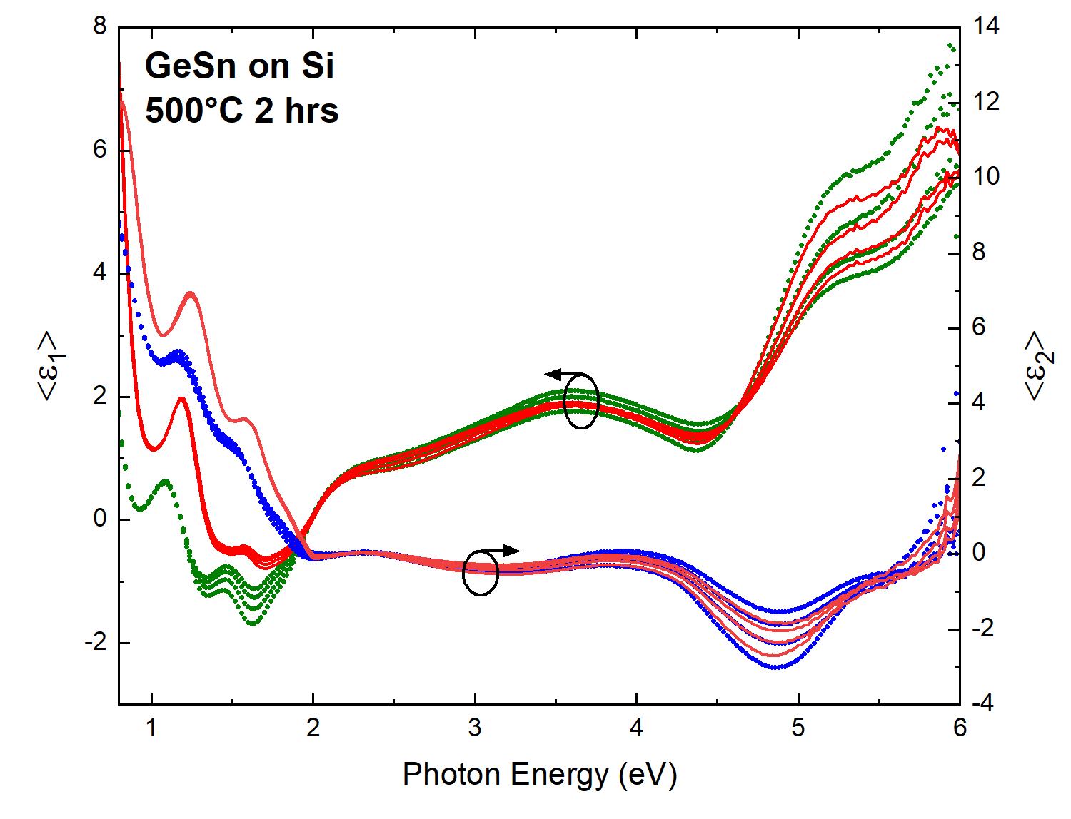
GeSn on Si: Optical Constants
Critical points of Ge’s optical constants were modified for GeSn at 6.9% Sn.
Point-by-point fit for the oxide’s optical constants to improve the model.
After anneal pseudodielectric function with non-uniformity within the GeSn and GeSn oxide layers.
Only reliable data that can be gathered is that the thickness of the oxide is about 600 Å.
J. A. Woollam Co., Guide to Using WVASE32 (2017).
T. Nunley et al., J. Vacu. Sci. Technol. B 34 (2016).

Slide 22


GeSn on Si: IR Ellipsometry
Because of the unreliable results of UVVASE, the after anneal thicknesses were determined with IRVASE.
Model consisted of Drude model for the Si and GeSn layers. The oxide was modeled with a general oscillator layer.
The TO and LO phonon frequencies were found to be 0.11 eV and 0.12 eV, consistent with anisotropic trigonal GeO₂ (0.105-0.124 eV).
Pseudodielectric of GeSn on Si annealed at 500°C for 2 hours with labeled TO and LO phonon frequencies.
TO: Peak of $ε_{2}$
LO: Peak of Loss Function, $Im\left(−\frac{1}{ε}\right)=\frac{ε_{2}}{ε_{1}^{2}+ε_{2}^{2}}$
J. A. Woollam Co., Guide to Using WVASE32 (2017).
T. Nunley et al., J. Vacu. Sci. Technol. B 34 (2016).
H. Fujiwara, Spectroscopic Ellipsometry (John Wiley & Sons, 2007).
S. Zollner et al., J. Vacu. Sci. Technol. B (2019).
P. Armand et al., Mater. Res. Bull. 129, 110881 (2020).

Slide 23



GeSn on Si: Oxidation Kinetics
Oxide growth and loss of GeSn epilayer is similar that of the Ge epilayer on Si
GeSn consumption rate was estimated with a linear fit through the origin where $\%GeSn Con.= 0.54$
Bulk $α$-GeO₂: $\%Ge Con.= 0.56$
The small incorporation of Sn in the Ge slightly decreased the consumption of the epilayer
I. Rahaman et al., Appl. Phys. Lett. 125, (2024).
A. Lignie et al., J. Appl. Crystallogr. 45, 272 (2012).

Slide 24




GeSn on Si: After Anneal Powder XRD
After annealing new peaks, like Ge on Si, were seen on the spectra
$β$-Sn powder 99.5% were compared to spectra, confirming none is present
(004) peak separates, corresponding to Ge (004) and GeSn (004), caused by Sn migration in the epilayer.
Higher temperature anneals show similar patterns to the oxide formed on Ge on Si
Unknown peak at $2θ=21°$; if Si is present in epilayer, may correspond to cristobalite-$β$ or an $α$-quartz SiO₂.
P. Zaumseil, J. Appl. Crystallogr. 48, 528 (2015).
I. Rahaman et al., Appl. Phys. Lett. 125 (2024).
A. Lignie et al., J. Appl. Crystallogr. 45, 272(2012).
Materials Project: mp-8352 and mp-6930

Slide 25





GeSn on Si: High Resolution XRD
$$sx=\frac{qx}{2π}=\frac{1}{λ}[\cos\left(ω\right)−\cos\left(2θ−ω\right)]$$
$$sz=\frac{qz}{2π}=\frac{1}{λ}[\sin\left(ω\right)+\sin\left(2θ−ω\right)]$$
In-Plane and Out-of-Plane Lattice Constants:
$a_{∥,⊥GeSn}=\frac{q_{∥,⊥Si}−q_{∥,⊥GeSn}}{q_{∥,⊥GeSn}}a_{Si}+a_{Si}$
Relaxed Lattice Constant:
$a_{0}=a_{⊥}+\frac{2ν_{GeSn}\left(a_{∥GeSn}−a_{⊥GeSn}\right)}{1+ν_{GeSn}}$
Poisson’s ratio: $ν_{GeSn}=\left(1−x\right)ν_{Ge}+xν_{Sn}$
Relaxation and Sn content:
$\%R=\frac{a_{∥GeSn}−a_{Si}}{a_{0GeSn}−a_{Si}}, \%Sn=\frac{a_{0GeSn}−a_{Ge}}{a_{0Sn}−a_{Ge}}$
Epilayer becomes more relaxed after anneal and Sn content is reduced.
 | In-Plane | Out-of-Plane | Relaxed
 | $a_{∥}$ (Å) | $a_{⊥}$ (Å) | $a_{0}$ (Å)
As-Received: | 5.692(0.001) | 5.731(0.001) | 5.715(0.001)
650°C 2 hrs: | 5.697(0.001) | 5.693(0.001) | 5.695(0.001)
P. F. Fewster, X-Ray Scattering From Semiconductors and Other Materials, (World Scientific Pub. Co. 2015).
W. Ni et al., J. Cryst. Growth 227–228, 756 (2001).

Slide 26

Conclusion
Ge on Si oxidation followed the parabolic rate model from the Deal-Grove model, leading to an Activation Energy of 4±2 eV.
Both GeSn and Ge had phonon frequencies that were consistent with known values for trigonal GeO₂
Non-uniformity of the surface layers caused complicated models.
Powder diffraction confirmed the formation of $α$-GeO₂
HRXRD determined that after annealing:
Ge on Si: little to no change in the strain of the epilayer
GeSn on Si: Epilayer relaxed and Sn loss

Slide 27
Temperature-Dependent Recombination Rate Analysis of Minority Carrier Lifetime in Mid-Wave Infrared Antimonide-Based Devices

Slide 28




Introduction
A critical parameter is the Minority Carrier Lifetime (MCL) measured by Time-Resolved Photoluminescence.
time that a material stays in the excited state by recording the time the material photoluminesces before returning to the ground state.
Model can be used to determine dominant recombination mechanisms
Radiative, Shockley-Read-Hall, Auger
The MCL is affected by different parameters such as strain engineering and localization.
Localization causes a significant increase in the MCL at low temperatures that does not predict material quality.
R. Carrasco et al., J. Appl. Phys. 129, 184501 (2021).
P. Grant et al., Appl. Phys. Lett. 124, 111110 (2024).
R. Carrasco et al., Appl. Phys. Lett. 120, 031102 (2022).

Slide 29




Recombination Mechanisms: Radiative
Electron-hole pairs recombine, emitting a photon near the bandgap.
More efficient in direct bandgap materials, then indirect.
For intrinsic semiconductors, $n_{i}^{2}=n_{0}p_{0}$
For n-type materials, Doping Density $N_{D}=n_{0}−p_{0}$
Intrinsic carrier concentration
$$n_{i}=2{\left(\frac{kT}{2πℏ}\right)}^{3/2}{\left(m_{e}m_{h}\right)}^{3/4}e^{−E_{g}/2kT}$$
$$τ_{Rad}=\frac{n_{i}^{2}}{G_{r}(n_{0}+p_{0})}$$
Radiative Generation Rate (Integrated thermal emissions spectrum; influenced by the temperature dependence of the bandgap, photon density, absorption coefficient, and intrinsic carrier concentration)
Electron and hole concentrations
P. Landsberg, Recombination in Semiconductors (Cambridge University Press, 2003).
I. Pelant et al., Channels of radiative recombination in semiconductors (2012).
C. Kittel, Introduction to Solid State Physics (John Wiley & Sons, New York, 1995).
R. Carrasco et al., J. Appl. Phys. 129, 184501 (2021).
E. Steenbergen et al., Temperature-dependent minority carrier lifetimes of InAs/InAs_{1-x}Sb_{x} type-II superlattices (2012).

Slide 30




Recombination Mechanisms: SRH
Doping Density
Photogenerated carriers recombine at trap states in the bandgap, which are caused by lattice defects and impurities.
Non-radiative recombination
Defect-Capture Cross Section
$$τ_{SRH}=\frac{τ_{p0}\left(n_{0}+n_{1}\right)+τ_{n0}(p_{0}+p_{1})}{n_{0}+p_{0}}$$
Electron and hole lifetimes
$$τ_{p0}=\frac{1}{σ_{p}ν_{p}N_{SRH}}$$
$$τ_{n0}=\frac{1}{σ_{n}ν_{n}N_{SRH}}$$
Characteristic carrier concentrations
$$p_{1}=n_{i}\exp\left(\frac{−\left(E_{SRH}−E_{v}\right)}{k_{B}T}\right)$$
$$n_{1}=n_{i}\exp\left(\frac{−\left(E_{c}−E_{SRH}\right)}{k_{B}T}\right)$$
Electron and hole concentrations
Defect Level
P. Landsberg, Recombination in Semiconductors (Cambridge University Press, 2003).
I. Pelant et al., Non-radiative recombination (2012).
R. Carrasco et al., J. Appl. Phys. 129, 184501 (2021).
P. Webster et al., J. Appl. Phys. 133, 125704 (2023).
E. Steenbergen et al., Temperature-dependent minority carrier lifetimes of InAs/InAs1-xSbxtype-II superlattices (2012).

Slide 31



Recombination Mechanism: Auger
Excess energy is transferred to a third charge carrier sending that carrier to higher energy state.
Non-radiative recombination, that dissipates as heat.
Auger-1 coefficient describes electron-electron collisions that occur in the conduction band
For n-type doping, $m_{h}>m_{e}$ making other Auger processes negligible.
Intrinsic carrier concentration
$$τ_{Auger}=\frac{{2n_{i}}^{2}}{n_{0}^{2}+n_{0}p_{0}}×τ_{A1}$$
Intrinsic Auger-1 Coefficient
$$τ_{A1}=\frac{3.8×{10}^{−18}ε_{∞}^{2}{\left(1−γ\right)}^{\frac{1}{2}}\left(1+2γ\right)}{\left(m_{e}/m_{0}\right){\left|F_{1}F_{2}\right|}^{2}}×{\left(\frac{E_{g}}{kT}\right)}^{3/2}\exp\left(\frac{1+2γ}{1+γ}\frac{E_{g}}{kT}\right)$$
$γ=\frac{m_{e}}{m_{h}}$
Electron and hole concentrations
P. Landsberg, Recombination in Semiconductors (Cambridge University Press, 2003).
I. Pelant et al., Non-radiative recombination (2012).
A. Beattie et al., Proc. R. Soc. Lond. A 249, 16 (1959).
R. Carrasco et al., J. Appl. Phys. 129, 184501 (2021).
E. Steenbergen et al., Temperature-dependent minority carrier lifetimes of InAs/InAs1-xSbxtype-II superlattices (2012).

Slide 32

Previous Observations: Strain Engineering
Strain balanced InAs/InAsSb superlattices are used in mid-wave infrared (MWIR) sensing due to their tunable cutoff wavelength.
Problem:
Strain-balance conditions are required to grow thick InAs/InAsSb superlattice active regions. InAs layers must be thicker resulting in wide potential wells for electrons and holes are confined in the narrow wells of the InAsSb layers.
Theory:
By incorporating Ga to create InGaAs, the lattice constant can be adjusted, reducing the compressive tensile mismatch to create more balanced layer thickness.
R. Carrasco et al., J. Appl. Phys. 129, 184501 (2021).

Slide 33

Previous Observations: Strain Engineering
Samples to evaluate the incorporation of Ga:
A: Undoped InAs/InAsSb SL- Reference
B: Undoped InGaAs/InAsSb SL - 20% Ga
C: p-type npBp InGaAs/InAsSb SL - npBp structure
D: n-type nBn InGaAs/InAsSb SL –nBn structure
The Ga incorporation:
slightly reduced the minority carrier lifetime but increases carrier diffusion length, $L_{D}={(Dτ_{mc})}^{1/2}$, improving carrier transport
Doped samples are SRH limited at 0.5 $μ$s at $<$120 K which is favorable for MWIR applications. 0.5 $μ$s is considered long especially with the increased mobility that Ga incorporation enables
R. Carrasco et al., J. Appl. Phys. 129, 184501 (2021).

Slide 34

Previous Observations: Localization Effects
In a study by Lin et al., InAs/InAsSb SL had a minority carrier lifetime of 12.8 $μ$s at 15 K using time-resolved photoluminescence
Not caused by high material quality, but rather Carrier Localization:
Localization occurs when electrons and holes become trapped in random potential wells caused by structural disorder.
Thickness fluctuations causes potential minima that act as localization centers
Trapped carriers occupy separated localized states, slowing recombination, leading to belief of high material quality.
Z. Lin et al., Appl. Phys. Lett. 107, 201107 (2015).
P. Landsberg, Recombination in Semiconductors (Cambridge University Press, 2003).

Slide 35


Previous Observations: Localization Effects
Samples to investigate the cause of the long minority lifetime:
A: Bulk InAsSb - Reference
B: MWIR InAs/InAsSb SL -Short Period (12.8 $μ$s lifetime at 15 K)
C: LWIR InAs/InAsSb SL - Long Period
Steady-state photoluminescence from 15 K - 300 K revealed the localization.
FWHM broadened below 40 K – Carriers reside in localized states, exhibiting different Fermi levels due to various localization centers.
Sample B blue shifted by 3 meV from 15 K to 50 K – carriers delocalize as temperature increases. After, carriers occupy extended states.
Localization was specific to short-period MWIR SL.
This reveals that localization needs to be identified and taken into account when studying InAs/InAsSb superlattices.
Z. Lin et al., Appl. Phys. Lett. 107, 201107 (2015).

Slide 36



Time-Resolved Photoluminescence
Measurement of the amount of time that a material stays in the excited state by recording the time the material photoluminesces before returning to the ground state.
Liquid helium (~5 K to 77 K); Liquid Nitrogen (77 K-300 K).
Recombination Lifetime Model
Minority Carrier Lifetime:
$\frac{1}{τ_{MCL}}=\frac{1}{{φτ}_{rad}}+\frac{1}{τ_{SRH}}+\frac{1}{τ_{Auger}}$
$φ$-photon recycling factor
Gives insight into dominant material’s quality, recombination mechanisms, and defect density.
R. Carrasco et al., J. Appl. Phys. 129, 184501 (2021).

Slide 37


Trap-Delayed Recombination Model
At low temperatures ($<$100 K), MCL increases significantly due to localization.
Modeled by: $\frac{1}{τ_{MCL}}=\frac{1}{τ_{Loc}}+\frac{1}{τ_{Emis}+τ_{Cont}}$;
$τ_{Emis}=\frac{A}{T^{2}}\exp\left(\frac{Δ_{Loc}}{kT}\right)$
$τ_{Loc}$- Initial lifetime due to localization.
$Δ_{Loc}$- Temperature carriers escape to extended states.
$A$- Rate of carriers that are released.
$τ_{Cont}$- Lifetime at extended states.

Slide 38





(1) GaInAsSbBi
Recombination Lifetime Model 100 K – 300 K
Trap-Delayed Recombination Model ~5 K – 150 K
Doping Density (x10¹⁵ cm⁻³) $N_{D}$ | 0.71
Defect Level (meV) $E_{C}−E_{SRH}$ | 79.6
Defect Density (m⁻¹) ${σN}_{SRH}$ | 31.0
Bloch Overlap Integral $\left|F_{1}F_{2}\right|$ | 0.50
From 100 K – 225 K, SRH dominates.
Then drops due to Auger recombination due to large Bloch overlap integral.
Energy Separation (meV) $Δ_{Loc}$ | 4.20
Loc. State Lifetime ($μ$s) $τ_{Loc}$ | 4.89
Amplitude ($μs∙K^{2}$) $A$ | 735
Cont. Lifetime ($μ$s) $τ_{Cont}$ | 0.2
Longest $τ_{Loc}$ suggesting carriers may remain trapped for longer intervals.

Slide 39





(2) Graded Doping nBn
Recombination Lifetime Model 100 K – 300 K
Trap-Delayed Recombination Model ~5 K – 150 K
Doping Density (x10¹⁵ cm⁻³) $N_{D}$ | 6.29
Defect Level (meV) $E_{C}−E_{SRH}$ | 1.65
Defect Density (m⁻¹) ${σN}_{SRH}$ | 6.21
Bloch Overlap Integral $\left|F_{1}F_{2}\right|$ | 0.15
SRH and Auger are at the same magnitude until about 150 K, neither are dominating in this region.
Energy Separation (meV) $Δ_{Loc}$ | 2.80
Loc. State Lifetime ($μ$s) $τ_{Loc}$ | 1.89
Amplitude ($μs∙K^{2}$) $A$ | 1970
Cont. Lifetime ($μ$s) $τ_{Cont}$ | 0.5
Lowest $Δ_{Loc}$ and shortest $τ_{Loc}$ but largest $A$.
Carriers may escape more easily.

Slide 40





(3) InAs/InAsSb SL
Recombination Lifetime Model 100 K – 300 K
Trap-Delayed Recombination Model ~5 K – 125 K
Doping Density (x10¹⁵ cm⁻³) $N_{D}$ | 0.79
Defect Level (meV) $E_{C}−E_{SRH}$ | 108
Defect Density (m⁻¹) ${σN}_{SRH}$ | 11.7
Bloch Overlap Integral $\left|F_{1}F_{2}\right|$ | 0.19
From 100 K – 200 K, SRH dominates.
From 200 K – 300 K, Auger dominates.
Energy Separation (meV) $Δ_{Loc}$ | 12.5
Loc. State Lifetime ($μ$s) $τ_{Loc}$ | 3.65
Amplitude ($μs∙K^{2}$) $A$ | 396
Cont. Lifetime ($μ$s) $τ_{Cont}$ | 0.65
Largest $Δ_{Loc}$ indicate stronger confinement of carriers from structural disorder in SL.

Slide 41
Conclusion
Demonstrated the temperature-dependent analysis of the minority carrier lifetime using time-resolved photoluminescence.
Dominant recombination mechanisms and the effects of localization were determined by the Recombination Lifetime and the Trap-Delayed Recombination Model.
The minority carrier lifetime can be affected by different factors like strain engineering or depend on the device.

Slide 42
Thank you!

