Slide 1


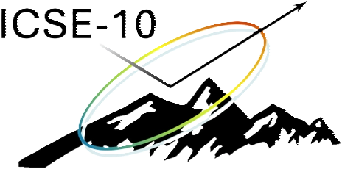
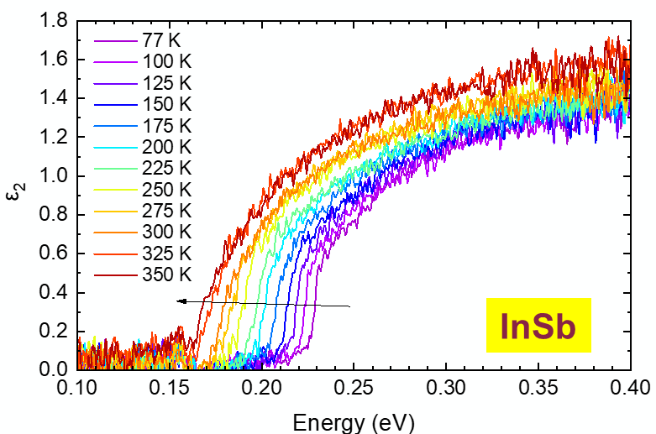
Measurements of temperature-dependent optical constants and comparison with theory
10th International Conference on Spectroscopic Ellipsometry (ICSE-10) Boulder, CO, USA, 8-13 June 2025
FA9550-20-1-0135 AFOSR
FA9550-24-1-0061 AFOSR
FA9453-23-2-0001 AFRL
DMR-2235447 NSF
DMR-2423992 NSF
Stefan Zollner
Department of Physics
New Mexico State University Las Cruces, NM, USA
Email: zollner@nmsu.edu.
WWW: http://femto.nmsu.edu

Slide 2
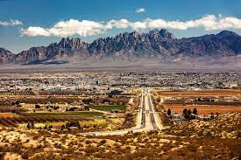
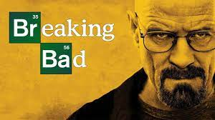
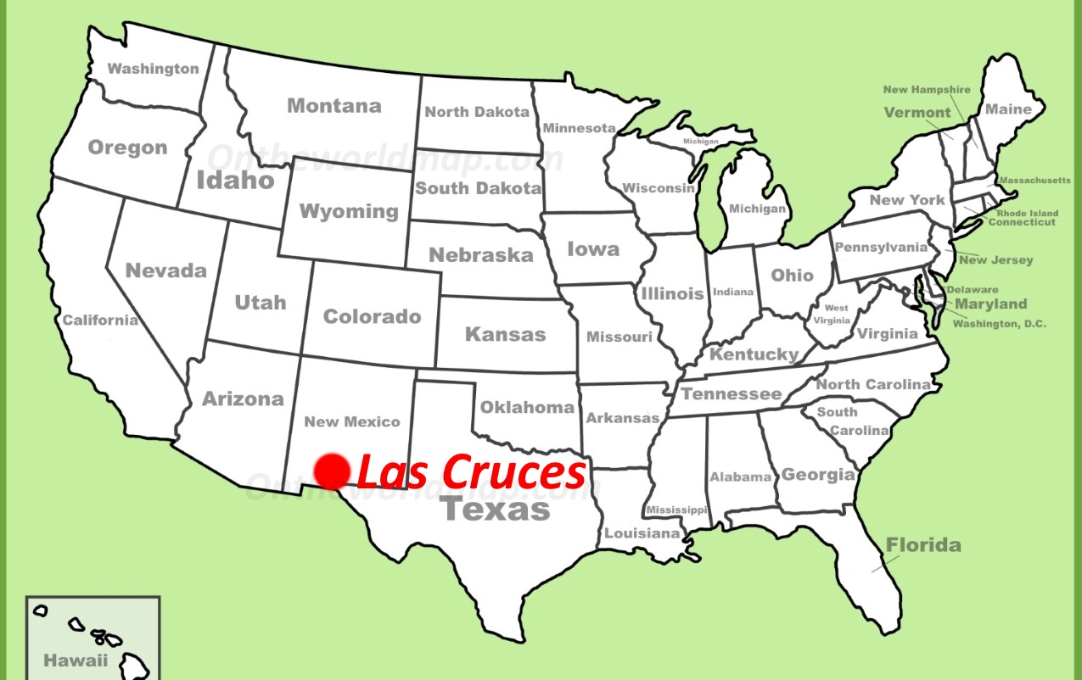


Where is Las Cruces, NM ???
White Sands NP

Slide 3
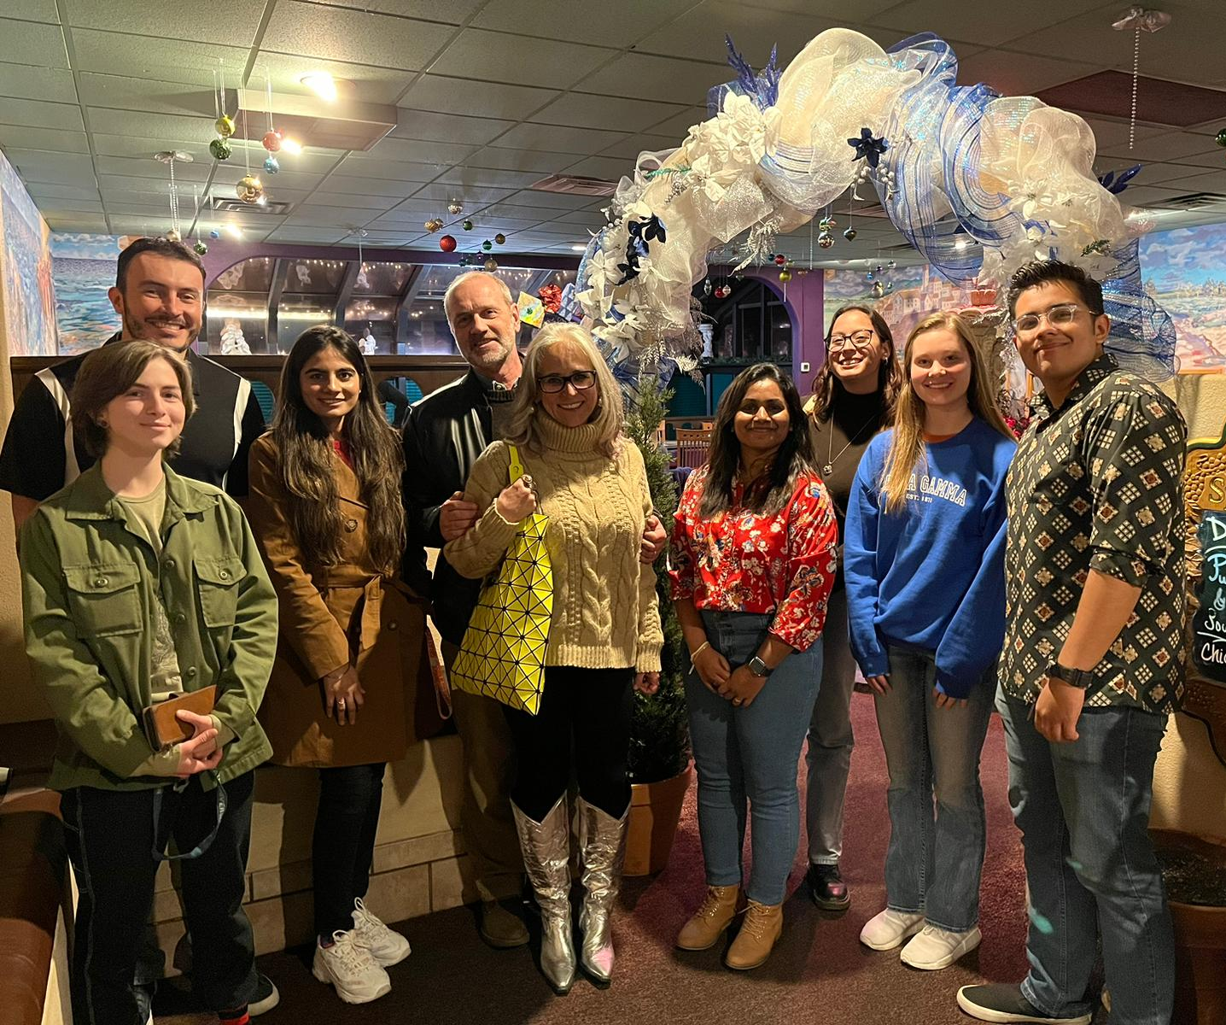
Students and Collaborators (2010-2025)
PhD. students (10): Lina S. Abdallah, Nalin Fernando, Nuwanjula S. Samarasingha, Farzin Abadizaman, Carola Emminger, Rigo A. Carrasco, Yoshitha Hettige, Carlos A. Armenta, Sonam Yadav, Beata Hroncova.
MS students (5): Travis I. Willett-Gies, Cesar A. Rodriguez, Jaden R. Love, Haley B. Woolf, Aaron Lopez Gonzalez.
Undergraduate students (22): Amber A. Medina, Maria Spies, Cayla M. Nelson, Eric DeLong, Christian J. Zollner, Khadijih N. Mitchell, Ayana Ghosh, T. Nathan Nunley, Laura G. Pineda, Luis A. Barrera, Dennis P. Trujillo, Jaime M. Moya, Jacqueline A. Cooke, Alexandra P. Hartmann, Cesy M. Zamarripa, Zachary Yoder, Pablo P. Paradis, Melissa Rivero Arias, Atlantis K. Moses, Danissa P. Ortega, Gabriel Ruiz, Meghan Worrell.
Ellipsometry collaborators: Jose Menendez (Arizona State), Arnold M. Kiefer (AFRL/RY), Mathias Schubert (Nebraska), Premysl Marsik (Fribourg), Christian Bernhard (Fribourg), Igal Brener (Sandia), Wim Geerts (Texas State), Tom Tiwald (JAW), Preston Webster (AFRL/RV), Martin Veis, Jan Hrabovsky (Charles University), Dagmar Chvostova, Alexandr Dejneka, Marina Tyunina (IOP/CAS).
Thin-film epitaxial samples from many different sources: Arizona State, Delaware, Texas, IIT Indore, Texas State, AFRL/RY+RV, Arkansas, Sandia, NREL, NASA, SOITEC, QuantTera, Connecticut, IBM, Global Foundries, UNM, Ohio State, etc.
Stefan Zollner, ICSE-10 2025, Boulder, CO

Slide 4
ICSE Conference Topics
1993 (Paris), 1997 (Charleston, SC, USA), 2003 (Vienna), 2007 (Stockholm), 2010 (Albany), 2013 (Kyoto), 2016 (Berlin), 2019 (Barcelona), 2022 (Beijing), 2025 (Boulder, CO, USA)
Instrumentation to acquire ellipsometric angles, Jones matrices, or MM elements.
Analysis of ellipsometry data to determine (isotropic or anisotropic) optical constants.
Ellipsometry as a non-destructive characterization tool: How thick is my film?
Fundamental mechanisms of light-matter interactions.
What can the dielectric function tell us about a material?
S. Zollner in Ellipsometry at the Nanoscale ed. by M. Losurdo and K. Hingerl (Springer, Heidelberg, 2013), p. 607-627.
Stefan Zollner, ICSE-10 2025, Boulder, CO

Slide 5
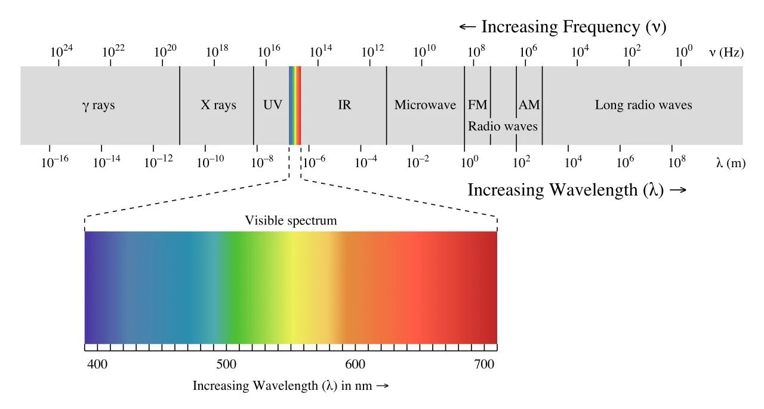
Electromagnetic Spectrum
An electromagnetic wave interacts with positive and negative charges through the Coulomb force.
Infrared:
Lattice vibrations (phonons), free carriers (Drude response)
Visible and UV: Valence electrons, electronic band structure (electrons, holes, interband transitions, critical points)
X-rays: Core electrons; Gamma-rays: Nuclear processes
Stefan Zollner, ICSE-10 2025, Boulder, CO

Slide 6
Outline: Infrared Response of Crystalline Solids
Lorentz model for absorption by optical phonons in polar crystals.
Trends with mass and ionicity.
Temperature dependence of optical phonon energies:
Anharmonic decay of optical phonons.
Two-phonon absorption in LiF and NiO.
Beyond the Lorentz model: Frequency-dependent decay rate
Lowndes model (TO/LO oscillator).
Splitting of optical phonons in uniaxial crystals: ZnO, SiC, NiO
Multimode behavior in GaAs_{1-x}P_{x} alloys
Berreman effect at LO energy: Insulator on metal (LiF on Ag)
Drude model for free carrier absorption: Ni and Au
Plasmon-phonon coupling.

Slide 7
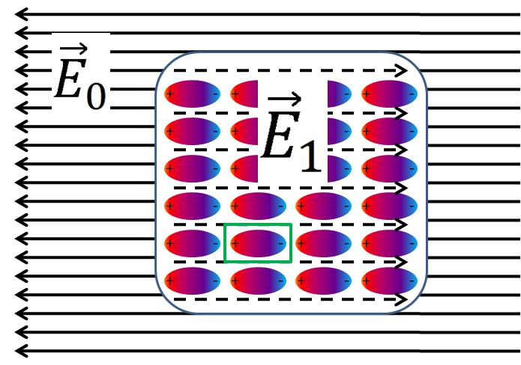
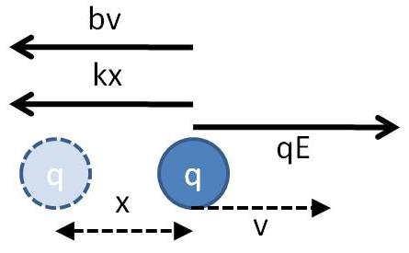
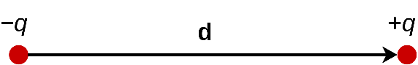
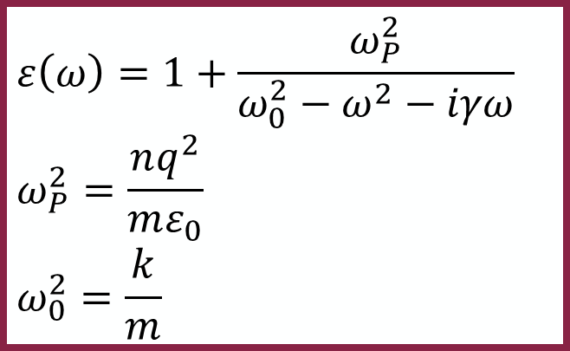
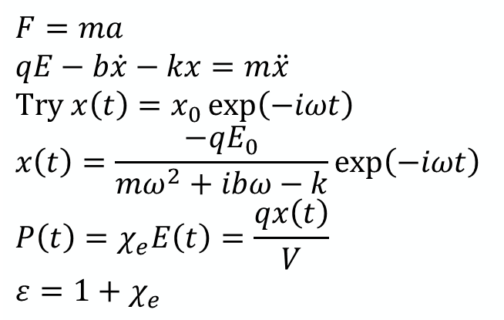

Lorentz Model for Oscillating Charges
$$E\left(t\right)=E_{0}\exp\left(−iωt\right)$$
q
Static screening.
Friction proportional to velocity.
Small displacement (harmonic).
$$ε\left(ω\right)=1+\frac{ω_{P}^{2}}{ω_{0}^{2}−ω^{2}−iγω} \\ ω_{P}^{2}=\frac{nq^{2}}{mε_{0}} \\ ω_{0}^{2}=\frac{k}{m}$$
dipole moment
$$F=ma \\ qE−b\dot{x}−kx=m\ddot{x}$$
$$\text{Try} x\left(t\right)=x_{0}\exp\left(−iωt\right) \\ x\left(t\right)=\frac{−qE_{0}}{mω^{2}+ibω−k}\exp\left(−iωt\right)$$
$$P\left(t\right)=χ_{e}E\left(t\right)=\frac{qx\left(t\right)}{V}$$
$$ε=1+χ_{e}$$
Charge density
Resonance frequency
H. Helmholtz, Ann. Phys 230, 582 (1875)
F. Wooten, Optical Properties of Solids, 1972

Slide 8
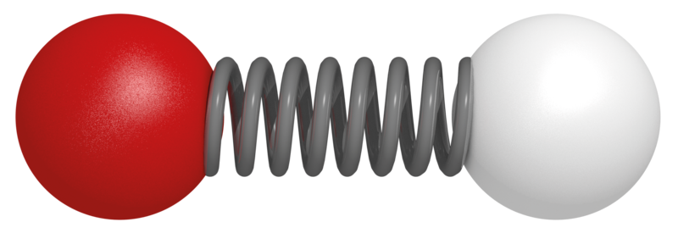
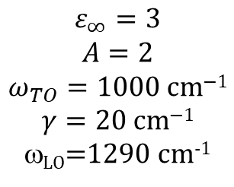
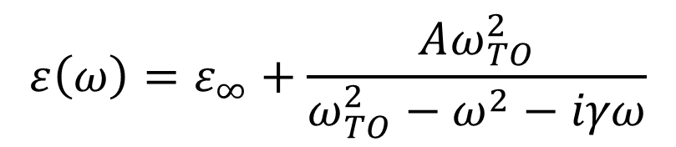
Lorentz Model for Oscillating Charges
$$ε\left(ω\right)=ε_{∞}+\frac{Aω_{TO}^{2}}{ω_{TO}^{2}−ω^{2}−iγω}$$
TO
LO
ε(ω) shows symmetric TO resonance peak.
Loss function Im(−1/ε) peaks at LO frequency.
$$ε_{∞}=3$$
$$A=2$$
$$ω_{TO}=1000 \text{cm}\text{−1}$$
$$γ=20 \text{cm}\text{−1}$$
ω_{LO}=1290 cm⁻¹
TO
LO
Ionic bond
F. Wooten, Optical Properties of Solids, 1972
M. Schubert, Infrared Ellipsometry, 2004

Slide 9
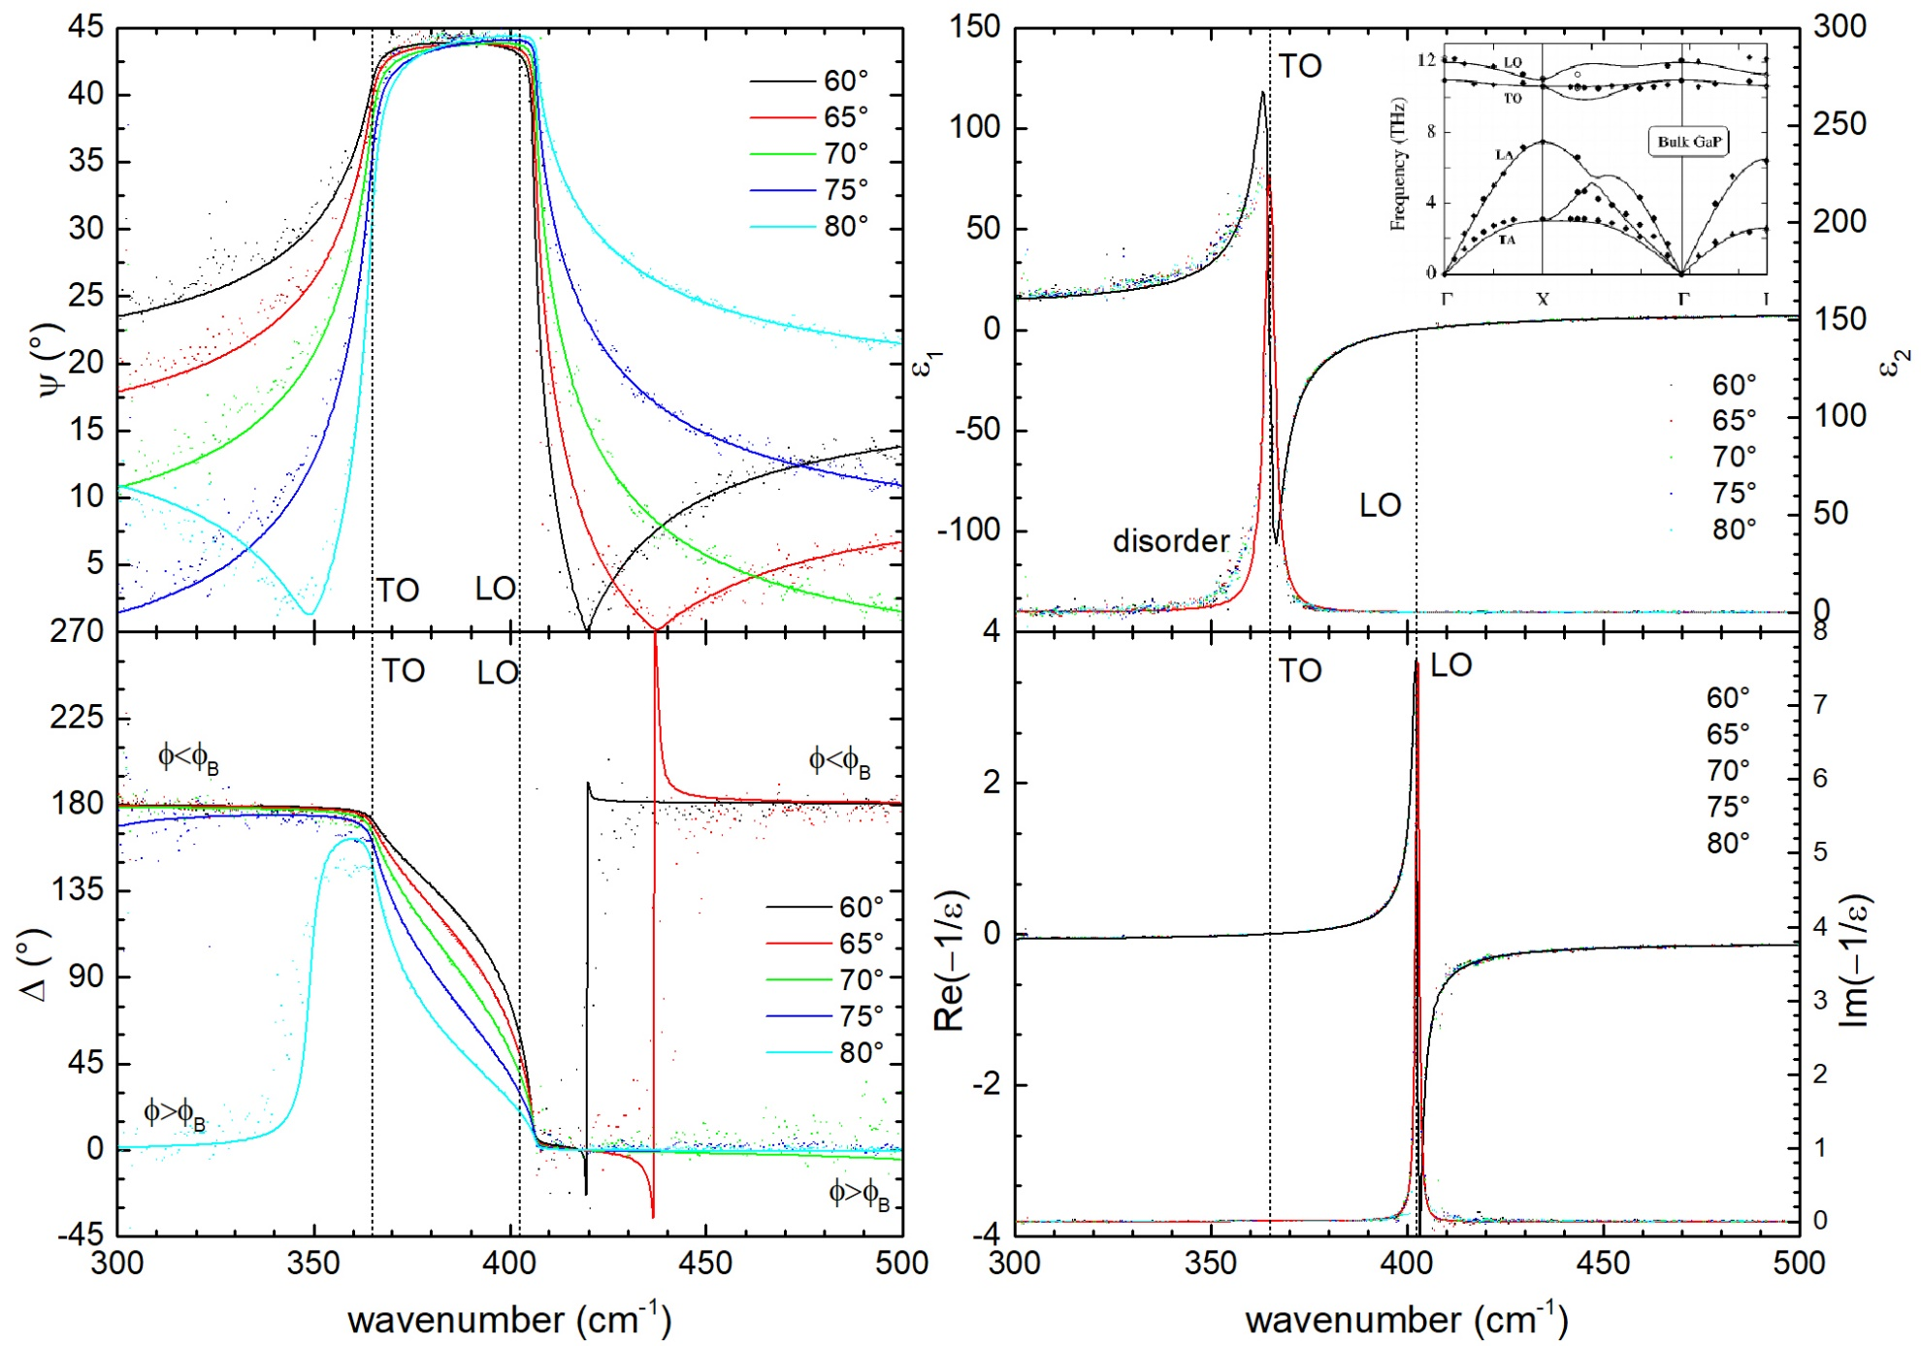

GaP shows nearly perfect Lorentz oscillator
psi
epsilon
Reststrahlen
Band
ε_{s}=15.7
ε∞=9.14
402.5 cm⁻¹
N. Samarasingha,
JVSTB 39, 052201 (2021)
364.9 cm⁻¹
Loss function
Delta

Slide 10
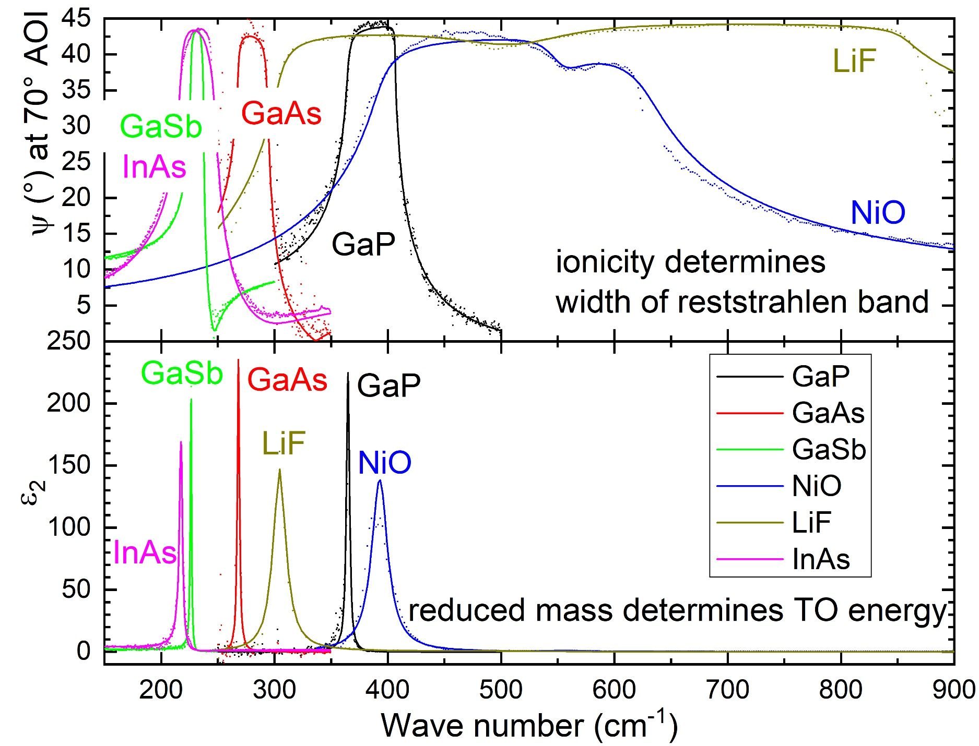
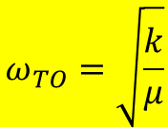
Infrared Lattice Vibrations (Lorentz model)
N. Samarasingha,
JVSTB 39, 052201 (2021)
$$ω_{TO}=\sqrt{\frac{k}{μ}}$$

Slide 11
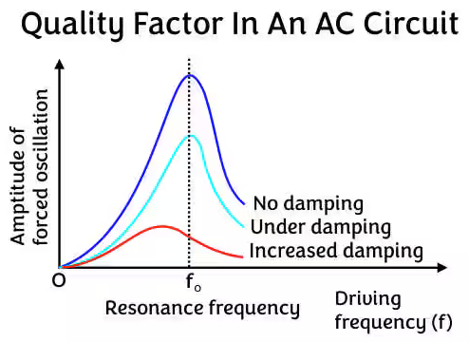
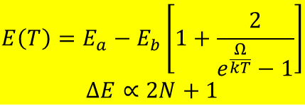
Why Temperature-Dependent Ellipsometry ???
Practical applications: Optical devices at low or high T.
Peaks get sharper at low temperature (easier to detect).
Thermal expansion is trivial (usually small contribution).
Finite lifetime: Quality factor decreases (broadening increases).
Temperature decreases the lifetime.
Damped oscillator is broader and has lower energy then undamped oscillator.
Temperature dependence yields energy of decay product and strength of interaction (complex self energy).
Distinguish intrinsic lifetime (homogeneous) broadening from inhomogenous broadening (disorder, defects, alloy, etc).
Inhomogeneous broadening does not change with temperature.
Phase transitions (Ni Curie temperature, phase change materials).
$$E\left(T\right)=E_{a}−E_{b}\left[1+\frac{2}{e^{\frac{Ω}{kT}}−1}\right]$$
$$ΔE∝2N+1$$
L. Viña et al., PRB 30, 1979 (1984).
SZ, Spectroscopic ellipsometry from 10 to 700 K,
Adv. Opt. Techn. 11, 117 (2022).

Slide 12
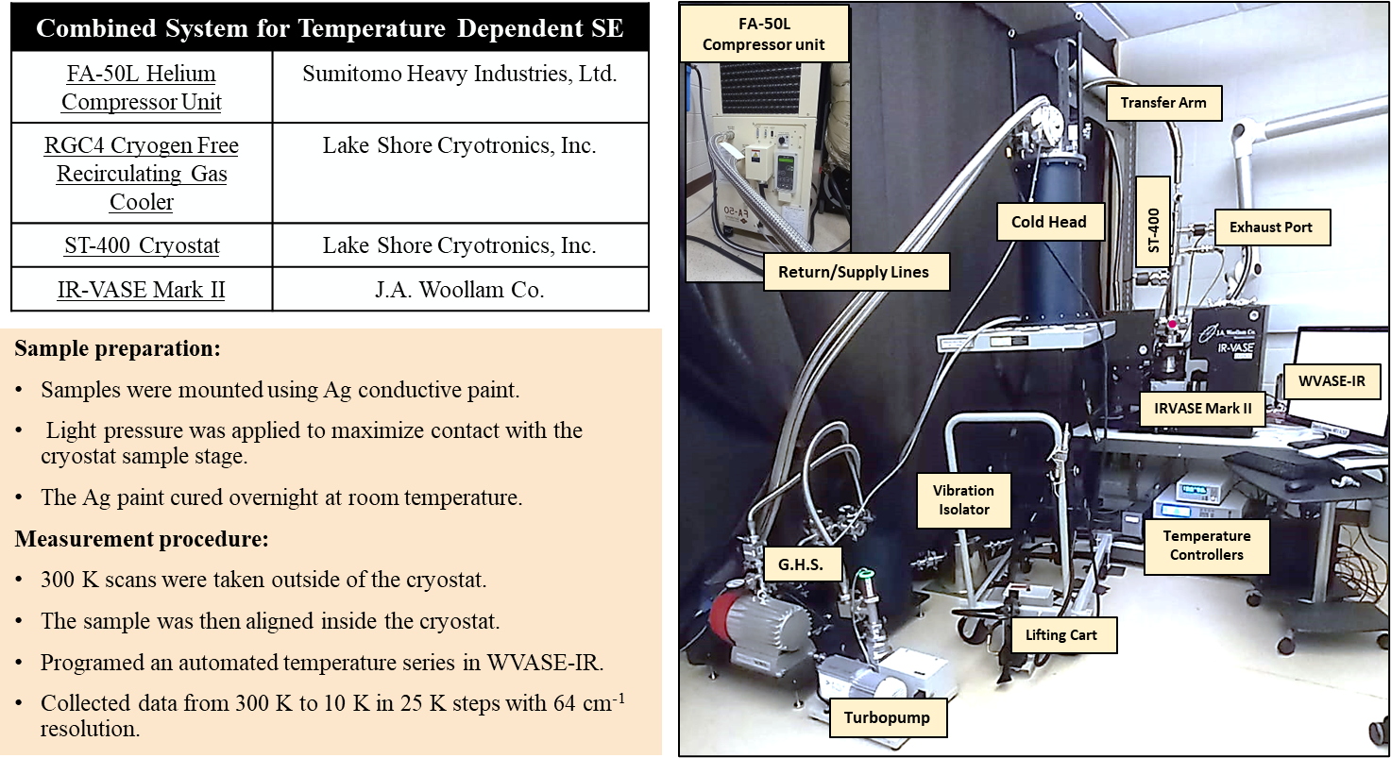
Tools for Temperature-Dependent Ellipsometry
Closed-cycle system works well.
Vibrations do not seem to be a problem.
Ongoing issue: Thin ice layer forms on sample (even in UHV).
Window calibration is important.
Custom feature: Diamond windows for cryostat.
ARO (W911NF-22-2-0130)
Jaden Love
Atlantis Moses

Slide 13
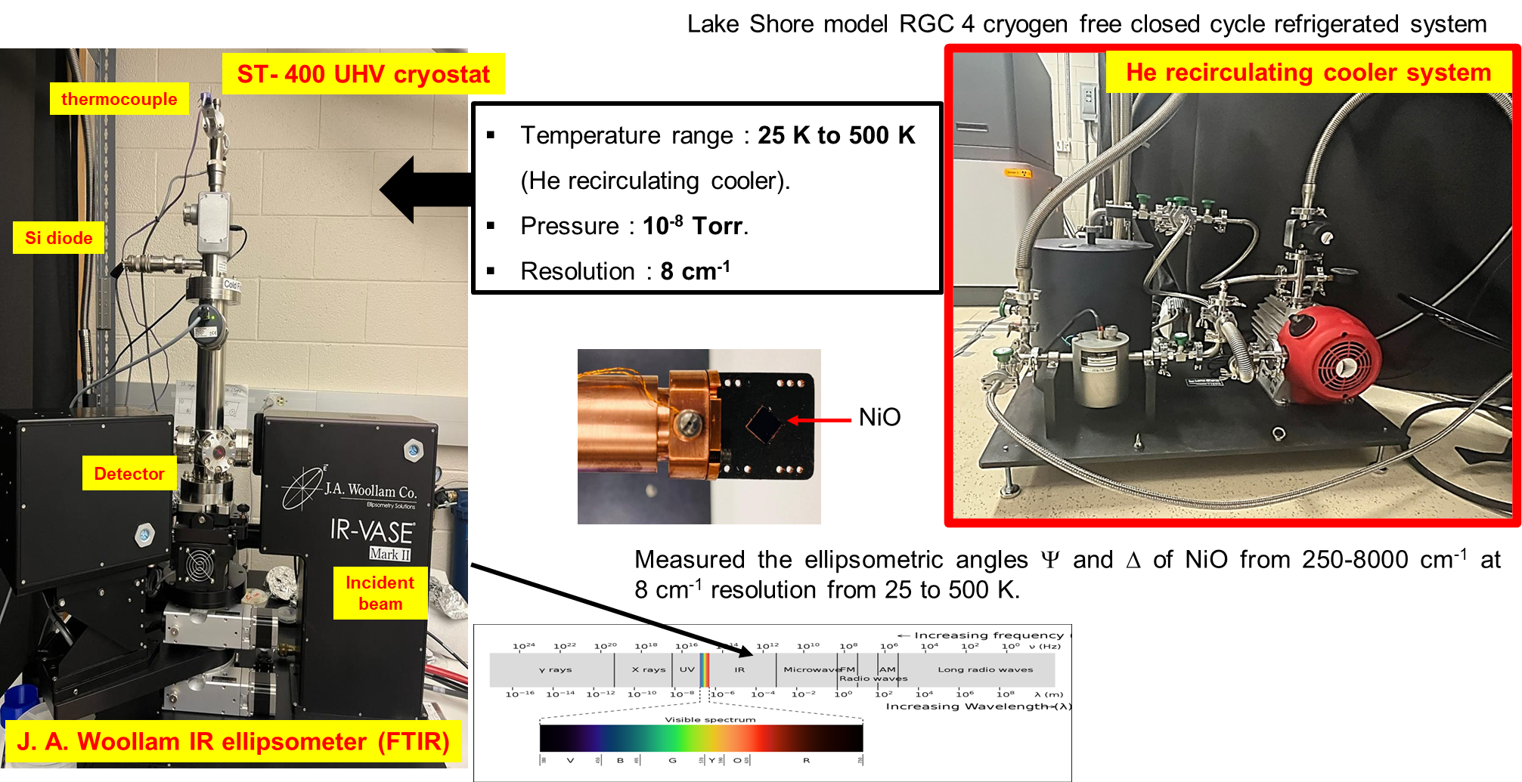
Tools for Temperature-Dependent Ellipsometry
Jaden Love
Atlantis Moses

Slide 14
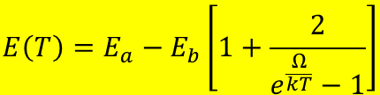
Temperature dependence of GaP phonon energies
GaP
Anharmonic phonon decay: TO, LO -> TA + LA
Broadenings increase.
TO and LO energies decrease.
Born effective charge: constant.
ε_{s}, ε∞ increase (Penn gap)
Zunger PRB 1999
$$E\left(T\right)=E_{a}−E_{b}\left[1+\frac{2}{e^{\frac{Ω}{kT}}−1}\right]$$
N. Samarasingha et al., JVSTB 39, 052201 (2021)

Slide 15
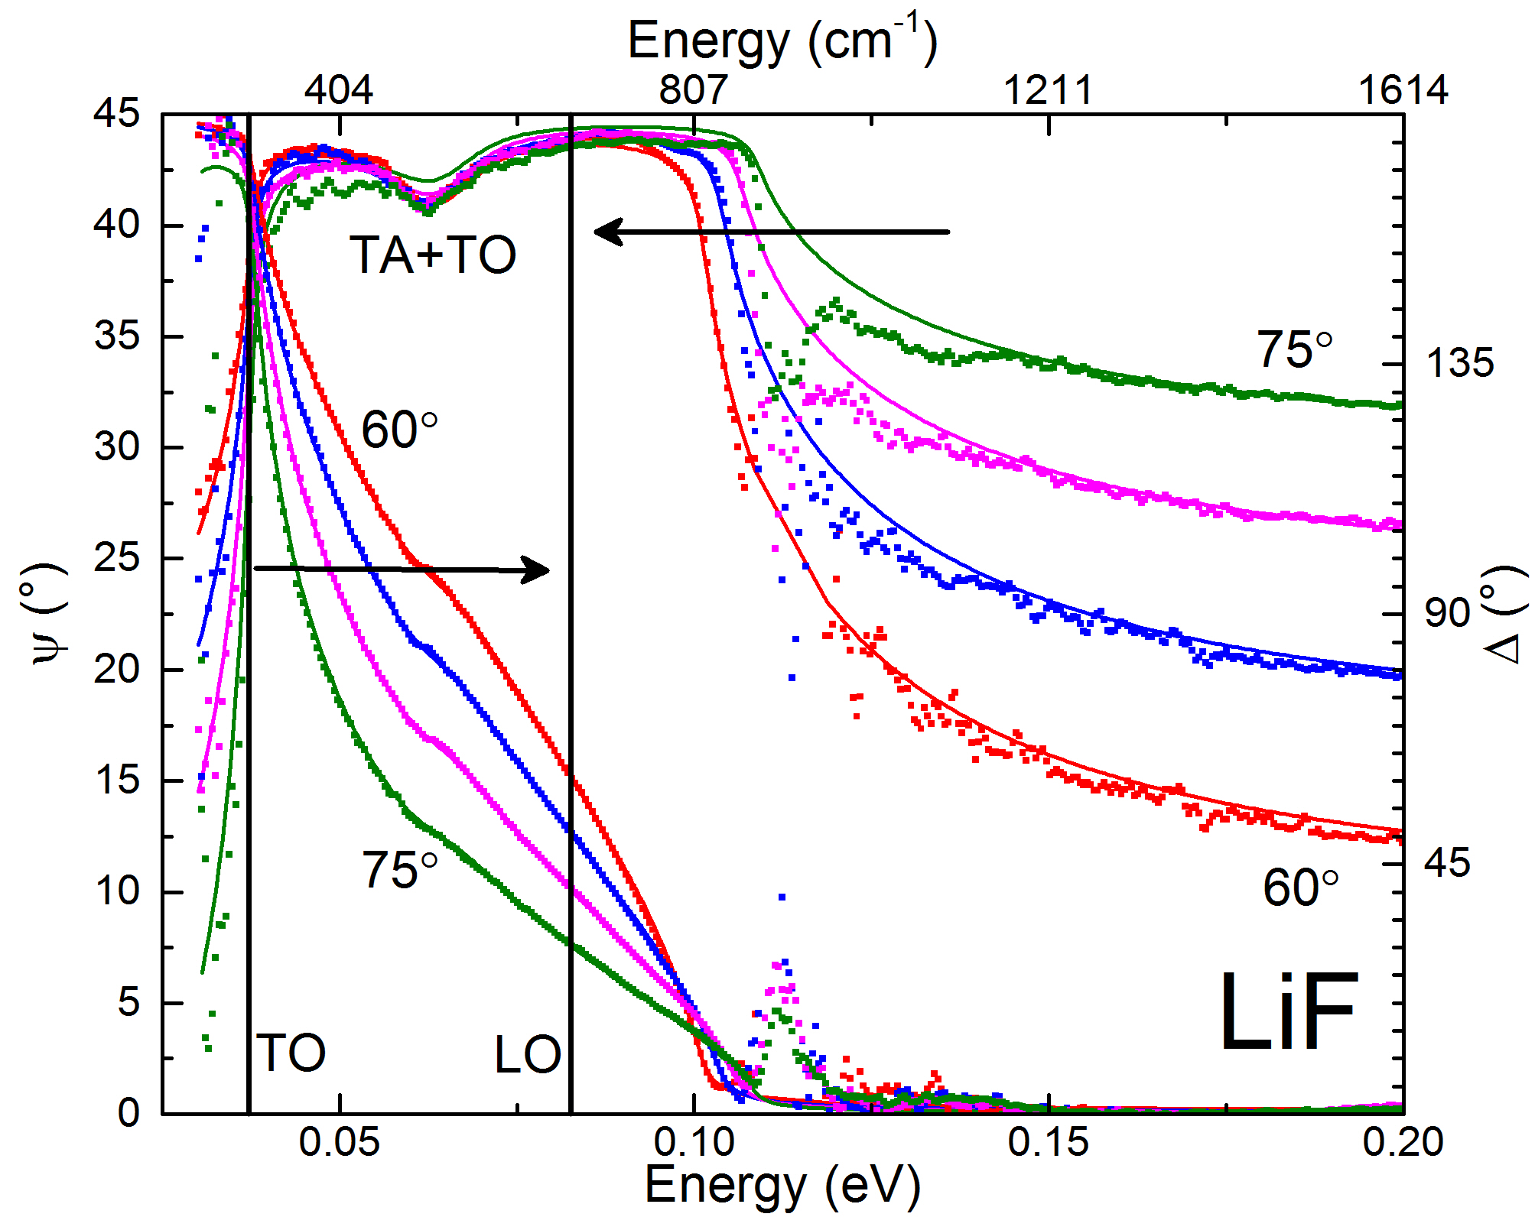
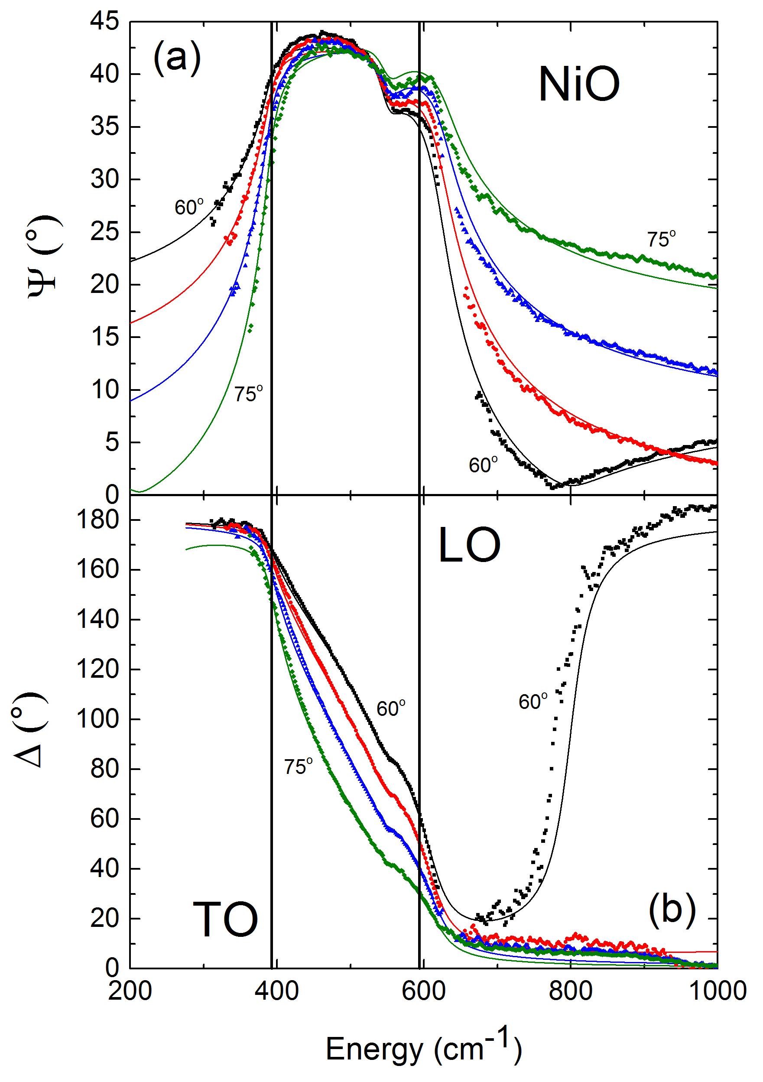
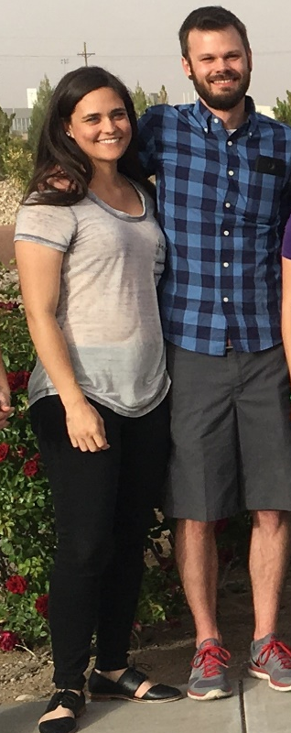
Two-phonon absorption in LiF and NiO
Small absorption in the reststrahlen band causes a dip or terrace.
Compare also with Al, Cu, Au (Fox, Optical Properties of Metals).
Willett-Gies & Nelson, JVST A 33, 061202 (2015).
Also Humlicek TSF 313-314, 687 (1998).

Slide 16
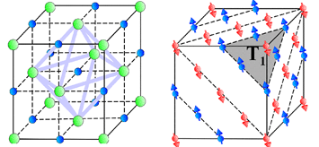
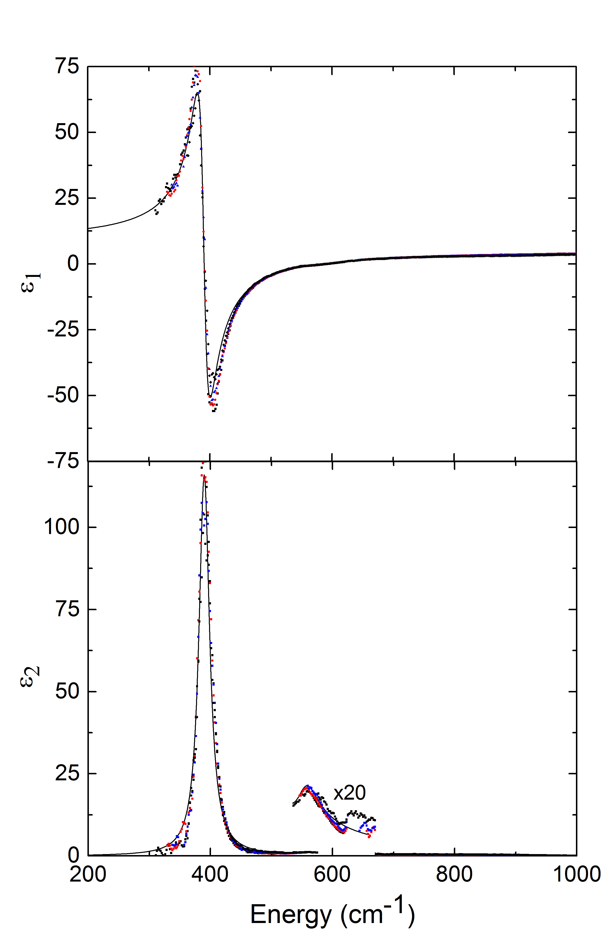
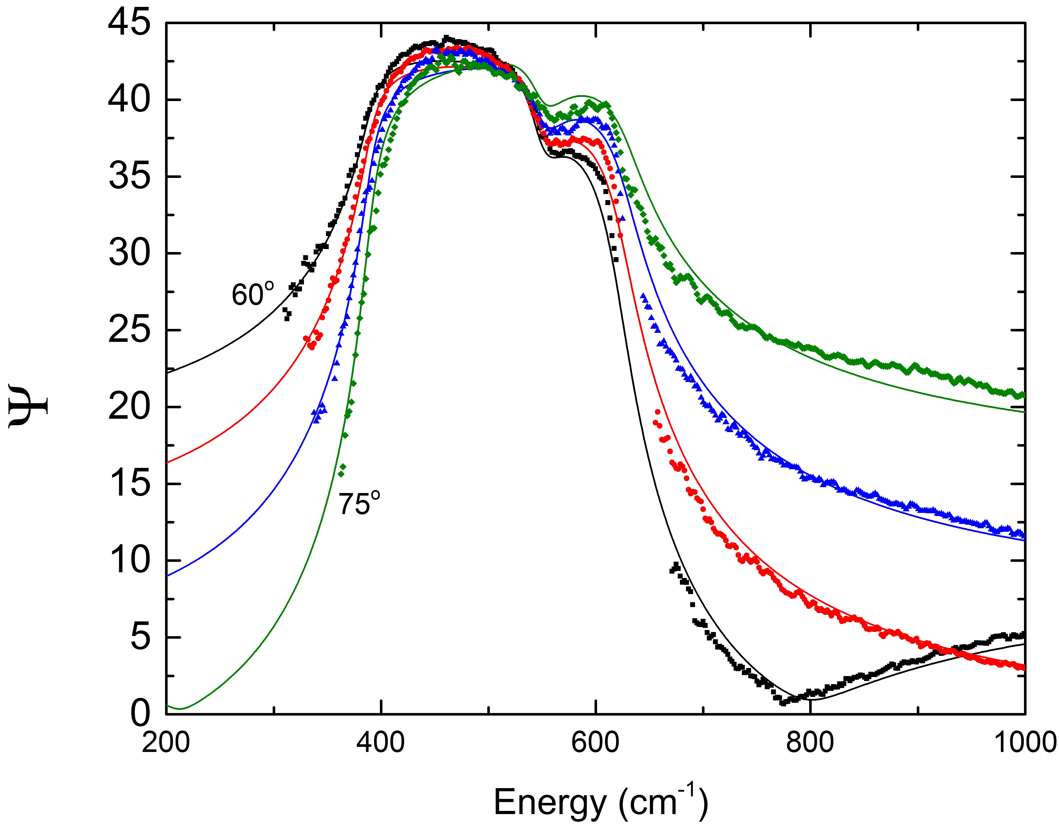
Two-Phonon Absorption in NiO
Rocksalt crystal structure (FCC), Space group 225 (Fm-3m).
Single TO/LO phonon pair: Γ₁₅
Antiferromagnetic ordering along (111), causes phonon splitting (8-30 cm⁻¹).
Second-order phonon absorption.
NiO cell
TO
Rooksby, Nature, 1943
ε_{s}=11.3
ε∞=5.0
NiO Reststrahlen Band
TA+TO phonon
Absorption in the reststrahlen band
Willett-Gies & Nelson,
JVST A 33, 061202 (2015)
16

Slide 17
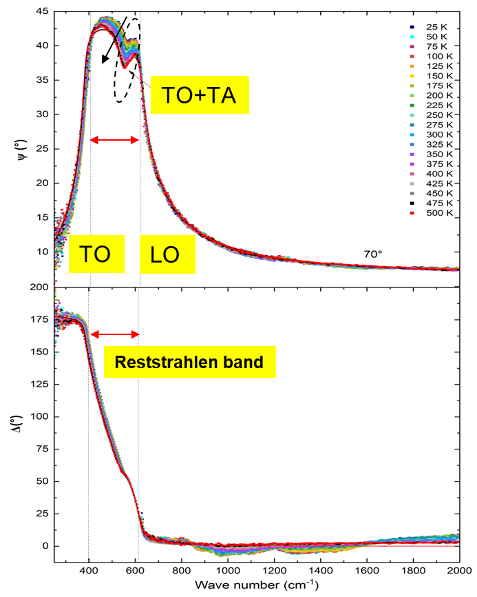
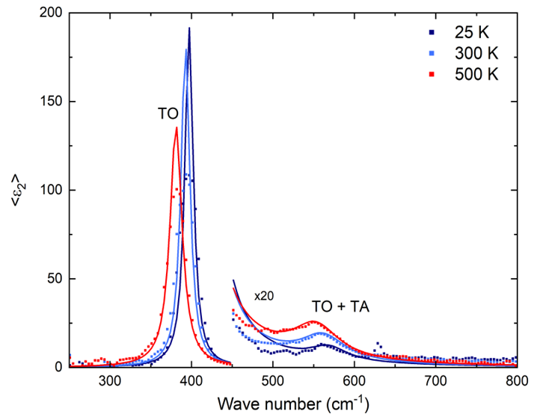

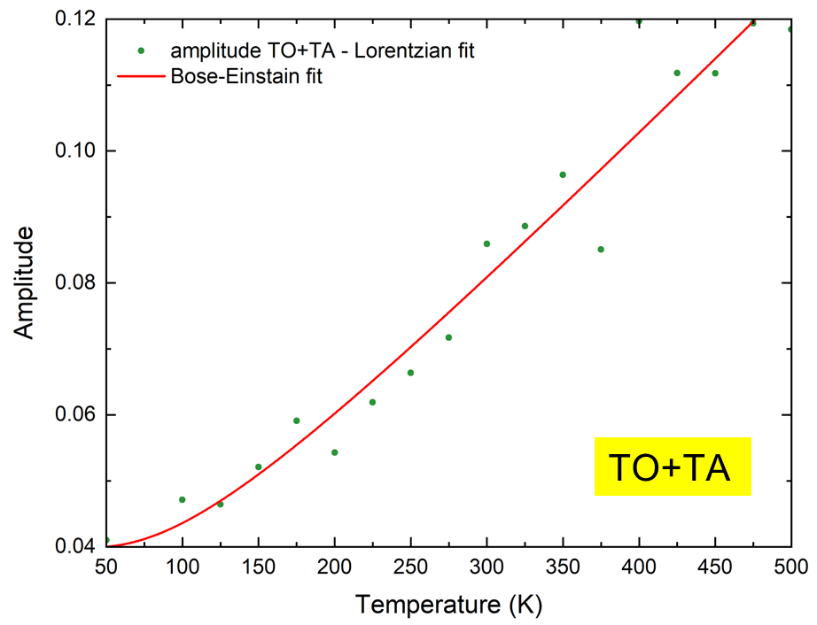
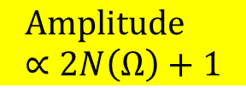
Temperature Dependence of Two-Phonon Absorption
NiO
NiO
Yoshitha Hettige
(ICSE-10)
$$\text{Amplitude}∝2N\left(Ω\right)+1$$
NiO
TO energy (49.6 meV) > 25.4 meV > TA(X) energy (16.5 meV)

Slide 18
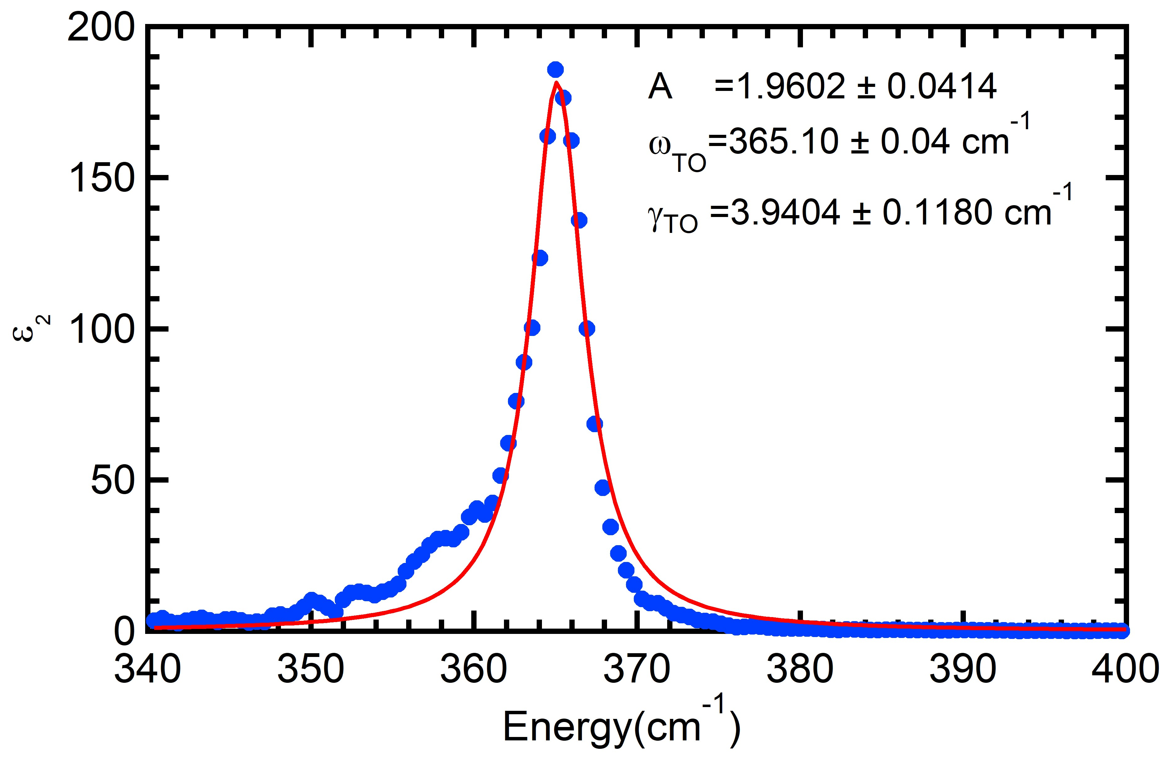


Frequency-Dependent Decay Rate
Lorentz oscillator: constant γ
$$iγω=ω_{TO}^{2}\frac{ε−ε_{s}}{ε−ε_{∞}}−ω^{2}$$
$$ε\left(ω\right)=ε_{∞}+\frac{ω_{P}^{2}}{ω_{0}^{2}−ω^{2}−iγω}$$
Difficult to evaluate because of noise.
GaP
300 K
GaN
300 K
γ_{TO}>γ_{LO}
γ_{TO}>γ_{LO}
N. Samarasingha et al., JVSTB 39, 052201 (2021).
E. Baron et al., Phys. Rev. Mater. 3, 104603 (2019).

Slide 19

Frequency-Dependent Decay Rate: TO-LO
Simplest case: Two different broadening parameters for TO and LO phonons.
$$ε\left(ω\right)=ε_{∞}\frac{ω_{LO}^{2}−ω^{2}−iγ_{LO}ω}{ω_{TO}^{2}−ω^{2}−iγ_{TO}ω}=ε_{∞}+\frac{\left(A−iBω\right)ω_{TO}^{2}}{ω_{TO}^{2}−ω^{2}−iγ_{TO}ω}$$
Or a complex Lorentzian amplitude.
γ_{TO}=γ_{LO}
γ_{TO}>γ_{LO}
MSE=1.6
MSE=1.2
Berreman and Unterwald, Phys. Rev. 174, 791 (1968)
Lowndes, Phys. Rev. B 1, 2754 (1970)
Gervais and Piriou, J. Phys. C Solid State Phys. 7, 2374 (1974).
N. Samarasingha et al., JVSTB 39, 052201 (2021).

Slide 20
Frequency-Dependent Scattering Rate
γ_{TO}>γ_{LO}
Anharmonic decay of optical phonons into acoustic phonons (TO, LO -> LA +TA phonon).
Frequency dependent decay rate: γ_{TO}>γ_{LO}.
TO phonon absorption coefficient becomes negative above LO energy (dotted line).
How do we fix this? The two-phonon absorption also contributes to the absorption, keeping the total absorption coefficient positive.
N. Samarasingha et al., JVSTB 39, 052201 (2021).

Slide 21
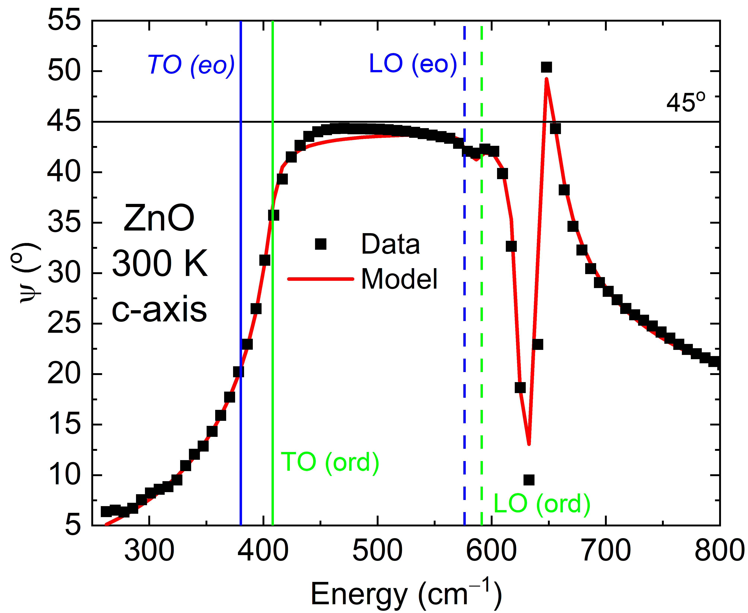
Reststrahlen Band in Uniaxial Crystal ZnO
Uniaxial crystal: Ordinary and extraordinary dielectric function.
Aspnes 1980: For c-axis oriented crystal, we measure the ordinary dielectric function (ε>>1).
Assumption breaks down near the LO frequency where ε is near zero.
4H-SiC
300 K
T. E. Tiwald et al., PRB 60, 11464 (1999).
N. Samarasingha et al., JVSTB 39, 052201 (2021).
Also: E. Franke et al., APL 70, 1668 (1997).

Slide 22
No Phonon Anisotropy in c-axis NiO (111)_{cubic}
Rocksalt Crystal Structure (FCC), Space Group 225 (Fm-3m).
Single TO/LO phonon pair.
Antiferromagnetic ordering along (111), should cause phonon splitting (8-30 cm⁻¹).
Anisotropy not visible in NiO (111).
NiO cell
TO
Rooksby, Nature, 1943
NiO Reststrahlen Band
ε_{s}=11.3
ε∞=5.0
Phonon anisotropy is too small to be visible in NiO (111).
Willett-Gies & Nelson,
JVST A 33, 061202 (2015)
22

Slide 23
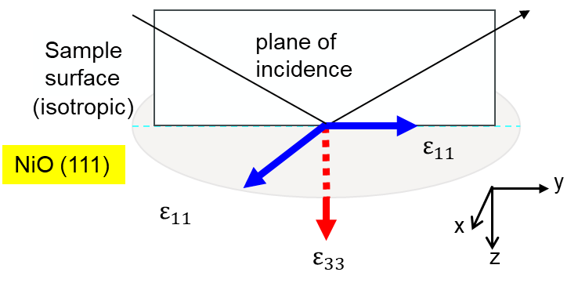
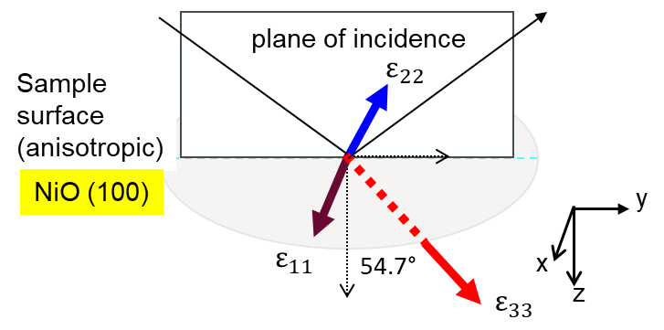
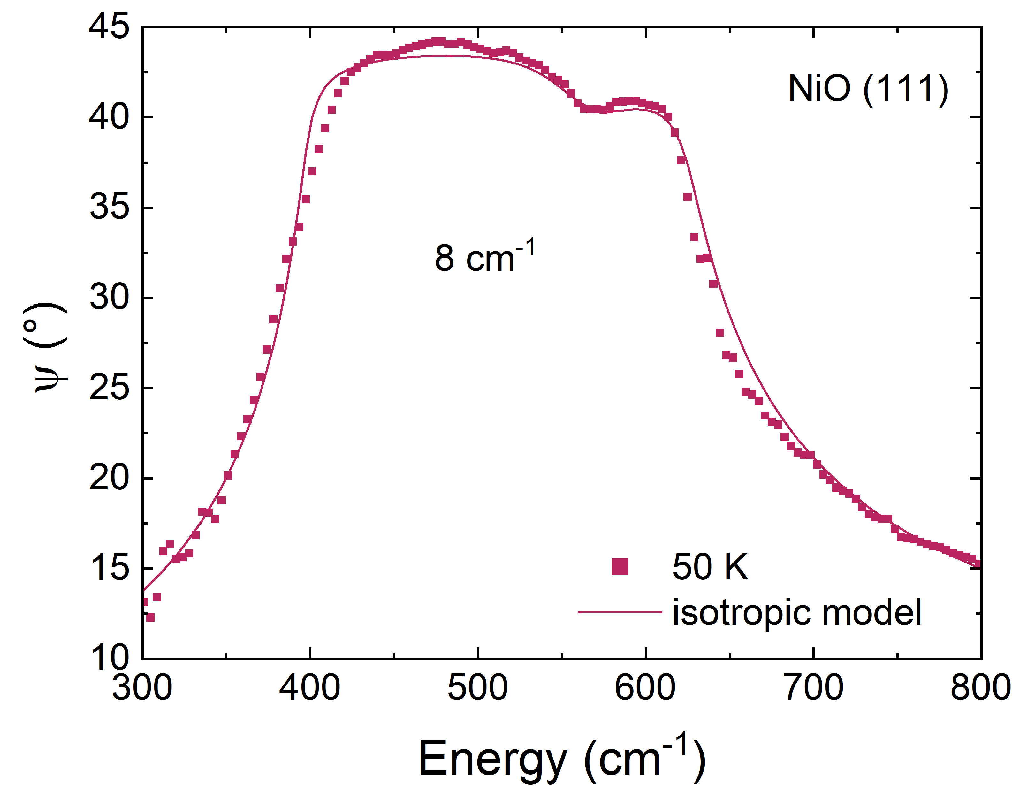
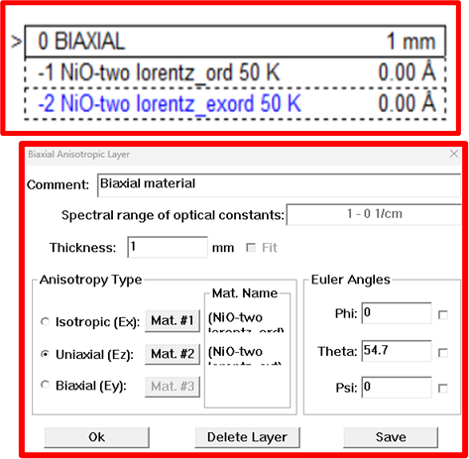
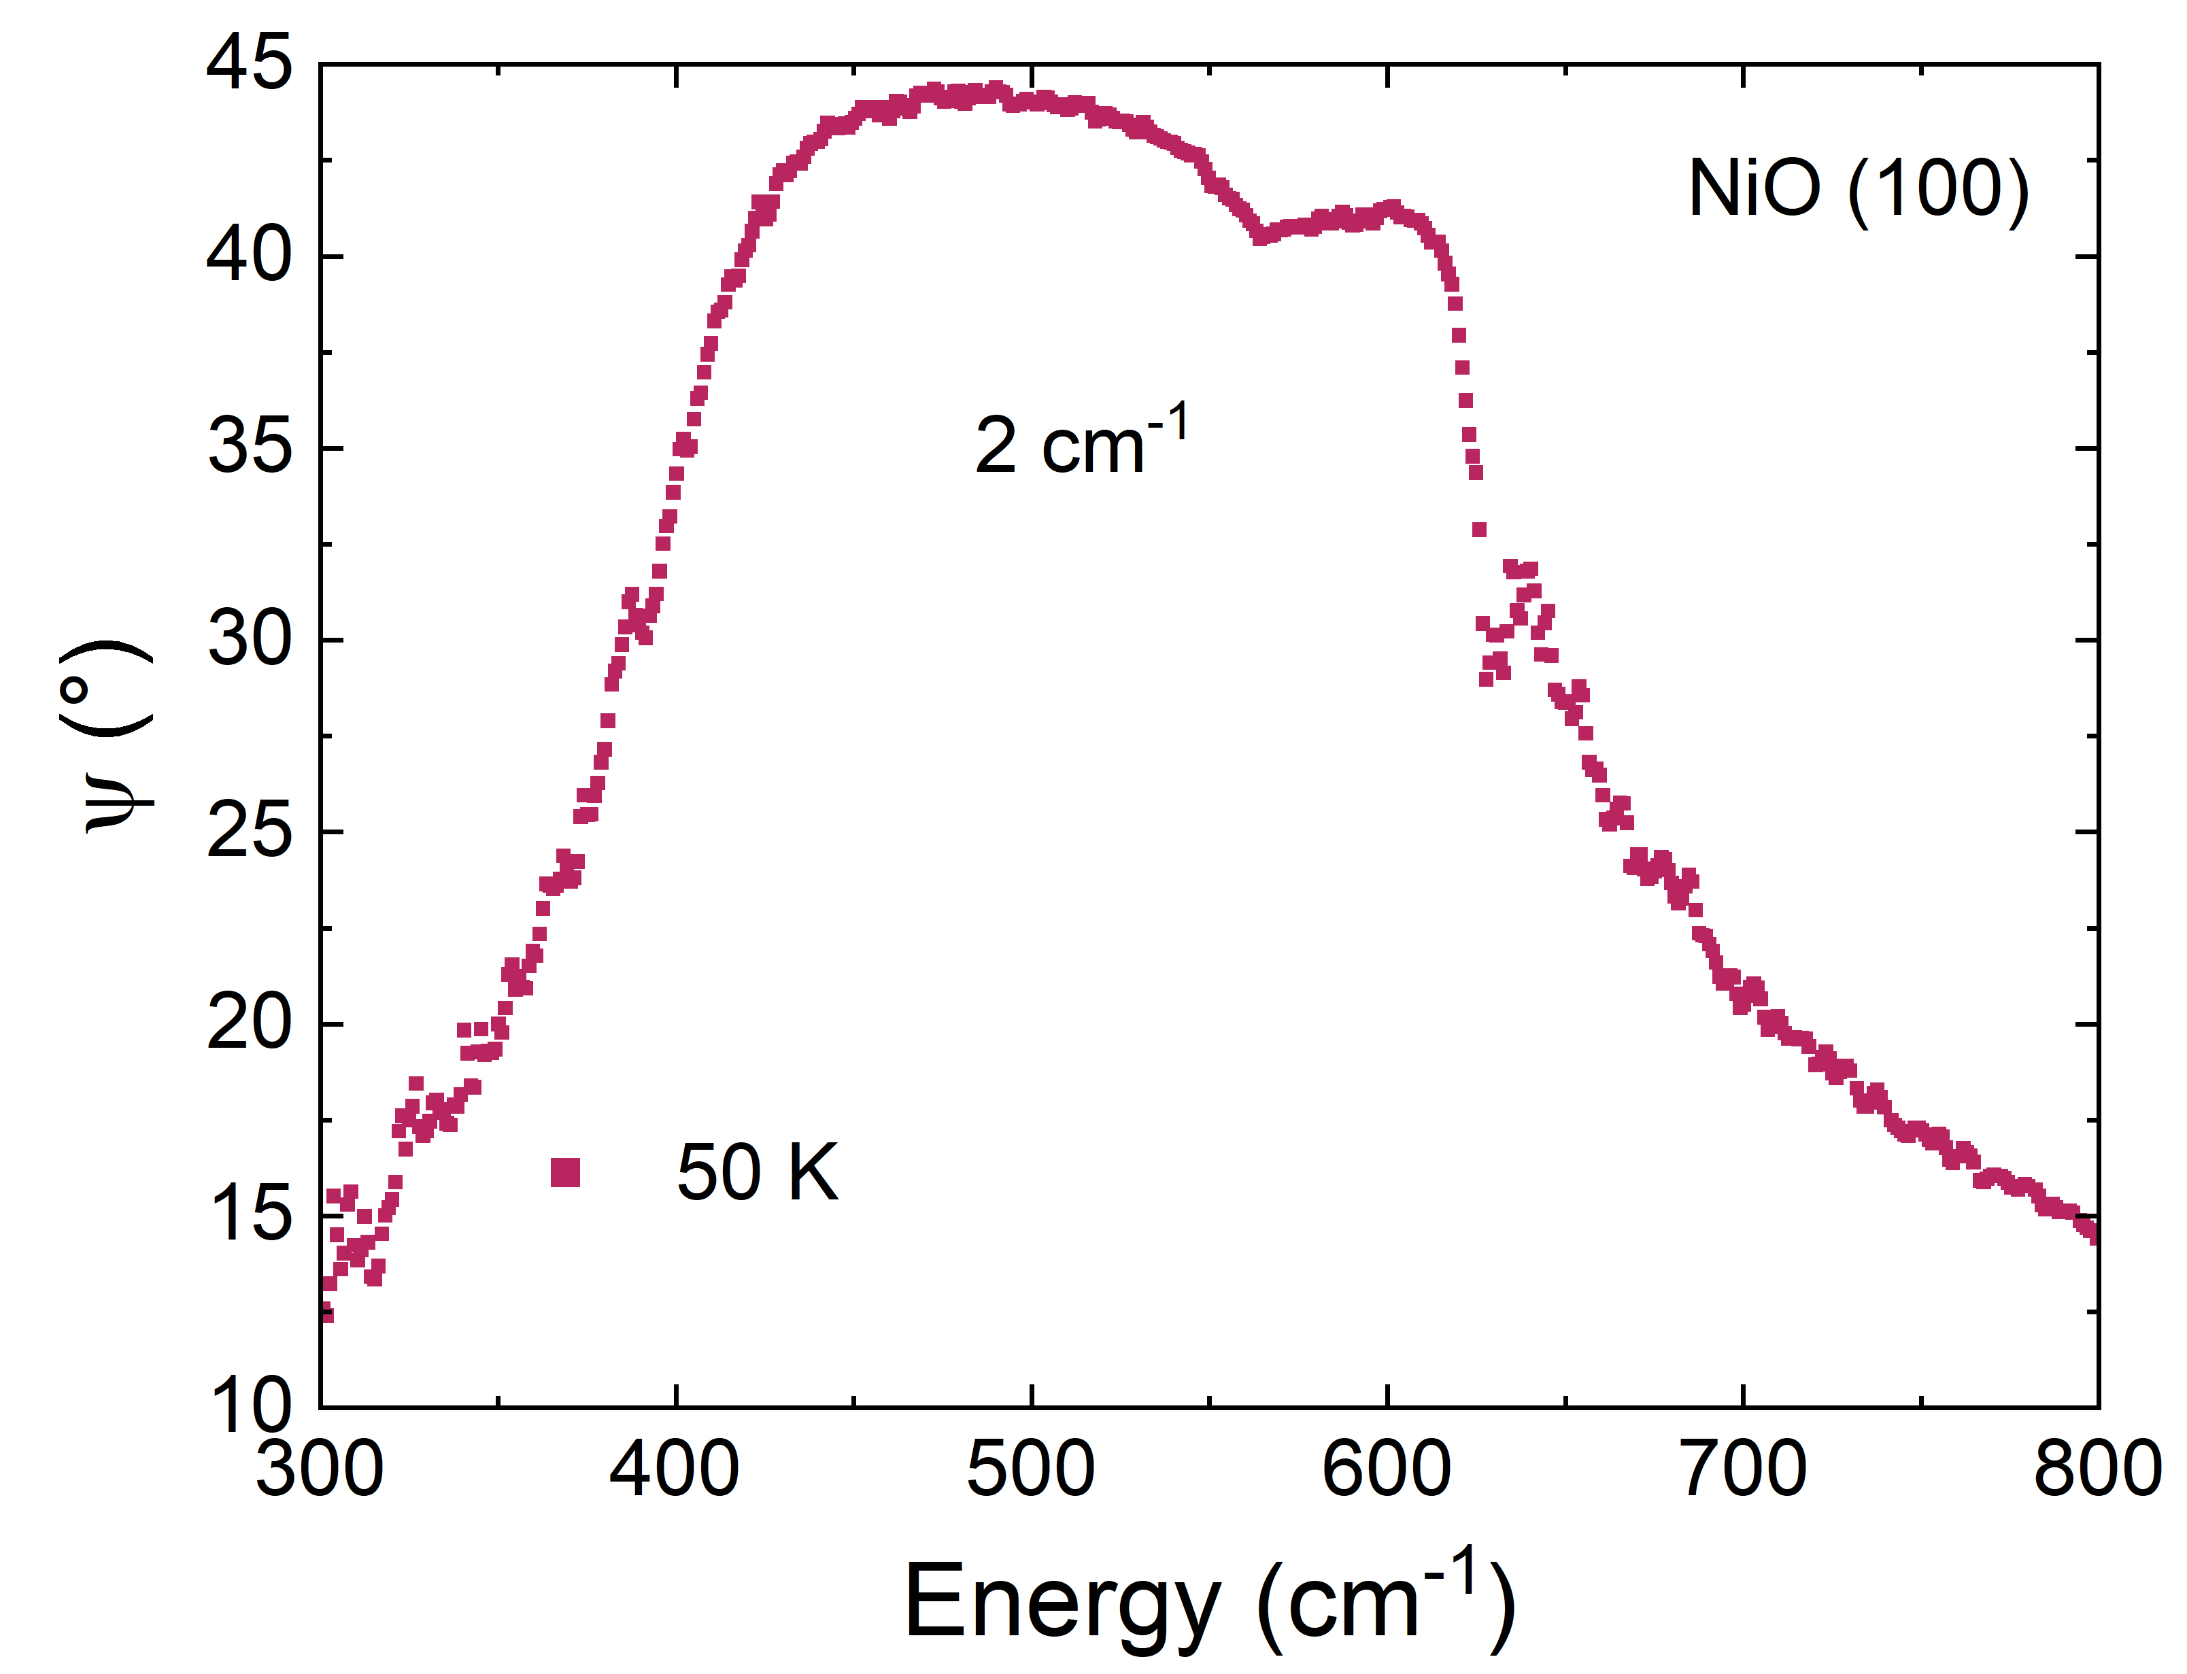
Compare NiO (111) and (100)
NiO (111)
Isotropic
NiO (100)
Anisotropic

Slide 24
Two-phonon absorption in LiF
Phonon energies in LiF:
TO: 304 cm⁻¹
LO: 669 cm⁻¹
LO phonon not seen in ε₂.
Ellipsometry only sees the TO phonon in bulk crystals.
Small absorption in the reststrahlen band causes a dip or terrace.
Compare also with Al, Cu, Au (Fox, Optical Properties of Metals).
Willett-Gies & Nelson, JVST A 33, 061202 (2015).
Also Humlicek TSF 313-314, 687 (1998).

Slide 25
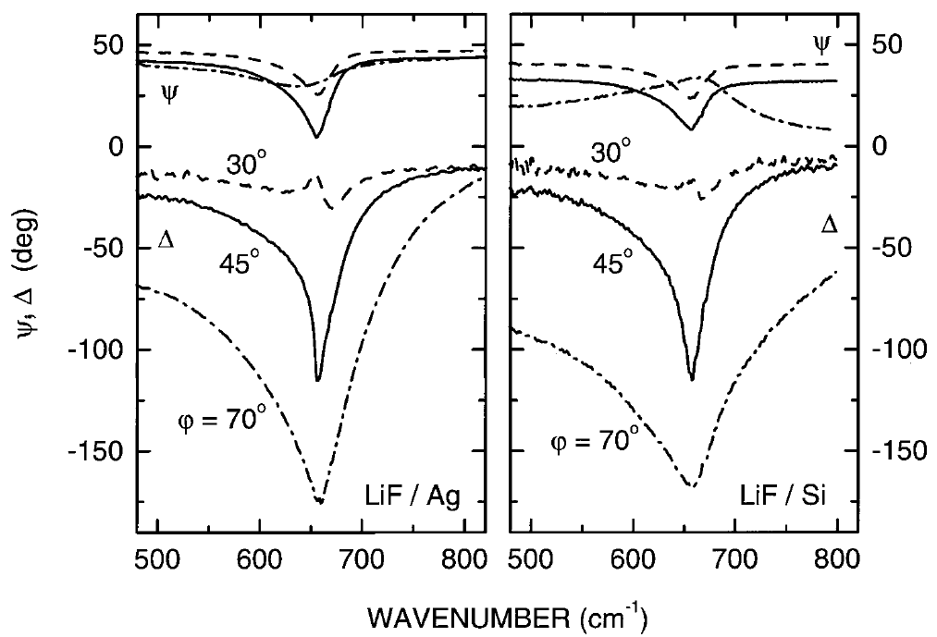
Berreman Effect: LiF on Ag
Light is a transverse wave:
only couples to TO phonons.
cannot excite LO phonons.
TO: peak in ε₂.
LO: peak in loss function.
However: Interference effects cause structures at the LO phonon energy in thin films.
That’s called the Berreman effect.
LO
LO
J. Humlicek, PSSB 215, 155 (1999).

Slide 26
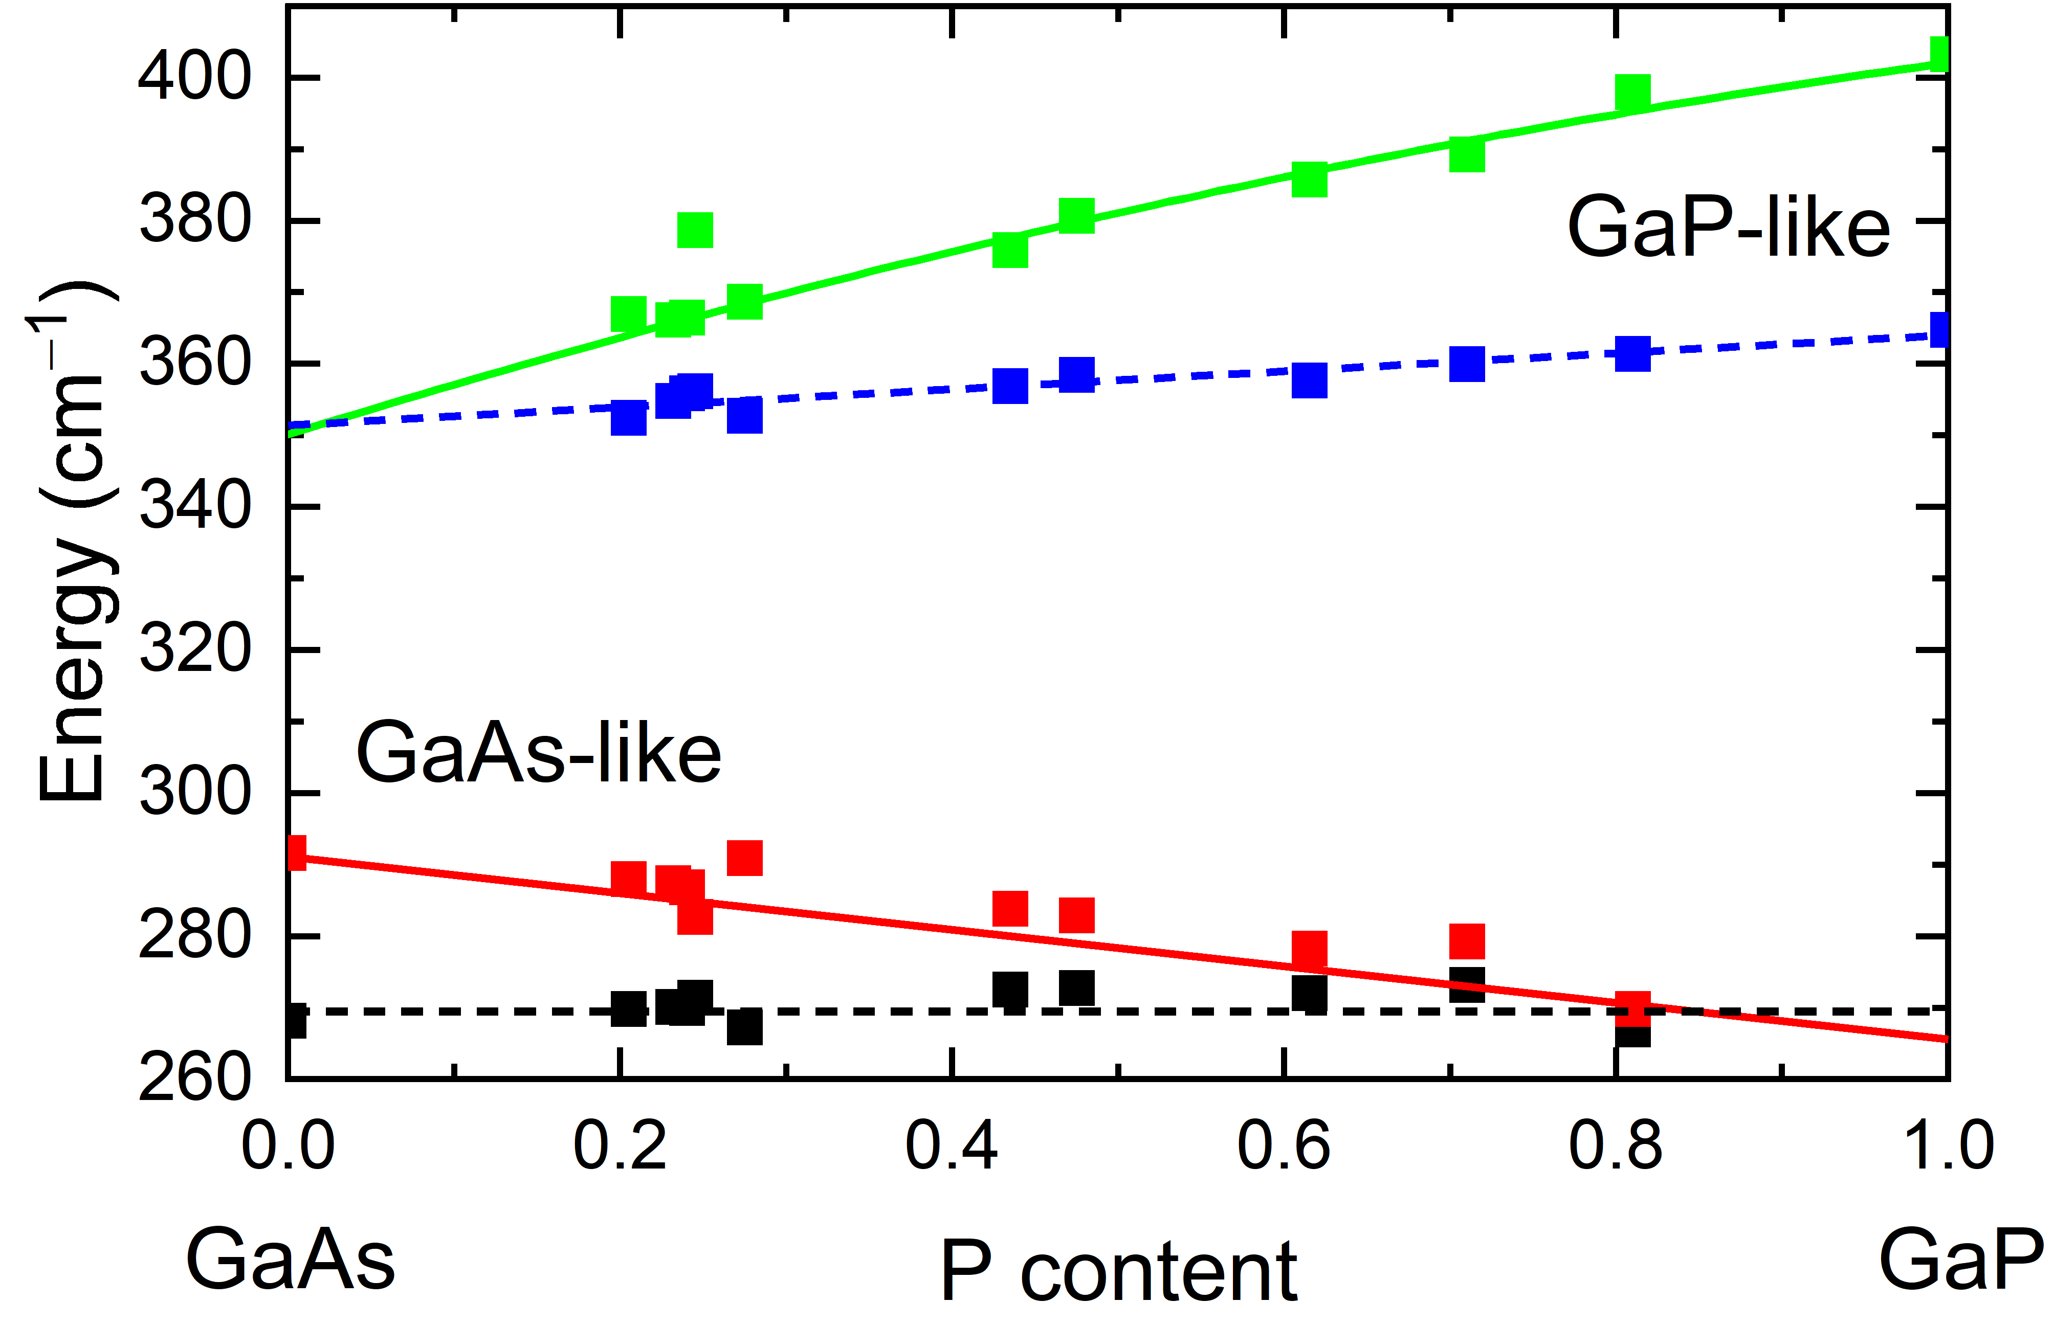
Multimode Behavior in Semiconductor Alloys
GaAs_{1-x}P_{x} alloys have four phonons:
2 TO, 2 LO.
Phonons cannot mix.
Energy pap between GaAs and GaP modes.
Some dependence of phonon energies on composition.
Vegard’s Law does not hold.
Two-mode behavior.
SZ et al., Appl. Phys. Lett. 123, 172102 (2023).

Slide 27
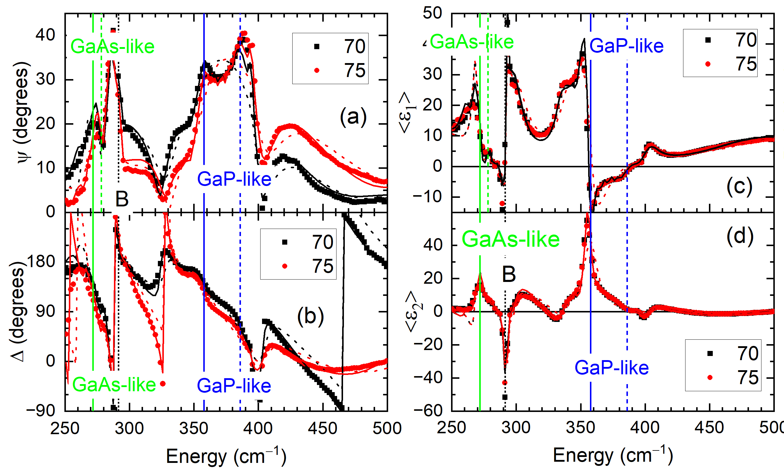
Berreman Effect in Semiconductor Alloys
GaAs_{1-x}P_{x} alloys (on GaAs substrate) have four phonons:
2 TO, 2 LO.
Two reststrahlen bands:
GaAs-like (TO, LO)
GaP-like (TO, LO)
Berreman mode: LO phonon of GaAs substrate shows up in ellipsometry spectra
LO phonons (of substrate or layer) are seen in many ellipsometry spectra of thin films.
SZ et al., Appl. Phys. Lett. 123, 172102 (2023).

Slide 28
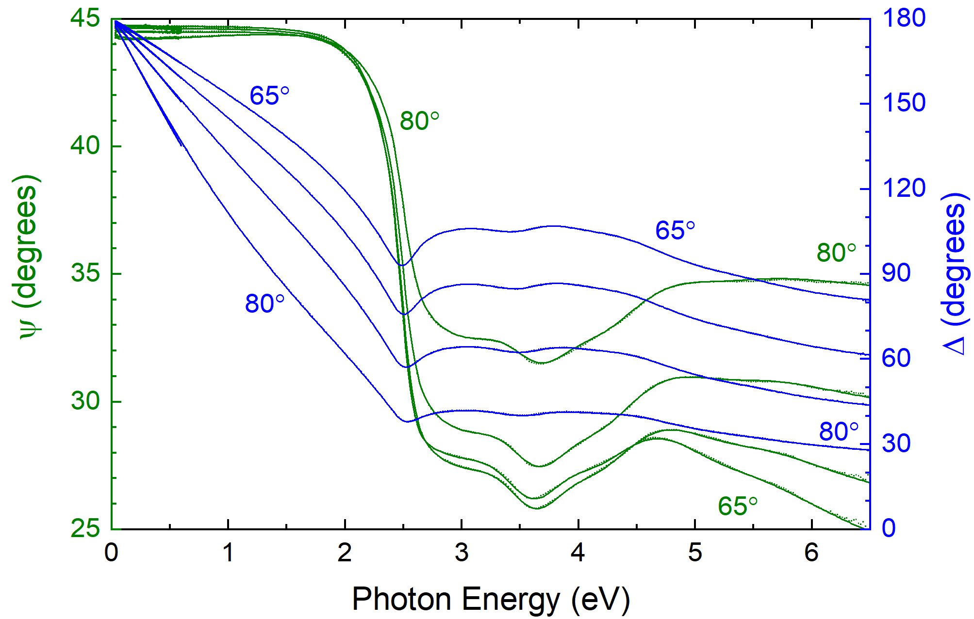
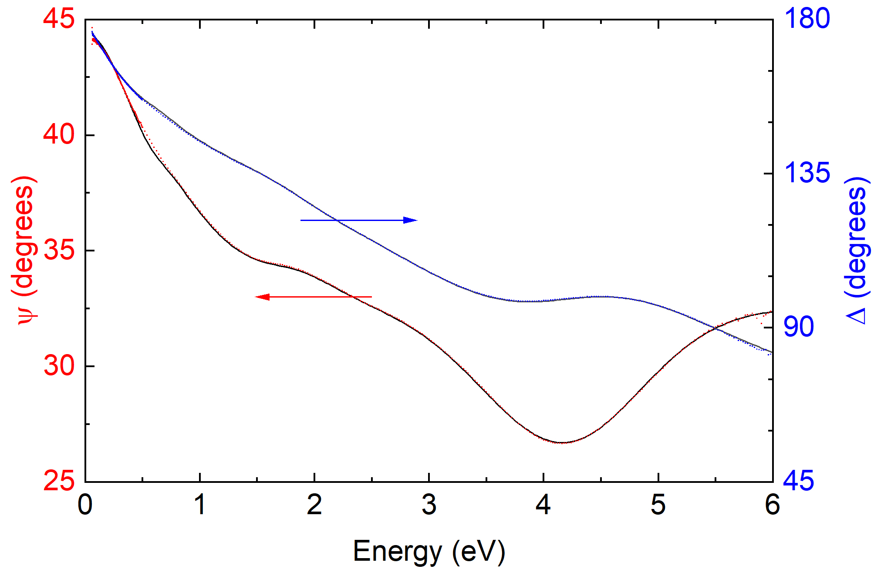
Drude Response of Metals
Au, 300 K
Ni, 300 K
Cleaning of surface (heating in UHV) is very important to obtain accurate results.
For a metal, psi should be 45 degrees up to VUV region.
Lowered because of interband transitions (more important for Ni because of partially filled d bands).
Why does psi never reach 45 degrees at low energies? Needs to be investigated. Anomalous skin effect?
F. Abadizaman and SZ, JVSTB 37, 062920 (2019).

Slide 29
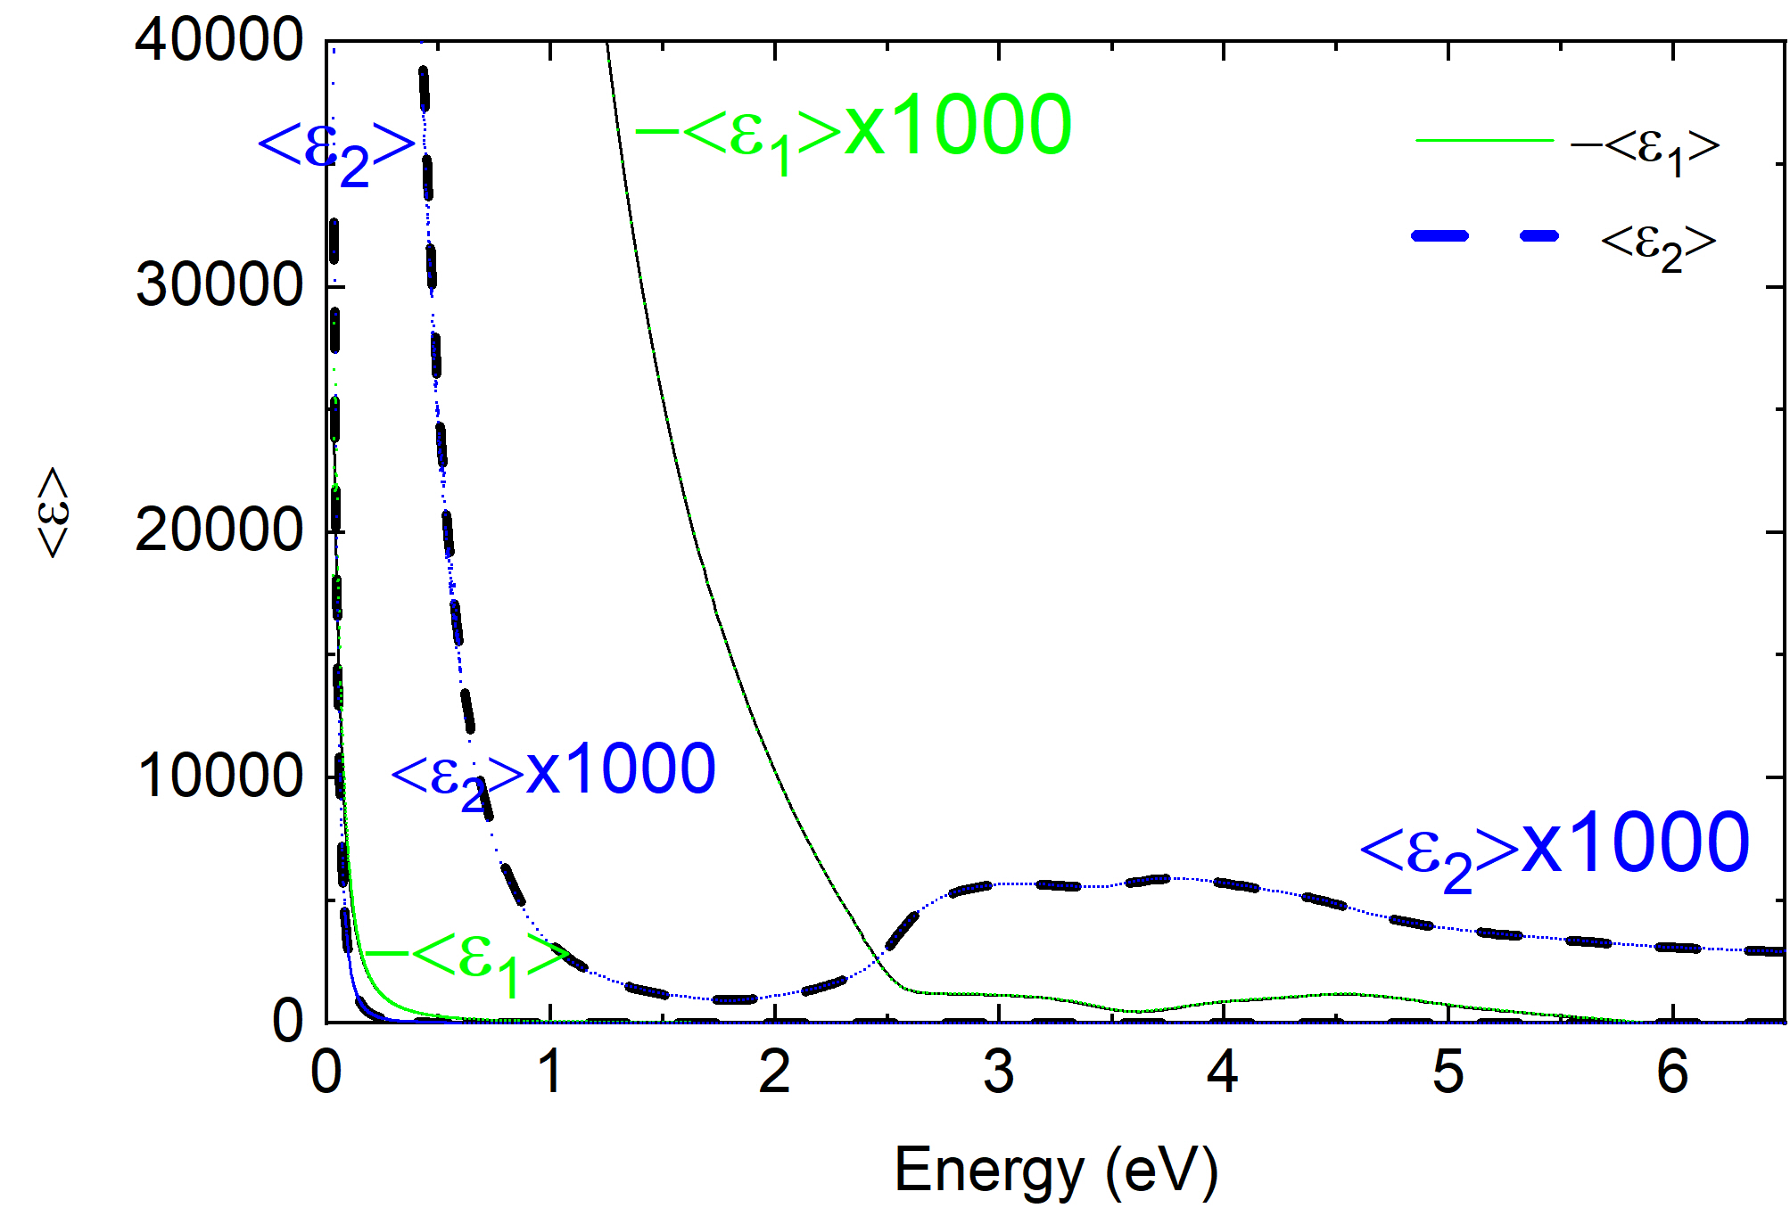
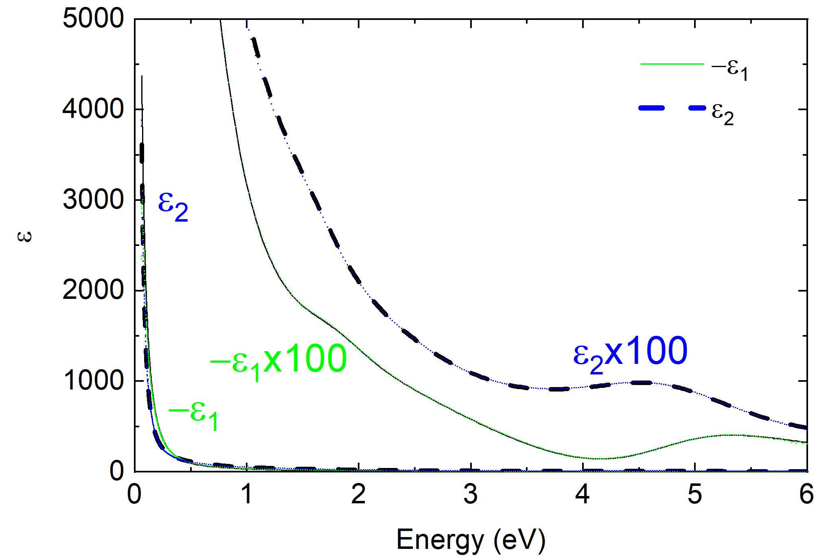

Dielectric Function of Metals (Drude Response)
Au, 300 K
Ni, 300 K
$$ε\left(ω\right)=ε_{∞}−\frac{ω_{P}^{2}}{ω^{2}+iγω}$$
−ε₁, ε₂ very large in IR.
Interband transitions in UV range.
Better representation of data with optical conductivity: σ=−iε₀ω(ε-1)
F. Abadizaman and SZ, JVSTB 37, 062920 (2019).

Slide 30

Drude Response of Ni (Temperature-dependent)
Fitting the dielectric function of Ni:
Two Drude terms (s-, d-electrons)
Four Lorentz oscillators for interband transitions.
d-electrons
s-electrons
σ=−iε₀ω(ε-1)
$$ε\left(ω\right)=ε_{∞}−\frac{ω_{P}^{2}}{ω^{2}+iγω}$$
F. Abadizaman, Jaden Love,
and SZ, JVSTA 40, 033202 (2022).

Slide 31
Singularity at the Curie Temperature of Ni
T_{c}
T_{c}
A
Two transitions merge into one above T_{c}.
Energy of interband transition at 4.8 eV shows typical redshift with increasing temperature.
Broadening decreases and shows singular behavior at the Curie temperature (similar to magnetization).
F. Abadizaman, Jaden Love, and SZ, JVSTA 40, 033202 (2022).

Slide 32
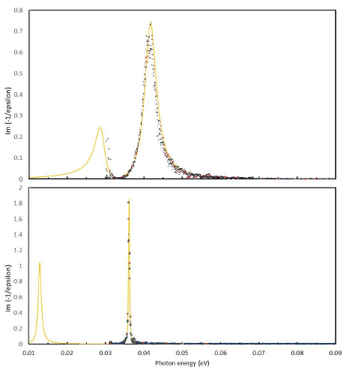


Plasmon-Phonon Coupling
Free carriers are longitudinal excitations, cannot mix with TO phonons.
Look at the loss function! Also, broadening.
7E17 cm⁻³
A
$$ω_{P}^{2}+ω_{LO}^{2}=ω_{LP}^{2}+ω_{UP}^{2}$$
UP
7E17 cm⁻³
$$ω_{P}ω_{TO}=ω_{LP}ω_{UP}$$
LP
LO mode couples with free carrier plasmon
to form
lower and upper
plasmon-phonon polaritons.
7E16 cm⁻³
UP
7E16 cm⁻³
LP
A. A. Kukharskii, Solid-State Commun. 13, 1761 (1973).
SZ, JVSTB 37, 012904 (2019).
Also see posters by Daniel Franta.

Slide 33
Summary and Outlook
Lorentz model for absorption by optical phonons in polar crystals.
Trends with mass and ionicity.
Temperature dependence of optical phonon energies:
Anharmonic decay of optical phonons.
Two-phonon absorption in LiF and NiO.
Beyond the Lorentz model: Frequency-dependent decay rate
Lowndes model (TO/LO oscillator).
Splitting of optical phonons in uniaxial crystals: ZnO, SiC, NiO
Multimode behavior in GaAs_{1-x}P_{x} alloys
Berreman effect at LO energy: Insulator on metal (LiF on Ag)
Drude model for free carrier absorption: Ni and Au
Plasmon-phonon coupling

Slide 34
Thank you! Questions?
PhD. students (10): Lina S. Abdallah, Nalin Fernando, Nuwanjula S. Samarasingha, Farzin Abadizaman, Carola Emminger, Rigo A. Carrasco, Yoshitha Hettige, Carlos A. Armenta, Sonam Yadav, Beata Hroncova.
MS students (5): Travis I. Willett-Gies, Cesar A. Rodriguez, Jaden R. Love, Haley B. Woolf, Aaron Lopez Gonzalez.
Undergraduate students (22): Amber A. Medina, Maria Spies, Cayla M. Nelson, Eric DeLong, Christian J. Zollner, Khadijih N. Mitchell, Ayana Ghosh, T. Nathan Nunley, Laura G. Pineda, Luis A. Barrera, Dennis P. Trujillo, Jaime M. Moya, Jacqueline A. Cooke, Alexandra P. Hartmann, Cesy M. Zamarripa, Zachary Yoder, Pablo P. Paradis, Melissa Rivero Arias, Atlantis K. Moses, Danissa P. Ortega, Gabriel Ruiz, Meghan Worrell.
Ellipsometry collaborators: Jose Menendez (Arizona State), Arnold M. Kiefer (AFRL/RY), Mathias Schubert (Nebraska), Premysl Marsik (Fribourg), Christian Bernhard (Fribourg), Igal Brener (Sandia), Wim Geerts (Texas State), Tom Tiwald (JAW), Preston Webster (AFRL/RV), Martin Veis, Jan Hrabovsky (Charles University), Dagmar Chvostova, Alexandr Dejneka, Marina Tyunina (IOP/CAS).
Thin-film epitaxial samples from many different sources: Arizona State, Delaware, Texas, IIT Indore, Texas State, AFRL/RY+RV, Arkansas, Sandia, NREL, NASA, SOITEC, QuantTera, Connecticut, IBM, Global Foundries, UNM, Ohio State, etc.

Slide 35
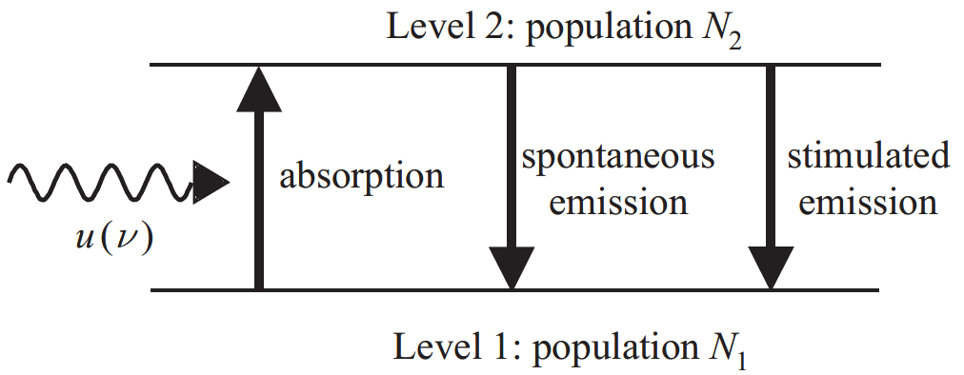

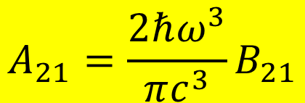

Einstein Coefficients for Interaction Processes
One coefficient is sufficient:
B₁₂
A₂₁
B₂₁
$$g_{1}B_{12}=g_{2}B_{21}$$
$$A_{21}=\frac{2ℏω^{3}}{πc^{3}}B_{21}$$
In equilibrium: N₁, N₂ constant. Absorption and emission balance.
Black-body radiation
Use Fermi’s Golden Rule to calculate B₁₂
$$u\left(ℏω\right)$$
$$B_{12}N_{1}u\left(ℏω\right)=A_{21}N_{2}+B_{21}N_{2}u\left(ℏω\right)$$
Albert Einstein, Strahlungs-Emission und Absorption nach der Quantentheorie, DPG Verh. 18, 318 (1916); Phys. Z. 18, 121 (1917).

