Slide 1
Band filling and relaxation effects in the transient dielectric function of Ge
Stefan Zollner
New Mexico State University, Las Cruces, NM 88003
Ph.D. thesis of Carlos Armenta (2025)
To be continued by Beata Hroncova
In collaboration with:
Martin Zahradník, Mateusz Rebarz, Carola Emminger, Shirly Espinoza, Saul Vazquez-Miranda, Jakob Andreasson
ELI Beamlines Facility, The Extreme Light Infrastructure ERIC, Za Radnicí 835, 25241 Dolní Brežany, Czech Republic
AFOSR (Grant No. FA9550-24-1-0061, Lt. Col. Wooddy S. Miller Ph.D.)
AFRL (Grant No. FA9453-23-2-0001)
http://femto.nmsu.edu

Slide 2
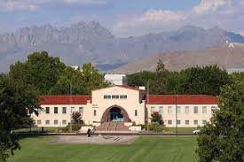
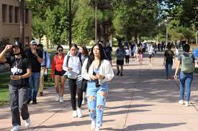
New Mexico State University, Las Cruces
Land grant institution, Carnegie R1 Comprehensive: Arts and Sciences, Education, Business, Agriculture
Ph.D. programs in sciences, engineering, agriculture; Ag extension; Chile Pepper Institute
12,700 students (11,000 UG, 1,700 GR), 1000 faculty
Minority-serving, Hispanic-serving (60% Hispanic/NA, 26% White)
Small-town setting (111,000)
Military-friendly institution (Army and Air Force ROTC programs)
Nearby federal labs: WSMR, NASA, Holloman AFB, Ft. Bliss, Sandia, LANL, AFRL.
Community engagement classification (first-generation students, Pell grant recipients)
Physics: BS/BA, MS, PhD degrees. 67 UG and 39 GR students.
12 faculty (HE Nuclear and Materials Physics), 2.4 M$ research expenditures. ABET-accredited BS in Physics and BS in Engineering Physics
http://femto.nmsu.edu

Slide 3
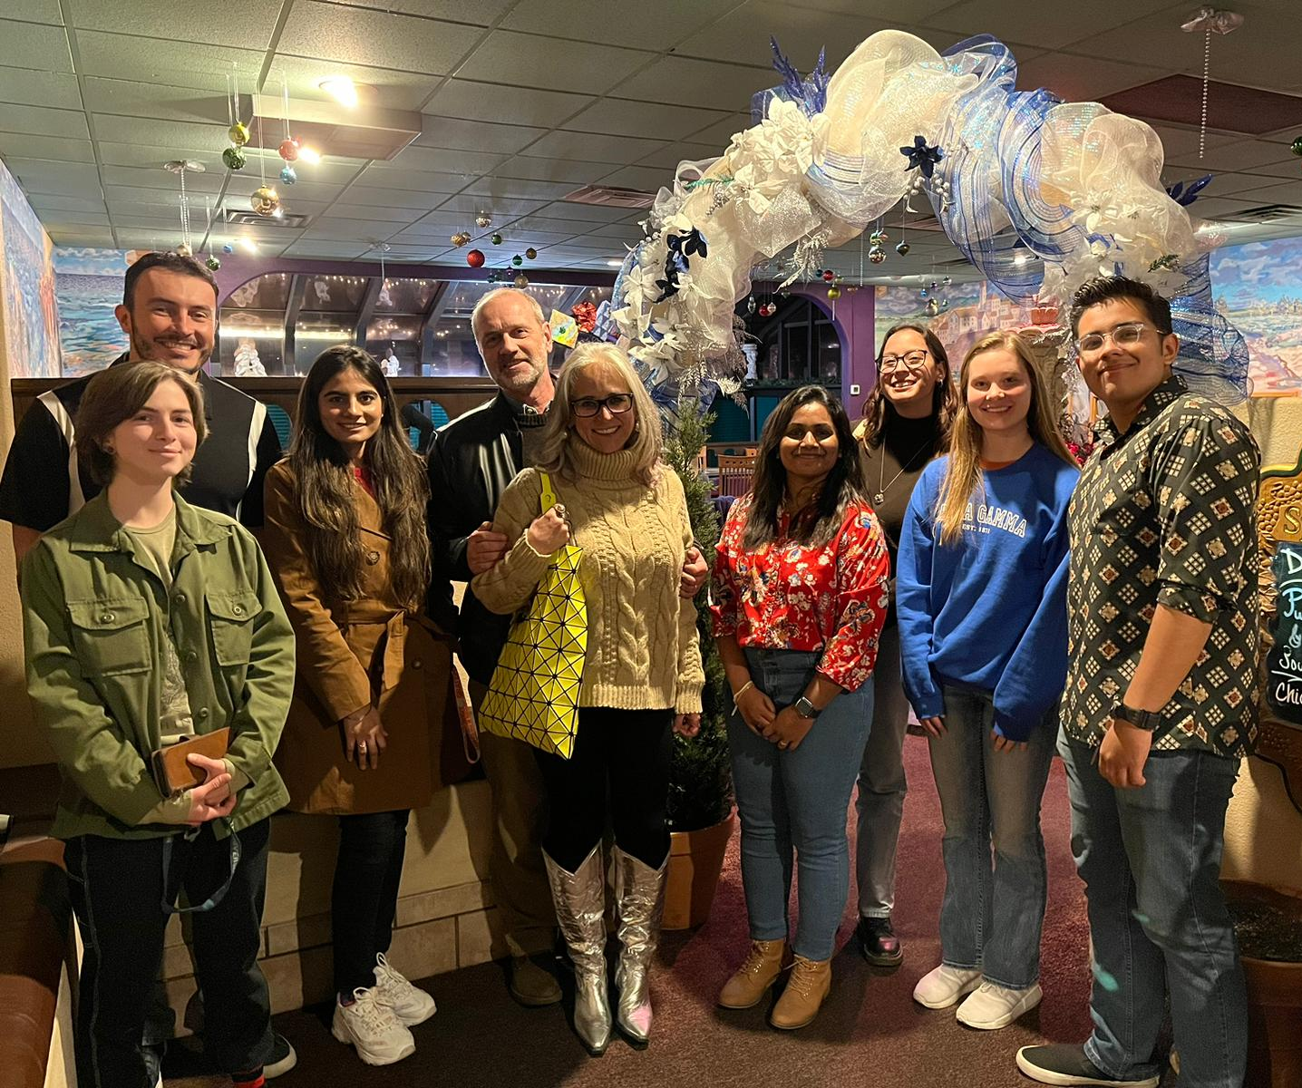
DOD SCALE: Clearable Semiconductor Workforce
PhD. students (10): Lina S. Abdallah, Nalin Fernando, Nuwanjula S. Samarasingha, Farzin Abadizaman, Carola Emminger, Rigo A. Carrasco, Carlos A. Armenta, Yoshitha D. Hettige, Sonam Yadav, Beata Hroncova.
MS students (5): Travis I. Willett-Gies, Cesar A. Rodriguez, Jaden R. Love, Haley B. Woolf, Aaron Lopez Gonzalez.
Undergraduate students (22): Amber A. Medina, Maria Spies, Cayla M. Nelson, Eric DeLong, Christian J. Zollner, Khadijih Mitchell, Ayana Ghosh, T. Nathan Nunley, Laura G. Pineda, Luis A. Barrera, Dennis P. Trujillo, Jaime M. Moya, Jacqueline A. Cooke, Alexandra P. Hartmann, Cesy M. Zamarripa, Zachary Yoder, Pablo P. Paradis, Melissa Rivero Arias, Atlantis K. Moses, Danissa P. Ortega, Gabriel Ruiz, Meghan Worrell, Jesus Marquez.
US citizens in bold. Current students in italics.
Most work in semiconductor wafer manufacturing, electronics and photonics, aerospace R&D, STEM education.
http://femto.nmsu.edu
3

Slide 4
Current Projects and Interests
Improve the fundamental understanding of photonic devices and components (AFOSR).
Explore or re-examine fundamental principles underlying light propagation and light-matter interaction (ONR EO/IO Sensors).
Materials characterization (ellipsometry, photoluminescence, XRD) for IR detectors and lasers.
Fundamental principles of photon absorption at the direct band gap (Emminger, Hroncova).
Explore photon absorption by optical interband transitions above the lowest gap (Armenta).
Explore photon absorption in highly excited semiconductors (Armenta).
Defects in Ge-Sn alloys by IR photoluminescence under hydrostatic pressure (Yadav, Worrell).
Thermal oxidation of Ge and Ge-Sn alloys (Woolf, MS thesis).
Direct gap absorption in α-tin to measure hole concentration (Love, MS thesis).
Characterization of insulating TaN for superconducting Q-bits (Lopez-Gonzalez, MS thesis)
http://femto.nmsu.edu
4

Slide 5
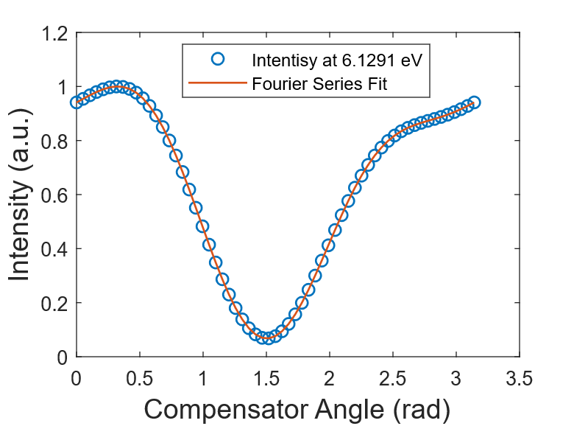
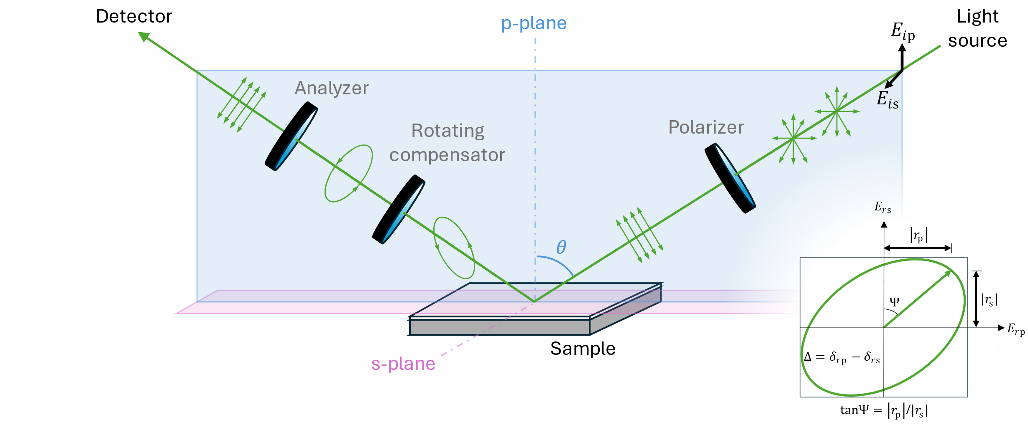

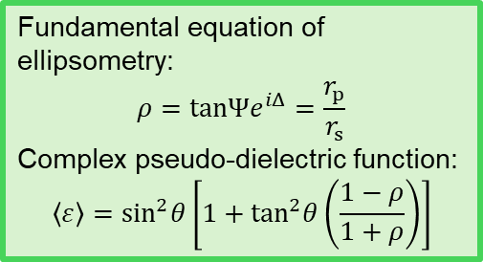
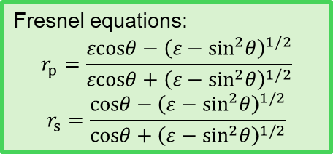
Spectroscopic ellipsometry
Fundamental equation of ellipsometry:
$$ρ=tanΨe^{iΔ}=\frac{r_{p}}{r_{s}}$$
Complex pseudo-dielectric function:
$$\left\langle ε\right\rangle =\sin^{2}θ\left[1+\tan^{2}θ\left(\frac{1−ρ}{1+ρ}\right)\right]$$
Fresnel equations:
$$r_{p}=\frac{εcosθ−{\left(ε−\sin^{2}θ\right)}^{1/2}}{εcosθ+{\left(ε−\sin^{2}θ\right)}^{1/2}}$$
$$r_{s}=\frac{cosθ−{\left(ε−\sin^{2}θ\right)}^{1/2}}{cosθ+{\left(ε−\sin^{2}θ\right)}^{1/2}}$$
RCE in Jones matrix/vector formalism:
$$L_{out}=AR(−A)R(C)CR(−C)SR(−P)PL_{in}$$
$$I\left(C\right)=I_{0}\left(α_{0}+α_{2}cos2C+β_{2}sin2C+α_{4}cos4C+β_{4}sin4C\right)$$
Ellipsometric angles:
$$tan2Ψ=−\frac{\sqrt{\frac{\left(α_{2}^{2}+β_{2}^{2}\right){\left(1−cosδ\right)}^{2}}{\sin^{2}δ}+4{\left(−α_{4}sin2P+β_{4}cos2P\right)}^{2}}}{2\left(α_{4}cos2P+β_{4}sin2P\right)}$$
$$tan2Δ=\left(\frac{1−cosδ}{2sinδ}\right)\frac{α_{2}sin2P−β_{2}cos2P}{2\left(α_{4}cos2P+β_{4}sin2P\right)}$$
H. Fujiwara, Spectroscopic Ellipsometry (Wiley, 2007).
R. Kleim et al., J. Opt. Soc. Am. A 11, 2550 (1994).
Notes:
We need to measure the dielectric function of the material. To do this, we used spectroscopic ellipsometry. This technique consists of measuring the reflection coefficients of the material at an angle θ while modulating the polarization of both, the incident and reflected light.
In this particular configuration, the incident unpolarized light at a specific wavelength is sent through a polarizer. The component that is polarized in the plane of incidence is called p-ploarized, and parallel to this plane are s-polarized. After light reflects off the sample, it then goes through a retarder which we call a compensator, and another polarizer, which we call the analyzer. There needs to be a rotating optical component, which in this case is the compensator.
In the end, we measure an intensity as a function of the compensator angle. If we fit this intensity with a Fourier series, and obtain the Fourier coefficients, we can use them to obtain the ellipsometric angles Ψ and Δ. These ellipsometric angles are related to the reflection coefficients for s- and p-polarized waves through what is known as the fundamental equation of ellipsometry.
Dielectric function can be obtained from the reflection coefficients through Fresnel’s equations. However, what is obtained is a pseudo-dielectric function, rather than the actual dielectric function. The reason for this is that the obtained reflection comes from the sample as a whole. It does not distinguish if the sample is multilayered, if there is surface roughness, or if there are backside reflections. To extract the actual dielectric function some modeling is required.

Slide 6
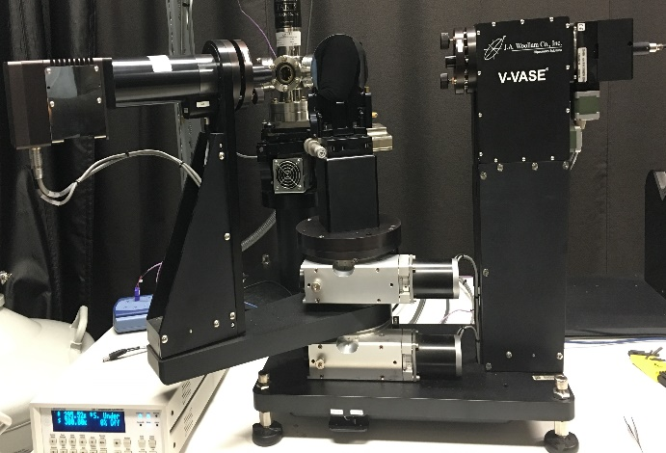
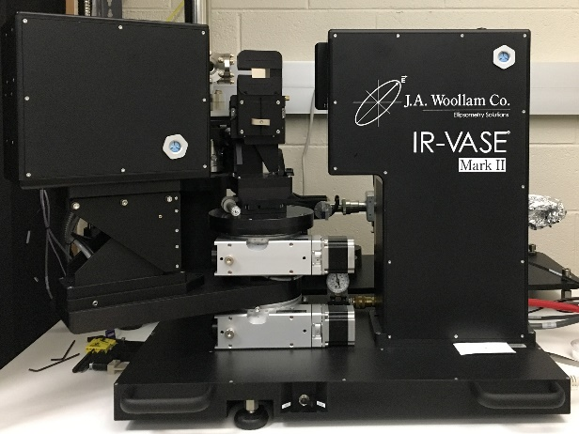
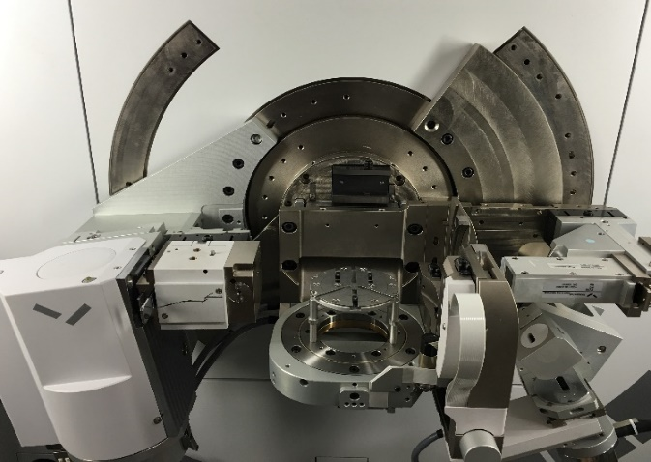


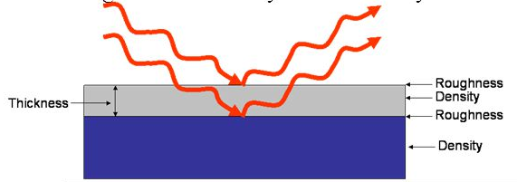
Ellipsometry and X-Ray Instrumentation
Spectroscopic Ellipsometer 190 to 2500 nm (0.5 to 6.5 eV)
Mid-Infrared Ellipsometer 1.25 to 40 μm (250 to 8000 cm⁻¹)
X-ray diffraction & reflectance
Spectroscopic Ellipsometry:
Thickness (100 to 10000 Å)
Absorption, band gap
Refractive index
FTIR ellipsometry:
Very thick films (> 5000 Å)
Phonon absorption
Optical Constants
XRD/XRR:
Crystal structure
Lattice spacings (strain)
Thickness (5 Å to 1000 Å)
Surface, roughness layer
Density
detector
Monochromator
polarizer
analyzer
Φ
Stefan Zollner, 2023, AFRL Lectures Series 1
sample
Notes:
Birstein-Moss shift

Slide 7
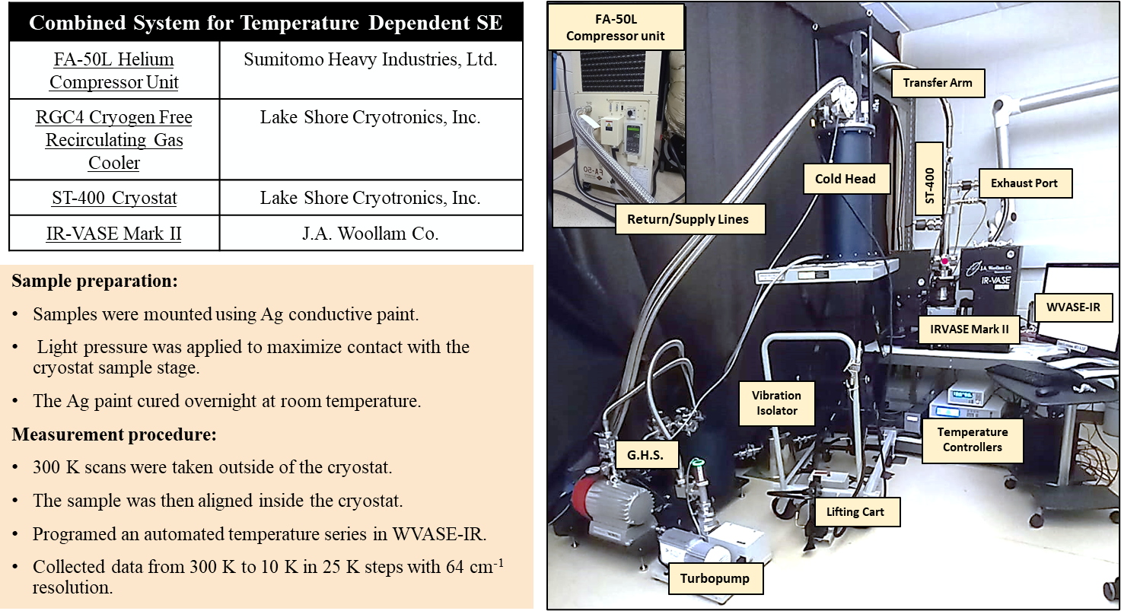
Tools for Temperature-Dependent Ellipsometry
Closed-cycle system works well.
Vibrations do not seem to be a problem.
Ongoing issue: Thin ice layer forms on sample (even in UHV).
Window calibration is important.
Custom feature: Diamond windows for cryostat.
Jaden Love, Atlantis Moses
SZ, Adv. Opt. Techn. 11, 117 (2022)
ARO (W911NF-22-2-0130)
7

Slide 8
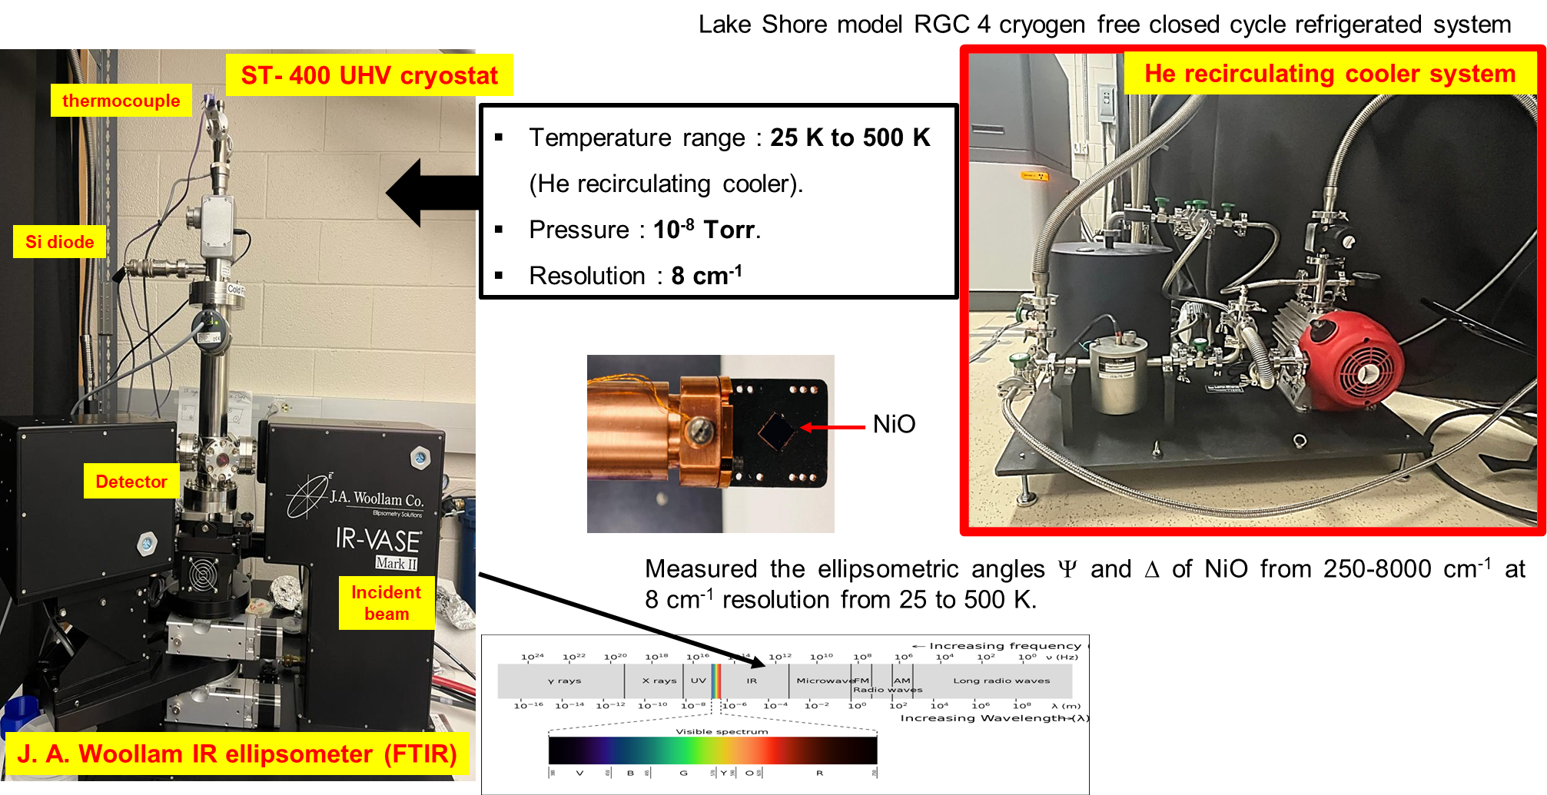
Tools for Temperature-Dependent Ellipsometry
Jaden Love
Atlantis Moses
8

Slide 9
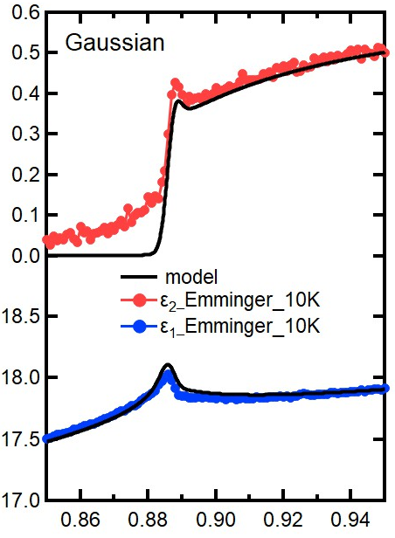
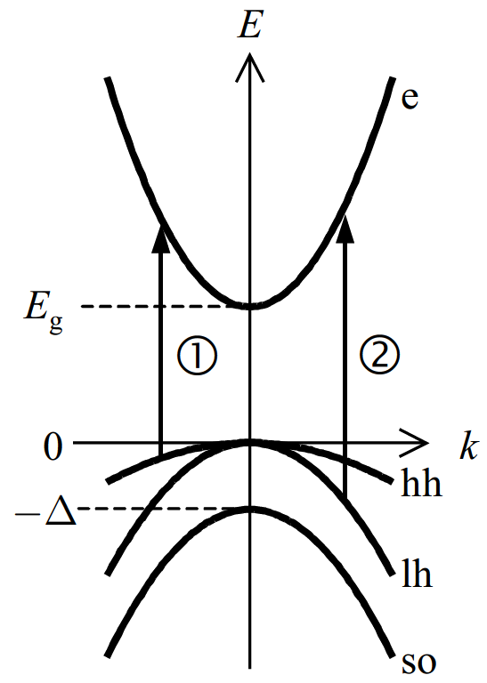
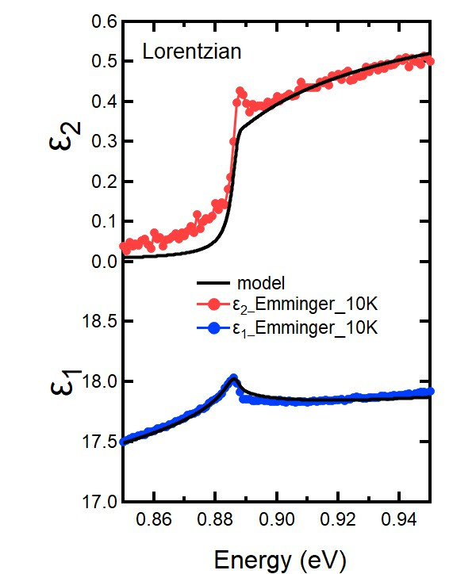
Direct Gap Absorption in Germanium
Quantitative agreement
Fundamental interaction:
k.p band structure theory.
Elliot-Tanguy theory for excitonic absorption.
Fixed parameters:
Electron and hole masses (temperature dependent).
Excitonic binding energy R.
Amplitude A (derived from k.p matrix element P).
Adjustable parameters:
Broadening Γ: 2.3 meV
Band gap E₀
Linear background A₁ and B₁ (contribution from E₁ to real part of ε)
To be continued for other materials (Ge-Sn alloys) and higher temperatures.
Ge
ε₂
ε₁
Carola Emminger et al., JAP 131, 165701 (2022)

Slide 10
Can k.p Theory Predict Absorption for Other Materials?
Experimental data suggests that there should be a universal scaling law for the direct gap absorption.
Need low-temperature ellipsometry measurements for InAs, GaSb, GaAs, InP, GaP, etc.
Need to verify with calculations for binary compounds and semiconductor alloys.
Can this theory be generalized for superlattices (Kronig-Penney model)?
Marko Milosavljevic, JAP 138, 093103 (2025)

Slide 11
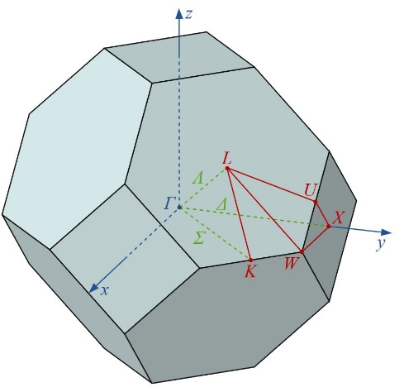
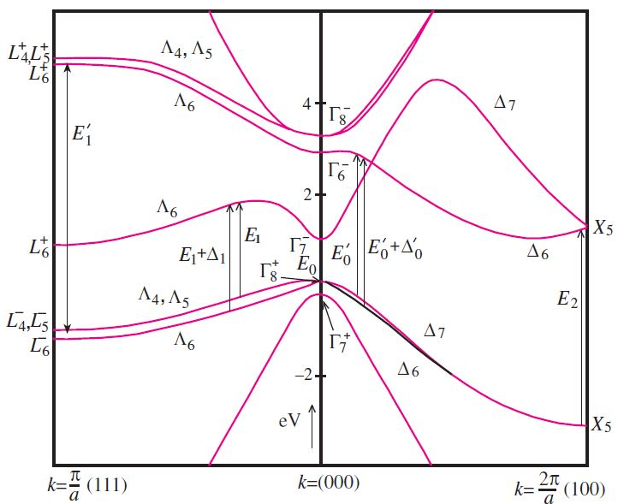
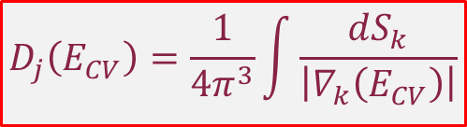
Direct Absorption at Higher Energies
Structures in ε due to interband transitions
Joint density of states
Van Hove singularities
$$D_{j}\left(E_{CV}\right)=\frac{1}{4π^{3}}\int{\frac{dS_{k}}{\left|∇_{k}\left(E_{CV}\right)\right|}}$$
E₁’
Ge
Ge
Armenta and Zollner, JAP 137, 245701 (2025)

Slide 12
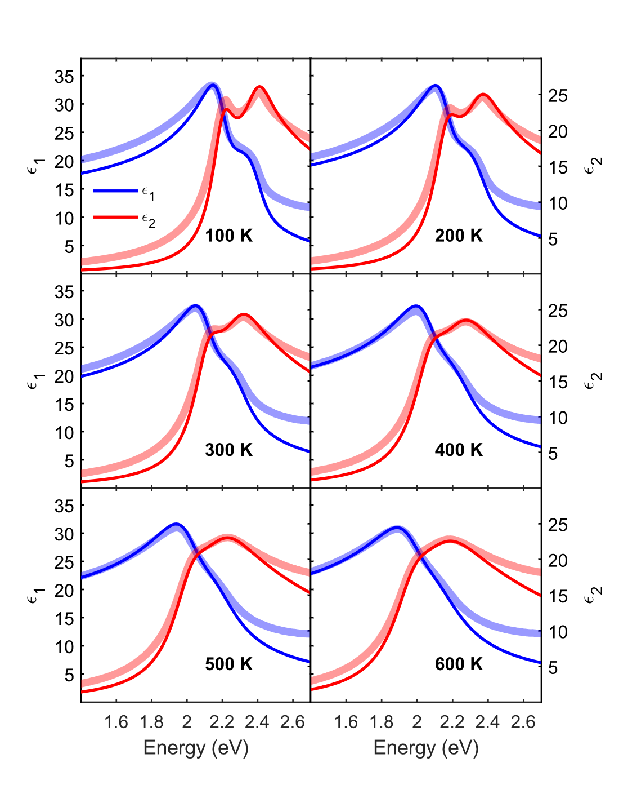
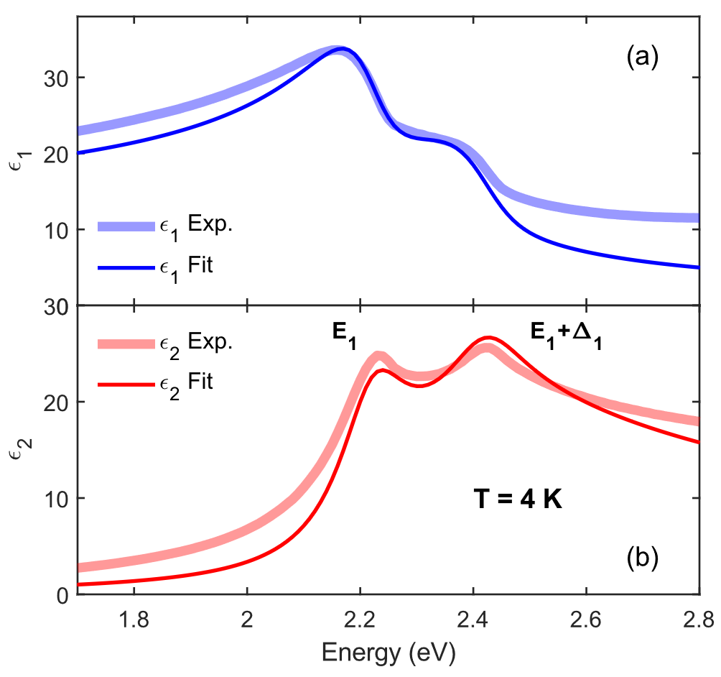
Direct Absorption at Higher Energies
k.p theory works very well for E₁ and E₁+Δ₁ transitions.
Effective masses and dipole matrix element from k.p theory.
Two-dimensional excitons (Tanguy).
No parameter for amplitude of absorption peaks.
Ge
Armenta and Zollner, JAP 137, 245701 (2025)

Slide 13
Can we connect the two spectral regions?
Ge
Maybe ???
Conduction band nonparabolicity
k-dependent optical transition matrix elements
ε₂
Ge
ε₁
Kane, J. Phys. Chem. Solids 1, 249 (1957)

Slide 14
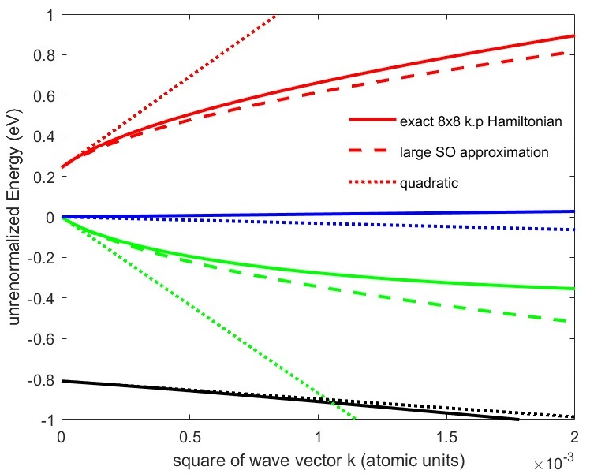
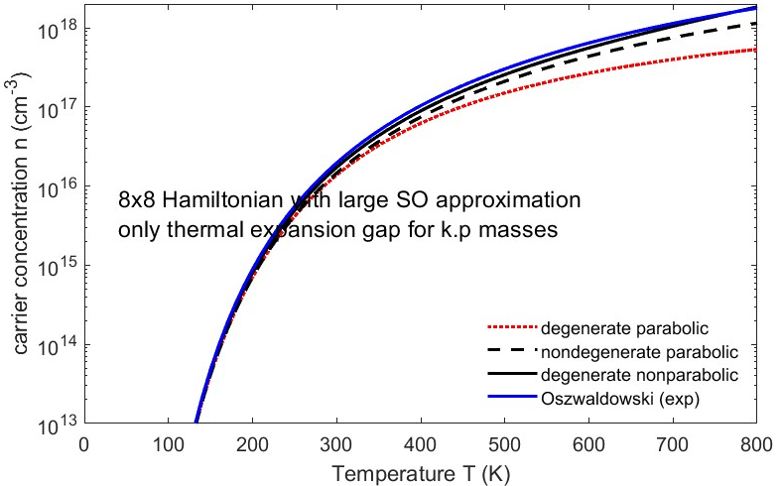
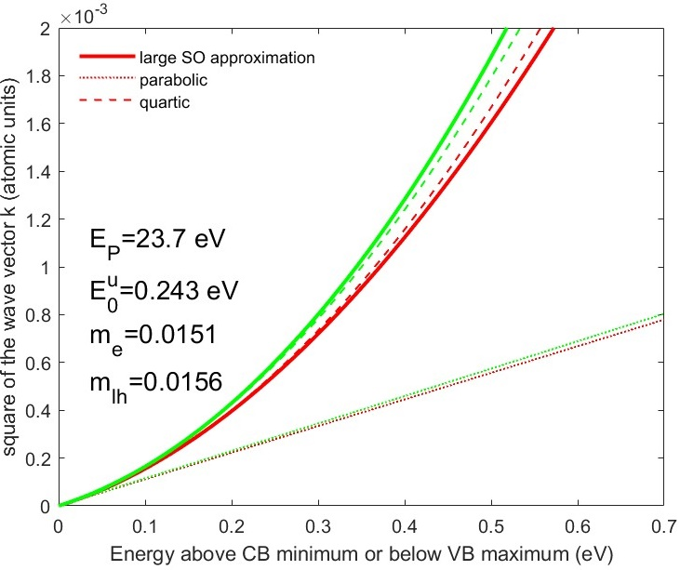
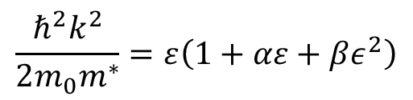
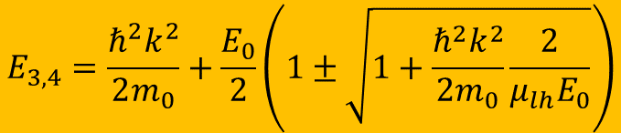

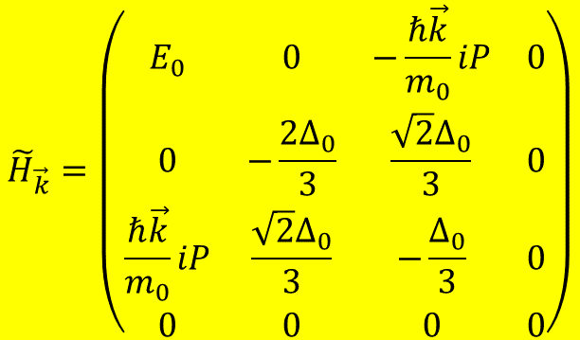
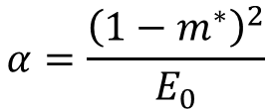
Nonparabolicity of InSb conduction band from k.p theory
Kane 8x8 k·p Hamiltonian:
Energy versus k²
Intrinsic carrier concentration
n=2x10¹⁸ cm⁻³ at 800 K
$${\tilde{H}}_{\vec{k}}=\left(\begin{matrix}E_{0} & 0 & −\frac{ℏ\vec{k}}{m_{0}}iP & 0 \\ 0 & −\frac{2Δ_{0}}{3} & \frac{\sqrt{2}Δ_{0}}{3} & 0 \\ \frac{ℏ\vec{k}}{m_{0}}iP & \frac{\sqrt{2}Δ_{0}}{3} & −\frac{Δ_{0}}{3} & 0 \\ 0 & 0 & 0 & 0\end{matrix}\right)$$
Cubic characteristic equation (solid):
$$\tilde{E}\left(\tilde{E}−E_{0}\right)\left(\tilde{E}+Δ_{0}\right)−\frac{ℏ^{2}k^{2}E_{P}}{2m_{0}}\left(\tilde{E}+\frac{2Δ_{0}}{3}\right)=0$$
$$\frac{ℏ^{2}k^{2}}{2m_{0}m^{∗}}=ε\left(1+αε+βε^{2}\right)$$
Density of CB states
Large spin-orbit approximation (dashed):
$$α=\frac{{\left(1−m^{∗}\right)}^{2}}{E_{0}}$$
$$E_{3,4}=\frac{ℏ^{2}k^{2}}{2m_{0}}+\frac{E_{0}}{2}\left(1±\sqrt{1+\frac{ℏ^{2}k^{2}}{2m_{0}}\frac{2}{μ_{lh}E_{0}}}\right)$$
S. Zollner, JVST A 43, 012801 (2025)
Kane, J. Phys. Chem. Solids 1, 249 (1957).
14
Notes:
Birstein-Moss shift

Slide 15
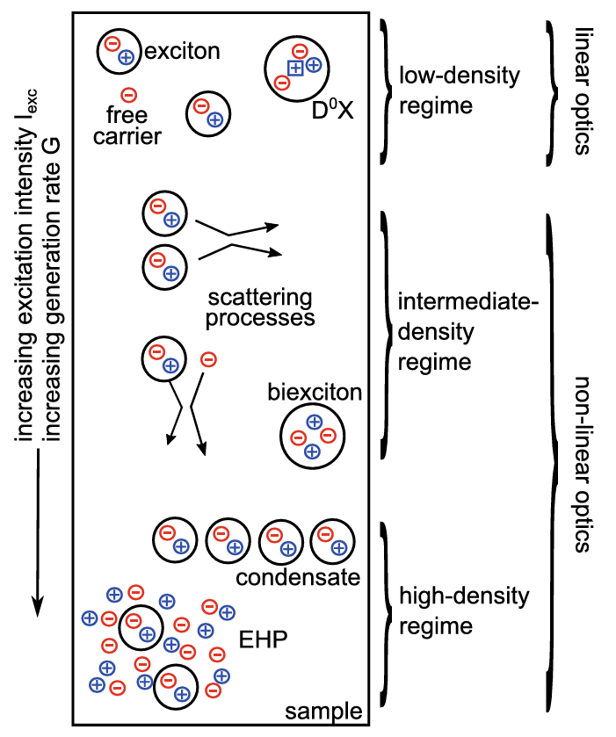





Absorption in Highly Excited Semiconductors
Pump
The study of non-linear effects in germanium induced by photoexcited carriers by using time resolved ellipsometry:
Carrier-carrier scattering.
Carrier-phonon scattering.
Intervalley scattering.
Momentum and energy relaxation of hot carriers.
$$Δt$$
$$ω$$
Probe
$$p$$
$$E$$
$$s$$
$$E$$
$$φ$$
Plane of incidence
Sample
Kalt, Klingshirn, Semiconductor Optics 2 (Springer, 2024)

Slide 16
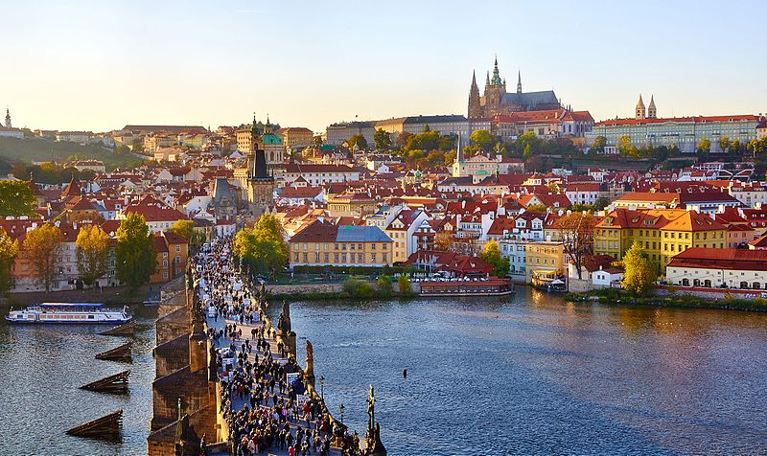
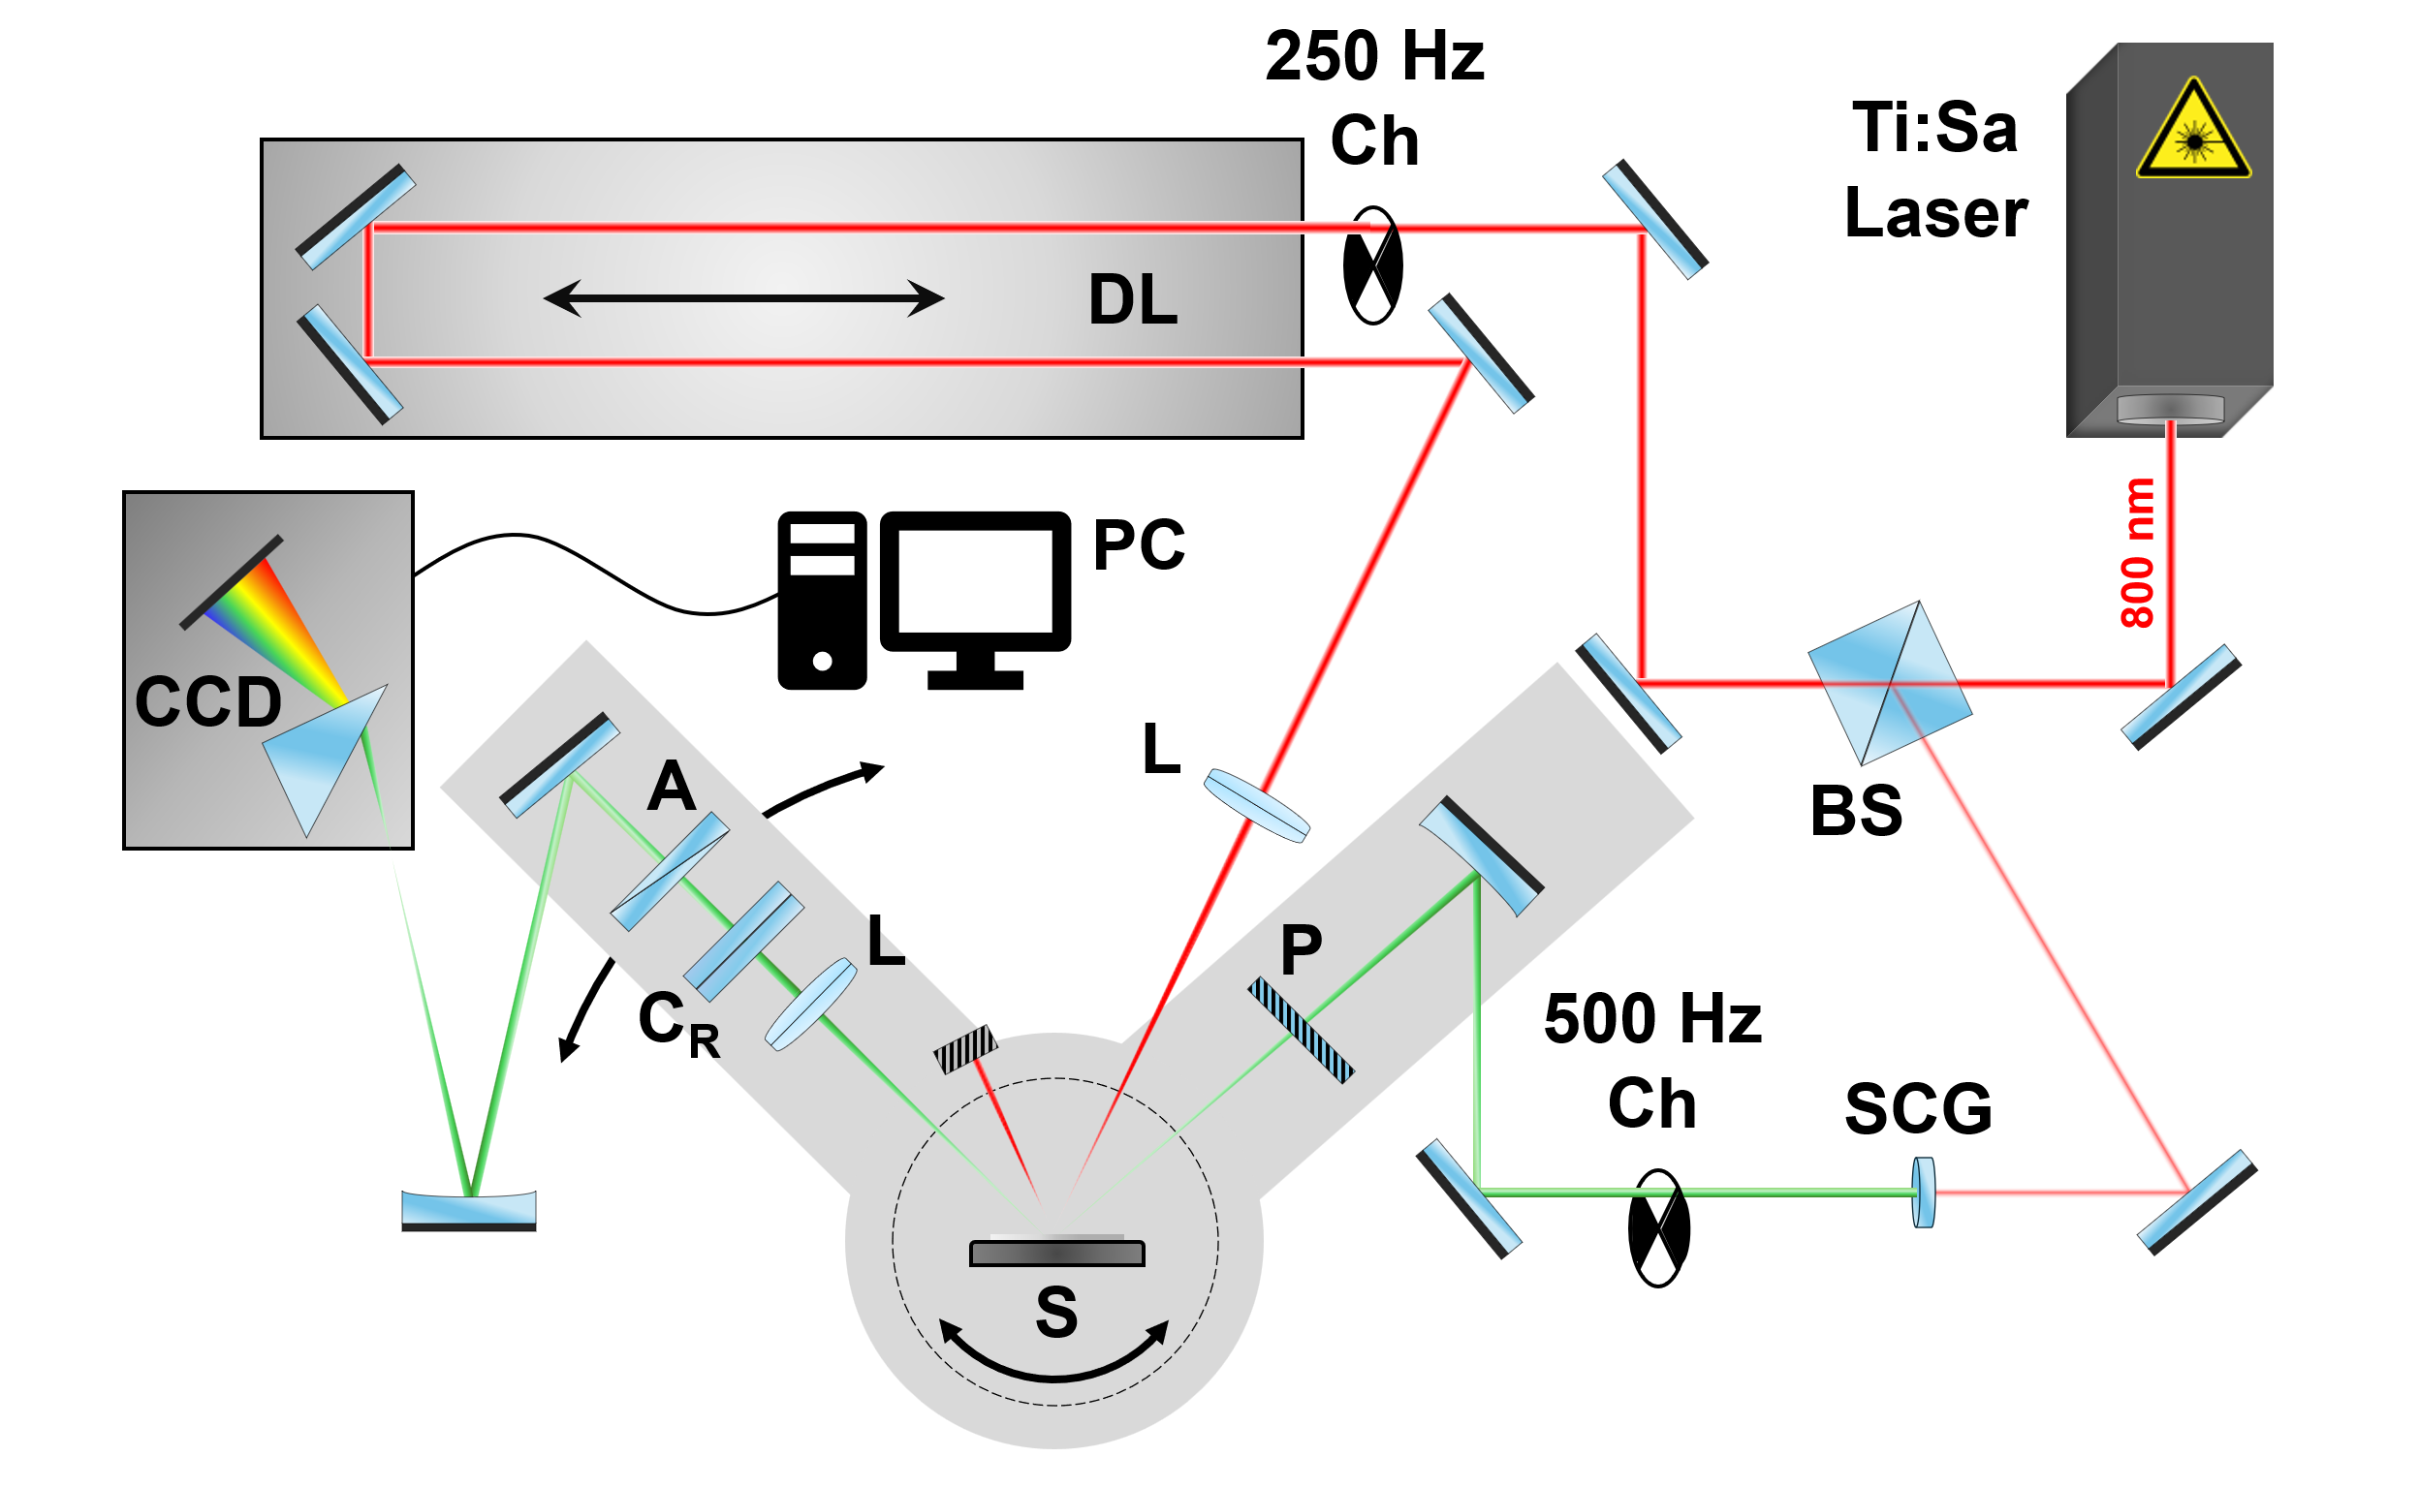
Experiment: Pump-Probe Ellipsometry
pump beam path
Ch: Chopper (500 Hz, 250 Hz)
A: Analyzer
P: Polarizer
C_{R}: Rotating Compensator
L: Lens
S: Sample
DL: Delay Line (~6.67 ns pump-probe delay, 3 fs resolution)
BS: Beam Splitter
SCG: Super-continuum Generation
CCD: Charge-coupled device detector
probe beam path
S. Richter, Rev. Sci. Instrum. 92, 033104 (2021).
S. Espinoza, Appl. Phys. Lett. 115, 052105 (2019)
ELI Beamlines, Dolni Bezany, Czech Republic

Slide 17
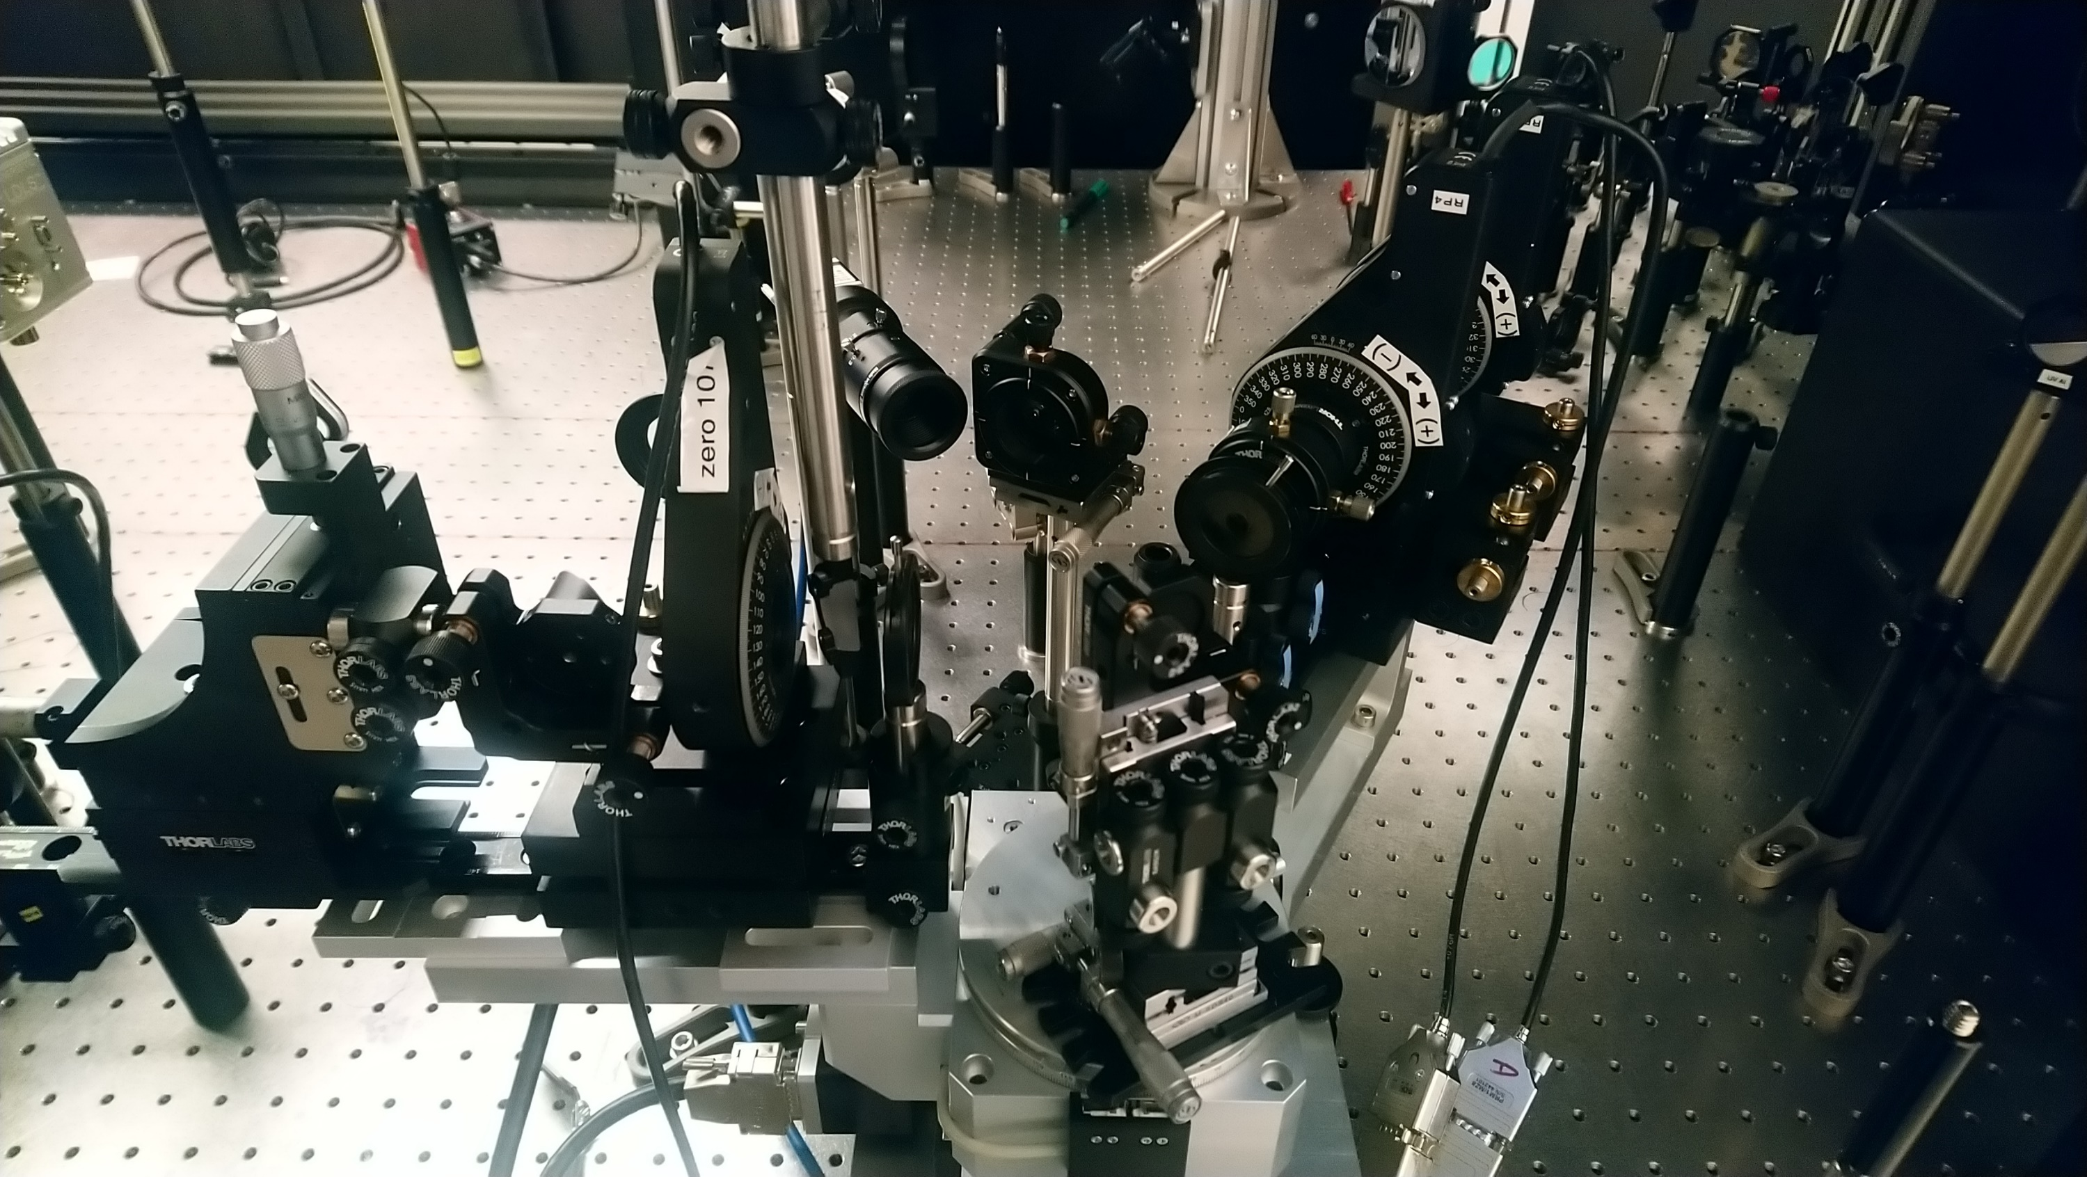
Set-up: Femtosecond pump-probe ellipsometry
Pump
Rotating compensator ellipsometer:
Compensator was rotated in steps of 10º for a total of 55-65 angles.
Probe beam of 350-750 nm at 60º incidence angle.
P-polarized pump beam: 35 fs pulses of 800 nm wavelength at 1 kHz repetition rate.
Delay time from -10 to 50 ps.
Time resolution of about 500 fs.
Focusing lens
Probe
Analyzer
Compensator
Polarizer
Sample Stage
Espinoza et al., APL 115, 052105 (2019)
ELI Beamlines, Dolni Bezany, Czech Republic

Slide 18
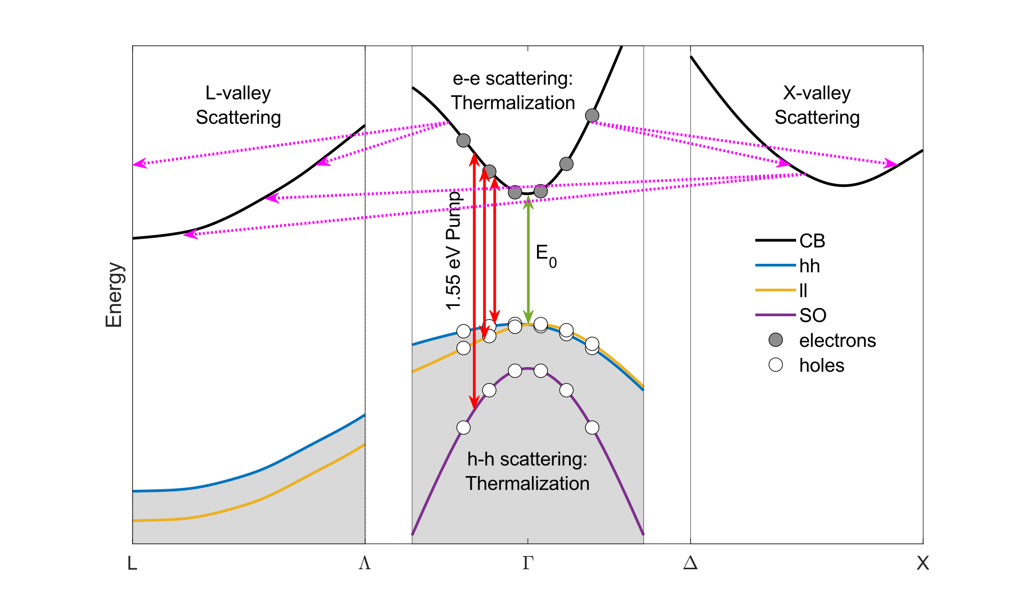
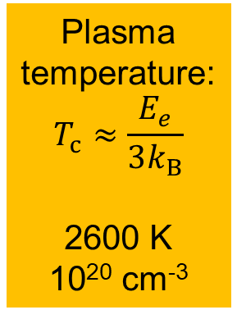
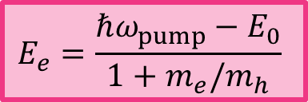
First 100s of femtoseconds
$$E_{e}=\frac{ℏω_{pump}−E_{0}}{1+m_{e}/m_{h}}$$
Plasma temperature:
$$T_{c}≈\frac{E_{e}}{3k_{B}}$$
2600 K
10²⁰ cm⁻³
Intervalley scattering is more efficient than intravalley scattering.
H. Kalt, C. F. Klingshirn, Semiconductor Optics 2 (Springer, 2024). R. R. Alfano, Semiconductors Probed by Ultrafast Laser Spectroscopy I (Academic, 1984).
Notes:
To begin with, the initial pulse promotes electrons from all three valence bands to the conduction band at the center of the Brillouin zone. These initial carriers then thermalize to a distribution with a well-defined temperature. This thermalization process happens under a few fs and it happens via carrier-carrier scattering. These hot carriers are at a very high temperature (much greater than the lattice temperature) and have excess energy given by E_{e}, shown in this expression. As the carriers relax and cool down, they will scatter from the Г-valley to the satellite valleys and will eventually cluster at the L-valley (the lowest valley).

Slide 19
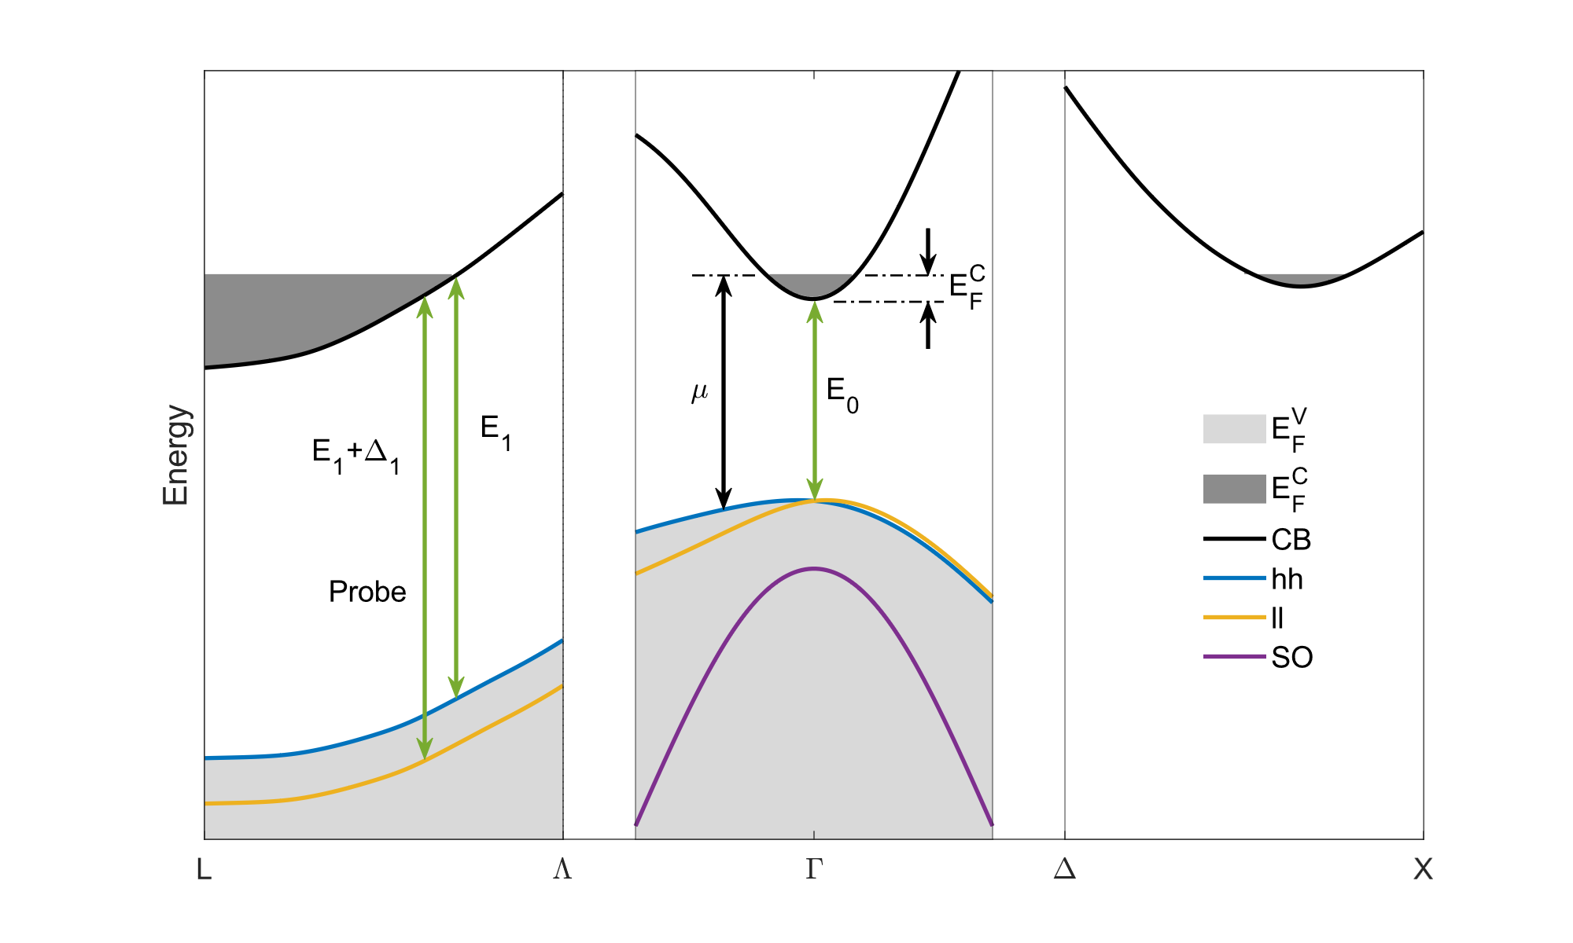



First few Picoseconds: Thermal Equilibrium
Filled states cannot absorb light.
No theory for screening in 2D.
$$E_{F}^{C(Γ)}=E_{F}^{C(L)}=E_{F}^{C(X)}$$
Plasma temperature:
$$T_{c}≈\frac{E_{e}}{3k_{B}}$$
2600 K
10²⁰ cm⁻³
$$∆E=∆E_{str}+∆E_{BGR}+∆E_{BM}$$
$$μ=E_{F}^{C}+E_{g}$$
H. Kalt, C. F. Klingshirn, Semiconductor Optics 2 (Springer, 2024). P. Vashishta, Appl. Phys. Rev. B. 25, 6492 (1982).
Notes:
The presence of these hot carriers will then raise the quasi-Fermi energy of the conduction band. On a ps scale, we assume that Fermi energy is the same across all three valleys. This processes of filling the CB and lifting of Fermi energy are what affect the optical functions of the material, as well as the energy of the bandgap (or in our case, the energy of the CPs E₁ and E₁+Δ₁, which is where we are probing).
Therefore, if we want to model the dielectric function, the goal then becomes to calculate the change in the Fermi energy induced by these hot carriers.

Slide 20
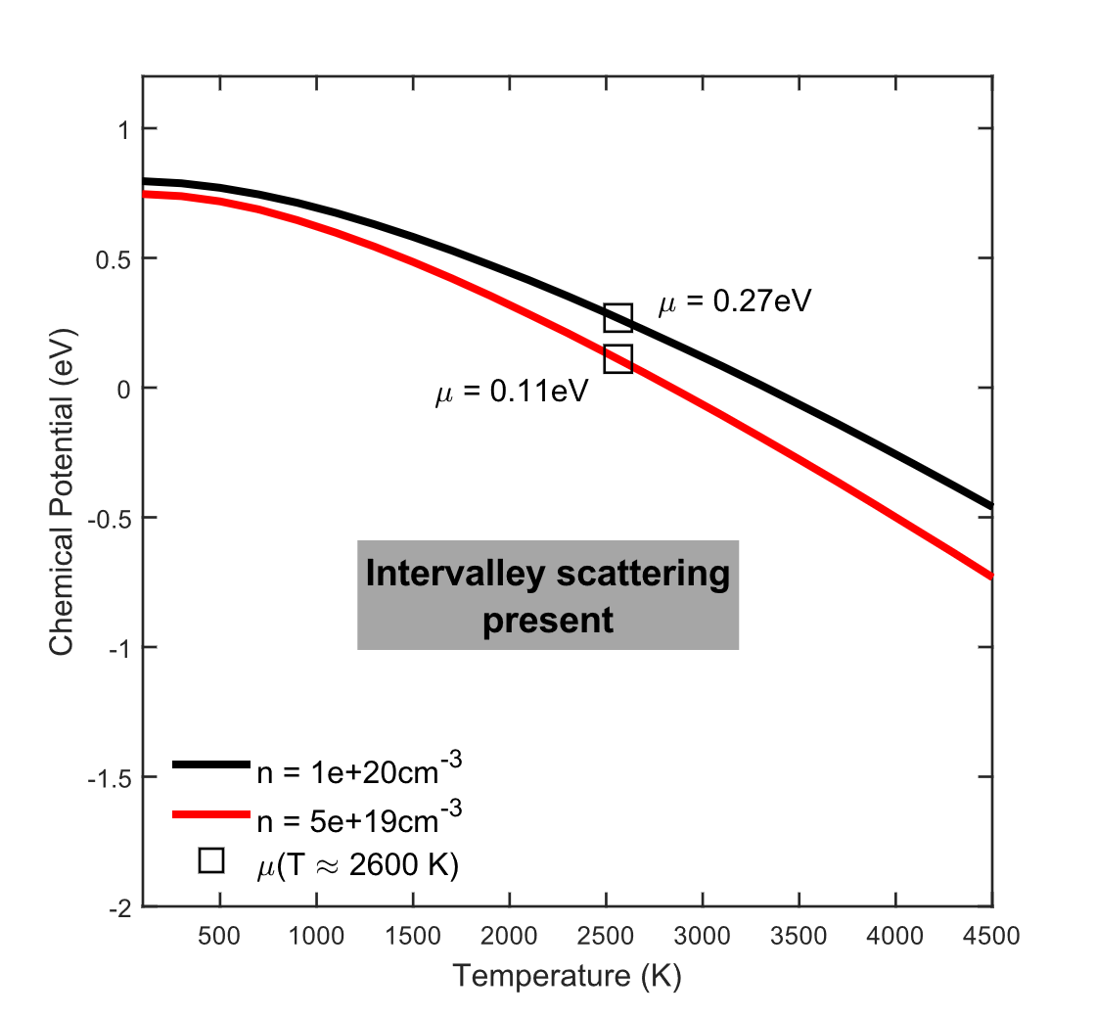
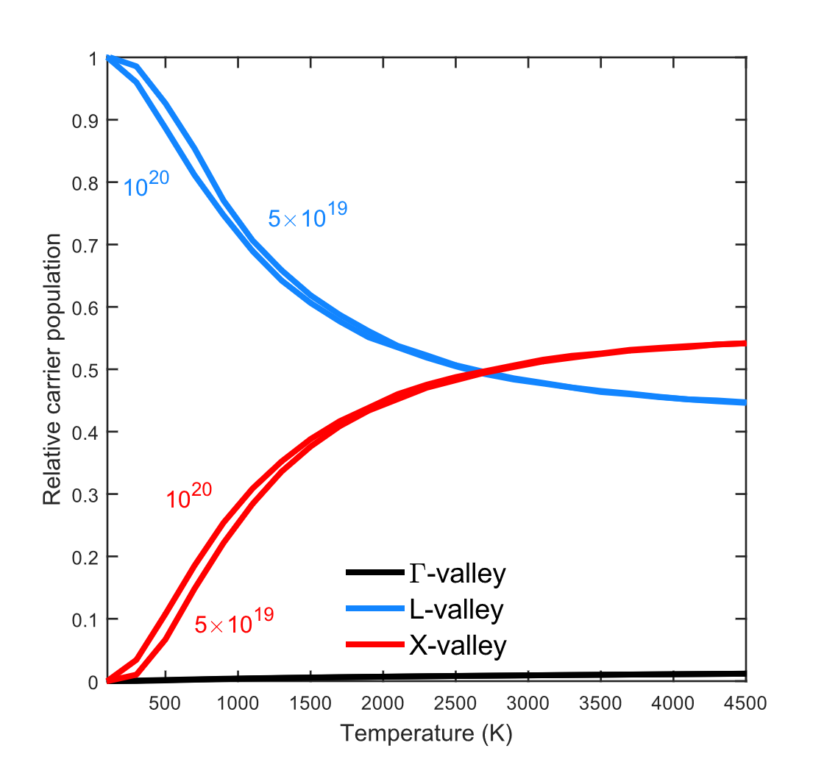

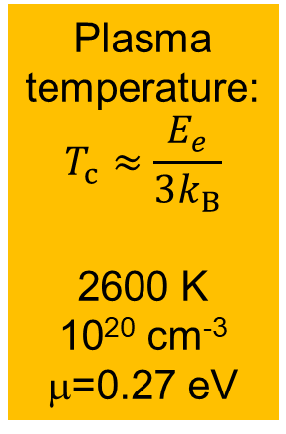



Charge Carrier Statistics from Device Physics
Plasma temperature:
$$T_{c}≈\frac{E_{e}}{3k_{B}}$$
2600 K
10²⁰ cm⁻³
μ=0.27 eV
$$n\left(T\right)=n_{L}\left(T\right)+n_{Γ}\left(T\right)+n_{X}(T)$$
$$\sim 55\%$$
$$\sim 45\%$$
Carriers located at the satellite valleys.
$$\sim 0\%$$
A. L. Smirl, in Physics of Nonlinear Transport in Semiconductors, ed. by Kerry, Barker, and Jacoboni (Plenum, 1980).
J. Menéndez et al., Phys. Rev. B. 101, 195204 (2020).
Notes:
Once we know the density, we allow for intervalley scattering by summing over the density across all three valleys and then solve for the Fermi energy as a function of temperature. The figure on the left shows the Fermi energy for both previously estimated densities. The figure on the right shows the relative valley population. We see that at high temperatures, about 55% of the carriers lie on the X-valley and the rest on the L-valley. As the temperature decreases, the carriers relocate to the L-valley more and more. The Γ- valley, on the other hand, remains close to zero at all temperatures.
This gives us the evolution of the Fermi energy and temperature of the carriers, and these are the parameters we need to model the dielectric function.

Slide 21
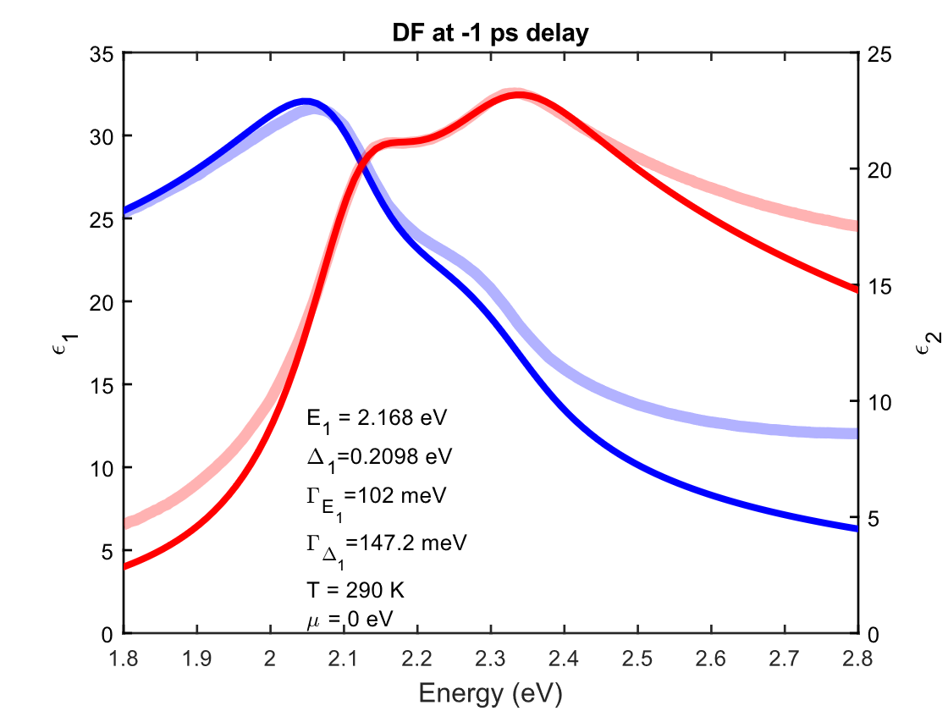
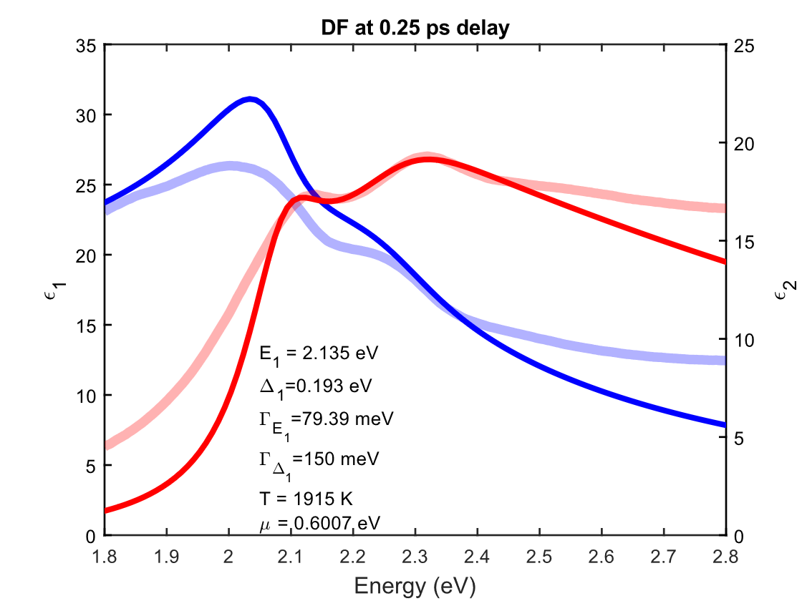
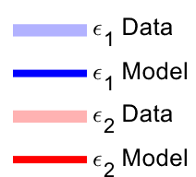
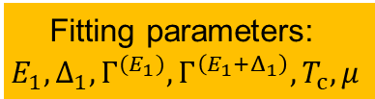
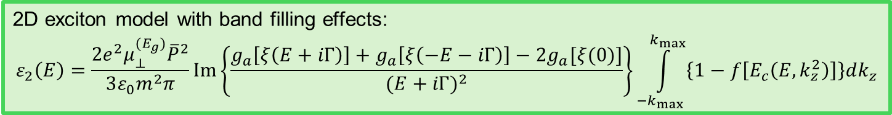
Band Filling Model
2D exciton model with band filling effects:
$$ε_{2}\left(E\right)=\frac{2e^{2}μ_{⊥}^{(E_{g})}{\overline{P}}^{2}}{3ε_{0}m^{2}π}Im\left\{\frac{g_{a}\left[ξ\left(E+iΓ\right)\right]+g_{a}\left[ξ\left(−E−iΓ\right)\right]−2g_{a}[ξ(0)]}{{(E+iΓ)}^{2}}\right\}\int_{−k_{max}}^{k_{max}}{\left\{1−f\left[E_{c}\left(E,k_{z}^{2}\right)\right]\right\}dk_{z}}$$
Steady state (negative delay)
250 fs delay
1900 K
10²⁰ cm⁻³
μ=0.60 eV
Fitting parameters:
$$E_{1},Δ_{1},Γ^{(E_{1})},Γ^{\left(E_{1}+Δ_{1}\right)},T_{c},μ$$
Carlos Armenta, Ph.D. thesis (NMSU, 2025)
Notes:
On the left is shown the fit at -1 ps (the steady state dielectric function), where the translucent curves are the experimental data, and the solid lines are the model. On the right we can see the data at 250 fs after the pump hits the sample. While the model is not perfect (broadening seems to be slightly off), it does seem to capture the reduction in the amplitude of ε₂ induced by the carrier dynamics.

Slide 22
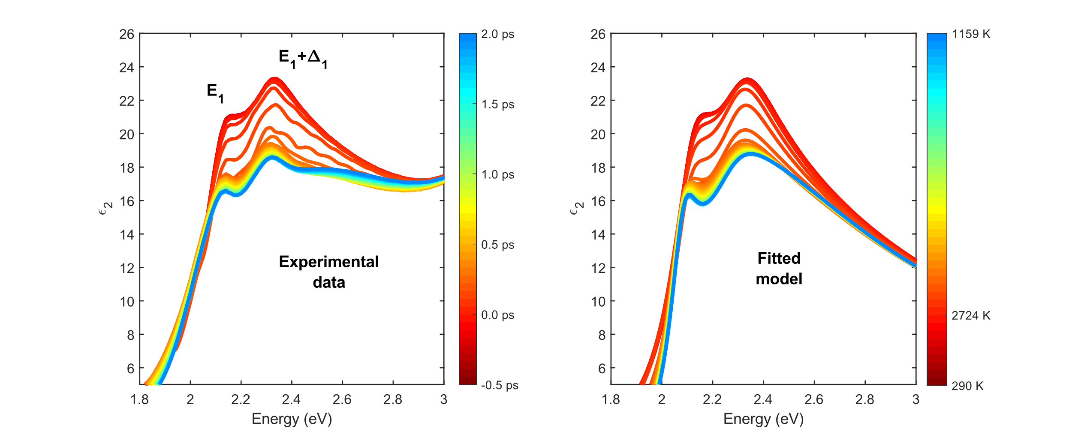
Band Filling Model
2D exciton model with band filling effects:
$$ε_{2}\left(E\right)=\frac{2e^{2}μ_{⊥}^{(E_{g})}{\overline{P}}^{2}}{3ε_{0}m^{2}π}Im\left\{\frac{g_{a}\left[ξ\left(E+iΓ\right)\right]+g_{a}\left[ξ\left(−E−iΓ\right)\right]−2g_{a}[ξ(0)]}{{(E+iΓ)}^{2}}\right\}\int_{−k_{max}}^{k_{max}}{\left\{1−f\left[E_{c}\left(E,k_{z}^{2}\right)\right]\right\}dk_{z}}$$
T is a fit parameter
10²⁰ cm⁻³
Fermi singularity?
Carlos Armenta, Ph.D. thesis (NMSU, 2025)
Notes:
Here are the results. On the left we see the data from -0.5 ps up to 2 ps. On the right, we see the fit for these delays, which seems to present a reasonable match. A feature that the model does not seem to capture is this bump next to the CPs, which looks like a Fermi singularity. We had previously stated that we didn’t expect to see this feature because of high temperatures. It could be that we are underestimating the rate of cooling of the carriers (carriers are cooling faster than previously calculated).
On the other hand, the fitted Fermi energy does seem to follow the previously calculated values (the dots are the fitted Fermi energy at different delays). The cooling of the carriers seems to walk along the red curve (the calculated Fermi energy for 10²⁰ cm⁻³). So the model looks promising.
At around 1 ps, the Fermi energy seems to remain constant (it seems that the carriers are not cooling anymore). This is likely because the original reduction of the amplitude of ε₂ is induced by other additional processes and not just band-filling effects. We would need a more sophisticated model to account for these additional effects.

Slide 23
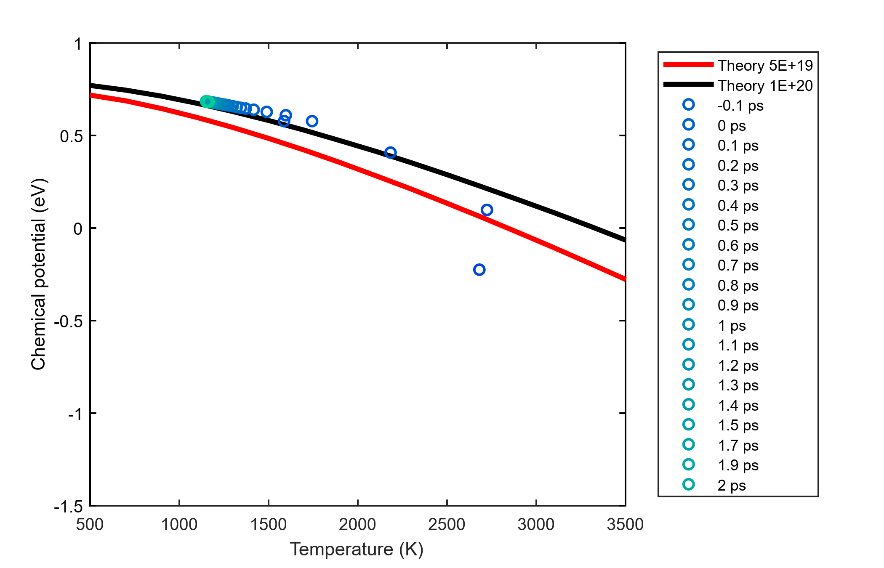
Band Filling Model
2D exciton model with band filling effects:
$$ε_{2}\left(E\right)=\frac{2e^{2}μ_{⊥}^{(E_{g})}{\overline{P}}^{2}}{3ε_{0}m^{2}π}Im\left\{\frac{g_{a}\left[ξ\left(E+iΓ\right)\right]+g_{a}\left[ξ\left(−E−iΓ\right)\right]−2g_{a}[ξ(0)]}{{(E+iΓ)}^{2}}\right\}\int_{−k_{max}}^{k_{max}}{\left\{1−f\left[E_{c}\left(E,k_{z}^{2}\right)\right]\right\}dk_{z}}$$
n=10²⁰ cm⁻³
Carriers cool with increasing delay time.
Fermi singularity?
Carlos Armenta, Ph.D. thesis (NMSU, 2025)
Notes:
Here are the results. On the left we see the data from -0.5 ps up to 2 ps. On the right, we see the fit for these delays, which seems to present a reasonable match. A feature that the model does not seem to capture is this bump next to the CPs, which looks like a Fermi singularity. We had previously stated that we didn’t expect to see this feature because of high temperatures. It could be that we are underestimating the rate of cooling of the carriers (carriers are cooling faster than previously calculated).
On the other hand, the fitted Fermi energy does seem to follow the previously calculated values (the dots are the fitted Fermi energy at different delays). The cooling of the carriers seems to walk along the red curve (the calculated Fermi energy for 10²⁰ cm⁻³). So the model looks promising.
At around 1 ps, the Fermi energy seems to remain constant (it seems that the carriers are not cooling anymore). This is likely because the original reduction of the amplitude of ε₂ is induced by other additional processes and not just band-filling effects. We would need a more sophisticated model to account for these additional effects.

Slide 24
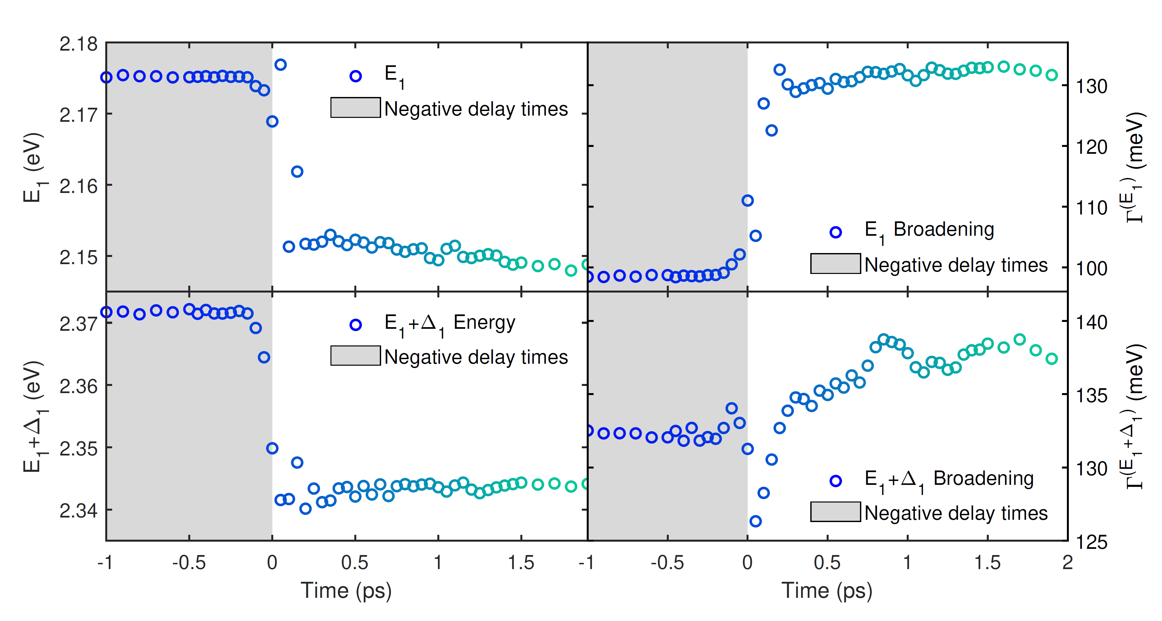
Band Filling Model
2D exciton model with band filling effects:
$$ε_{2}\left(E\right)=\frac{2e^{2}μ_{⊥}^{(E_{g})}{\overline{P}}^{2}}{3ε_{0}m^{2}π}Im\left\{\frac{g_{a}\left[ξ\left(E+iΓ\right)\right]+g_{a}\left[ξ\left(−E−iΓ\right)\right]−2g_{a}[ξ(0)]}{{(E+iΓ)}^{2}}\right\}\int_{−k_{max}}^{k_{max}}{\left\{1−f\left[E_{c}\left(E,k_{z}^{2}\right)\right]\right\}dk_{z}}$$
Redshift: band gap renormalization
(25-30 meV)
Fermi singularity?
Carlos Armenta, Ph.D. thesis (NMSU, 2025)
Notes:
Here are the results. On the left we see the data from -0.5 ps up to 2 ps. On the right, we see the fit for these delays, which seems to present a reasonable match. A feature that the model does not seem to capture is this bump next to the CPs, which looks like a Fermi singularity. We had previously stated that we didn’t expect to see this feature because of high temperatures. It could be that we are underestimating the rate of cooling of the carriers (carriers are cooling faster than previously calculated).
On the other hand, the fitted Fermi energy does seem to follow the previously calculated values (the dots are the fitted Fermi energy at different delays). The cooling of the carriers seems to walk along the red curve (the calculated Fermi energy for 10²⁰ cm⁻³). So the model looks promising.
At around 1 ps, the Fermi energy seems to remain constant (it seems that the carriers are not cooling anymore). This is likely because the original reduction of the amplitude of ε₂ is induced by other additional processes and not just band-filling effects. We would need a more sophisticated model to account for these additional effects.

Slide 25
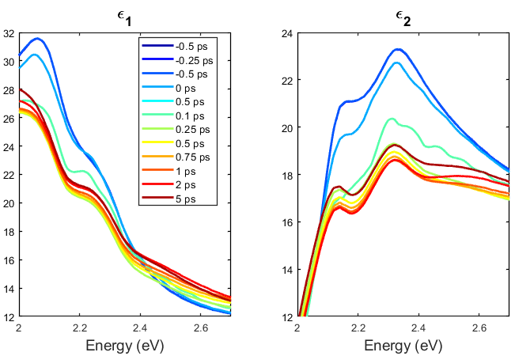
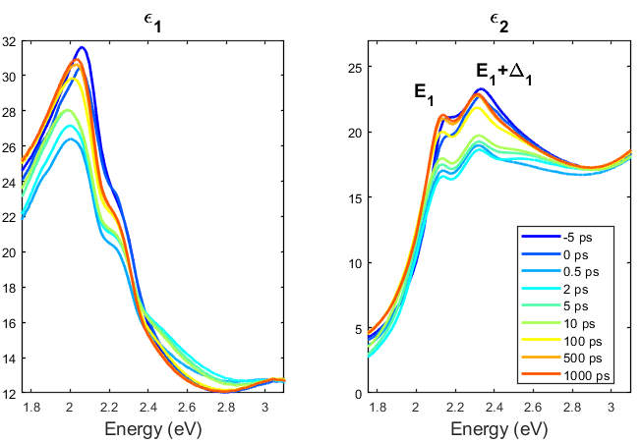


Dielectric Function at Longer Delay Times
$ε$ almost fully recovers after 100 ps.
$ε_{2}$ decreases within
the first 2 ps.
Model diffusion and recombination.
Carlos Armenta, Ph.D. thesis (NMSU, 2025)
Notes:
This is another view of the same data. On the left, you can see from -5 ps to 1 ns. On the right, you can see from -0.5 ps up to the first 5 ps. Again, we see the initial reduction in the amplitude of ε₂, which reaches its maximum change at around 1 ps and then starts to recover. This time regime (the first ps) is where scattering and relaxation of carriers takes place and is where we will focus on to try to model the dielectric function.

Slide 26


Thermal Excitation of Electron-Hole Pairs
InSb
α-tin
Jaden Love, MS thesis (NMSU, 2025)
M. Rivero, JVST B 41, 022203 (2023)
Notes:
This is another view of the same data. On the left, you can see from -5 ps to 1 ns. On the right, you can see from -0.5 ps up to the first 5 ps. Again, we see the initial reduction in the amplitude of ε₂, which reaches its maximum change at around 1 ps and then starts to recover. This time regime (the first ps) is where scattering and relaxation of carriers takes place and is where we will focus on to try to model the dielectric function.

Slide 27
Conclusions
Precision measurements of optical absorption from mid-IR to near-UV with temperature-dependent spectroscopic ellipsometry.
It is possible to predict direct gap IR absorption in Ge from k.p theory.
A similar theory describes the UV absorption in Ge near E₁ and E₁+Δ₁.
Can we close the gap in our theory between IR and UV? (conduction band nonparabolicity, k-dependent optical dipole matrix element)
Does this theory work for other materials? Is there a universal scaling law? (Need measurements on binary compounds and thick Ge-Sn and III/V alloy layers.)
Femtosecond pump-probe ellipsometry measurements of transient absorption in Ge at high carrier concentration.
Good agreement with band filling model based on Fermi-Dirac carrier statistics.
No model for screening of excitonic absorption in two dimensions.
Test band filling model to describe temperature-dependent dielectric function of InSb.

