Slide 1
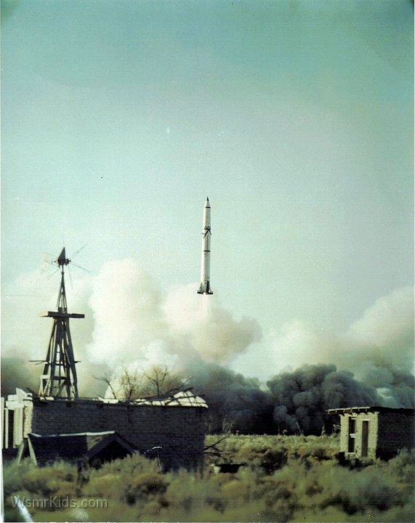
WSMR Developmental Employee -Openings -
Electronics Engineer
White Sands Missile Range: 3 Vacancies
Pay Scale & Grade: GS-07, developmental to GS-12
Open & Closing Date: 1/6/2023-1/20/2023
About this position: These vacancies are under the Army Fellow Program. The Army Fellow Program is an exciting opportunity to embark on a developmental, accelerated career path as a Civilian Army employee with continued training and educational opportunities. Fellows may also receive paid training, certifications and rotational assignments. Don't Wait! Apply now to start your Civilian Army career today!
Applicants must apply at: USAJOBS - Job Announcement: https://www.usajobs.gov/GetJob/ViewDetails/696510200

