Slide 1
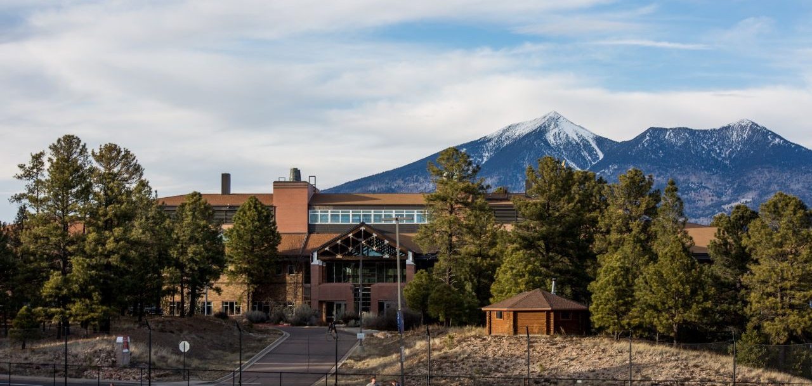
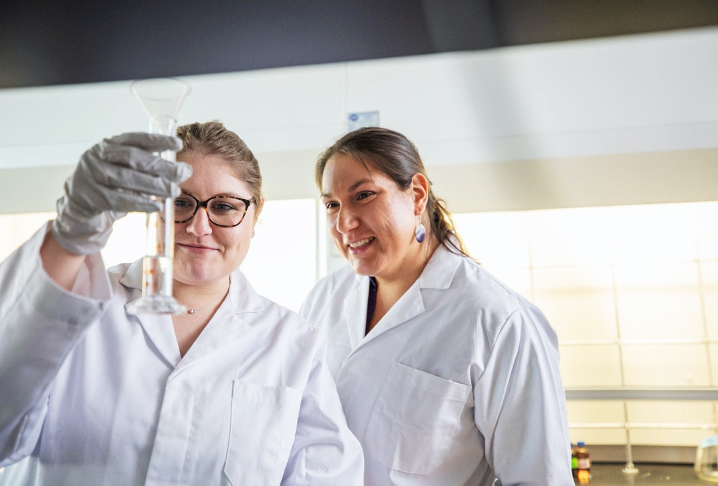
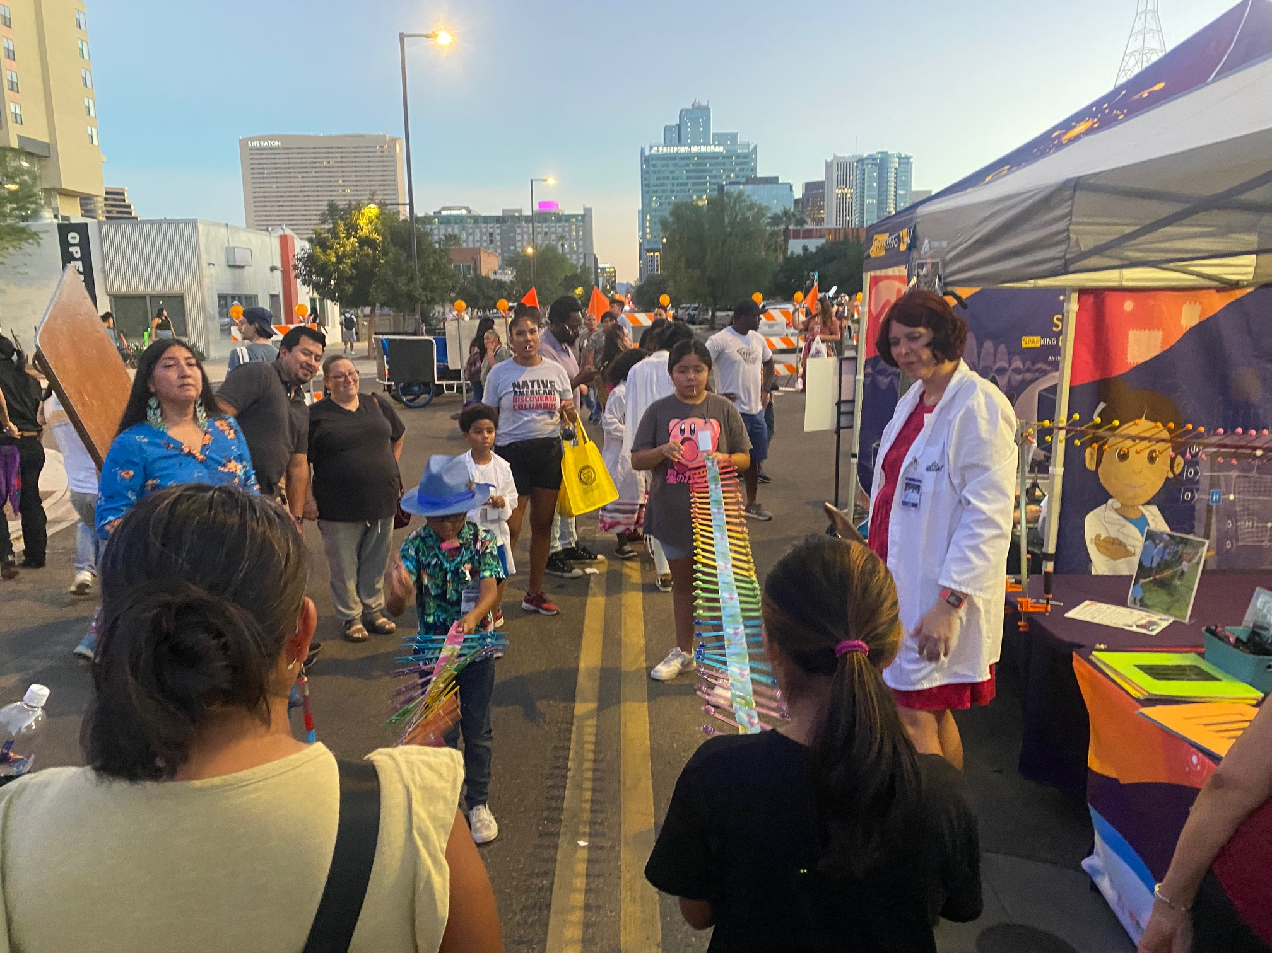
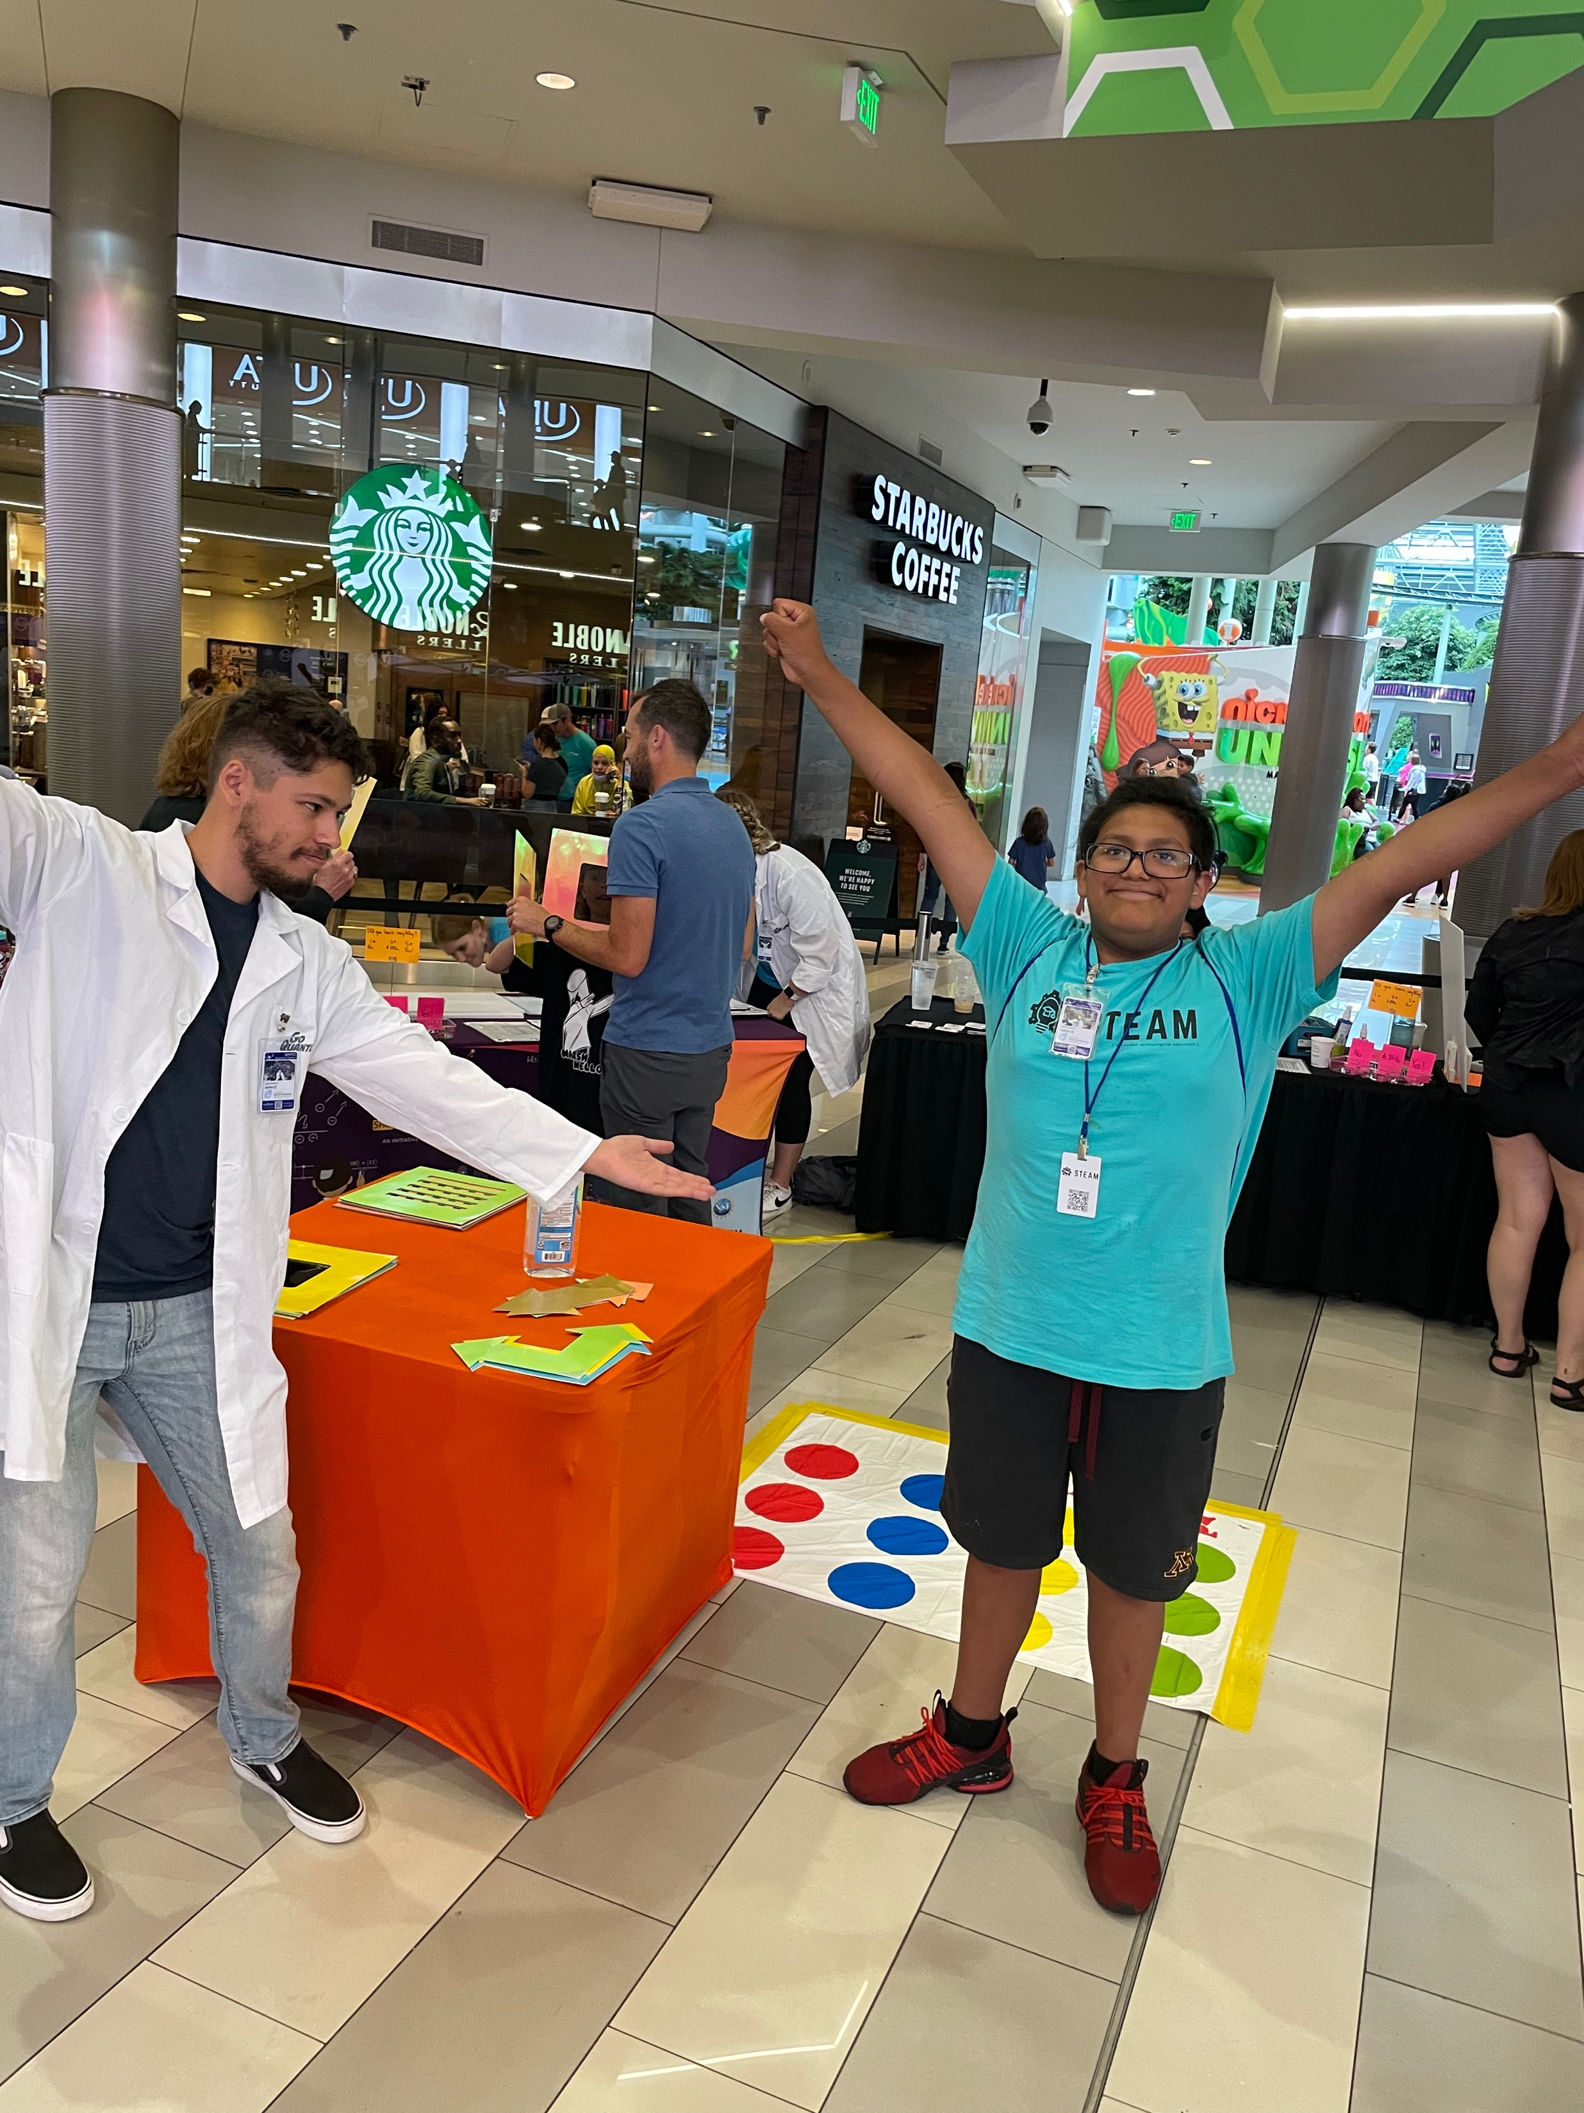
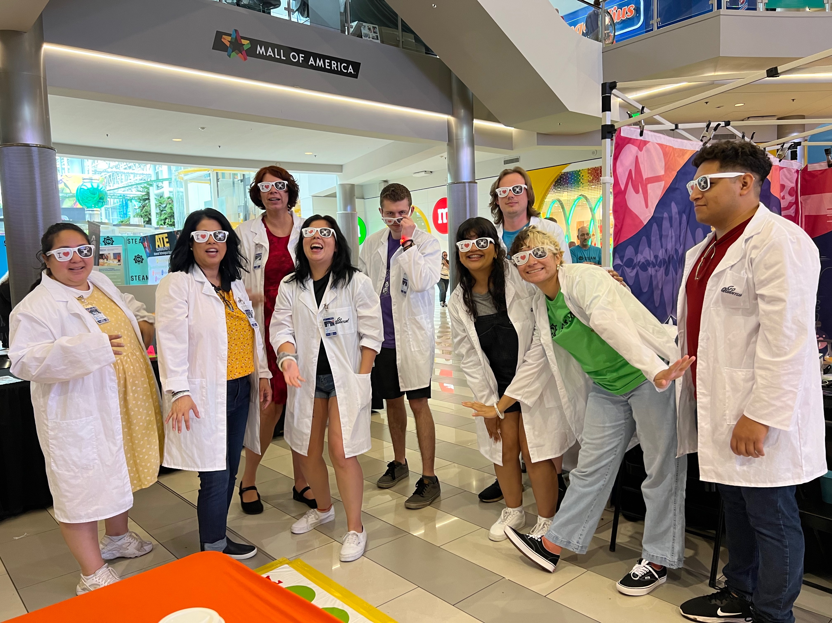
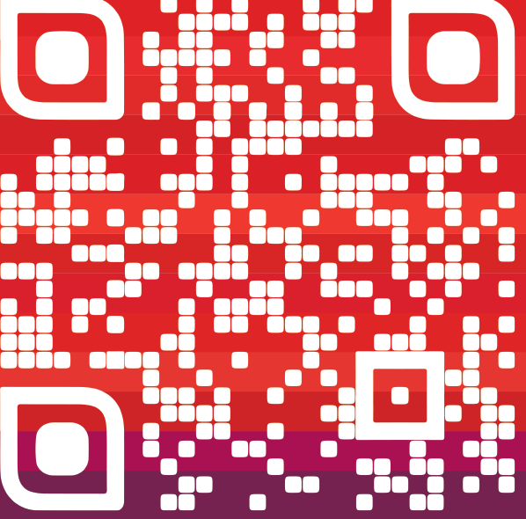
PhD in Applied Physics & Materials Science
A Program for 2050, not 1950!
Full tuition waiver and health insurance
Financial support through teaching or research assist.
Apply Online: nau.edu/graduateapply
PhD Emphases in Applied Physics or Materials Science
Active Outreach Opportunities Serving Remote and Underserved Communities
Professional Development Classes and
Travel Support Opportunities
Find out more
Apply By January 1
Mira.nau.edu

